Slide 1
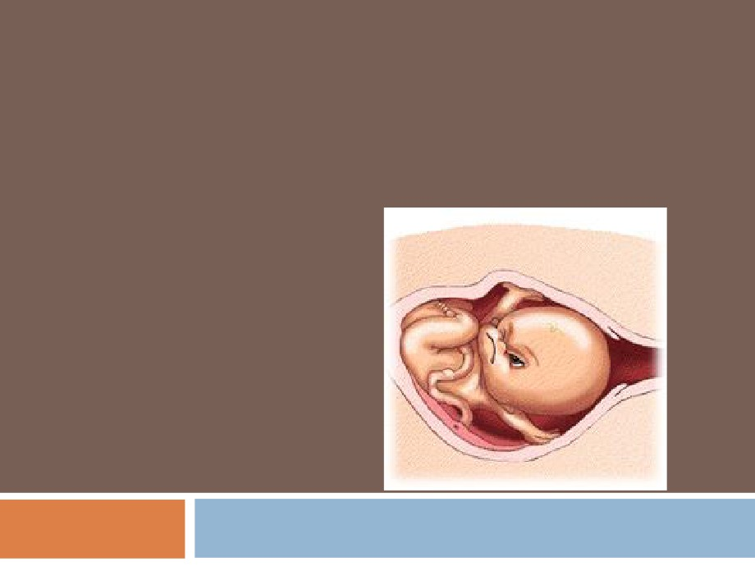
ONSET AND PHYSIOLOGY OF
LABOR
Dr. Hana Alzamil

Slide 2
Objectives:
• Define labor/labour (parturition).
• Recognize the factors triggering the onset of labor.
• Describe the hormonal changes that occur before
and during labor.
• Describe the phases of uterine activity during
pregnancy and labor.
• Know the clinical stages of labor.

Slide 3
Parturition
Definition
Uterine contractions that lead to
expulsion of the fetus to extrauterine
environment
Towards the end of pregnancy the
uterus become progressively more
excitable and develops strong rhythmic contractions that lead to expulsion of the fetus.

Slide 4
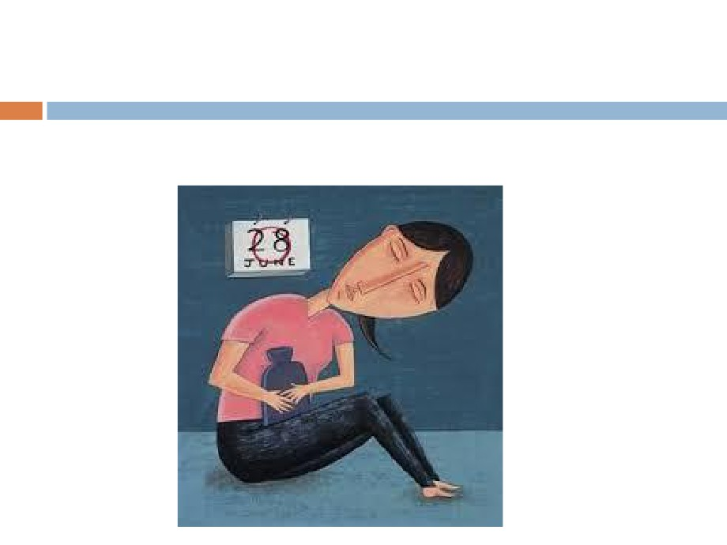
Small group activity
Does non pregnant uterus contract?

Slide 5
Parturition
Uterus is spontaneously active.
Spontaneous depolarization of pacemaker cells (Telocytes).
Gap junctions spread depolarization Exact trigger is unknown
Hormonal changes Mechanical changes

Slide 6
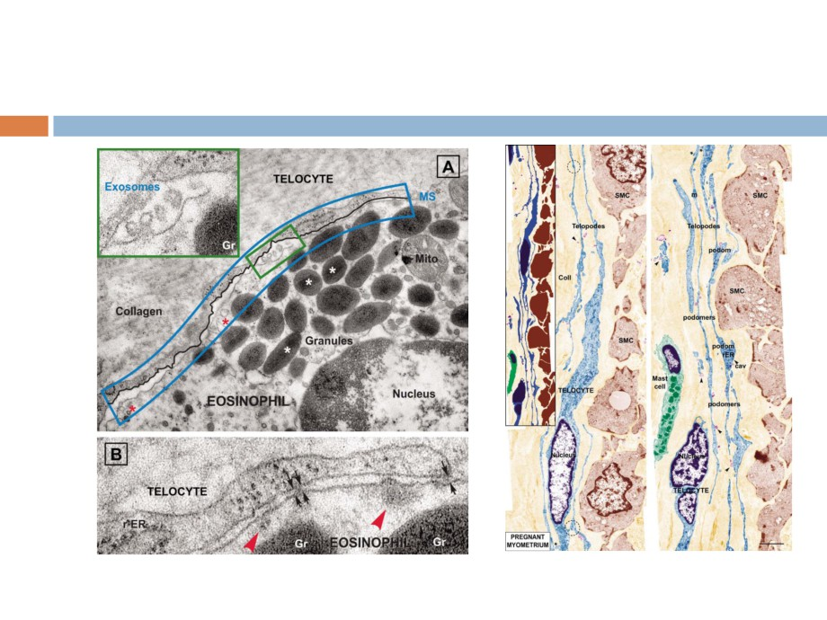
Telocytes

Slide 7
Hormonal changes
Estrogen & Progesterone
Progesterone inhibit uterine contractility Estrogen stimulate uterine contractility From 7th month till term
Progesterone secretion remain constant Estrogen secretion continuously increase
◉ Increase estrogen/progesterone ratio

Slide 8
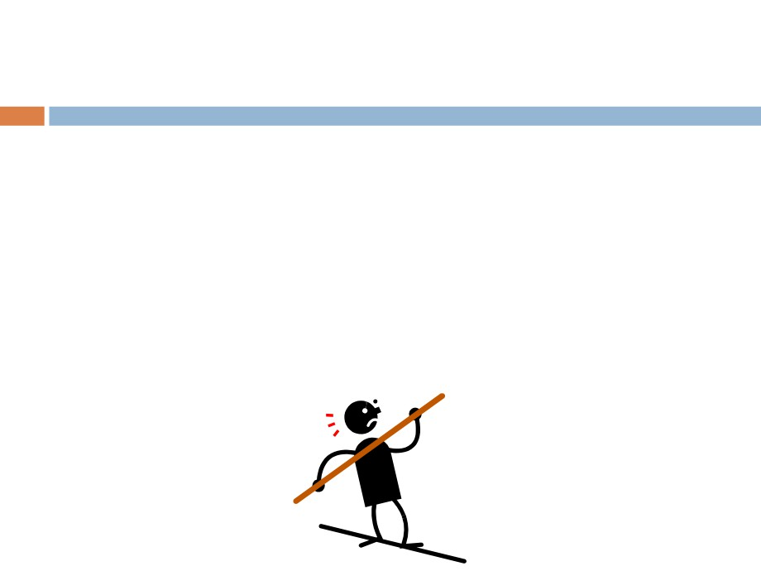
Hormonal changes
Progesteron ▼ GAP junctions
Estrogen
▲ GAP junctions ▲ Oxytocin
▼ Oxytocin receptor
receptors.
▼Prostaglandins. ▲ Resting mem.
▲ Prostaglandins
E
Potential
P

Slide 9
Hormonal changes
Oxytocin
◉ Dramatic ▲of oxytocin receptors (200 folds)
gradual transition from passive relaxed to active excitatory muscle
(↑responsiveness).
◉ Increase in Oxytocin secretion at labor
◉ Oxytocin increase uterine contractions by Directly on its receptors
Indirectly by stimulating prostaglandin production

Slide 10
Hormonal changes
Prostaglandins
◉ Central role in initiation & progression of human labour
◉ Locally produced (intrauterine)
◉ Oxytocin and cytokines stimulate its production  Prostaglandin stimulate uterine contractions by: Direct effect:
Through their own receptors
Upregulation of myometrial gap junctions Indirect effect:
Upregulation of oxytocin receptors

Slide 11
Parturition

Slide 12
Mechanical changes
Stretch of the uterine muscle  Increases contractility
Fetal movements Multiple pregnancy Stretch of the cervix
◉ Increases contractility (reflex)
Membrane sweeping & rupture Fetal head
Positive feedback mechanism

Slide 13
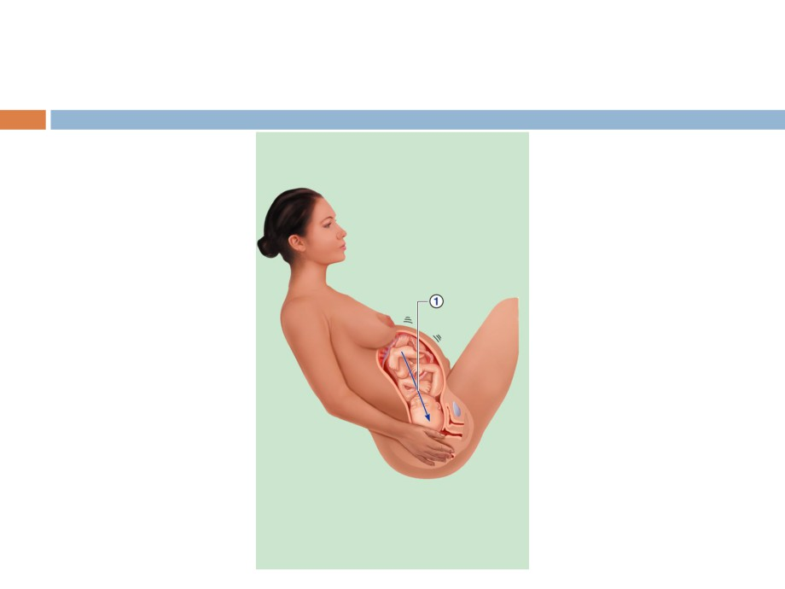
Initiation of Labor
Baby moves
deeper into mother’s birth canal
Figure 16.19, step 1

Slide 14
Initiation of Labor
Baby moves
deeper into mother’s birth canal
Pressoreceptors in cervix of
uterus excited
Figure 16.19, step 2

Slide 15
Initiation of Labor
Baby moves
deeper into mother’s birth canal
Afferent
impulses to hypothalamus
Pressoreceptors in cervix of
uterus excited
Figure 16.19, step 3

Slide 16
Initiation of Labor
Hypothalamus sends efferent
impulses to posterior pituitary, where oxytocin is stored
Baby moves
deeper into mother’s birth canal
Afferent
impulses to hypothalamus
Pressoreceptors in cervix of
uterus excited
Figure 16.19, step 4

Slide 17
Initiation of Labor
Hypothalamus sends efferent
impulses to posterior pituitary, where oxytocin is stored
Posterior pituitary releases oxytocin to blood; oxytocin
targets mother’s uterine
muscle
Baby moves deeper into mother’s birth canal
Afferent
impulses to hypothalamus
Pressoreceptors in cervix of
uterus excited
Figure 16.19, step 5

Slide 18
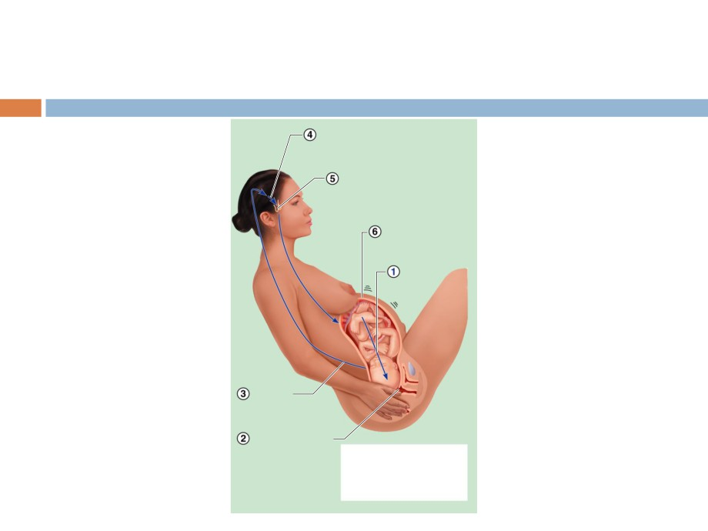
Initiation of Labor
Hypothalamus sends efferent
impulses to posterior pituitary, where oxytocin is stored
Posterior pituitary releases oxytocin to blood; oxytocin
targets mother’s uterine
muscle
Uterus responds by contracting more vigorously
Baby moves deeper into mother’s birth canal
Afferent
impulses to hypothalamus
Pressoreceptors
in cervix of uterus excited
Positive feedback mechanism continues to cycle until interrupted
Figure 16.19, step 6
by birth of baby

Slide 19
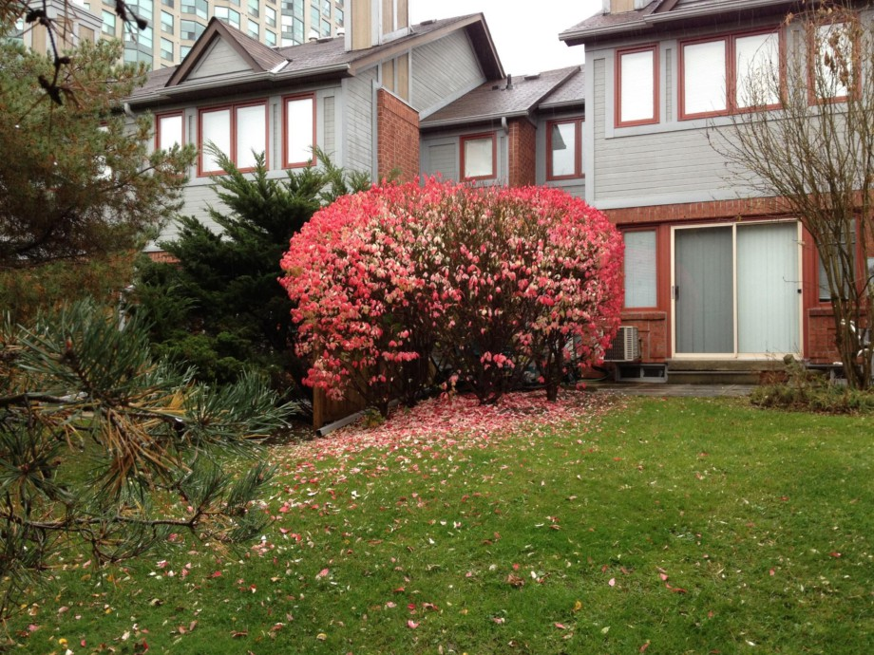

Slide 20
Phases of parturition
Phase 0
Pregnancy: uterus is relaxed (quiescent) Phase 1
Activation Phase 2
Stimulation: stage 1& stage 2 Phase 3 = stage 3
Delivery of the placenta and uterine involution

Slide 21
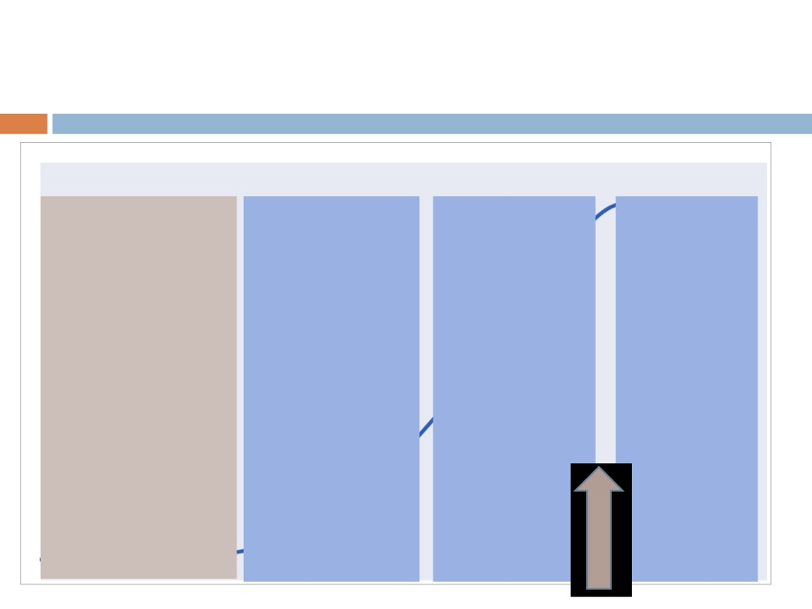
Uterine Activity During Pregnancy
21
Inhibitors
Uterotrophins
Uterotonins Involution
•Progesterone
• Estrogen
• Prostaglandins • Oxytocin
•Prostacycline
• Progesterone
• Oxytocin
•Relaxin
• Prostaglandins
•Nitric Oxide
• CRH
•Parathyroid
hormone-related peptide
Quiescence
Activation
Stimulation Involution
Phase 0
Phase 1
Phase 2 Phase 3

Slide 22
Phases of parturition
Phase 0 (pregnancy)
Increase in cAMP level
Increase in production of
Prostacyclin (PGI2) cause uterine relaxation
Nitric oxide (NO)
cause uterine relaxation
Adapted from Smith, 2007

Slide 23
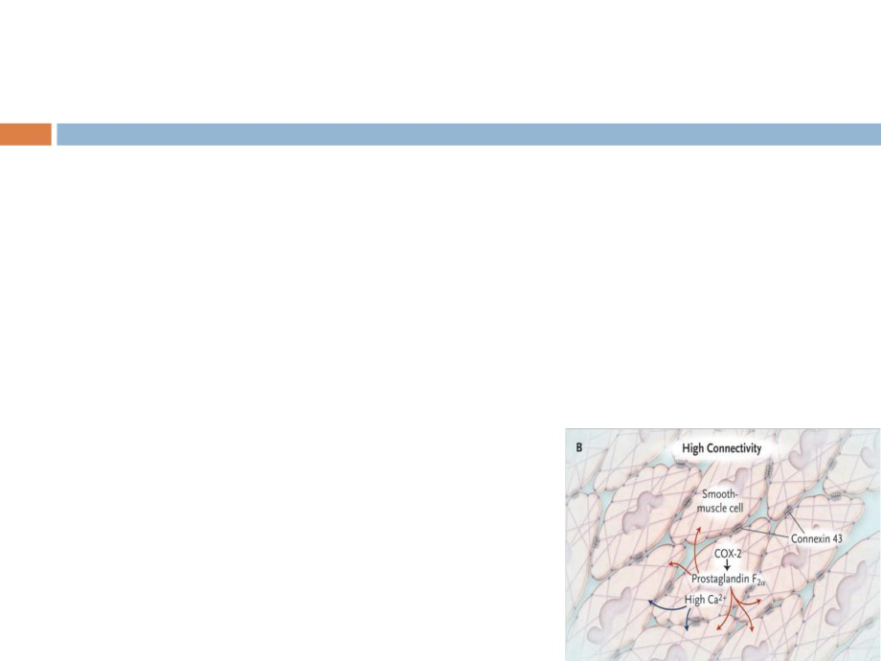
Phases of parturition
Phase 1 (activation)
◉ Occurs in third trimester
◉ Promote a switch from quiescent to active uterus
◉ Increase excitability & responsiveness by Increase expression of gap junctions Increase G protein-coupled receptors
Oxytocin receptors
PGF2 alpha receptors

Slide 24
Phases of parturition
Phase 2 (stimulation)
◉ Occurs in last 2-3 gestational weeks  Increase in synthesis of uterotonins Cytokines
Prostaglandins Oxytocin
◉ Includes 2 stages: Stage 1
Stage 2

Slide 25
Phases of parturition
Phase 3 (uterine involution) Pulsatile release of oxytocin Delivery of the placenta Involution of the uterus
Occurs in 4-5 weeks after delivery
Lactation helps in complete involution

Slide 26
Mechanism of parturition
Contractions start at the fundus and spreads to the lower segment
The intensity of contractions is strong at the fundus but weak at the lower segment
In early stages: 1 contraction/ 30 minuets As labor progress: 1 contraction/ 1-3 minutes
Abdominal wall muscles contract
Rhythmical contractions allows blood flow

Slide 27
Onset of labor
During pregnancy
◉ Periodic episodes of weak and slow
rhythmical uterine contractions (Braxton Hicks) 2nd trimester
Towards end of pregnancy
◉ Uterine contractions become progressively stronger
◉ Suddenly uterine contractions become very strong leading to:
Cervical effacement and dilatation

Slide 28
Stages of Labor
Dilation (stage 1)
◉ Cervix becomes dilated  Full dilation is 10 cm
◉ Uterine contractions begin and increase
◉ Cervix softens and effaces (thins)
◉ The amnion ruptures (“breaking the water”)  Longest stage at 6-12 hours

Slide 29
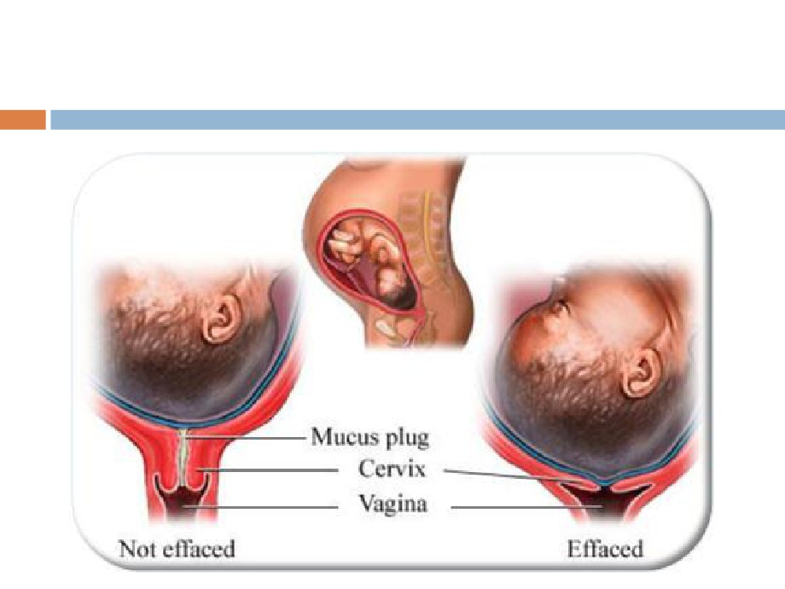
Cervical effacement and dilatation

Slide 30
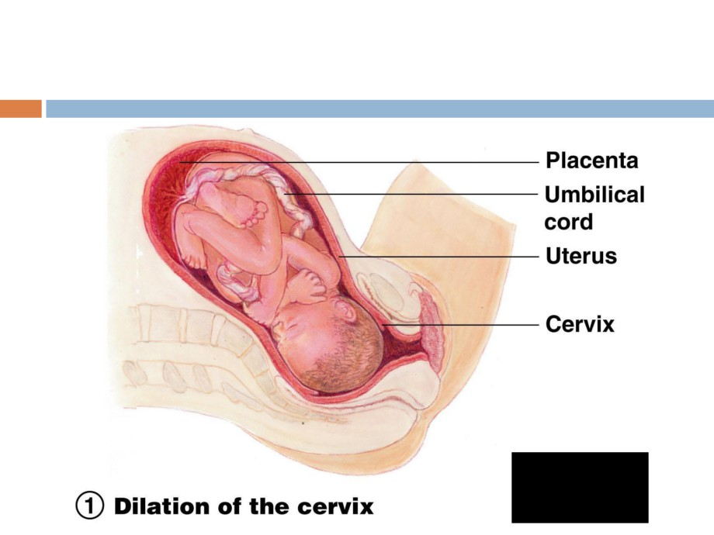
Stages of Labor
F
(1 of 3)

Slide 31
Stages of Labor
Expulsion (stage 2)
Infant passes through the cervix and vagina
Can last as long as 2 hours, but typically is 50 minutes in the first birth and 20 minutes in subsequent births
Normal delivery is head first (vertex position)
Breech presentation is buttocks-first

Slide 32
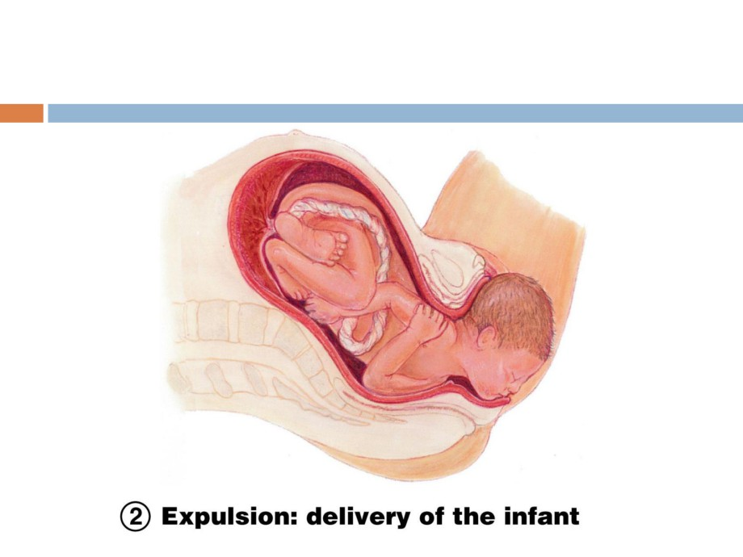
Stages of Labor
Figure 16.20 (2 of 3)

Slide 33
Stages of Labor
Placental stage (stage 3) Delivery of the placenta
Usually accomplished within 15 minutes after birth of infant
Afterbirth—placenta and attached fetal membranes
All placental fragments should be
removed to avoid postpartum bleeding

Slide 34
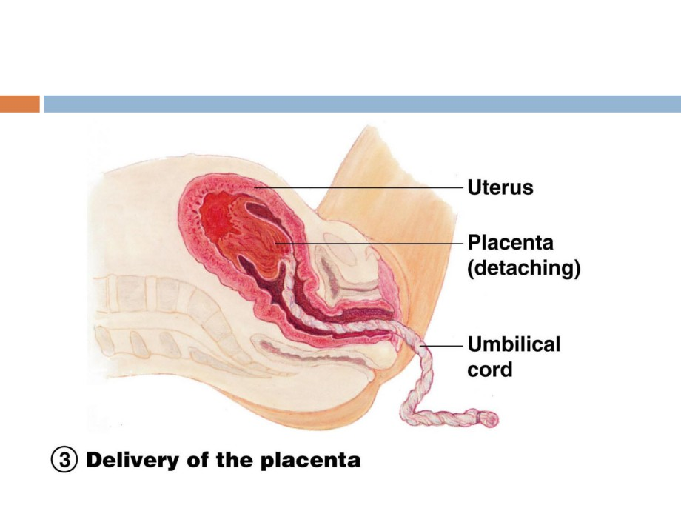
Stages of Labor
Figure 16.20 (3 of 3)

Slide 35
New arrival

Slide 36
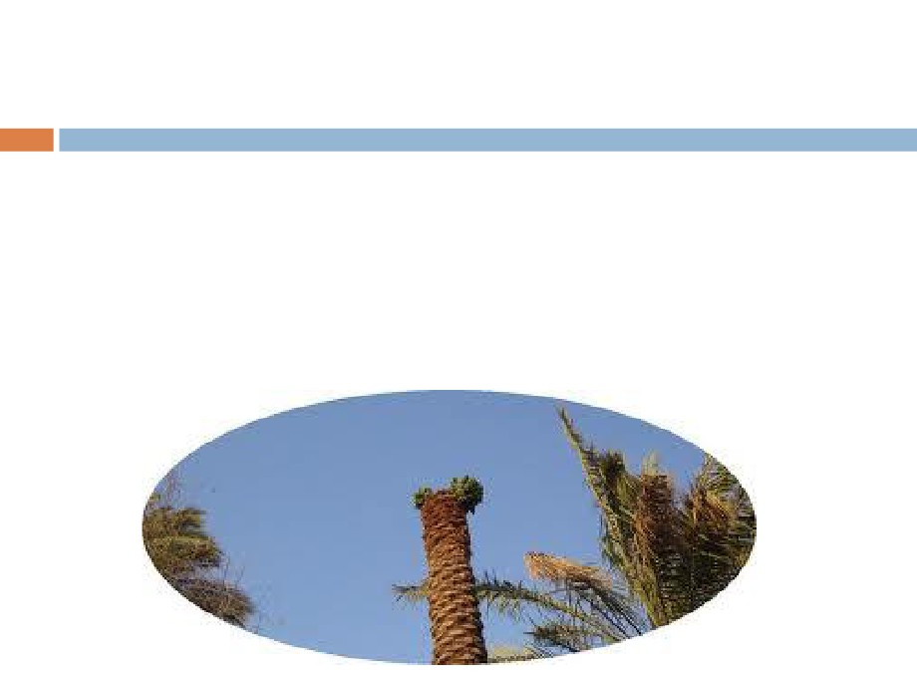
مت قبل هذا وكنت {ف΄جΎءه ΎالمخΎض إلى جذع النخلة قΎلت Ύϳ لϳتني
تحتك ني قد جόل ربك نس Ύϳمنس}23{ ΎϳفنΎداه Ύمن تحته Ύأل تحز
} سΎقْ َلϳك رْب ΎجنΎϳ سر}24{Ύϳوهزي إلϳك بجذع النخلة ت25{
فكلي واشربي وقري َϳن } Ύسورة مرϳم..

