Slide 2
Objectives
 Physiological anatomy of the breast
 Physiological changes during breast development (Mamogenesis)
 Physiological changes during lactation
(Lactogenesis) and their physiological action  Phases of lactogenesis.
 Physiological changes during Galactopoeisis.  Endocrine and autocrine control.
 Involution (the termination of milk production).

Slide 3
Small group activity
 What is the structure of human breast?

Slide 5
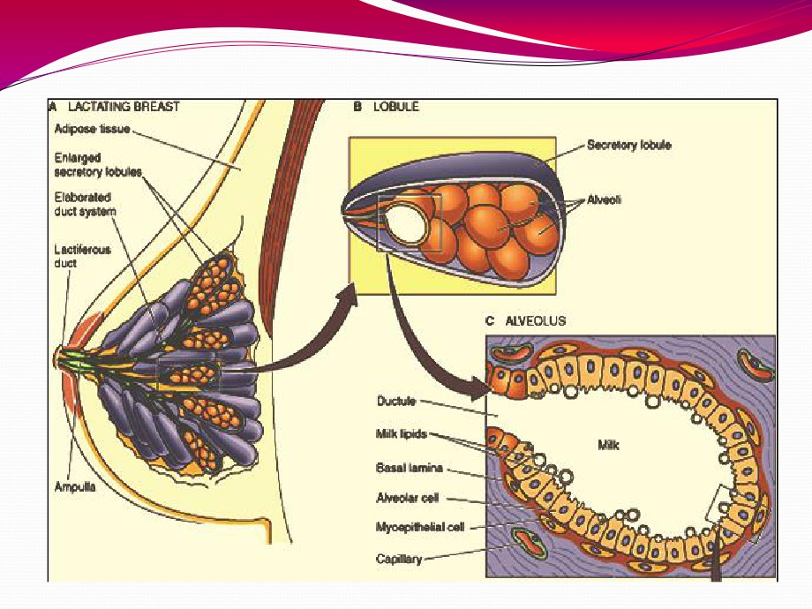

Slide 6
Small group activity
 Where does milk come from?

Slide 7
Theories
 Uterine milk theory: Vessel connecting the uterus to the breast (diversion of menstrual blood to the breast)
 Chyle theory: Milk is derived directly from chyle (milky fluid of emulsified fat absorbed from the intestinal tract into lymphatic system).
 Synthesis theory: Milk is formed from
substrates carried to the gland in the blood

Slide 8
Where does milk come
from?

Slide 11
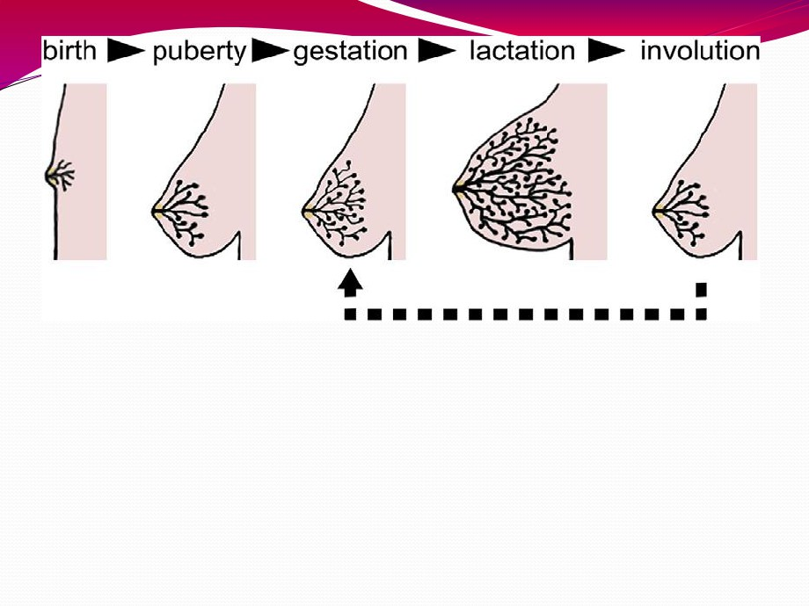
Fig. 1. Mammary gland development. The postnatal development of female mammary tissue occurs in several steps regulated by hormones. At birth, the mammary epithelium consists of limited ducts. At puberty, high levels of circulating hormones stimulate both the proliferation of the mammary epithelial cells (MECs) and the enlargement of the surrounding fat pad. At the onset of pregnancy, epithelial ducts elongate, branch and alveoli develop. During lactation, the mammary epithelium reach its maximal development containing numerous alveoli, which produce huge amounts of milk. Upon weaning, milk production ceases, the mammary alveoli regress (involution) and the mammary epithelium returns to a non-pregnant state.

Slide 12
Breast development (mamogenesis)
 During puberty
 Estrogen stimulate proliferation of ducts and deposition of fat
 Progesterone stimulate development of lobules

Slide 13
Breast development (mamogenesis)
 During pregnancy
 Complete development of glandular tissue

Slide 14
Breast development (mamogenesis)
 Endocrine system plays a major role in synchronizing development (mamogenesis) and function (lactogenesis) of mammary gland with reproduction
 Three categories of hormones:
 Reproductive hormones (endocrine)
 Estrogen, progesterone, prolactin, oxytocin and hPL  Metabolic hormones (endocrine)
 GH, corticosteroids, thyroxin, PTH and insulin  Mammary hormones (autocrine)
 GH, prolactin, parathyroid hormone-related protein (PTHrP) and leptin

Slide 15
Size of the breast & lactation

Slide 16
reast development (mammogenesis)
 Reproductive hormones (direct effect)
 Estrogen (placenta)
 Growth & branching of ductal system (with GH)  Fat deposition in the stroma
 Progesterone (placenta)
 Growth of lobule-alveolar system(budding of
alveoli and secretory changes in epithelial cells )
Although estrogen and progesterone are essential for physical development of the breasts, they inhibit actual secretion of milk

Slide 17
Breast development (mamogenesis)
 Prolactin (anterior pituitary)
 Its level increases during pregnancy (10-20 times)  Its main function is milk production
 Sudden drop in E & P after delivery allows milk production
 It is controlled mainly by hypothalamic hormone
 PIH (Dopamine)
 Human placental lactogen (placenta)
 Facilitate mammogenesis
 Delay milk production

Slide 19
ctogenesis
 Lactogenesis: cellular changes by which mammary
epithelial cells are converted from a non secretory state to a secretory state: 2 stages
 Lactogenesis 1: (Cytologic and enzymatic differentiation of alveolar
epithelial cells).
 Starts in mid pregnancy and characterized by expression of many genes involved in synthesis of milk components (increase in the uptake transport systems for amino acids, glucose, and calcium required for milk synthesis).
 Hormones involved:
1.
Progesterone (suppresses milk secretion) Prolactin and/or placental lactogen
2.
3.
Growth hormone
4.
Glucocorticoids (Cortisol)

Slide 20
Lactogenesis
 Lactogenesis 2: (Copious secretion of all milk components).
 Around parturition withdrawal of progesterone + high level of prolactin leads to:
 Further increase in expression of milk protein genes  Glands absorb increased quantities of metabolic substrates from the blood.
 Movement of cytoplasmic lipid droplets and casein into alveolar Lumina
 Transfer of immunoglobulins
 Secretion of colostrum followed by milk

Slide 21
Lactogenesis
 Lactogenesis 2:
 Suckling stimulates further increase in expression of genes involved in milk secretion with expansion of
alveolar epithelium
 Lactation is maintained by removal of milk  2 hormones involved
 Prolactin (milk production)  Oxytocin (milk let-down)

Slide 23
Stages of lactogenesis
Mamogenesis Lactogenesis Galctopoesis

Slide 25
ormonal regulation of lactogenesis
 1) Metabolic hormones (direct effect)
 GH
 Its secretion is stimulated by progesterone
 Increases production of IGF-1 by the liver and locally.
 Mediate cell survival and ductal growth  Corticosteroids
 Increases during pregnancy (five fold)
 Involved in breast development (permissive action on milk protein synthesis)

Slide 26
rmonal regulation of lactogenesis
 Thyroxin
 Essential for milk production
 Thyroxin & TSH level decreases during lactation
 TRH increases leading to stimulation of PRL (nasal administration to treat inadequate
lactation )
 Insulin
 Low during lactation
 Shunt of nutrients from storage depots to milk synthesis

Slide 27
rmonal regulation of lactogenesis
 2) Mammary hormones
 GH
 Progesterone stimulates its secretion  Leptin
 Increases during pregnancy (increase adipose tissue)
 Decreases with lactation  PTHrP
 Increases during lactation  Mobilizes bone calcium
 Increase in alkaline phosphatase

Slide 28
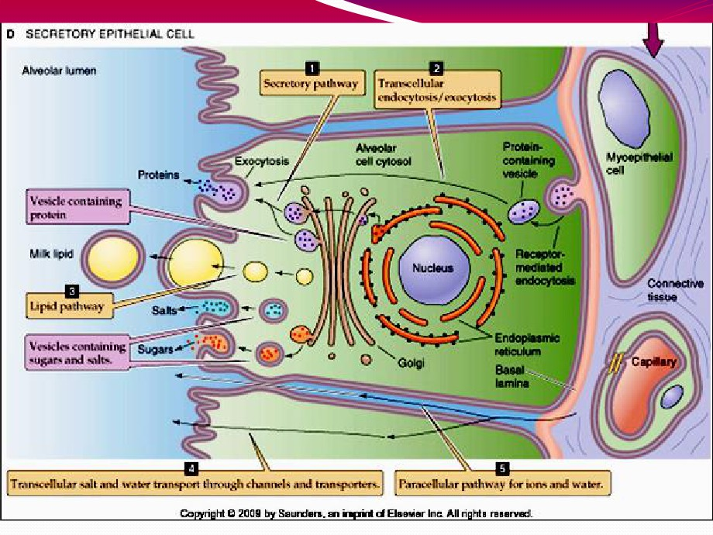

Slide 29
The pathways for milk secretion and synthesis by the mammary epithelial cell. I: Exocytosis of milk protein, lactose, and other components of the aqueous phase in Golgi-derived secretory vesicles. II: Milk fat secretion via the milk fat globule. III: Direct movement of mono valent ions, water, and glucose across the apical membrane of
the cell. IV: Transcytosis of components of the interstitial space. V: The paracellular pathway for plasma
components and leukocytes. Pathway V is open only during pregnancy, involution, and in inflammatory states such as mastitis. SV = Secretory vesicle; RER = Rough endoplasmic reticulum; BM = Basement membrane; MFG = Milk fat globule; CLD = Cytoplasmic lipid droplet; N = Nucleus; PC = Plasma cell; FDA = Fat-depleted adipocyte; TJ = Tight junction; GJ = Gap junction; D = Desmosome; ME = Myoepithelial cell.

Slide 30
Galactopoeisis

Slide 31
lactopoeisis
 Definition: Galactopoeisis is defined as the maintenance of lactation once lactation has been established.
 Role of Hormones
 Prolactin: milking-induced surge is a direct link between the act of nursing (or milk removal) and the galactopoeitic hormones involved in maintaining lactation.
 Growth Hormone: support increase in synthesis of lactose, protein, and fat in the mammary gland
 Glucocorticoids: galactopoeitic in physiological doses

Slide 32
 Thyroid Hormones: galactopoeitic
 Ovarian Hormones :
 Estrogen in very low doses is galactopoietic  Progesterone alone has no effect on galactopoeisis because there are no
progesterone receptors in the mammary gland during lactation

Slide 34
Suckling reflex
What
about---?

Slide 35
Suckling reflex

Slide 36
 Milk production is a
"use it or lose it" process.
The more often and effectively the baby nurses, the more milk will be produced
 Milk production <100 ml/day in day 1 postpartum
 Milk production by day 3 reaches 500 ml/day
 Milk composition changes dramatically(↓Na+2& Cl- ) due to closure of tight junctions that block paracellular
pathway

Slide 38
من كاملϳن لمن أراد أنϳ ت حولϳ ϳقول تόال ϰوالوالداتϳ رضόن أولدϫن 
الرضاعة) [البقرة:233] .
إشارة علمϳة دقϳقة أخرى للقرآن الكرϳم نراهϳ حدد مدة الرضاعة بما وفي  ϳقرب من الحولϳن ، في الϳة رقم(14) في سورة لقمان : ووصϳنا النسان
بوالدϳه حملته أمه وϫنـا عل ϰوϫن وفصاله في عامϳن )، (15)في سورة الحقاف:] حملته أمه كرϫـا ووضόته كرϫـا وحملهوالϳة وفصاله ثϼثون شهرا)
منϫ ذا أن إرضاع الحولϳن لϳس حتمـا ، بلϫ و التمام ، وϳجوز وϔϳهم  القتصار عل ϰما دونه ، كما أشارت الحكام السϼمϳة الخاصة بالرضاعة
ض منهما ترا ِ عنفصال اعتمادا عل ϰقوله تόال ϰفΈن أراداإل ϰذلك ،
وتشاور ف ϼجناح علϳهما )الϳة 233 البقرة.

Slide 39
AAP Recommendations
 Exclusive breast feeding
for the first six months of life
 Continued breast
feeding for at least one year, ‘As long as is
desired by mother and
child’.
American Academy of Pediatrics (2005). "Breastfeeding and the Use of Human Milk." Pediatrics 115(2): 496-506.

Slide 40
Failure of breast feeding

