Slide 1
ANATOMY OF THE FEMALE REPRODUCTIVE SYSTEM
Prof. Ahmed Fathalla Ibrahim
Professor of Anatomy
College of Medicine
King Saud University
E-mail: ahmedfathala@gmail.com

Slide 2
OBJECTIVES
At the end of the lecture, students should:
List the organs of female reproductive system.
Describe the pelvic peritoneum in female.
Describe the position and relations of the ovaries.
List the parts of the uterine tube.
Describe the anatomy of uterus regarding: subdivisions, cavity, relations, ligaments & main support.
Describe the anatomy of vagina regarding: structure, extent, length & relations.
Describe the supply (arteries, veins, lymph, nerves) of female reproductive system.

Slide 3
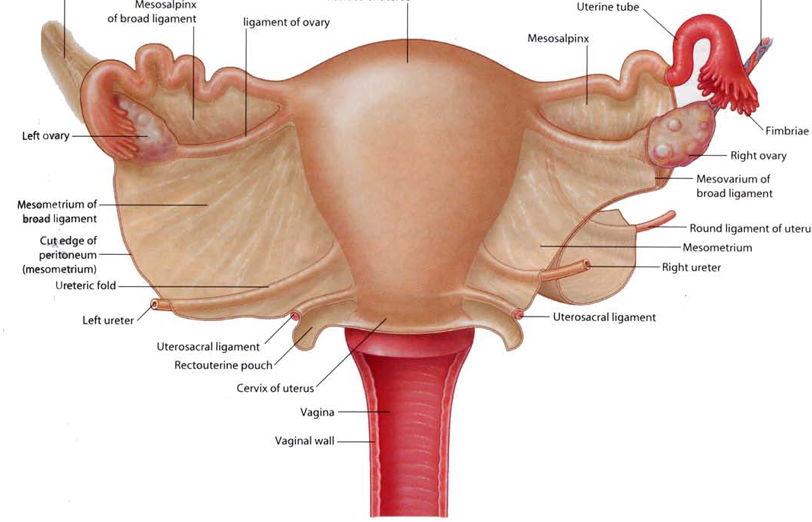
FEMALE REPRODUCTIVE SYSTEM
UTERINE TUBE
OVARY
UTERUS
V
A
G
I
N
A
POSTERIOR VIEW

Slide 4
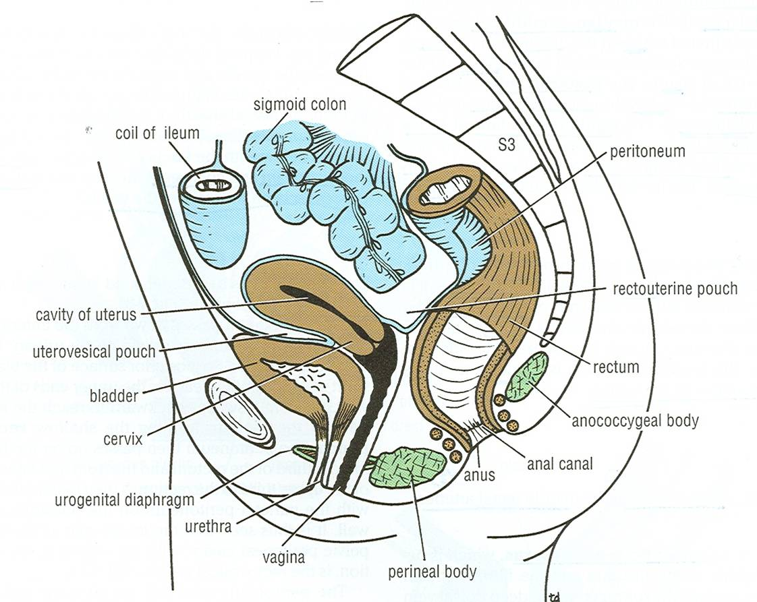
PELVIC PERITONEUM IN FEMALE
BROAD
LIGAMENT
Rectouterine (Douglas) pouch: Reflection of peritoneum from rectum to upper part of posterior surface of vagina
Uterovesical (vesicouterine) pouch: Reflection of peritoneum from uterus to upper surface of urinary bladder
Broad ligament of uterus: Extension of peritoneum from lateral wall of uterus to lateral wall of pelvis, encloses the uterine tubes

Slide 5
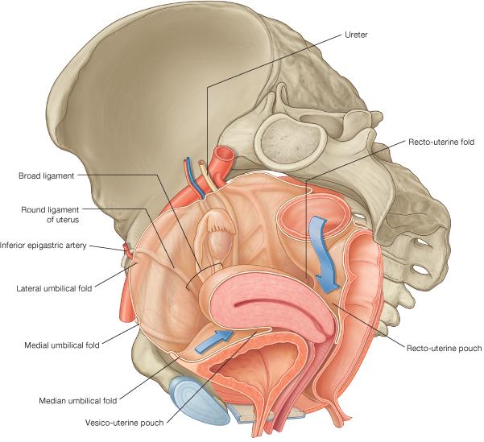
PELVIC PERITONEUM IN FEMALE

Slide 6
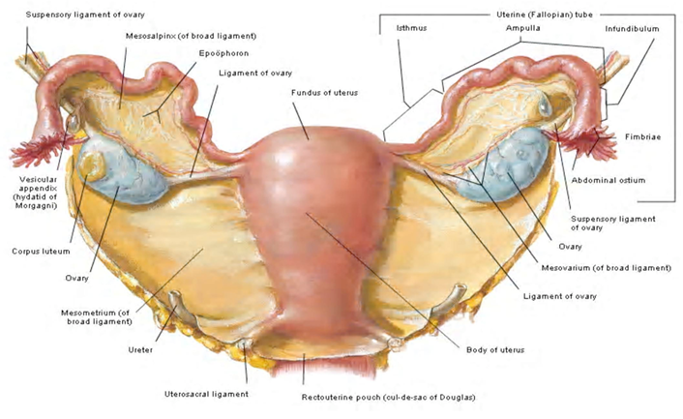
THE OVARIES
BROAD
LIGAMENT
Female pelvic organs
(Posterior view)
It is an almond-shaped organ.
It is attached to the back of the broad ligament by a peritoneal fold (mesovarium)
Its medial end is attached to uterus by ligament of ovary.
Its lateral end is related to the fimbriae of the uterine tube.

Slide 7
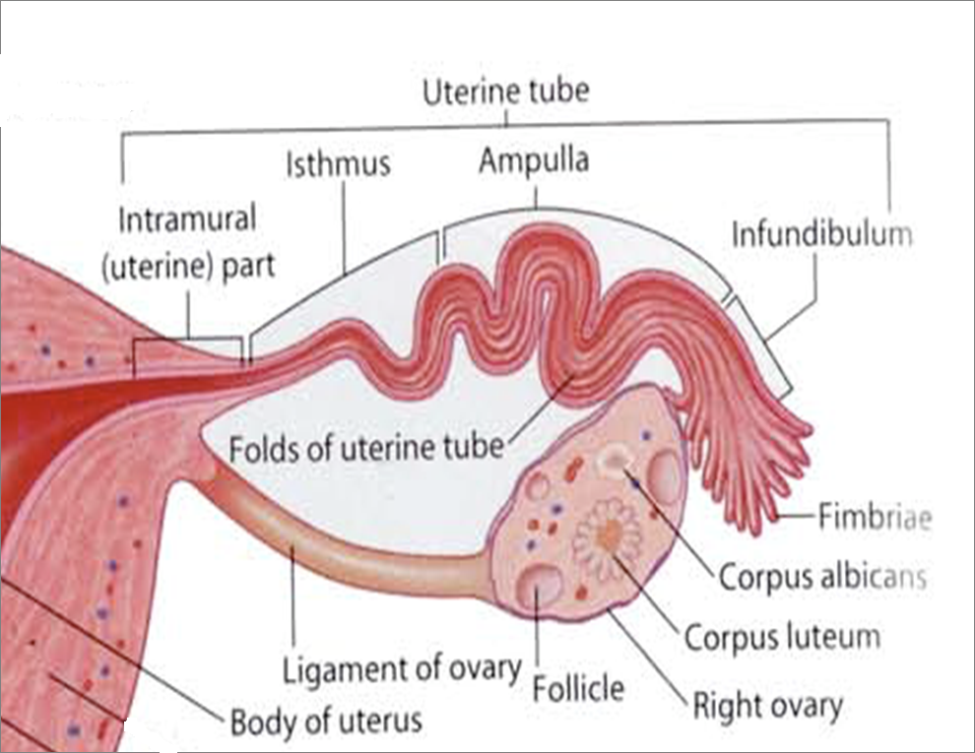
THE UTERINE (FALLOPIAN) TUBES
It is 10 cm long.
It is enclosed in the broad ligament of uterus.
It is divided into:
1) Intramural part: opening into the uterine wall
2) Isthmus: narrowest part
3) Ampulla: widest part (site of fertilization)
4) Infundibulum: funnel-shaped end, has finger-like processes (fimbriae), related to ovary
2
3
1
4
X

Slide 8
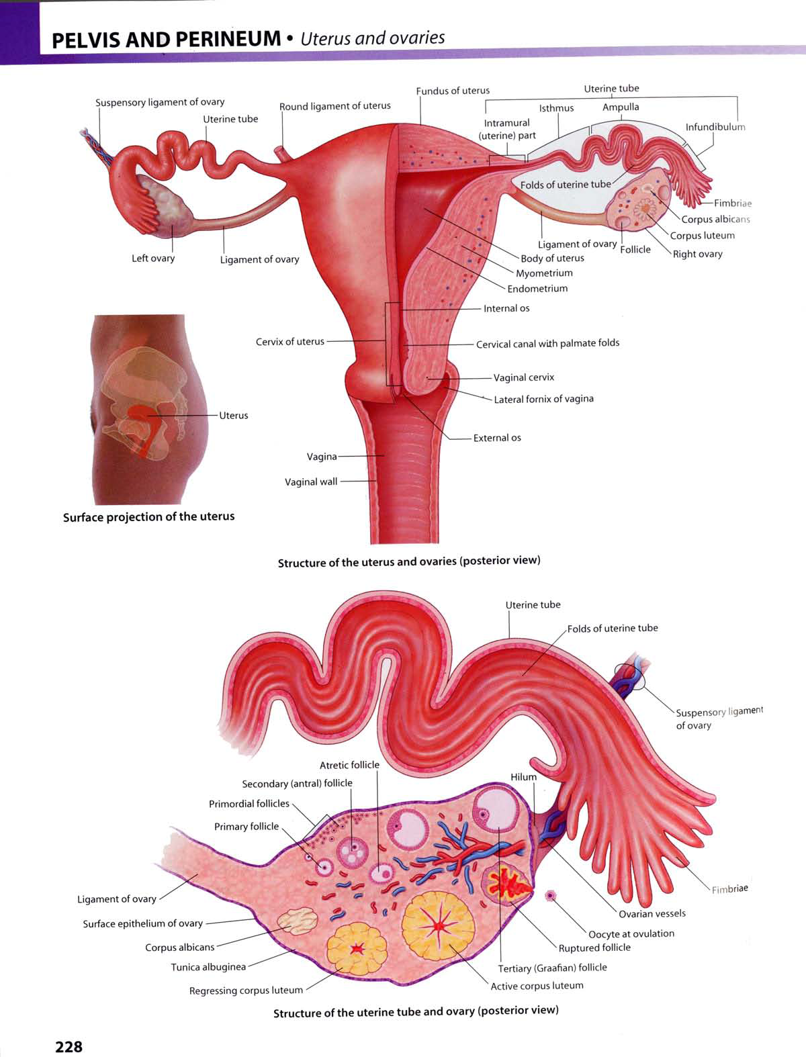
FUNCTION OF:
OVARIES: PRIMARY SEX ORGANS IN FEMALE
Production of female germ cells
Secretion of female sex hormones
UTERINE TUBES:
Site of fertilization
Transport of fertilized ovum into the uterus

Slide 9
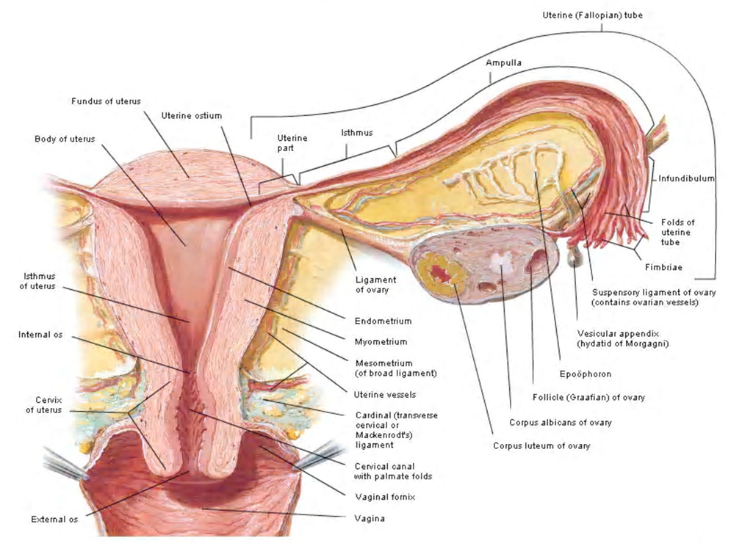
THE UTERUS
2’
A hollow, pear-shaped muscular organ
Divided into:
Fundus: no cavity
Body: cavity is triangular
Cervix: cavity is fusiform, divided into:
*Supravaginal part
*Vaginal part
3’
1’
Fundus
Body

Slide 10
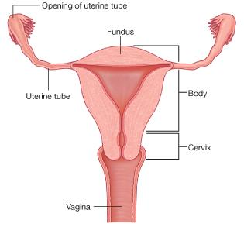
THE UTERUS
FUNDUS: The part of uterus above the level of uterine tubes
BODY: The part of uterus from the level of uterine tube to the level of the isthmus
of uterus
CERVIX: The part of the uterus below the level of the isthmus of the uterus

Slide 11
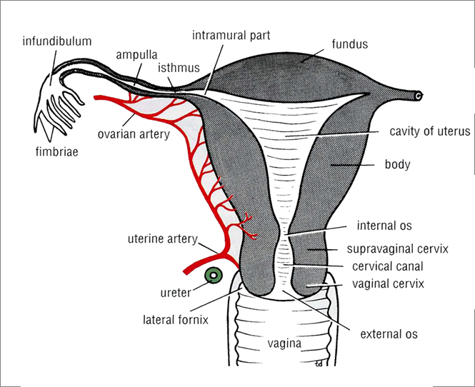
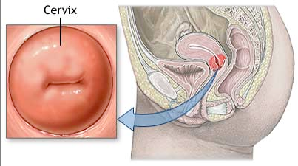

THE CERVICAL CANAL
Multiparous
Nulliparous
INTERNAL OS: opening between cavity of body of uterus & cavity of cervix (cervical canal)
EXTERNAL OS: opening between cervical canal & cavity of vagina
In a nulliparous woman: external os appears circular.
In a multiparous woman: external os appears as a transverse slit with an anterior & a posterior lip.

Slide 12
RELATIONS OF UTERUS
FUNDUS + BODY + SUPRAVAGINAL PART OF CERVIX:
Anterior: superior surface of urinary bladder
Posterior: sigmoid colon
Lateral: uterine artery
VAGINAL PART OF CERVIX: surrounded by vaginal fornices
Anterior: anterior fornix of vagina
Posterior: posterior fornix of vagina
Lateral: lateral fornices of vagina

Slide 13
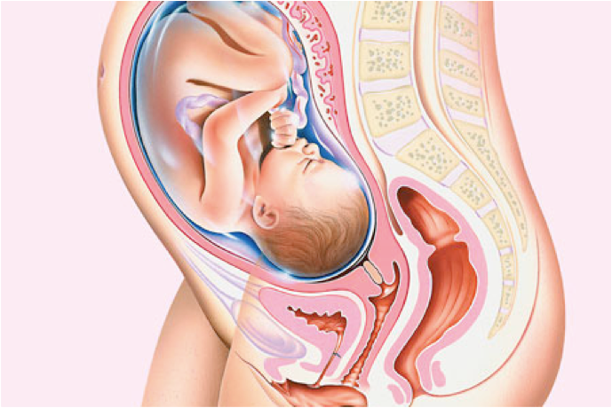
FUNCTION OF UTERUS

Slide 14
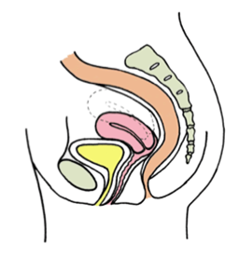
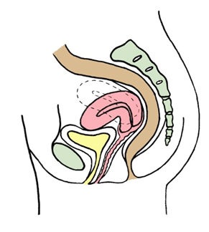
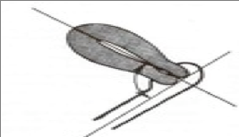
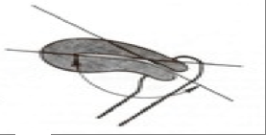
POSITIONS OF UTERUS
ANTEFLEXED UTERUS
ANTEVERTED UTERUS
Long axis of body of uterus is bent
forward on long axis of cervix
Long axis of whole uterus is bent
forward on long axis of vagina

Slide 15
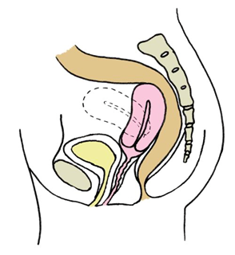
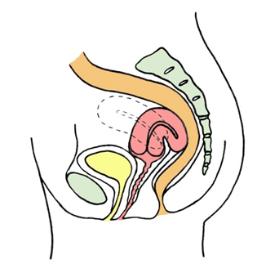
POSITIONS OF UTERUS
RETROVERTED UTERUS
RETROFLEXED UTERUS
Fundus & body of uterus are bent backward
on the vagina and lie in rectouterine pouch
Long axis of body of uterus is bent
backward on long axis of cervix

Slide 16
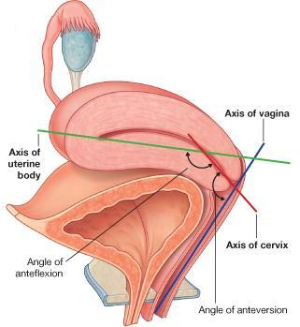
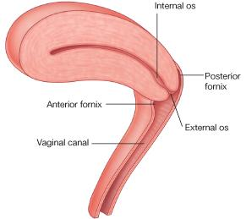
USUAL POSITION OF UTERUS
ANTEVERTED ANTEFLEXED UTERUS

Slide 17
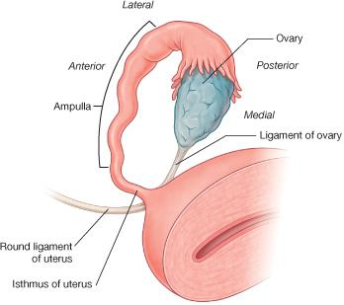
LIGAMENTS OF UTERUS
1)Ligaments at junction between fundus & body of uterus
(At the level of uterine tube)
2
Extends through inguinal canal
to labium majus
1

Slide 18
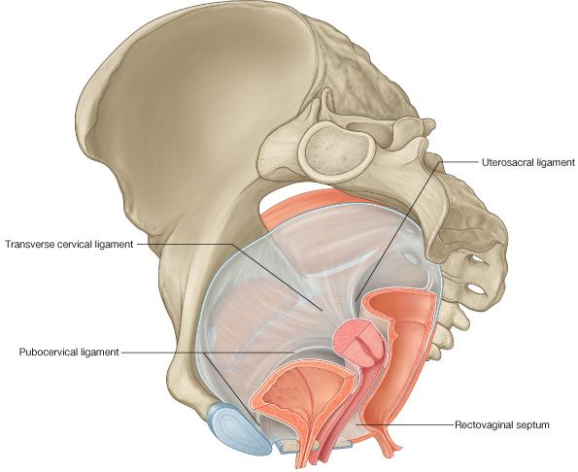
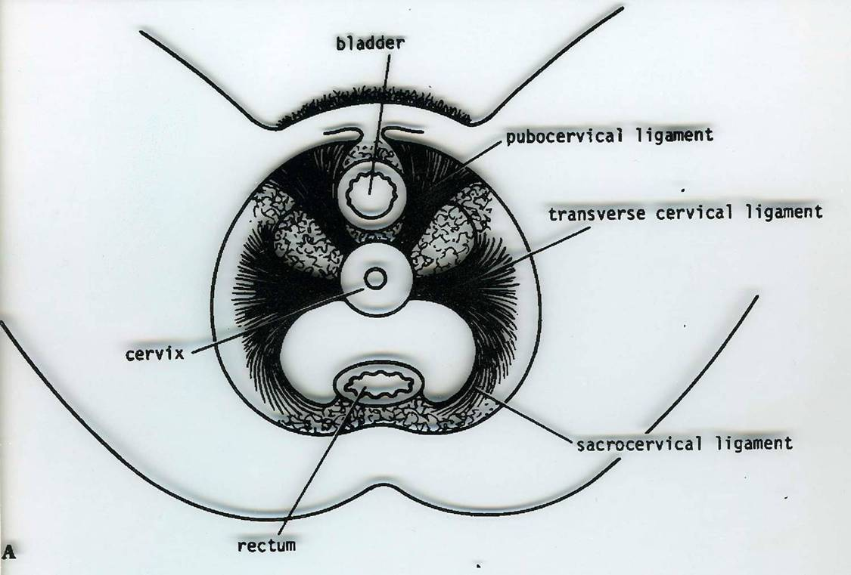
LIGAMENTS OF UTERUS
2)Ligaments of cervix
Extend from cervix to: anterior (pubocervical),
pelvic walls lateral (transverse cervical or cardinal)
posterior (uterosacral or sacrocervical)

Slide 19
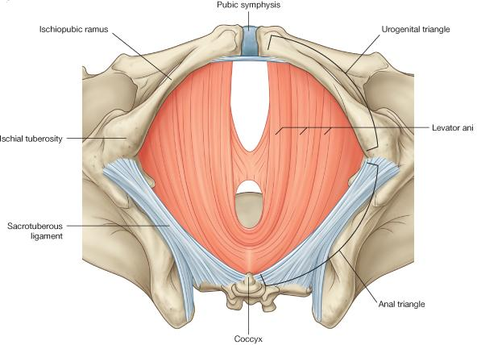
LEVATOR ANI MUSCLES
FORM THE PELVIC FLOOR: separate pelvis from perineum
FORM PELVIC DIAPHRAGM: traversed by urethra, vagina & rectum
SUPPORT PELVIC ORGANS
Levator ani
Urethra
Vagina
Urethra
Rectum
Rectum
Vagina

Slide 20
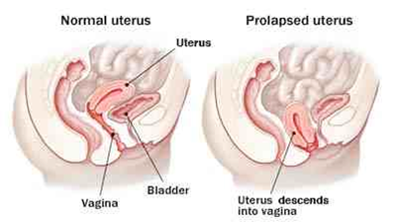
SUPPORT OF UTERUS
Ligaments of cervix (especially transverse cervical)
Round ligament of uterus (maintains anteverted anteflexed position)
Levator ani muscles
UTERINE PROLAPSE
Downward dispalcement of uterus due to damage of:
Ligaments of uterus
Levator ani muscles

Slide 21
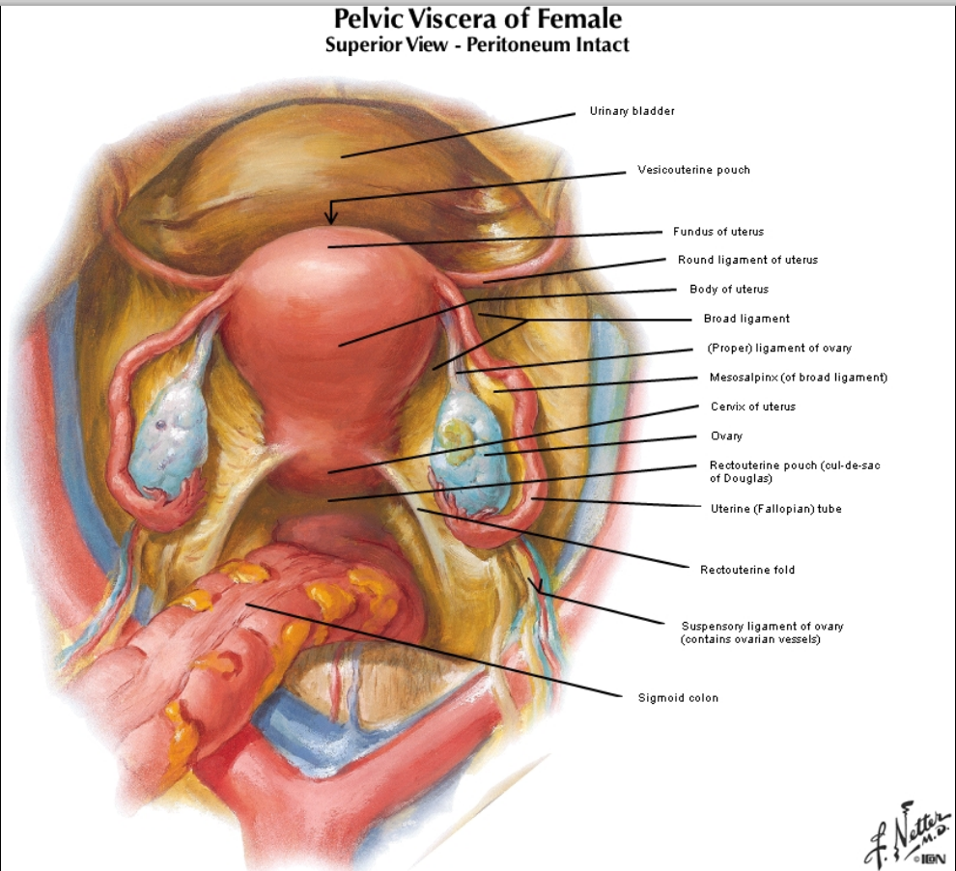
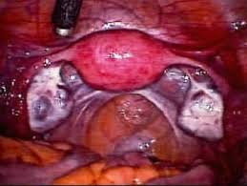
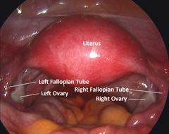
FEMALE PELVIC ANATOMY
Laparoscopic view

Slide 22
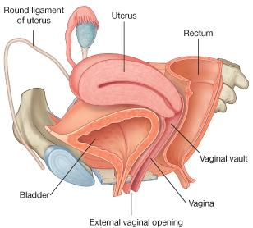
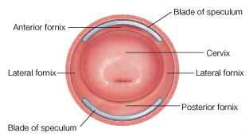
VAGINA
STRUCTURE: Fibro-muscular tube
EXTENT: From external os, along pelvis & perineum, to open in the vulva (female external genitalia), behind urethral opening
LENGTH: Its anterior wall (7.5 cm) is shorter than its posterior wall (9 cm)
FUNCTION: 1) Copulatory organ & 2) Birth canal

Slide 23
RELATIONS OF VAGINA
ANTERIOR: Urinary bladder (in pelvis) & urethra (in perineum)
POSTERIOR: Rectum (in pelvis) & anal canal (in perineum)
LATERAL: ureters (in pelvis)

Slide 24
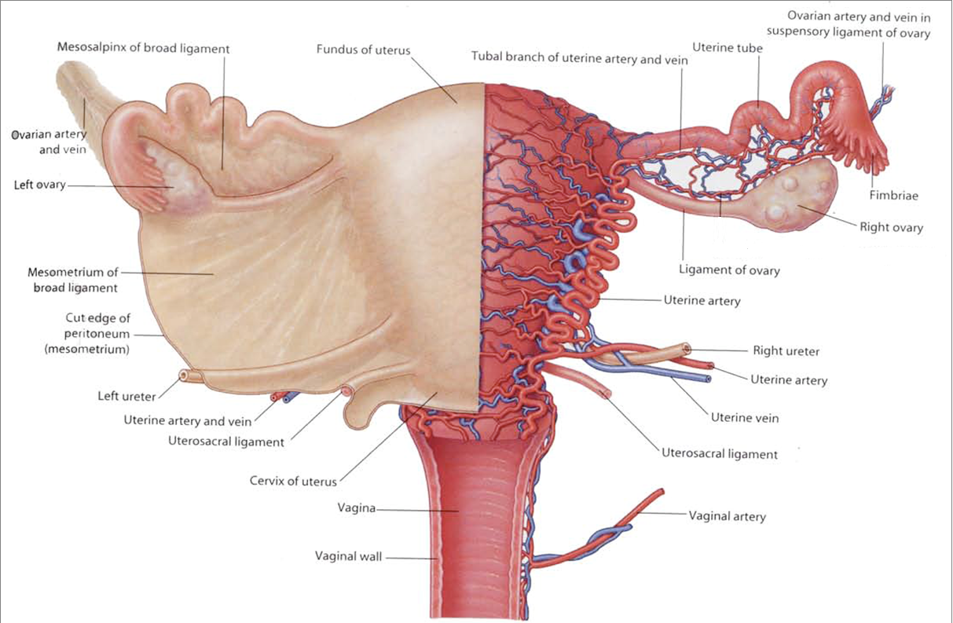
ARTERIAL SUPPLY
From abdominal aorta
From internal iliac artery
(Artery of pelvis)

Slide 25
ORGAN | ARTERIES | VEINS | LYMPHATICS | NERVES (AUTONOMIC)
OVARIES | OVARIAN (ABDOMINAL AORTA) | OVARIAN (TO INFERIOR VENA CAVA & LEFT RENAL VEIN) | TO PARAAORTIC LYMPH NODES (IN ABDOMEN) | OVARIAN PLEXUS (IN ABDOMEN)
UTERINE TUBES | OVARIAN UTERINE | OVARIAN UTERINE | PARAAORTIC INTERNAL ILIAC | OVARIAN INFERIOR HYPOGASTRIC
UTERUS | UTERINE (INTERNAL ILIAC ARTERY IN PELVIS) | UTERINE PLEXUS (TO INTERNAL ILIAC VEIN) | TO INTERNAL ILIAC LYMPH NODES (IN PELVIS) | INFERIOR HYPOGASTRIC PLEXUS (IN PELVIS)
VAGINA | VAGINAL (INTERNAL ILIAC ARTERY IN PELVIS) | VAGINAL PLEXUS (TO INTERNAL ILIAC VEIN | TO INTERNAL ILIAC LYMPH NODES (IN PELVIS) | INFERIOR HYPOGASTRIC PLEXUS (IN PELVIS)

Slide 26
QUESTION 1
Which one of the following structures is related (or attached) to the lateral end of the ovary?
Fimbriae of uterine tube
Ampulla of uterine tube
Ligament of ovary
Round ligament of uterus

Slide 27
QUESTION 2
Which one of the following structures is anterior to the uterus?
Urinary bladder
Ureter
Sigmoid colon
Ovary

Slide 28
QUESTION 3
Which one of the following groups of lymph nodes are the sentinel nodes (very first nodes affected) in cases of cancer ovary?
Superficial inguinal
Internal iliac
Paraaortic
External iliac

Slide 29
THANK YOU

