Slide 1
Development of male genital system
Prof. Ahmed Fathalla Ibrahim

Slide 2
OBJECTIVES
At the end of the lecture, students should be able to:
List the causes of differentiation of genitalia into the male type.
Describe the origin of each part of the male internal & external genitalia.
List the causes & describe the events of descent of testis.
List the common anomalies of male genital system & describe the causes of each of them.

Slide 3
TESTIS & EPIDIDYMIS

Slide 4
MALE GENITAL SYSTEM

Slide 5
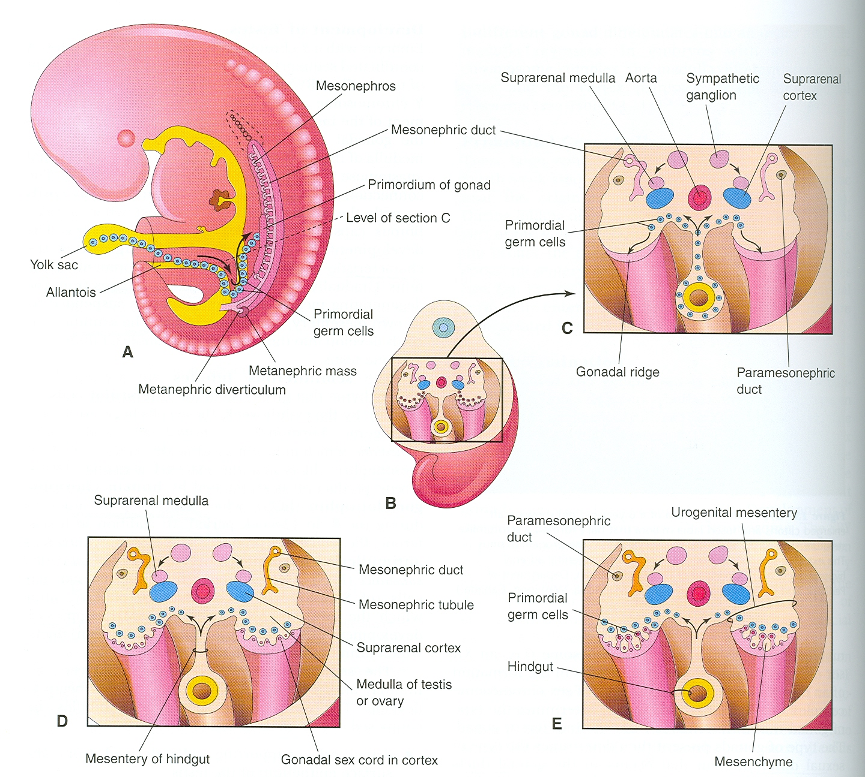

Slide 6
DEVELOPMENT OF GONADS
During 5th week: gonadal development occurs.
Until 7th week: gonads are similar in both sexes.
Gonads are derived from 3 sources:
Mesothelium (mesodermal epithelium lining the coelomic cavity)
Underlying mesenchyme
Primordial germ cells

Slide 7
INDIFFERENT GONADS
Gonadal ridge: a bulge on the medial side of mesonephros produced by:
Proliferation of mesothelium (cortex)
Proliferation of mesenchyme (medulla)
Gonadal (primary sex) cords: The proliferating mesothelial cells fuse to form cords.
Primordial germ cells: endodermal cells of the yolk sac migrate along dorsal mesentery of hindgut to gonadal ridges & become incorporated into gonadal cords.

Slide 8
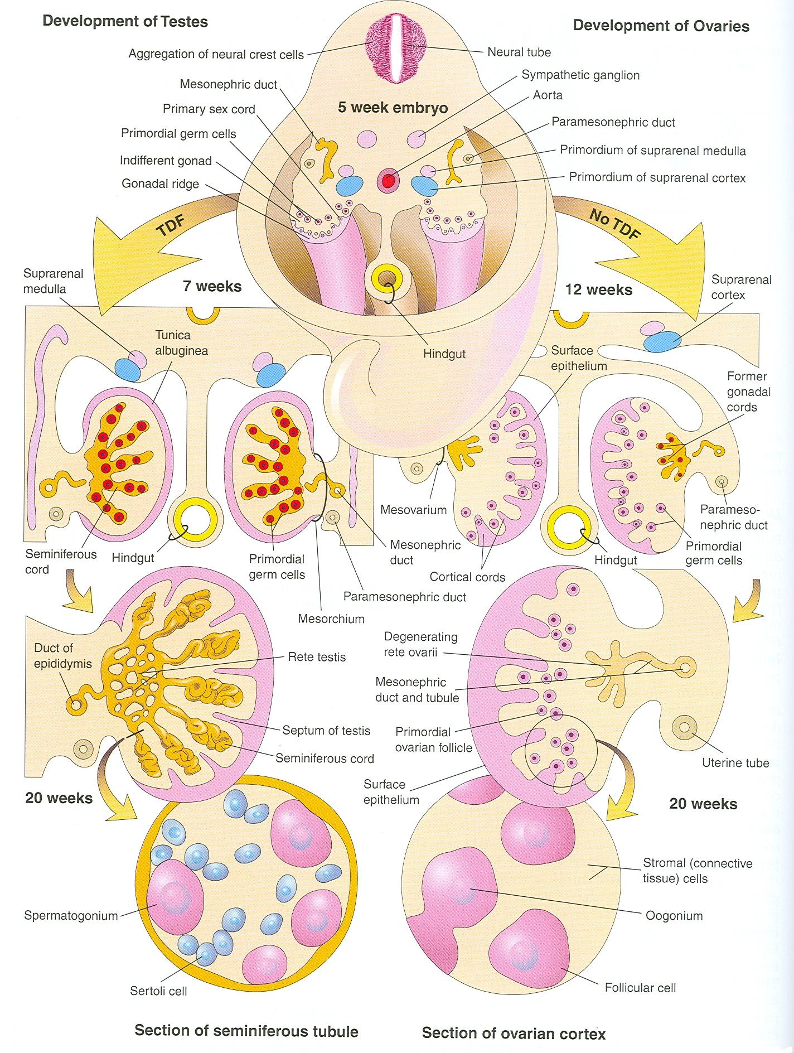
In Medulla
Germ cells
Mesothelial cells

Slide 9
DEVELOPMENT OF TESTIS
The Y chromosome has a testis-determining factor (TDF) that differentiates gonad into testis.
At 7th week:
Regression of cortex & differentiation of medulla into testis.
Gonadal cords condense & extend into medulla to form seminiferous cords.
The characteristic feature is the development of a thick fibrous capsule (tunica albuginea) that separates the enlarging testis from mesonephros.

Slide 10
DEVELOPMENT OF TESTIS
Seminiferous cords develop into: semineferous tubules
Semineferous tubules remain solid until puberty. Its walls are composed of:
Sertoli cells: derived from surface epithelium of testis (mesothelial cells)
Spermatogonia: derived from primordial germ cells
By eighth week, mesenchyme surrounding semineferous cords gives rise to interstitial cells (of Leydig) secreting testosterone

Slide 11
DEVELOPMENT OF TESTIS (SUMMARY)
Regression of cortex
& differentiation of medulla
Gonadal cords extend to medulla
& form medullary (semineferous) cords
Appearance of
Tunica Albuginea
Semineferous cords give rise to:
Semineferous tubules
Mesenchyme surrounding tubules
gives rise to: Interstitial cells of Leydig
Germ cells
Spermatogonia
Mesothelial cells
Sertoli cells

Slide 12
DEVELOPMENT OF MALE GENITAL DUCTS
Leydig’s cells
Sertoli cells
Testosterone (8th week)
Müllerian inhibiting substance
(Anti- Müllerian hormone) (7th week)
Masculine differentiation of
mesonephric duct: epididymis,
vas deferens, seminal glands,
ejaculatory duct.
2) Masculine differentiation of
external genitalia
Suppression of development
of paramesonephric
(Müllerian) duct

Slide 13
DEVELOPMENT OF MALE GENITAL GLANDS
SEMINAL GLAND: mesodermal outgrowth from mesonephric duct.
PROSTATE GLAND: endodermal outgrowth from prostatic urethra.
BULBOURETHRAL GLAND: endodermal outgrowth from spongy urethra.
Stroma & smooth muscles in
2 & 3 are derived from surrounding mesenchyme

Slide 14
SUMMARY OF DEVELOPMENT OF MALE INTERNAL GENITALIA
MESODERMAL STRUCTURES
Testis: from medulla of genital ridge
Semineferous tubules: from medullar cords of ridge
Sertoli cells: from mesothelial cells of ridge
Leydig’s cells: from mesenchyme surrounding the tubules
Epididymis, vas deferens, seminal glands, ejaculatory duct: from mesonephric duct
ENDODERMAL STRUCTURES
Spermotogonia: from primordial germ cells of yolk sac
Prostate gland: from prostatic urethra
Bulbourethral glands: from spongy urethra

Slide 15
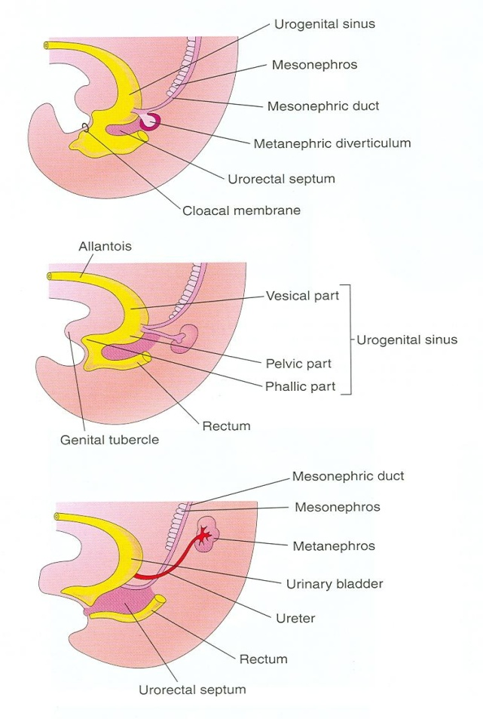
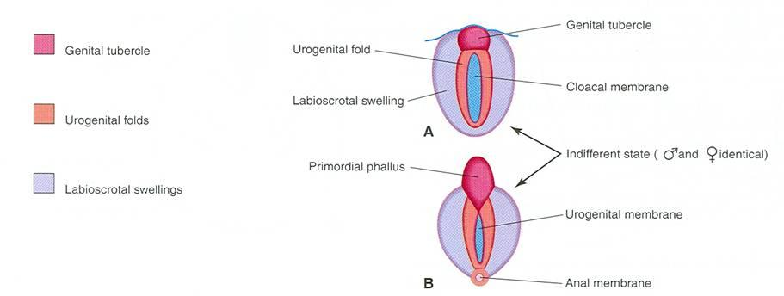
Genital tubercle: produced from mesenchyme at the cranial end of cloacal membrane. It elongates to
form a primordial phallus
Urogenital folds: develop on each side of cloacal membrane
Labioscrotal swellings: develop on
each side of urogenital folds
INDIFFERENT STAGE
OF
EXTERNAL GENITALIA
(from 4th to 7th week)

Slide 16
DEVELOPMENT OF MALE EXTERNAL GENITALIA (stimulated by testosterone)
Begins at 9th week
Complete differentiation at 12th week:
The phallus enlarges to form the penis
The urogenital folds fuse to form the spongy (penile) urethra
The labioscrotal folds (swellings) fuse to form the scrotum

Slide 17
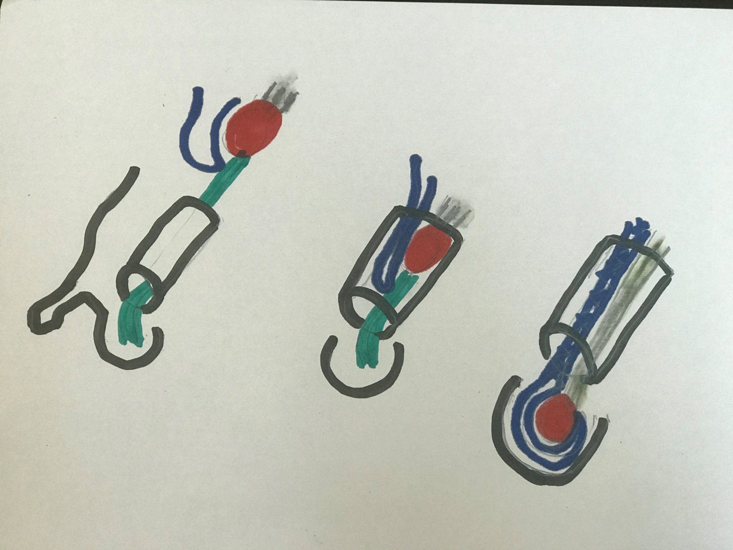
Vessels, nerves & lymphatics
of testis
- Internal Descent: from posterior abdominal wall
to Deep Ring
- External Descent: from Deep Ring to scrotum
Processus vaginalis
Testis
Gubernaculum
testis
Deep Ring
Inguinal canal
Superficial Ring
Spermatic
cord
Scrotum
Tunica vaginalis
1
2
3

Slide 18
DESCENT OF TESTIS

Slide 19
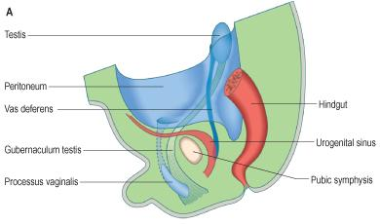
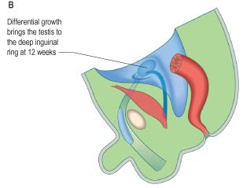
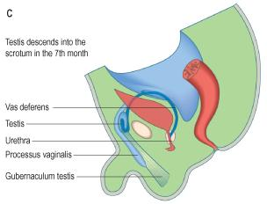
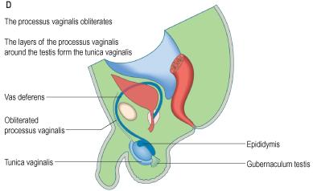
Internal descent
Inguinal canal
Labioscrotal fold
External descent
Scrotum

Slide 20
DESCENT OF TESTIS
Gubernaculum: a mesenchymal band extending from inferior pole of gonad to labioscrotal fold.
Inguinal canal: a pathway formed by gubernaculum through layers of anterior abdominal wall.
Processus vaginalis: a peritoneal fold passing through inguinal canal before testis to facilitate its descent.

Slide 21
INTERNAL DESCENT OF TESTIS
Definition: Descent of testis from posterior abdominal wall to deep inguinal ring.
Time: During 12th week
Cause: a relative movement resulting from elongation of cranial part of abdomen away from its caudal part (future pelvic cavity).

Slide 22
EXTERNAL DESCENT OF TESTIS
Definition: Descent of testis from deep inguinal ring, through inguinal canal, to scrotum
Time: Begins in 7th month and takes 2 to 3 days
Causes:
Controlled by androgens
Guided by gubernaculum
Facilitated by processus vaginalis
Helped by increased intra-abdominal pressure resulting from growth of abdominal viscera

Slide 23
EXTERNAL DESCENT OF TESTIS
More than 97% of full-term new born males have both testes in scrotum.
During first 3 months after birth, most undescended testes descend into scrotum.
No spontaneous descent occurs after the age of 1 year.

Slide 24
EXTERNAL DESCENT OF TESTIS
Complete descent of testis is associated by:
Degeneration of gubernaculum
Obliteration of stalk of processus vaginalis
Persistence of part of processus vaginalis surrounding the testis in the scrotum to form “tunica vaginalis”

Slide 25
CHRYPTORCHIDISM (UNDESCENDED TESTIS)
Incidence: in up to 30% of premature & 3-4% of full term males
Cause: deficiency of androgens
Common sites: look to figure
Complications:
Sterility, if bilateral
Testicular cancer (20-44%)

Slide 26
CONGENITAL INGUINAL HERNIA
Definition: Herniation of a loop of intestine through a non-obliterated processus vaginalis.
A: incomplete B: complete (in scrotum)
Cause: The processus vaginalis does not obliterate & remains in open communication with the peritoneal cavity.

Slide 27
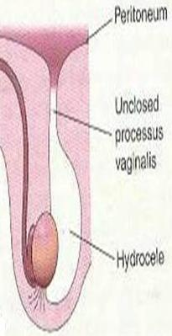
HYDROCELE OF SPERMATIC CORD
Accumulation of fluid in spermatic cord due to a non-obliterated portion of stalk of processus vaginalis
HYDROCELE OF TESTIS
Accumulation of fluid in tunica vaginalis
(in scrotum) due to non-obliteration
of the whole stalk of Processus vaginalis

Slide 28
QUESTION 1
Which one of the following structure is a derivative of male urethra?
Seminal gland
Prostate gland
Vas deferens
Ejaculatory duct

Slide 29
QUESTION 2
Which one of the following cells are responsible for masculine differentiation of external genitalia?
Sertoli cells
Leydig’s cells
Mesothelial cells
Primordial germ cells

Slide 30
THANK YOU

