Slide 1
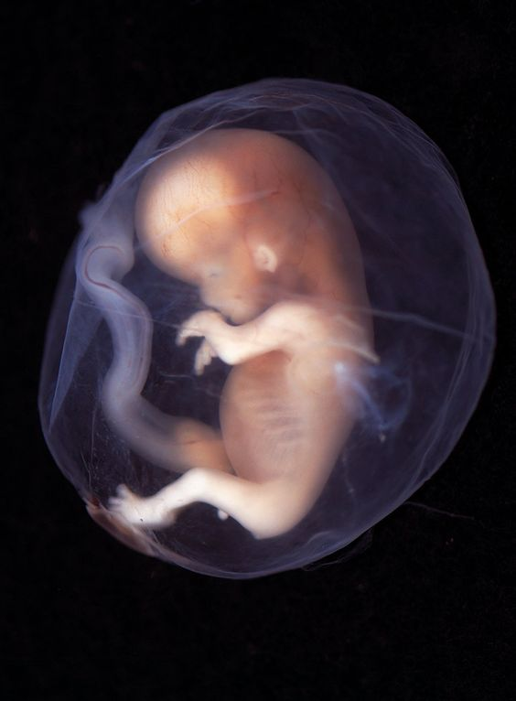
PLACENTA
KHALEEL ALYAHYA, PHD, MED
KING SAUD UNIVERSITY
COLLEGE OF MEDICINE
@KHALEELYA

Slide 2
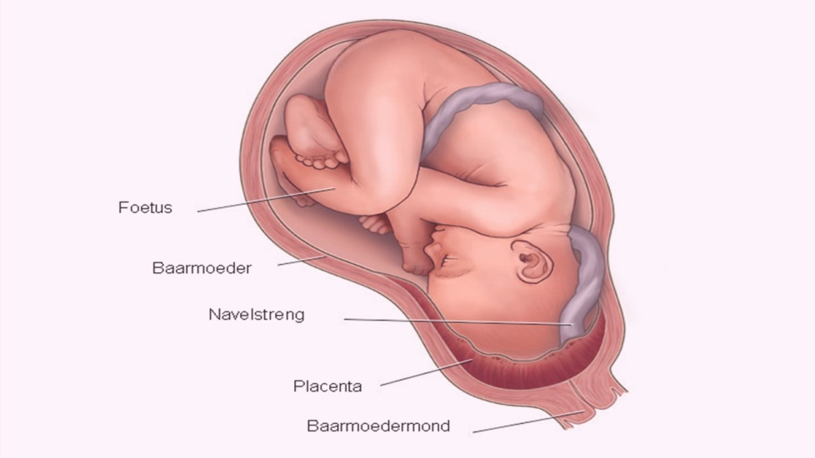
INTRODUCTION
It is a fetomaternal structure.
Formed by the beginning of the 4th month.
It is the primary site for exchange of gases and nutrients between mother and fetus.

Slide 3
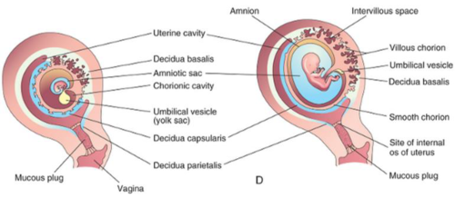
FORMATION
Fetal Part:
Villous Chorion.
It is the bushy area at the embryonic pole.
Its villi are more in number, enlarged and branch profusely.
Maternal Part:
Decidua Basalis
Decidua (Gravid Endometrium) :
It is the functional layer of the endometrium during pregnancy which is shed after parturition.

Slide 4
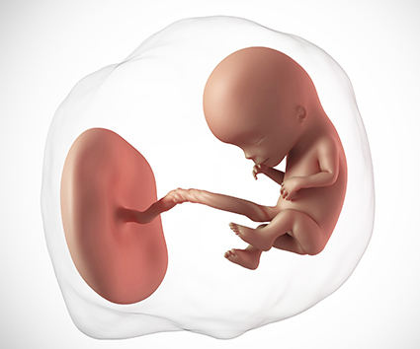
FULL TERM PLACENTA
Discoid in shape.
Weighs (500 – 600)g.
Diameter 15-25 cm.
Thickness 2-3 cm.
Umbilical cord is attached to the center.
It has two surfaces:
Fetal
Maternal

Slide 5
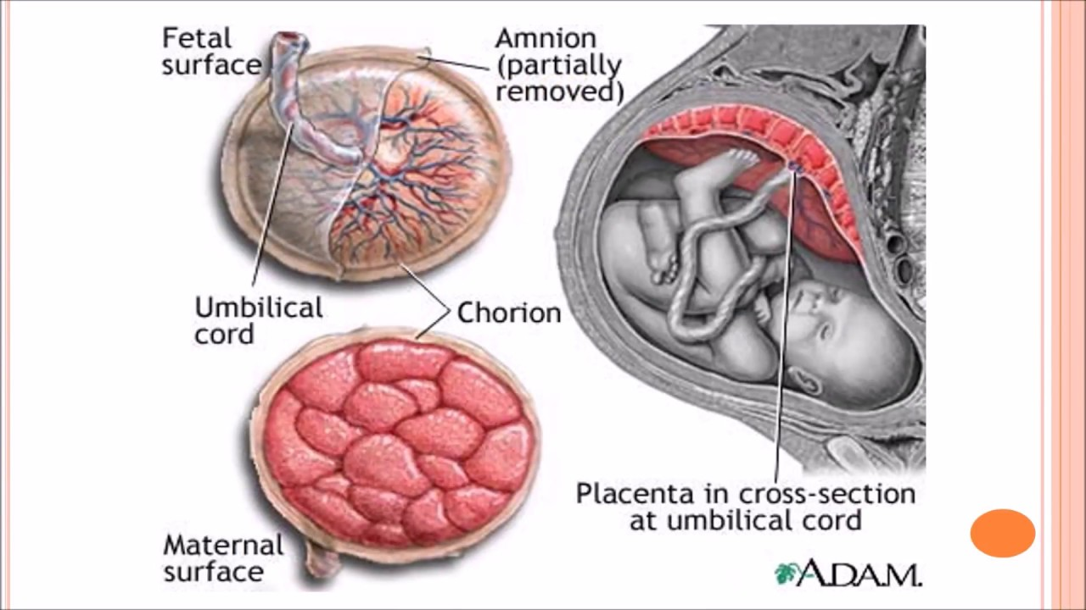
Surfaces
FETAL SURFACE
Smooth because it is covered with the amnion.
The umbilical cord is attached to its center.
The chorionic vessels are radiating from the umbilical cord.
MATERNAL SURFACE
Rough.
Formed of (15 –20) irregular convex areas (Cotyledons) which are separated by grooves (placental septa).
Each cotyledon is covered by a thin layer of decidua basalis.

Slide 6
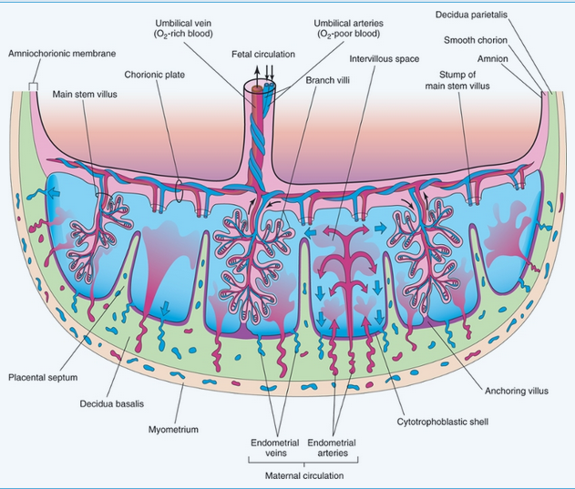
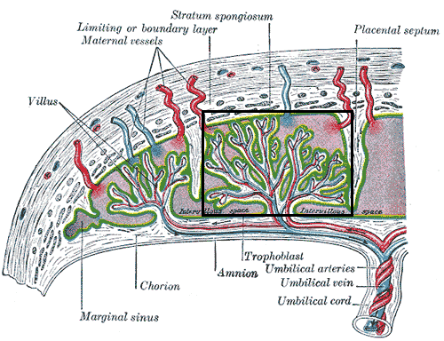
Structure of a Cotyledon
It consists of two or more stem villi with their many branch villi.
It receives (80-100) maternal spiral arteries that enter the intervillous spaces at regular intervals.

Slide 7
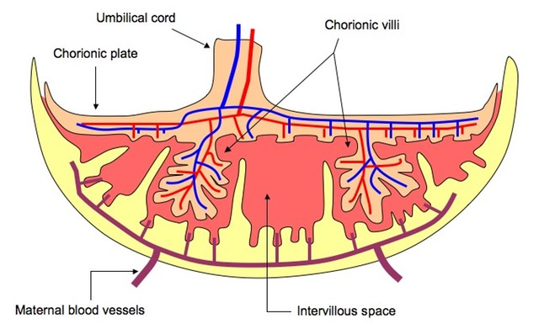
INTERVILLOUS SPACE
Large blood filled spaces which are freely communicating.
They receive spiral arteries from the lacunae in the syncytiotrophoblast.
The spaces are drained through endometrial veins.
Both arteries and veins pass through pores in the cytotrophoblastic shell.

Slide 8
Fetal Placental Circulation
Two Umbilical Arteries:
Carry poorly oxygenated blood from the fetus to the placenta.
Within the branch chorionic villi, they form:
Arterio-capillary venous network:
It brings the fetal blood extremely close to the maternal blood.
The well oxygenated fetal blood in the capillaries passes into veins accompanying the chorionic arteries.
At the umbilical cord, they form the One Umbilical Vein.

Slide 9
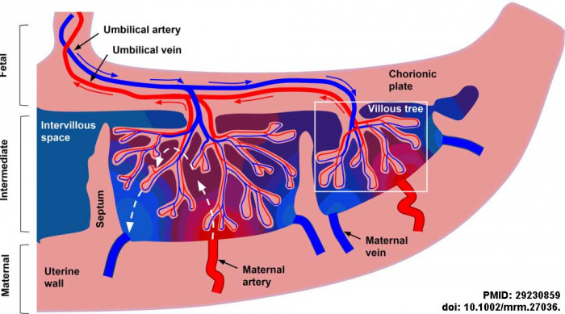
MATERNAL Placental Circulation
80 –100 spiral endometrial arteries discharge into the intervillous space.
The blood is propelled in jet like fountains by the maternal blood pressure.
The pressure of this entering blood is higher than that in the intervillous space.
It forms a roof of the space.
As the pressure dissipates, the blood flows slowly around the branch villi.
Exchange of metabolites and gases with the fetal blood.
As the pressure decreases, the blood flows back from the chorionic plate and enter the endometrial veins to the maternal circulation.

Slide 10
PLACENTAL MEMBRANE
It is a composite thin membrane of extra fetal tissues which separates the fetal and maternal bloods.
Up to (20) weeks, it is composed of four layers:
Syncytiotrophoblast.
Cytotrophoblast.
Connective tissue of the villus.
Endothelium of fetal capillaries.
At full term it becomes thinner and composed of three layers only:
Syncytiotrohoblast.
Connective tissue.
Endothelium of the capillaries.
At some sites, the syncytio comes in direct contact with the endothelium of the capillaries and forms Vasculosyncytial placental membrane.

Slide 11
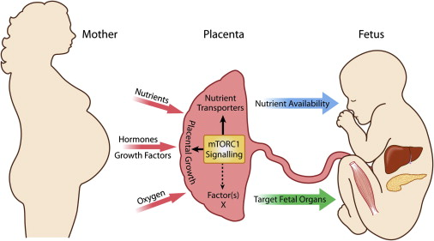
FUNCTIONS
Metabolic
Synthesis of Glycogen, Cholesterol and Fatty Acids.
They supply the fetus with nutrients and energy.
Transportation
Gases:
Exchange of O2, CO2 and CO is through simple diffusion.
The fetus extracts (20 –30) ml of O2/minute from the maternal blood.
Nutrients and Electrolytes:
Water, Amino acids, Carbohydrates, Vitamins and Free Fatty Acids are rapidly transferred to the fetus.
Maternal Antibodies:
Maternal immunoglobulin G gives the fetus passive immunity to some infectious diseases (measles, small box) and not to others (chicken box).

Slide 12
FUNCTIONS
Drugs and Drug metabolites:
They cross the placenta by simple diffusion.
They can affect the fetus directly or indirectly by interfering with placental metabolism.
Hormones:
Protein hormones do not reach the embryo in sufficient amounts.
Some of these hormones (Thyroxine & Testosterone which may cause masculinization of a female fetus) can cross the placental membrane.
Waste products:
Urea and uric acid pass through the placental membrane by simple diffusion.

Slide 13
FUNCTIONS
Endocrine Synthesis:
Progesterone:
Maintains pregnancy if the corpus luteum is not functioning well.
Estrogen
Stimulates uterine growth and development of the mammary glands.
hCS or Hpl:
Human placental lactogen (human chorionic somatomammotropin) a growth hormone that gives the fetus the priority on maternal blood glucose.
It promotes breast development for milk production.
hCG:
Human chorionic gonadotropin maintains the corpus luteum and used as indicator of pregnancy.

Slide 14
DRUG ADDICTION
Fetal drug addiction can be due to some drugs as Heroin.
All sedatives and analgesics can affect the fetus to some degree.
Drugs used for management of labor can cause respiratory distress to the newborn.

Slide 15
ANOMALIES OF PLACENTA
Placenta Accreta:
Abnormal absence of chorionic villi with partial or complete absence of the decidua basalis.
Placenta Percreta:
Chorionic villi penetrate the myometrium to the perimetrium.
The most common presenting sign of these two anomalies is trimester bleeding.
Placenta Previa:
The blastocyst is implanted close to or overlying the internal uterine os.
It is associated with late pregnancy bleeding.
Delivery is through Cesarean section.

Slide 16
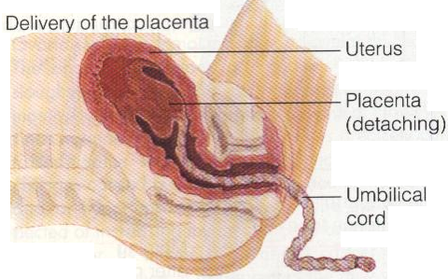
Fate of Placenta
The strong uterine contractions that continue after birth compress uterine blood vessels to limit bleeding & cause the placenta to detach from the uterine wall (within 15 minutes after birth of the infant).

Slide 17
QUESTIONS!

