Slide 1
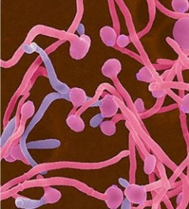
Candida infection Tricpmonas vaginalis Bacterial vaginosis

Slide 2
Type of infection
Females
Cervicitis
Vulvovaginitis
Urethritis
Bacterial vaginosis (BV)
Salpingitis (pelvic inflammatory disease [PID])
Endometritis
Genital ulcers
Pregnant females
Disease in the neonate.
Children and postmenopausal women
Males
Urethritis
Epididymitis
Prostatitis
Genital ulcers

Slide 3
Abnormal vaginal secretion
Normal physiological vaginal secretion
Vaginal infection
Trichimoniasis
Vulvovaginitis candiasis
Bacterial vaginnosis
Desquamative inflammatory vaginitis
Cervicitis
Infectious
Noninfectious
Esterogen deficiency

Slide 4
History & symptoms of valvovaginitis
General gyneclogical history( age Neonatal ,pregnancy,prepubescent,atrophic post menop)
Onset,,Esterogen depletion)
Menstrual history
Pregnancy
Sexual Hx
Contraception
Sexual relationship
Prior infection
General medical Hx
Allergies
DM
Malignancies
Immunodeficiecy
Medication OCP<steroids,duches
Symptoms
Discharge(quality scanty)physiological OCP
Oder(BV,FB,EV fistula)
Valvular disconfort(HSV)
Dyspareunia
Abdominal pain (tricho) PID

Slide 5
Examination
Breast
Adequate illumination
Magnification if possible
Give a patient mirror
Inspect external genetalia
Lesions
Erythema
Vaginal mucosa
Erythema
Lesion
Secretion
Examination of cervix
Ectropion
Lesions
Erythema
Endocervical secretion
Collect cervical and vaginal specimen
Bimanual examination

Slide 6
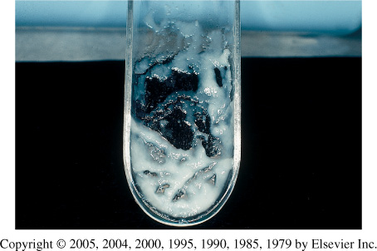
Characteristic of normal vaginal secretion
Desquamated vaginal epithelial cell
Lactobacilli dominate
PH 3.5 to 4.6
Oderless
No itching or irritation
Deonot soil underclothing1

Slide 7
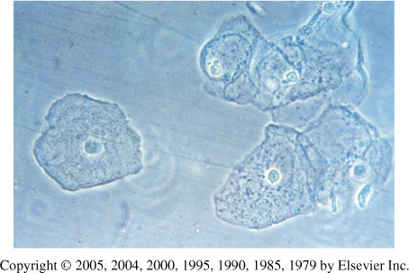
The human vagina
Lined with 25 layers of epithelium cells.
Separation of microbial pathogens from the normal genital microbiota.
Lactobacilli
Corynebacterium spp.
Gardnerella vaginalis
coagulase-negative staphylococci, Staphylococcus aureus
Streptococcus agalactiae
Enterococcus spp.
Escherichia coli
Anaerobes
Yeasts

Slide 8
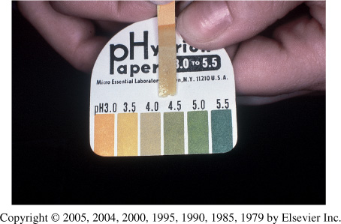
Vaginal PH examination

Slide 9
Cassification of vulvovaginitis
Complicated
Underlying illness
HIV
DM
Recurrent infection 4 or more per year
Non albican candida
Pregnancy
Sever infection
Culture confirmation mandatory
Antifungal suscep. Testing
Treat for 10-14 days with vaginal or oral agent
Other topical
Boric acid
5 fluorocytocine
Consider treatment of the partners
Long term suppressive treatment for frequently recurrent diseases
Uncomplicated
Sporadic
No underlying disease
By Candida albican
Not pregnanat
Mild to moderate severity
Any available topical agent
Fluconazole 150mg as a single oral dose

Slide 10
Candida infections yeast infection moniliasis
Candidiasis or thrush is a fungal infection (mycosis) of any of the Candida species (yeasts) of which Candida albicans is the most common.
Common superficial infections of skin and mucosal membranes by Candida causing local inflammation and discomfort.

Slide 11
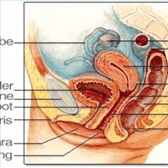

Slide 12
Candidal vulvovaginitis vaginal thrush
Infection of the vagina’s mucous membranes by Candida albicans.
75% of adult women
Found naturally in the vagina
Hormonal changes
Change in vaginal acidity.
Broad-spectrum antibiotics.
Use of corticosteroid medications
Pregnancy.
20-30 years
Poorly controlled diabetes mellitus.

Slide 13
Risk factors
Antibiotics
Pregnancy
Diabetes (poorly controlled)
Immunodeficiency
Contraceptives
Sexual behaviour
Tight-fitting clothing
Female hygiene

Slide 14
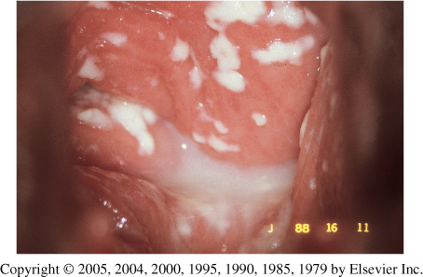
Symptoms
Vulval itching
Vulval soreness and irritation
Superficial dyspareunia.
Dysuria
Odourless vaginal discharge
thin and watery or thick and white (cheese-like)
Erythema (redness)
Fissuring
satellite lesions.

Slide 15
Types of candidal vulvovaginitis
Uncomplicated thrush
single episode/less than four episodes in a year.
mild or moderate symptoms
caused by the Candida albicans .
Complicated thrush
four or more episodes in a year.
severe symptoms.
Pregnancy
poorly controlled diabetes/immune deficiency.
not caused by the Candida albicans

Slide 16
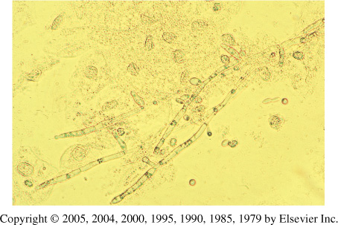
Diagnosis
History & symptoms
physical and pelvic exam
Candidiasis can be similar to other diseases:
Sexually transmitted diseases
Chlamydia
Trichomoniasis
Bcterial vaginosis
Gonorrhea

Slide 17
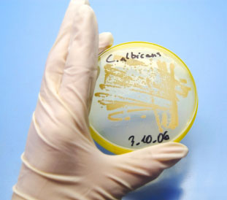
Candida albicans

Slide 18
Treatment
Butoconazole cream
Clotrimazole
1% cream
vaginal tablet
Miconazole
2% cream
vagina suppository
Nystatin
vaginal tablet
Oral Agent:
Fluconazole- oral one tablet in single dose

Slide 19
Treatment
Short-course topical formulations
single dose and regimens of 1–3 days
effectively treat uncomplicated candidal vulvovaginitis
Topical azole drugs are more effective than nystatin
Azole drugs relief of symptoms in 80%–90% of cases.
Treatment failure
In up to 20% of cases
If the symptoms do not clear within 7–14 days

Slide 20
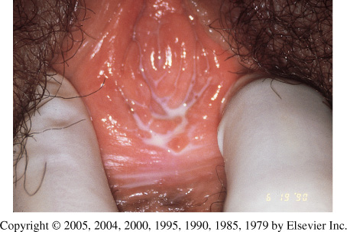
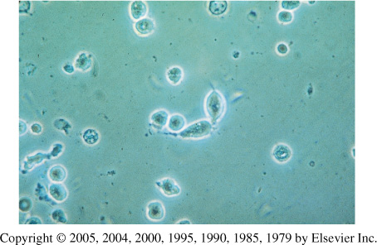
Trichomoniasis
(sexually-transmitted infection)
Symptoms
Purulent vaginal discharge
yellow or greenish in color
Vulvar irritation (strawberry)
Dysurea
Dyspareunia
Abnormal vaginal odor
The wet mount's fast results

Slide 21
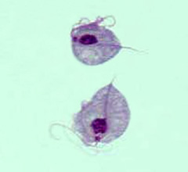
Culture is considered the gold standard for the diagnosis of trichomoniasis. Its disadvantages include cost and prolonged time before diagnosis

Slide 22
Management
Confirm the diagnosis
Wet preparation (miss 30%)
Culture
Gram Stain
Confirm all current sexual partners treated
Oral metronidazole
500 mg bid for 7 days
2 g daily for 3-5 days
If Rx failure -Consultation with experts
Susceptibility testing
Higher dose of metronidazole
Alternative Tinidazole

Slide 23
Bacterial Vaginosis
Floral imbalance
Lactobacillus acidophilus
Gardnerella vaginalis
Mycoplasma hominis
Mobiluncus species
Anaerobes
Bacteroides (Porphyromonas)
Peptostreptococcus
Fusobacterium
Prevotella
Lactobacilli
Compete with other microorganisms for adherence to epithelial cells
Produce antimicrobial compounds such as organic acids (which lower the vaginal pH) hydrogen peroxide, and bacteriocin-like substances

Slide 24
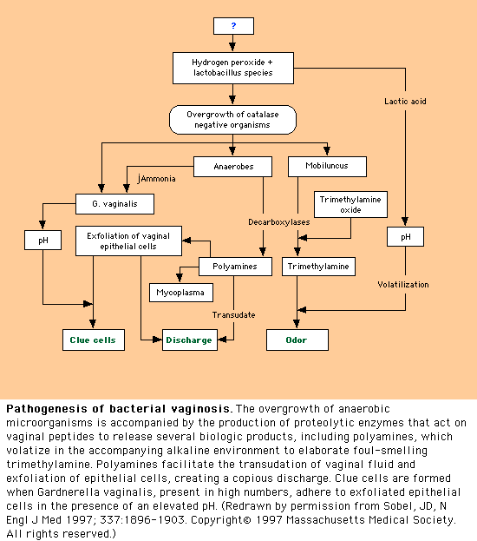

Slide 25
Pathogenesis
Marked reduction in lactobacillus
Decreased hydrogen peroxide production
Polymicrobial superficial infection: overgrowth of G. vaginalis and anaerobic bacteria
Lactobacilli predominate after metronidazole treatment

Slide 26
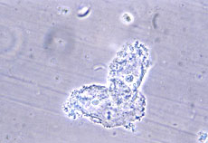
Epidemiology
The most common vaginal infection in women of childbearing age-29%
Risk factors
Multiple or new sexual partners
(sexual activity alteration of vaginal pH)
Early age of first sexual intercourse
Douching
Cigarette smoking
Use of IUD
*Although sexual activity is a risk factor for the infection, bacterial vaginosis can occur in women who have never had vaginal intercourse

Slide 27
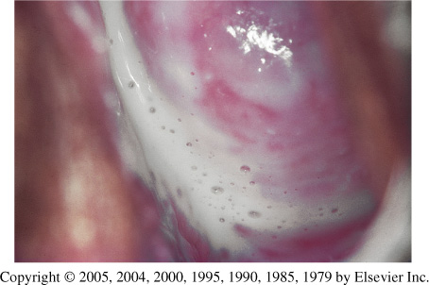
Clinical Features
Most cases (50-75%) Homogenous grey vaginal discharge
Dysuria and dyspareunia rare
Pruritus and inflammation are absent
Fishy vaginal discharge
During menstruation
After intercourse
Minimal itching or irritation
Absence of inflammation is the basis of the term "vaginosis" rather than vaginitis

Slide 28
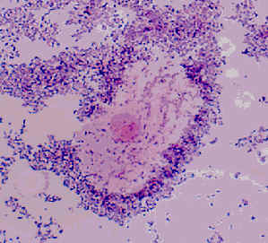
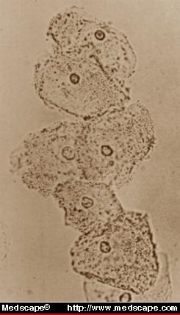
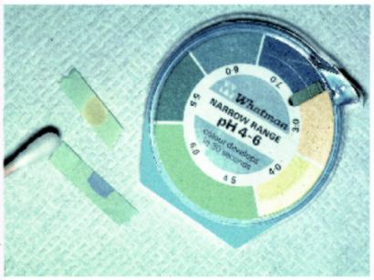
Diagnostic Methods
Clinical/Microscopic Criteria
Gram Stain (“Gold Standard”)
Clue cells on saline wet mount of vaginal discharge (on >20% cells)
Bacteria adhered to epithelial cells; most reliable single indicator
Vaginal pH > 4.5
Elevated pH and increased amine
Sensitivity 87%; Specificity 92%
*Culture- poor predictive value for G. vaginalis as prevalent in healthy asymptomatic women
*DNA probes- expensive, poor predictive value alone

Slide 29
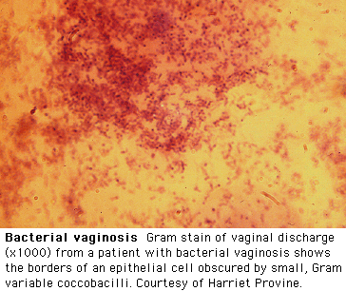
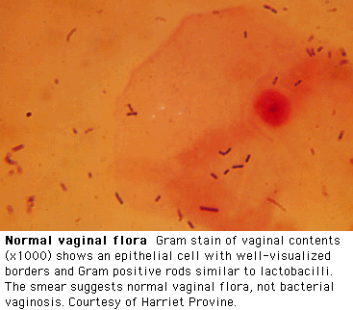
Diagnosis by Gram Stain

Slide 30
Treatment Recommendations
Oral metronidazole 500 mg bid x 7 days ($5)
84-96% cure rate
Single dose therapy (2g) may be less effective
Oral Clindamycin 300 mg bid x 7 days ($28)
Less effective
Topical treatments (higher recurrence rates)
Metronidazole gel (0.75%) 5 g PV qhs x 5 days ($30)
70-80% cure rate
Clindamycin cream (2%) 5 g PV qhs x 7 days ($31)
Less effective
May lead to Clindamycin resistant anaerobic bacteria

Slide 31
Specimen Obtained during gynecological examination
Vaginal secretion
PH
Saline wet preparation
KOH wet preparation
Cervical cultural and non cultural
GC
C.trachomatis
Vaginal culture
Candida
Trichomonas vaginalis
Cervical cytological examination if not documented within previous 12 months

Slide 32
Routine bacterial cultures not helpful
Routine NOT helpful
Wet mount- 60% sensitive (Trichomoniasis ,BV )
Abnormal or foul odor using a (KOH) "whiff test,"
The Gram stain is useful to diagnose BV
Using the Nugent scoring system
A wet mount+ a yeast culture and Trichomonas culture
Recommended tests to diagnose vaginitis.
Performing only a wet mount, without yeast or Trichomonas culture,
50% of either of these agents of vaginitis will be missed
A sensitive DNA probe assay is available
Combines the detection of yeasts, Trichomonas, and G. vaginalis as a marker for BV

