Slide 1
Pathology of Uterine Cervix
Reference: Robbins & Cotran Pathology and Rubin’s Pathology

Slide 2
Lecture Outline: Pathology of the uterine cervix.
Some common benign conditions and infections.
Understand the concepts of dysplasia and intraepithelial neoplasia in the female genital tract and the role of a cervical screening program.
Know the incidence, risk factors, clinical presentation, pathological features and prognosis of cervical squamous cell carcinoma.

Slide 3
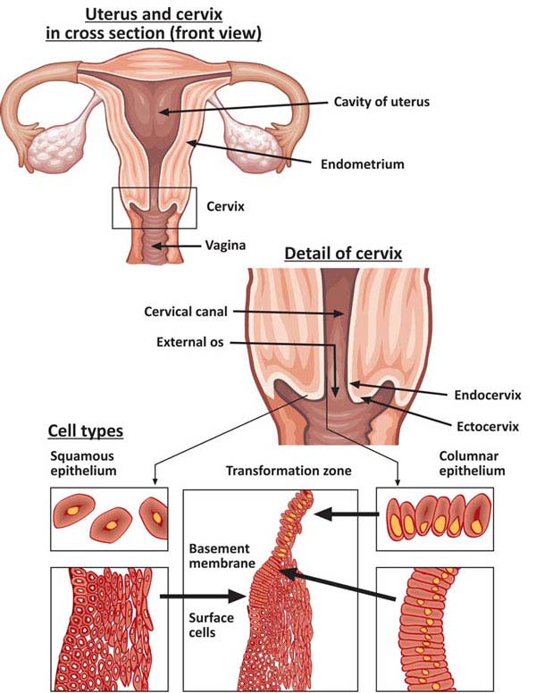
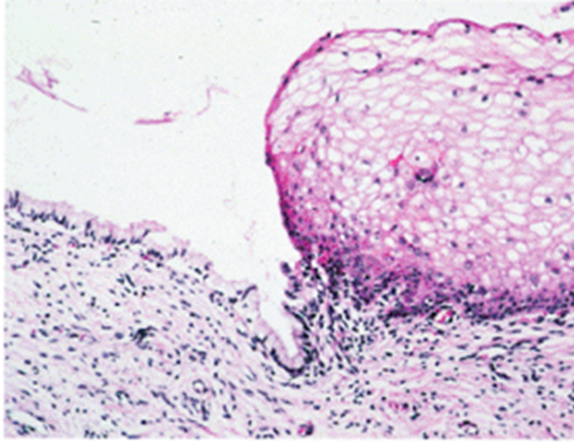

Slide 4
SQUAMOUS METAPLASIA
In it the columnar cells are replaced by squamous cells. It is seen in cervix at the squamo-columnar junction. Squamous metaplastic epithelium is the area most affected by HPV infection and the area where dysplasia and malignant transformation starts. (note: squamous metaplastic epithelium is benign and by itself not considered premalignant).

Slide 5
Cervical polyp
This is a small, pedunculated mass.
Most polyps originate from the endocervix (endocervical polyps) and few from the ectocervix (ectocervical polyps).
They are not true neoplasms.
The lesion is characterized by overgrowth of benign cervical stroma covered by cervical epithelium:
The epithelium covering the polyp can be columnar or stratified squamous or sometimes partly both.
The stroma is made up of fibrous tissue with thick-walled blood vessels and inflammatory cells.
http://images.wisegeek.com/diagram-of-vaginal-polyps.jpg

Slide 6
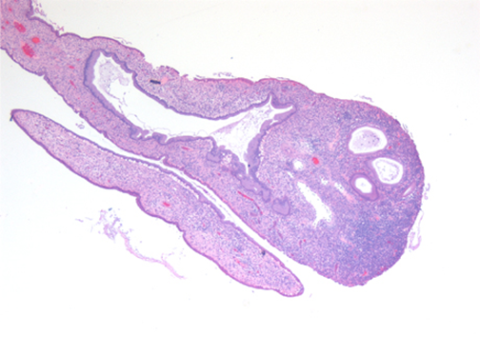
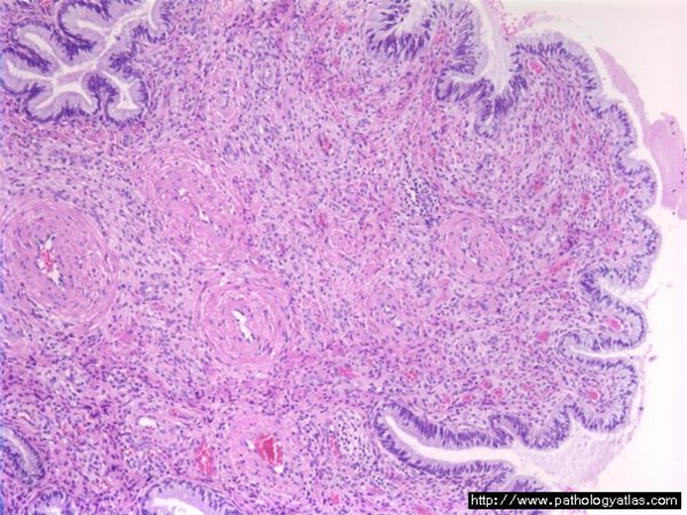
Cervical polyp
http://sunnybrook.ca/uploads/cx_polyp_vd_1.jpg

Slide 7
CERVICITIS
Inflammation of cervix.
Can be non-infectious or infectious.

Slide 8
Noninfectious (Nonspecific) Cervicitis
Is inflammation of the cervix caused by chemical (e.g. douche) or mechanical (e.g. tampon, diaphragm) irritation. It is can be acute or chronic.
Clinical appearances
Often asymptomatic.
The cervix appears red and swollen.
Histology
The inflammatory cells are seen (neutrophils, plasma cells and lymphocytes).
Squamous metaplasia is common in chronic cervicitis.

Slide 9
Infectious cervicitis
Can be caused by various organisms e.g. staphylococci, enterococci, Gardnerella vaginalis, Trichomonas vaginalis, Candida albicans and Chlamydia trachomatis and HPV.
Most often involves the endocervix.
May be asymptomatic
May manifest as vaginal discharge or itching.

Slide 10
Candidiasis (moniliasis)
Common.
Involves cervix and vagina.
Associated with diabetes mellitus, pregnancy, antibiotic therapy, oral contraceptive use and immunosuppression.
Characterized by white patchy mucosal lesions with thick curdy white discharge and vulvovaginal pruritis. Ulcers may develop.
Cytology smears show: Fungal colonies in the form of spores and branching pseudo hyphae on the cervical epithelium. Chronic inflammatory cells are present.
"Candida pap 1" by Nephron - Own work. Licensed under CC BY-SA 3.0 via Wikimedia Commons - http://commons.wikimedia.org/wiki/File:Candida_pap_1.jpg#/media/File:Candida_pap_1.jpg

Slide 11
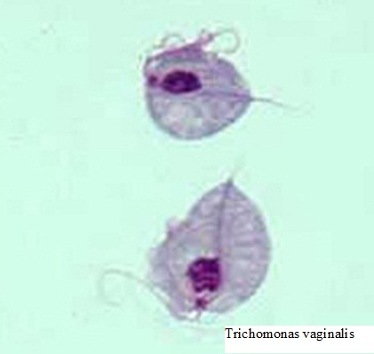
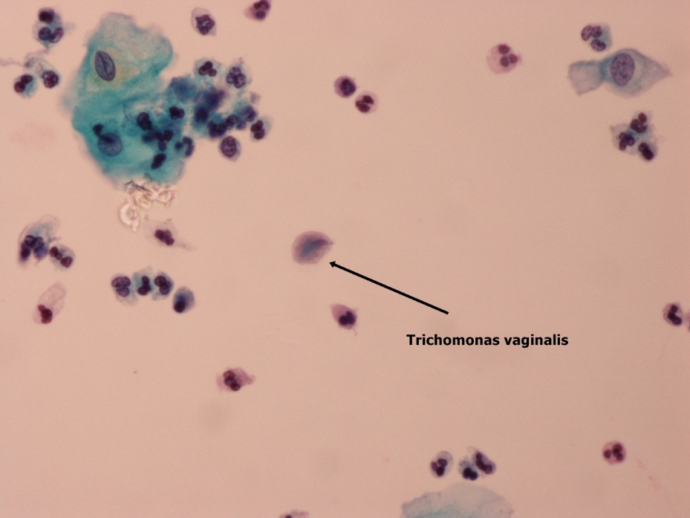
Trichomoniasis
It is caused by a unicellular flagellated protozoan called Trichomonas vaginalis.
It is sexually transmitted disease.
Involves the vagina and cervix.
Clinical presentation:
Greenish-yellow frothy and foul smelling vaginal discharge .
Painful urination.
vulvovaginal itching or irritation.
dyspareunia
Pap smear (cytology) shows:
The organism can be identified in the in Pap smear slides in a background of inflammatory cells.
They can also be visualized by examination of a saline wet preparation in which the motile trophozoites are seen.
http://www.medthical.com/trichomoniasis.html
http://137.189.150.85/cytopathology/Slide/31-7G3.jpg

Slide 12
Chlamydia trachomatis Cervicitis
Clamydia trachomatis is an obligate, gram-negative intracellular pathogen.
Clamydial cervicitis is the most common sexually transmitted disease in the developed countries. It may coexist with Neisseria gonorrhoeae infection.
It is a frequent cause of pelvic inflammatory disease.
Chlamydial infection can also cause a condition known as lymphogranuloma venereum.
Clinically
Is most often asymptomatic.
In symptomatic cases there is a mucopurulent cervical discharge with a reddened, congested and edematous cervix. It may be associated with urethritis.

Slide 13
Herpes simplex virus (HSV) Cervicitis
HSV Type 2 infection accounts for majority of genital herpes cases and is spread by sexual contact.
It produces vesicles and ulcers that can involve the cervix, vagina, vulva, urethra and perianal skin.
Pap smears show multinucleated cells with intranuclear “Cowdry type” viral inclusions (nuclei have ground glass appearance due to accumulation of viral particles).
"Herpes simplex virus pap test" by Nephron - Own work. Licensed under CC BY-SA 3.0 via Wikimedia Commons - http://commons.wikimedia.org/wiki/File:Herpes_simplex_virus_pap_test.jpg#/media/File:Herpes_simplex_virus_pap_test.jpg

Slide 14
Human papilloma virus (HPV) infection
HPV infection of the cervix is common.
Over 20 serotypes of HPV infect the female genital areas and cause a variety of different lesions depending on the serotypes.
Clinical behavior
HPV infection causes koilocytic atypia in the cervical squamous epithelium.
HPV infection is associated with increased risk of subsequent cervical cancer.
HPV infection may cause any of the following depending on the HPV serotype:
Condyloma: Usually caused by HPV serotypes 6 and 11. It develops in the squamous epithelium of the ectocervix. The lesions may be flat or exophytic (called exophytic condyloma acuminatum).
Mild dysplasia: is usually caused by "low risk" HPV serotypes, 6 and 11.
High- grade dysplasia: is caused by "high risk” HPV (types 16 and 18) and moderate risk HPV (types 31, 33 and 35).

Slide 15
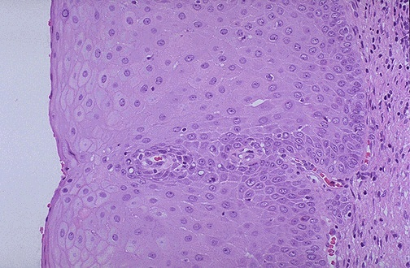
http://classconnection.s3.amazonaws.com/313/flashcards/1780313/jpg/11359563278872.jpg
KOILOCYTES:
are squamous epithelial cells that has undergone structural change due to infection of the cell by HPV. They show koilocytosis or koilocytic atypia which is the following cellular changes:
Nuclear enlargement .
Irregular nuclear membrane.
Nuclear hyperchromasia.
Perinuclear halo (clear area around the nucleus).
Normal
http://www.microcorre.com/GYN/FEM003.jpg

Slide 16
CERVICAL INTRAEPITHELIAL NEOPLASIA (CIN) Also known as SQUAMOUS INTRAEPITHELIAL LESIONS (SIL) & CERVICAL CARCINOMA

Slide 17
Cervix Carcinoma
Most common cervical cancer is squamous cell carcinoma. Other types are adenocarcinoma, neuroendocrine carcinoma etc.
Cervical carcinoma used to be a major causes of cancer-related death in women.
Nowadays there is dramatic improvement in management of this disease because now there is early diagnosis (and therefore early treatment). As a result deaths due to cervical cancer are decreasing. The early diagnosis is due to the use of a screening method/program called PAP screening test.
The wide use of PAP screening program has lowered the incidence of invasive cancer and deaths by it.

Slide 18
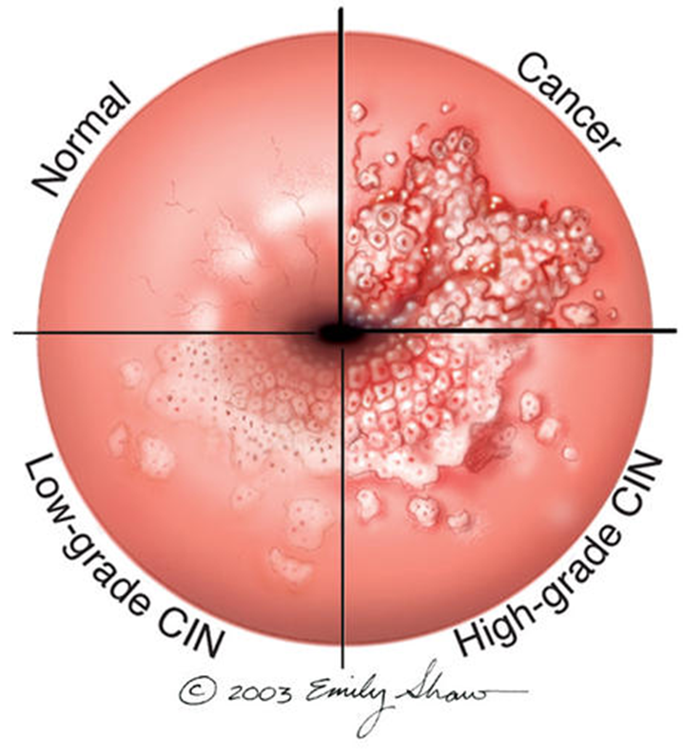
Precancerous lesion of cervical carcinoma: cervical intraepithelial neoplasia (CIN) or squamous intraepithelial lesions (SIL).
All invasive squamous cell carcinomas arise from non invasive pre-cancerous cervical squamous epithelium called cervical intraepithelial neoplasia (CIN) or squamous intraepithelial lesions (SIL).
Note: not all cases of CIN/SIL progress to invasive cancer and some cases of CIN/SIL may spontaneously regress.
Cases of high grade CIN/SIL have a higher risk of progression to cancer. High grade CIN/SIL are associated the high-risk HPV serotypes.
Timely detection and diagnosis of CIN/SIL is essential in preventing the development of invasive carcinoma.

Slide 19
Cervical intraepithelial neoplasia (CIN)
CIN are precancerous lesions of the cervix.
Pre-cancer changes can precede the development of invasive cancer by many years.
Cervical intraepithelial neoplasia (CIN) terminology is used for histological reporting.
CIN lesions may begin as Low Grade CIN and progress to High Grade CIN, or they might start straight away as High Grade CIN.
On the basis of histology, pre-cancer lesions are graded as follows:
CIN I : Mild Dysplasia.
CIN II : Moderate Dysplasia .
CIN III : Severe Dysplasia and Carcinoma in situ (CIS).

Slide 20
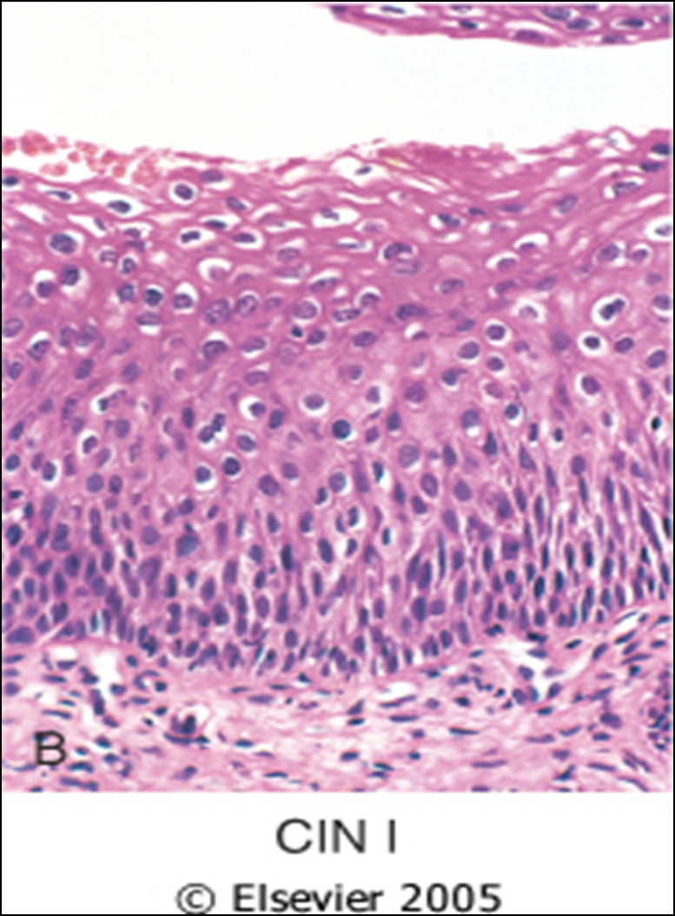
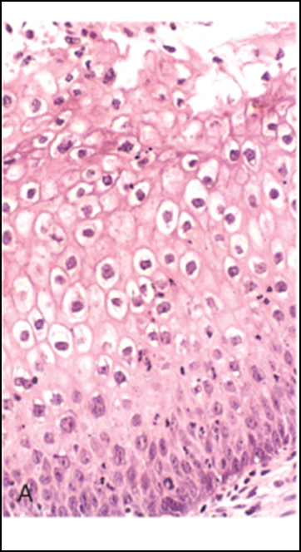
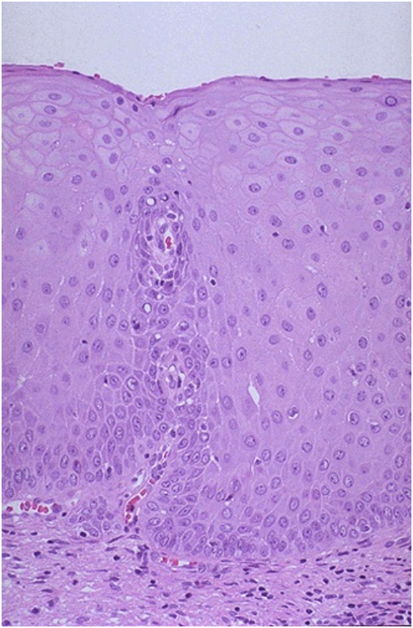
Cervical biopsy
Mild dysplasia = CIN I
with HPV associated koilocytes. Lower 1/3rd of the epithelium is replaced by pleomorphic cells.
Koilocytes of HPV
Normal

Slide 21
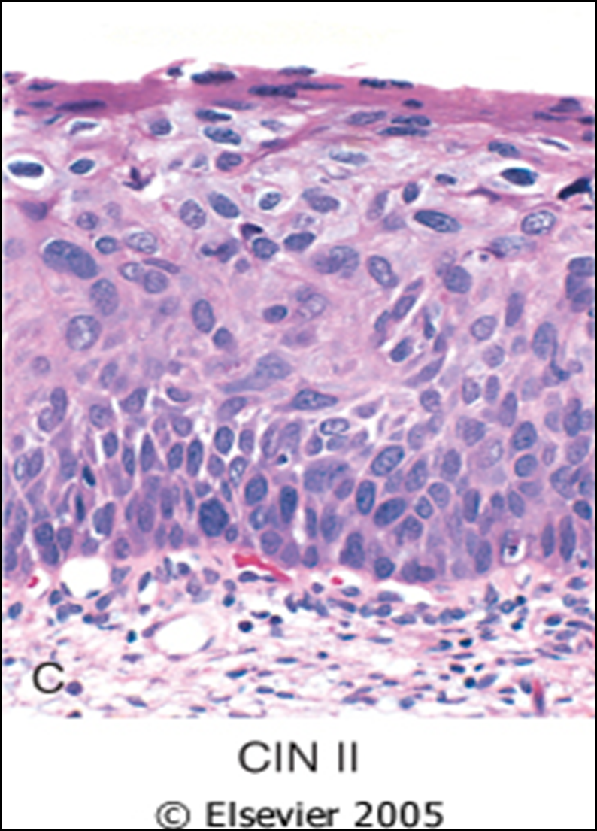
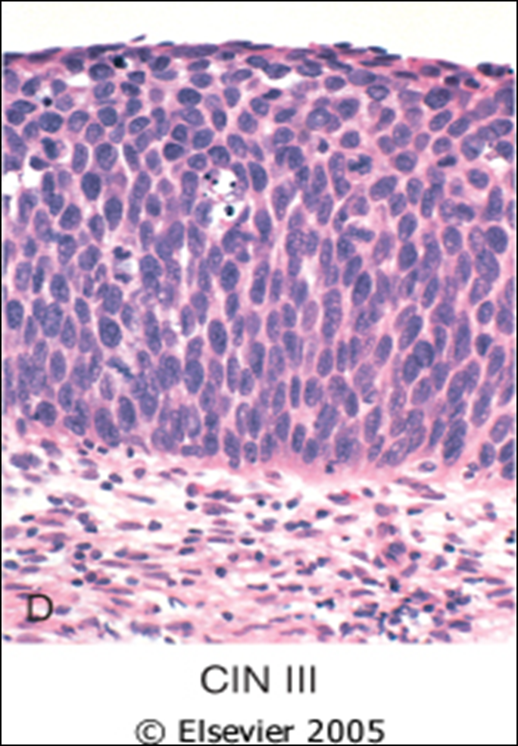
Cervical biopsy
Moderate dysplasia = CIN II. There is progressive atypia in the layers of the epithelium; lower 2/3rd of the epithelium is replaced by pleomorphic cells.
Severe dysplasia = CIN III (CIS). There is diffuse atypia and loss of maturation. All levels of the epithelium are replaced by pleomorphic cells, (full thickness).

Slide 22
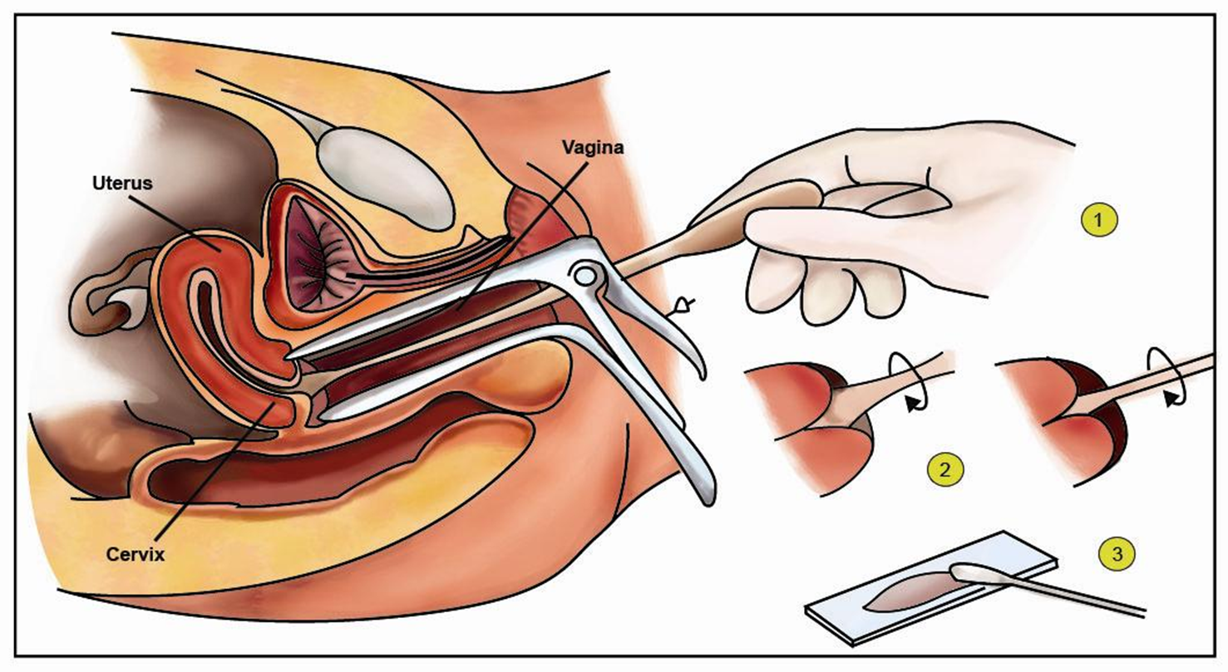
PAP SCREENING TEST: CYTOLOGY SCREENING FOR PRECANCEROUS LESIONS
Cytological examination can detect precancerous squamous intraepithelial lesions long before any abnormality can be seen grossly, using the PAP screening test.
PAP test is the cytological examination of the cells of cervix. In it the cervix is examined and the cells lining the cervical wall at the transformation zone are scrapped off (sampled) with a spatula and then transferred onto a slide, processed, stained (Papanicolaou stain) and then examined under a light microscope to look for squamous intraepithelial lesions (SIL) and a diagnosis is made.
This screening for pre-cancer should be done on all women usually from age of 21 years and onwards.
http://www.ivf-clinic-india.com/pics/Pap-Smear.jpg

Slide 23
Cytology Pap Smear/Screening
The terminology used in Pap smears is squamous intraepithelial lesions (SIL).
SILs are divided into low grade and high grade SIL.
In cytology smear report these are few of the possible diagnoses:
Normal cells/ Negative for squamous intraepithelial lesion.
Low Grade SIL = LSIL (= CIN1/mild dysplasia on histology).
High Grade SIL = HSIL ( = CIN2 and CIN3/ moderate to severe dysplasia on histology).
About 1 to 5% of low Grade SIL become invasive squamous cell carcinomas.
About 6 to74% of high Grade SIL become invasive squamous cell carcinomas.

Slide 24
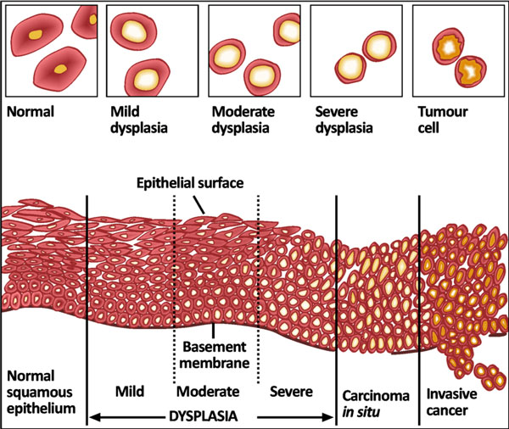
http://ab-histology.blogspot.com/

Slide 25
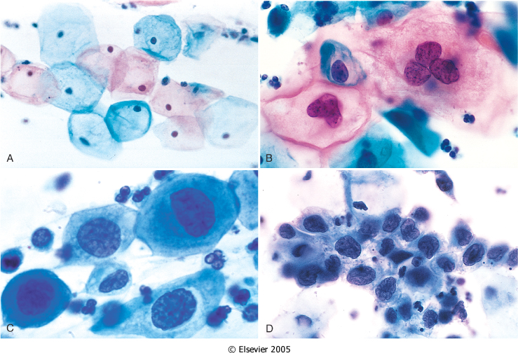
The cytology of cervical intraepithelial neoplasia as seen on the Papanicolaou smear. Cytoplasmic staining in superficial cells (A&B) may be either red or blue.
A, Normal exfoliated superficial squamous epithelial cells.
B, CIN I/ low grade SIL .
C, CIN II/ high grade SIL.
D, CIN III/ high grade SIL.
Note the reduction in cytoplasm and the increase in the nucleus to cytoplasm ratio, which occurs as the grade of the lesion increases. This reflects the progressive loss of cellular differentiation on the surface of the lesions from which these cells are exfoliated.

Slide 26
Risk Factors and causes for CIN/ SIL and cervical carcinoma
Risk Factors
Early age at first intercourse.
Multiple sexual partners.
A male partner with multiple previous sexual partners.
Persistent infection by high risk papillomaviruses.
Other risk factors: low socioeconomic groups.
Rare among virgins and multiple pregnancies.
Cause
The HPV virus. The HPV is the number one cause for abnormal cells of the cervix.
HPV is a skin virus, which results in warts, common warts ,flat warts, genital warts (condylomas), planter warts, and precancerous lesions.
HPV can be detected in 85 -90 % of pre-cancer lesions.
High risk types HPV : 16, 18, 31, 33, 35, 39, 45, 52, 56, 58, and 59.
Low risk types HPV :6, 11, 42, 44 . These types result in condylomas.
Treatment
Laser or cone biopsy is the most effective method of managing patients with High grade SIL in cancer prevention.

Slide 27
CIN/SIL & RULES OF PAP TEST
Note:
Women with SIL/CIN have no visible signs or symptoms and it is difficult to diagnose SIL/CIN without a Pap smear/exam.
Therefore regular pap exams should be done on women, to detect any SIL.
It is a common testing procedure for HPV infection. The Pap smear detects HPV infection early.
General rules of Pap Screening (pap smear test) are:
Should start pap test by the age of 21.
For women between age 21 to 29: pap test should be done every 3 years.
For women between age 30-64 : there are 2 possibilities.
Either do only pap test once every 3 years.
Or do two tests (co-testing) at the same time → the pap test + DNA in-situ hybridization HPV testing, every 5 years.
NOTE: This HPV DNA in-situ hybridization (ISH) test. It is done to identify the serotype of the HPV. This test will determine whether you carry high or low risk strains of the virus. HPV DNA screening test should not be used before age 30 if pap test is normal.

Slide 28
Invasive Cervical Carcinoma
About 75-90% of invasive cancers are squamous cell carcinomas.
The remainder are Adenocarcinoma.
It is the 8th most common cause of cancer death in women in US now (was #1 in 1940's); still #1 in other countries
Reduction in the West is due to Papanicolaou smear test (PAP test) which detects premalignant lesions.
MORPHOLOGY
The tumors may be invisible or present as an exophytic mass.
Cervical carcinomas are graded from 1 to 3 (i.e. well, moderately and poorly differentiated) based on cellular differentiation and staged from 1 to 4 depending on clinical spread.

Slide 29
http://home.ccr.cancer.gov/inthejournals/archives/images/guis_img.png Reference Gius D, Funk MC, Chuang EY, Feng S, Huettner PC, Nguyen L, Bradbury CM, Mishra M, Gao S, Buttin BM, Cohn DE, Powell MA, Horowitz NS, Whitcomb BP, Rader JS. Profiling microdissected epithelium and stroma to model genomic signatures for cervical carcinogenesis accommodating for covariates. Cancer Res 67: 7113–23, 2007

Slide 30
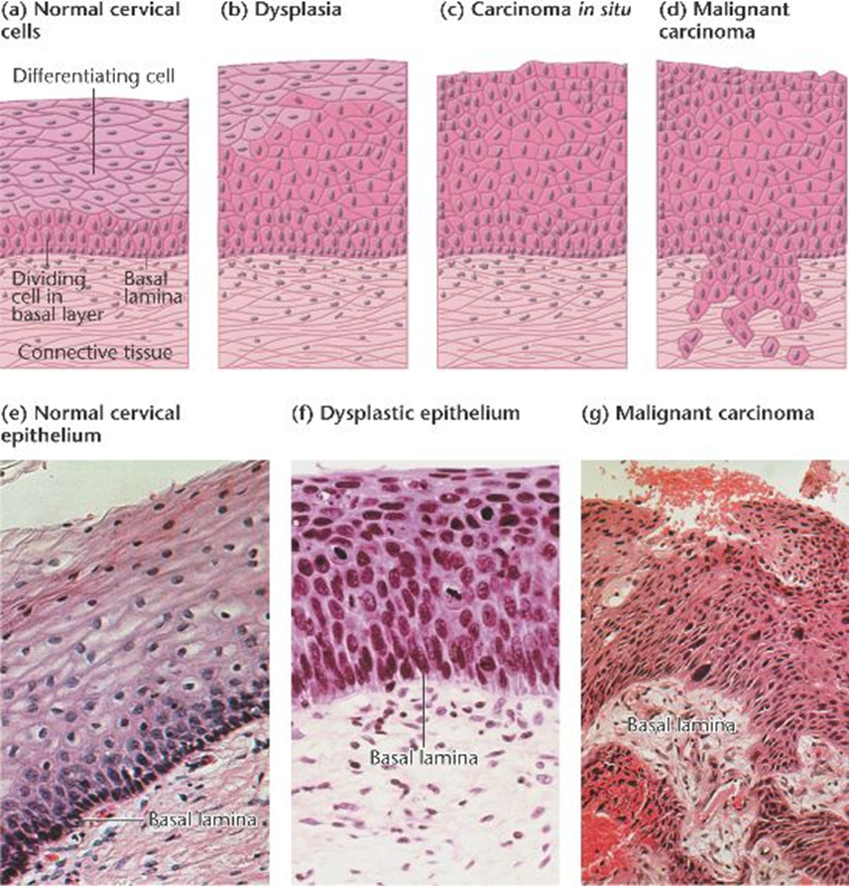

Slide 31
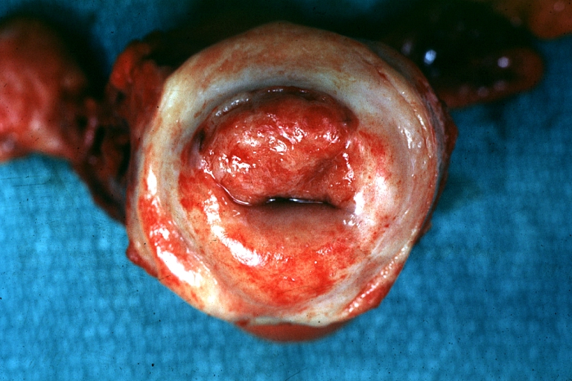
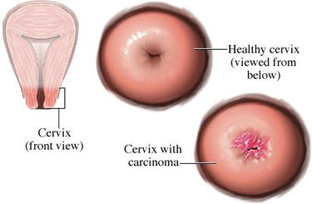
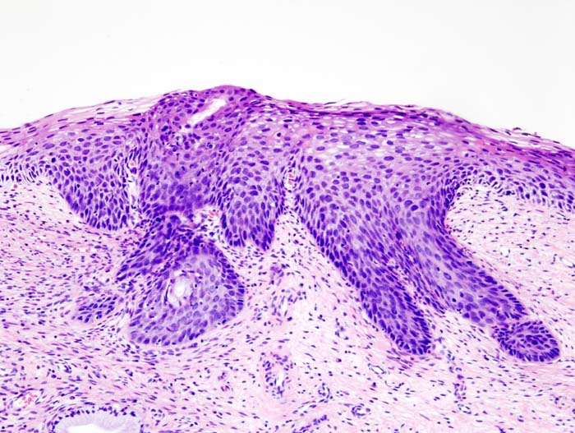
Cervical cancer
http://www.wikidoc.org/images/d/d6/Cervical_Carcinoma.jpg
http://ehealthmd.com/content/what-cervical-cancer
http://www.wikidoc.org/images/d/d6/Cervical_Carcinoma.jpg

Slide 32
INVASIVE SQUAMOUS CELL CARCINOMA OF CERVIX:
Squamous cell carcinomas typically arise from pre-cancer CIN/SIL lesions at the transformation zone.
Mean age: 51 years, uncommon before age 30 years but most are ages 45 - 55 years.
Nowadays, due to the pap screening test, many of cervical cancers are diagnosed in early stages, and majority are diagnosed in the pre-invasive CIN/SIL phase.
Advanced cases of Squamous cell carcinoma are seen in women who either have never had a Pap smear or have waited many years since the last pap smear.
Clinical features:
The early stages of cervical cancer may be completely asymptomatic. On colposcopic examination: cervix shows a mosaic vascular pattern and the lesions appear as white patches after application of acetic acid to cervix .
Vaginal bleeding, contact bleeding, or cervical mass.
In advanced disease, metastases may be present in the abdomen, lungs or elsewhere.
Symptoms of advanced cervical cancer may include: loss of appetite, weight loss, fatigue, pelvic pain, back pain, leg pain, swollen legs, heavy bleeding from the vagina, bone fractures.

Slide 33
Cervical Carcinoma: Treatment
Depending on the stage there are different treatment options:
If patient wants to be able to have children, the cancer is removed with a cone biopsy (cervical conization), and then followed up regularly.
Simple hysterectomy (removal of the whole uterus including part of the vagina).
Radical hysterectomy (removal of the whole uterus including part of the vagina along with the removal of lymph nodes in the pelvis.
Chemotherapy and radiotherapy maybe needed in advanced cases.

Slide 34
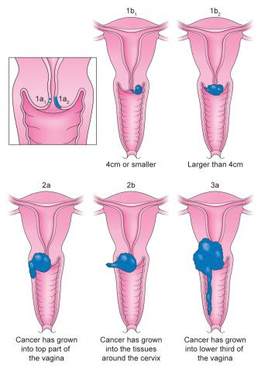
Cervical Carcinoma, Staging
0- Carcinoma in Situ.
1- Confined to the cervix.
2- Extension beyond the cervix without extension to the lower third of Vagina or Pelvic Wall.
3- Extension to the pelvic wall and/or lower third of the vagina.
4- Extends to adjacent organs.
http://www.jostrust.org.uk/sites/default/files/styles/large/public/Cervical%20cancer%20stages.jpg?itok=KeOqGkCs

Slide 35
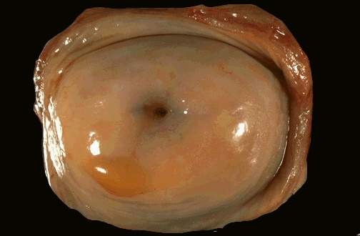
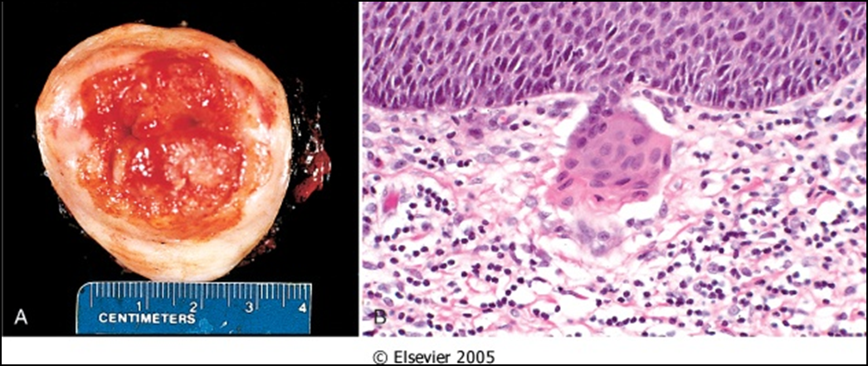
A, Carcinoma of the cervix, well advanced. B, Early stromal invasion occurring in a cervical intraepithelial neoplasm
http://homepage.smc.edu/wissmann_paul/anatomy2textbook/cervixNormalGross.jpg

Slide 36
