Slide 1
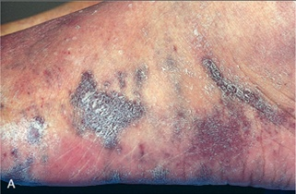
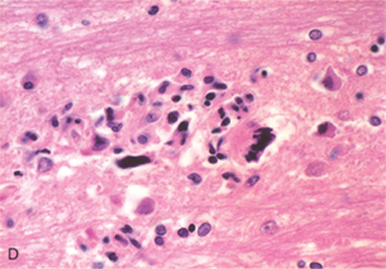
pathology of aids
Dr Ammar C. Al-Rikabi and Sufia Hussain.

Slide 2
Syphilitic chancre

Slide 3
a) Secondary syphilis. B) Secondary syphilis in a human immunodeficiency virus-positive man.

Slide 4
a) Mucous patch. b) Mucous patch in an infant. C) Mucous patch.

Slide 5
The structure of HIV. The human immune deficiency virus (HIV)-1 virion. The viral particle is covered by a lipid bilayer derived from the host cell and studded with viral glycoproteins gp41 and gp120.

Slide 6
Herpes simplex.

Slide 7
Examples of viral inclusions. A, Cytomegalovirus infection in the lung; infected cells show distinct nuclear (long arrow) and ill-defined (short arrows) cytoplasmic inclusions. B, Mucosal herpesvirus infection; infected cells show glassy nuclear inclusions (long arrow)

Slide 8
Viral infections. HIV encephalitis. Note the microglial nodule and multinucleated giant cell.

Slide 9
Host responses in the absence of appropriate T cell-mediated immunity. A, Mycobacterium avium infection in a patient with AIDS, showing massive intracellular macrophage infection with acid-fast organisms (filamentous and pink in this acid-fast stain). B, M. leprae infection in a patient with lepromatous leprosy; there are abundant acid-fast bacilli proliferating within macrophages.

Slide 10
The morphologic spectrum of tuberculosis. immunocompetent individuals, tubercular granulomas may not show central caseation

Slide 11
Secondary pulmonary tuberculosis. The upper parts of both lungs are riddled with gray-white areas of caseation and multiple areas of softening and cavitation.

Slide 12
Pneumocystis pneumonia. A, The alveoli are filled with a characteristic foamy "cotton candy" exudate. B, Silver stain demonstrates cup-shaped cyst walls within the exudate.

Slide 13
Chromomycosis.

Slide 14
Coccidioidomycosis.

Slide 15
Phaeohyphomycosis.

Slide 16
Cryptococcal infection. A, Whole-brain section showing the numerous areas of tissue destruction associated with the spread of organisms in the perivascular spaces. B, At higher magnification it is possible to see the cryptococci in the lesions.

Slide 17
The morphology of fungal infections. A, The diagnosis of candidiasis is made by observing the characteristic pseudohyphae and blastoconidia (budding yeasts) in tissue sections or exudates. B, Invasive aspergillosis of the lung in a bone marrow transplant patient. C, Histologic sections from this case, stained with Gomori methenamine-silver (GMS) stain, show septate hyphae with acute-angle branching, features consistent with Aspergillus.

Slide 18
Kaposi sarcoma. Gross photograph, illustrating coalescent red-purple macules and plaques of the skin.

Slide 19
Kaposi’s sarcoma.

Slide 20
Kaposi’s sarcoma.

Slide 22
Nodular Kaposi’s sarcoma

Slide 23
Lymphoma.

Slide 24
Diffuse large B-cell lymphoma. The tumor cells have large nuclei with open chromatin and prominent nucleoli.

Slide 25
pathology of aids
By
Dr Ammar C. Al-Rikabi and Sufia Hussain.

