Slide 1
Reproductive Physiology Hormones affecting female breast
Dr.Mohammed Alotaibi

Slide 2
Objectives
By the end of this lecture, you should be able to:
Know the physiologic anatomy of the breast.
Describe the physiological changes that occur in the breast during mammogenesis, lactogenesis, and galactopoeisis and the hormones involved.
Recognize the phases of lactogenesis.
Describe the endocrine and autocrine control of lactation.
Explain the physiological basis of suckling reflex and its role in lactation.

Slide 3
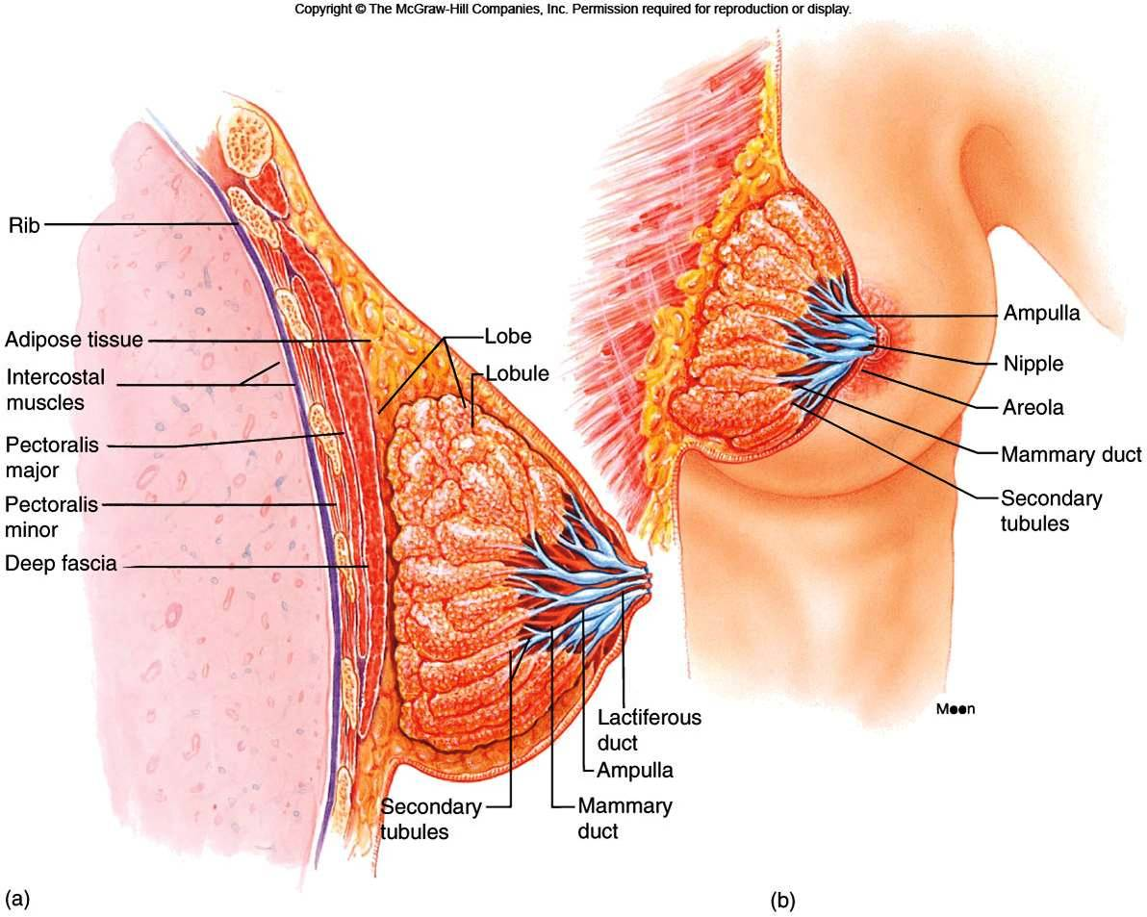
The structure of the breast and mammary glands

Slide 4
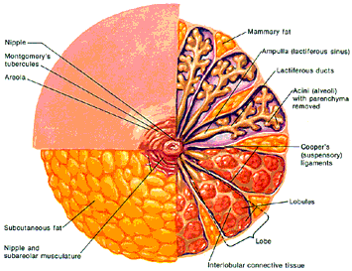
Each breast consists of 15-20 lobes of secretory tissue:
a. Each lobe has one lactiferous duct
b. Lobes (and ducts) are arranged radially
c. Lobes are composed of lobules
d. Lobules are composed of alveoli
fat
nipple
Lactiferous sinus
Montgomery glands
Lactiferous duct
areola
Alveoli
(alveolar gland)
Suspensory
ligament
(Cooper)
lobules
fat
Lobe
nipple
Interlobular connective tissue

Slide 5
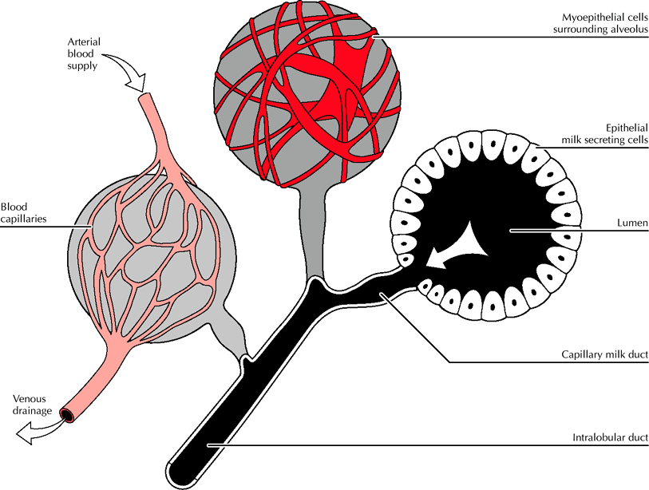
Where does milk come from?
The fundamental secretory unit of the breast is the alveolus

Slide 6
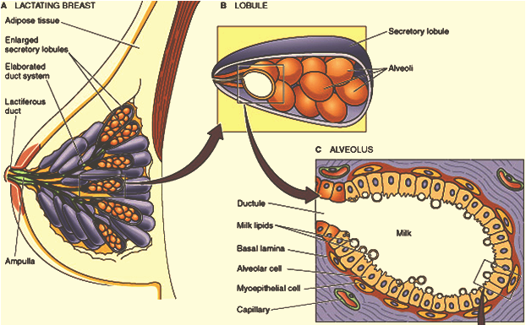
Lobule-Alveolar System
One cell layer
The function of the alveolar epithelial cells is to remove nutrients from the blood and transform these nutrients into the components of milk.

Slide 7
Stages of Mammary Gland Development
1) Mammogenesis (growth and development of mammary gland to a functional state)
2) Lactogenesis (initiation of milk secretion)
Lactogenesis 1
Lactogenesis 2
3) Galactopoiesis (maintenance of milk secretion in the postpartum period)
4) Involution (cessation of milk production)

Slide 8
Hormones affecting female breast
Mammogenic Hormones (promoting the proliferation of ductal and alveolar cells) [ductal & alveolar morphogenesis]
Estrogens
Progesterone
Prolactin (PRL)
Growth hormone
Glucocorticoid (Cortisol)
During puberty (ovarian hormones stimulate mammary growth)

Slide 9
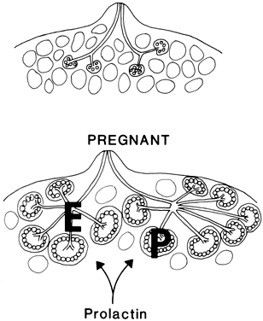
Ovarian Hormones
Estrogen
Growth & branching of ductal system (with GH)
Fat deposition in the stroma.
Progesterone
Growth of lobule-alveolar system (budding of alveoli and secretory changes in epithelial cells).
Although progesterone and estrogen are essential for physical development of the breasts, they inhibit the actual secretion of milk during pregnancy by interacting with prolactin receptors.

Slide 10
Lactogenesis
Lactogenesis: Cellular changes by which alveolar epithelial cells switch from a non-secretory to a secretory tissues (initiation of milk secretion).
Involves 2 Phases:
Lactogenesis 1
Lactogenesis 2
Lactogenic hormones (promoting initiation /onset of milk production by alveolar cells)

Slide 11
Lactogenesis 1
(Histological and enzymatic differentiations of alveolar epithelial cells).
Starts in mid-pregnancy and characterized by expression of many (but not all) of genes involved in the synthesis of milk components (increases in uptake transport systems for amino acids, glucose, and calcium required for milk synthesis).
Hormones involved:
Production and secretion of milk components in this stage are restricted to a limited number of alveolar epithelial cells with incompletely developed secretory mechanisms.
- Progesterone
- Prolactin (PRL)
- hPL (hCS)
- Growth hormone
- Glucocorticoid (Cortisol)
Alveologenesis

Slide 12
Lactogenesis 2
(Copious secretion of all milk components), starts 2-3 days postpartum
At parturition, withdrawal of progesterone + high level of prolactin leads to:
Further increase in expression of milk protein genes
Glands absorb large quantities of metabolic substrates from the blood
Movement of cytoplasmic lipid droplets and casein into alveolar lumen
Transfer of immunoglobulins (IgA)
Secretion of colostrum followed by milk
Suckling stimulates further increase in expression of most of genes involved in milk secretion with expansion of alveolar epithelium
Switch from endocrine to autocrine control of milk production

Slide 13
Hormones affecting female breast
Lactogenesis 2 hormones
Prolactin (PRL)
Growth hormone
Glucocorticoid (Cortisol)
Thyroxine
Insulin
All are required to facilitate the mobilization of nutrients and minerals

Slide 14
Prolactin (PRL)
Secreted from the anterior pituitary gland (Lactotrophs).
Its level rises steadily from the 5th week of pregnancy until birth (10-20 times the nonpregnant level) (enhanced by Estrogen)
It has mammogenic, lactogenic and galactopoietic effects.
It stimulates expression of genes that encode several milk components (casein/ lactalbumin, lactose and lipids)
Sudden drop in E & P after delivery allows milk production
It is inhibited mainly by hypothalamic hormone (Dopamine)
Thyrotropin-releasing hormone (TRH) can increase PRL

Slide 15
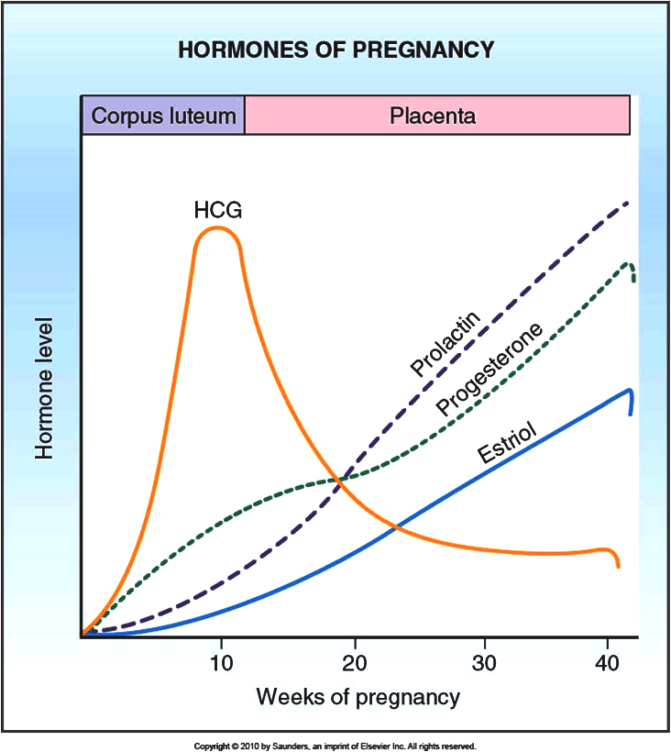
Prolactin (PRL)

Slide 16
Galactopoeisis
Galactopoeisis is defined as the maintenance of lactation once lactation has been established. starts 9-15 days postpartum
Galactopoietic Hormones: maintaining milk production after it has been established
PRL (primary)
Cortisol, Insulin, Thyroid and Growth hormones (permissive)
Oxytocin
Estrogen (very low dose is galactopoietic)
Progesterone (alone has no effect on galactopoeisis because it has no receptors in mammary glands at this stage)

Slide 17
The alveolar cell secretes the components of milk through five pathways
PRL stimulates transcription of the genes that encode several milk proteins.
IgA
PRL
Receptor

Slide 18
Oxytocin and psychogenic stimuli initiate milk ejection (“let-down”)
- Oxytocin (OT)
Galactokinetic Hormones: (promoting contraction of myoepithelial cells, and thus milk ejection).
Milk Ejection Reflex:
Oxytocin contracts the myoepithelial cells, forcing milk from the alveoli into the ducts and sinuses where it is removed by the infant (galactokinetic effect).

Slide 19
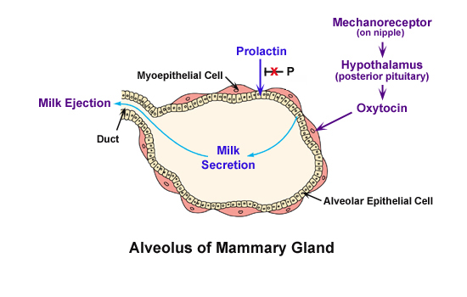
After delivery of placenta
(withdrawal of high P conc.)

Slide 20
Autocrine Control of Lactation
Influence of Local Factors Acting on the Breasts
It is not just the level of maternal hormones, but the efficiency of milk removal that governs the volume product in each breast
A protein factor called feedback inhibitor of lactation (FIL) is secreted with other milk components into the alveolar lumen
FIL, insensitive to prolactin →  milk production

Slide 21
Autocrine Control of Lactation
FIL
FIL
FIL

Slide 22
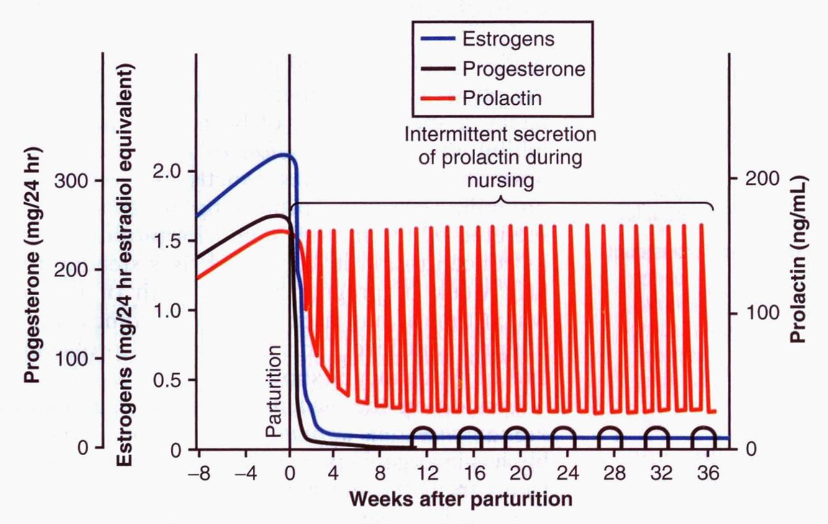
Suckling and Prolactin Secretion
Suckling is the most powerful physiological stimulus for PRL release

Slide 23
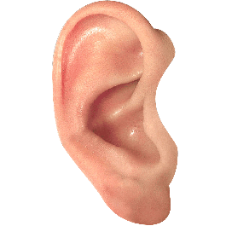
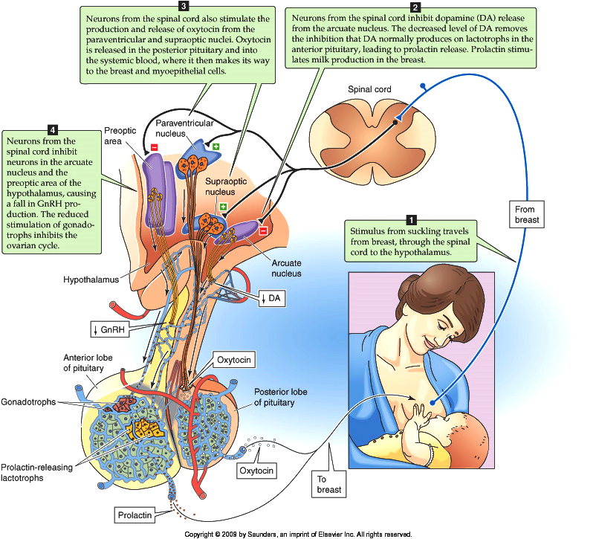
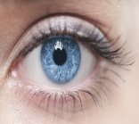
Suckling reflex
Psychogenic stimuli
Prolactin
-
suckling stimulates
the release of TRH from the hypothalamus

Slide 24
Milk production
Milk production is a "use it or lose it" process. The more often and effectively the baby nurses, more milk will be produced.
Lactation is maintained by continuous removal of milk.
Milk production <100 ml/day in day 1 postpartum.
Milk production by day 3 reaches 500 ml/day.
Involution: when the breasts stop producing milk completely after weaning.

Slide 25
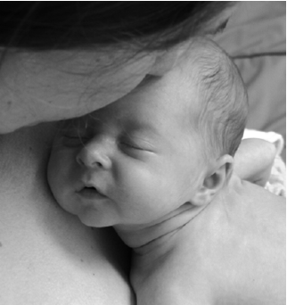
AAP Recommendations
Exclusive breastfeeding for the first six months of life
Continued breastfeeding for at least one year, ‘As long as is desired by mother and child’
يقول تعالى (والوالدات يرضعن أولادهن حولينِ كاملين لمن أراد أن يُتمَّ الرضاعة) [البقرة :233]
American Academy of Pediatrics (2005). "Breastfeeding and the Use of Human Milk." Pediatrics 115(2): 496-506.

Slide 26
The End
Thank You

