Slide 1
Reproductive Physiology Physiology of Pregnancy
GUYTON & HALL, Chapter 83
Dr.Mohammed Alotaibi

Slide 2
Objectives
By the end of this lecture, you should be able to:
Describe fertilization and the implantation of the blastocyst in the uterus
Recognize the development and the normal physiology of the placenta
Describe the physiological functions of placental hormones during pregnancy
Explain the physiological response of mother’s body to pregnancy

Slide 3
Fertilization
If the ovum becomes fertilized by a sperm, a new sequence of events called gestation or pregnancy takes place, and the fertilized ovum eventually develops into a full-term fetus.

Slide 4
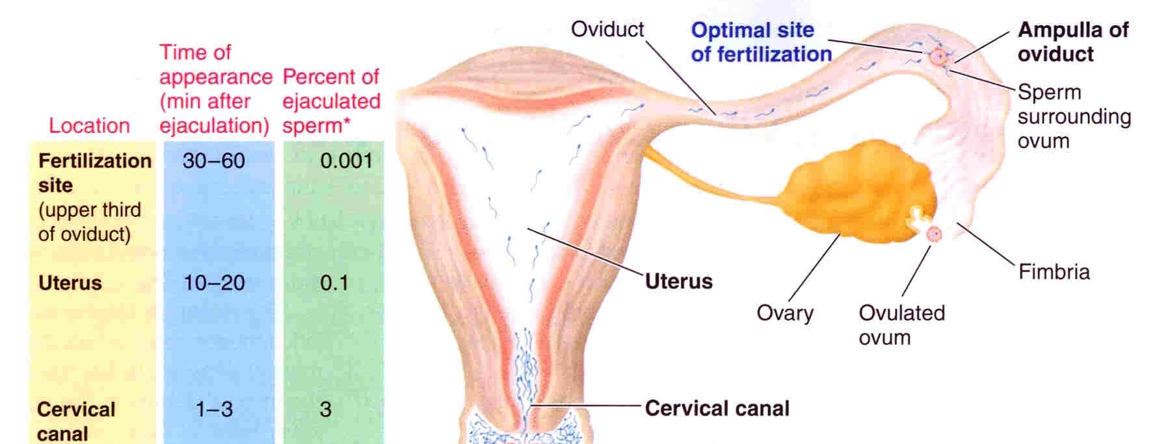
Fertilization
After ejaculation, sperms reach ampulla of fallopian tube within 30-60 min (PG and OT actions)

Slide 5
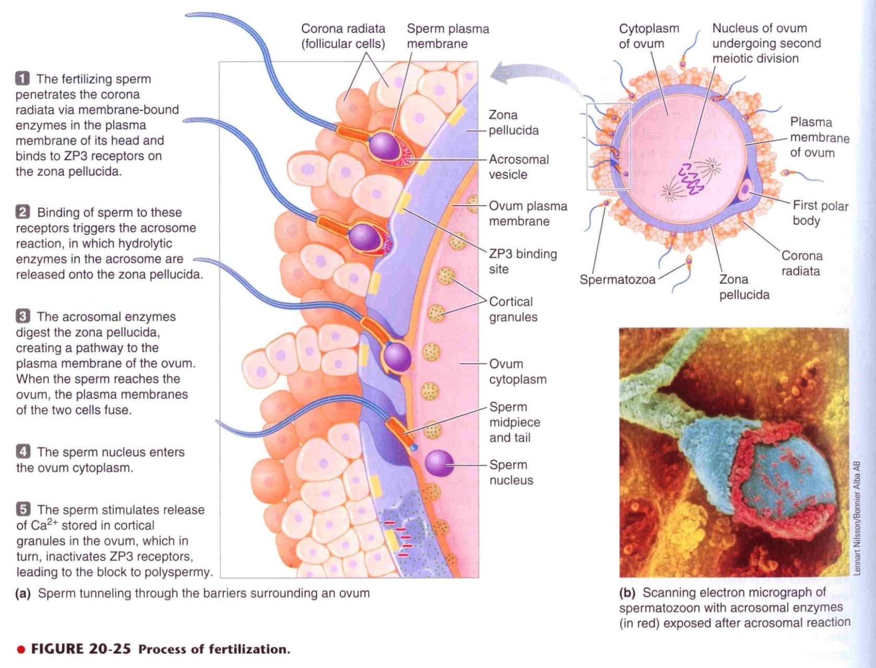
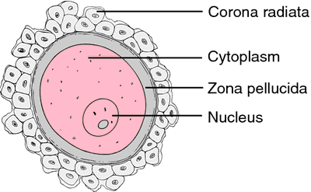
Fertilization
ZP3 Receptor
(zona pellucida glycoprotein 3)

Slide 6
Fertilization
Oocyte divides to form mature ovum (female pronucleus 23 unpaired chr.)
Head of sperm swells (male pronucleus 23 unpaired chr)
Fertilized ovum (zygote) contains 23 paired chr.
The 23 chr. of the male and female pronuclei align themselves to re-form a complete complement of 46 chromosomes

Slide 7
Zygote

Slide 8
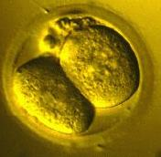
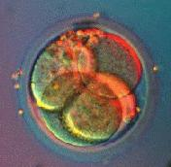
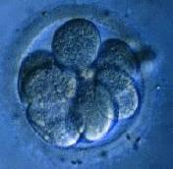
Cleavage
Following fertilization, the zygote undergoes several mitotic divisions inside the zona pellucida (overall size does not change).
1st cleavage yields a 2 celled embryo
each cell is called a blastomere and is totipotent
Divisions continue rapidly until the 32 cell stage (morula)

Slide 9
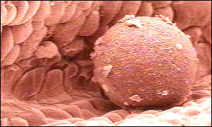
Traveling
Zygote begins to divide as it travels through oviduct.
Implants into endometrium.

Slide 10
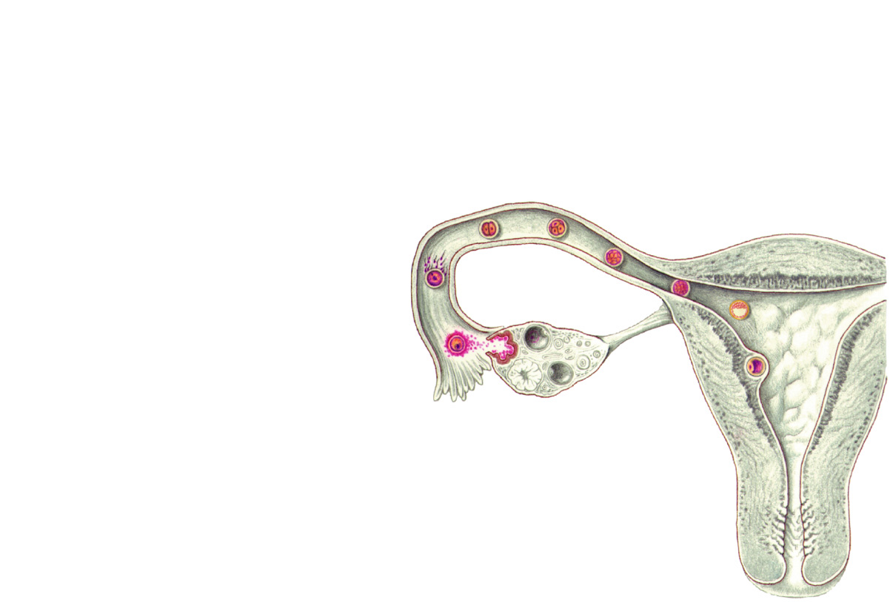
Transport of fertilized ovum
Transport: fluid current + action of cilia + weak contractions of the fallopian tube
Delayed transport allows cell division to occur before the dividing ovum (Blastocyst ~100 cells) enters the uterus
3 to 5 days
Isthmus: Progesterone
Ovary
Uterine tube
Secondary oocyte
Ovulation
Uterus
Endometrium

Slide 11
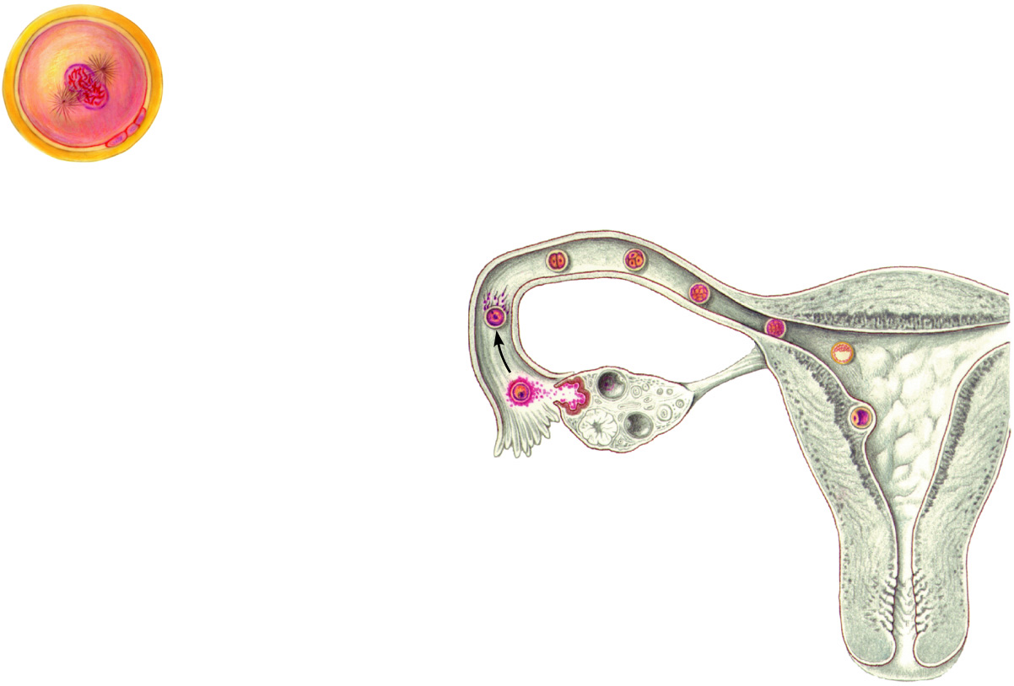
Cleavage
(a)
Zygote (fertilized egg)
Fertilization
(a)
Ovary
Uterine tube
Secondary oocyte
Ovulation
Uterus
Endometrium

Slide 12
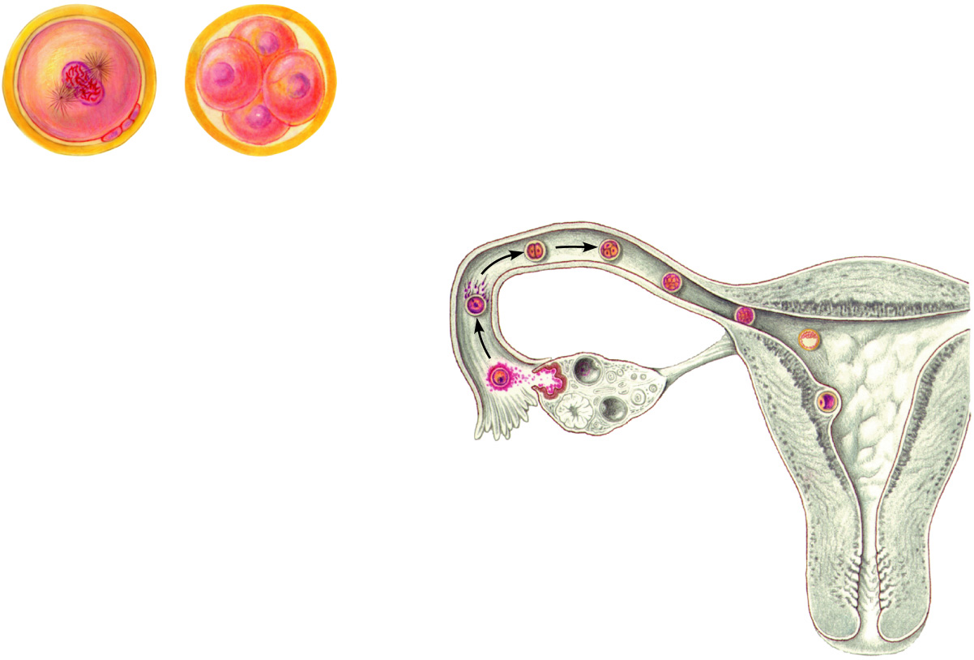
Cleavage
(a)
Zygote (fertilized egg)
(b)
Early cleavage 4-cell stage
(b)
Fertilization
(a)
Ovary
Uterine tube
Secondary oocyte
Ovulation
Uterus
Endometrium

Slide 13
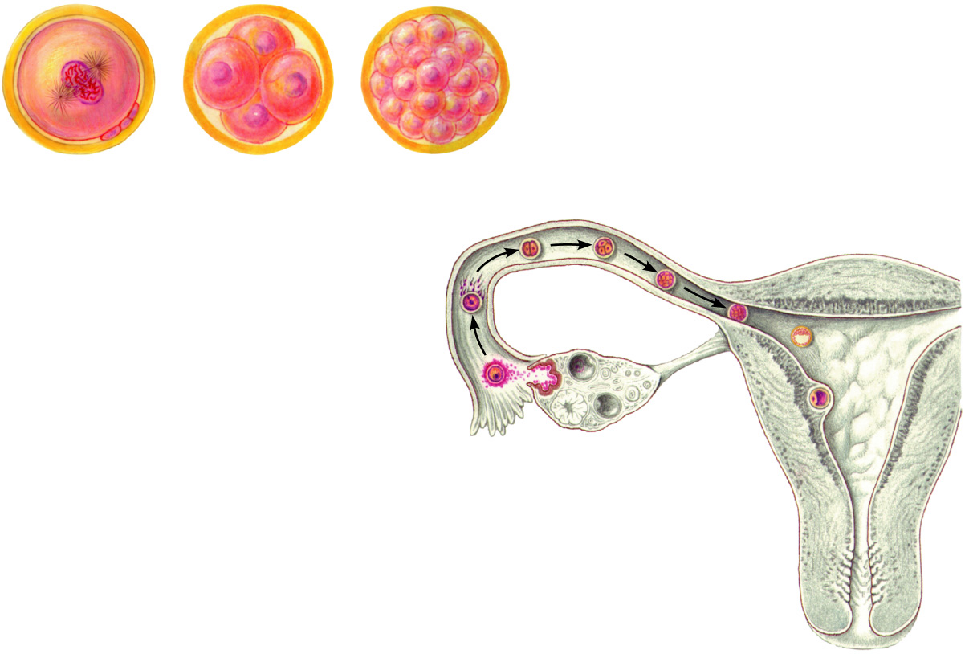
Cleavage
(a)
Zygote (fertilized egg)
(b)
Early cleavage 4-cell stage
(c)
Morula
(b)
(c)
Fertilization
(a)
Ovary
Uterine tube
Secondary oocyte
Ovulation
Uterus
Endometrium

Slide 14
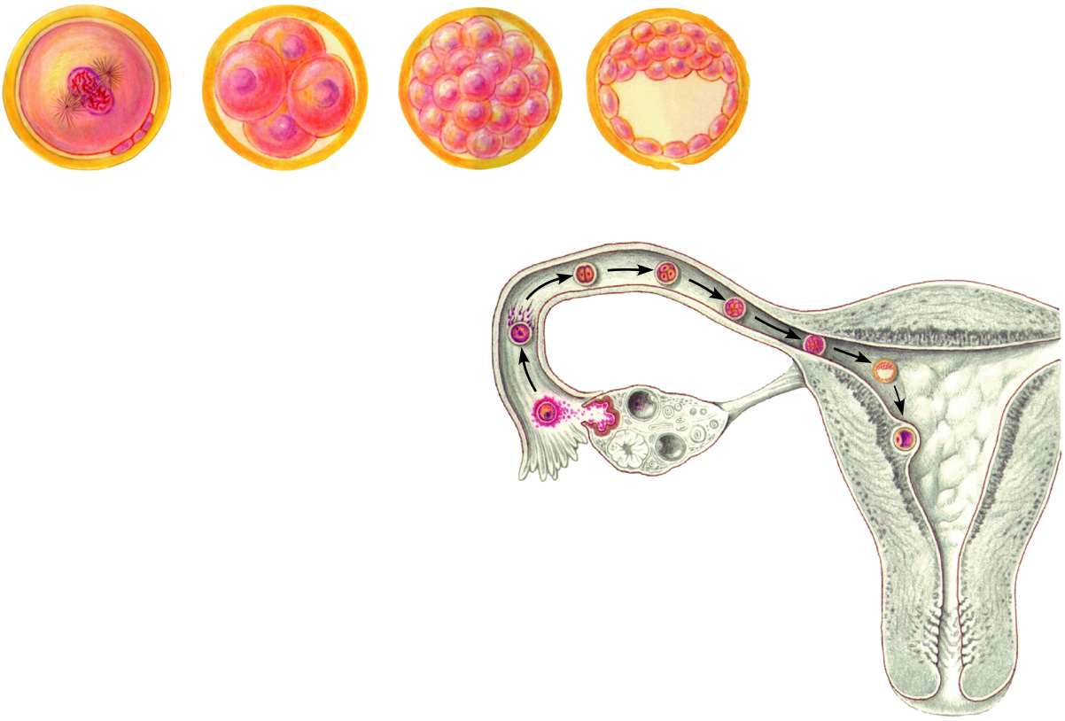
Cleavage
Blastocyst cavity
(a)
Zygote (fertilized egg)
(b)
Early cleavage 4-cell stage
(c)
Morula
(d)
Early blastocyst
(b)
(c)
Fertilization
(a)
Ovary
(d)
Uterine tube
Secondary oocyte
Ovulation
Uterus
Endometrium

Slide 15
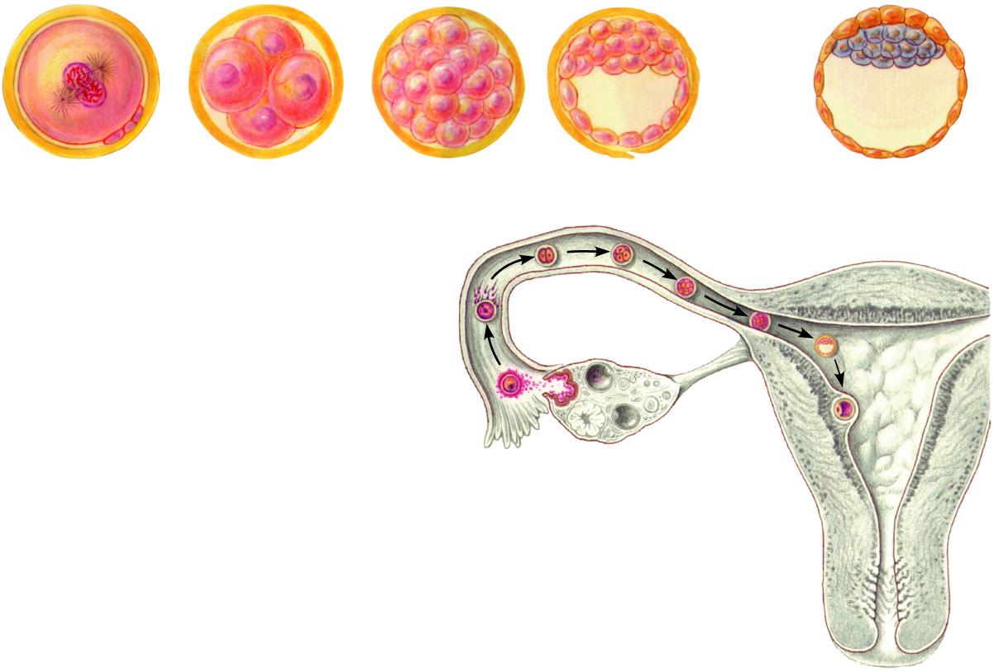
Cleavage
Blastocyst cavity
Inner cell mass
Trophoblast
(a)
Zygote (fertilized egg)
(b)
Early cleavage 4-cell stage
(c)
Morula
(d)
Early blastocyst
(e)
Late blastocyst (implanting)
(b)
(c)
Fertilization
(a)
Ovary
(d)
Uterine tube
Secondary oocyte
(e)
Ovulation
Uterus
Endometrium

Slide 16
Implantation
Implantation occurs 5-7 day after fertilization.
Blood sinuses supplied with blood from the mother develop around the outsides of the trophoblastic cords.
- While the trophoblastic cords from the blastocyst are attaching to the uterus, blood capillaries grow into the cords from the vascular system of the newly forming embryo.
- 21 days after fertilization, blood starts to be pumped by fetal heart.
More and more trophoblast projections develop (placental villi)

Slide 17
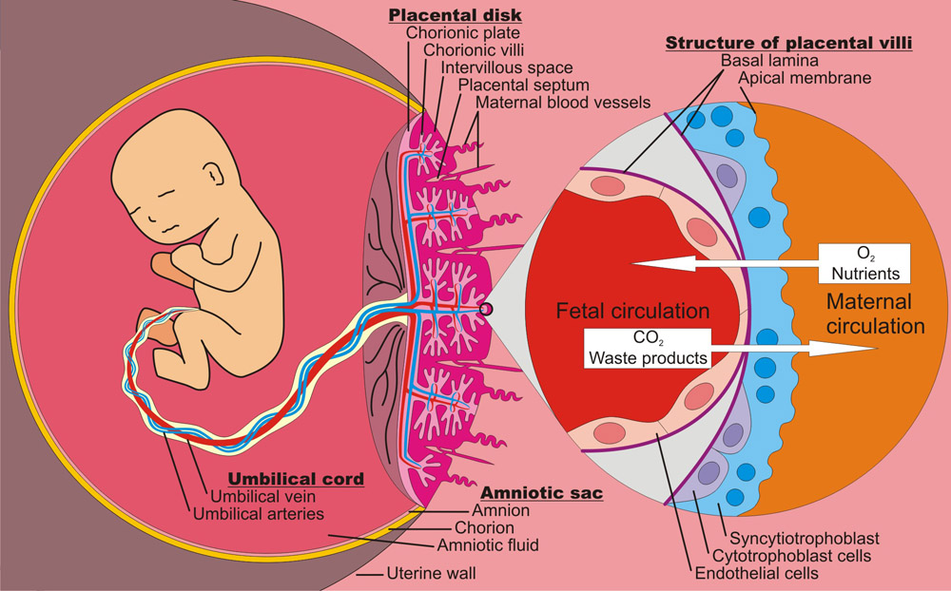
Function of the Placenta
Major functions
Respiration
Nutrition
Excretion
Endocrine
Protection

Slide 18
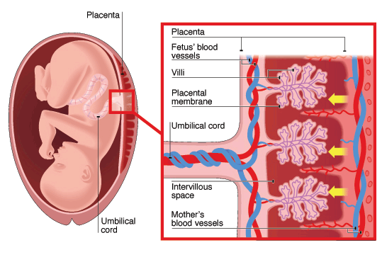
Placental permeability and membrane diffusion conductance
In the early months of pregnancy, the placental membrane is still thick because it is not fully developed.
The surface area is small because the placenta has not grown.
In later pregnancy, the permeability increases because of thinning of the membrane diffusion layers and because the surface area expands many times over.
PO2 ~30 mm Hg
PO2 ~50 mm Hg
Diffusion of oxygen through the placental membrane

Slide 19
Important factors facilitating delivery of oxygen to the fetal tissues
Diffusion of oxygen through the placental membrane
There are three reasons why this low PO2 is sufficient to deliver O2 to the fetal tissues:
Hemoglobin of the fetus
Fetal hemoglobin concentration
The Bohr effect

Slide 20
Important factors facilitating delivery of oxygen to the fetal tissues
Hemoglobin of the fetus
Fetal hemoglobin (HbF)
The fetal hemoglobin concentration is about 50% greater than that of the mother
At the low PO2 levels in fetal blood, the fetal hemoglobin can carry 20 to 50% more oxygen than maternal hemoglobin can..
Oxygen-hemoglobin dissociation curves

Slide 21
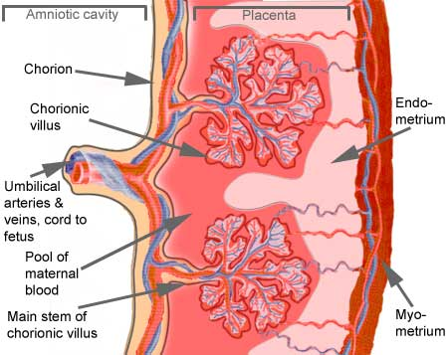
Important factors facilitating delivery of oxygen to the fetal tissues
Double Bohr Effect
High pH in fetal blood (alkaline). Low pH in mother’s blood (acidic)
These changes cause the capacity of fetal blood to combine with O2 to increase, and maternal blood to decrease, which forces more O2 from the maternal blood while enhancing oxygen uptake by the fetal blood.
O2
CO2
alkaline
acidic
PCO₂ 2-3 mm Hg higher in fetus

Slide 22
Diffusion of foodstuffs through the placental membrane
Fetus uses mainly glucose for nutrition so the trophoblast cells in placental villi transport glucose by carrier molecules; GLUT (facilitated diffusion)
Fatty acids diffuse due to high solubility in cell membrane (more slowly than glucose)
The placenta actively transports all amino acids, with fetal concentrations exceeding maternal levels.
K+, Na+ and Cl- diffuse from maternal to fetal blood

Slide 23
Excretion
Excretory products of the fetus diffuse through the placental membrane to maternal blood to be excreted with the waste products of the mother
Urea, uric acid and creatinine
Higher conc. of excretory products in fetal blood ensures continuous diffusion of these substances to the maternal blood

Slide 24
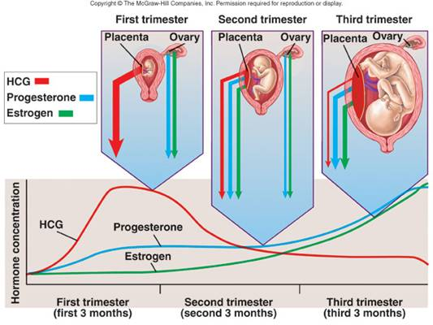
Placenta as an Endocrine Organ

Slide 25
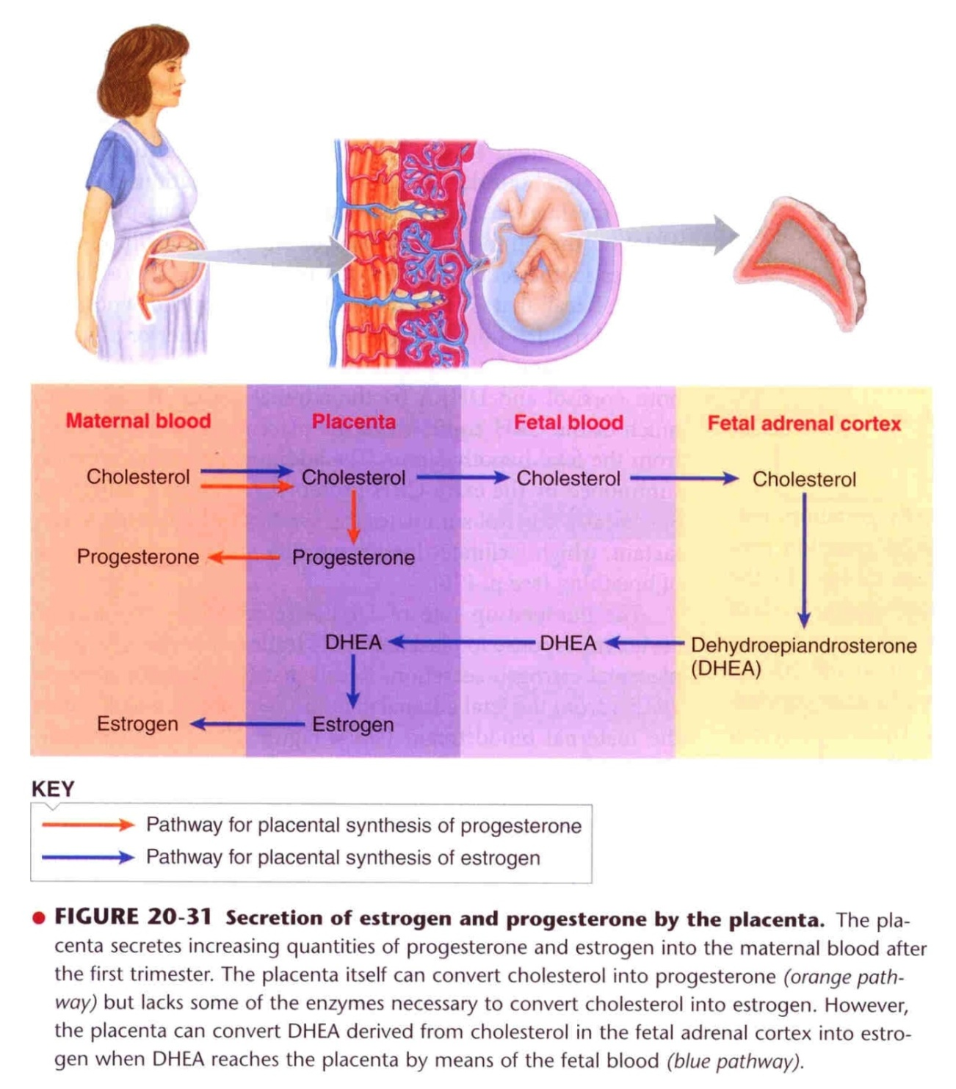
Sources of placental estrogen and progesterone
3β-HSD
DHEA
Aromatase
3β-Hydroxysteroid dehydrogenase
(3β-HSD)

Slide 26
Placenta as Endocrine Organ
Estrogen
Steroid hormone
Secreted by syncytial trophoblast cells
Towards the end of pregnancy it reaches 30×
Derived from weak androgen (DHEA) released from maternal & fetal adrenal cortex
Functions in the mother
Enlargement of uterus, breast & external genitalia
Relaxation of pelvic ligaments in preparation for labor
Activation of the uterus (gap junctions)

Slide 27
Placenta as Endocrine Organ
Progsterone
Steroid hormone
Secreted by syncytial trophoblast cells
Towards the end of pregnancy it reaches 10×
Derived from cholesterol
Functions in the mother
Provides nutrition to developing embryo (uterine secretory phase)
Development of decidual cells
Inhibits the contractility of the uterus

Slide 28
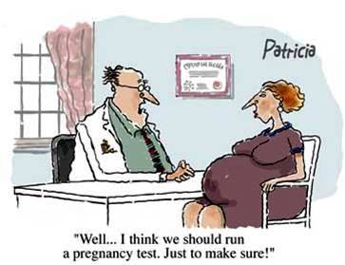
hCG level (pregnancy test)

Slide 29
Placenta as an Endocrine Organ
Human Chorionic Gonadotropin (hCG)
Glycoprotein
Secreted by syncytial trophoblast cells
Most important function is to maintain corpus luteum (↑estrogen & progesterone) till 13-17 weeks of gestation
Exerts interstitial (Leyding) cell-stimulating effect on testes of the male fetus (growth of male sex organs)

Slide 30
Placenta as an Endocrine Organ
Human Chorionic Somatomamotropin or Human placental lactogen (hPL)
Protein hormone
Secreted by placenta around 5th gestational week
Functions in the mother
Breast development
Weak growth hormone’s action
Inhibits insulin sensitivity =↓ glucose utilization
Promotes release of fatty acids

Slide 31
Placenta as an Endocrine Organ
Relaxin
Polypeptide
Secreted by corpus luteum and placenta
Functions in the mother
Relaxation of symphysis pubic ligament (weak)
Softens the cervix at delivery

Slide 32
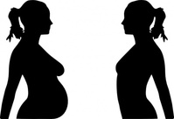
Physiological adaptation to pregnancy

Slide 33
Changes in maternal endocrine systems
Anterior pituitary gland enlargement (50%)
Release of ACTH, TSH and PL
FSH and LH almost totally suppressed
Adrenal gland
Increase glucocorticoids secretion (mobilize AA)
Increase aldosterone (reabsorb excess Na⁺ & retain fluid)
Thyroid gland enlargement (50%)
Increase thyroxine production (hCG)
Parathyroid gland enlargement
Increase PTH secretion (maintains normal Ca²⁺)

Slide 34
Changes in different organs
Increase in uterine size (50 gm to 1100 gm)
The breasts double in size
The vagina enlarges
Development of edema and acne
Masculine or acromegalic features
Weight gain 10-12 kg (last 2 trimesters)
Increase appetite
Removal of food by fetus
Hormonal effect

Slide 35
Metabolism and kidney function during pregnancy
Increase basal metabolic rate (15%).
Increase in daily requirements for:
Iron
Phosphates
Calcium
Vitamins - vitamin D (Ca²⁺ absorption)
The renal tubules’ reabsorptive capacity for Na, Cl, and water is increased as much as 50%.
The renal blood flow and GFR increase up to 50%.
Normal pregnant woman accumulates only about 5 pounds (2.27Kg) of extra water and salt.

Slide 36
Changes in circulatory system
Increase in cardiac output (30-40%) by 27th weeks.
Increase in blood flow through the placenta.
Increase in maternal blood volume (30%) due to:
Increase aldosterone and estrogen (↑ ECF)
Increase activity of the bone marrow (↑ RBCs)

Slide 37
Changes in respiration
Increase in O₂ consumption (20%):
Increase BMR
Increase in body size
Increase in respiratory rate (RR).
Progesterone ↑ sensitivity of respiratory centre to CO₂
Increase in minute ventilation by 50% and a decrease in arterial PCO2 to several millimeters.

Slide 38
The End
Thank You

