Slide 1
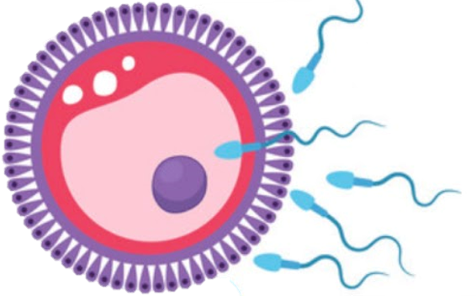
Female perineum and external genitalia
Reproductive block-Anatomy-Lecture 2
Editing file

Slide 2
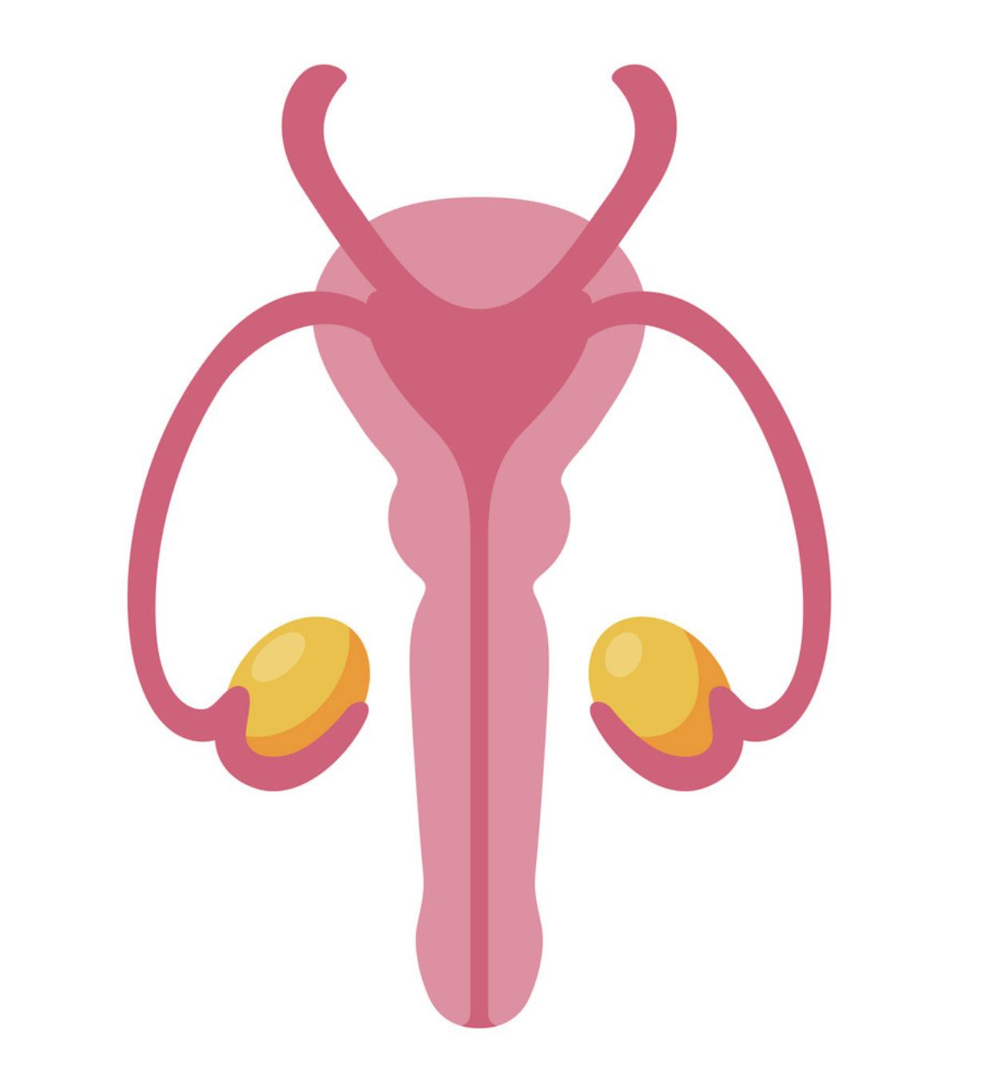
Color guide :
Only in boys slides in Green
Only in girls slides in Purple
important in Red
Notes in Grey
Objectives
At the end of the lecture, students should be able to:
Boundaries of the perineum.
Division of perineum into two triangles.
Boundaries & Contents of anal & urogenital triangles.
Lower part of Anal canal.
Boundaries & contents of Ischiorectal fossa.
Innervation, Blood supply and lymphatic drainage of perineum

Slide 3
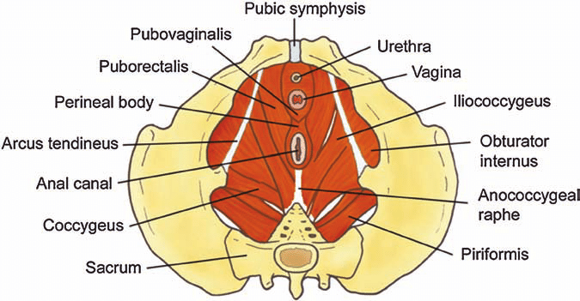
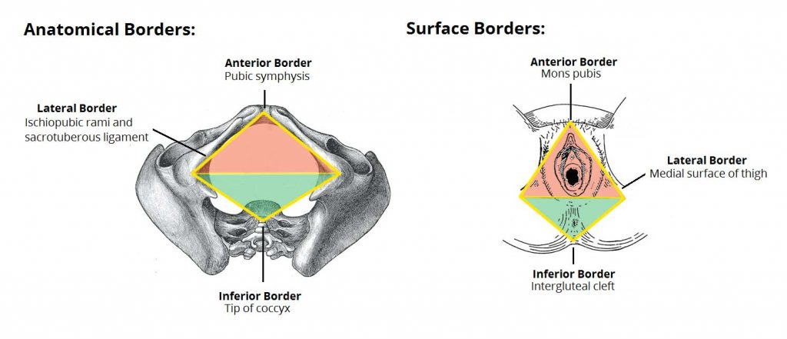
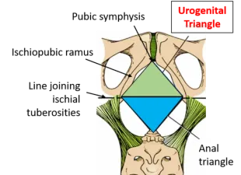
Perineum
It is the region of the body below the pelvic diaphragm (The outlet of the pelvis)
It is a diamond shaped area between the thighs
Perineum Contents:
Lower ends of urethra. 4. Anococcygeal body
Vagina 5. Anal canal
Perineal body 6.External genitalia
Relations | Anterior | Posterior | Lateral
Bony Boundaries | Symphysis pubis | Coccyx | Ischiopubic rami “anteriolateral” Ischial tuberosities Sacrotuberous ligaments “Posteriolateral”
Boundaries | Mons pubis | Inter gluteal folds | Medial surfaces of the thighs
By an imaginary line passing through two ischial tuberosities it divided into:
Anteriorly: urogenital triangle
Posterior: Anal triangle

Slide 4
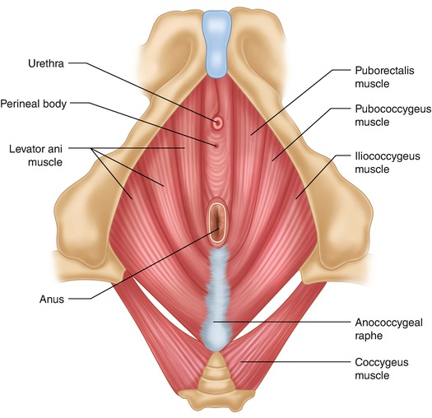
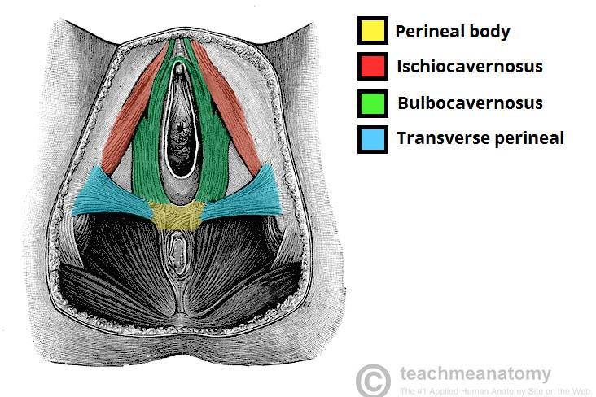
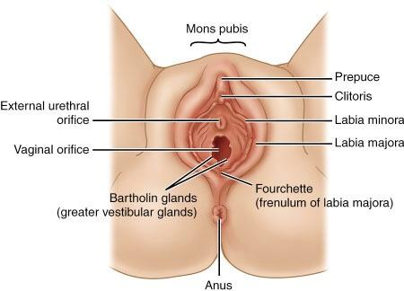
Perineum Contents
Anococcygeal Body | Perineal Body | Female External Genitalia (Vulva)
It is a complex musculotendinous structure Located between the anterior aspect of the coccyx & the posterior wall of the anorectal canal Function: Receives insertion of fibers of levator ani muscle | It is an irregular fibromuscular mass of variable size and consistency Located at midpoint of the line between the ischial tuberosities Lies in the subcutaneous tissue, posterior to vaginal vestibule and anterior to the anal canal & anus Forms the central point of the perineum & blends anteriorly with the perineal membrane Function: Gives attachment to perineal muscles Plays an important role in visceral support especially in female | Mons pubis : a collection of fat overlying the pubes. Clitoris Labia majora. Labia minora. Vestibule of vagina: The interval between the two labia minora. Vagina & urethra open into the vestibule through urethral orifice anteriorly and vaginal orifice posteriorly.

Slide 5
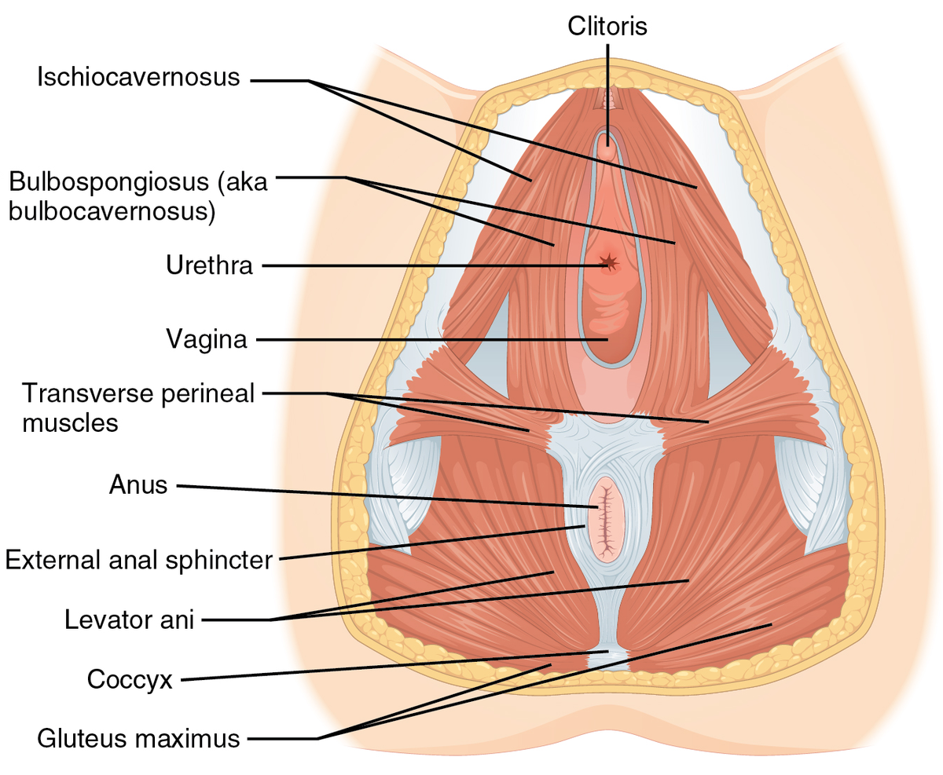
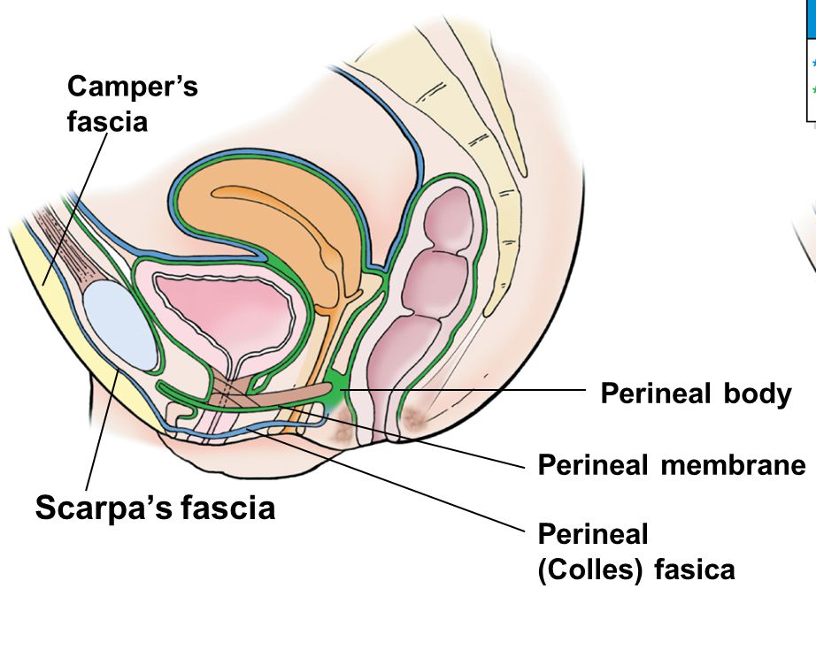
Urogenital Triangle
Urogenital Diaphragm
Boundaries
Anterior ➔ symphysis pubis
Posterior ➔ transverse line passing through the 2 ischial tuberosities
Lateral ➔ ischiopubic rami & ischial tuberosities
Contents
Lower part of urethra & Vagina
External genitalia (Vulva)
Fascia of Urogenital Triangle (Perineal Fascia)
is continuous anteriorly with the fascia of abdomen and consists of :
Deep perineal fascia invests the muscles in the superficial perineal pouch
Superficial fatty layer (Camper’s fascia) makes up the substance of mons pubis & labia majora and extends into the anal region
01
Superficial layer
consists of
02
Deep layer
Deep membranous layer (Colle’s fascia ): Does not extend to anal region. Becomes fused with the posterior margin of the perineal membrane
A triangular musculofascial diaphragm located in the anterior part of the perineum (in the urogenital triangle).
Fills in the gap between the pubic arch.
Composed of: Sphincter urethrae and the deep transverse perineal muscles enclosed within the superior and inferior layers of fascia of the urogenital diaphragm
The inferior layer of the fascia is formed by perineal membrane

Slide 6
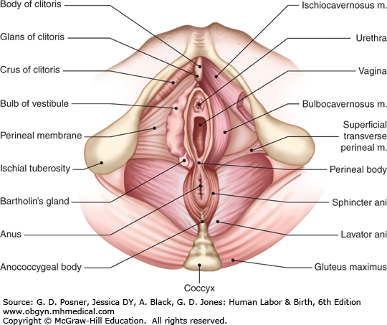
Perineal Pouches
Superficial perineal pouches
It is the space between the deep membranous layer of superficial fascia of perineum (Colle’s fascia) and the perineal membrane
Superior ➔ perineal membrane
Inferior ➔ membranous layer of superficial fascia
Lateral ➔ ischiopubic rami
Boundaries
Bulbs of vestibule: on each side of vaginal orifice
Crura of clitoris
Superficial perineal muscles:
Bulbospongiosus muscle, surrounds orifice of vagina and covers vestibular bulb
Ischiocavernosus muscle, covers crus of clitoris on each side
Superficial transverse perineal muscles
Greater vestibular glands: on each side of vaginal orifice
Perineal branch of pudendal nerve supplying muscles & skin
Contents

Slide 7
Perineal Pouches
Deep perineal pouches
It is a completely closed space deep to the perineal membrane
Superior ➔ superior fascia of the urogenital diaphragm
Inferior ➔ inferior fascia of the urogenital diaphragm (perineal membrane)
Lateral ➔ inferior portion of obturator internus fascia
Boundaries
Part of urethra
Part of vagina
Sphincter urethrae and Sphincter vaginae muscles, which is pierced by urethra & vagina
Deep transverse perineal muscles
Internal pudendal vessels
Dorsal nerve of clitoris (branch of Pudendal nerve)
Contents

Slide 8
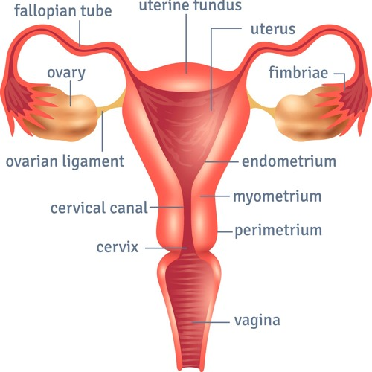
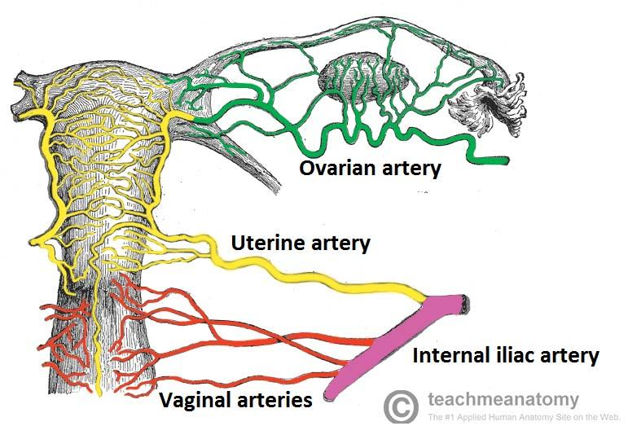
Vagina
is a muscular canal that leads from the uterus to the external orifice of the genital canal
It measures about 3 in. (8 cm) long.
It serves as the excretory duct for the menstrual flow & forms part of the birth canal.
The vaginal orifice in a virgin possesses a thin mucosal fold, called the hymen, which is perforated at its center. It lies posterior to the urethral orifice.
Vaginal artery: a branch of the internal iliac artery
Vaginal branch of the uterine artery
Arterial Supply
Venous Drainage
drain into the internal iliac veins.

Slide 9
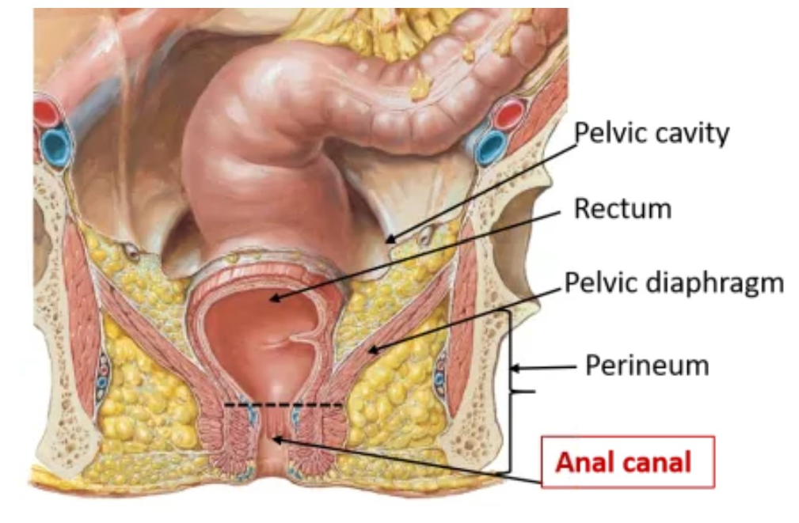
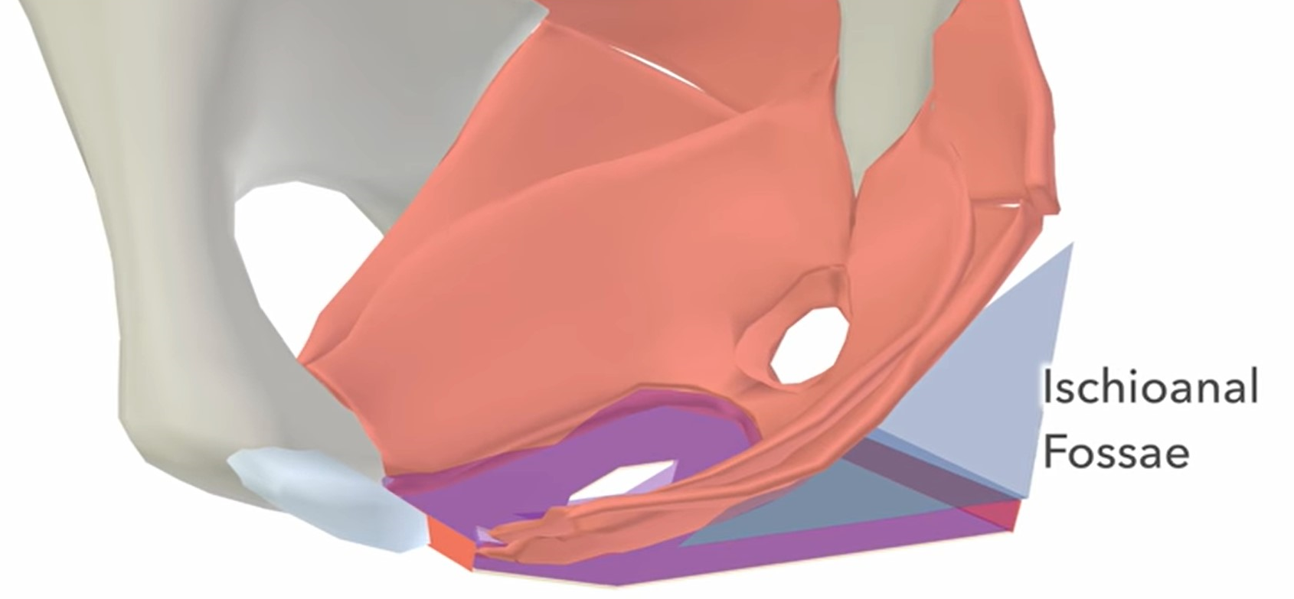
Anal Triangle
Boundaries:
1
Anterior ➔ Transverse line passing through the 2 ischial tuberosities
2
Lateral ➔ ischial tuberosity & sacrotuberous ligament
3
Posterior ➔ coccyx
2-Contents:
A. Lower part of Anal canal
B. Anococcygeal body
C. Ischiorectal fossa on each side
Anal canal
It is about 1.5 in. long, descending from the rectal ampulla to the anus.
Relations (In female):
Anteriorly ➔ Perineal body, urogenital diaphragm, and lower part of vagina
Posteriorly ➔ Anococcygeal body.
Laterally ➔ Ischiorectal fossae.
Divided into: (by the pectinate line)
Upper half: derived from hindgut (endoderm)
Lower half: derived from the Proctodeum (ectoderm)
The two parts have different blood supply, nerve supply and lymphatic drainage
A fascial lined wedge-shaped space on each side of the anal canal
Boundaries:
Base ➔ Skin of the perineum
Medial wall ➔ Levator ani & anal canal
Lateral wall ➔ Obturator internus, covered with fascia
Contents:
Dense fat
Pudendal nerve & internal pudendal vessels within the pudendal canal (A fascial canal formed by obturator fascia, located on the lateral wall of the ischiorectal fossa)
Inferior rectal nerve & vessels crossing the fossa to reach anal canal
Ischiorectal fossa

Slide 10
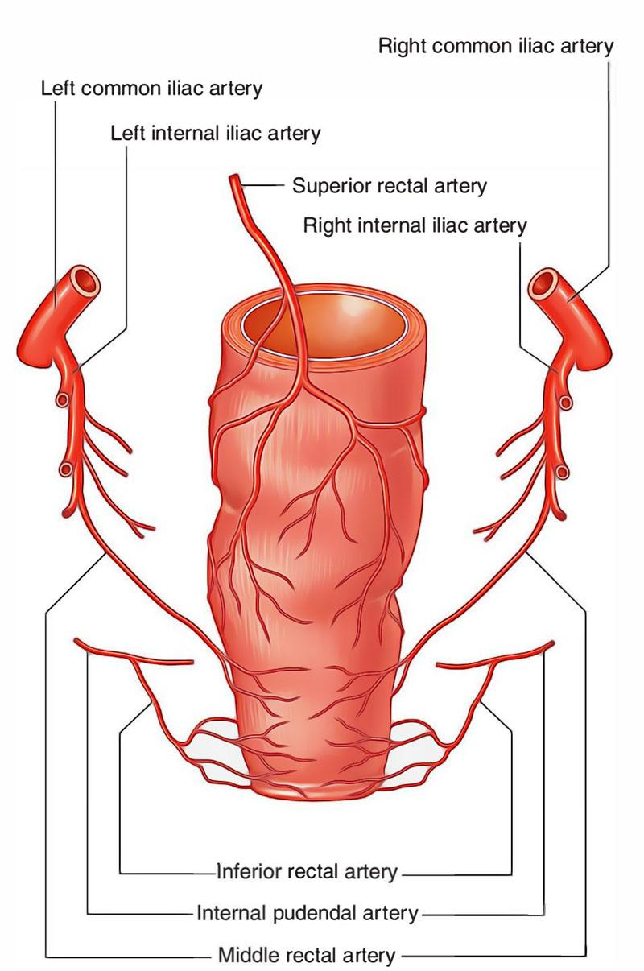
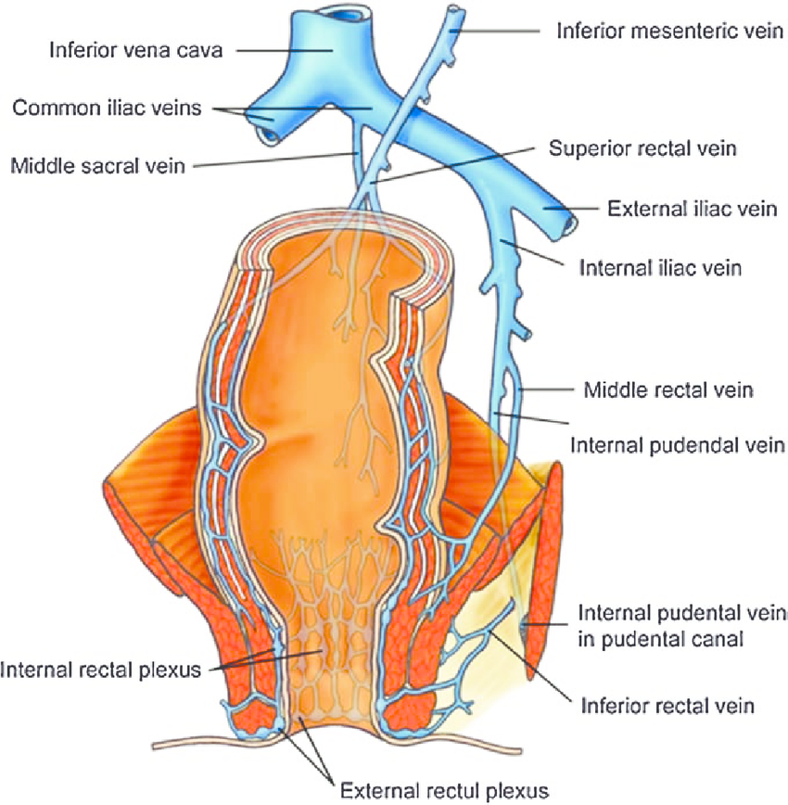
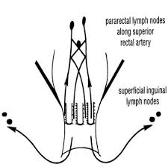
Anal canal supply:
 | Arterial supply | Venous drainage | Lymphatic drainage | Nerves
Upper half | Superior rectal a. (continuation of the inferior mesenteric a.) | Superior rectal vein drained into the inferior mesenteric vein (portal circulation) | Para-rectal nodes drained into inferior mesenteric lymph nodes and internal iliac lymph nodes | (sensitive to stretch) Autonomic nerve Visceral motor (Inferior Hypogastric Plexus) (sympathetic & parasympathetic)
Lower half | Inferior rectal a. (branch of internal pudendal a.) | Inferior rectal vein drained into the internal pudendal vein (Systemic circulation) | Superficial inguinal lymph nodes | (sensitive to pain) Somatic motor & sensory nerves - (Inferior rectal nerve branch of pudendal nerve) supplies external sphincter muscle of the anus and the skin of the anal region

Slide 11
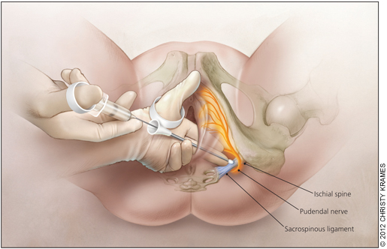
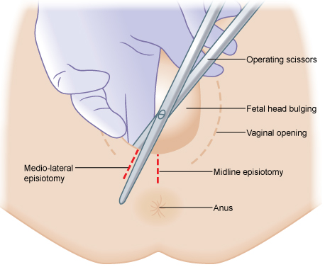
Pudendal Nerve Block
It is used in providing analgesia for the second stage of labour and to provide anesthesia of the perineum in order to create and repair an episiotomy.
Can be done by transvaginally or through perineal approach.
it divided into
Transvaginal method: The needle is passed through the vaginal mucous membrane toward the ischial spine. After the needle is passed through the sacrospinous ligament, the anesthetic solution is injected around the pudendal nerve
Perineal method: The ischial tuberosity is palpated subcutaneously through buttock . The needle is inserted on the medial side of the ischial
tuberosity to a depth of about 1 in. (2.5 cm) from the free surface of the tuberosity. The anesthetic is injected around the pudendal nerve.
An episiotomy is a surgically planned incision on the perineum and the posterior vaginal wall during second stage of labor to prevent perineal tear.

Slide 12
QUIZ
Q1 | Q2 | Q3 | Q4 | Q5 | Q6 | Q7 | Q8
B | B | A | A | D | A | D | B
Q1: which of the following bony boundaries is located in the anterior to perineum ?
A. Coccyx
B. Symphysis pubis
C. Ischiopubic rami
D. Ischial tuberosities
Q2: Vagina & urethra open into the vestibule through urethral orifice … &vaginal orifice …. A. Laterally, posteriorly B. Anteriorly , posteriorly
C. Anteriorly. Laterally . D.posteriorly , anteriorly
Q3: In transvaginal method, the needle is passed through the ……….toward the ……..
A. Vaginal mucous membrane, ischial spine
B. Vaginal mucous membrane , ischial tuberosity
C. Buttock , ischial spine
D. Buttock , ischial tuberosity
Q4: Which of the following is considered a landmark during a transvaginal pudendal n. block?
A. Ischial spine
B. Ischial tuberosity
C. Pubic rami
Q5: Crura of clitoris is one of the content of?
A. Deep perineal pouch
B. Anal triangle
C.pudendal canal
D. Superficial perineal pouch
Q6: which of the following is posterior to anal canal? A.Anococcygeal body B.vagina C.ischiorectal fossae D.perineal body
Q7: which of the following vein drains into inferior mesenteric vein?
A. Middle rectal vein
B. Internal pudendal vein
C. Inferior rectal vein
D. Superior rectal vein
Q8: which of the following boundaries is located in the base of Ischiorectal fossa?
A. Levator ani
B. skin of perineum
C. Pudendal nerve
D. Obturator internus

Slide 13
Members board
Team leaders
Abdulrahman Shadid
Ateen Almutairi
Boys team:
Mohammed Al-huqbani
Salman Alagla
Ziyad Al-jofan
Ali Aldawood
Khalid Nagshabandi
Sameh nuser
Abdullah Basamh
Alwaleed Alsaleh
Mohaned Makkawi
Abdullah Alghamdi
Girls team :
Ajeed Al Rashoud
‏Taif Alotaibi
‏Noura Al Turki
‏Amirah Al-Zahrani
‏Alhanouf Al-haluli
‏Sara Al-Abdulkarem
‏Renad Al Haqbani
‏Nouf Al Humaidhi
Jude Al Khalifah
Nouf Al Hussaini
Danah Al Halees
Rema Al Mutawa
Maha Al Nahdi
Razan Al zohaifi
Ghalia Alnufaei
Contact us:

