Slide 1
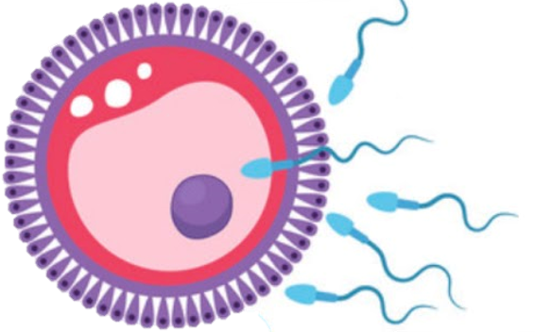
Female pelvis
Reproductive block-Anatomy-Lecture
Editing file

Slide 2
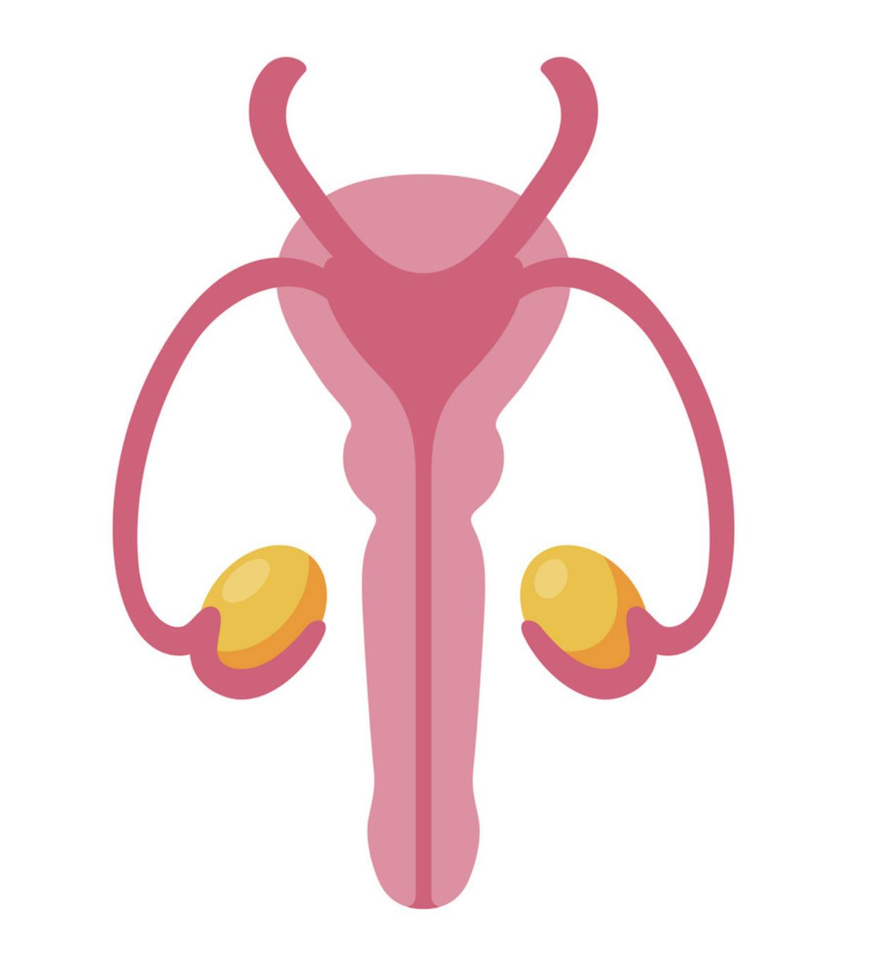
Color guide :
Only in boys slides in Green
Only in girls slides in Purple
important in Red
Notes in Grey
Objectives
At the end of the lecture, students should be able to:
Describe the anatomy of the pelvic wall, bones, joints & muscles.
Describe the boundaries and subdivisions of the pelvis.
Differentiate the different types of the female pelvis.
Describe the pelvic walls & floor.
Describe the components & function of the pelvic diaphragm.
List the arterial & nerve supply.
List the lymph & venous drainage of the pelvis.

Slide 3
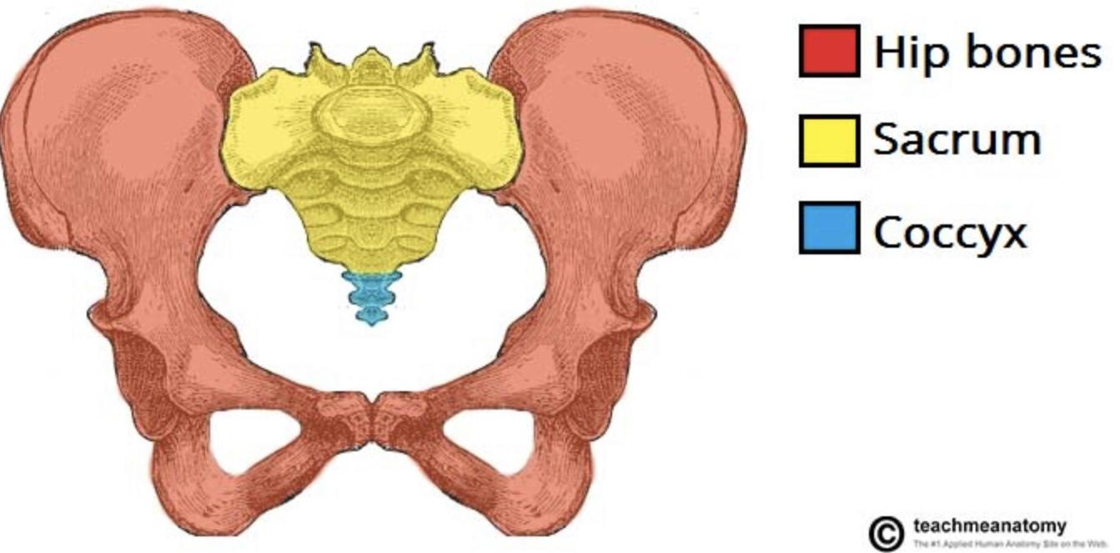
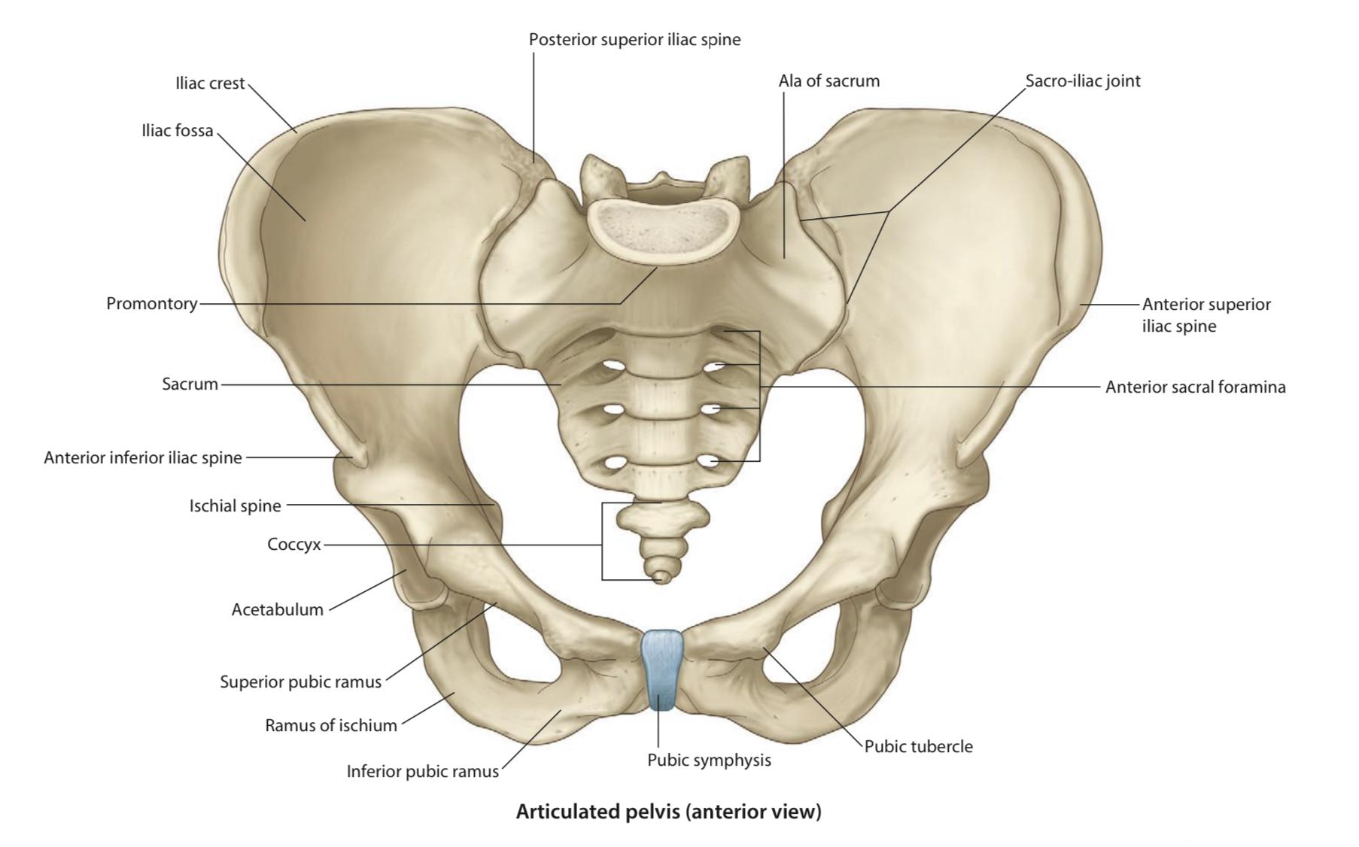
Introduction
The bony pelvis is composed of 4 bones, connected by 4 joints and lined by 4 muscles. The bony pelvis with its joints and muscles form a strong basin-shaped structure (with multiple foramina).
The pelvis contains and protects the:
Lower parts of the alimentary tract.
Urinary tract.
Internal organs of reproduction.
Four Bones
Two hip bones, which form the anterior & lateral walls.
Sacrum and coccyx, which form the posterior wall.
Sacroiliac joints
Four Joints
Anteriorly: Symphysis pubis (2ry Cartilaginous joint).
Posteriorly: Sacrococcygeal joint (2ry Cartilaginous joint).
Posterolaterally: Two Sacroiliac joints (Synovial joints, plain variety).
Sacrococcygeal joint
Symphysis pubis

Slide 4
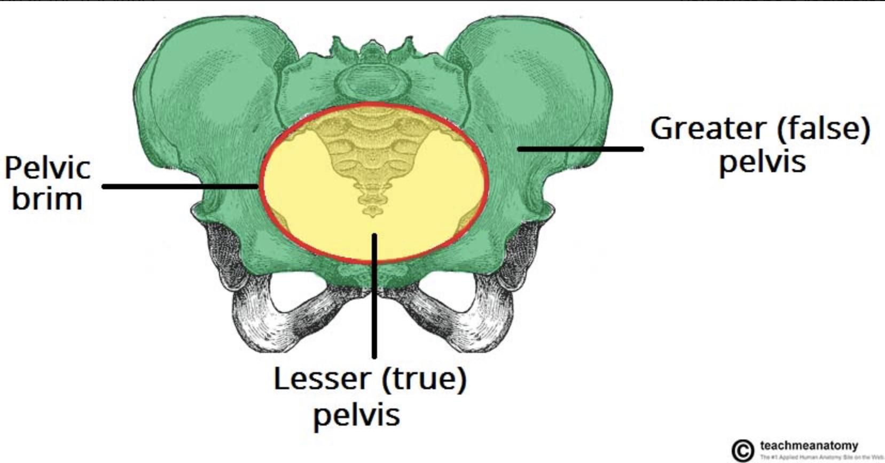
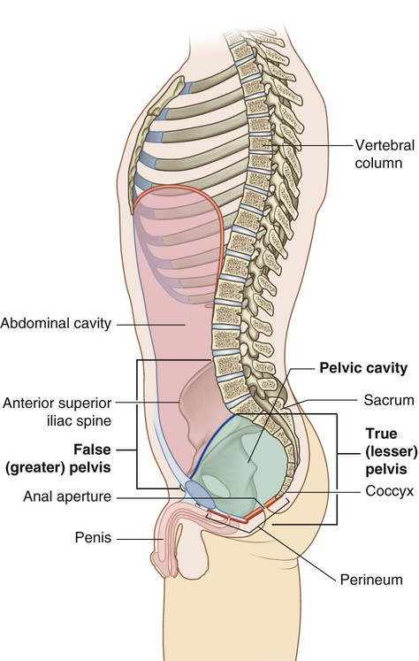
Pelvis
The pelvis is divided into two parts by the pelvic brim (inlet).
ABOVE
BELOW
False or greater pelvis
(Part of the abdominal cavity)
True or lesser pelvis
(Has 3 parts)
It supports the lower abdominal contents, it’s bounded by:
Anteriorly → Lower part of the anterior abdominal wall.
Posteriorly → Lumbar vertebrae.
Laterally → Iliac fossae and the iliacus muscle.
Inlet
(Oval/circular shape):
Outlet
(Diamond shape):
01
Cavity
02
03
The cavity is a short, curved canal, with a shallow anterior wall and a deeper posterior wall.
It lies between the inlet and the outlet.
Anteriorly → Symphysis pubis (upper border).
Posteriorly → Promontory & ala of sacrum.
Laterally → Iliopectineal (arcuate) lines.
Anteriorly → Symphysis pubis (lower border).
Posteriorly → Coccyx.
Anterolaterally → Ischiopubic ramus.
Posterolaterally → Sacrotuberous ligament.
★
★
★
★
★
★
★
★
★

Slide 5
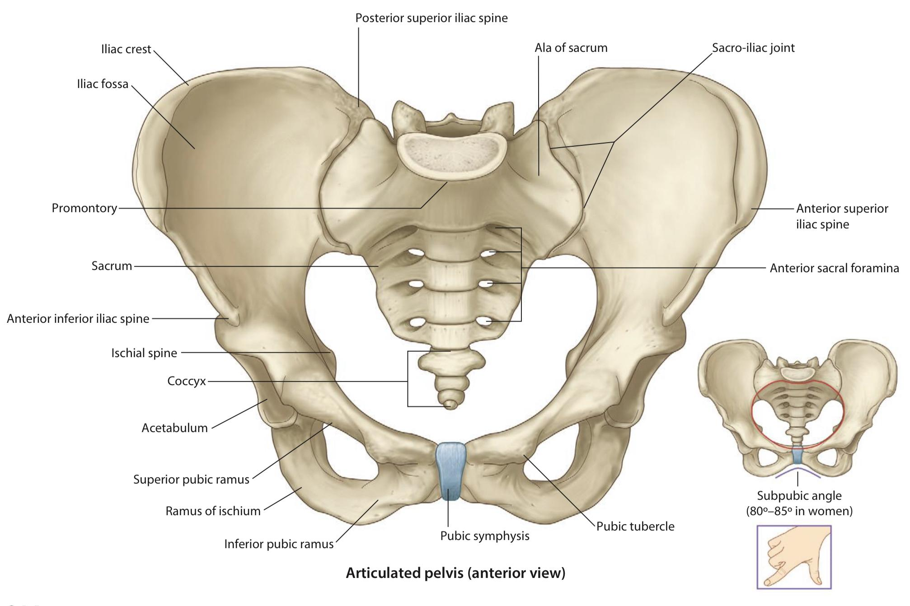
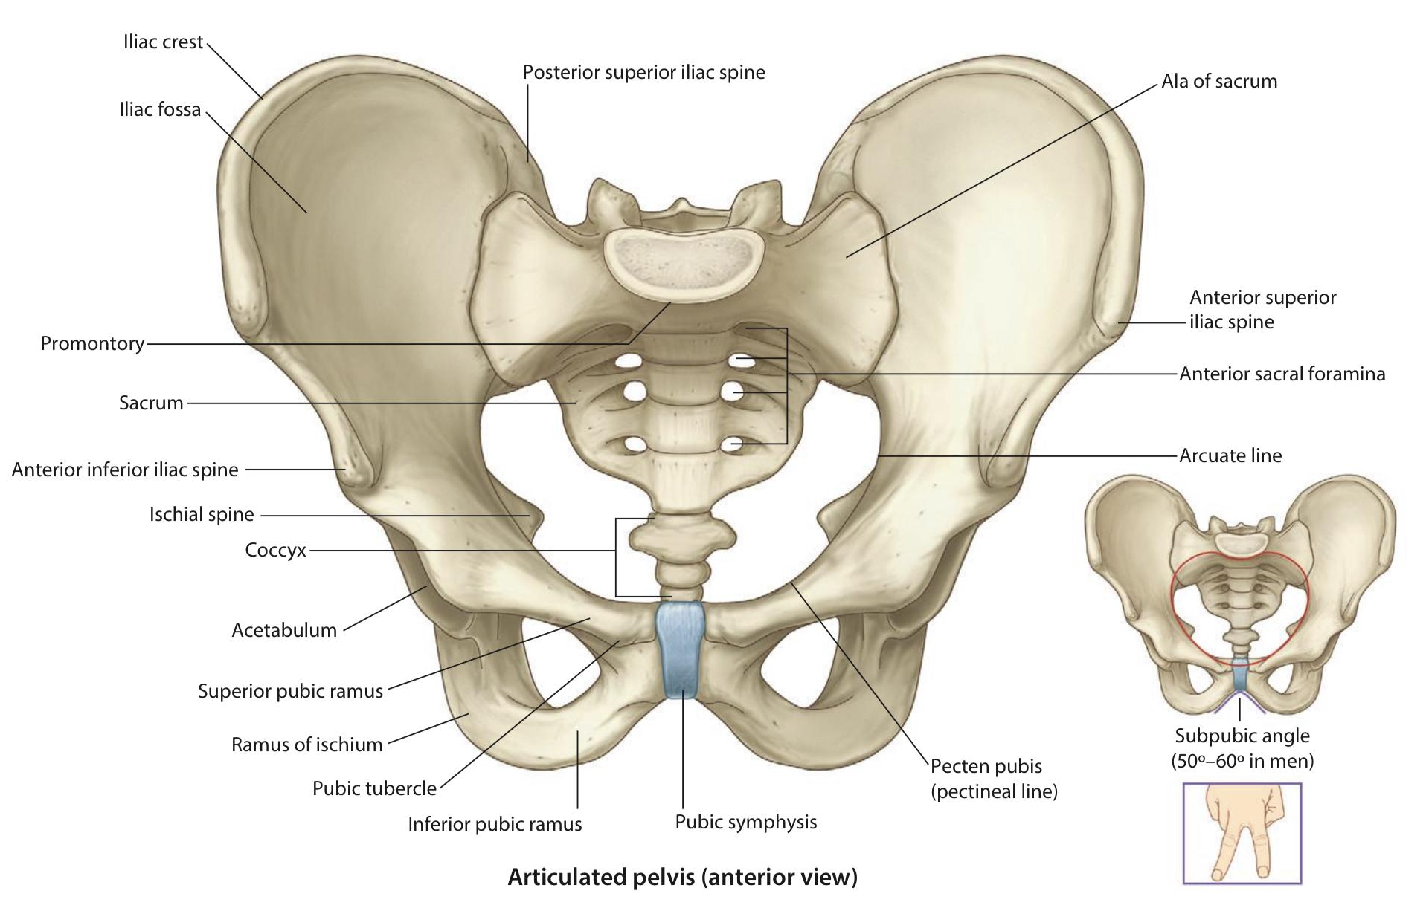
Main difference between & pelvis
In Males:
The Sacrum is usually longer, narrowest and curved.
The promontory and the ischial spines are inverted.
In Females:
The Sacrum is usually wider and shorter.
The Angle of the pubic arch is wider ( 80。- 85。).
The promontory and the ischial spines are less projecting.
Female
Male
Types of Female Bony Pelvis:
➔
Android (resembles male pelvis)
➔
Anthropoid (has both male and female characteristics)
➔
Gynecoid (typical female type)
➔
Platypelloid (least common)
Information of the shape and dimensions of the female pelvis is of great importance for obstetrics. Why?
because it is the bony canal through which the child passes during birth. Gynaecoid pelvis: considered the most suitable female pelvic shape for childbirth.

Slide 6
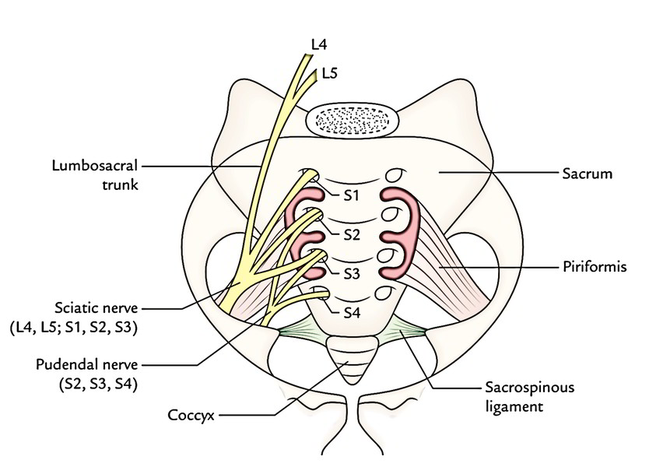
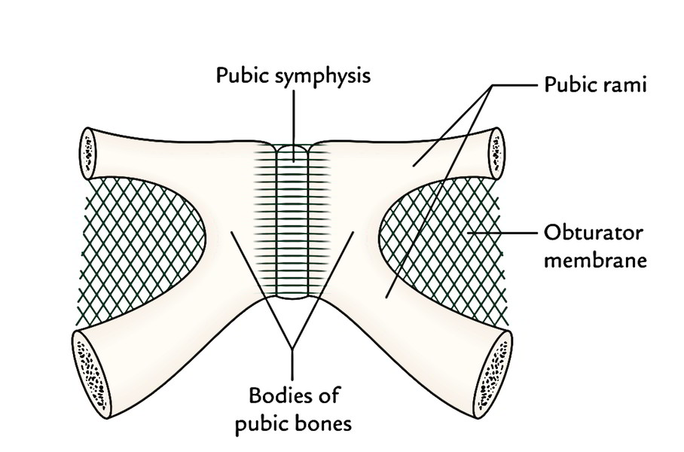
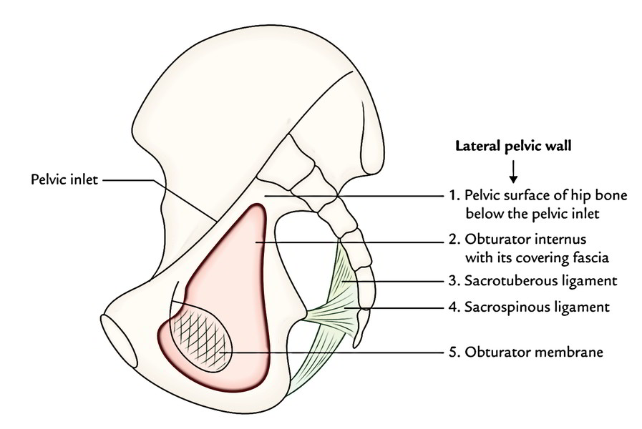
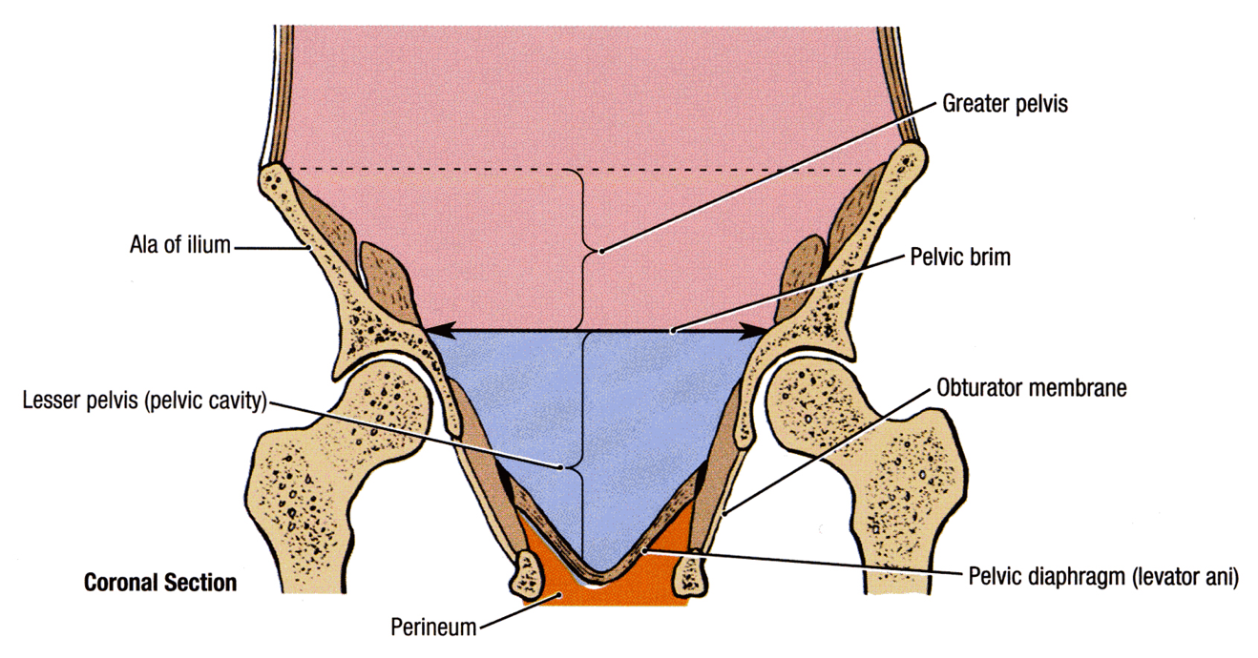
Pelvic Walls
The pelvis has 4 walls. The walls are formed by bones and ligaments that are lined with muscles covered with fascia and parietal peritoneum.
Anterior pelvic wall very narrow
Posterior pelvic wall deep & wide
It is the shallowest wall and has no muscles, it’s formed by:
The posterior surfaces of the bodies of the pubic bones.
The 2 pubic rami.
The symphysis pubis.
It is large & deeper, formed by:
Sacrum.
Coccyx.
Piriformis muscles & their covering of partial pelvic fascia.
★
★
★
★
Lateral pelvic wall
Inferior pelvic wall (pelvic floor)
★
★
Basin-like structure which supports the pelvic viscera and is formed by the pelvic diaphragm. It stretches across the lower part of the true pelvis and divides it into:
Main (true) pelvic cavity above, which contains the pelvic viscera.
Perineum below which carries the external genital organs.
It is formed by:
Part of the hip bone below the pelvic inlet.
Obturator internus and its covering & obturator fascia.
Sacrotuberous ligament.
Sacrospinous ligament.
★
★
★
★
★
★
★

Slide 7
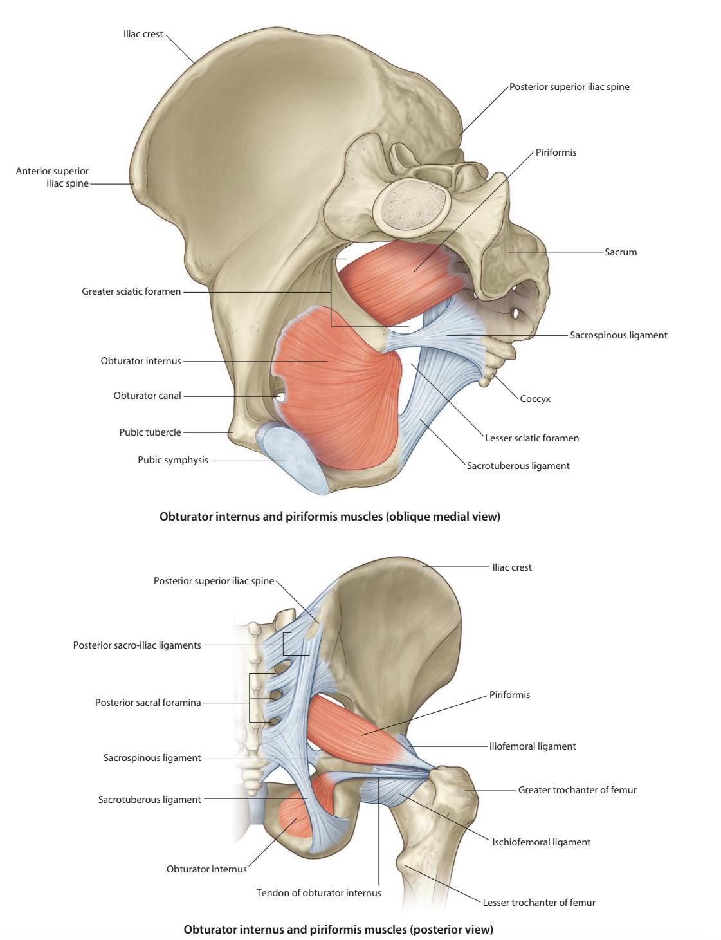
Pelvic Muscles (4 Muscles)
01
02
03
04
Piriformis
(part of posterior
pelvic wall)
Obturator Internus
(part of lateral
pelvic wall)
Levator Ani
(wide thin sheet-like muscle that has a linear origin)
Coccygeus
Muscle | Piriformis | Obturator Internus
Origin | Pelvic surface of the middle 3 sacral vertebrae. | Inner surface of the obturator membrane and the hip bone.
Insertion | It leaves the pelvis through the greater sciatic foramen, to be inserted into the Greater trochanter of the femur. | It leaves the pelvis through the lesser sciatic foramen, to be inserted into the Greater trochanter of the femur.
Nerve supply | Sacral plexus. | Nerve to obturator internus (from sacral plexus) .
Action | Lateral rotator of the femur at the hip joint.
01
02
★
★
★
★

Slide 8
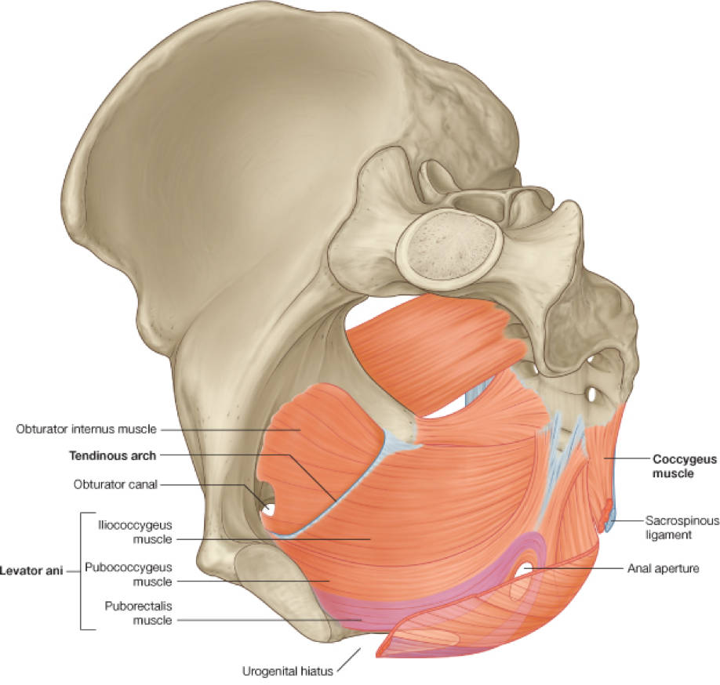
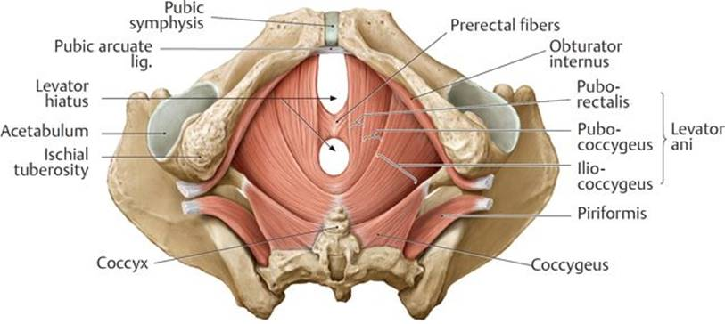
Pelvis Diaphragm
It is formed by the levator ani and the coccygeus muscles and their covering fasciae.
It is incomplete anteriorly to allow passage of:
Urethra in males.
Urethra and vagina in females.
★
★
★
★
★
Muscle | Levator Ani
Origin | Back of the body of the pubis. Tendinous arch of the obturator fascia. Spine of the ischium.
Fibers | Its fibers are divided into 3 parts: Pubococcygeus, Puborectalis & Iliococcygeus.
Nerve supply | Perineal branch of the 4th sacral nerve (S4) → upper surface. Perineal branch of the pudendal nerve → lower surface.
Action | The muscles of the two sides form an efficient muscular sling that supports and maintains the pelvic viscera in position. They resist the rise in intra pelvic pressure during the straining and expulsive efforts of the abdominal muscles (as in coughing). They have a very important role in maintaining fecal continence (puborectalis) by acting as a sphincter at the anorectal junction. They serve as a vaginal sphincter in the female.
Muscle | Coccygeus
Origin | Ischial spine. | Coccygeus muscle has the same attachment as the sacrospinous ligament.
Insertion | Lower end of sacrum & coccyx.
Nerve supply | branches of the 4th and 5th sacral nerves .
Action | Assist the levator ani in supporting the pelvic viscera.
03
04

Slide 9
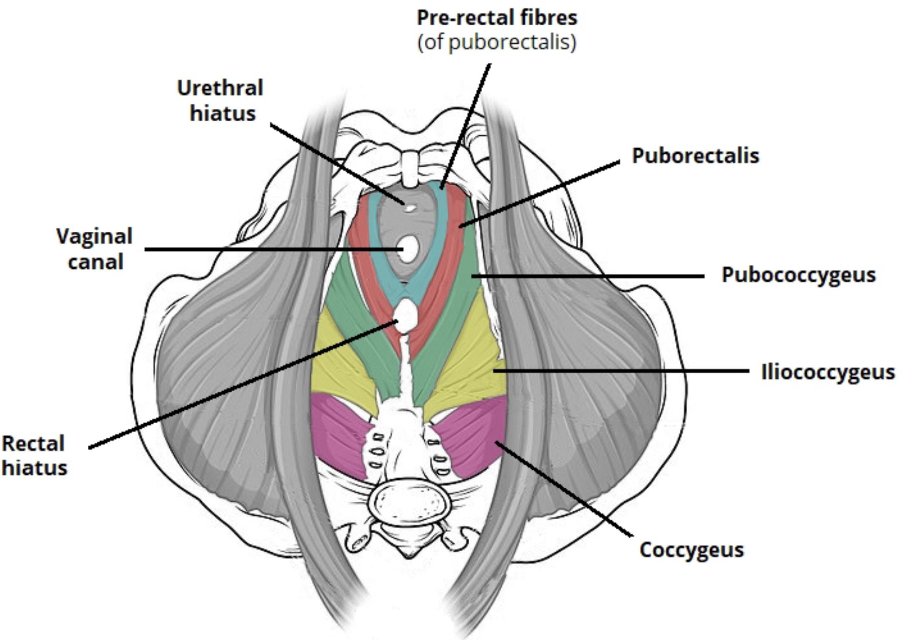
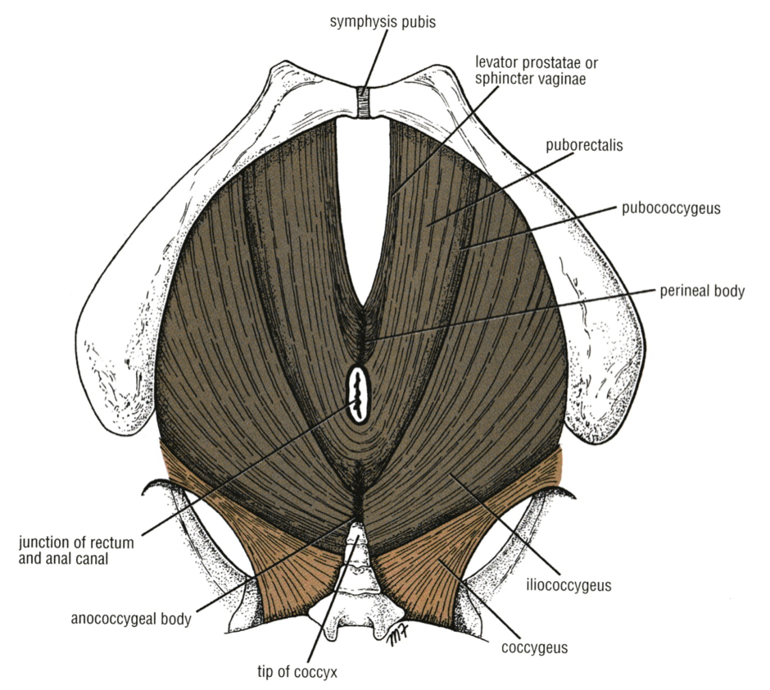
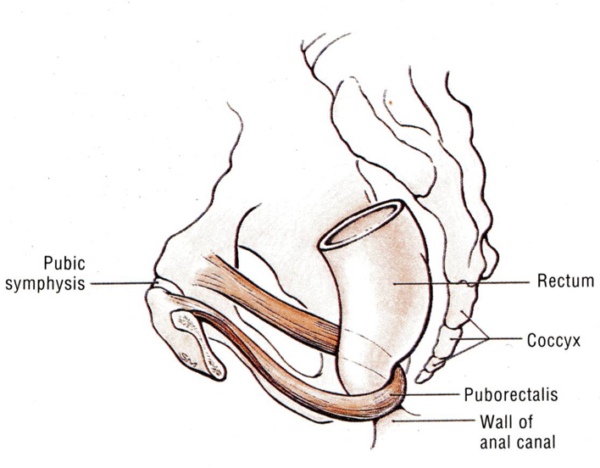
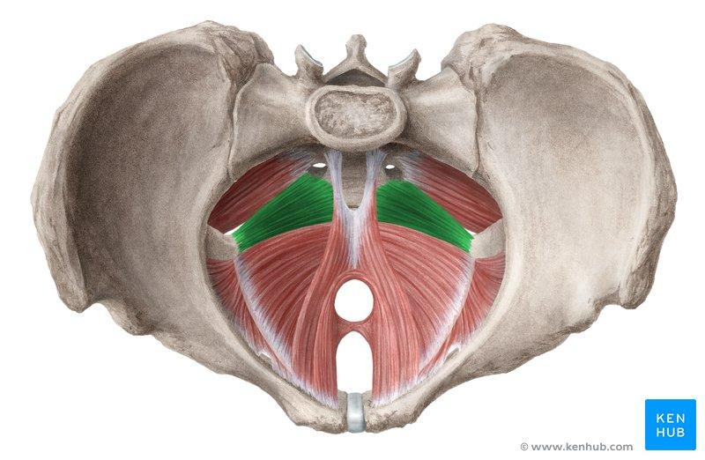
Levatores Ani Muscles (Fibers)
❷
1. Pubococcygeus (Anterior part)
❶
3. Iliococcygeus or
Ischiococcygeus
(Posterior part)
❸
Origin: originates from the posterior surface of the body of the pubis.
Insertion: inserted into the perineal body & coccyx.
Action: stabilizes the perineal body & forms a sling around the prostate or the vagina.
Insertion: Inserted into the anococcygeal body and the coccyx.
Origin of Ischiococcygeus: arises from the ischial spine.
2. Puborectalis
(Intermediate part)
Levator prostate:
Supports prostate.
Stabilizes perineal body.
forms a sling around the recto-anal Junction.
It has a very important role in maintaining fecal continence.
★
★
Sphincter vaginae:
constricts the vagina.
Stabilizes perineal body.
★
★
^{Ischiococcygeus}
★

Slide 10
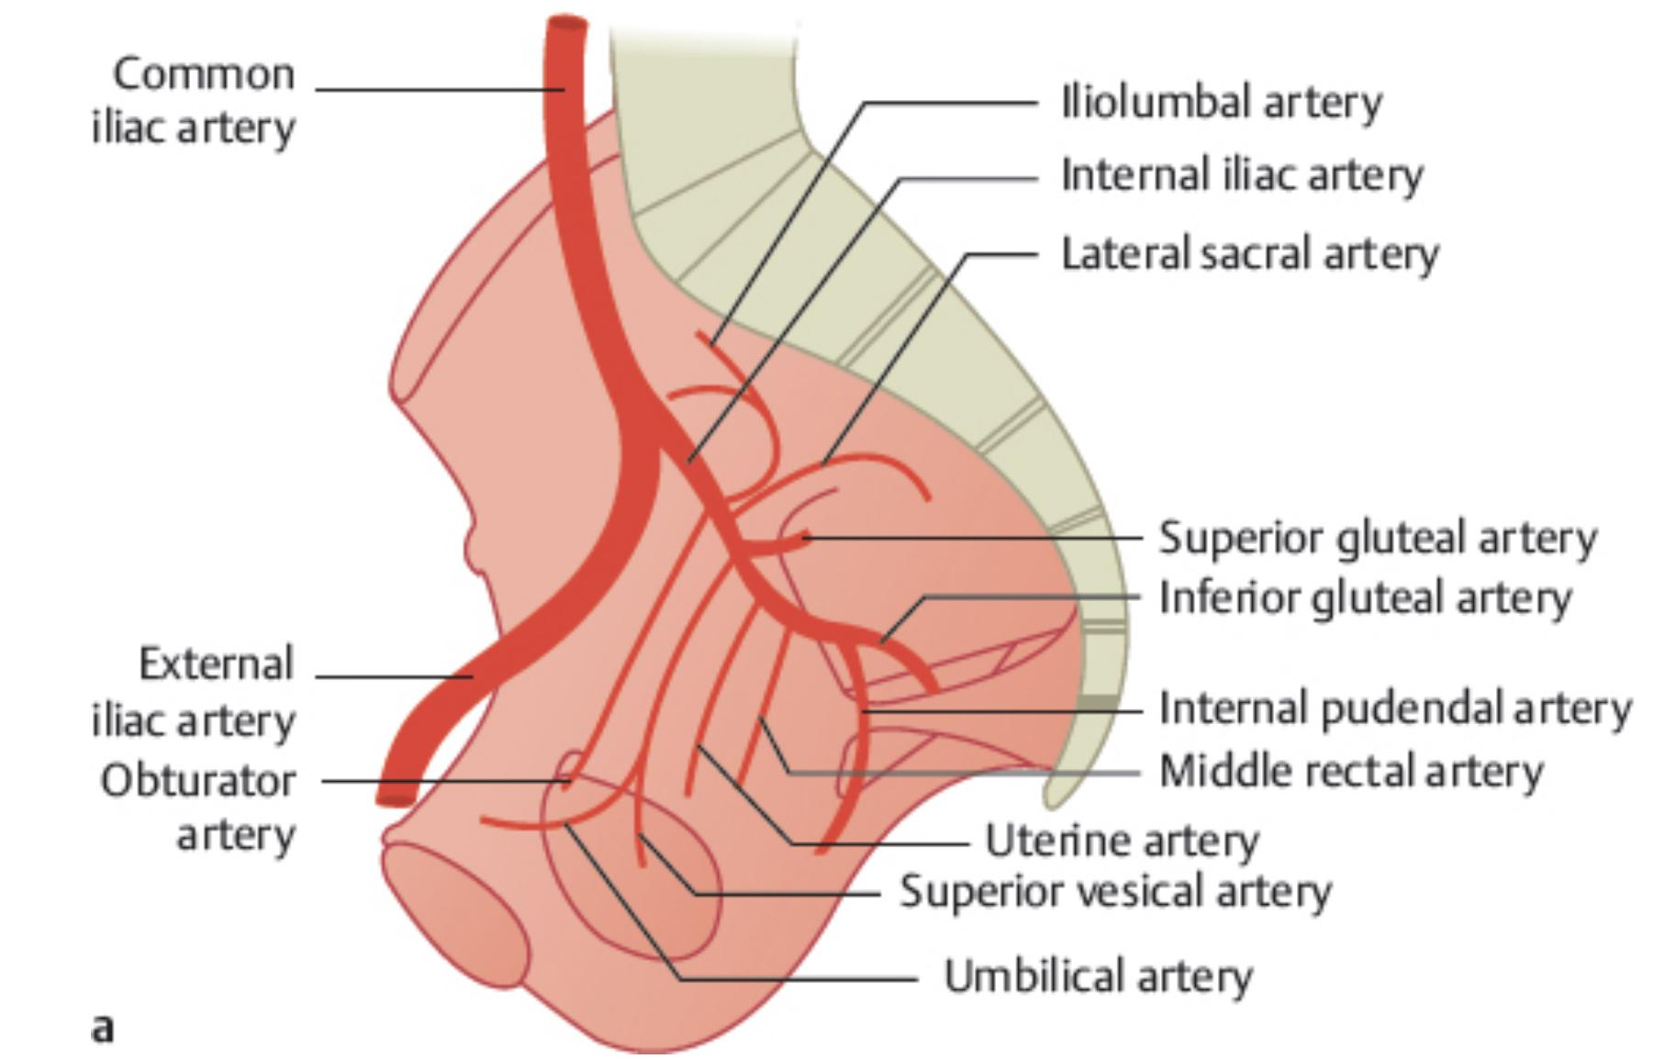
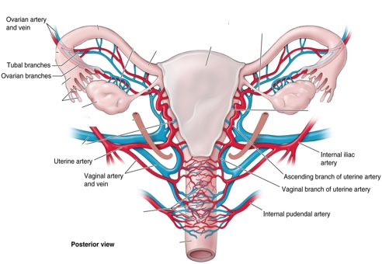
Arterial Supply of the Pelvis
01
Internal iliac artery (IIA): One of the 2 terminal branch of the Common iliac artery.
Course: Arises in front of the sacroiliac joint → It descends downward & backwards over the pelvic inlet → It divides at the upper border of the greater sciatic foramen into: Anterior & Posterior divisions.
Posterior Division | Parietal | Iliolumbar artery Lateral Sacral arteries (2 branches) Superior Gluteal artery | Supplies: Posterior abdominal wall, Posterior pelvic wall & Gluteal region.
Anterior Division |  | Obturator artery Inferior Gluteal artery | Supplies: Gluteal region, Perineum, Pelvic viscera, Medial (adductor) region of thigh (by obturator artery), The fetus (through the umbilical arteries).
 | Visceral | Umbilical artery: gives the superior vesical artery: the distal part of this artery fibrosed and forms the medial umbilical ligament. Inferior Vesical artery in male or vaginal in female: In the male it supplies the Prostate and the Seminal Vesicles. It also gives the artery of the Vas Deferens. Middle Rectal artery Internal Pudendal artery: It is the main arterial supply to the perineum.
 | Visceral (Female) | Vaginal artery: Replaces the inferior vesical artery. Uterine artery*: Crosses the Ureter superiorly and supplies the uterus & uterine tube. * May be wrongly ligated in hysterectomy. = damage to ureter, leading to renal failure.
02
Ovarian artery (in female): Arises from the Abdominal aorta.

Slide 11
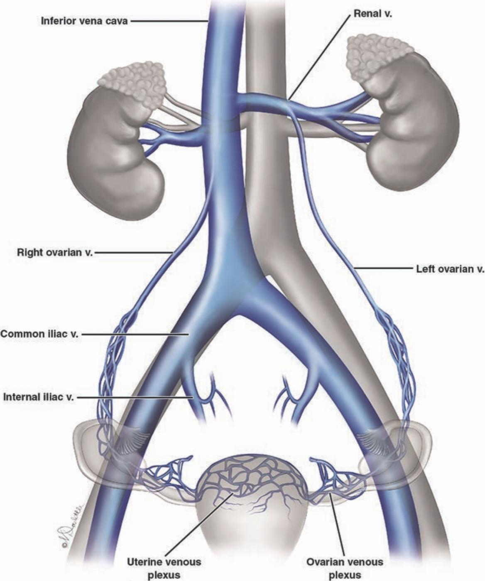
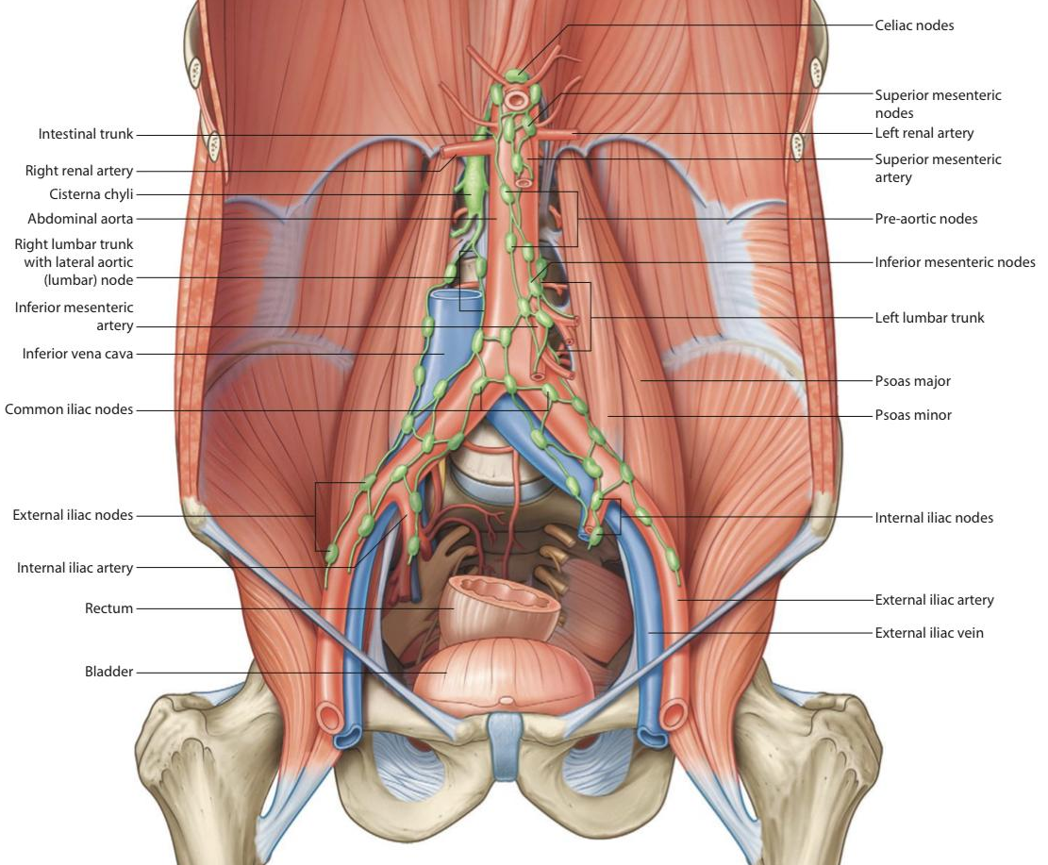
Supply of the Pelvis
Venous drainage
Nerve Supply
Internal iliac veins:
It collect tributaries corresponding to the branches of the internal iliac artery.
joins the external iliac vein in front of the sacroiliac joint to form the common iliac vein (the common iliac veins join at the level of L5 to give the inferior vena cava).
Ovarian vein:
Right vein drains into IVC.
Left vein drains into left renal Vein.
Somatic
Sacral plexus:
from ventral (anterior rami) of L4 & L5 (lumbosacral trunk) + S1, S2, S3 and most of S4.
It gives pudendal nerve to perineum.
★
★
★
Autonomic
Sympathetic (Pelvic part of sympathetic trunk):
It is the continuation of the abdominal part of sympathetic trunk. It descends in front of the ala of the sacrum.
The 2 sympathetic trunks unite inferiorly in front of the coccyx and form a single ganglion (Ganglion Impar).
Superior & Inferior Hypogastric plexuses.
Parasympathetic (Pelvic splanchnic nerves):
(From S2, 3 & 4): preganglionic fibers to pelvic viscera & hindgut.
Lymphatic drainage
The lymph nodes and vessels are arranged along the main blood vessels.
Thus, there are external iliac nodes, internal iliac nodes, and common iliac nodes.
Lymph from Common iliac nodes & the (Ovaries, uterine tubes & fundus of uterus) passes to Lateral aortic (paraaortic) nodes.
★
★
★

Slide 12
QUIZ
Q1 | Q2 | Q3 | Q4 | Q5 | Q6 | Q7 | Q8
C | A | C | D | C | D | B | C
Q1: The Sacroiliac joints is:
A. Anterolateral - Cartilaginous joint
B. Posteriomedial - Cartilaginous joint
C. Posterolateral - Synovial joint
D. Anteriomedial - Synovial joint
Q2: The False (greater) pelvis is bounded posteriorly by: A. Lumbar vertebrae
B. Sacral vertebrae
C. Iliac fossa & iliacus muscle
D. Promontory
Q3: Which of the following is false about the INLET of true pelvis?
A. It’s part of lesser pelvis
B. It’s bounded anteriorly by Symphysis pubis
C. It’s bounded posteriorly by Coccyx
D. It’s bounded laterally by Iliopectineal (arcuate) lines
Q4: Which of the following is female pubic arch angle?
A. 45。
B. 50。- 60。
C. 70。
D. 80。- 85。
Q5: Which of the following is formed by Sacrotuberous ligament?
A. Anterior pelvic wall
B. Posterior pelvic wall
C. Lateral pelvic wall
D. Inferior pelvic wall (floor)
Q6: The nerve supply of levator ani muscles:
A. Branches of 4th and 5th sacral nerves
B. Branche 4th sacral nerve
C. Branch of the pudendal nerve
D. Both B & C
Q7: The relaxation of which of the following muscle fibers leads to defecation?
A. Pubococcygeus
B. Puborectalis
C. Iliococcygeus
D. Coccygeus
Q8: The ovarian artery originated from:
A. Uterine artery
B. Vaginal artery
C. Abdominal aorta
D. Internal iliac artery

Slide 13
Members board
Team leaders
Abdulrahman Shadid
Ateen Almutairi
Boys team:
Mohammed Al-huqbani
Salman Alagla
Ziyad Al-jofan
Ali Aldawood
Khalid Nagshabandi
Sameh nuser
Abdullah Basamh
Alwaleed Alsaleh
Mohaned Makkawi
Abdullah Alghamdi
Girls team:
Ajeed Al Rashoud
‏Taif Alotaibi
‏Noura Al Turki
‏Amirah Al-Zahrani
‏Alhanouf Al-haluli
‏Sara Al-Abdulkarem
‏Renad Al Haqbani
‏Nouf Al Humaidhi
Jude Al Khalifah
Nouf Al Hussaini
Danah Al Halees
Rema Al Mutawa
Maha Al Nahdi
Razan Al zohaifi
Ghalia Alnufaei
Contact us:

