Slide 1
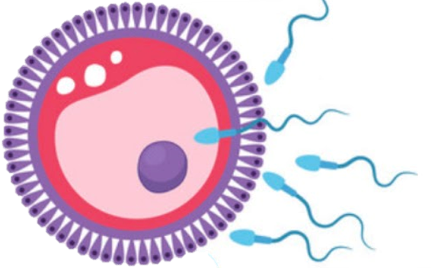
Male reproductive system
Reproductive block-Anatomy-Lecture 4
Editing file

Slide 2
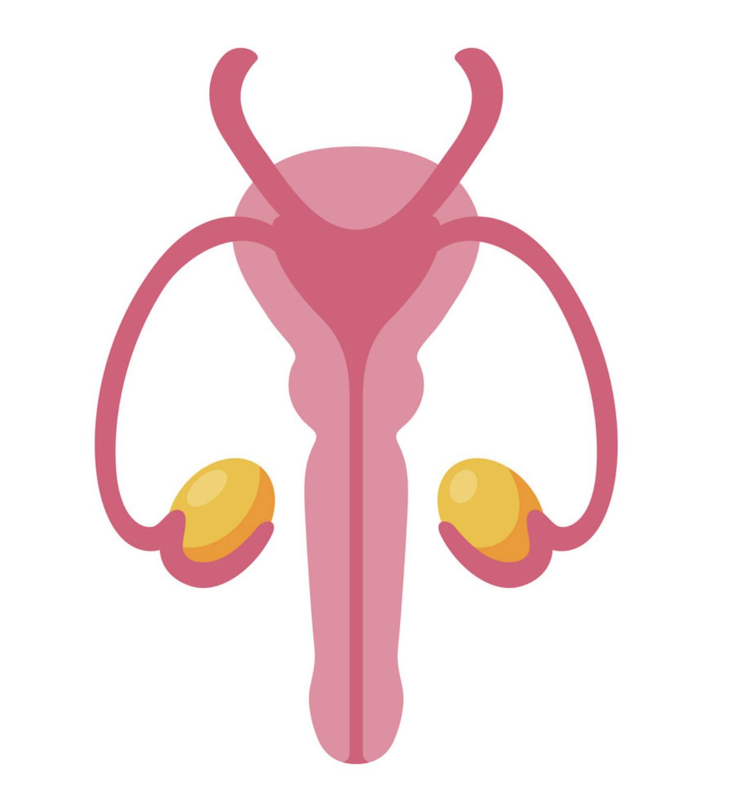
Color guide :
Only in boys slides in Green
Only in girls slides in Purple
important in Red
Notes in Grey
Objectives
At the end of the lecture, students should be able to:
List the different components of the male reproductive system.
Describe the anatomy of the primary and the secondary sex organs regarding: (location, function, structure, blood supply & lymphatic drainage).
Describe the anatomy of the male external genital organs.

Slide 3
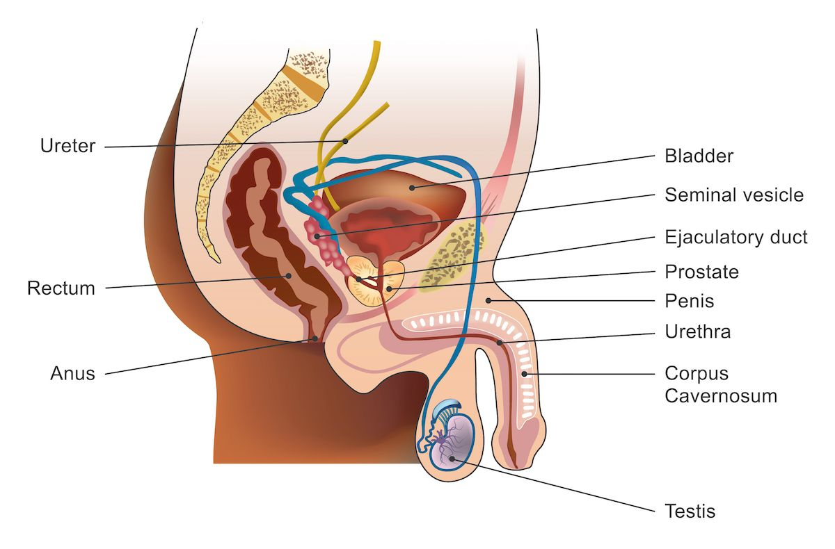
Components of the Male Reproductive System
It Divided into
Primary sex organ
Reproductive tract
Accessory sex glands
External genitalia
First: Testes
Second: Epididymis
Fourth: Seminal Vesicles
Seventh: Penis
Third: Vas Deferens
Fifth: Prostate Gland
Spermatic Cord
Sixth: Bulbourethral Glands
Functions
Secretion of seminal fluid.
Nourishing, activation of sperms.
Protection of sperms.

Slide 4
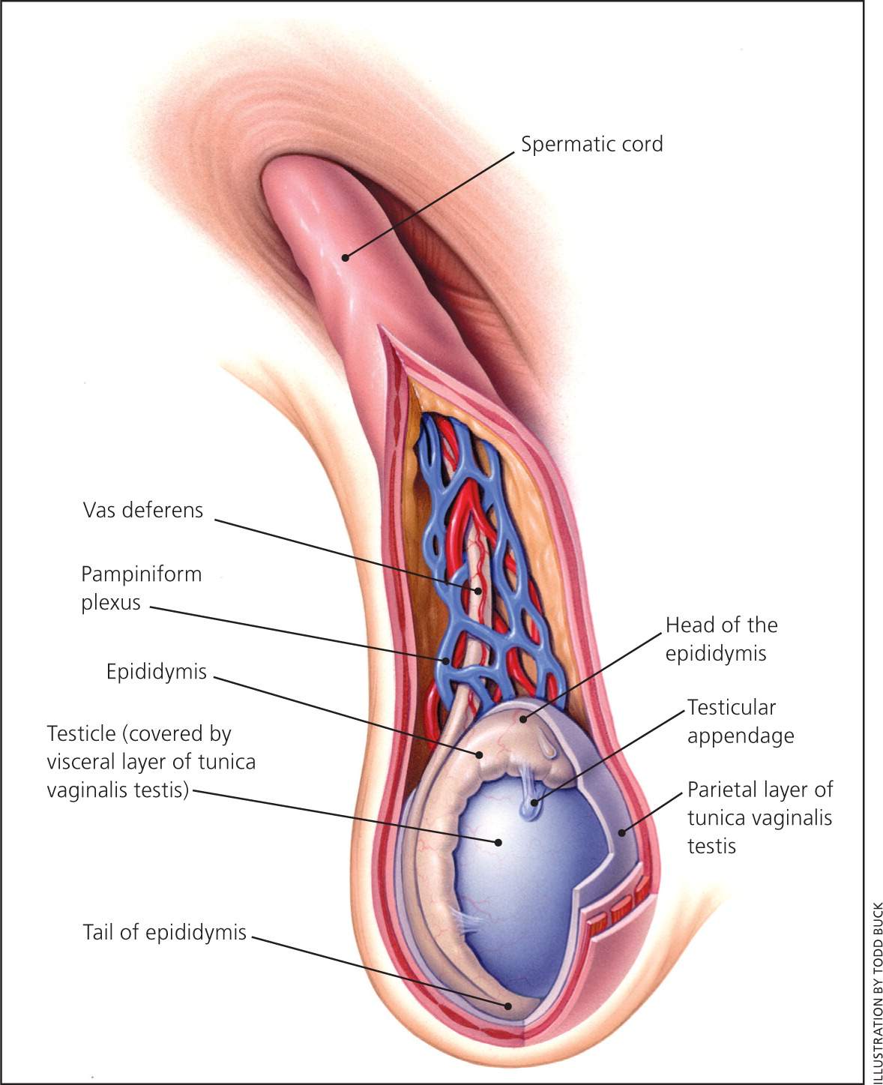
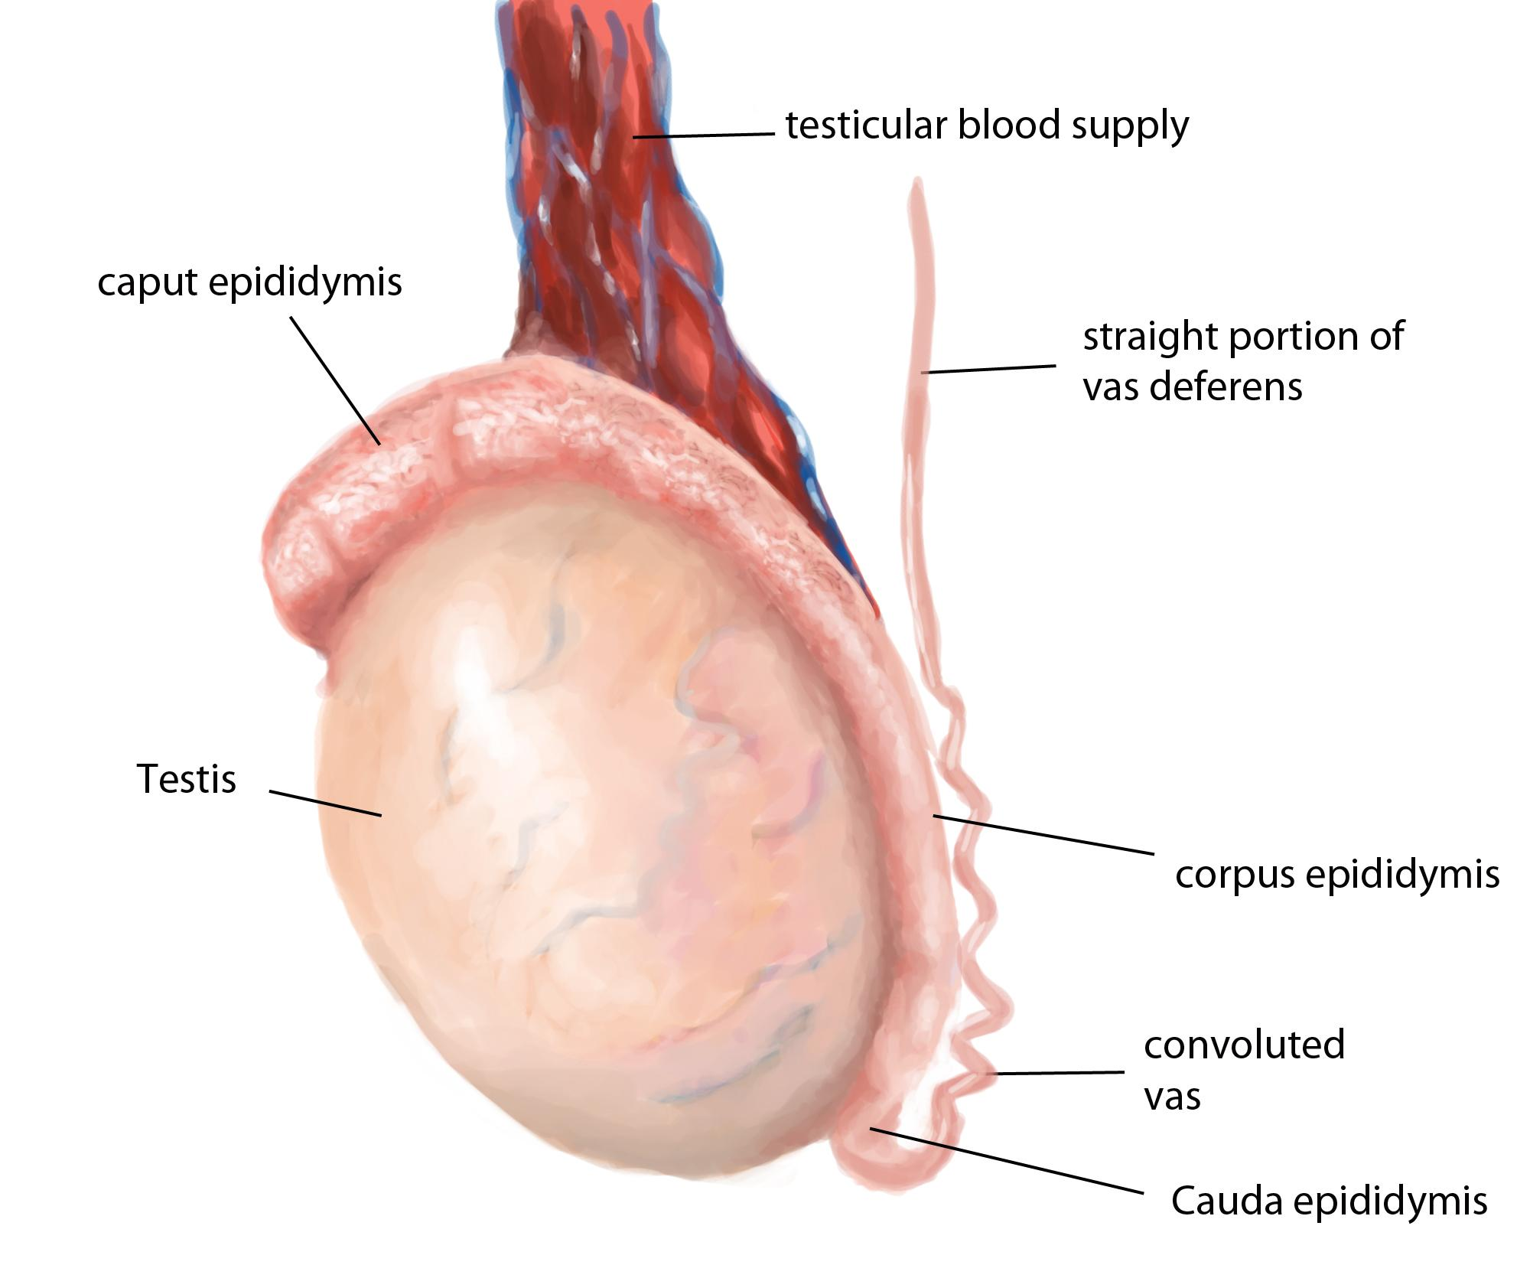
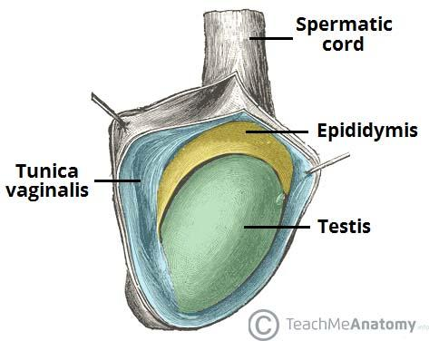
First: Testes
Testes: Scrotum
An outpouching of loose skin and superficial fascia.
The left scrotum is slightly lower than the right.(because the sigmoid colon compress the left testicalc vein so left testes descend down ,and that's why varicose vein appear first in the left side)
Functions:
Houses and protects the testis.
Regulates testicular temperature (no testicular -superficial - fat).
It has thin skin with sparse hair and sweat glands.
The Dartos muscle lies within the superficial fascia and replaces Scarpa's fascia of the anterior abdominal wall. (In cold weather the skin of the scrotum shrinks upward , & In hot weather the muscle relaxes and the Scrotum descend downward )
Testes: Shape
Testes: Functions
Spermatogenesis
Hormone production(Androgens=Testosterone)
Paired almond
suspended in the scrotum by the spermatic cord
Testis or Testicle(singular), Testes(plural).
Its volume is about 20-25 ml.
length 4-5 cm. ،Weight 10.5-14 gm.
Testes: Coverings
1
Tunica Vginalis:
2
Tunica Albuginea:
Peritoneal covering formed of parietal and visceral layers.
It surrounds the testis and epididymis.
It allows free movement of testis within the scrotum.
It is a whitish fibrous capsule.

Slide 5
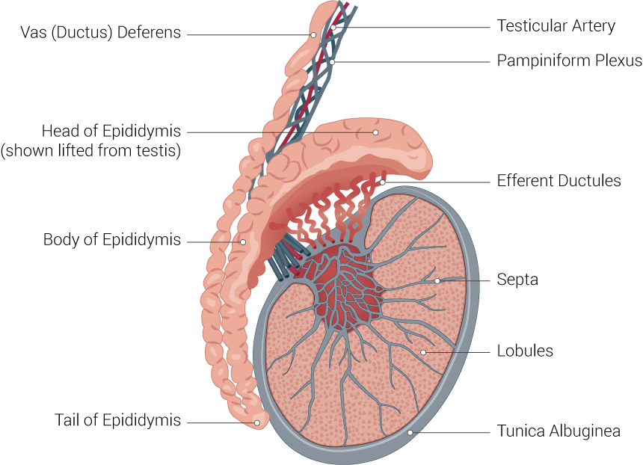
First: Testes cont.
Testes: Internal Structures
Fibrous septae: extend from the capsule, dividing the testis into 200-300 lobules (average 250).
lobules: Each lobule contains 1-3 Seminiferous Tubules (each is 60cm coiled tubule)
Seminiferous Tubules:
They are the site of spermatogenesis.
They form the bulk of the testicular tissue.
In between the seminiferous tubules lies the Interstitial cells of Leydig which secretes Testosterone hormone.
Rete testis:
A network of tubules.
It is the site of merging of the seminiferous tubules.
Testes: Supply
Arterial supply
Venous drainage
Lymphatics drainage
Testicular Artery
it arises from the abdominal aorta at the level of L3
Pampiniform plexus of veins : About dozen of veins which forms a network within the spermatic cord, they become larger as they approach the inguinal canal to form the Testicular vein.
Right vein drains into IVC
Left vein drains into Left renal vein
Testicular Lymphatics follow arteries and veins of the testis and end in the Lumbar(paraortic) nodes.
Scrotum, Penis and Prepuce terminate in Superficial inguinal nodes.
important In case of testicular carcinoma

Slide 6
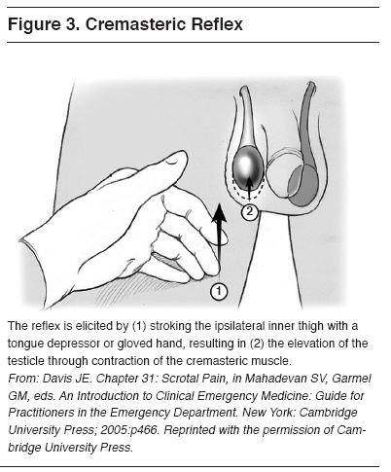
First: Testes cont.
Cremasteric Reflex
Indication: Evaluation of Testicular pain in case of (Testicular Torsion).
Observation: rise of the testicle on the same side (normal).
Interpretation:
Normal: it is present with Epididymitis.
Absent (No testicles rise): suggestive of Testicular Torsion.
*Also absent in 50% of boys under the age of 30 months (Do not use this under the age of 30 months).
Technique: Examiner strokes or pinches the skin in the upper medial thigh. It causes cremasteric contraction which is Supplied by the genital branch of genitofemoral nerve.
Cremasteric Reflex
Nerve involved: Genitofemoral (GFN) from (L1, L2).
it’s a reflex thus has an afferent fibers, center and efferent fibers
Sensory(afferent) :
Femoral branch of (GFN)
Ilioinguinal.
Center : L1 ,L2
Motor (efferent): Genital branch of (GFN)
Efficacy:
Test sensitivity for Testicular Torsion: 99%.
*Assumes age over 30 months(2.5 years )

Slide 7
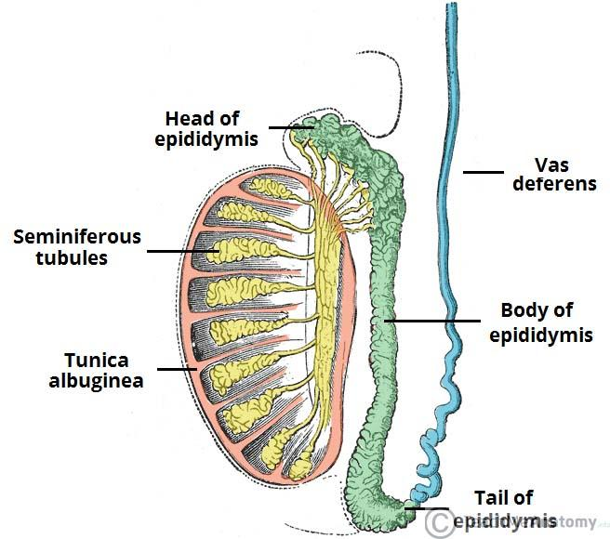
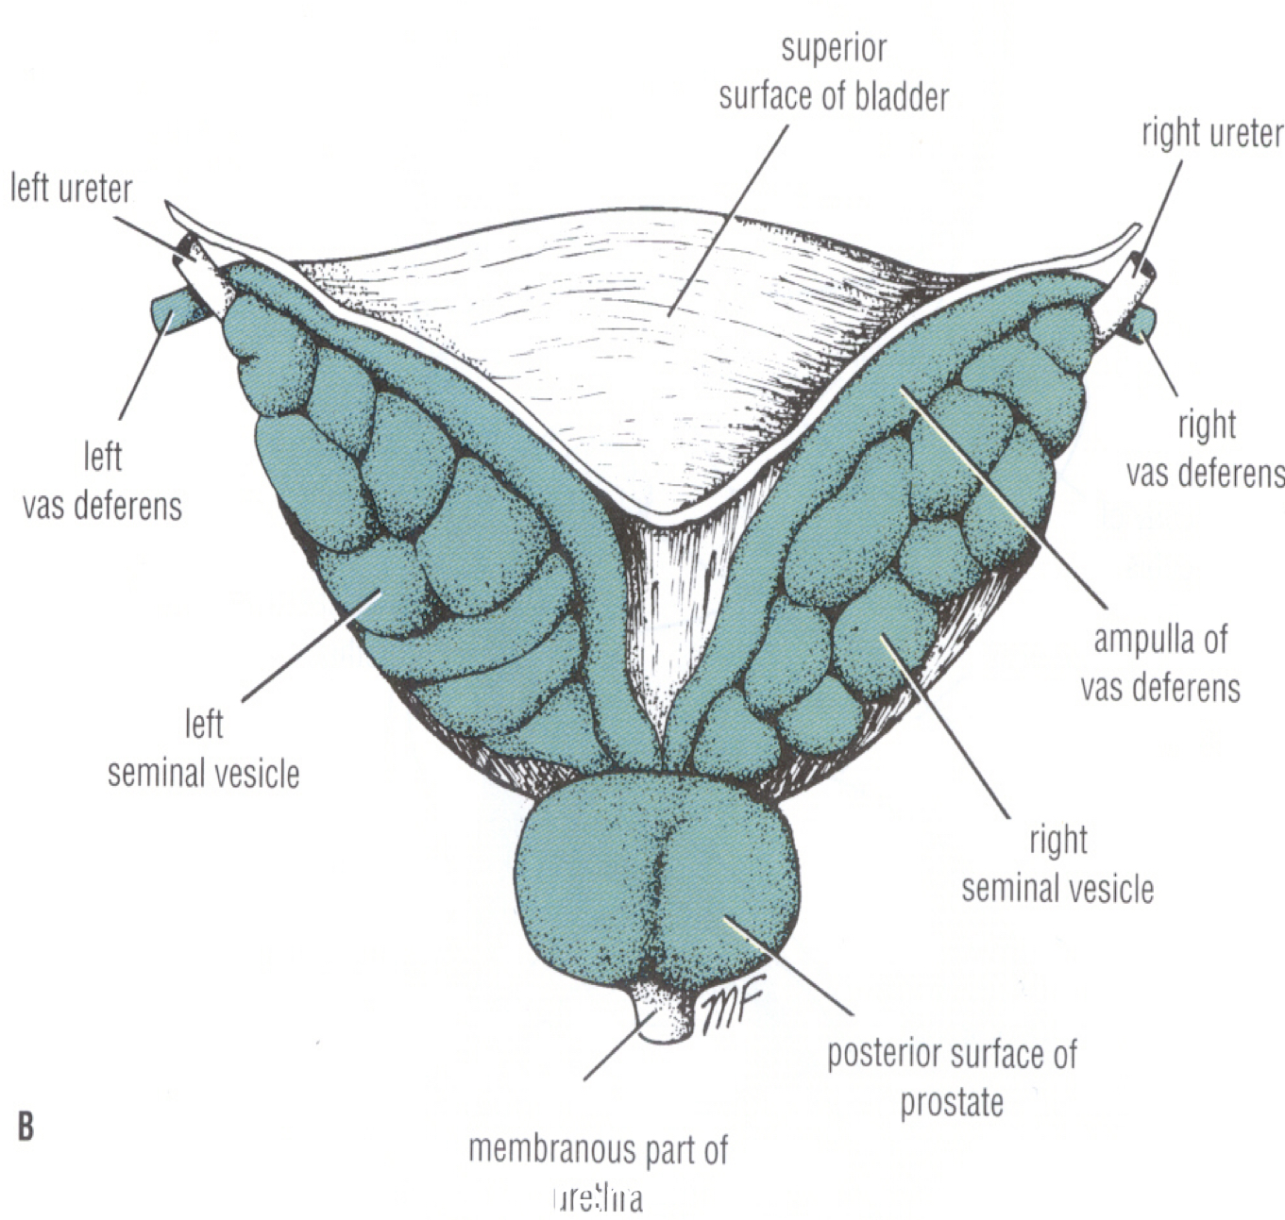
Second: Epididymis
Third: Vas Deferens
Shape and Location
Divisions
Functions
It is a single coiled tubule.
6 meters long.
Located on the posterior and superior margins of the testis.
Head: receives (rete testis) efferent ductules from the testes. (the most expanded part above the Testicle)
Body: behind the Testicle
Tail: continuous with vas deferens.
Secrete and absorbs the nourishing fluid.
Recycles damaged spermatozoa.
Stores spermatozoa up to 2 weeks to allow for physiological maturation of sperms
It is a muscular tube about 45 cm long.
Carries sperms from the epididymis to pelvic cavity.
Passes through the inguinal canal as one of the contents of the spermatic cord .
It crosses the lower end of the ureter.
Its terminal part is dilated to form the Ampulla of the vas.
It joins the duct of the seminal vesicle to form the ejaculatory duct which opens into the prostatic urethra.

Slide 8
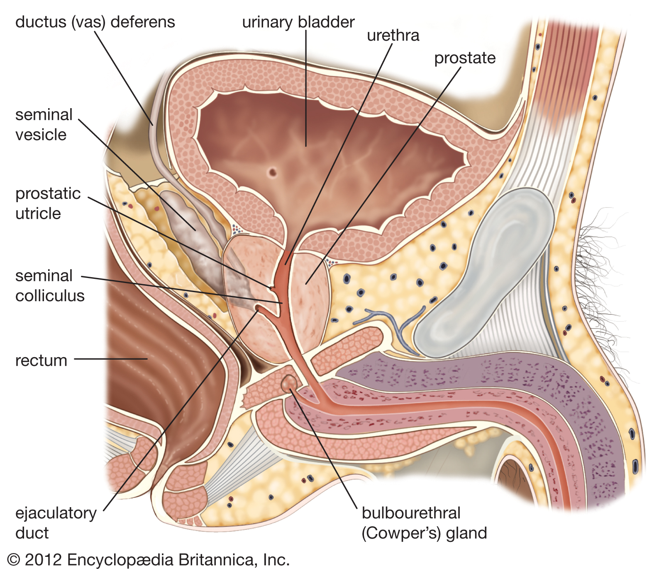
Fourth: Seminal Vesicle & Ejaculatory ducts
Seminal Vesicle
Paired elongated glands (SV).
Located posterior & inferior to the urinary bladder.
Lies lateral to the vas deferens.
Secrete (60% of the Seminal fluid).
Ejaculatoru ducts
Formed by the union of the lower end of the vas deferens and the duct of the seminal vesicle.
Its length is about 2.5cm (1 inch)
The 2 ejaculatory ducts open into the prostatic urethra on both sides of the seminal colliculus.
They drain the seminal fluid into the prostatic urethra.

Slide 9
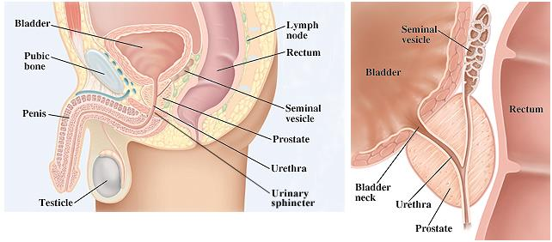
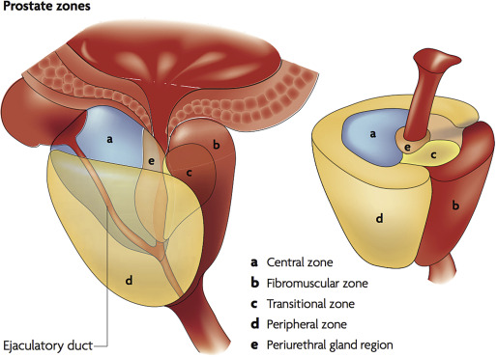
Fifth: Prostate gland
Prostate gland:Structure
The Largest male accessory gland.
It is a fibromuscular glandular tissue.
It is a walnut size.
Prostate gland: Location
It is located at the neck of bladder.
It is traversed by the prostatic urethra.
Prostate gland: Shape
Shape: Conical, It has:
Base (Superior): Attached to neck of urinary bladder.
Apex (Inferior): rests on the Urogenital diaphragm.
Four Surfaces:
Anterior
Posterior
2 lateral (Right & Left) surfaces.

Slide 10
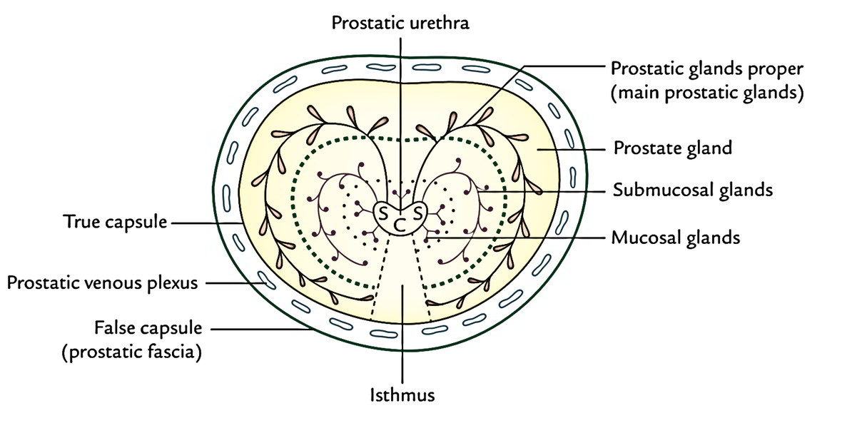
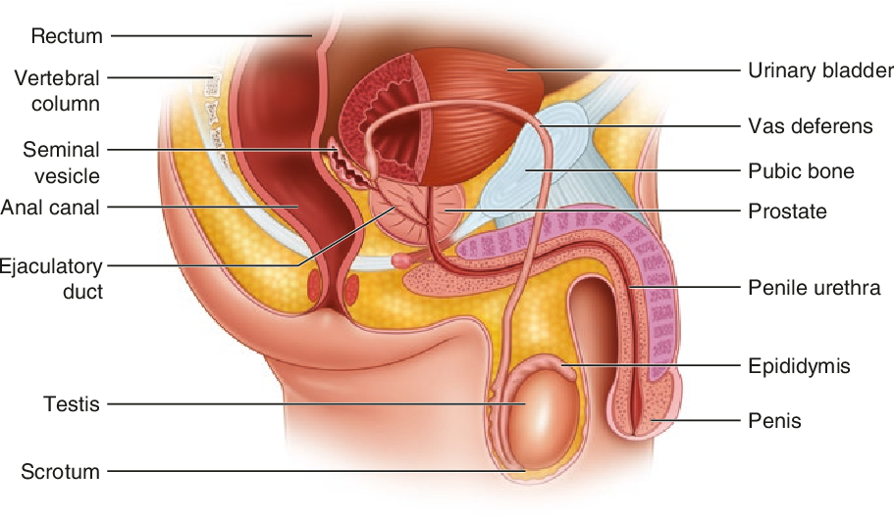
Fifth: Prostate gland
Prostate gland: Functions
It secretes enzymes which has the following functions:
Aid in activating sperm motility.
Mucus degradation.
Neutralize the acidity of female reproductive tract (Alkaline fluid).
Antibiotic
It secretes (20-30% of seminal fluid.)
Houses prostatic urethra
Prostate gland: Capsule
Internally: it has a dense fibrous capsule (prostatic\true capsule)
Externally: surrounded from outside by a fibrous prostatic sheath(false capsule)which is continuous with the puboprostatic part of the levator ani muscle, (levator prostate).
In between the prostatic capsule and the prostatic fibrous sheath lies the prostatic venous plexus.
Prostate gland: Relations
Anterior: Symphysis pubis (SP).
Superior: Neck of the bladder.
Posterior: Rectum (important for PR examination)
Inferior: Urogenital diaphragm (UGD)
Lateral: Medial margins of levator ani muscles (levator prostate)
Urogenital diaphragm
Symphysis pubis

Slide 11
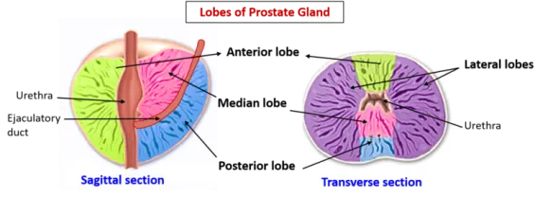
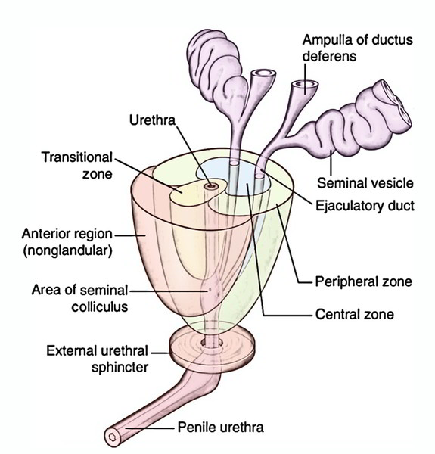
Fifth: Prostate gland
Prostate gland: Lobes
Anatomically divided into 5 lobes according to their relation to the urethra
Urologists & Sonographers, divide the prostate into Peripheral and Central (Internal) zones instead of lobes
Within each lobe are four lobules, which are defined by the ducts and connective tissue
01
Anterior lobe (isthmus):
Lies anterior to the urethra.
Fibromuscular.
has no glandular tissue
02
Posterior lobe (correspond to peripheral zone):
Posterior to the urethra and inferior to the ejaculatory ducts.
03
Two lateral lobes:
On each side of urethra.
Rich in glandular tissue.
Middle (median):
Represented by The Central zone
Between the urethra and ejaculatory ducts & closely related to neck of urinary bladder.
Usually it projects into lumen of the urinary bladder distorting the internal urethral sphincter, after the age of 40 years, (Benign Prostatic Hyperplasia).
Rich in glandular tissue.
04

Slide 12
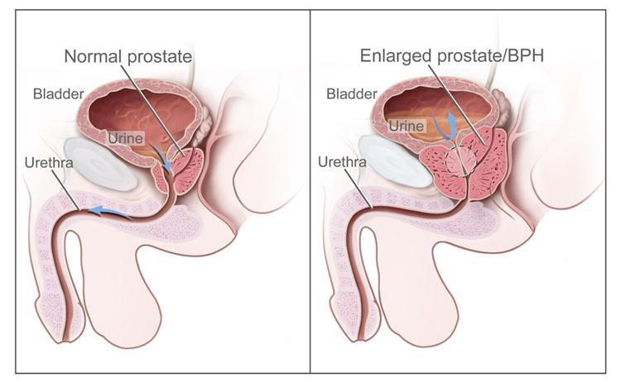
Fifth: Prostate gland cont.
Prostate gland: supply
Arterial supply
Venous drainage
Lymphatics drainage
Inferior vesical artery from internal iliac artery.
Prostatic venous plexus.
Lies between prostatic fibrous capsule and prostatic sheath.
Drains into the internal iliac veins.
Continuous superiorly with the vesical venous plexus of the urinary bladder. continuous posteriorly to the internal vertebral venous plexus Within the vertebral canal (in case of prostate cancer it could metastasis to vertebral column and the brain)
Internal iliac lymph nodes.
Prostate gland: Clinical relation
Benign: Hypertrophy of the Prostate
Common after middle age.
An enlarged prostate projects into the urinary bladder and distorts the prostatic urethra.
The middle lobe often enlarges and obstructs the internal urethral orifice, this leads to Nocturia, Dysuria, Frequency and Urgency.
Malignant: Prostatic carcinoma
Common after the age of 55.
prostate is felt hard & irregular in per- rectal examination, malignant cells metastasize first to internal iliac & sacral lymph nodes (lymphatic spread).
Later to distant nodes , bone & brain through internal vertebral venous plexuses. (venous spread)
Can cause obstruction to urine flow because of its close relationship to the prostatic urethra.

Slide 13
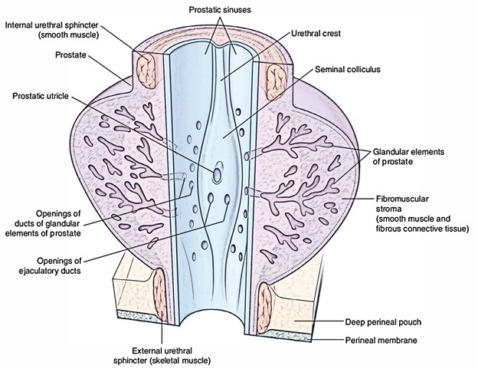
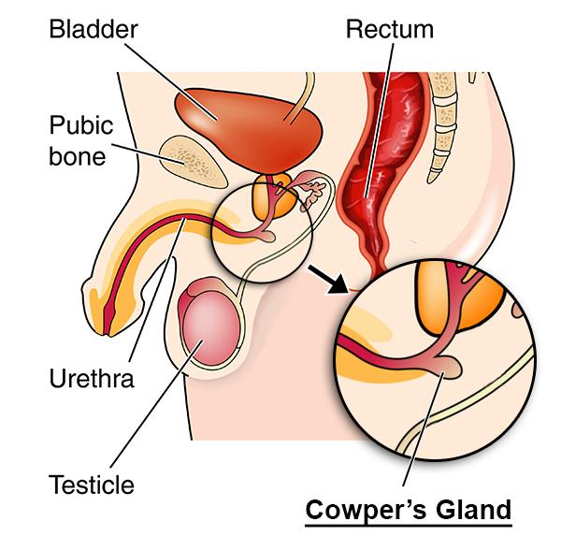
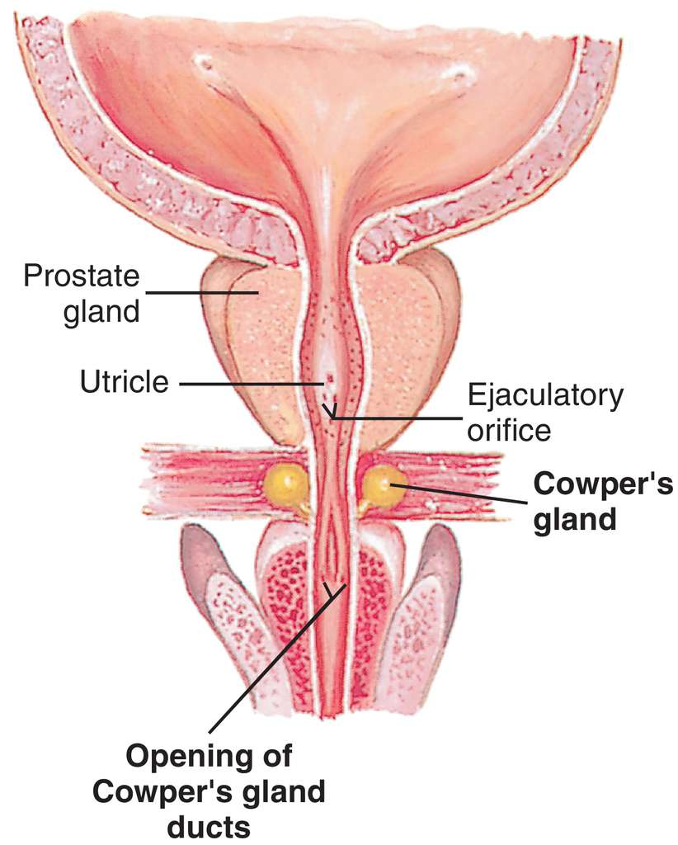
Fifth: Prostate gland cont.
Prostate gland: Prostatic Urethra
The following structures are seen on the posterior wall of the prostatic urethra:
Seminal colliculus:
A rounded eminence that opens into the prostatic utricle.
Urethral crest:
A longitudinal elevated ridge.
Prostatic sinus:
A groove on each side of the crest.
The prostatic gland opens into the prostatic sinus.
Prostatic utricle:
A depression on the summit of the urethral crest.
The ejaculatory ducts open on the sides of the utricle
Sixth: Bulbourethral Cowper's Gland
Small paired glands.
Located at the base of the penis.
Secrete alkaline mucus for:
Neutralization of urinary acids
Lubrication.

Slide 14
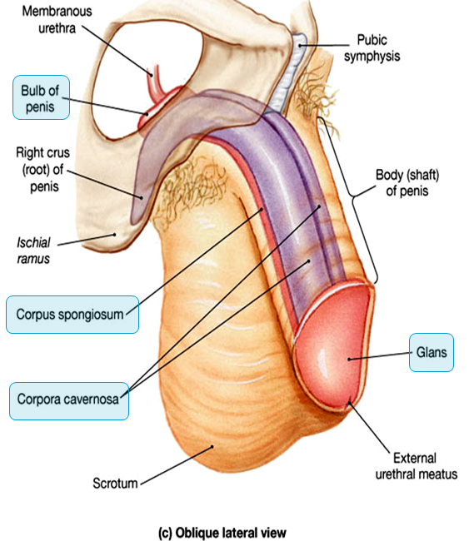
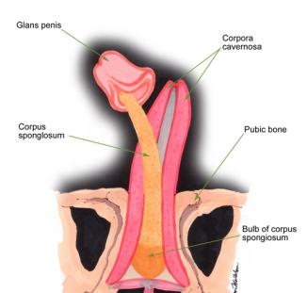
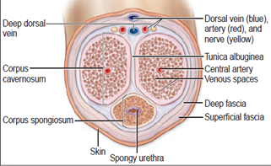
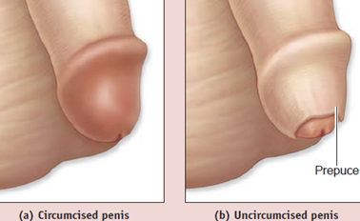
Seventh: Penis
A Copulatory and Excretory organ.
Excretory part:
Penile urethra transmits urine & seminal fluid.
Capulatory part:
Has (3) cylindrical masses of erectile tissue
Two Corpora Cavernosa
Two superior (right & left) masses of (Primary erectile tissue).
Provide the majority of rigidity & length of penis.
Their posterior expansions, forms the 2 Crurae Right crus and left crus which anchor penis to the pelvic bone (anchor tissue) against pelvic bone.
One Corpus Spongiosum
The single inferior mass (Secondary erectile tissue).
It is traversed by the penile urethra.
Anterior expansion: forms the Glans penis.
Posterior expansion: forms the bulb of the penis.
Prepuce or foreskin: fold of skin covering glans penis (before circumcision)

Slide 15
QUIZ
Q1 | Q2 | Q3 | Q4 | Q5 | Q6 | Q7 | Q8
A | A | B | C | B | D | C | B
Q1: Where is the body of the epididymis located related to the testes?
A. Posterior
B. Anterior
C. Superior
D. Inferior
Q2: Which group of the following lymph nodes receive from the testis? A. paraortic B. Pararectal
C. Superficial inguinal D Deep Inguinal
Q3: The union of the vas deferens and seminal vesicle form the …………..?
A. epididymis
B. Ejaculatory duct.
C. Urethra
D. Penis
Q4: Which of the following structures allows free movement of the testes
A. Cremasteric muscle
B. Tunica albugenia
C. Tunica vaginalis
D. Dartos muscle
Q5: which lobe of prostate gland has no glandular tissue
A. lateral
B. Anterior
C. middle
D. posterior
Q6: which structure will be affected in case of obstruction of internal iliac artery? A. penis B. testes C. Cowper's Gland D. prostate gland
Q7: in case of carcinoma of the penis. Cancer cells are likely to metastasize to which one of the following nodes?
A. paraortic B. Pararectal
C. Superficial inguinal D Deep Inguinal
Q8: when you are testing the Cremasteric Reflex in a patient, the normal observation should be
A. rise of the both testicles
B. rise of the testicle on the same side
C. rise of the testicle on the opposite side

Slide 16
Members board
Team leaders
Abdulrahman Shadid
Ateen Almutairi
Boys team:
Mohammed Al-huqbani
Salman Alagla
Ziyad Al-jofan
Ali Aldawood
Khalid Nagshabandi
Sameh nuser
Abdullah Basamh
Alwaleed Alsaleh
Mohaned Makkawi
Abdullah Alghamdi
Girls team :
Ajeed Al Rashoud
‏Taif Alotaibi
‏Noura Al Turki
‏Amirah Al-Zahrani
‏Alhanouf Al-haluli
‏Sara Al-Abdulkarem
‏Renad Al Haqbani
‏Nouf Al Humaidhi
Jude Al Khalifah
Nouf Al Hussaini
Danah Al Halees
Rema Al Mutawa
Maha Al Nahdi
Razan Al zohaifi
Ghalia Alnufaei
Contact us:

