Slide 1
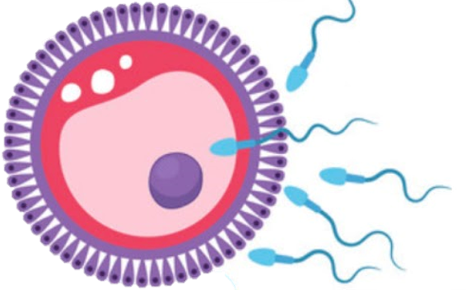
Female breast
Reproductive block-Anatomy-Lecture 5
Editing file

Slide 2
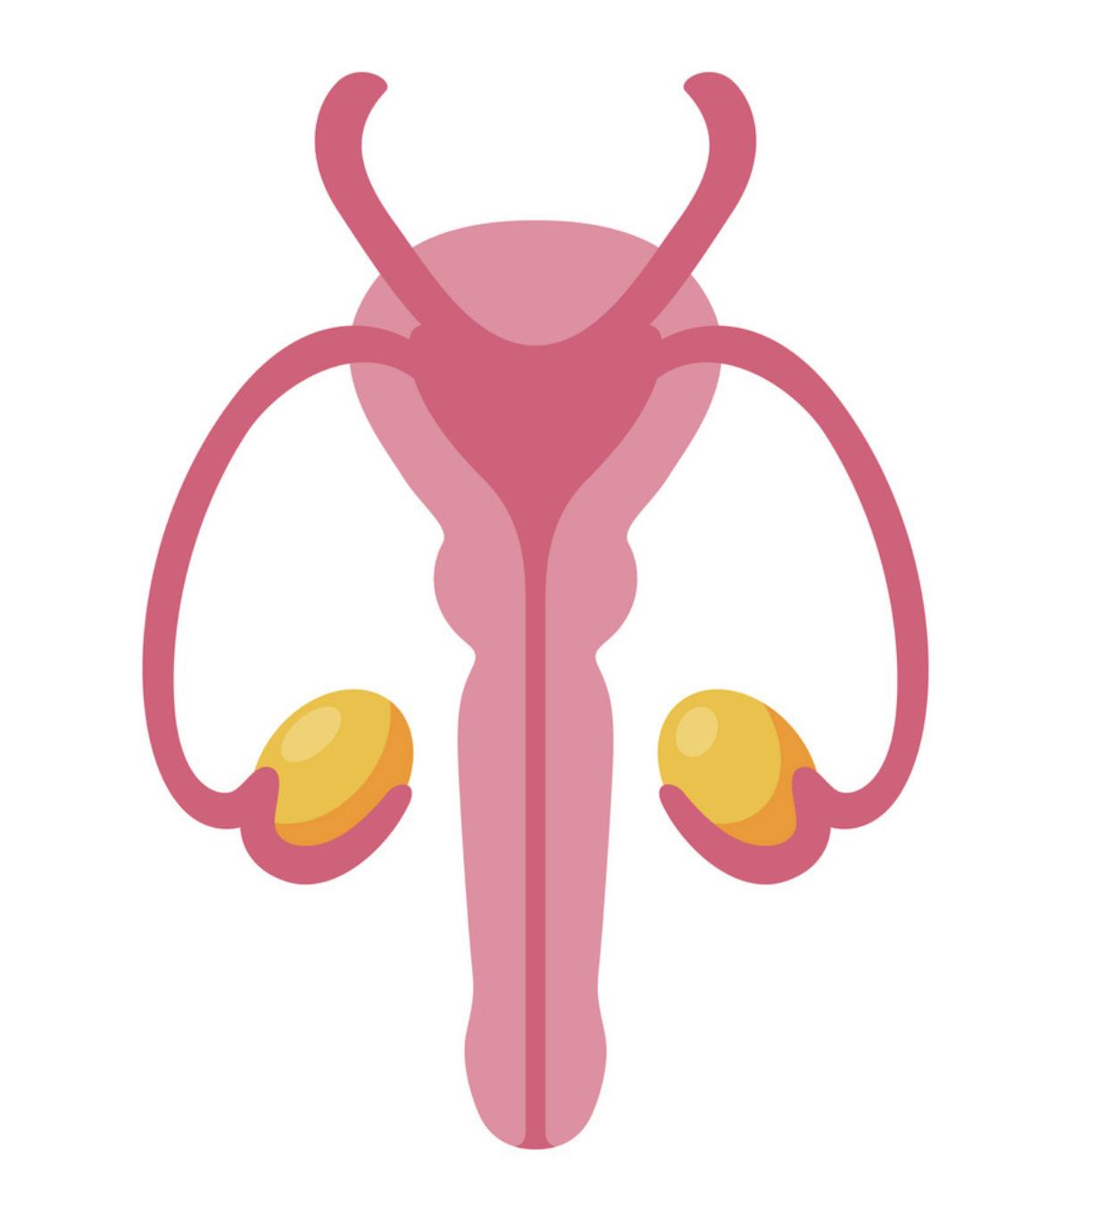
Color guide :
Only in boys slides in Green
Only in girls slides in Purple
important in Red
Notes in Grey
Objectives
At the end of the lecture, students should be able to:
Describe the shape and position of the breast.
Describe the structure of the mammary glands.
List the blood supply of the female breast.
Describe the lymphatic drainage of the female breast.
Describe the applied anatomy in the female breast.
Part 4
I don’t remember when was the last time I wrote one of these, I don’t even remember where I put it, maybe in one of the Embryology lecs? I wonder.
It’s Saturday, 10th of October 2020. COVID-19 is still going strong, I don’t know the exact number of cases right now due to the fact that all news sites are closed, I believe that the last time it was announced is probably two months ago and it was around 2.3 billion, yes with a B.
Oh look guys, we’re at part 4, who would’ve thought? And you’re still reading? You know I’m starting to develop this connection with you, I think we would’ve been great friends. I haven’t interacted with another person ever since this whole thing started you know? Internet and phone lines are all down and people stopped leaving their houses a long time ago.
But it’s alright, I got you, right? you’ll always be by my side.
The voices have been getting stronger don’t you agree? You must have heard them too! I’ve even caught myself replying to them more than once but I always play it off as if I wasn’t talking to them. I don’t want them to know I’m listening, I wanna hear what they’re saying behind my back so I’m acting that way.
I know it, they’re talking about me, they want to kill me don’t they? the wanna steal my food. I won’t let them. I still have enough food to last me for a month or two, guess being as paranoid as I am really payed off didn’t it?
Gotta go, they’re talking again, I wanna eavesdrop on them, I’ll be right back, don’t go anywhere.
-A Lost Man.

Slide 3
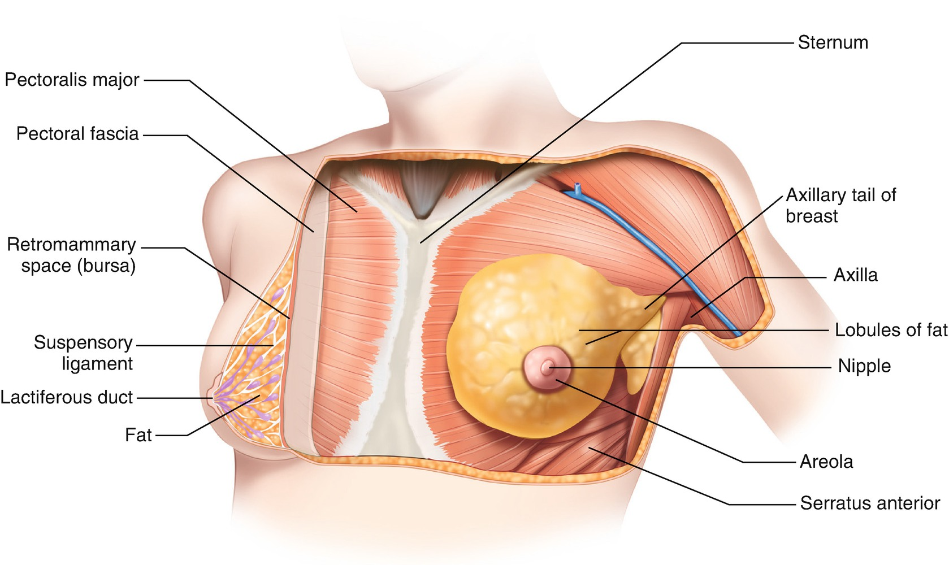
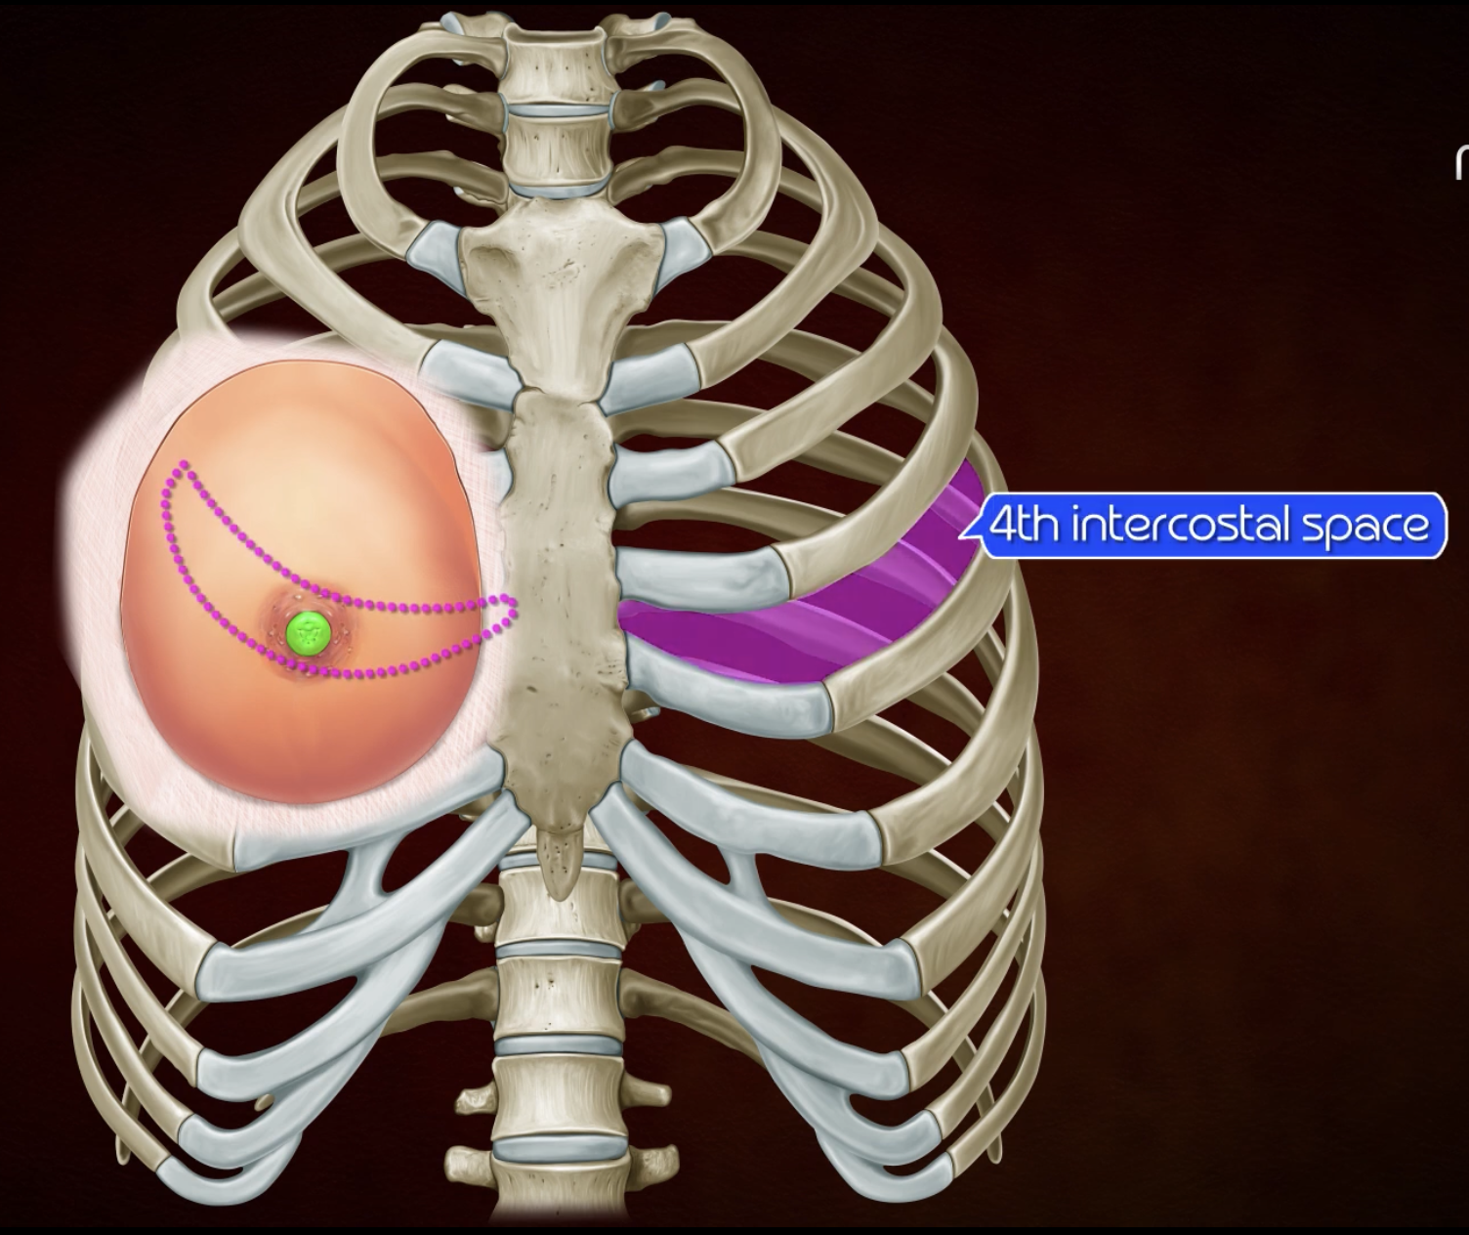
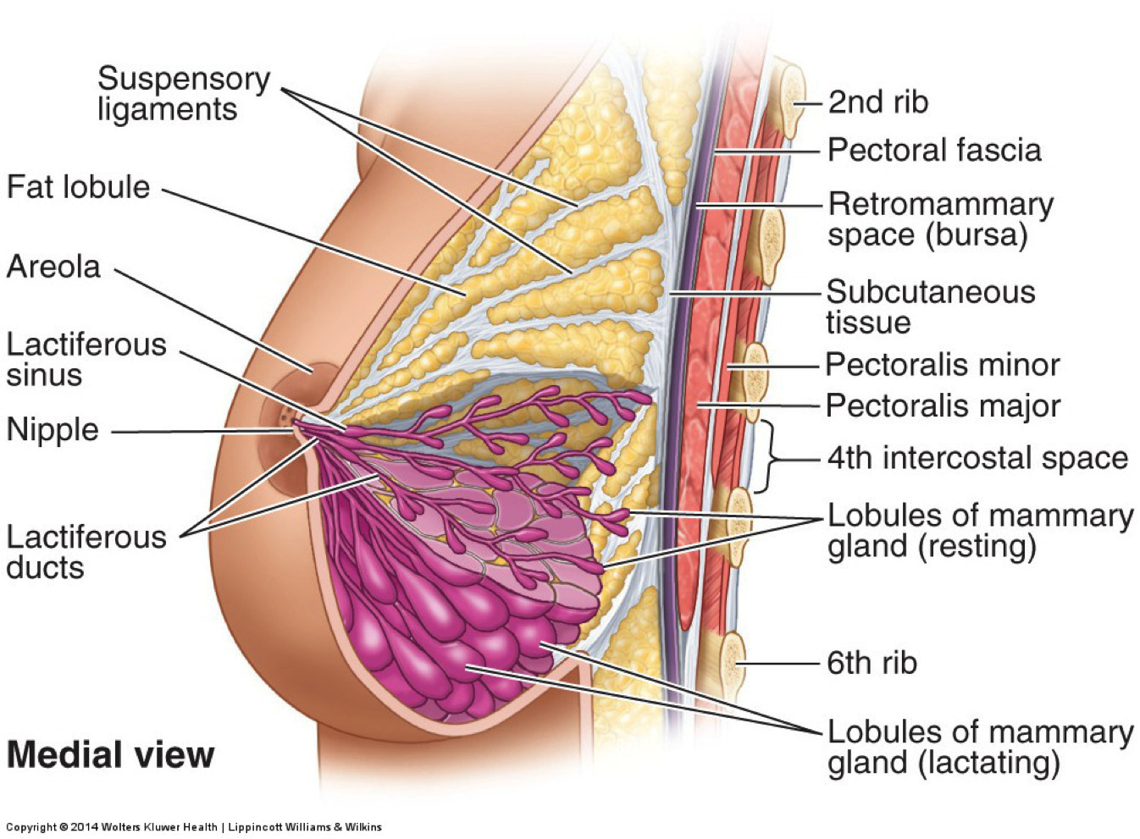
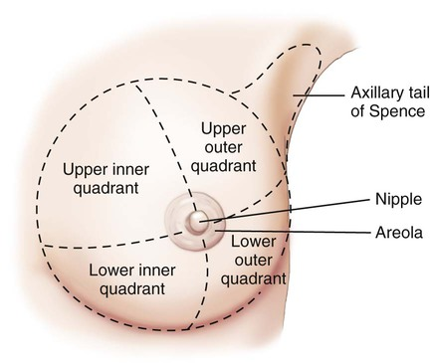
Breast
watch Highly recommended video covers most of the lecture
Shape
It is conical in shape and It has NO capsule
Location
It lies in superficial fascia of the front of chest.
It has
Apex (Nipple)
Base (3 muscles)
Tail (axillary tail/process)
Conical eminence that projects forwards from the anterior surface of the breast
It lies opposite 4th intercostal space
It carries 15-20 narrow pores of the lactiferous ducts
It is surrounded by Areola which it’s dark pink brownish circular area of skin
The subcutaneous tissues of nipple & areola are devoid of fat (It has erectile tissue)
Upper ⅔ of its base lies on fascia over Pectoralis major muscle
While its Inferolateral ⅓ lies on fascia over Serratus anterior & External oblique muscles
Vertically It extends from 2nd rib superiorly to 6th ribs inferiorly
Horizontally It extends from lateral margin of the sternum medially to midaxillary line laterally
Small superolateral part of the breast extends upward and laterally
Pierces the fascia at the lower border of pectoralis major muscle and sends a process into the axilla called the axillary tail or axillary process
Pectoralis
Major
Serratus
Anterior
External
Oblique

Slide 4
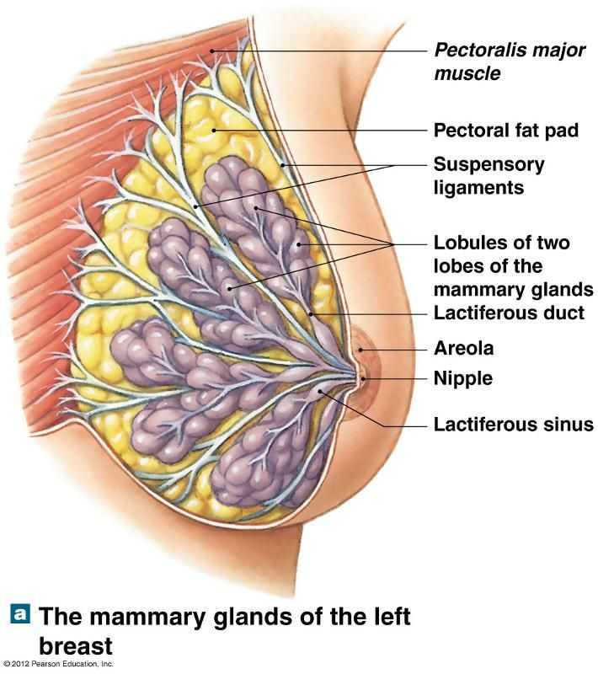
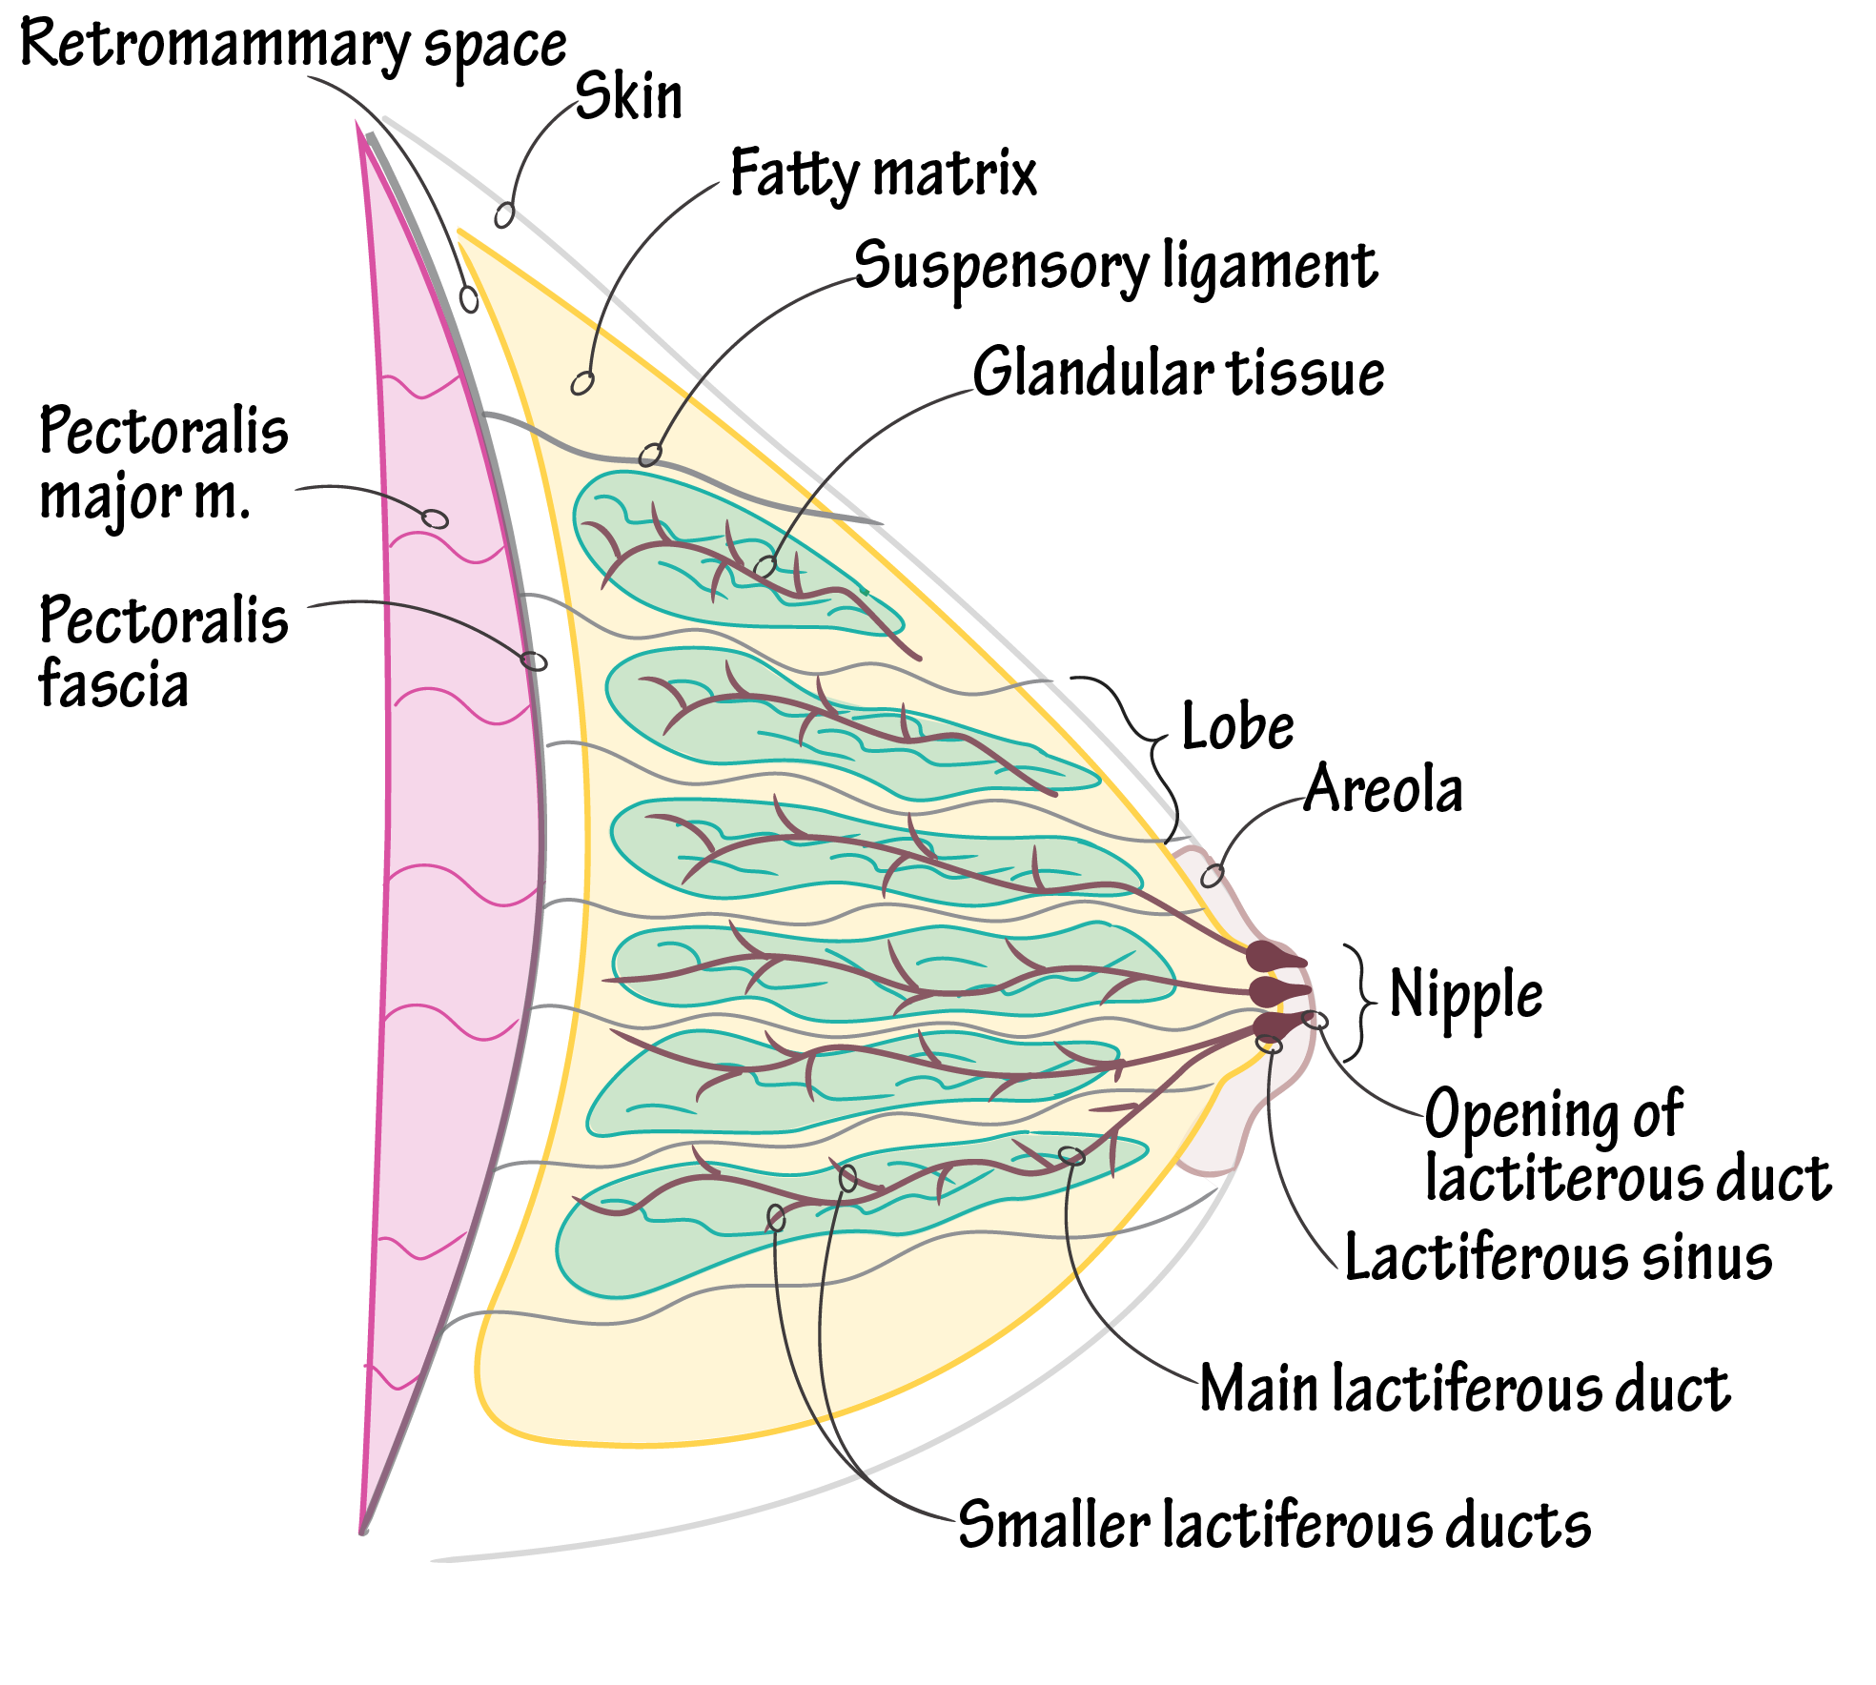
Mammary glands
They are Non capsulated, modified sweat glands (exocrine glands)
Present in both sexes,but it well developed in females. And Become functioning only in lactating females
Location : Lie on the front and the sides of the chest within the superficial fascia
Definition
Space that found behind the breasts and filled with loose connective tissue
Retromammary space
a layer of loose areolar tissue that separated the gland from deep fascia which covering the underlying muscles
Importance: allows the breast to move freely. + often the site of breast implantation
Structures of mammary gland
1
2
3
ligaments of Cooper (suspensory ligament)
The lobes and lobules are separated by interlobar and interlobular fibrous & fatty tissue called suspensory ligaments or ligaments of Cooper
run radially and connect the skin of breast with deep fascia of underlying pectoralis major muscle
importance: helps to give the breasts SUPPORT
it has cilinal importance also :When breast cancer occurs , it invade these ligaments leading to dimpling appearance of breast.
It is formed of 15-20 lobes, each lobe is formed of a number of lobules which are embedded in the subcutaneous fatty tissue of superficial fascia
It has from 15-20 lactiferous ducts which open by the same number of openings on the summit of the nipple

Slide 5
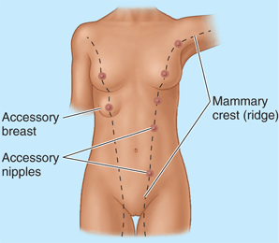
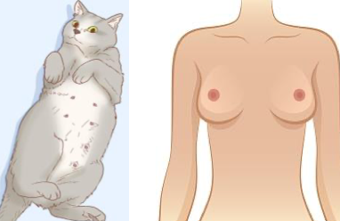
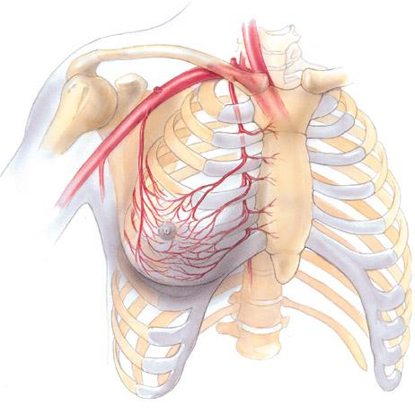
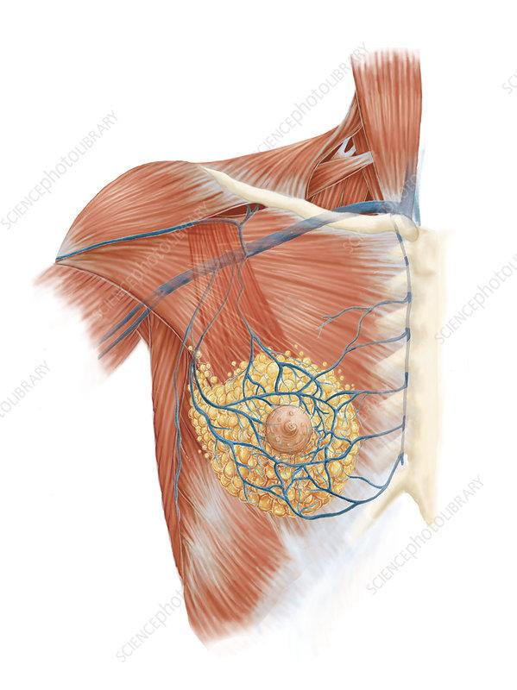
Mammary ridge
Supply of breast
The mammary glands (breast) are derived from 2 thickened strips ( mammary ridge) of epidermal ectoderm, the primitive mammary ridges or milk lines,
Which appear during week 6, The ridges extend from the axillae to the inguinal regions, but rapidly regress except in the thorax
In Human
In Animal
the ridge disappears EXCEPT for a small part in the pectoral region
Extends from the axilla to the inguinal region
several mammary glands are formed along this ridge
Animal vs human
Perforating branches & mammary branches of internal thoracic (internal mammary) artery
Mammary branches of lateral thoracic artery
Mammary branches of the posterior Intercostal arteries
Arterial supply
Internal thoracic A
Internal thoracic V
Lateral thoracic A
Perforating branches of Internal thoracic A
Axillary V
Medial mammary branches of Internal thoracic A
Veins are corresponding to the arteries:
Internal thoracic → brachiocephalic vein
Axillary → subclavian vein
Intercostal → azygous (Rt) or hemiazygous (Lt) venous system
Circular venous plexus (superficial) are found at the base of nipple→Finally, veins of this plexus drain into axillary & internal thoracic veins
Lateral mammary branches of Lateral thoracic A
Venous drainage
Lateral mammary branches of posterior intercostal A
Venous
Drainage
Circular venous plexus

Slide 6
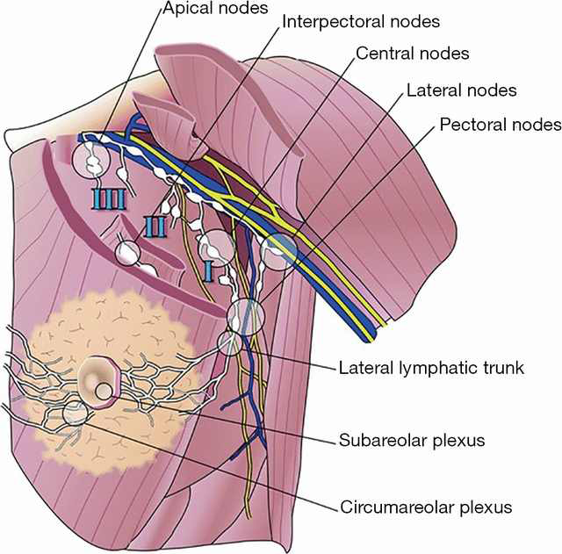
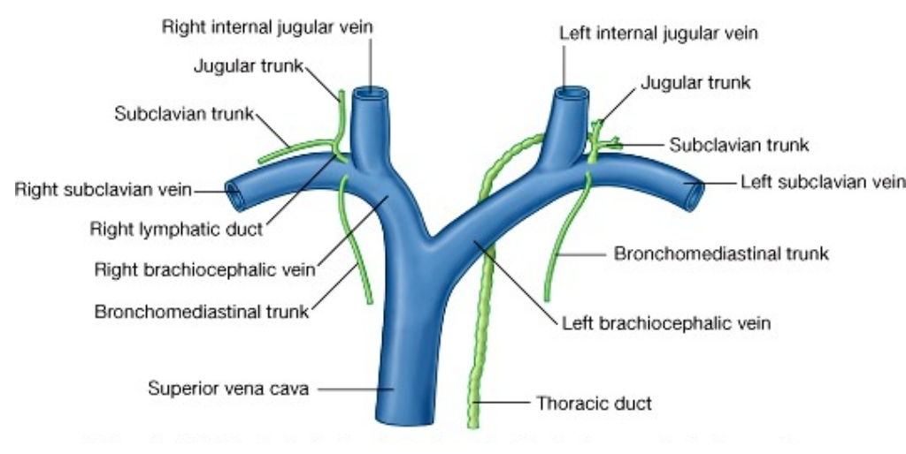
Axillary lymph nodes
They are arranged into 5 groups which lie in axillary fat
 | Pectoral (Anterior) group | lies on the pectoralis minor along lateral thoracic vessels
 | Subscapular (Posterior) group | lies on posterior wall of axilla on lower border of subscapularis; along subscapular vessels.
 | Brachial (Lateral) group | lies on lateral wall of axilla along 3rd part of axillary vessels.
 | Central group | lies in axillary fat at the base of axilla.
 | Apical group | lies at apex of axilla immediately behind the clavicle. Subclavian lymph trunk: it is formed by union of efferent lymph vessels of apical group, It usually opens in subclavian vein.
Efferent drainage continues with cervical lymph nodes. On the right side: It usually opens in right lymphatic duct (subclavian vein) On the left side: it usually opens into thoracic duct Both will terminate at the junction between the internal jugular and the subclavian vein,thus, the lymphatic drainage returns back to the circulation.
1
2
3
4
5

Slide 7
Lymphatic drainage of the breast
1) Plexus
Superficial lymphatic plexus | Both | Deep lymphatic plexus
Also called Subareolar lymphatic plexus. Lies beneath the areola. | Both plexuses radiate in many directions and drain into different lymph nodes (Axillary groups and Internal thoracic lymph nodes.) | Also called submammary plexus Lies on the deep fascia covering pectoralis major.
2) Gland parts
Central & lateral parts | Upper part | Medial part | Inferomedial part
(75%) Drain into pectoral group of axillary lymph nodes. | Drains into apical group of axillary lymph nodes. | Drains into internal thoracic (parasternal) lymph nodes, forming a chain along the internal thoracic vessels. | Anastomose with lymphatics of rectus sheath,linea alba and sub- diaphragmatic lymphatics.
Some lymphatics from the medial part of the gland pass across the front of sternum to anastomose with that of opposite side, Dangerous because even if the breast cancer was removed it still can appear in the opposite side

Slide 8
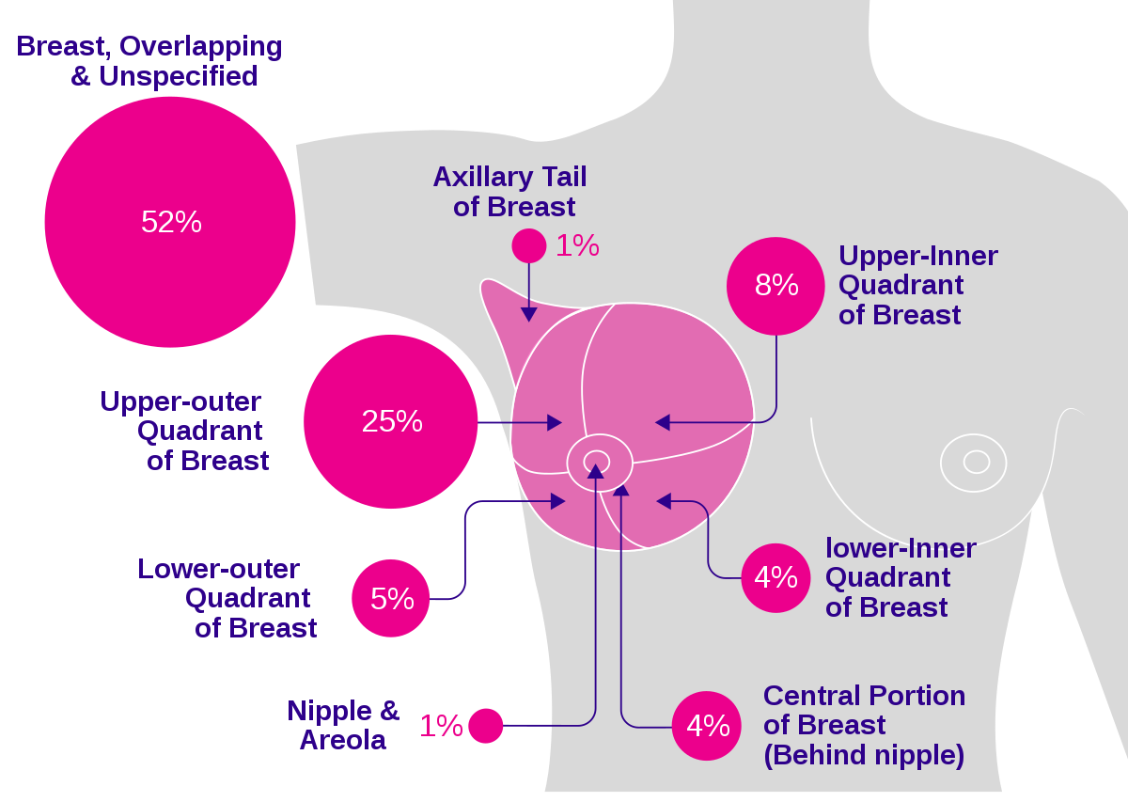
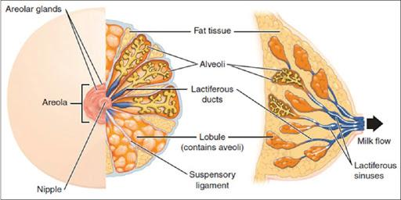
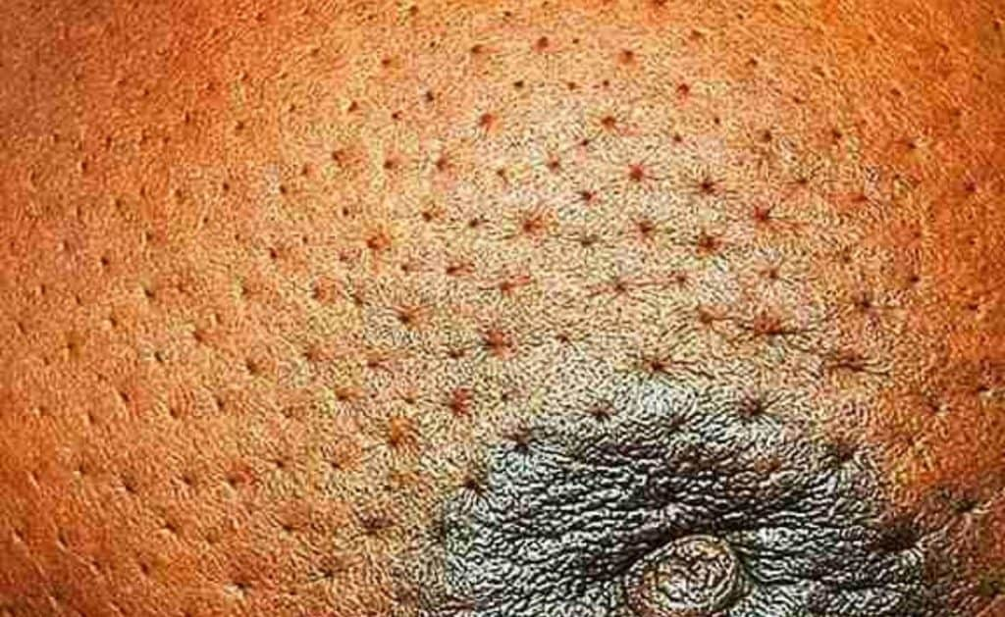
Breast cancer
Applied anatomy
It is a common surgical condition.
60% of carcinomas of breast occur in the upper lateral quadrant.
75% of lymph from the breast drains into the axillary lymph nodes.
In case of carcinoma of one breast, the other breast and the opposite axillary lymph nodes are affected because of the anastomosing lymphatics between both breasts.
In patients with localized cancer breast, a simple mastectomy, followed by radiotherapy to the axillary lymph nodes is the treatment of choice.
The lactiferous ducts are radially arranged from the nipple, so incision of the gland should be made in a radial direction to avoid cutting through the ducts.
Infiltration of the ligaments of Cooper leads to its shortening giving peau de’orange (skin dimpling) appearance of the breast.

Slide 9
Now we can say goodbye 👋🏼
Congratulations you have done with basic anatomy 🎊
Don’t forget to be proud of yourself you have studied 76 lectures of anatomy in the past two years.
We will start with a huge thanks for our amazing batch leaders, academic leaders and secret reviewer, we wouldn't done this without you 🤍
For our members 🧡
Thank you for your perfect work! we don’t think it would have been possible to achieve the goals without you and everyone efforts! You guys deserve a treat!
We think that’s time to show you Anatomy’s heroes
Mohammed Al-huqbani
Salman Alagla
Ziyad Al-jofan
Ali Aldawood
Khalid Nagshabandi
Sameh nuser
Abdullah Basamh
Alwaleed Alsaleh
Mohaned Makkawi
Abdullah Alghamdi
Khalid AL-Dossari
Naif Al-Dossari
Faisal Alqifari
Suhail Basuhail
Jehad Alorainy
Khalid AlKhani
Omar Alammari
Maha Al Nahdi
Razan Al zohaifi
Amirah Al Dakhilallah
Rahaf Al Shabri
Rawan Al Zayed
Ghaida Al Braithen
Alwateen Al Balawi
Reema Al Masoud
Fay Al Buqami
Haifa Al Waily
Ajeed Al Rashoud
‏Taif Alotaibi
‏Noura Al Turki
‏Amirah Al-Zahrani
‏Alhanouf Al-haluli
‏Sara Al-Abdulkarem
‏Renad Al Haqbani
‏Nouf Al Humaidhi
Jude Al Khalifah
Nouf Al Hussaini
Danah Al Halees
Rema Al Mutawa
Renad Al Mutawa
Reham Yousef

Slide 10
QUIZ
Q1 | Q2 | Q3 | Q4 | Q5 | Q6 | Q7 | Q8
C | B | B | C | D | B | C | A
Q1: The nipple of the breast lies opposite of?
A. 3rd costal cartilage
B. 3rd intercostal space
C. 4th intercostal space
D. 4th costal cartilage
Q2: which of the following helps the breast to move freely? A.ligaments of cooper B. Retromammary space
C.axillary tail D.lobes and lobules
Q3: Where is the circular venous plexus are found?
A. At the apices of nipple
B. At the base of nipple
C. At the base of the breast
D. Lateral to thoracic lymph nodes
Q4: mammary ridge extends from the….………. to the…………:
A. Axilla, diaphragm
B. Neck, inguinal region
C. Axilla, inguinal region
D. Axilla, umbilicus
Q5: carcinomas of the breast mostly occur in:
A. Lower medial quadrant
B. Lower lateral quadrant
C. Upper medial quadrant
D. Upper lateral quadrant
Q6: peau de’orange appearance of the breast is due to the infiltration of: A. Pectoral fascia B. Ligament of cooper C. Areola
D. Lactiferous ducts
Q7: The right subclavian trunk opens into
A. Brachiocephalic vein
B. Thoracic duct
C. Subclavian vein
D.Jugular trunk
Q8: The upper part of the breast drain into which group of Axillary lymph nodes?
A. Apical group
B. Pectoral group
C. Brachial group
D. Central group

Slide 11
Members board
Btw if you see anything out of place in this lec, it’s probably written by me so chill it’s just a joke since this is the last anatomy lec -Also reviewer
Team leaders
btw we need to thank these two for making anatomy much more entertaining for us for the past two years.
Thank you for your work.
Abdulrahman Shadid
Ateen Almutairi
Boys team:
Mohammed Al-huqbani (Absolute)
Salman Alagla
Ziyad Al-jofan
Ali Aldawood
Khalid Nagshabandi (Tiffany* )
Sameh nuser
Abdullah Basamh (on his 473rd coffee cup)
Alwaleed Alsaleh (I miss you:()
Mohaned Makkawi(you too)
Abdullah Alghamdi
Girls team :
Ajeed Al Rashoud
‏Taif Alotaibi
‏Noura Al Turki
‏Amirah Al-Zahrani
‏Alhanouf Al-haluli
‏Sara Al-Abdulkarem
‏Renad Al Haqbani
‏Nouf Al Humaidhi
Jude Al Khalifah
Nouf Al Hussaini
Danah Al Halees
Rema Al Mutawa
Maha Al Nahdi
Razan Al zohaifi
Ghalia Alnufaei
-Last Anatomy lec y’all, I’ll miss reviewing this team’s work.
-No I’m not crying
-Maybe
-Ok yes -Also also Reviewer
Contact us:

