Slide 1
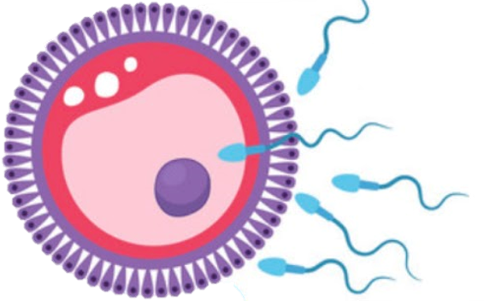
Female Reproductive System
Reproductive block-Anatomy-Lecture
Editing file

Slide 2
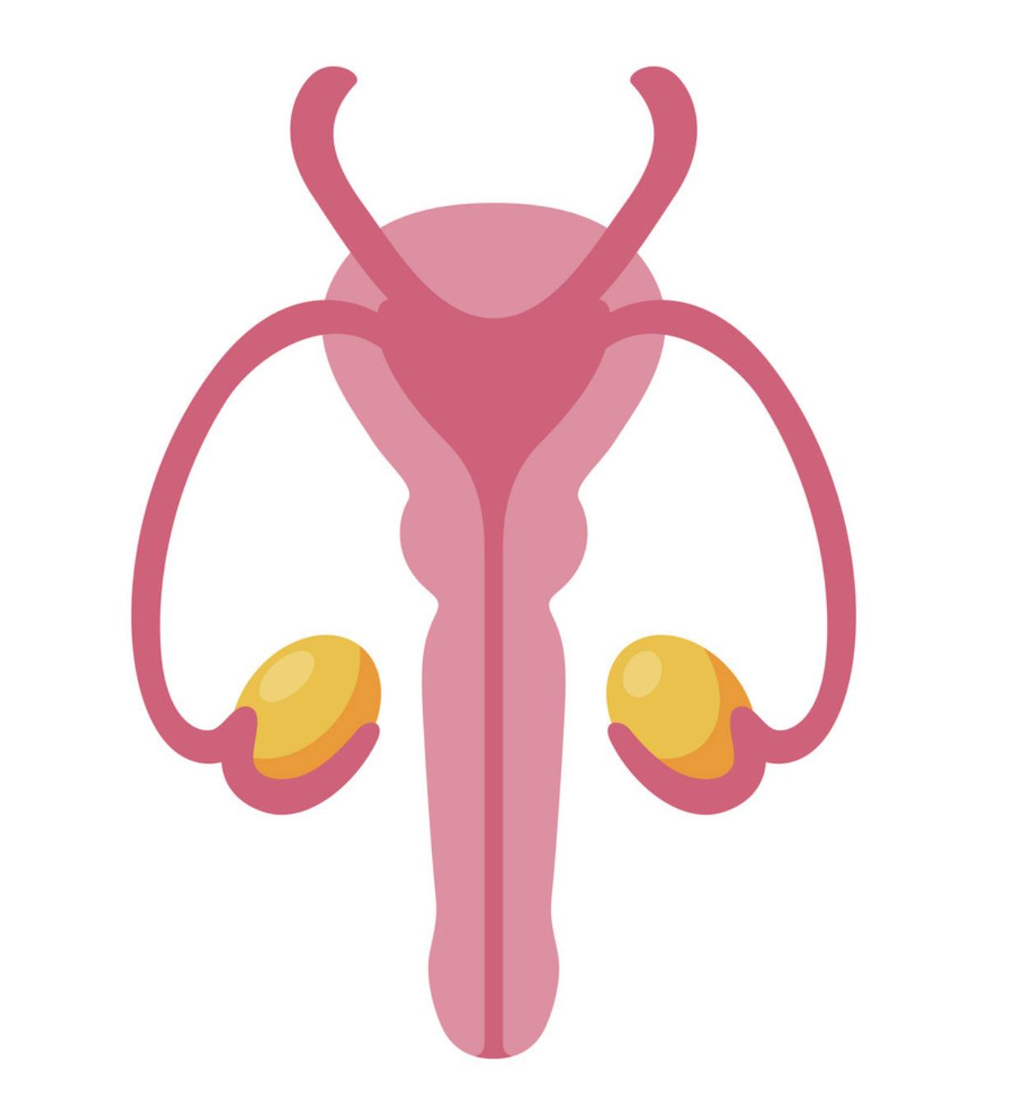
Color guide :
Only in boys slides in Green
Only in girls slides in Purple
important in Red
Notes in Grey
Objectives
At the end of the lecture, students should be able to:
List the organs of female reproductive system.
Describe the pelvic peritoneum in female.
Describe the position and relations of the ovaries.
List the parts of the uterine tube.
Describe the anatomy of uterus regarding: subdivisions, cavity, relations, ligaments & main support.
Describe the anatomy of vagina regarding: structure, extent, length & relations.
Describe the supply (arteries, veins, lymph, nerves) of female reproductive system.

Slide 3
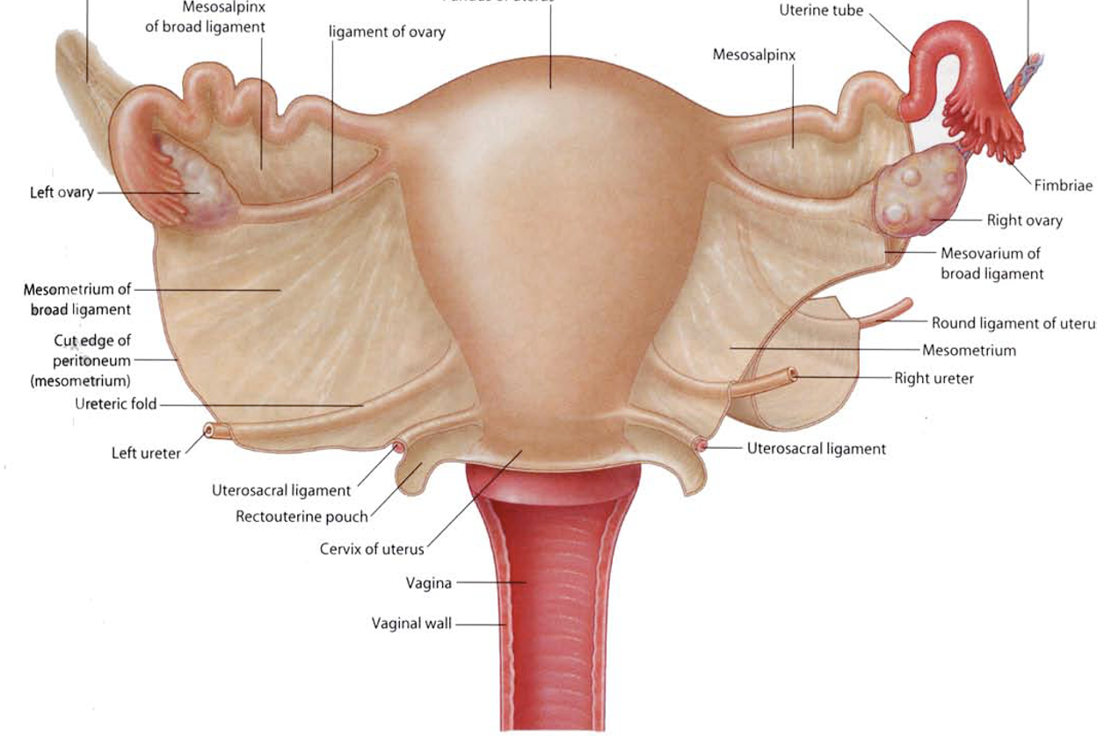
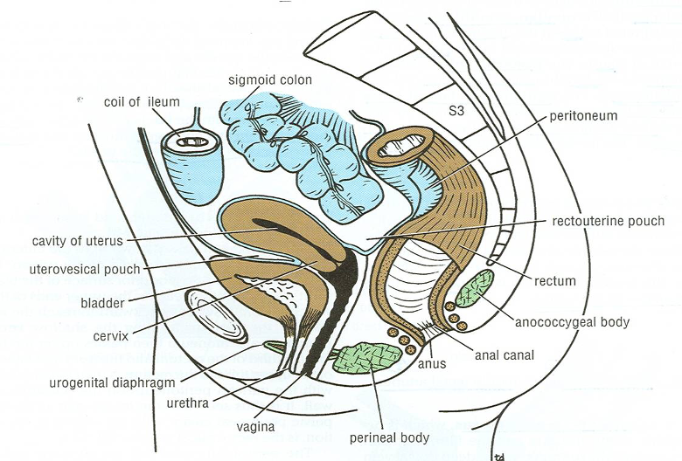
Pelvic peritoneum in female
Uterovesical (vesicouterine) pouch: Reflection of peritoneum from uterus to upper surface of urinary bladder.
3
Broad ligament of uterus: Extension of peritoneum from lateral wall of uterus to lateral wall of pelvis, encloses the uterine tubes.
has 3 parts: Mesosalpinx, Mesovarium and Mesometrium
1
Rectouterine (Douglas) pouch: Reflection of peritoneum from rectum to upper part of posterior surface of vagina. Used in the treatment of end stage renal failure in patients who are treated with peritoneal dialysis in which the tip of dialysis catheter is placed into the deepest point of the pouch.
(this is where pus collects in a pelvic infection)
2
Uterus
Uterine tube
Left ovary
Right ovary
Broad ligament
Broad ligament
recto-uterine pouch
utero-vesical pouch
Recto-uterine pouch
Posterior view
Vesico-uterine pouch
Vagina

Slide 4
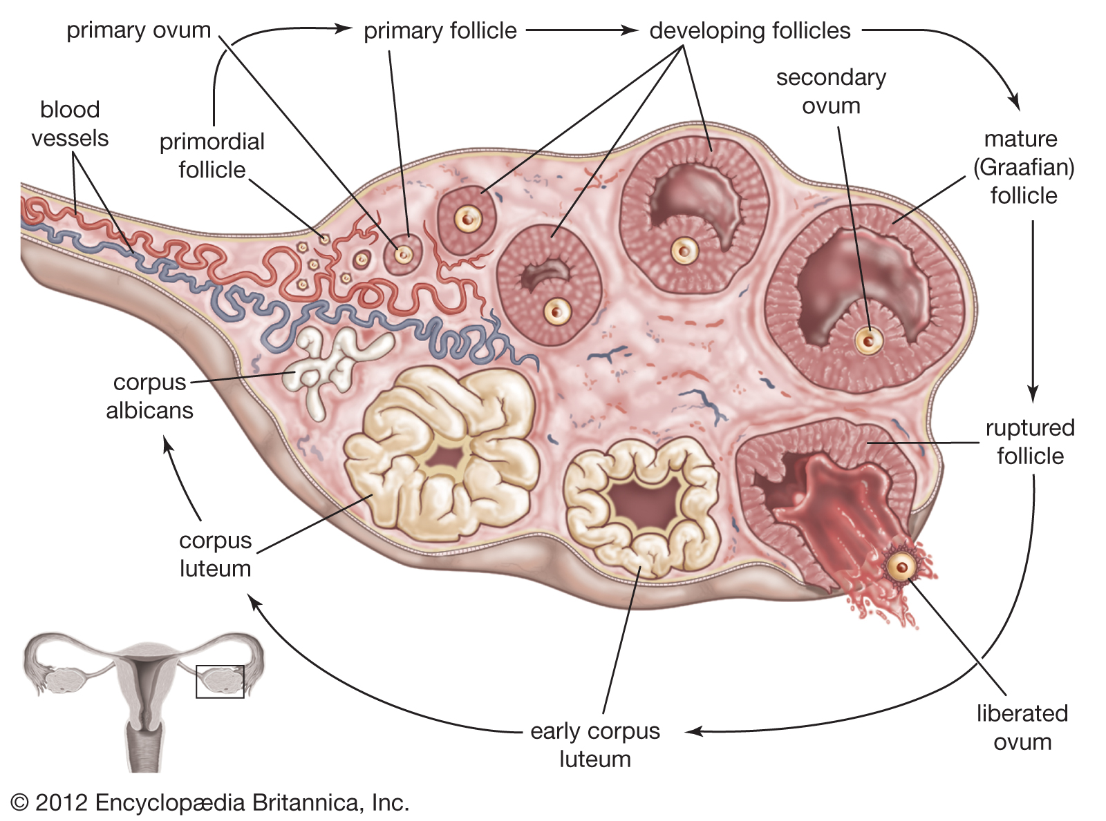
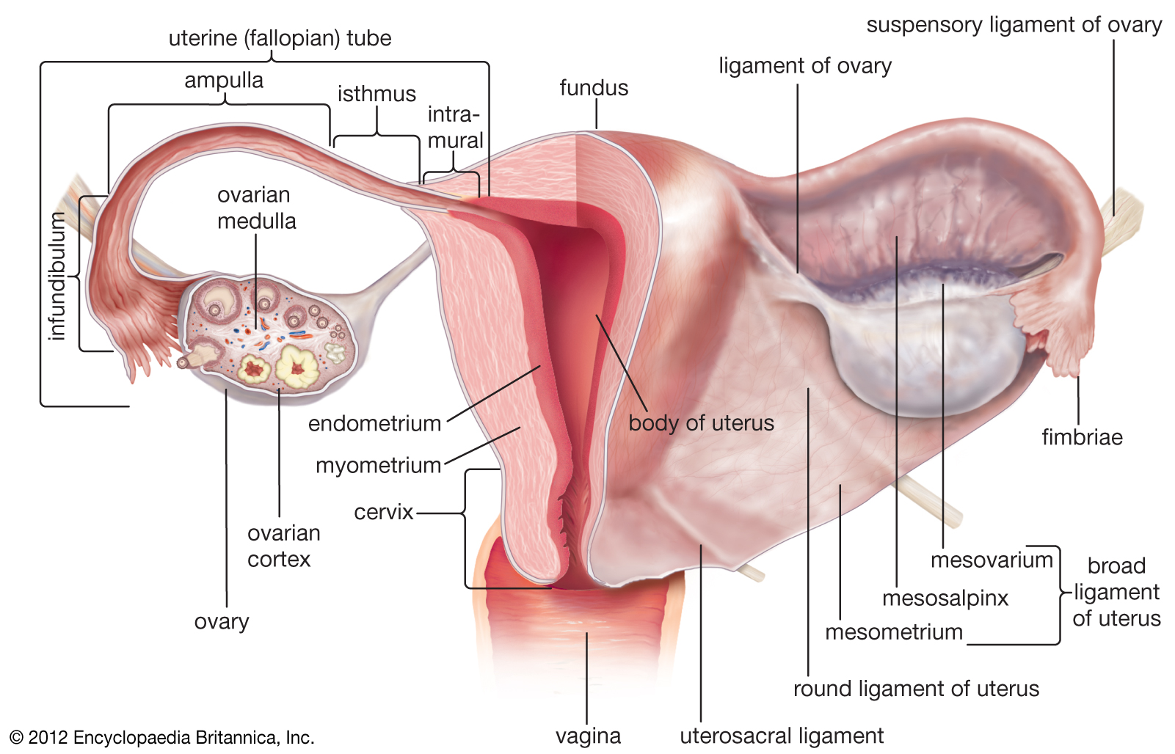
The Ovaries:
Primary sex organs in female
It is an almond-shaped organ
It is attached to the back of the broad ligament by a peritoneal fold (mesovarium & the other parts of the broad ligament are important in keeping the ovaries in its place and position. The position of the ovaries are variable but usually are found hanging down in rectouterine pouch while during pregnancy the enlarging uterus will pull up the ovaries in the abdominal cavity)
Its medial end is attached to the uterus by the ligament of the ovary
Its lateral end is related to the fimbriae of the uterine tube
Function: Production of female germ cells (Oocyte/egg) , Secretion of female sex hormones (estrogen & progesterone)

Slide 5
The uterine (fallopian) tubes
It is 10 cm long
It is enclosed in the broad ligament of uterus
Function: Site of fertilization, Transport of fertilized ovum into the uterus
Divided into:
3
2
1
01
02
03
Intramural part
opening into the uterine wall
Isthmus
narrowest part
Ampulla
widest part (site of fertilization) Equipped everything for the fertilization (the tissue lining of this area and the micro-environment signals all help the fertilization happens)
4
04
Infundibulum
funnel- shaped end, has finger- like processes (fimbriae), related to ovary
fimbriae have a special movement that helps to grab the oocyte
Usually women are born with approximately 2 millions eggs in their ovaries. Before puberty about 11 thousands of these eggs die in every month. At puberty a woman has only about 400 thousands eggs remaining in her ovaries and after puberty a women will lose one thousand eggs every month instead of 11 thousands and only one of the one thousand follicles will mature and reach to the fallopian tubes. this phenomenon of the degeneration/dying of this huge number of eggs is independent of any hormonal production, pregnancy, nutritional supplements, lifestyle, birth controlling pills. Basically independent of any process or anything that could be done even ovulation inhibition or stimulation and nothing will stop the death of one thousands eggs every month. This means out of the 2 millions follicles only about 400 follicles will be matured during the whole life of the woman. After menopause (age 50-55) only very little or no follicles remain in her ovaries.

Slide 6
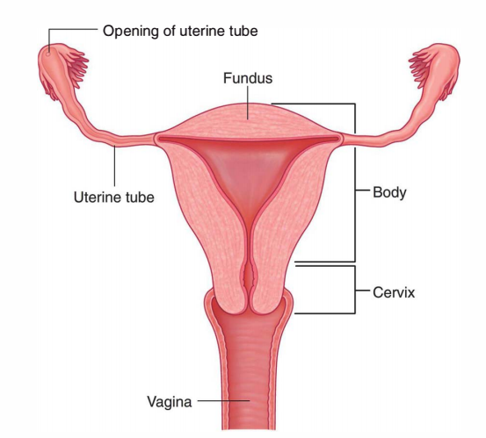
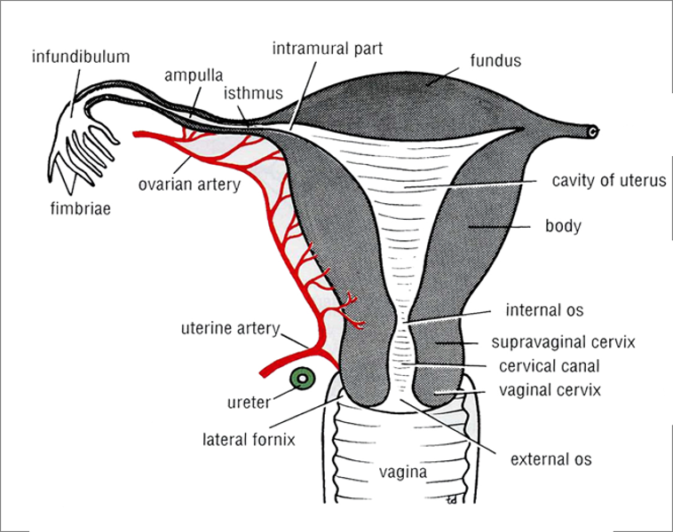
The Uterus
A hollow, pear-shaped muscular organ
Function: pregnancy
no cavity
implantation site
above the level of uterine tubes
Fundus
Fundus
Body
Divided into:
Body
cavity is triangular
from the level of uterine tube to the level of the isthmus of uterus
Supravaginal part
Cervix
Vaginal part
cavity is fusiform
below the level of the isthmus of the uterus
divided into: Supravaginal part, Vaginal part
Cervix:
Relations of uterus
Fundus + body + supravaginal part of cervix
Vaginal part of cervix
Anterior
Posterior
Lateral
Anterior
Posterior
Lateral
superior surface of urinary bladder
sigmoid colon
uterine artery
anterior fornix of vagina
posterior fornix of vagina
lateral fornices of vagina

Slide 7
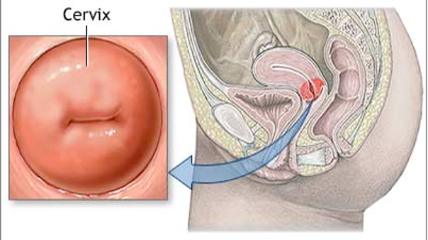
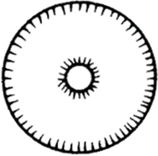
The Uterus: cervical canal
Internal OS
opening between cavity of body of uterus & cavity of cervix (cervical canal)
External OS
opening between cervical canal & cavity of vagina
In a nulliparous woman: external os appears circular
(Woman who Didn’t give birth, external os appears intact)
In a multiparous woman: external os appears as a transverse slit with an anterior & a posterior lip
(B/c during birth there will be expansion of the muscles and this will form these lips)
Nulliparous
Multiparous

Slide 8
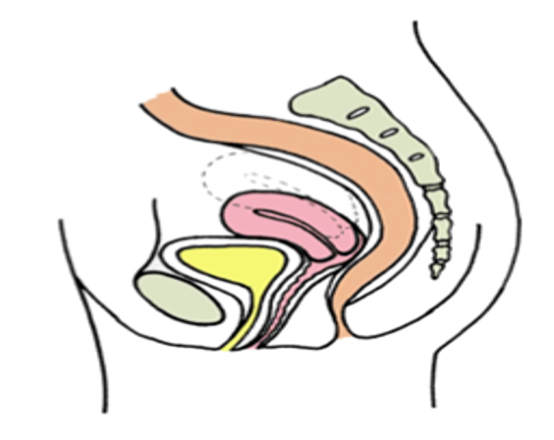
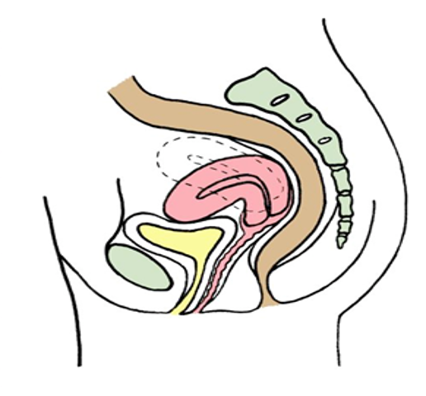
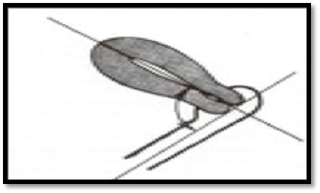
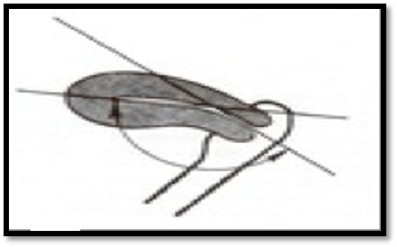
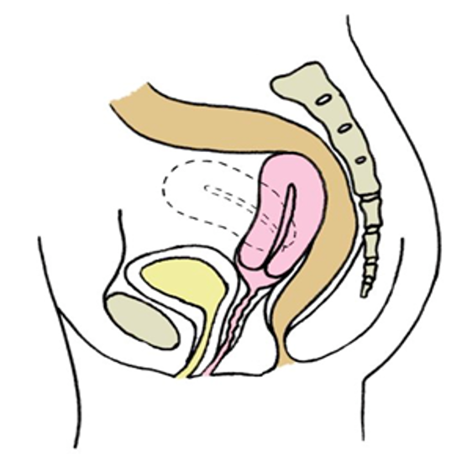
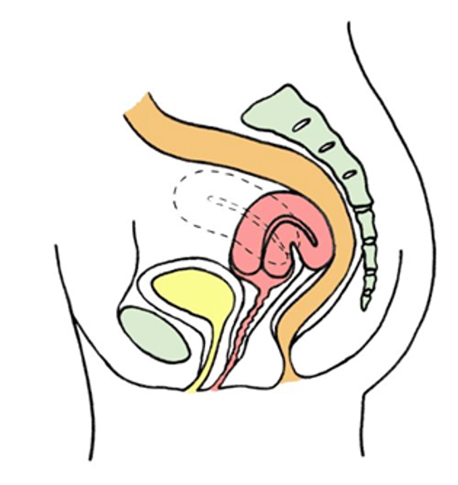
Positions of uterus
Usual position of uterus
Anteverted uterus
Anteflexed uterus
long axis of whole uterus is bent forward on long axis of vagina
long axis of whole body is bent forward on long axis of cervix
1
2
Fundus & body of uterus are bent backward on the vagina and lie in rectouterine pouch
Long axis of body of uterus is bent backward on long axis of cervix
3
4
Retroverted uterus
Retroflexed Uterus
Anteverted Anteflexed Uterus

Slide 9
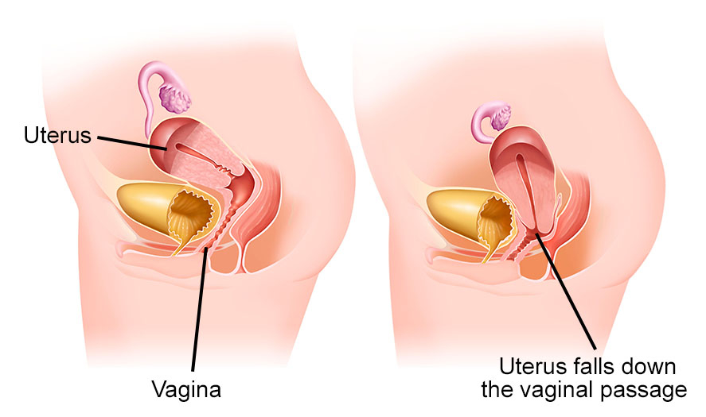
Support of uterus
Ligaments of uterus
Muscles
1
ligaments At junction between fundus & body of uterus (At the level of uterine tube)
1
Levator Ani muscles
Extends through inguinal canal to labium majus
They are Round ligament (anterior to the uterine tube) and ovarian ligament (posterior to the uterine tube)
Round ligament will maintains anteverted anteflexed position)
Forms:
pelvic floor: separate pelvis from perineum
pelvic diaphragm: traversed by urethra, vagina & rectum
Function: Support pelvic organs
2
Ligaments of cervix.
Extend from cervix to:
anterior portion as a pubocervical ligament
lateral portion as a transverse cervical or cardinal ligament The strongest one
posterior portion as an uterosacral or sacrocervical ligament
3
2
Clinical anatomy : Uterine prolapse
Downward displacement of uterus due to damage of:
Ligaments of uterus
Levator ani muscles
1

Slide 10
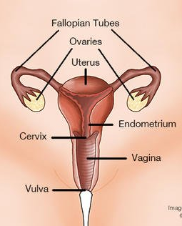
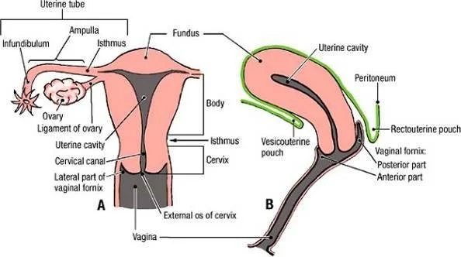
Vagina
Relations of the vagina
Structure: It’s Fibromuscular tube
Extent: from external os, along pelvis & perineum, to open in the vulva (female external genitalia), behind urethral opening
Vagina fornices (arches) : are the superior portions of the vagina, extending into the recesses created by the vaginal portion of cervix.
Length: Its anterior wall (7.5 cm) is shorter than its posterior wall (9 cm) The difference in length is due to the position of uterus
Functions: 1 ) Copulatory organ 2) Birth canal.
Anterior
Lateral
Urinary bladder (in pelvis) & urethra (in perineum)
ureters (in pelvis)
Posterior
Rectum (in pelvis) & anal canal (in perineum)

Slide 11
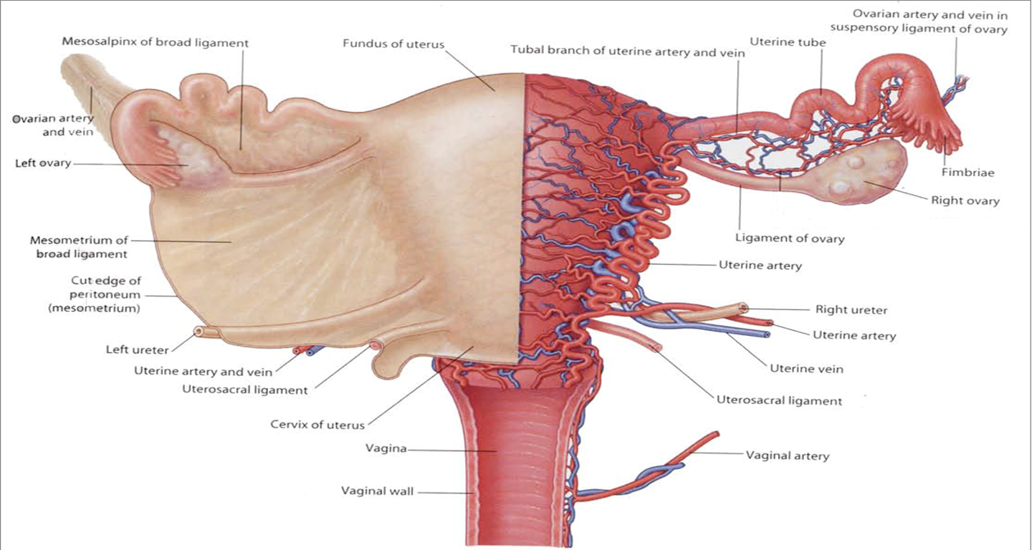
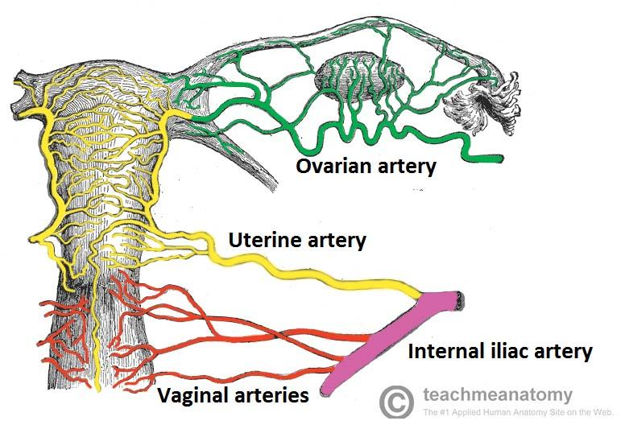
Arterial supply
Organ | Arteries | Veins | Lymphatics | Nerves (Autonomic)
Ovaries | Ovarian (branch of abdominal aorta) | Ovarian (drain to inferior vena cava & left renal vein) | To paraaortic lymph nodes (in abdomen)also called the sentinel lymph nodes and are the first ones to drain a metastasizing cancer (e.g. ovarian cancer) | Ovarian plexus (in abdomen)
Uterine tubes | -Ovarian (lateral) -Uterine. (Medial) | -Ovarian -Uterine | -Paraaortic -Internal iliac | -Ovarian -Inferior hypogastric
Uterus | Uterine (branch of internal iliac artery in pelvis) | Uterine plexus (drain to internal iliac vein) | To internal iliac lymph nodes (in pelvis) | Inferior hypogastric plexus (in pelvis)
Vagina | Vaginal (branch of internal iliac artery in pelvis) | Vaginal plexus (drain to internal iliac vein)
Uterine artery passes from the internal iliac artery and crosses above the ureter and reaches the cervix at the level of external os this is important clinically for the surgeon when performing hysterectomy to differentiate and distinguish between the uterine artery and the ureter.
mnemonic= "Water under the bridge"means: water (urine=ureter) is inferior to the bridge (uterine artery)
Remember: the supply to the ovaries and part of uterine tubes is always from the abdomen (abdominal aorta).
While the supply of the uterus and vagina and part of the uterine tubes is always from the pelvis (internal iliac artery).

Slide 12
QUIZ
Q1 | Q2 | Q3 | Q4 | Q5 | Q6 | Q7 | Q8
D | A | A | B | C | C | A | A
Q1: Regarding the female reproductive organs, which one of this statement is correct?
A. The ampulla is the most medial part of the uterine tube.
B. The rectum is anterior to the vagina.
C. The ovarian artery is a branch of the internal iliac artery of the pelvis.
D. The uterine tube is enclosed in the broad ligament of the uterus.
Q2: Which one of the following structures is related to the lateral end of the ovary? A. Fimbriae of uterine tube
B. Ampulla of uterine tube
C. Ligament of ovary
D. Round ligament of uterus
Q3: Which one of the following structures is anterior to the uterus?
A. Urinary bladder
B. Ureter
C. Sigmoid colon
D. Ovary
Q4: Which of the following is supplied by the ovarian artery?
A. Ovaries & uterus
B. Ovaries & uterine tubes
C. Uterine tubes & uterus
D. Uterus & vagina
Q5: Which of the following parts is the site of fertilization?
A. Intramural part B. Isthmus C. Ampulla
D. Infundibulum
Q6: Production of female germ cells is the function of which of the following?
A. Vagina
B. Uterus
C. Ovaries
D. Uterine tubes
Q7: Which groups of lymph nodes are the sentinel nodes in cases of ovarian cancer?
A. Paraaortic
B. Uterus node
C. External iliac
D. Superficial inguinal
Q6: Which one of the following structures is lateral to the Vagina?
A. Ureter
B. Uterus
C. Ovaries
D. Uterine tubes

Slide 13
Members board
Team leaders
Abdulrahman Shadid
Ateen Almutairi
Boys team:
Mohammed Al-huqbani
Salman Alagla
Ziyad Al-jofan
Ali Aldawood
Khalid Nagshabandi
Sameh nuser
Abdullah Basamh
Alwaleed Alsaleh
Mohaned Makkawi
Abdullah Alghamdi
Girls team :
Ajeed Al Rashoud
‏Taif Alotaibi
‏Noura Al Turki
‏Amirah Al-Zahrani
‏Alhanouf Al-haluli
‏Sara Al-Abdulkarem
‏Renad Al Haqbani
‏Nouf Al Humaidhi
Jude Al Khalifah
Nouf Al Hussaini
Danah Al Halees
Rema Al Mutawa
Maha Al Nahdi
Razan Al zohaifi
Ghalia Alnufaei
Contact us:

