Slide 1
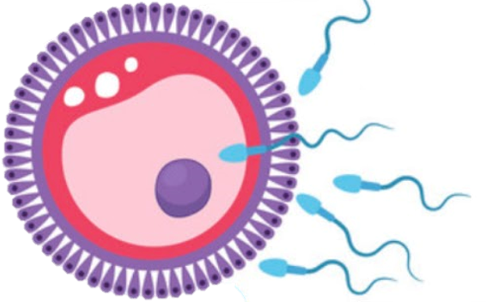
Development of Female Genital System
Reproductive block-Embryology-Lecture 1
Editing file

Slide 2
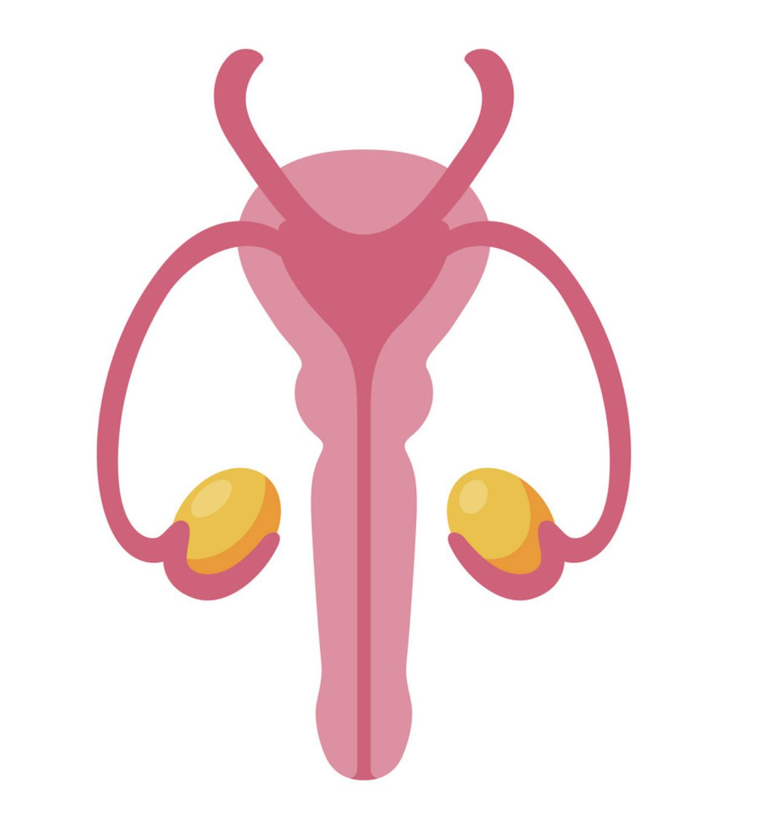
Color guide :
Only in boys slides in Green
Only in girls slides in Purple
important in Red
Notes in Grey
Objectives
At the end of the lecture, students should be able to:
Describe the development of gonads (indifferent & different).
Describe the development of the female gonad (ovary) and the internal genital organs (uterus, uterine tubes and vagina).
Describe the development of the external genitalia.
List the main congenital anomalies of female genital system.

Slide 3
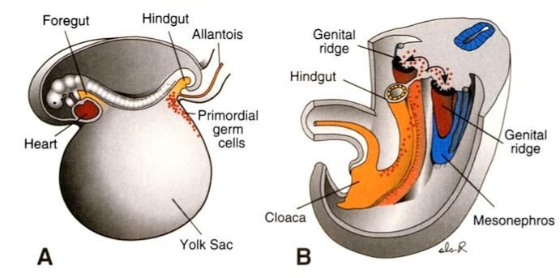
Development Of Genital System
Sex of the embryo is determined genetically at the time of fertilization
Gonads do not acquire male or female morphological characteristics until 7th week of development.
if The Y chromosome exist, it will express a gene called Testis-determining factor (TDF) gene = Male
No Y chromosome = No TDF = Female
Beginning of development
Genital system are developed from 2 longitudinal ridges of mesoderm which run down the entire length of the dorsal body wall.
These ridges are called urogenital ridges.
The medial region of this ridge differentiates into the genital ridge where the gonads develop
begin to develop during the 5th week in the genital ridge, and they are first undifferentiated and have only a cortex and a medulla
1
2
3
4

Slide 4
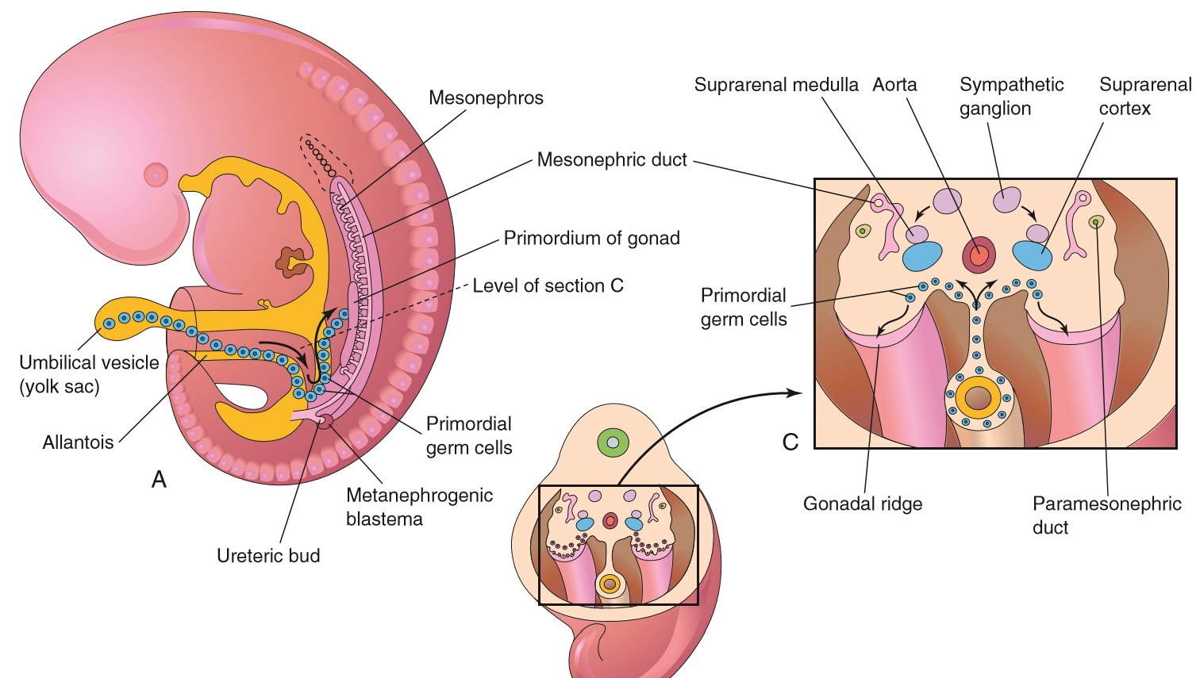
Development Of Undifferentiated Gonads
During the 4th week Large primitive cells, called primordial sex cells, form in the yolk sac.
They migrate along the dorsal mesentery of the hindgut to the genital ridges where they become incorporated into the developing gonads
Germ Cells arriving at 5th week
invading the genital ridge in the 6th week.
During arrival of Germ cells, the epithelium of the genital ridge proliferates, and epithelial cells penetrate the underlying mesenchyme Forming irregular shaped cord primitive sex cord indifferent gonad
In embryos with an XY complex, the medulla differentiates into a testis and the cortex regresses.
Males
4th week
5th & 6th week
in embryos
In embryos with an XX chromosome complex, the cortex differentiates into an ovary, and the medulla regresses.
Females

Slide 5
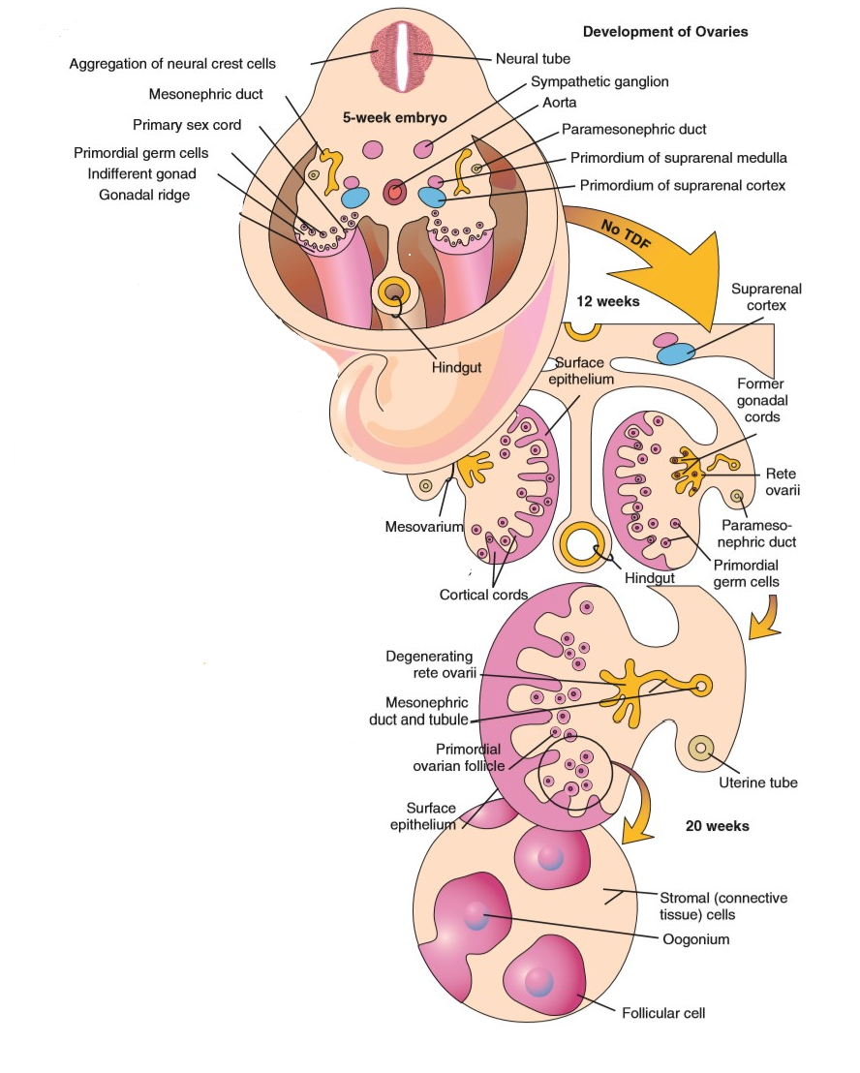
Development Of Ovary
Primitive sex cords dissociate into irregular cell cluster.
Later they will disappear and are replaced by vascular stroma forming ovarian medulla.
Surface epithelium of the female gonad proliferate.
7th week
In 7th week give rise to 2nd generation of cords, cortical cords
Penetrate the underlying mesenchyme
4th month
In 4th month these cortical cords split into isolated cell clusters which surrounding one or more primitive germ cells.
Germ cell will develop into oogonia and surrounding epithelial cells form follicular cells.

Slide 6
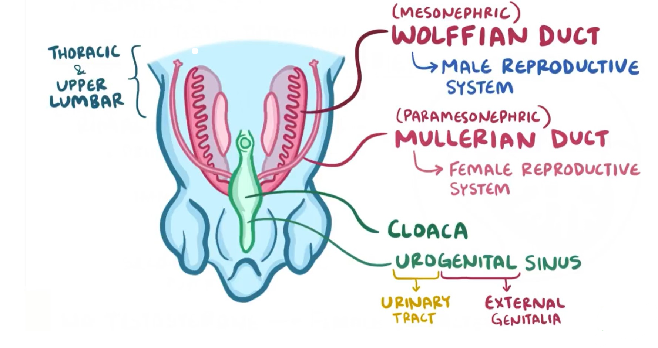
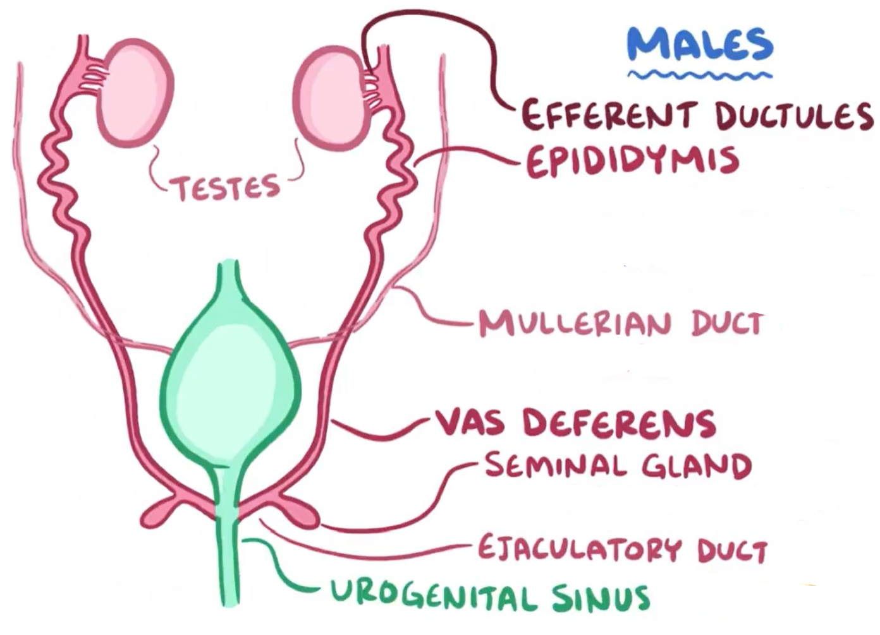
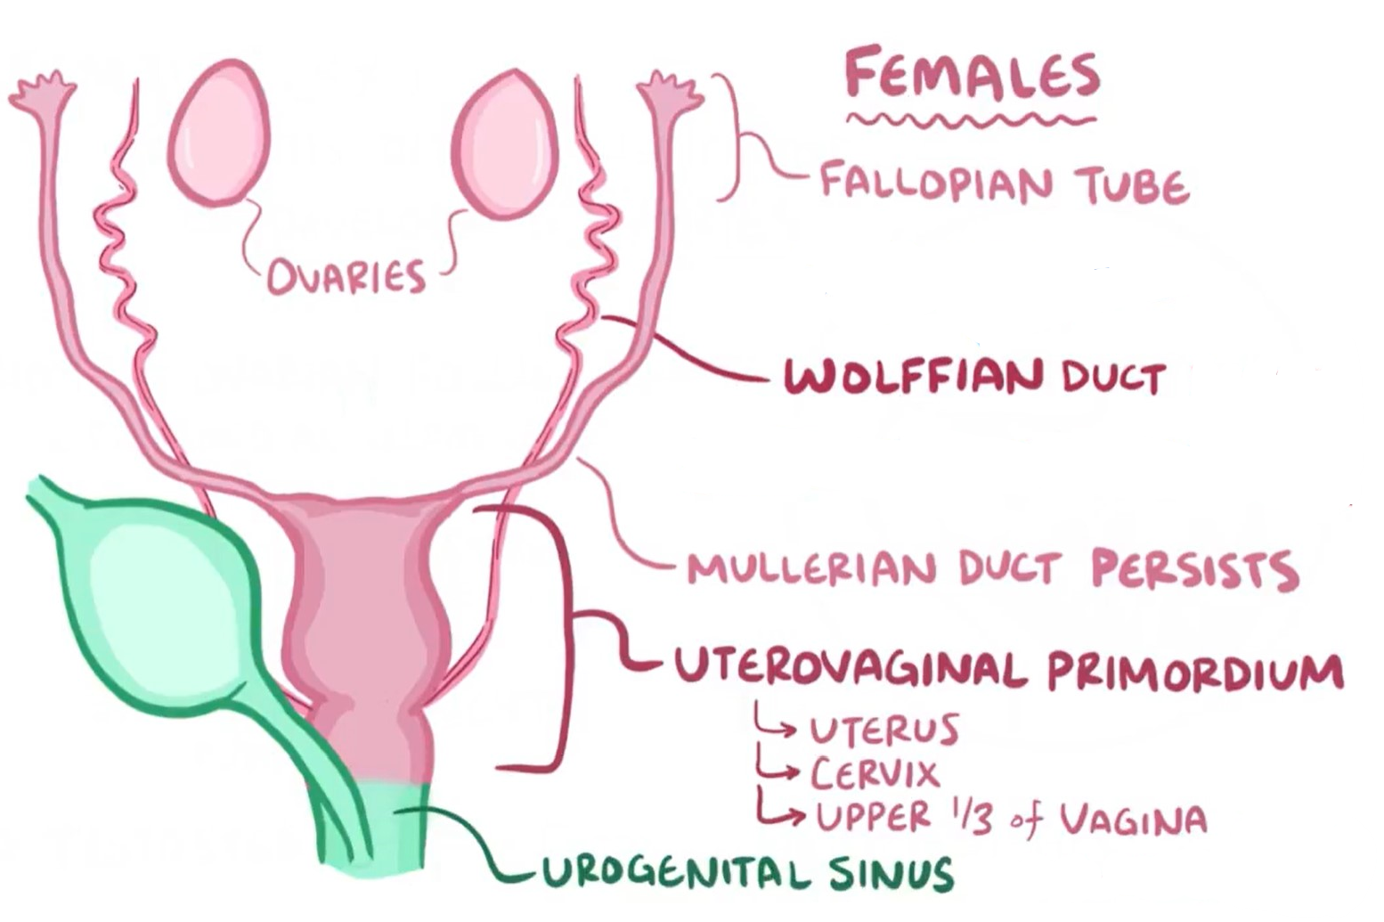
Development Of Genital Ducts
Two pairs of genital ducts develop in both sexes:
Mesonephric (Wolffian) Ducts 2. Paramesonephric (Mullerian) Ducts.
In Males
Mesonephric duct system remains to form efferent ductules, epididymis, vas deferens and ejaculatory duct, The seminal vesicle develops as a diverticulum from the developing vas
Paramesonephric ducts regress
In Females
Mesonephric ducts regress
Paramesonephric ducts develop into uterine tubes, uterus, and upper vagina
Initially, in Paramesonephric ducts development 3 parts can be recognized in each duct:
A cranial vertical portion opens into abdominal cavity
A horizontal part that crosses the mesonephric duct
both develop into the uterine tube
A caudal vertical part that fuses with its partner from the opposite side
Form uterine canal
Fused give rise to the body and cervix of the uterus and upper one third of vagina
Mesenchyme will form muscular coat of the uterus myometrium & perimetrium

Slide 7
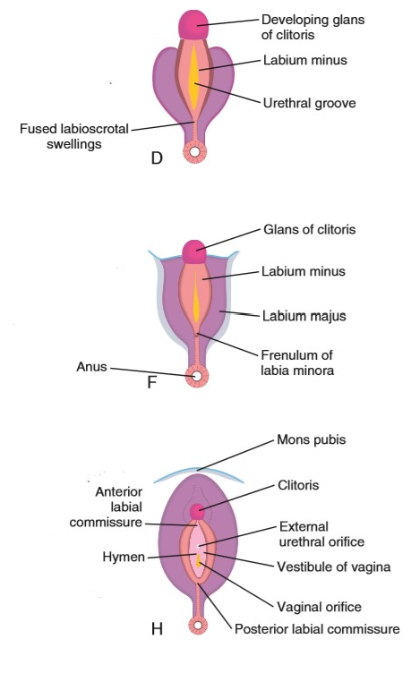
Development Of Vagina and External genitalia
Vagina
After solid tip of paramesonephric ducts reaches the urogenital sinus, 2 solid evagination (sinovaginal bulbs) grow out and proliferate to form vaginal plate which is form the lower two third of Vagina
By 5th week outgrowth is entirely canalized
External genitalia
in the 3rd week, mesenchyme cells originated from primitive streak migrate around the cloacal membrane to form a pair of cloacal folds.
another pair of elevation, genital swelling (Labioscrotal swellings) become visible on each side of the urethral folds (Labioscrotal Folds) these will form labia majora they fuse to form posterior and anterior Labial Commissures.
3
3
1
Cranial to cloacal membrane the folds unite to form the genital tubercle (Phalls), then The genital tubercle elongates slightly to form clitoris
4
Urethral folds do not fuse to form labia minora
4
2
Caudally the folds are subdivided into urethral folds anterior & anal folds posterior
Urogenital groove is open and forms the vestibule
5
1
Estrogens produced by both placenta and fetal ovaries stimulate development of the external genitalia of the female
5
2

Slide 8
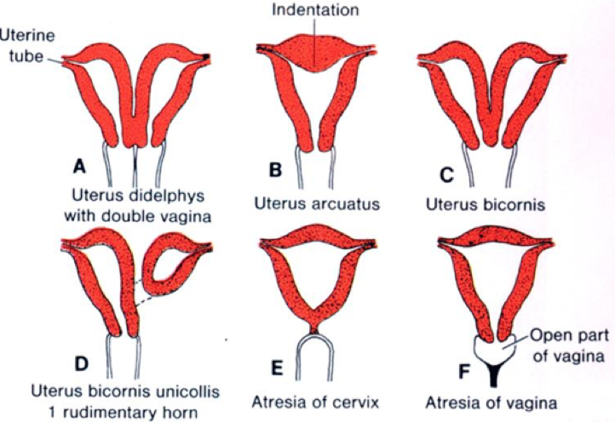
Congenital Anomalies
Girls’ slide only
Various types of anomalies can result due to:
Arrest of development of the uterovaginal primordium during the 8th week.
Incomplete development of the paramesonephric ducts.
Incomplete fusion of the paramesonephric ducts.
Failure of parts of one or both paramesonephric ducts to develop.
Incomplete canalization.
Cervical Atresia: It may be combined with incomplete development of the upper vagina or lower uterus.
Vaginal Anomalies:
Atresia (Partial or complete).
Double vagina.
Transversely septate vagina: Results from faulty canalization of the fused müllerian ducts.
Remnants of mesonephric (wolffian) ducts may persist in the anterolateral wall of vagina or adjacent to the uterus within the broad ligament or mesosalpinx.
Some of common anomalies :

Slide 9
Summary: Timeline
5th week
Time of fertilization
Gonads start to develop
Germ Cells arriving
The epithelium of the genital ridge proliferates, and penetrate the underlying mesenchyme
Vagina outgrowth is entirely canalized
Sex of the embryo is determined genetically
3rd week
6th week
Mesenchyme cells originated from primitive streak migrate around the cloacal membrane to form a pair of cloacal folds.
Germ Cells invading the genital ridge
7th week
4th week
Gonads acquire male or female morphological characteristics
Surface epithelium rise to 2nd generation of cortical cords and cointine of Penetrating the underlying mesenchyme
Large primitive cells, called primordial sex cells, form in the yolk sac and migrate along the dorsal mesentery
16th week (4th month)
Cortical cords split into isolated cell clusters which surrounding one or more primitive germ cells.

Slide 10
QUIZ
Q1 | Q2 | Q3 | Q4 | Q5 | Q6 | Q7 | Q8
B | D | A | C | C | A | B | A
Q1: Estrogens stimulate development of the …..
A. Genital System
B. external genitalia of the female
C. Ovary
D. Gonads
Q2: which of these event happened in 7th week of development A. Germ Cells invading the genital ridge B. Surface epithelium rise to 3rd generation of cortical cords
C. Mesenchyme cells originated from primitive streak and migrate D. Gonads acquire male or female morphological characteristics
Q3: which of these form the lower two third of Vagina
A. sinovaginal bulbs
B. caudal vertical part of Paramesonephric ducts
C. A horizontal part of Paramesonephric ducts
D. Urogenital groove
Q4: In embryos with an XX chromosome
A. cortex differentiates into a Genital System, and the medulla regresses
B. cortex regresses, and the medulla differentiates into an ovary
C. cortex differentiates into an ovary, and the medulla regresses
D. cortex regresses, and the medulla differentiates into a Genital System
Q5: Germ Cells invading the genital ridge happen in
A. 5th week
B. 4th week
C. 6th week
D. 7th week
Q6: Cranial part to cloacal membrane form A. clitoris B. labia majora C. labia minora D. vestibule
Q7: Cortical cords split into isolated cell clusters in which week
A. 6th week
B. 16th week
C. 10th week
D. 7th week
Q8: in development Of Genital Ducts in males which of the following is correct
A. Wolffian duct system remains and Mullerian ducts regress
B. both Wolffian duct system and Mullerian ducts remains
C. Wolffian duct system regress and Mullerian ducts remains
D. both Wolffian duct system and Mullerian ducts regress

Slide 11
Members board
Team leaders
Abdulrahman Shadid
Ateen Almutairi
Boys team:
Mohammed Al-huqbani
Salman Alagla
Ziyad Al-jofan
Ali Aldawood
Khalid Nagshabandi
Sameh nuser
Abdullah Basamh
Alwaleed Alsaleh
Mohaned Makkawi
Abdullah Alghamdi
Girls team :
Ajeed Al Rashoud
‏Taif Alotaibi
‏Noura Al Turki
‏Amirah Al-Zahrani
‏Alhanouf Al-haluli
‏Sara Al-Abdulkarem
‏Renad Al Haqbani
‏Nouf Al Humaidhi
Jude Al Khalifah
Nouf Al Hussaini
Danah Al Halees
Rema Al Mutawa
Maha Al Nahdi
Razan Al zohaifi
Ghalia Alnufaei
Contact us:

