Slide 1
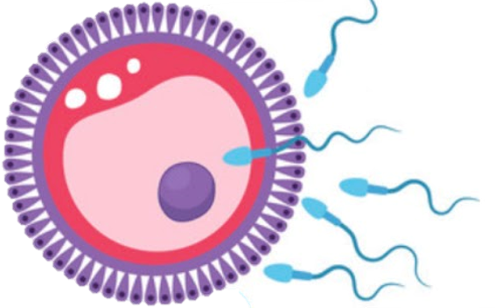
Gametogenesis and uterine cycles
Reproductive block-Embryology -Lecture 2
Editing file
Stay educated
<Slightly bigger than the academic’s

Slide 2
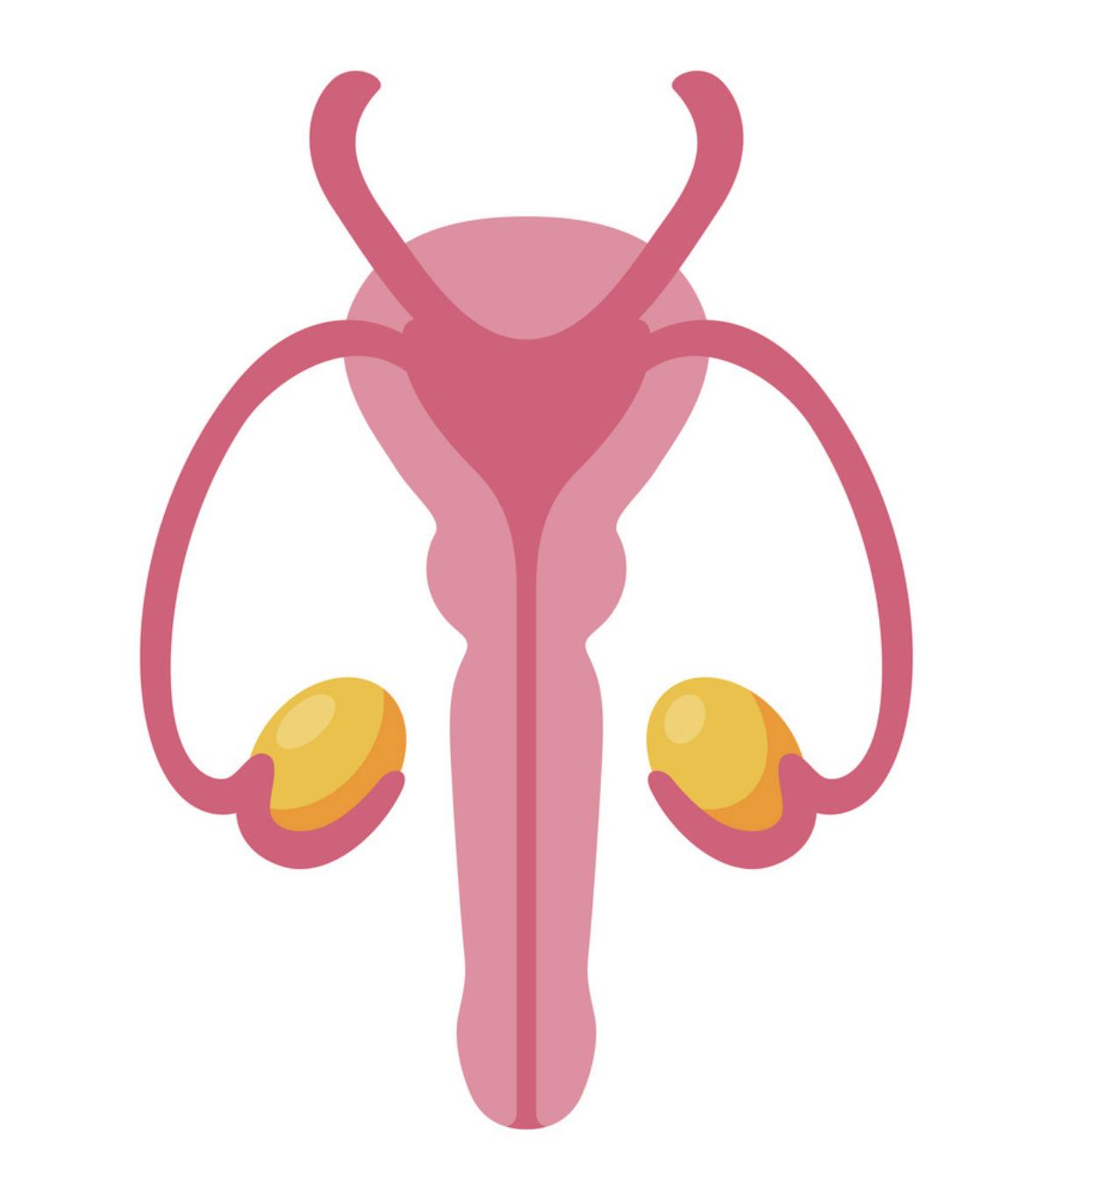
Color guide :
Only in boys slides in Green
Only in girls slides in Purple
important in Red
Notes in Grey
Objectives
At the end of the lecture, students should be able to:
Describe the female cycles (Ovarian & Uterine).
Define and differentiate the types of gametogenesis.
Describe briefly the process of spermatogenesis.
Describe briefly the process of oogenesis.
Do people seriously read these?
My quarantine vibes, enjoy :)

Slide 3
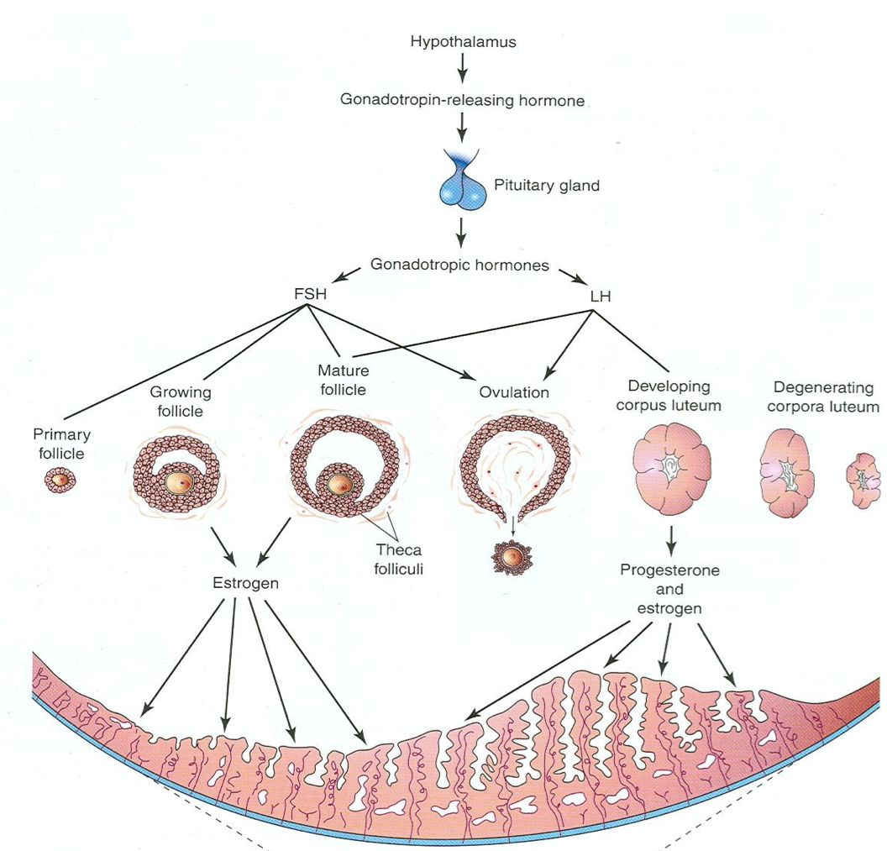
Female Reproductive Cycles
The reproductive cycle start at puberty normally continues until the menopause
Reproductive cycles depend upon activities & coordination of:
Hypothalamus
Pituitary gland
Ovaries
Uterine tubes
Uterus
Vagina
Mammary glands.
1- GnRH (Gonadotropin-releasing hormone)
The cycle starts by the release of GnRH by neurosecretory cells of the hypothalamus
It is carried to the Anterior Pituitary gland to stimulate the release of two Hormones that act on Ovaries (FSH and LH)
2- FSH (Follicle-Stimulating Hormone)
It is secreted by the anterior pituitary gland
Functions:
It stimulates the ovarian primary follicle to become mature (Follicular Phase)
It stimulate the follicular cells to produce estrogen which regulates the development and functions of the reproductive organs
3- LH (Luteinizing Hormone)
It is secreted by the anterior pituitary gland
Functions:
It serves as a trigger for ovulation
Stimulates the corpus luteum to produce progesterone
Stimulates the mature follicles to produce Estrogen.

Slide 4
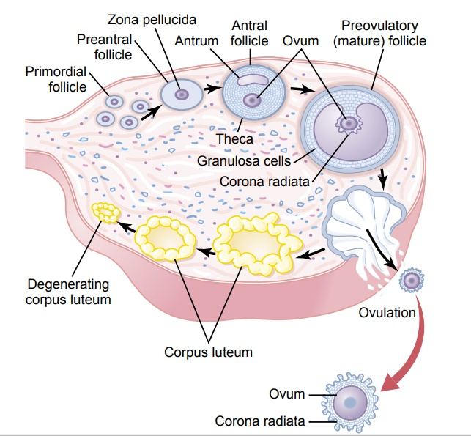
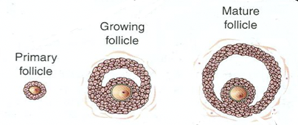
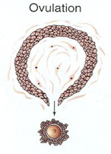
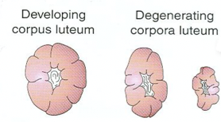
Ovarian Cycle
The ovarian cortex contains 400,000-500,000 primary follicle (or primordial follicles)
Each primary follicle consist of one primary oocyte which is encircled by a single layer of flat follicular cells
The ovarian cycle is under the control of the pituitary gland and is divided into 3 phases (FOL)
1- Follicular Phase
2- Ovulation
3- Luteal Phase
After puberty the simple flat follicular cells become cuboidal, then columnar then forming many layers around the oocyte
The follicle enlarges until it gets mature
Early development of the follicle is induced by FSH
The follicle produces a swelling in the surface of the ovary
Final stages of maturation requires LH
LH causes ovulation which is the rupture of the mature follicle
Now the remaining part of the ruptured follicle is called corpus luteum which secretes progesterone and small amount of estrogen
The 2 hormones stimulate the endometrial glands to secrete and prepare endometrium for implantation of the fertilized ovum (Blastocyst)
IF the oocyte is fertilized the corpus luteum enlarges and remains until the 4th month of pregnancy
IF the oocyte is not fertilized then the corpus luteum will degenerate into a corpus albican in 10-12 days

Slide 5
Menstrual (Uterine) Cycle
It is a cyclic change that occurs in the endometrium of the uterus due to the effect of estrogen and progesterone
The menstrual cycle ranges from 23-35 days in 90% of women and the average is about 28 days It sometimes varies in the same woman.
It is divided into 4 phases:
Phase | Menstrual | Proliferative (Follicular) | Luteal | Ischemic
Start | 1st day | 5th day | 14th day | 27th day
Duration | Lasts for 4-5 days | Lasts for 9 days | Lasts for 13 days | Lasts for ONE day
 | The functional layer of the endometrium is sloughed off and discarded. Blood is discharged from the vagina with small pieces of endometrial tissue | Is a phase of repair and proliferation. Coincides with the growth of the ovarian follicle it is controlled by Estrogen which increases the thickness of the endometrium into 2-3 folds also increases in number and length of uterine glands Branches of the uterine artery elongate and become spiral | It is also called secretory of progesterone phase Coincides with the growth of the corpus luteum Endometrium increases in thickness under the influence of estrogen and progesterone. Glandular epithelium secretes glycogen rich material. Arteries grow to the surface and become increasingly coiled Large venous network develop and Direct arterio-venous anastomoses are the prominent features. | Degeneration of the corpus luteum leads to a decrease level of estrogen and progesterone which will lead to: Loss of interstitial fluid Marked shrinkage of the endometrium Spiral arteries constricts Venous stasis Ischemic necrosis due to ruptured vessels Blood spreads to the connective tissue Loss of 20-80 ml of blood Entire compact and most of the spongy layer of the endometrium is discarded
Description

Slide 6
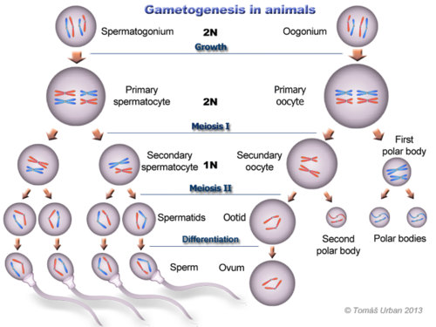
Gametogenesis (Gamete formation)
Gametogenesis is the production of mature male & female gametes (Sperms & Ova).
Gametes are direct descendant of primordial germ cells.
Primordial germ cells are first observed in the wall of the yolk sac the 4th week. then it migrate into the future gonad region.
Spermatogenesis: It is the series of changes by which the primitive germ cells (spermatogonia) are transformed into mature sperms.
divided according to the gendar to :
Oogenesis: Sequence of events by which the primitive germ cells (oogonia) are transformed into mature oocytes.
Types of cell division happen in gametogenesis:
Meiosis 1: At the beginning, (prophase) germ cells replicate their DNA so that each of the 46 chromosomes is duplicated into sister Chromatid.
By the end, each new cell formed (Secondary Spermatocyte or Secondary Oocyte) has a haploid (half) number and each one of half number of chromosome of the Primary Spermatocyte or primary Oocyte.
1
Mitosis: a type of cell division that results in two daughter cells each having the same number(Diploid) as the parent nucleus
2
Meiosis: takes place in the germ cells to produce gametes. It consists of two cell divisions, meiosis I & meiosis II, during which the Diploid number of chromosomes (46) is reduced to Haploid number (23).
Meiosis 2:

Slide 7
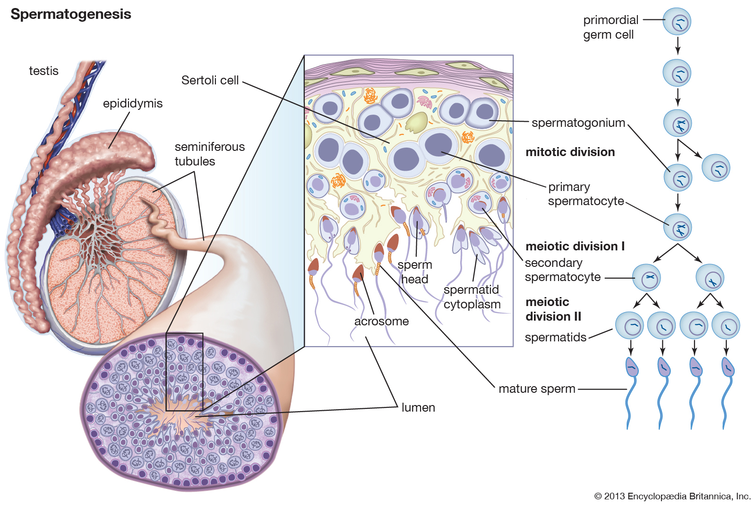
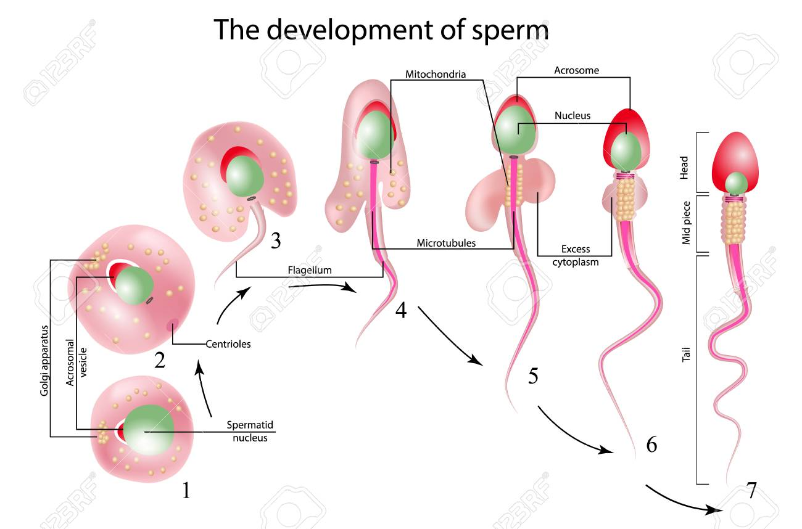
Spermatogenesis:
Jokes aside, stay home and stay safe nerds
Did y’all miss me? -not so secret lecture reviewer
Aim | Site | Time | Duration | Store
Formation of sperms with haploid number of chromosomes. | Seminiferous tubules of the testis. | From puberty till old age | About two months. | Sperms are stored and become functionally mature in the Epididymis
1
Each spermatogonium divides by mitosis into 2 daughter Spermatogonia
2
Each daughter spermatogonia grows to give rise to primary spermatocyte (46).
3
Primary spermatocyte undergoes meiosis I to give rise to secondary spermatocyte (22+ x) or (22+y).
4
Each secondary spermatocyte undergoes meiosis II to form 4 haploid spermatids (half size 23).
5
Spermatids are transformed into
4 mature sperms by a process called spermiogenesis.
6
Change in shape (metamorphosis) through which the Spermatids are transformed into mature motile Sperms:
Nucleus is condensed and forms most of the head.
Golgi apparatus forms the Acrosome, (acrosomal cap).
Mitochondria forms a spiral sheath.
Centriole elongates to form the axial filament.

Slide 8
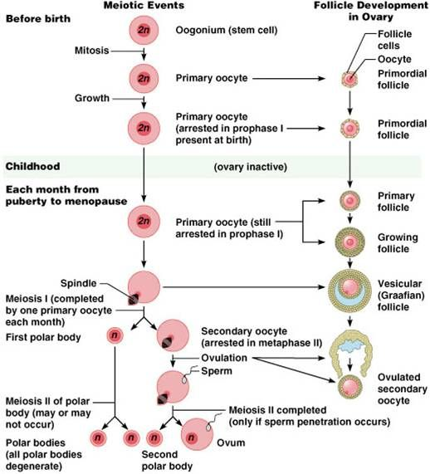
Oogenesis:
Events imp with time
Aim | Site | Time | Duration
Formation of secondary oocytes with haploid number of chromosomes. | Cortex of the ovary | Starts very early during fetal life Completed after puberty and ends at menopause. | It occurs monthly Except during pregnancy.
1
Before Birth (During early fetal life): primitive ova (Oogonium, Oogonia) proliferate by mitotic division into 2 daughter oogonium and enlarge to form Primary Oocytes with diploid number of chromosome, (44+XX) =(46).
2
At Birth: all primary oocytes have completed the prophase of the 1st meiotic division and remain arrested at prophase
3
After Puberty: Shortly before ovulation, A reduction division by which Primary Oocyte completes its first meiotic division (which was arrested at prophase) and give rise to Secondary oocyte (22+X)= (23) & First Polar Body.
 The Secondary Oocyte receives almost all the cytoplasm.
 The First Polar Body It is small nonfunctional cell that soon degenerates and receives very little amount of cytoplasm.
4
At ovulation: the nucleus of the secondary oocyte begins the second meiotic division but progresses only to metaphase where division is arrested.
If the secondary oocyte is fertilized: the second meiotic division is completed as the sperm penetrates the zona pellucida. otherwise it degenerates in 24 hours after ovulation. The secondary oocyte divides into mature ovum and 2nd polar body which degenerates.
Most of the cytoplasm is retained by the Mature Oocyte (Fertilized Oocyte). The rest is in the 2nd Polar Body which soon degenerates.
5

Slide 9
QUIZ
Q1 | Q2 | Q3 | Q4 | Q5 | Q6 | Q7 | Q8
D | B | B | A | C | C | B | A
Q1: How many sperms are produced from primary spermatocyte?
A. 1 Sperm
B. 2 Sperm
C. 3 Sperm
D. 4 Sperm
Q2: what is the fate of secondary oocyte if it is not get fertilized A. re enter the cycle B. degenerates
C. become polar body D. get out with the Menstrual Cycle bleeding
Q3: Which hormone will be released at ovulation?
A. Progesterone
B. LH
C. GnRH
D. FSH
Q4: : When does the primary oocyte complete its first meiotic division?
A. Shortly before ovulation
B. After fertilization
C. after birth
D. Before puberty
Q5: : In which phase does the secondary oocyte arrest in?
A. Anaphase
B. Telophase
C.Metaphase
D. Prophase
Q6: Menstruation is caused by decline in the level of? A. FSH B. LH C.Progesterone D.Estrogen
Q7: site of the Oogenesis
A.Cortex of the uterus
B. Cortex of the ovary
C. medulla of the ovary
D. medulla of the uterus
Q8: Luteal phase lasts for
A. 13 days
B. 14 days
C. 9 days
D. 2-3 days

Slide 10
Members board
Team leaders
Abdulrahman Shadid
Ateen Almutairi
Boys team:
Mohammed Al-huqbani
Salman Alagla
Ziyad Al-jofan
Ali Aldawood
Khalid Nagshabandi
Sameh nuser
Abdullah Basamh
Alwaleed Alsaleh
Mohaned Makkawi
Abdullah Alghamdi
Badr Alshehri
Girls team :
Ajeed Al Rashoud
‏Taif Alotaibi
‏Noura Al Turki
‏Amirah Al-Zahrani
‏Alhanouf Al-haluli
‏Sara Al-Abdulkarem
‏Renad Al Haqbani
‏Nouf Al Humaidhi
Jude Al Khalifah
Nouf Al Hussaini
Danah Al Halees
Rema Al Mutawa
Maha Al Nahdi
Razan Al zohaifi
Ghalia Alnufaei
Contact us:

