Slide 1
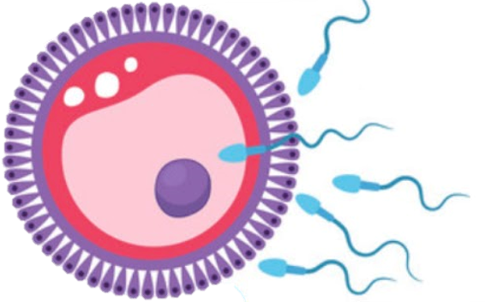
Development of the male reproductive organs
Reproductive block-Embryology-Lecture 3
Editing file

Slide 2
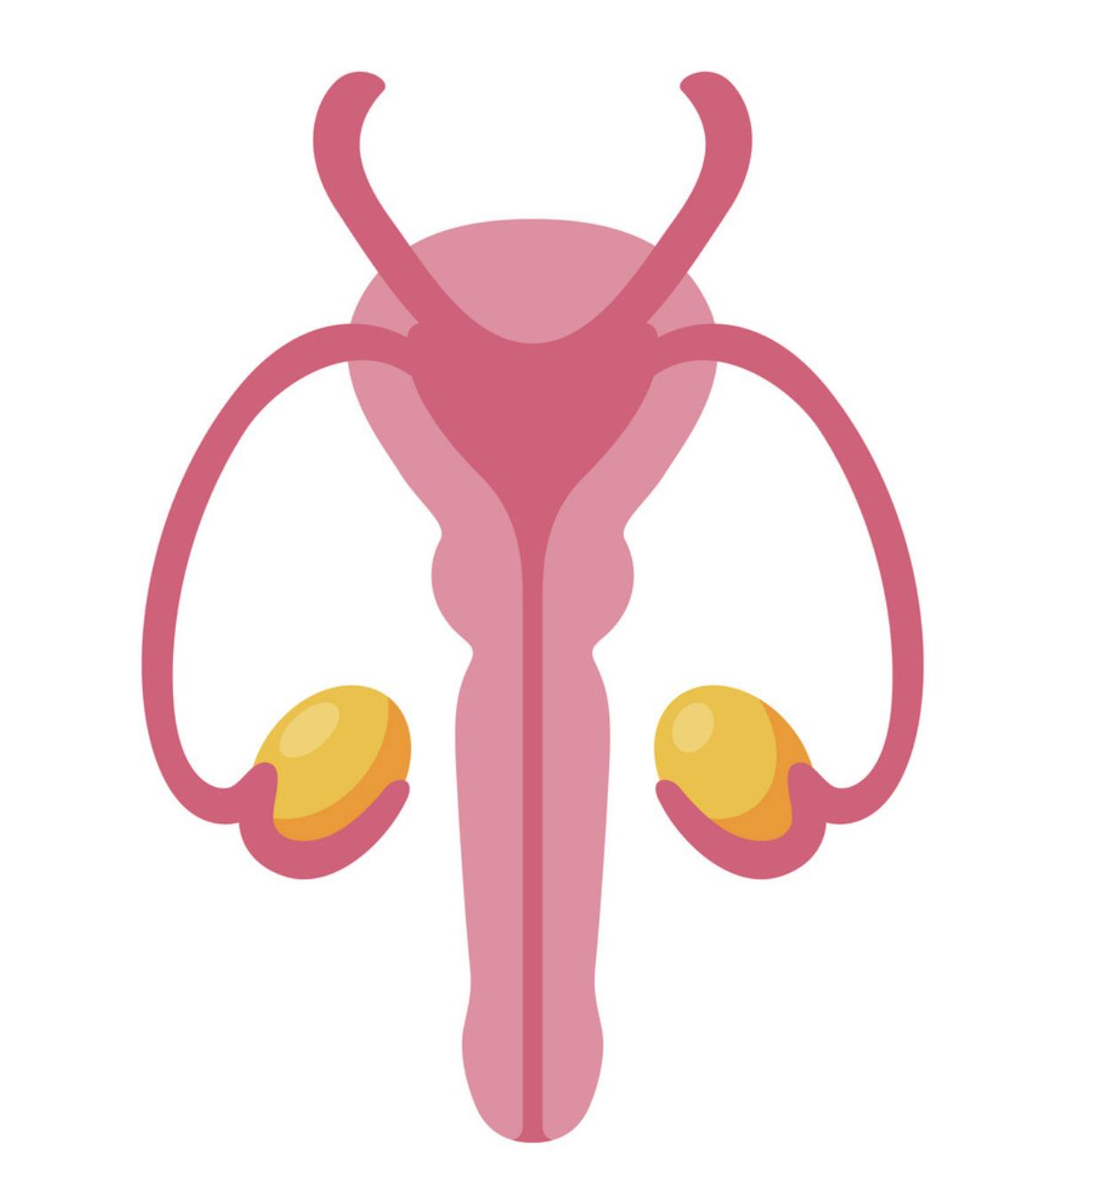
Color guide :
Only in boys slides in Green
Only in girls slides in Purple
important in Red
Notes in Grey
Objectives
At the end of the lecture, students should be able to:
List the causes of differentiation of genitalia into the male type.
Describe the origin of each part of the male internal & external genitalia.
List the causes & describe the events of descent of testis.
List the common anomalies of male genital system & describe the causes of each of them.

Slide 3
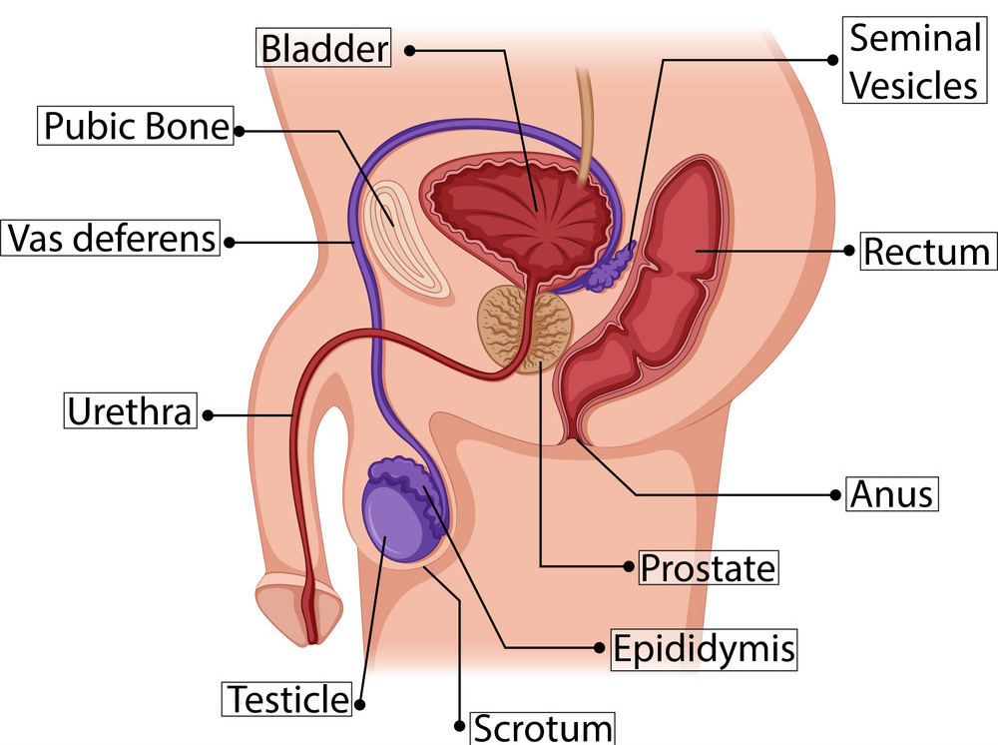
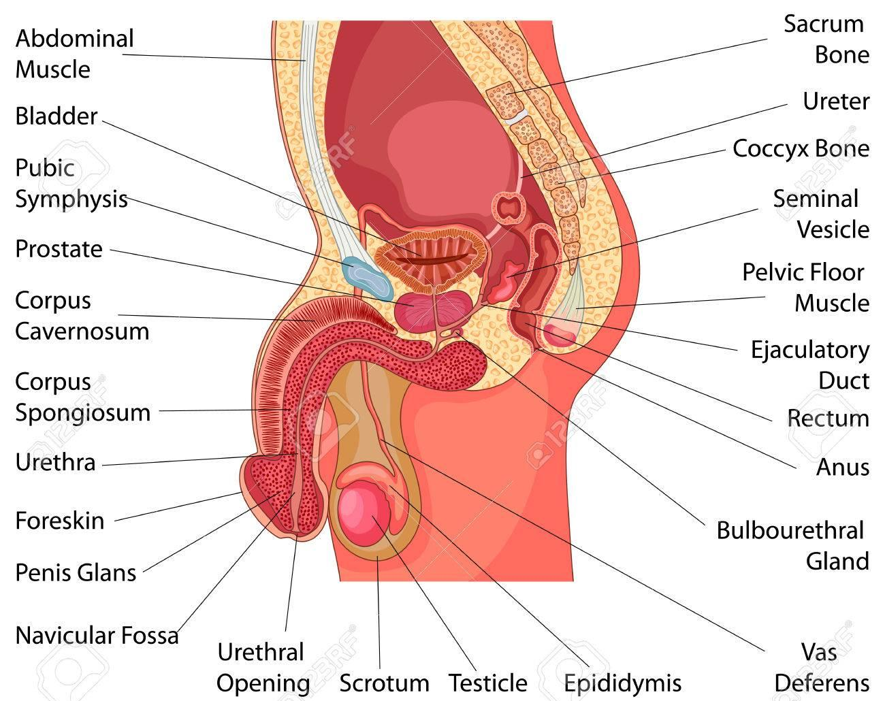
Male genital system
1
Gonad :
Testis.
2
Genital Ducts:
Epididymis.
Vas deferens.
Urethra.
3
Genital Glands:
Seminale vesicle.
Prostate.
Bulbourethral Glands.

Slide 4
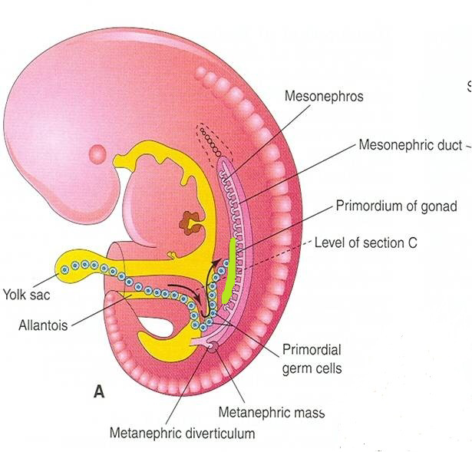
Development of Gonads
Gonads are derived from 3 sources:
1) Primordial germ cells
2) Underlying mesenchyme
3)Mesothelium (epithelium lining the coelomic cavity)
During 5th week gonadal development occurs.
Until 7th week gonads are similar in both sexes and called INDIFFERENT GONADS
Proliferation of mesothelium (cortex)
Gonadal ridge:
a bulge on the medial side of mesonephros produced by
Proliferation of mesenchyme (medulla)
Indifferent Gonads
Gonadal (primary sex) cords:
The proliferating mesothelial cells fuse and penetrate the underlying mesenchyme to form primitive gonadal cords.
Primordial germ cells:
endodermal cells of the yolk sac migrate along dorsal mesentery of hindgut to gonadal ridges & become incorporated into gonadal cords.

Slide 5
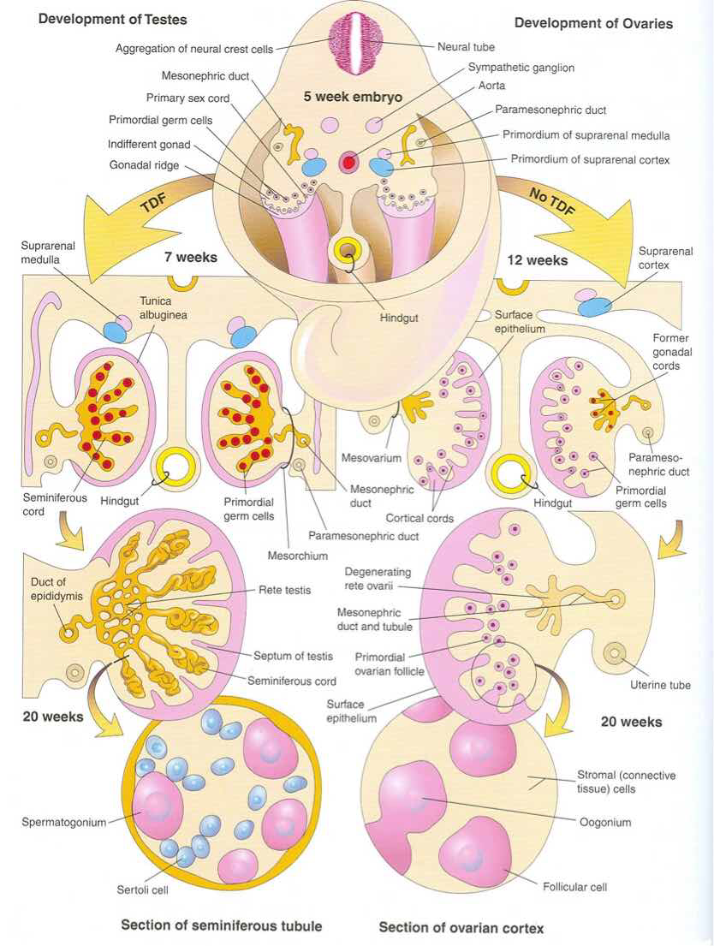
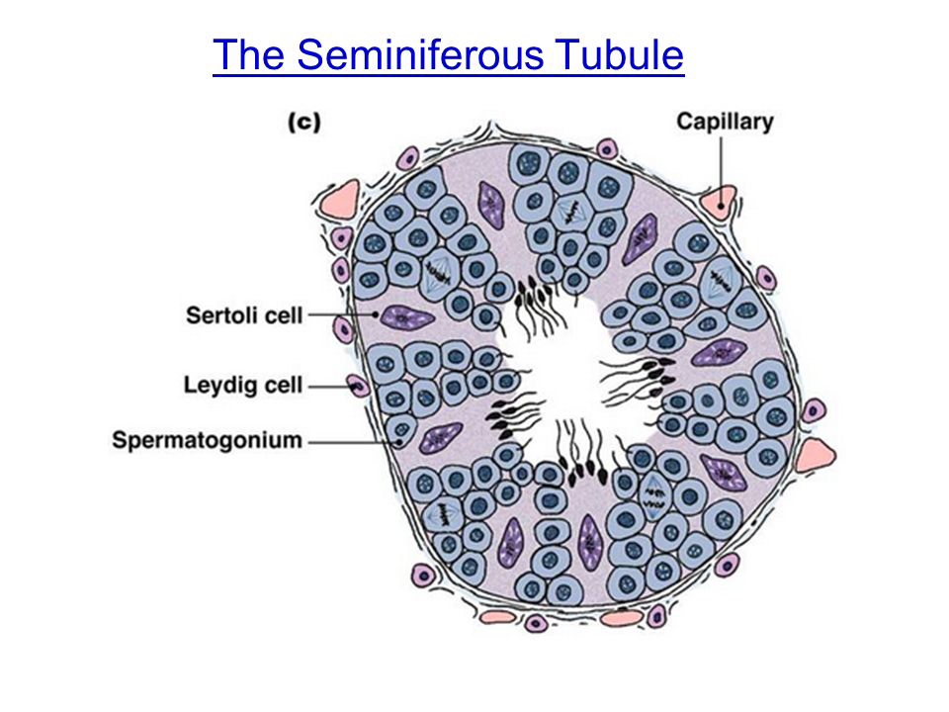
Development of Testis
The genetic sex determined at fertilization and the presence of Y chromosome representante the male phenotype and it has a testis- determining factor (TDF) that differentiates primitive gonad into testis and also differentiates germ cell
At 7th week
Regression of cortex & differentiation of medulla (of primitive gonad) into testis.
The characteristic feature is the development of a thick fibrous capsule (tunica albuginea) that separates the enlarging testis from mesonephros.
Gonadal cords condense & extend into all the medulla (Medullary cords) to form Seminiferous cords.
Seminiferous cords develop into Seminiferous tubules.
Seminiferous tubules remain solid until puberty and Its walls are composed of:
Sertoli cells derived from surface epithelium of testis (mesothelial cells)
Spermatogonia derived from primordial germ cells (endodermal in origin).
At 8th week
Mesenchyme surrounding seminiferous cords mesothelial cells gives rise to interstitial cells (of Leydig) secreting testosterone.

Slide 6
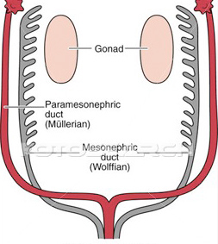
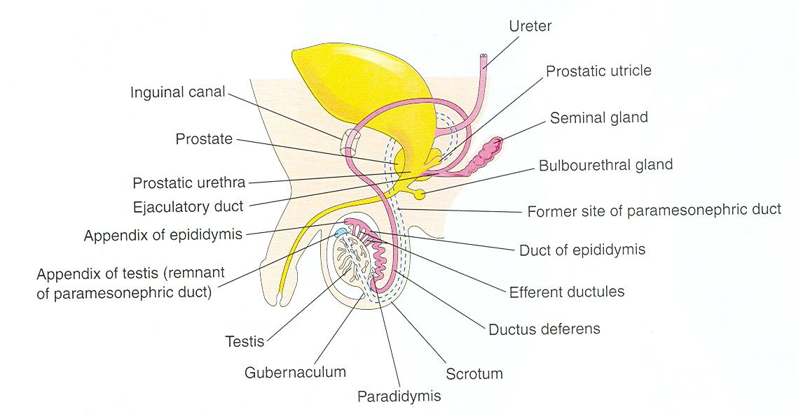
Development of internal genitalia
1) Ducts
Cell | Leydig cells | Sertoli cells
Secretes | Testosterone (8th week) | Müllerian inhibiting substance (Anti- Müllerian hormone) (7th week)
Function | 1) Masculine differentiation of mesonephric duct : epididymis, vas deferens, seminal glands, ejaculatory duct. 2) Masculine differentiation of external genitalia | Suppression of development of paramesonephric (Müllerian) duct
2) Glands
Glands
Seminal | mesodermal outgrowth from mesonephric duct
Prostate | endodermal outgrowth from prostatic urethra.
Bulbourethral | endodermal outgrowth from spongy urethra
Stroma & Smooth muscles in prostate and bulbourethral glands are derived from surrounding mesenchyme.

Slide 7
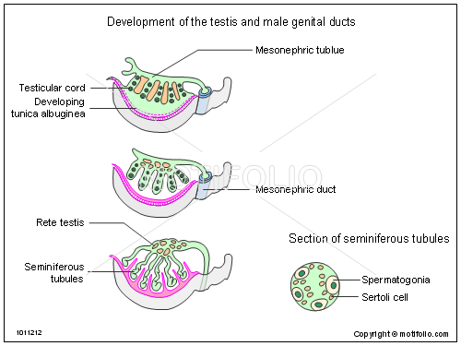
Summary from male slides
Testis
Regression of cortex
+
differentiation of medulla
Gonadal cords extend to medulla & form medullary (semineferous) cords
Appearance of Tunica Albuginea
Semineferous cords give rise to: Semineferous tubules
Germ cells
Spermatogonia
Mesenchyme surrounding tubules gives rise to: Interstitial cells of Leydig
Mesothelial cells
Sertoli cells
2) Internal genitalia
Mesodermal structures | Endodermal structures
Testis: from medulla of genital ridge. | Spermatogonia: from primordial germ cells of yolk sac.
Seminiferous tubules: from medullary cords of ridge. | Prostate gland: from prostatic urethra.
Sertoli cells: from mesothelial cells of ridge. | Bulbourethral gland: from spongy urethra.
Leydig cells: from mesenchyme surrounding the tubules.
Epididymis, vas deferens, seminal gland, ejaculatory duct: from mesonephric duct.

Slide 8
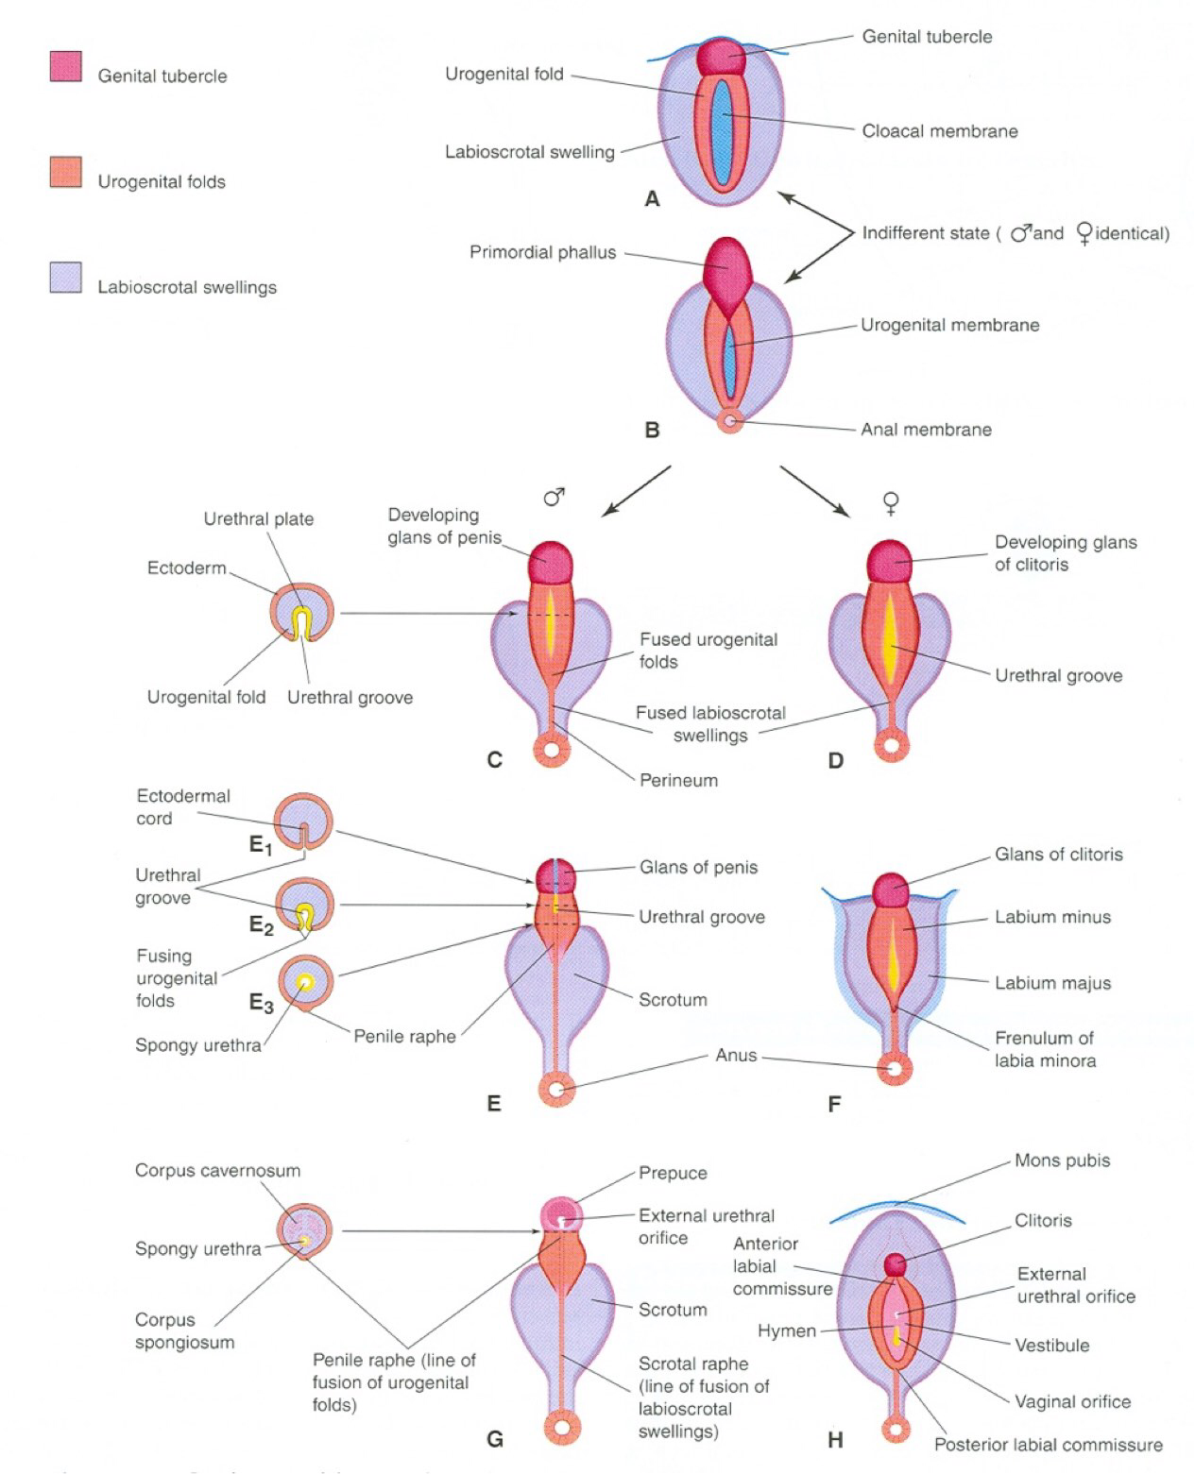
Development of external genitalia
Indifferent Stage
(from 4th to 7th week)
Genital tubercle
produced from mesenchyme at the cranial end of cloacal membrane. It elongates to form a primordial phallus
Urogenital folds | Labioscrotal swellings
develop on each side of cloacal membrane | develop on each side of urogenital folds
Different Stage
Stimulated by testosterone
Begins at 9th week
Complete differentiation at 12th week:
The phallus enlarges to form the penis
The urogenital folds fuse to form the spongy (penile) urethra
The labioscrotal folds (swellings) fuse to form the scrotum

Slide 9
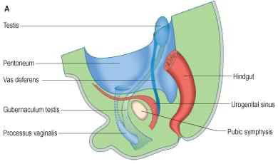
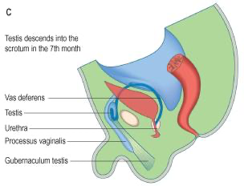
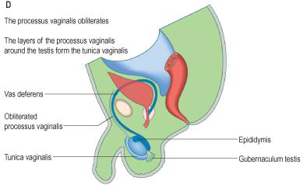
Descent of testis
Gubernaculum: a mesenchymal band extending from inferior pole of gonad to labioscrotal fold.
Inguinal canal: a pathway formed by gubernaculum through layers of anterior abdominal wall.
Processus vaginalis: a peritoneal fold passing through inguinal canal before testis, to facilitate its descent
Descent of testis occurs in 2 steps:
Types | 1.Internal | 2.External
Definition | Descent of testis from posterior abdominal wall to deep inguinal ring. | Descent of testis from deep inguinal ring, through inguinal canal, to scrotum
Time | During 12th week | Begins in 7th month and takes 2 to 3 days
Causes | a relative movement resulting from elongation of cranial part of abdomen away from its caudal part (future pelvic Inguinal canal cavity). | 1. Controlled by androgens. 2. Guided by gubernaculum. 3. Facilitated by processus vaginalis. 4. Helped by increased intra-abdominal pressure resulting from growth of abdominal viscera.
Internal Descent
External Descent

Slide 10
External Descent of Testis
More than 97% of full-term newborn males have both testes in scrotum.
During first 3 months after birth, most undescended testes descend into scrotum.
No spontaneous descent occurs after the age of 1 year.
Complete descent of testis is associated by:
1
Degeneration of gubernaculum.
2
Obliteration of stalk of processus vaginalis.
3
Persistence of part of processus vaginalis surrounding the testis in the scrotum to form “tunica vaginalis”
Descent of testis

Slide 11
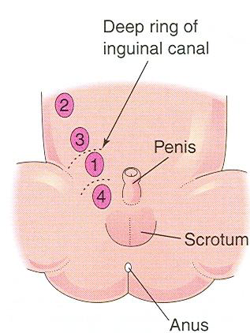
Congenital Deformities
Hydrocele of spermatic cord
Congenital inguinal hernia
Hydrocele of testis
Cryptorchidism
Incidence: is up to 30% of premature & 3-4% of full term males
Cause: deficiency of androgens.
Common sites: Cryptorchid testes may be in the abdominal cavity or anywhere along the usual path of descent of the testis, but they are usually in the inguinal canal. look to figure.
Complications:
1. Sterility, if bilateral.
2. Testicular cancer (20-44%).
Accumulation of fluid in spermatic cord
due to a non-obliterated portion of stalk of processus vaginalis
-Definition: Herniation of a loop of intestine through a non- obliterated processus vaginalis .
-Types: A: incomplete
B: complete (in
-Cause: The processus
vaginalis does not obliterate & remains in open communication with the peritoneal cavity
Accumulation of fluid in tunica vaginalis (in scrotum) due to non-obliteration of the whole stalk of Processus vaginalis
scrotum)
4

Slide 12
QUIZ
Q1 | Q2 | Q3 | Q4 | Q5 | Q6 | Q7 | Q8
D | D | D | B | B | D | A | C
Q1: which one of the following is considered indifferent gond?
A. Gonadal ridge
B. Gonadal cord
C. Primordial germ cells
D. All of above
Q2: interstitial cells (of Leydig) secreting testosterone. happen…? A. During 5th week
B. During 6th week
C. At 7th week
D. By 8th week
Q3: Mesodermal outgrowth from spongy urethra is:
A. Seminal gland
B. Prostate gland
C. Bulbourethral gland
D. Non of above
Q4: Complete descent of testis is associated by:
A. Formation of gubernaculum
B. Obliteration of stalk of processus vaginalis
C. Degradation of tunica vaginalis
D. All of above
Q5: Deficiency of androgens cause?
A. Inguinal hernia
B. Cryptorchidism
C. Hydrocele of spermatic cord
D. Hydrocele Of Testis
Q6: Accumulation of fluid in tunica vaginalis cause: A. Inguinal hernia
B. Cryptorchidism
C. Hydrocele of spermatic cord
D. Hydrocele Of Testis
Q7: The processus vaginalis remains in open communication with the peritoneal cavity cause:
A. Inguinal hernia
B. Cryptorchidism
C. Hydrocele of spermatic cord
D. Hydrocele Of Testis
Q8: Accumulation of fluid in spermatic cord cause:
A. Inguinal hernia
B. Cryptorchidism
C. Hydrocele of spermatic cord
D. Hydrocele Of Testis

Slide 13
Members board
Team leaders
Abdulrahman Shadid
Ateen Almutairi
Boys team:
Mohammed Al-huqbani
Salman Alagla
Ziyad Al-jofan
Ali Aldawood
Khalid Nagshabandi
Sameh nuser
Abdullah Basamh
Alwaleed Alsaleh
Mohaned Makkawi
Abdullah Alghamdi
Girls team :
Ajeed Al Rashoud
‏Taif Alotaibi
‏Noura Al Turki
‏Amirah Al-Zahrani
‏Alhanouf Al-haluli
‏Sara Al-Abdulkarem
‏Renad Al Haqbani
‏Nouf Al Humaidhi
Jude Al Khalifah
Nouf Al Hussaini
Danah Al Halees
Rema Al Mutawa
Maha Al Nahdi
Razan Al zohaifi
Ghalia Alnufaei
Contact us:

