Slide 1
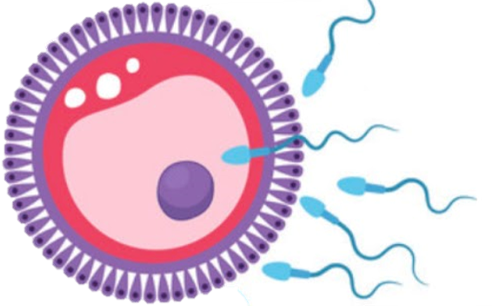
Placenta
Reproductive block-Embryology-Lecture 4
Editing file

Slide 2
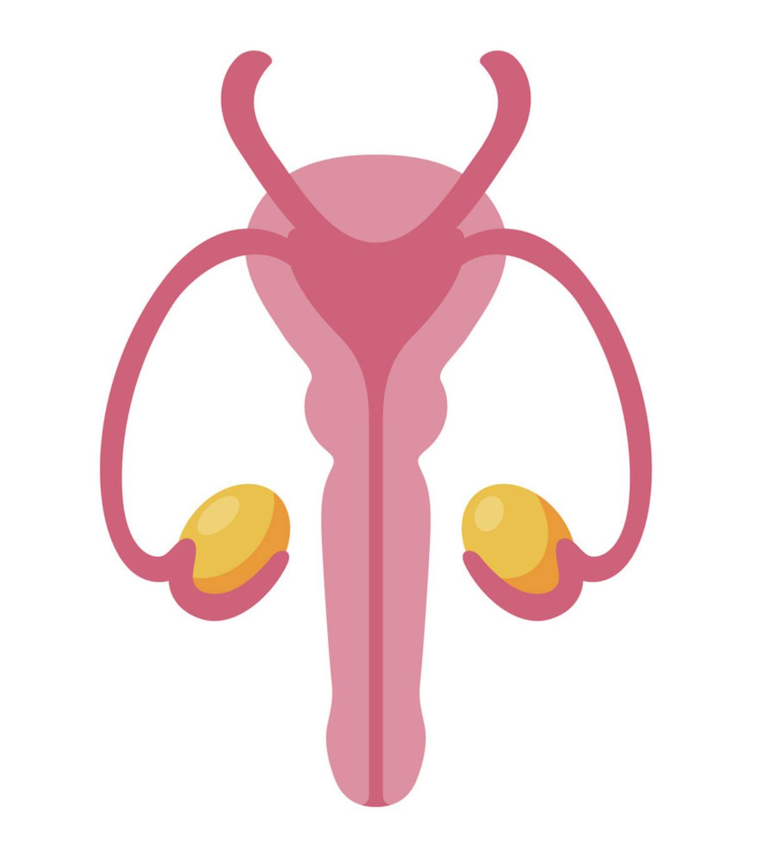
Color guide :
Only in boys slides in Green
Only in girls slides in Purple
important in Red
Notes in Grey
Objectives
At the end of the lecture, students should be able to:
Identify nothing because there is no objectives in the Dr’s lectures
There is also nothing here but we want to fill the space
It is worth noting that, this lecture was done while coronavirus pandemic
I would like to thank the batch and academic leaders for their hard working in these two years
Free space for adding any things

Slide 3
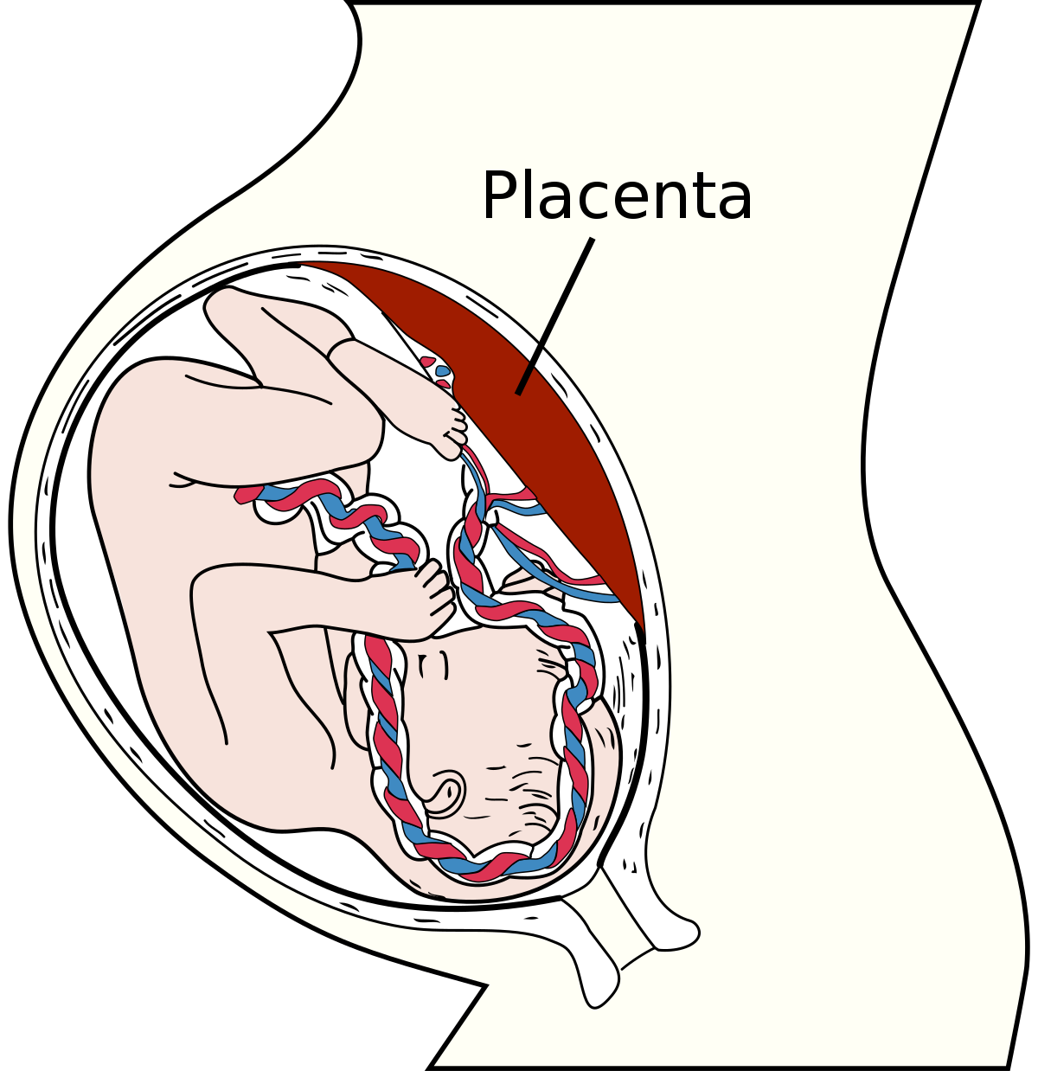
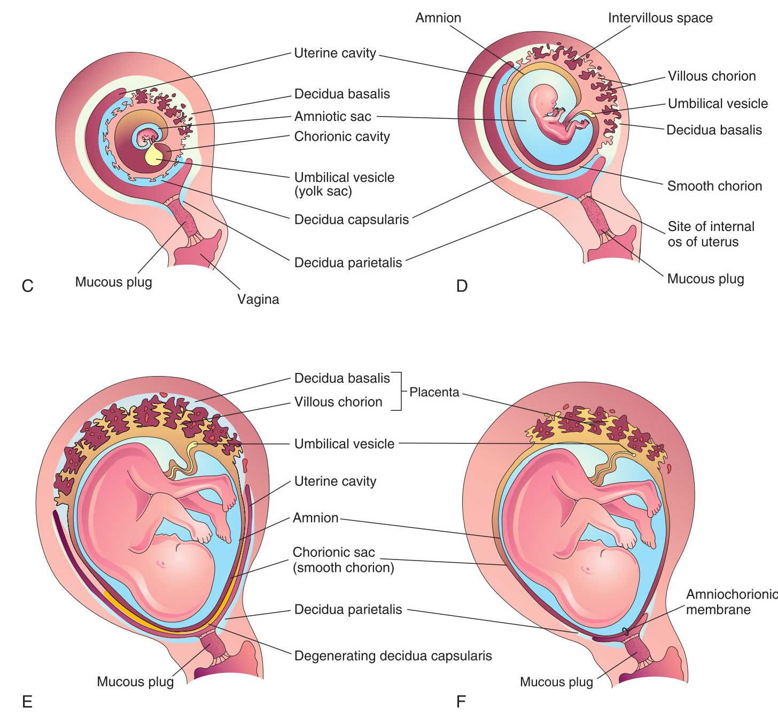
Placenta
Introduction
It is a fetomaternal structure.
Formed by the beginning of the 4th month. and by the end of the 4th month a complete vascular network in placenta is established (after degenerate of corpus luteum)
It is the primary site for exchange of gases and nutrients between mother and fetus
Full term placenta shows: Discoid in shape, Weighs (500 – 600)g, Diameter 15-25 cm, Thickness 2-3 cm.
Umbilical cord is attached to the center.
It has two surfaces: Fetal & Maternal.
Fate of placenta : Within 15 minutes after birth of the infant, the strong uterine contractions that continue after birth compress uterine blood vessels to limit bleeding & cause the placenta to detach from the uterine wall.
Formation
Fetal Part
Villous Chorion.
It is the bushy area at the embryonic pole.
Its villi are more in number, enlarged and branch profusely.
Maternal Part
Decidua Basali (part of the decidua deep to the conceptus.)
By the end of 4th month, the decidua basalis is replaced by the fetal component of the placenta.
Decidua (Gravid Endometrium): It is the functional layer of the endometrium during pregnancy which is shed after parturition.

Slide 4
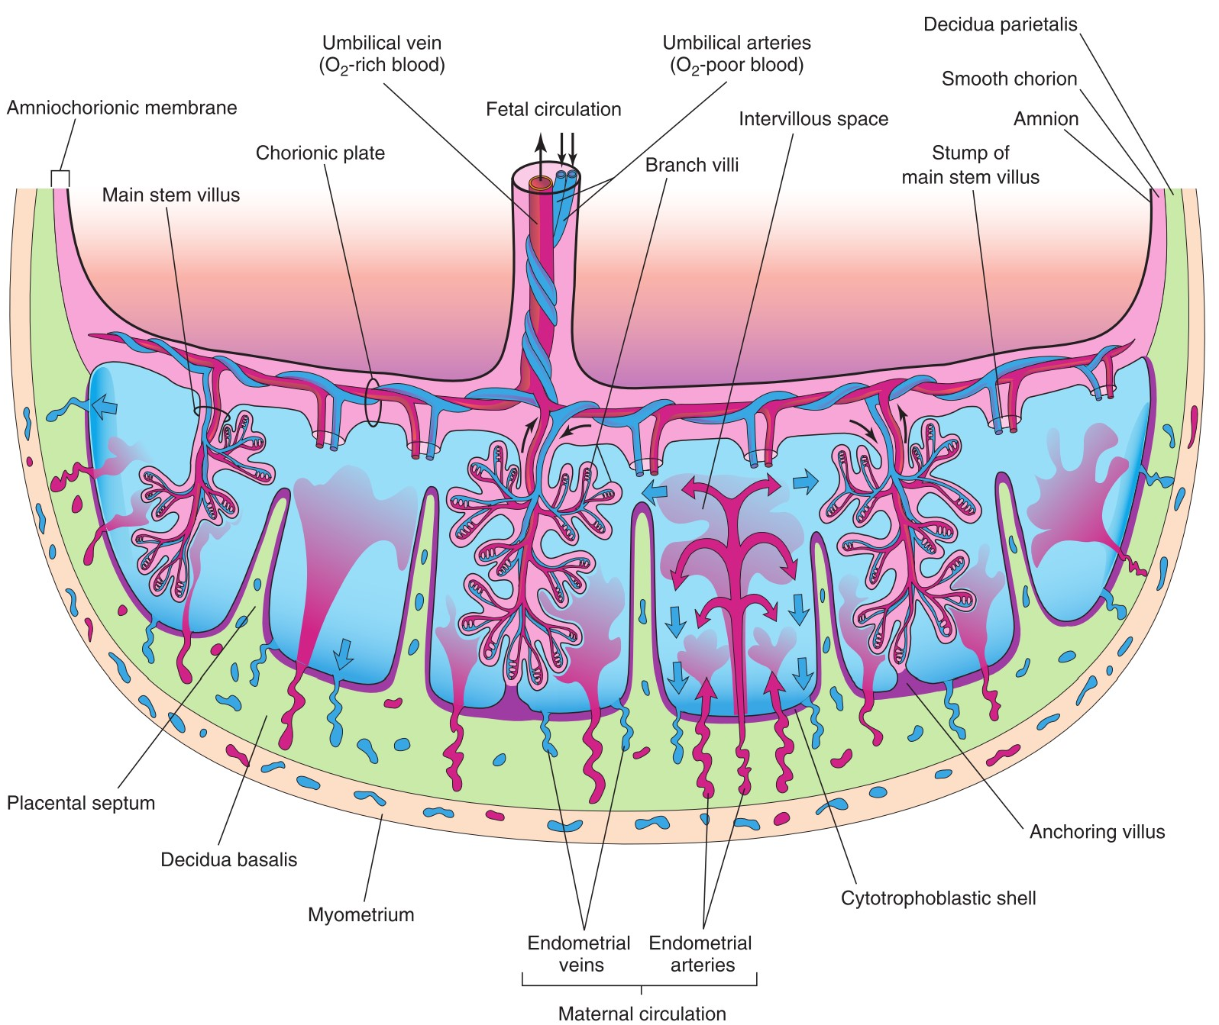
Placenta cont.
Placental externally
Surfaces
Fetal Surface
Maternal Surface
Smooth because it is covered with the amnion.
Developed from chorionic sac.
The umbilical cord is attached to its center.
The chorionic vessels are radiating from the umbilical cord.
Rough.
Derived from endometrium.
Formed of (15 –20) irregular convex areas (Cotyledons) which are separated by grooves (placental septa).
Each cotyledon is covered by a thin layer of decidua basalis.
Placental internally
Structure of a Cotyledon
It consists of two or more stem villi with their many branch villi.
It receives (80-100) maternal spiral arteries that enter the intervillous spaces at regular intervals.
Intervillous Space
Large blood filled spaces which are freely communicating.
They receive spiral arteries from the lacunae in the syncytiotrophoblast.
The spaces are drained through endometrial veins.
Both arteries and veins pass through pores in the cytotrophoblastic shell.
Cotyledon

Slide 5
Placental circulation
Fetal placental circulation
80 –100 spiral endometrial arteries discharge into the intervillous space.
The blood is propelled in jet like fountains by the maternal blood pressure.
Now the pressure of this entering blood is higher than that in the intervillous space.
It forms a roof of the space.
As the pressure dissipates, the blood flows slowly around the branch villi.
Exchange of metabolites and gases with the fetal blood.
As the pressure decreases, the blood flows back from the chorionic plate and enter the endometrial veins to the maternal circulation.
Two Umbilical Arteries:
Carry poorly oxygenated blood from the fetus to the placenta.
Within the branch chorionic villi, they form:
Arterio-capillary venous network:
It brings the fetal blood extremely close to the maternal blood.
The well oxygenated fetal blood in the capillaries passes into veins accompanying the chorionic arteries.
❸
❷
❹
❶
At the umbilical cord, they form the One Umbilical Vein.
Maternal placental circulation

Slide 6
Placental Membrane
It is a composite thin membrane of extra fetal tissues which separates the fetal and maternal bloods.
Upto(20) weeks
it is composed of four layers:
At full term
it becomes thinner and composed of three layers only:
1
Syncytiotrophoblast
1
Syncytiotrophoblast
2
Cytotrophoblast.
2
Connective tissue of the villus
3
Connective tissue of the villus
3
Endothelium of fetal capillaries
Endothelium of fetal capillaries
4
At some sites, the syncytio comes in direct contact with the endothelium of the capillaries and forms Vasculo syncytial placental membrane.

Slide 7
Functions of placenta
Has there main function
1. Metabolic
2. Transportation of:
3. Endocrine Synthesis:
Synthesis of:
Glycogen
Cholesterol
Fatty Acids
which supply the fetus with nutrients and energy.
A) Gases:
Exchange of O2, CO2 and CO is through simple diffusion.
The fetus extracts (20 –30) ml of O2/minute from the maternal blood
B) Drugs and Drug metabolites:
They cross placenta by simple diffusion.
They can affect the fetus directly or indirectly by interfering with placental metabolism.
(1) Progesterone:Maintains pregnancy if the corpus luteum is not functioning well
(2) Estrogen: Stimulates uterine growth and development of the mammary glands.
(3) Human chorionic somatotropin (HCS) or Hpl: A growth hormone that gives the fetus the priority on maternal blood glucose. It promotes breast development for milk production
(4)Human chorionic gonadotropin (HCG) : Maintains the corpus luteum and used as indicator of pregnancy.
C) Maternal Antibodies: Maternal immunoglobulin G gives the fetus passive immunity to some infectious diseases (measles, small box) and not to others (chicken box).
D) Hormones: Protein hormones do not reach the embryo in sufficient amounts. some of these hormones (Thyroxine & Testosterone which may cause masculinization of a female fetus) can cross the placental membrane.
E) Waste products: Urea and uric acid pass through the placental membrane by simple diffusion.
F) Nutrients and Electrolytes: Water, Amino acids, Carbohydrates, Vitamins and Free Fatty Acids are rapidly transferred to the fetus.

Slide 8
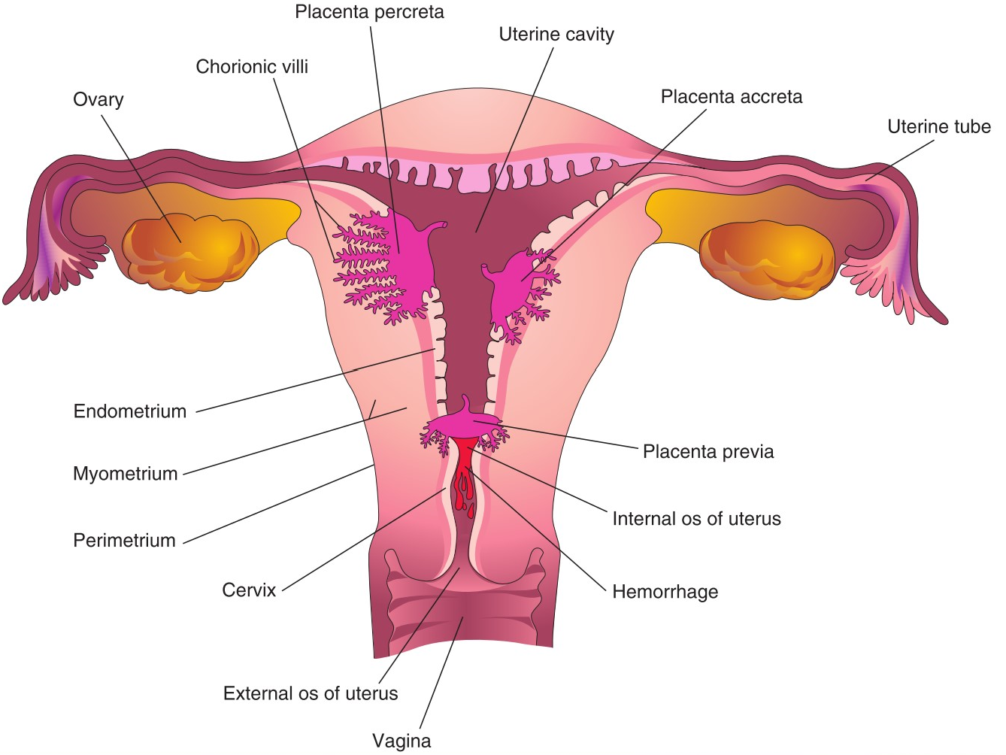
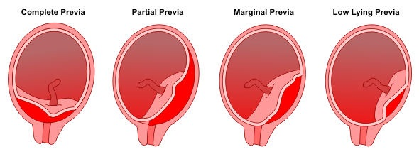
Anomalies Of Placenta
Effect Of Maternal Drugs On Fetus
Placenta Accreta
Abnormal absence of chorionic villi with partial or complete absence of the decidua basalis.
Placenta Percreta
Chorionic villi penetrate the myometrium to the perimetrium.
The most common presenting sign of these two anomalies is trimester bleeding.
Placenta Previa
The blastocyst is implanted close to or overlying the internal uterine os.
It is associated with late pregnancy bleeding.
Delivery is through Cesarean section.
Fetal drug addiction can be due to some drugs as Heroin.
All sedatives and analgesics can affect the fetus to some degree.
Drugs used for management of labor can cause respiratory distress to the newborn

Slide 9
QUIZ
Q1 | Q2 | Q3 | Q4 | Q5 | Q6 | Q7 | Q8
C | C | B | A | B | D | B | B
Q1: Which of the following layers mostly disappears in full term placenta
A. syncytiotrophoblast
B. Endothelium of fetal capillaries
C. Cytotrophoblasts
D. Connective tissue of the villi
Q2: Which of the following Anomalies is associated with late pregnancy bleeding A. Placenta Accreta B. Placenta Percreta
C. Placenta Previa D. Placenta increta
Q3: fetal surface of placenta Derived from…..
A. endometrium
B. chorionic sac
C. Yolk sac
D. Connective tissue of the villus
Q4: placenta can synthesis ……..
A. Glycogen
B. Collagen
C. amino acid
D. protein
Q5: which of these hormone Maintains the corpus luteum
A. hCS
B. hCG
C.Progesterone
D. Estrogen
Q6: The most common presenting sign of Placenta Percreta A. anal bleeding B. pain in the abdomen C. blood in urine D. trimester bleeding
Q7: the Umbilical Arteries carry
A. deoxygenated blood
B. poorly oxygenated blood
C. highly oxygenated blood
D. mixed blood
Q8: Each Cotyledon contains
A. one or more stem vill
B. two or more stem vill
C. only two stem vill
D. at least three stem vill

Slide 10
Members board
Team leaders
Abdulrahman Shadid
Ateen Almutairi
Boys team:
Mohammed Al-huqbani
Salman Alagla
Ziyad Al-jofan
Ali Aldawood
Khalid Nagshabandi
Sameh nuser
Abdullah Basamh
Alwaleed Alsaleh
Mohaned Makkawi
Abdullah Alghamdi
Girls team :
Ajeed Al Rashoud
‏Taif Alotaibi
‏Noura Al Turki
‏Amirah Al-Zahrani
‏Alhanouf Al-haluli
‏Sara Al-Abdulkarem
‏Renad Al Haqbani
‏Nouf Al Humaidhi
Jude Al Khalifah
Nouf Al Hussaini
Danah Al Halees
Rema Al Mutawa
Maha Al Nahdi
Razan Al zohaifi
Ghalia Alnufaei
Contact us:

