Slide 1
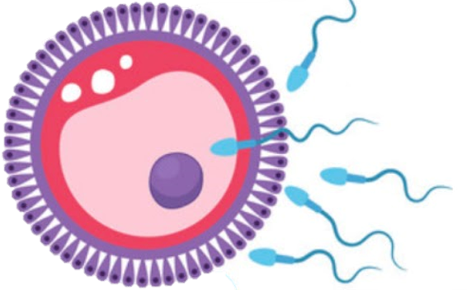
Fertilization and Implantation
Reproductive block-Embryology-Lecture 5
Editing file

Slide 2
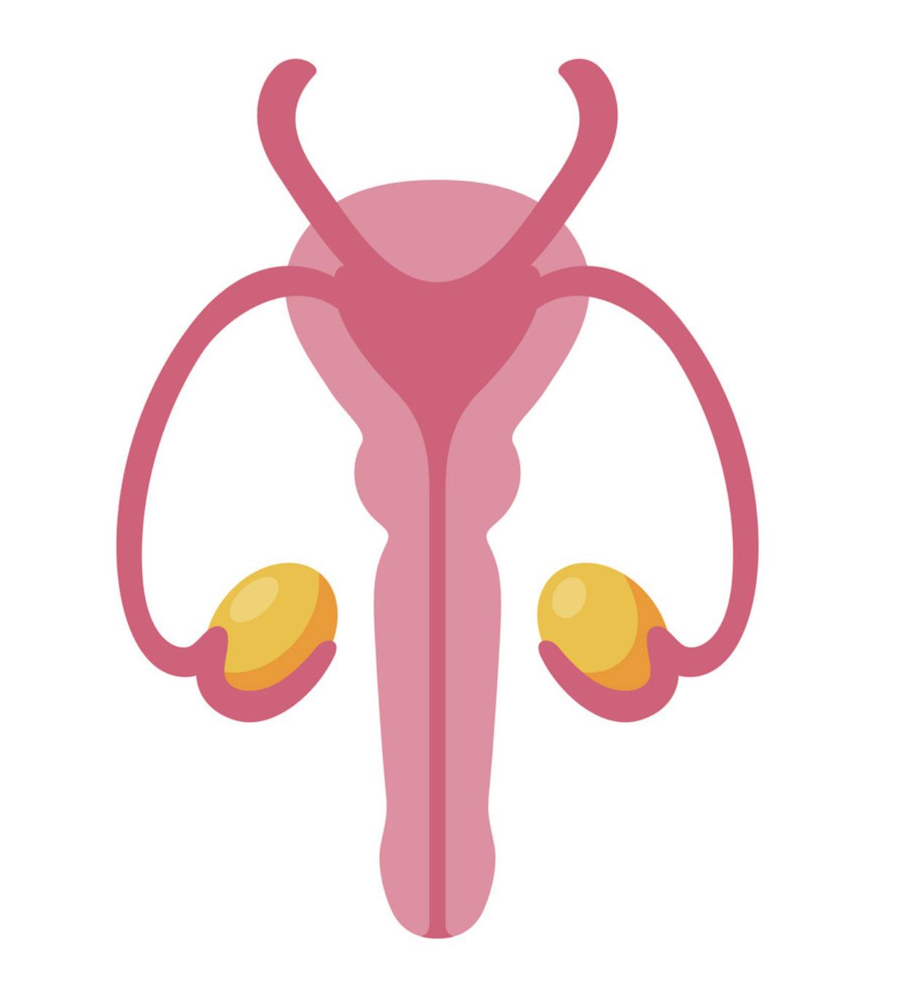
Color guide :
Only in boys slides in Green
Only in girls slides in Purple
important in Red
Notes in Grey
Objectives
At the end of the lecture, students should be able to:
Identify fertilization and its site.
List the phases of fertilization.
Describe the results of fertilization.
Describe the formation of blastocyst.
Identify implantation and its site.
Describe the mechanism of implantation.
List the common sites of ectopic pregnancies.

Slide 3
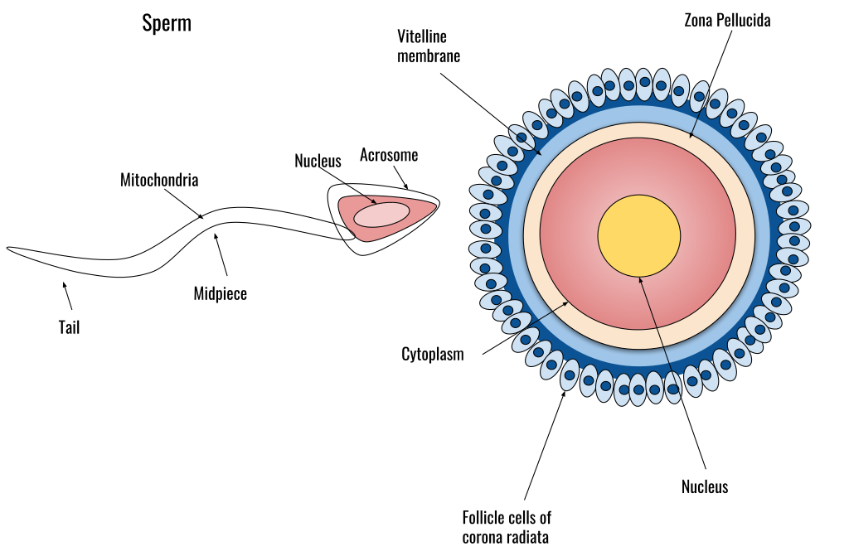
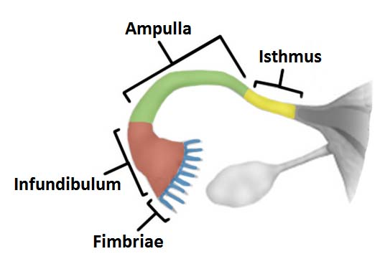
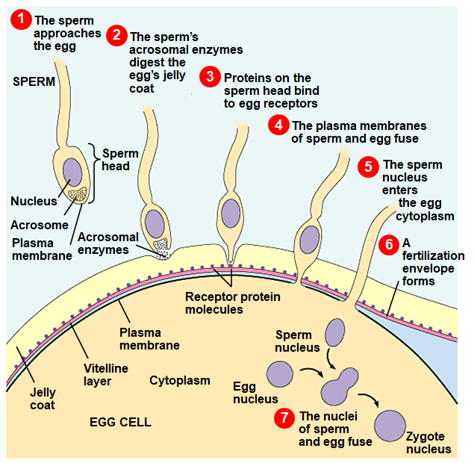
Fertilization
It is the process during which a male gamete (sperm), and a female gamete (oocyte), unite together to form a single cell (ZYGOTE).
It is a complex process, begins with a contact between sperm & ovum.
Ends up with intermingling of the maternal and paternal chromosomes
Location of Fertilization
It usually occurs in the ampulla of uterine tube, which is the widest part of the tube.
Also may occur in any other part of the tube, but Never occurs in the uterine cavity.
Chemical signal from oocyte attracts the sperms.
Also peristaltic movement of the tube from medial to lateral help the sperm to reach the oocyte
Phase of Fertilization
Passage of the sperm through the cells of the corona radiata by the effect of:
Hyaluronidase enzyme secreted from the sperms.
By movement of its tail.
Fusion of the plasma membranes of the oocyte and the sperm.
5
Formation of the female pronucleus
1
3
6
Formation of the male pronucleus.
2
Penetration of the zona pellucida by acrosine (a substance secreted from acrosomal cap)
4
Completion of the second meiotic division of the oocyte, which was arrested at (metaphase)
Union of the 2 pronuclei to form the zygote
7

Slide 4
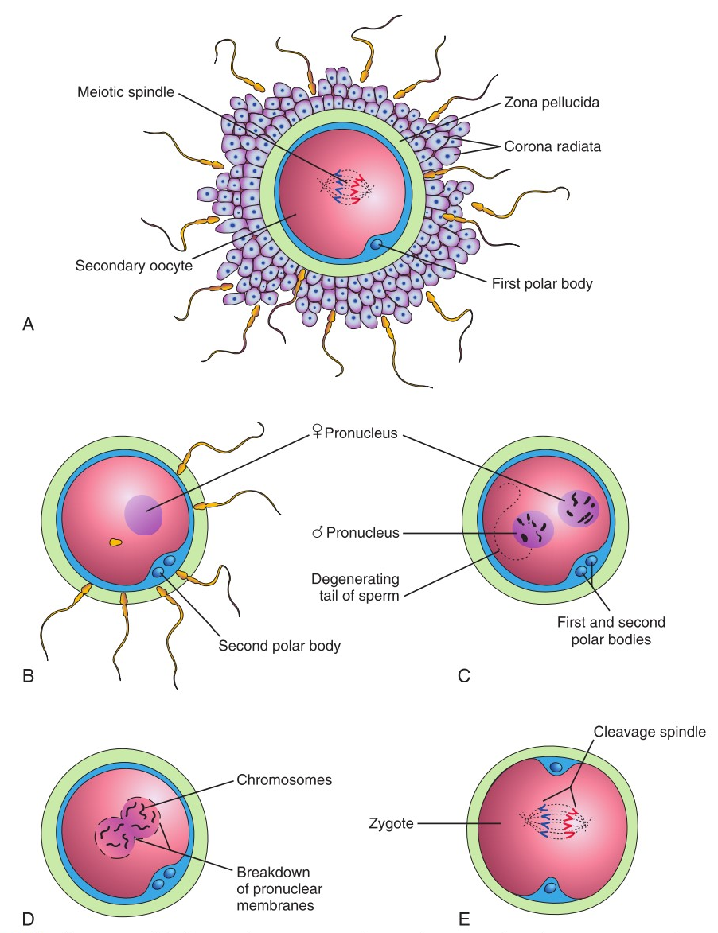
Fertilization cont.
The Zygote
Is genetically a unique structure.
Half of its chromosomes comes from the father and the other half comes from the mother.
New combination is formed which is different from either of the parents, This mechanism forms biparental inheritance and leads to variation of the human species.
Embryo's chromosomal sex is determined at the time of fertilization by the type of sperm (X or Y) that fertilizes the oocyte. So, it is the father whose gamete decides the sex.
when the lucky sperm enter, a reaction called Zonal reaction happen which is a change in properties of zona pellucida that makes it impermeable to other sperms
Results of Fertilization
1
It stimulates the penetrated oocyte to complete its 2nd meiotic division.
3
Determines the sex of the embryo.
2
Restores the diploid number of chromosomes.
4
Initiates cleavage of the zygote (cell division).

Slide 5
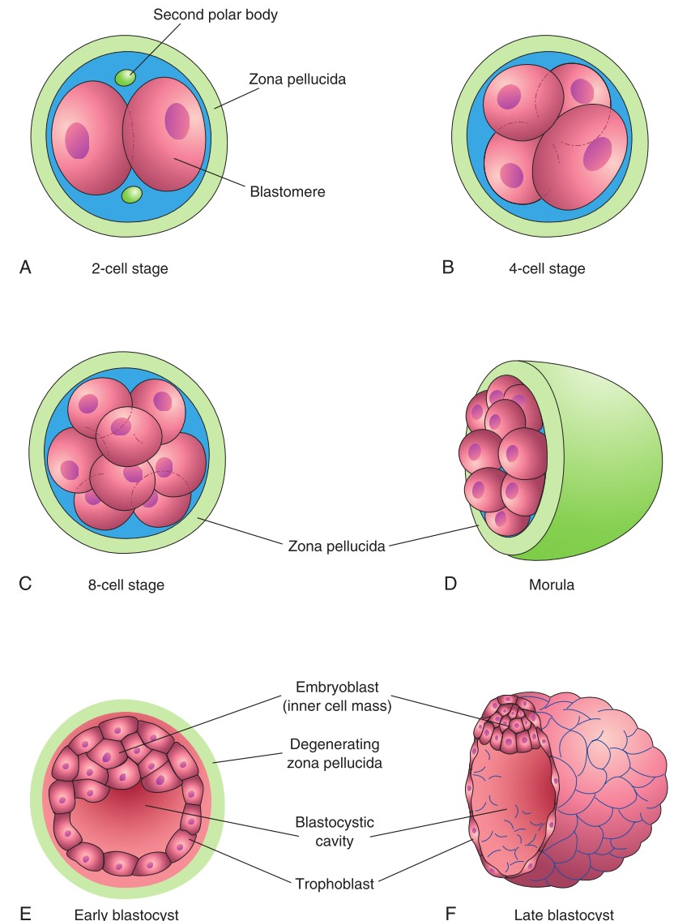
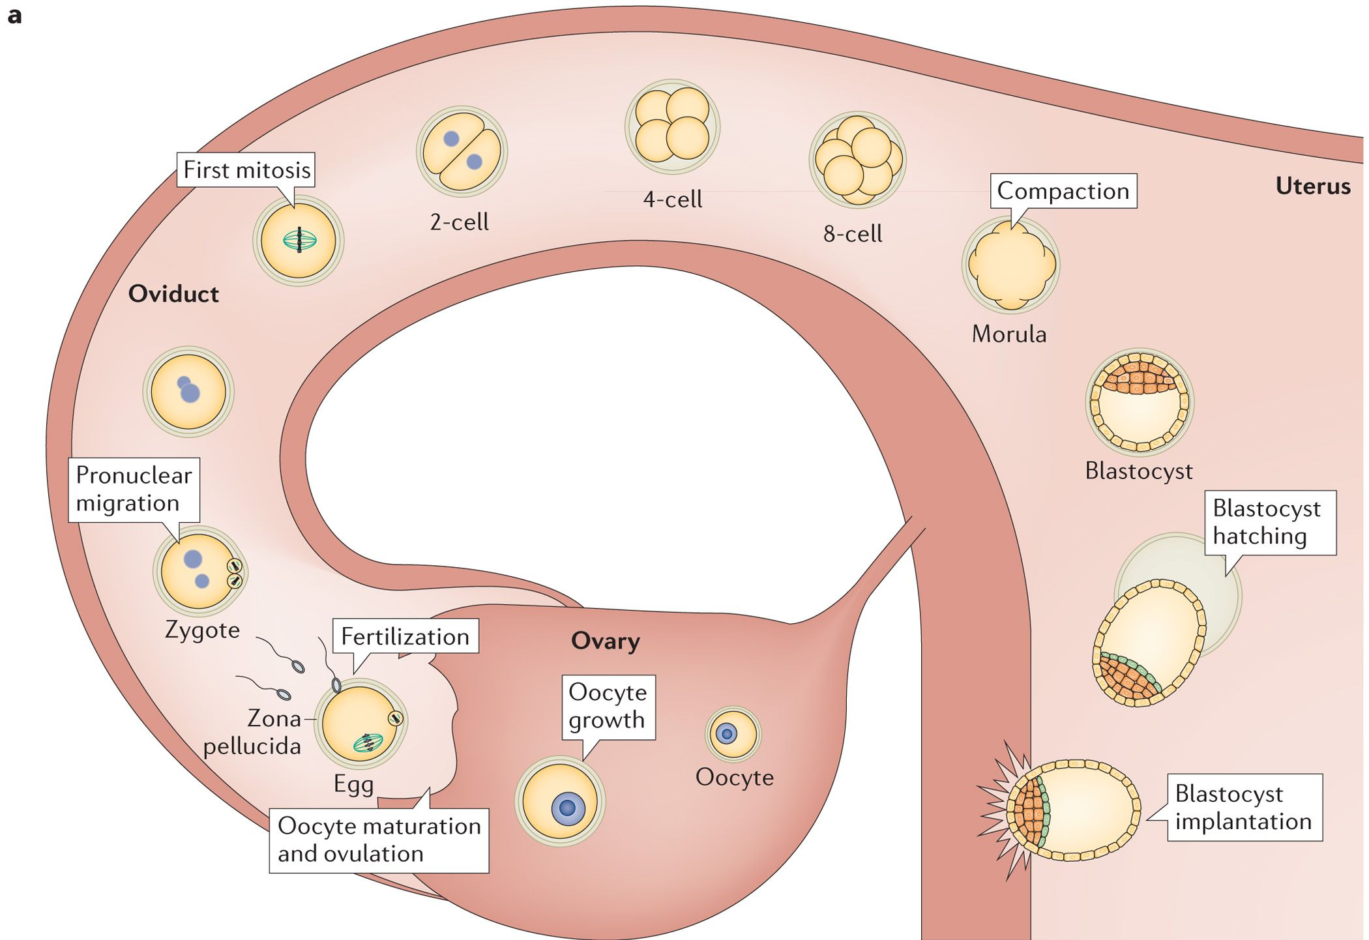
Fertilization cont.
Cleavage of Zygote
Morula
01
02
It is the repeated mitotic divisions of the zygote.
Normally occurs in the uterine tube.
Rapid increase in the number of the cells.
These smaller embryonic cells are now called, Blastomeres.
Cleavage begins about 30 hours after fertilization.
Zygote divides into 2, then 4, then 8, then 16 cells and lies within the thick zona pellucida during cleavage.
Zygote migrates in the uterine tube during cleavage from its lateral end to its medial end.
The zona pellucida is a thick translucent membrane under the microscope.
When there are 16 to 32 blastomeres the developing human is called MORULA.
Spherical Morula is formed about the 3rd day after fertilization.
It resembles mulberry or blackberry.
It reaches the uterine cavity by the 4th day.
A cavity appears within the morula dividing its cells into 2 groups now its called blastocyst
Zona pellucida is still found in this stage
Blastocyst
03
A cavity appears within the morula dividing its cells into 2 groups:
Outer cell layer called trophoblast.
Inner cell layer (mass) called Embryoblast attached to one of the poles of the blastocyst.
The cavity is called blastocystis cavity or blastocele.

Slide 6
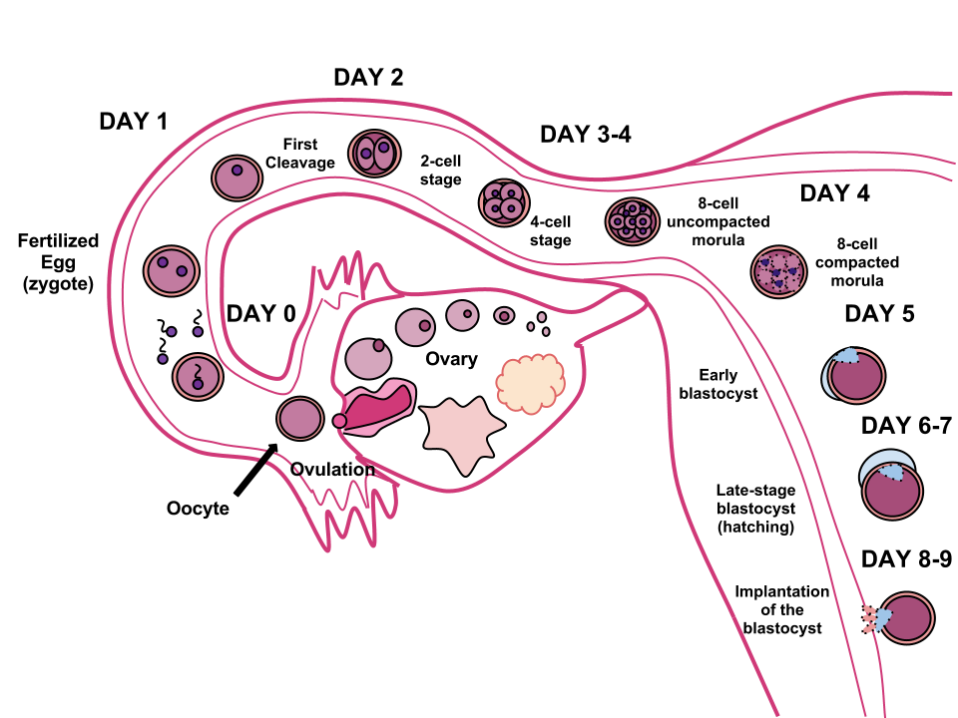
Implantation
Definition
It is the process by which the Blastocyst penetrates the superficial (compact) layer of the endometrium of uterus (in which stage implantation happen ? Blastocyst )
Site
Time
Normal site of implantation is the posterior wall of the body of the uterus near the fundus.
It begins about the 6th day after fertilization and completed by the 11th or 12th day
Detection of Implantation
Can be detected by:
Ultrasonography
hCG (human chorionic gonadotropin which is secreted by the Syncytiotrophoblast) about the end of 2nd week.( detected in the urine (used as a pregnancy test)
Early Pregnancy Factor
is an immunosuppressant protein secreted by trophoblast cells
Appears in maternal serum within 24--48 hrs,after implantation.
It is the basis for EPT (Early pregnancy test) in the first 10 days of development.

Slide 7
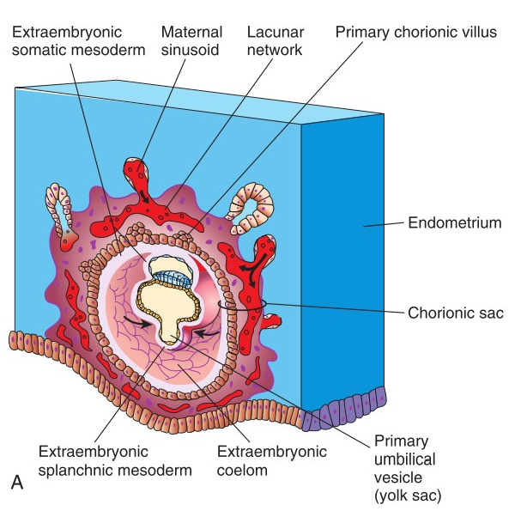
Implantation: Mechanism
By 4th day
The Morula reaches the uterine cavity It remains free within the uterine cavity for one or two days. Fluid passes from uterine cavity to the Morula. Now the Morula is transformed into Blastocyst, its cavity is called blastocystic cavity or blastocele, and its cells divided into Embryoblast & Trophoblast.
By 6th day
blastocyst adheres to the endometrium
By 11th or 12th day.
Syncytiotrophoblast erodes the endothelial lining of the maternal capillaries which known as sinusoids Now blood of maternal capillaries reaches the lacunae so Uteroplacental circulation begins Endometrial cells undergo a process called apoptosis (programmed cell death) to facilitates invasion of endometrium by the Syncytiotrophoblast. Syncytiotrophoblast engulf these degenerated cells for nutrition of the embryo
By 7th day
Trophoblast differentiated into 2 layers: Syncytiotrophoblast (outer multinucleated cytoplasmic mass, with indistinct cell boundary) Cytotrophoblast (inner layer, mitotically active)
By 13th day
Proliferation of Cytotrophoblast cells produce extension within the Syncytiotrophoblast to form primary chorionic villi
By 5th day
the zona pellucida degenerates & disappears to allows the blastocyst to increase in size and penetrates the endometrium The embryoblast projects into the blastocystic cavity, while the trophoblast forms the wall of the blastocyst
By 8th day
blastocyst is superficially embedded in the compact layer of the endometrium
Day 4
Day 7
Day 8
Day 9
By 10th or 11th day.
Blood-filled Lacunae appear within the Syncytiotrophoblast which communicate with each other forming a network
Day 10
Day 12
Day 13

Slide 8
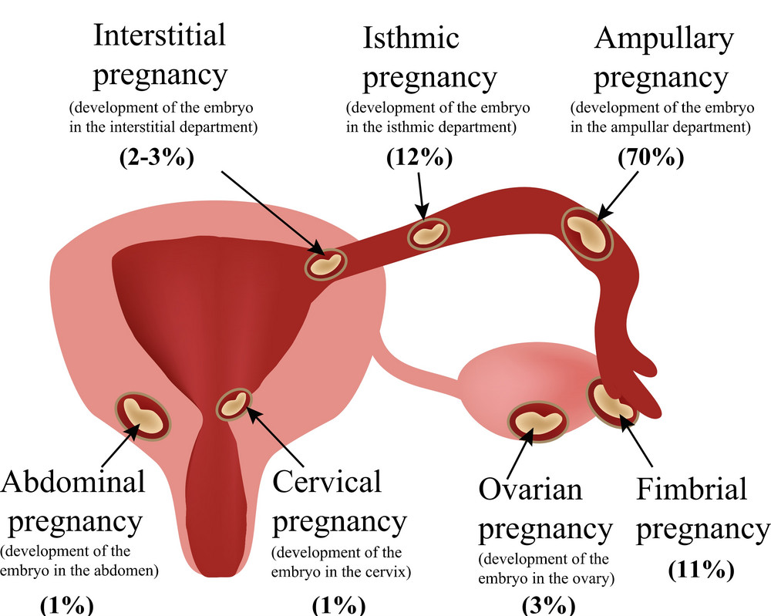
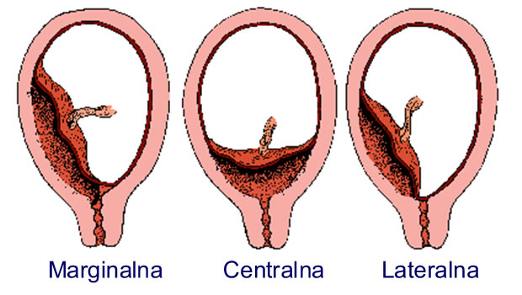
Ectopic Pregnancy
It means implantation outside the uterine cavity (normally, it’s near the fundus)
95 to 97% of ectopic pregnancies occurs in the uterine tube.
Most are in the ampulla & isthmus.
Could happen in
Placenta Previa
Tubal :is the most common type of ectopic pregnancy
Ovarian: is the least common type of ectopic pregnancy
Abdominal.
Pelvic
Cervical.
Placenta Previa:
Implantation occurs in the lower uterine segment
Has 3 types:
Placenta previa centralis: the placenta anchor in internal os of the cervix
Placenta previa lateralis :in the lower part of the body of the uterus
Placenta previa marginalis :in the lower part of the body of the uterus and reach the cervix

Slide 9
QUIZ
Q1 | Q2 | Q3 | Q4 | Q5 | Q6 | Q7 | Q8
A | A | C | B | D | C | A | D
Q1: Fertilization mainly occurs in?
A. In ampulla of uterine tube
B. In isthmus of uterine tube
C. In uterine cavity
D. In the vagina
Q2: Which of the following happens immediately after fertilization? A. Restore the diploid number B. Formation of blastocyst
C. Become haploid D. Beginning of 2nd meiotic
Q3: During implantation which one of the following structures will invade the endometrium?
A. Cytotrophoblast
B. Epiblast
C. Syncytiotrophoblast
D. Hypoblast
Q4: 20-years-old woman presented to the clinic with late period, she was referred to the lab for blood investigations, which one of the following enzymes will be found?
A. hSG
B. hCG
C. Estrogen
Q5: What is the normal site for Implantation?
A. Ampulla
B. Uterine tube
C. lateral wall of the body of the uterus
D. posterior wall of the body of the uterus
Q6: in which day the Implantation start ? A. 7th day B. 4th day C. 6th day D. 11th day
Q7: the outer cell layer of the Blastocyst called ?
A. trophoblast
B. blastocele
C. blastocystis
D. Morula
Q8: in which day the Uteroplacental circulation begins ?
A. 13th day B. 7th day C. 9th day D. 11th day

Slide 10
Members board
Team leaders
Abdulrahman Shadid
Ateen Almutairi
Boys team:
Mohammed Al-huqbani
Salman Alagla
Ziyad Al-jofan
Ali Aldawood
Khalid Nagshabandi
Sameh nuser
Abdullah Basamh
Alwaleed Alsaleh
Mohaned Makkawi
Abdullah Alghamdi
Girls team :
Ajeed Al Rashoud
‏Taif Alotaibi
‏Noura Al Turki
‏Amirah Al-Zahrani
‏Alhanouf Al-haluli
‏Sara Al-Abdulkarem
‏Renad Al Haqbani
‏Nouf Al Humaidhi
Jude Al Khalifah
Nouf Al Hussaini
Danah Al Halees
Rema Al Mutawa
Maha Al Nahdi
Razan Al zohaifi
Ghalia Alnufaei
Contact us:

