Slide 1
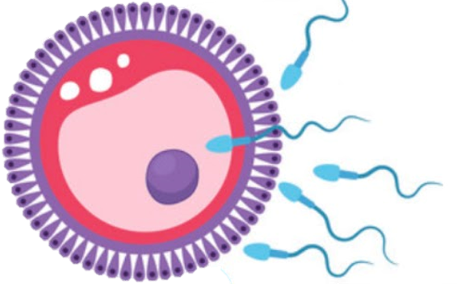
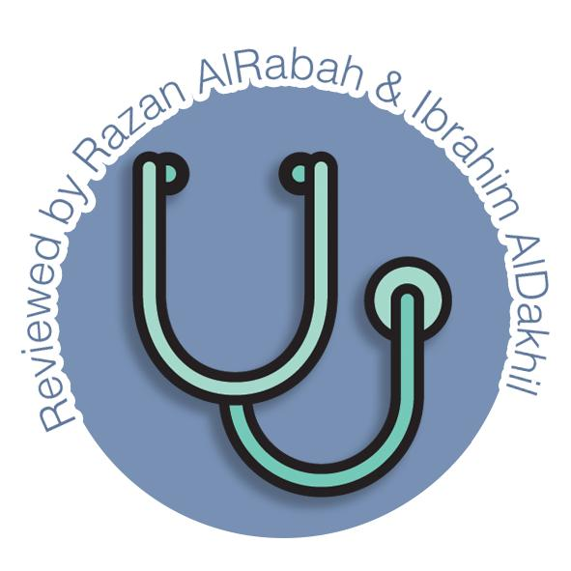
Fetal circulation
Reproductive block-Embryology-Lecture 6
Editing file

Slide 2
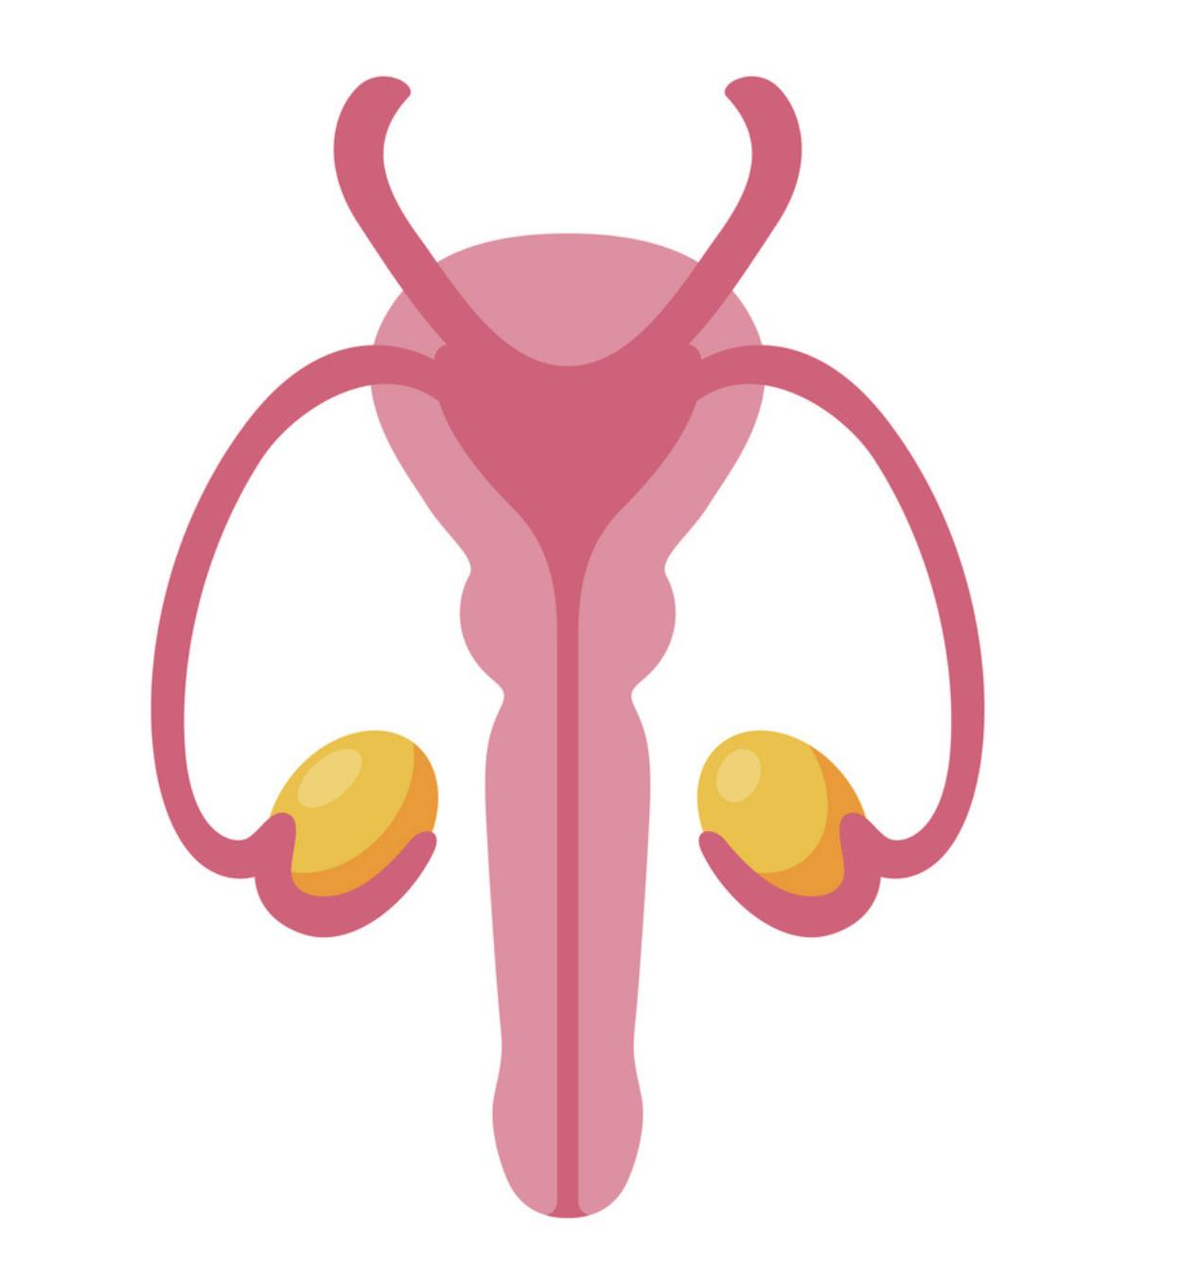
Color guide :
Only in boys slides in Green
Only in girls slides in Purple
important in Red
Notes in Grey
Objectives
At the end of the lecture, students should be able to:
Identify the nothing again because there is no objective here
Part 3
So I decided to turn this into a series “The Diaries of a Dying Man”, pretty dramatic isn’t it? This is the 3rd entry into this series, for those of you who care enough to read the previous two, you’ll have to search for it, but I’ll give you a hint, check pharma and micro teams, which lecs you ask? I won’t say, it’ll ruin the fun.
God who am I even talking to? It’s not like there are any survivors left, and even if there are, I doubt they’ll be this carefree that they’ll read this nonsense. But I need to do this, it’s the only thing keeping me sane.
Today is the 20th of April, 2020. I believe that it’s Monday, but I wouldn’t know for sure. The number of cases is at 2.4 million, Yes, you read that right, million.
I can’t even remember the last time I heard a human voice other than mine, I’ve been hearing voices all day but I’m certain they’re in my head, at least I hope so.
Tbh I’d expect anything these days, my house being possessed wouldn’t be a surprise.
No no that’s not possible, I must be hallucinating. Anyway, thankfully my food supply will last me for a few more months, so that’s not an issue. But I can’t help but worry, who knows how long this will last? I might need to go searching for food in a few months, but for now I can’t be stressed about that or else I’ll really lose my mind.
I hope this end soon, I miss my friends.
-A Terrified Man

Slide 3
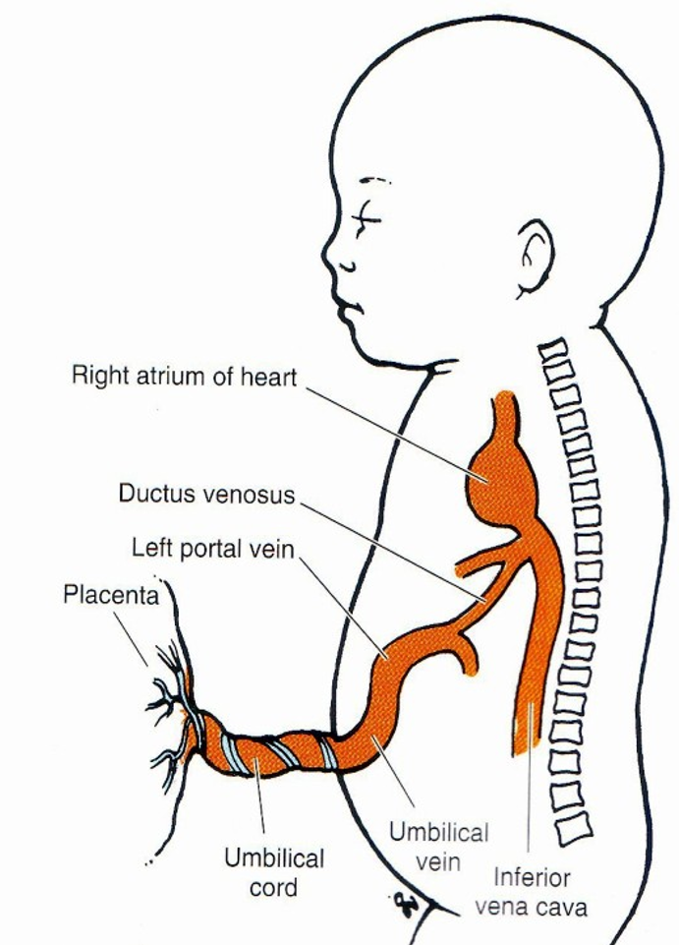
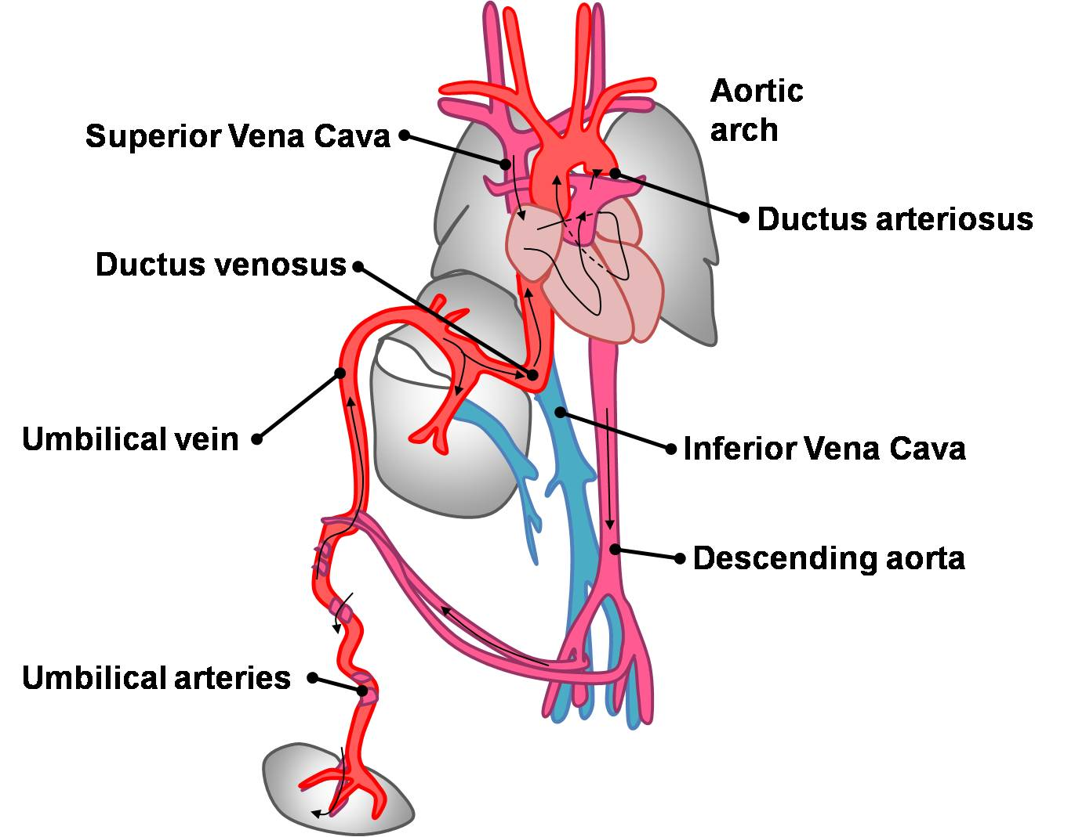
Fetal circulation
Fetal Cardiovascular system is designed for two purposes :
To serve prenatal needs.
To permit modifications at birth, which establish the neonatal circulation.
Good respiration in the newborn infant is dependent completely upon normal circulatory changes that occur at birth.
Three structures are very important in the transitional circulation:
Ductus venosus.( duct between 2 veins, umbilical vein and IVC)
Ductus arteriosus.( duct between 2 arteries, between pulmonary artery and the aortic artery )
Foramen ovale.(opening in the heart between R & L atrium )
Blood reaches & leave the fetus through the umbilical cord which is contains :
Two arteries
One vein.

Slide 4
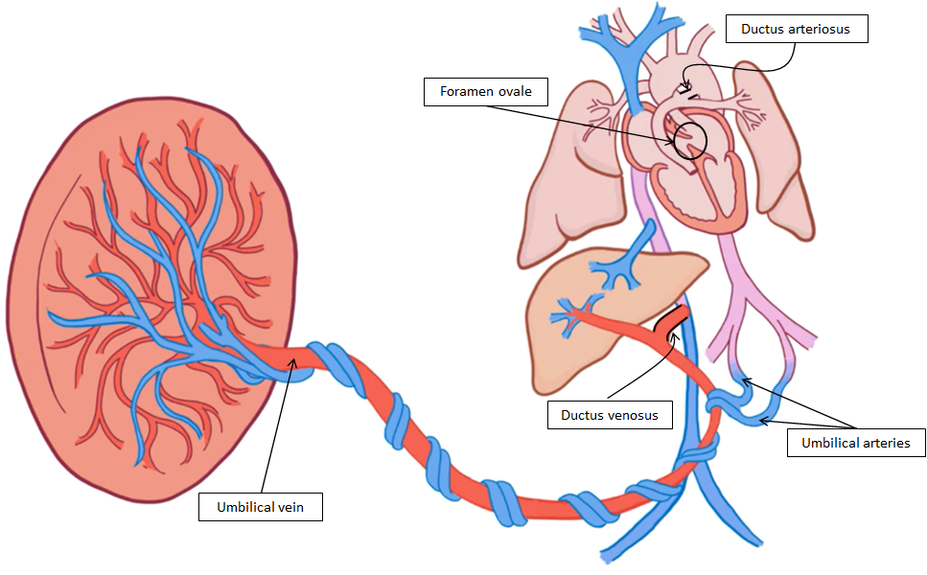
Steps Of Fetal Circulation
1
Highly oxygenated blood passes from the placenta through the umbilical vein.
Half of this blood reaches the IVC directly through the ductus venosus.
The other Half passes first to liver sinusoids then to the IVC.
It is believed that there is a valve in the liver at the entrance of the umbilical vein. This valve controls the amount of blood going either to the liver sinusoids or to the Ductus venosus.
3
Then to the left ventricle to the ascending aorta , and the aortic arch to supply the head and neck , brain , heart (cardiac muscle), liver & upper limbs so they receive highly oxygenated blood.
➌
➎
➋
➍
4
Small amount of highly oxygenated blood that remains in right atrium mixes with venous blood of the SVC passes to right ventricle .
➎
➊
2
Blood of the IVC which is highly oxygenated reaches the right atrium, then directly to the left atrium through the foramen ovale.
5
Then to pulmonary artery then to ductus arteriosus (between the pulmonary trunk & proximal part of descending aorta) , to the descending aorta , to the lower half of the fetal body .Then back to placenta via the umbilical arteries

Slide 5
Changes after Birth
01
ligation of the umbilical cord
04
Constriction of ductus arteriosus
Sudden fall of blood pressure in the IVC and the right atrium. so, The valve of the ductus venosus constricts.
By the end of the first 24 hours 20% of the lumen of the ductus is closed .
By the end of 48 hours 82% is closed .
By 96 hours 100% of the duct is closed .
It is believed that, there is a substance released from fetal lungs during their initial inflation called Bradykinin.
This substance has a contractile effect on smooth muscles of the ductus arteriosus.
The action of this substance appears to be dependant on the high Oxygen saturation of the aortic blood.
When oxygen tension reaches 50 mmHg in the ductus arteriosus it causes constriction of its smooth muscles.
During intrauterine fetal life the patency of ductus arteriosus (before birth) is controlled by the low contents of oxygen in the blood passing through it.
So hypoxia and other ill-defined factors keep the ductus arteriosus patent.
02
Aeration of the lungs at birth
Marked increases in the pulmonary blood flow.
Dramatic fall in pulmonary vascular resistance .
Thinning in the wall of the pulmonary arteries .
03
Closure of foramen ovale
physiological closure , (immediately) due to decrease of pressure in the right atrium while increase in left atrium forces the septum primum against the septum secundum
Anatomical closure ,(12 weeks\3 months ) due to proliferation of the epithelium in both septums

Slide 6
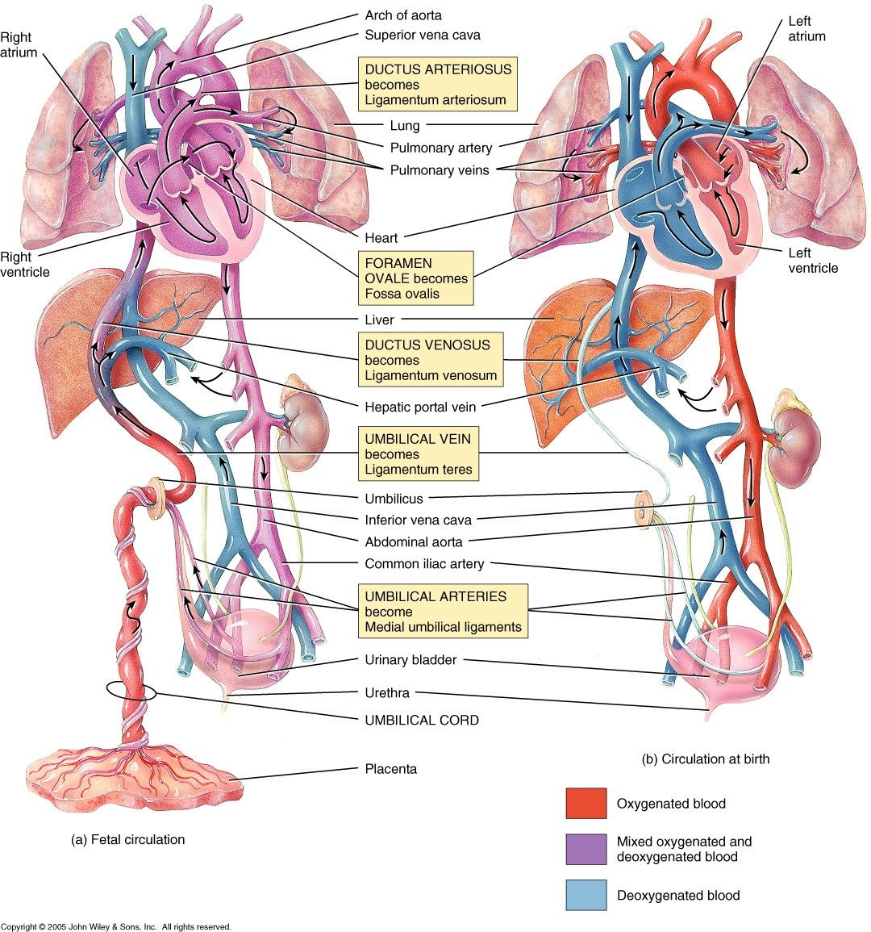
Adult derivatives of fetal structures
Adult derivatives of fetal vascular structures
Umbilical vein | Ligamentum teres
Umbilical arteries | medial umbilical ligaments
Ductus venosus | Ligamentum venosum
Ductus arteriosus | Ligamentum arteriosum
Foramen ovale | fossa ovalis

Slide 7
QUIZ
Q1 | Q2 | Q3 | Q4 | Q5 | Q6 | Q7 | Q8
B | C | B | B | C | D | A | B
Q1: The umbilical cord contains :
A. Two veins & two arteries.
B. Two arteries & one vein.
C. One vein & one artery.
D. Two veins & one artery.
Q2:The ductus arteriosus will close completely after :
A. 69 hour. B. 94 hour.
C.96 hour. D.64 hour.
Q3: Half of blood passes from the placenta reaches the IVC directly through the :
A. Ductus arteriosus.
B. Ductus venosus .
C. Liver sinusoids .
D. Foramen ovale .
Q4: After ligation of the umbilical cord there is sudden fall of blood pressure in :
A. SVC & left atrium .
B. IVC & right atrium.
C. SVC & right atrium .
D. IVC & left atrium .
Q5: In Adult derivatives of fetal Umbilical arteries is:
A. Ligamentum venosum.
B. Ligamentum arteriosum.
C.medial umbilical ligaments.
D. Ligamentum teres .
Q6: In Adult derivatives of fetal Umbilical vein is:
A. Ligamentum venosum.
B. Ligamentum arteriosum.
C.medial umbilical ligaments.
D. Ligamentum teres .
Q7: In Adult derivatives of fetal Ductus venosus is :
A. Ligamentum venosum.
B. Ligamentum arteriosum.
C.medial umbilical ligaments.
D. Ligamentum teres .
Q8: In Adult derivatives of fetal Ductus arteriosus is :
A. Ligamentum venosum.
B. Ligamentum arteriosum.
C.medial umbilical ligaments.
D. Ligamentum teres .

Slide 8
Members board
Team leaders
Abdulrahman Shadid
Ateen Almutairi
Boys team:
Mohammed Al-huqbani
Salman Alagla
Ziyad Al-jofan
Ali Aldawood
Khalid Nagshabandi
Sameh nuser
Abdullah Basamh
Alwaleed Alsaleh
Mohaned Makkawi
Abdullah Alghamdi
Badr Alshehri (I want a pin please ;( )
Girls team :
Ajeed Al Rashoud
‏Taif Alotaibi
‏Noura Al Turki
‏Amirah Al-Zahrani
‏Alhanouf Al-haluli
‏Sara Al-Abdulkarem
‏Renad Al Haqbani
‏Nouf Al Humaidhi
Jude Al Khalifah
Nouf Al Hussaini
Danah Al Halees
Rema Al Mutawa
Maha Al Nahdi
Razan Al zohaifi
Ghalia Alnufaei
Contact us:

