Slide 1
Family Medicine
Team 438
BREAST FEEDING
Editing file
This lecture is based on male’s slides
Lecture Objectives:
To be aware of WHO recommendation
To increase awareness about the benefits of breastfeeding.
To know about the properties of breastfeeding.
To educate about the basics of breastfeeding and empower parents to make an informed choice.
To educate about the harms associated with formula feeding.
To know how can you deal with Breast Engorgement
To know about the contraindication of breastfeeding
Important
Original content
Only in girls slides
Only in boys slides
Doctor’s notes

Slide 2
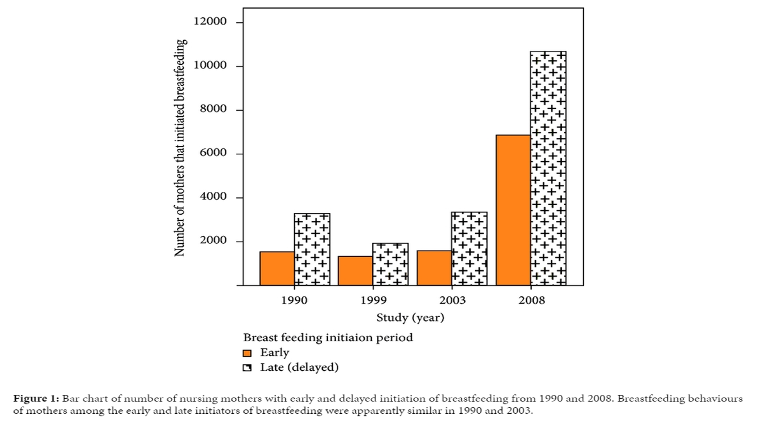
READ ONLY
THE BABY-FRIENDLY HOSPITAL INITIATIVE
Provides guidance on the implementation, training, monitoring, assessment and re-assessment of the Ten Steps to Successful Breastfeeding and the International Code of Marketing of Breast-milk Substitutes, a set of recommendations to regulate the marketing of breast-milk substitutes, feeding bottles and teats adopted by the 34th World Health Assembly (WHA).
IMPORTANT
SKIN-TO-SKIN CONTACT
Is when the infant is placed prone on the mother’s abdomen or chest in direct ventral-to-ventral skin-to-skin contact.
Immediate skin-to-skin contact is done immediately after delivery, less than 10 minutes after birth.
Early skin-to-skin contact was defined as beginning any time from delivery to 23 hours after birth.
Skin-to skin contact should be uninterrupted for at least 60 minutes. The infant is thoroughly dried and kept warm (for instance by being covered across the back with a warmed blanket).
EARLY INITIATION OF BREASTFEEDING
Involves a breastfeeding initiation time of within 1 hour after birth.
Delayed breastfeeding initiation means initiating breastfeeding after the first hour after birth (2–23 hours after birth or a day or more after birth).
Timing of breastfeeding initiation:
Early breastfeeding: if initiated to baby within the first one hour of birth.
Delayed breastfeeding: if the time of the first breastfeeding initiation is more than one hour after birth).

Slide 3
Showing Mothers how to Breastfeed:
Is a supportive interventions that enable mothers to breastfeed successfully.
This support usually involves showing mothers how to hold and position their infant to attach to the breast.
IMPORTANT
A GOOD BREASTFEEDING LATCH
The ideal latch encompasses both the nipple and the surrounding areola.
A proper latch if the baby's chin and tip of nose are touching breast.
Clamping down just on the nipple is not only inefficient for drawing out milk but can also cause nipple damage and pain.
Why a good breastfeeding latch is important?
A good latch is the foundation of successful breastfeeding. It allows your baby to feed freely, and stop when satisfied.
It's also the only way to make breasts are stimulated to produce more milk.
SHOWING MOTHERS HOW TO EXPRESS BREAST MILK
To reassure mothers that milk is being produced by their breasts (particularly in the first few days after birth).
To enable a mother to provide breast milk in the event, that she will need to be separated from her infant.
Expression of breast milk is primarily done or taught through hand expression, by placing the thumb and fingers around the areola.
The use of a mechanical pump only when necessary.

Slide 4
ROOMING-IN
Involves keeping mothers and infants together in the same room, immediately after leaving the labour room after a normal facility birth or from the time when the mother is able to respond to the infant, until discharge.
This means that the mother and infant are together throughout the day and night, apart from short intervals when the mother has a specific need, for instance, to use the bathroom.
IMPORTANT
DEMAND FEEDING
Involves recognizing and responding to the infant’s display of hunger and feeding cues and readiness to feed.
Demand, or baby-led feeding puts no restrictions on the frequency or length of the infants’ feeds, or the use of one or both breasts at a feed.
Mothers are advised to breastfeed whenever the infant shows signs of hunger, or as often as the infant wants.
AVOIDANCE OF PACIFIERS OR DUMMIES
Involves advising mothers to avoid offering pacifiers or dummies and may, in addition, involve teaching mothers alternative methods to calm and soothe their infants.
Unrestricted pacifier use means that pacifiers or dummies can be offered liberally to infants to suck on during their stay at the facility providing maternity and newborn services.
AVOIDANCE OF FEEDING BOTTLE AND TEATS
Involves offering oral feeds (of expressed breast milk or, when medically indicated, a combination of expressed breast milk and other fluids) without using feeding bottles and teats, but instead feeding by cup, dropper, or spoon when the infant is not on the breast.

Slide 5
READ ONLY
CREATING AND ENABLING ENVIRONMENT
Breastfeeding policies in facilities providing maternity and newborn services need to cover all established standards of practice and be fully implemented and publicly and regularly communicated to staff.
Training of health workers enables them to build on existing knowledge and develop effective skills, give consistent messages and implement policy standards according to their roles.
Antenatal breastfeeding education for mothers can encourage discussion, help prepare mothers practically and promote initiation of breastfeeding after delivery. It may include counselling and information given in a variety of ways.
Discharge planning and linkage to continuing support before discharge from the facility providing maternity and newborn services, it is necessary to plan for breastfeeding after discharge and to provide linkage to continuing and consistent support outside the facility, to help mothers to sustain breastfeeding.
TEN STEPS TO SUCCESSFUL BREASTFEEDING
IMPORTANT
WHO/UNICEF Ten Steps to Successful Breastfeeding
1 | Have a written breastfeeding policy communicated to all health care staff.
2 | Train all health care staff to implement this policy.
3 | Inform all pregnant women about benefits of breastfeeding.
4 | Initiate the breastfeeding within the first hour.
5 | Show mothers how to breastfeed and how to maintain lactation.
6 | Give newborn infants no food or drink other than breast milk, unless medically indicated.
7 | Allow mothers and infants to remain together 24 hour a day.
8 | Encourage breast feeding on demand.
9 | Give no artificial nipples or pacifiers to breastfeeding infants.
10 | Foster the establishment of breastfeeding support groups and refer mothers to them on discharge from hospital.

Slide 6
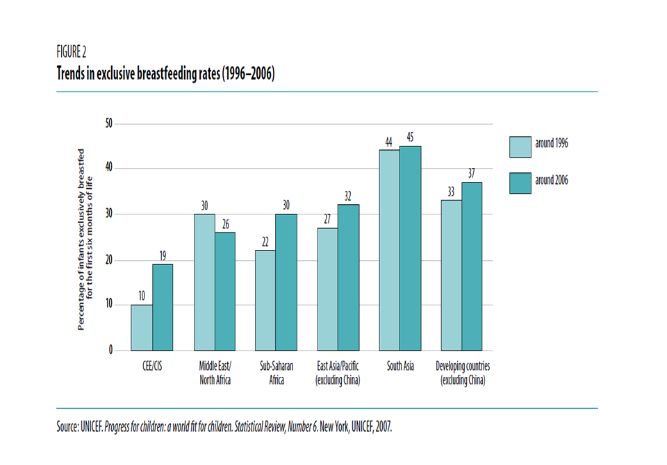
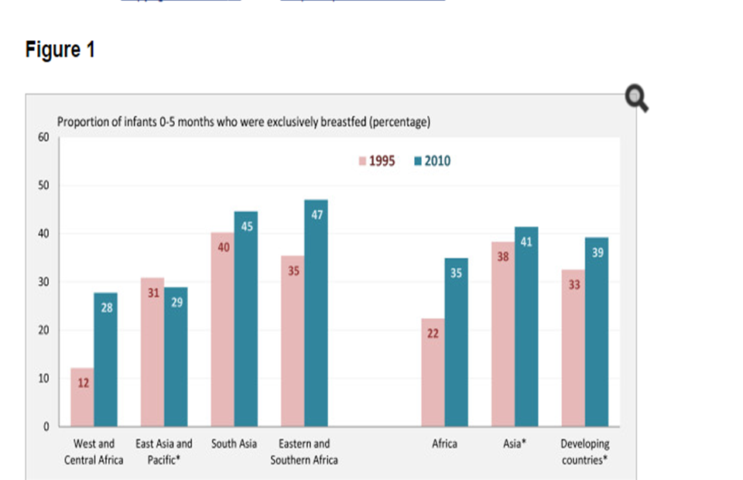
IMPORTANT
RECOMMENDATIONS OF WHO
breastfeeding should begin within one hour of birth
Exclusive breastfeeding until 6 months of age
Introduce complementary foods with continued
breastfeeding up to 2 years. In addition:
breastfeeding should be "on demand", as often as the child wants day and night
bottles or pacifiers should be avoided.
breastfeeding should not be decreased when starting on solids.
READ ONLY
Around 32% of children less than 5 years of age in developing countries are stunted and 10% are wasted.
It is estimated that sub-optimal breastfeeding, especially non exclusive breastfeeding in the first 6 months of life, results in 1.4 million deaths and 10% of the disease burden in children younger than 5 years.
SUB-OPTIMAL BREASTFEEDING:

Slide 7
HOW OFTEN SHOULD I BREASTFEED AND HOW LONG SHOULD A FEEDING LAST?
A woman should breastfeed when her baby shows signs of being hungry
A baby can show that he or she is hungry by:
Waking up from sleep.
Moving the head around as if he or she is looking for the breast.
Sucking on his or her hands, lips, or tongue.
HOW DO I KNOW IF MY BABY IS GETTING ENOUGH BREAST MILK?
You can tell if your baby is getting enough breast milk by:
Checking his or her diapers.
By day 4 or 5 after birth, babies should have at least 6 wet diapers a day.
Checking his or her bowel movements – By day 4 after birth, babies should have 4 or more bowel movements a day. By day 5, their bowel movements should be yellow.
Having your doctor or nurse check to see if your baby is gaining weight.
PROPERTIES, COMPOSITION & VOLUME OF BREAST MILK
PROPERTIES | COMPOSITION | MILK VOLUME
Biologic specificity => Long-chain omega-3 Fatty Acids Important for brain and retinal development Higher Iqs (a meta-analysis of 20 studies showed scores of cognitive function on average 3.2 points higher among children who were breastfed compared with those who were formula fed) | Proteins | Healthy exclusively breastfeeding women produce approximately 750 to 800 mL per day of milk when lactation is fully established. However, milk volume varies among individuals and can range from 450 to 1200 mL per day. Milk volume is low on the first two days postpartum, increases markedly on days three and four, then gradually increases to levels seen in full lactation.
 | The concentration of protein in breast milk (0.9 g per 100 ml) is lower than in animal milks.
 | Fat
 | (3.5 g per 100ml) provides up to 50% of caloric needs, cholesterol levels constant, lipolytic enzymes aid in fat digestion)
 | Carbohydrates
 | (lactose = milk sugar) predominantly in human milk (7 g per 100 ml) provides up to 40% caloric needs, essential for development of CNS, enhances calcium & iron absorption)
 | Vitamins and minerals
 | Breast milk normally contains sufficient vitamins for an infant, unless the mother herself is deficient. The exception is vitamin D. The infant needs exposure to sunlight to generate endogenous vitamin D or, if this is not possible, a supplement. The minerals iron and zinc are present in relatively low concentration, but their bioavailability and absorption is high.

Slide 8
IMMUNOLOGIC SPECIFICITY
Colostrum = Baby’s first vaccination
Is the special milk that is secreted in the first 2–3 days after delivery.
It is produced in small amounts, about 40–50 ml on the first day, but is all that an infant normally needs at this time.
Colostrum is rich in white cells and antibodies, especially IgA, and it contains a larger percentage of protein, minerals and fat-soluble vitamins (A, E and K) than later milk
ANTI-MICROBIAL ACTIVITY of BREAST MILK
Breast milk contains many factors that help to protect an infant against infection including:
White blood cells
Which can kill microorganisms
Oligosaccharides
which prevent bacteria from attaching to mucosal surfaces.
Whey proteins (lysozyme and lactoferrin)
which can kill bacteria, viruses and fungi
Immunoglobulin
principally (IgA), which coats the intestinal mucosa and prevents bacteria from entering the cells.
Carbohydrates (Bifidus factor)
growth factor present only in human milk required for establishing an acidic environment in the gut to inhibit growth of bacteria, fungi and parasites)
HORMONAL CONTROL OF MILK PRODUCTION
There are two hormones that directly affect breastfeeding are prolactin and oxytocin.
The prolactin level is highest about 30 minutes after the beginning of the feed, so its most important effect is to make milk for the next Feed.
More prolactin is produced at night, so breastfeeding at night is especially helpful for keeping up the milk supply.

Slide 9
BENEFITS OF BREASTFEEDING
To Mother
1
Psychological (attachment, bonding, security)
Decreased postpartum bleeding, depression, T2DM.
More rapid uterine involution due to increased of oxytocin.
Decreased menstrual blood loss.
Method of birth control (98% protection in the first six months after birth)
Earlier return to pregnancy weight.
Decreased risk of breast cancer.
Decreased risk of ovarian cancer.
Decreased risk of hip fractures and osteoporosis in the postmenopausal period.
To Baby
2
Better dental health
Increased visual acuity
Decreased duration and intensity of illnesses
Less allergies
Better health & less risk of illnesses
BREASTFEEDING AND UTI
The risk of UTI was 2-3 times higher in non-breastfed children when compared with exclusively breastfed children
The protective effect of breastfeeding was dependent on the duration of breastfeeding as well as the gender of the child or infant.
A longer duration of breastfeeding was associated with a lower risk of infection after weaning and the effect was stronger in girls.

Slide 10
Why some mothers choose formula vs breast milk?
Distressed by physical discomfort of early breastfeeding problems.
Convenience issues.
Pressures of employment/school.
Worries that breast shape will change.
Formula manufacturers manipulate people through their advantages.
Doctors and nurses need more lactation training.
Moms given very little time to adjust to changes of postpartum.
Family demands.
Non-supportive family/health professionals.
Embarrassment.
Lack of confidence in self.
Feeling that one cannot produce enough milk.
NUMBERS ARE NOT IMP
FORMULA MILK ILLNESS “RELATIVE RISK” BY TIMES
2-7
2.4
3
2.4
Allergies, eczema
2.6-5.5
1.5-1.9
Gastroenteritis
1.8-6.7
Diabetes type 1
Inflammatory bowel disease
Otitis media
Urinary tract infections
Hodgkin's lymphoma
6-10
3.8
1.7-5
3.9
2.1
3
2
Necrotizing enterocolitis
Haemophilus
influenzae meningitis
Pneumonia
Respiratory syncytial virus infection
Sepsis
Industrialized-world hospitalization
Sudden infant death syndrome

Slide 11
RISK REDUCTION OF BREAST MILK
Diabetes:
Up to a 30% reduction in the incidence of type 1 DM is reported for infants who exclusively breastfed for at least 3 months.
Childhood leukaemia:
A reduction of 20% in the risk of acute lymphocytic leukaemia and 15% in the risk of acute myeloid leukaemia in infants breastfed for 6 months or longer.
Sudden Infant Death Syndrome (SIDS):
A 36% reduction in risk of SIDS
BREAST ENGORGEMENT
Engorgement refers to swelling within the breast tissue, which can be painful. In some women with engorgement, the breasts become firm, flushed, warm to the touch, and feel as if they are throbbing. Some women develop a slight fever
The best treatment for engorgement is to:
1
Empty the breasts frequently and completely by breastfeeding.
2
Expressing milk by hand or breast pump can help to soften the areola and allow the baby to latch on more easily.
3
Use of a cold compress or ice pack can be helpful in relieving the discomfort of engorgement.
4
Pain medications : Paracetamol / Ibuprofen are safe.

Slide 12
HIV AND BREASTFEEDING
An HIV-infected mother can pass the infection to her infant during pregnancy, delivery and through breastfeeding.
However, antiretroviral (ARV) drugs given to either the mother or HIV-exposed infant reduces the risk of transmission.
WHO recommends that when HIV-infected mothers breastfeed, they should receive ARVs and follow WHO guidance for infant feeding:
The 2016 WHO recommendation on HIV and infant feeding
Recommendations |  | Strength of the recommendation | Quality of the evidence
For how long should a mother living with HIV breastfeed if she is receiving ART and there is no evidence of clinical, immune or viral failure?
Mothers living with HIV should breastfeed for at least 12 months and may continue breastfeeding for up to 24 months or beyond (similar to the general population) while being fully supported for ART adherence. (See the WHO consolidated guidelines on ARV drugs for interventions to optimize adherence) |  | Strong | 12 months: low 24 months: very low
Guiding practice statements
If a mother living with HIV does not exclusively breastfeed, is mixed feeding with ART better than no breastfeeding at all?
Mothers living with HIV and health-care workers can be reassured that ARV treatment reduces the risk of postnatal HIV transmission in the context of mixed feeding. Although exclusive breastfeeding is recommended, practising mixed feeding is not a reason to stop breastfeeding in the presence of ARV drugs.

Slide 13
CONTRAINDICATION OF BREASTFEEDING
Untreated brucellosis
01
02
Active or untreated tuberculosis (use expressed milk)
Infant with galactosaemia
06
03
Active herpes simplex on her breast (use expressed milk)
Mothers who are receiving diagnostic or therapeutic radioactive isotopes.
05
04
Mothers with H1N1 influenza, temporarily be isolated until become afebrile
Conditions that are not contraindications to breastfeeding:
Mothers with:
Hepatitis B.
Hepatitis C.
OPTIONS if BREASTFEEDING is NOT POSSIBLE
Mom can still use her milk, even if she decides not to breastfeed:
Use a breast pump (electric), efficient to produce milk.
Cup or bowl feeding.
Spoon feeding.
Eyedropper or feeding syringe.
Nursing supplementer.
THE END
There is no freedom of choice for humans if it has been taken away from them at the beginning.
Breastfeeding is not a choice, but an obligation to the choice, Give your child the freedom of choice.

Slide 14
QUIZ!
Which one of the following if a benefit for breastfeeding mothers?
A. Decrease risk of cancers B. Slower uterine involution
C. Increase chance for pregnancy early
Which of the following is a component of mother’s milk?
A. Vitamin D B. Fructose C. Lactose
Which one of the following will be reduced if we use breast milk for the baby?
A. Sudden Infant Death Syndrome (SIDS) B. Type 2 DM
C. Ovarian cancer
Which one of the following conditions is contraindicated for break milk?
A. Hepatitis B. B. Mother with H1N1 C. Hepatitis C
Why some moms choose formula milk Instead of Breast milk?
A. Embarrassment B. Family demands C. A+B
Answers
1. A, 2. C, 3. A, 4. B, 5. C

Slide 15
Team Leaders
Abdulrahman Bedaiwi & Jude Alotaibi
Team Members
Alhanouf Alhaluli
Ajeed Alrashoud
Jehad Alorainy
Mashal Abaalkhail
Mohannad Alqarni
Naif Alsolais
Rahaf Alshabri
Rawan Alzayed
Rema Almutawa
Thank you!
Give us your feedback!

