Slide 1
Female Reproductive System
Objectives:
By the end of the lecture you should be able to:
1- Describe the histological structure and fate of ovarian follicles.
2- Describe the histological structure of:
Ovary.
Oviducts (Fallopian tubes).
Uterus.
Vagina.
Resting and lactating mammary gland.
Editing file
Important
Doctor notes / Extra

Slide 2
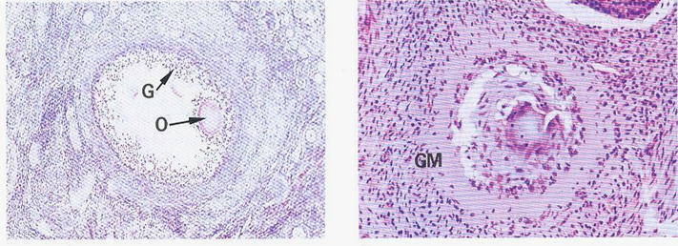
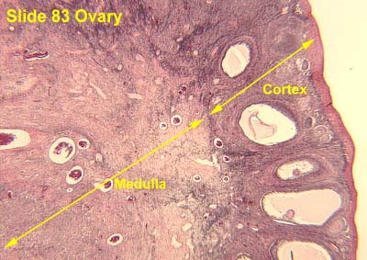
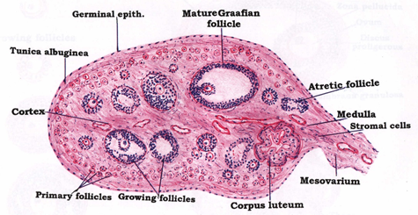
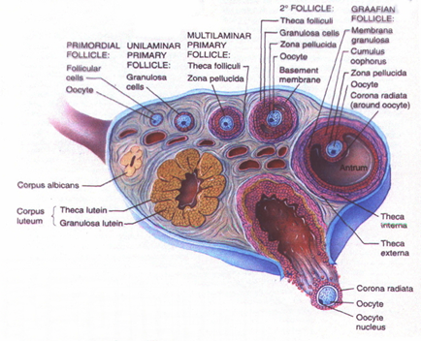
ADULT OVARY
Germinal epithelium: outer layer of flat cells.
Tunica albuginea: dense C.T layer. tunica= Layer, albuginea= white
Outer cortex: ovarian follicles and interstitial cells.
Atretic (atrophied) Follicles:
During growth of the ovarian follicles, many of them do not reach maturation and they degenerate, and are finally replaced completely by fibrous tissue and are called atretic follicles or corpora atretica.
Inner medulla: highly vascular loose C.T.

Slide 3
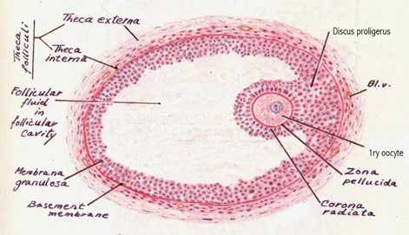
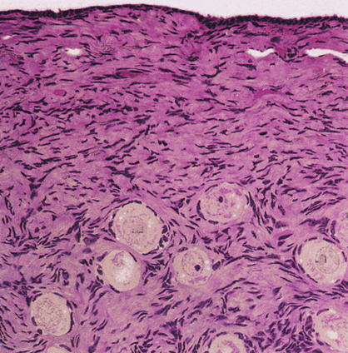
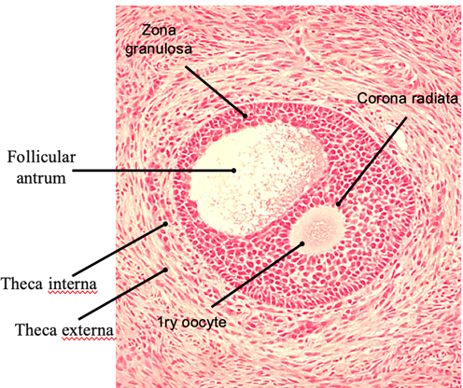
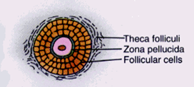
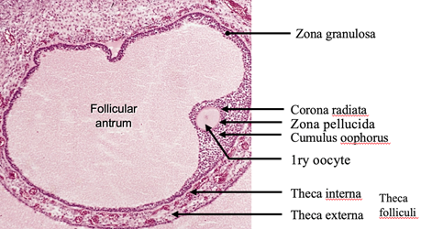
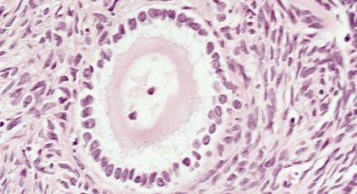
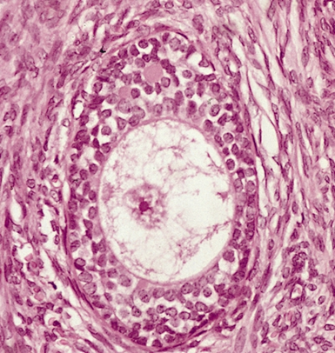
Ovarian Follicles: the cortex of the ovary in adults contains the following types (stages) of follicles:
1-Primordial Follicles | 2-Primary Follicles | 3-Secondary (Antral) Follicles | 4-Mature Graafian Follicles
The only follicles present before puberty. The earliest and most numerous stage. Located superficially under the tunica albuginea. Each is formed of a primary oocyte (25 µm), surrounded by a single layer of flat follicular cells. | They develop from the primordial follicles, at puberty under the effect of FSH. A-Unilaminar primary follicles: similar to primordial follicles, but: the primary oocyte is larger (40µm). the follicular cells are cuboidal in shape. B-Multilaminar primary follicles: Explained in next slide 1ry oocyte larger (70-80 µm) corona radiata granulosa cells zona pellucida theca folliculi follicular fluid (liquor folliculi) | Multilaminar primary follicles become secondary follicles when a complete antrum filled with liquor folliculi is formed. 1ry oocyte is larger & pushed to one side. (150 µm) Theca folliculi differentiates into theca interna cellular layer and theca externa fibrous layer. we know it’s Secondary (Antral) Follicles stage when the small follicular fluid drops merge together forming a lake-like large drop of fluid. | large, thin walled wide follicular antrum large 1ry oocyte (200-250 µm) zona pellucida corona radiata cumulus oophorus (are granulosa cells acting as a neck to connect oocytes to the wall) zona granulosa basement membrane theca folliculi: theca interna & theca externa
A
B

Slide 4
Multilaminar primary follicles
1ry oocyte
corona radiata (is the layer of granulosa cells radiating around the oocyte) (corona=crown, radiata=radiating).
granulosa cells
zona pellucida (acting like glue between oocyte and corona radiata)
theca folliculi (capsule-like condensed C.T. & fibers surrounding the follicle from the surrounding material)

Slide 5
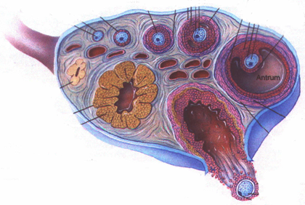
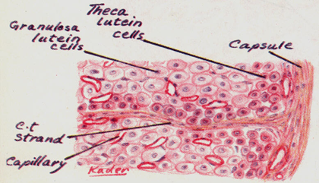
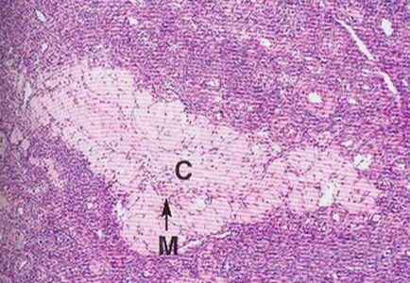
Corpus Luteum
Ovulation occurs at day 14 of the cycle, under the effect of LH.
The follicle collapses and forms a corpus luteum.
zona granulosa → granulosa lutein cells.
Theca interna → theca lutein cells.
Bleeding may occur → corpus haemorrhagicum.
Fertilization → corpus luteum of pregnancy. (secretes progesterone and estrogen for nourishment of wall of utrine )
No fertilization → corpus luteum of menstruation.
At the end → corpus albicans. (develops after 6 months in pregnancy & after 14 days in menstruation)
Corpus luteum of menstruation lasts about 10 days.
Corpus luteum of pregnancy persists for six months.
Fate of corpus luteum: formation of a white degenerated fibrous body, corpus albicans.
Corpus Albicans:
It is a white degenerated fibrous body formed by involution (Atrophy) of corpus luteum (degenerated corpus luteum).
Secretory cells of corpus luteum degenerate and are phagocytosed by macrophages.
Function of corpus luteum:
Granulosa lutein cells: secrete progesterone.
Theca lutein cells: secrete estrogen.

Slide 6
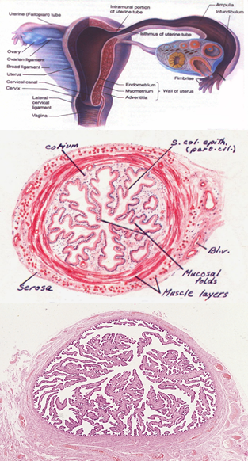
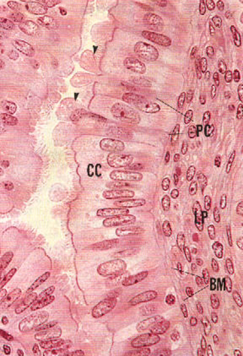
OVIDUCTS (FALLOPIAN TUBES)
Mucosa:
Highly folded. (to increase surface area to allow passage of large oocyte).
Epithelium: Simple columnar partially ciliated.
Ciliated cells: (wider)
Non-secretory.
Cilia beat toward uterus.
Non-ciliated cells: (thinner)
Thinner, also called peg cells.
Secretory cells.
Apices bulge above ciliated cells.
Their apices contain nutritive material to nourish gametes (sperms & oocytes).
Corium of C.T.
Musculosa:
Inner circular.
Outer longitudinal.
Serosa (because fallopian tubes are covered by peritoneum).
All parts of fallopian tube have similar components but they differ in diameter.

Slide 7
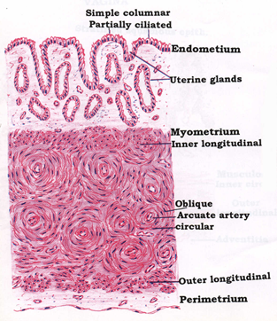
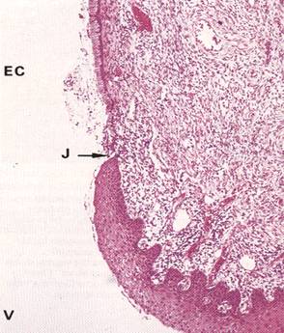
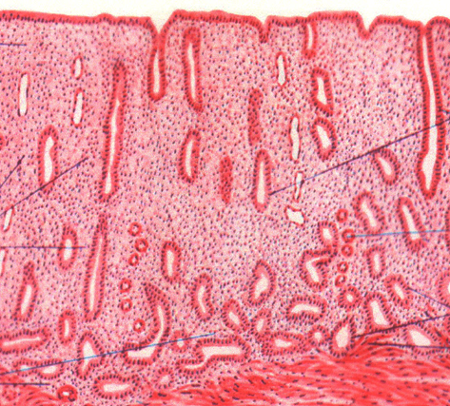
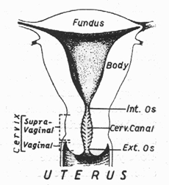
THE UTERUS
Fundus & Body |  |  | Uterine Cervix
Endometrium (mucosa) | Myometrium (musculosa) | Perimetrium (serosa) | Mucosa | Substance of the cervix
Epithelium: simple columnar partially ciliated. Corium: Endometrial glands: simple tubular. Stromal cells. (make components of placenta) Blood vessels. Leucocytes. Reticular fibers. | 3 ill-defined smooth muscle layers: Stratum submucosum: longitudinal. Stratum vasculare: circular smooth muscle fibres in figure of 8 arrangement around large blood vessels. Stratum supravasculare: longitudinal. | Formed of simple squamous epith. (mesothelium) and sub-epithelial C.T. | Epithelium: simple columnar in the cervical canal, but it changes to stratified squamous epith. (non-keratinized) at the external os. Corium: CT containing tubulo-alveolar glands. | dense fibrous tissue with few smooth muscle fibers.

Slide 8
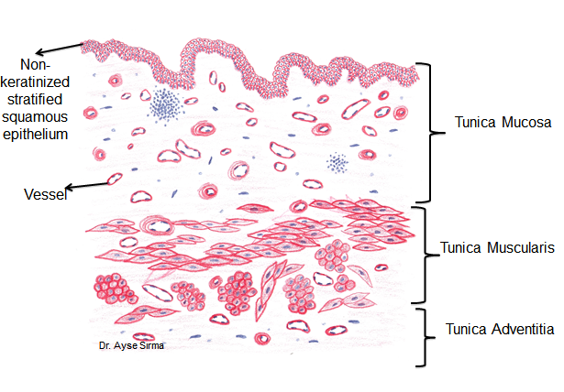
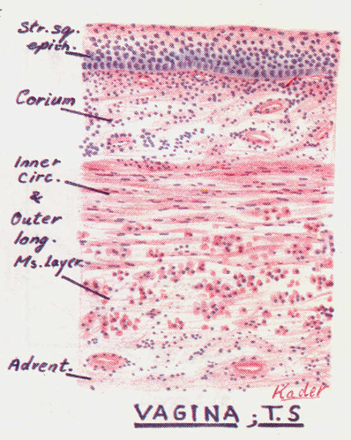
VAGINA
Mucosa: shows transverse folds and is made of:
Epithelium: stratified squamous epithelium non-keratinized, rich in glycogen.
Corium: of dense C.T., very rich in blood vessels, elastic fibres and leukocytes.
Musculosa:
formed of interlacing inner circular and outer longitudinal layers of smooth muscle fibres.
Adventitia: formed of loose C.T.

Slide 9
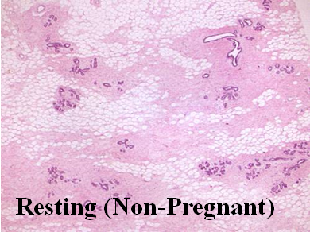
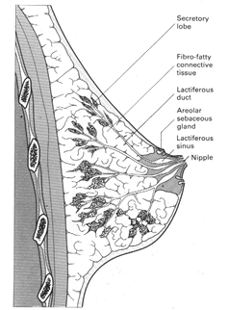
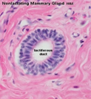
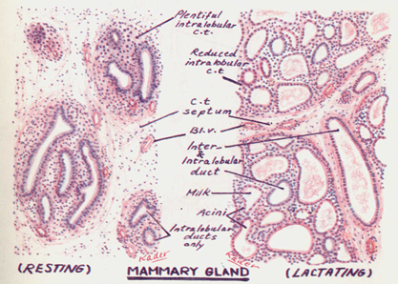
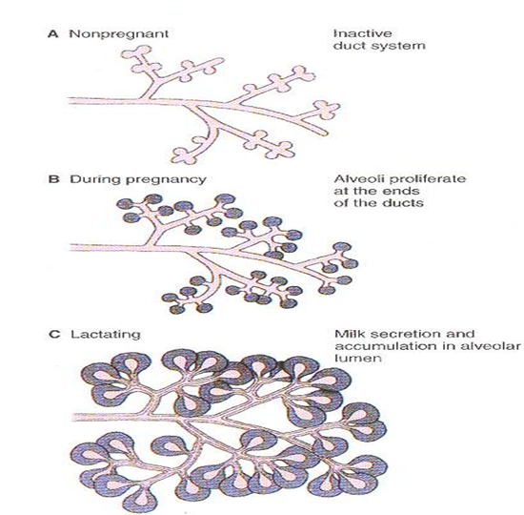
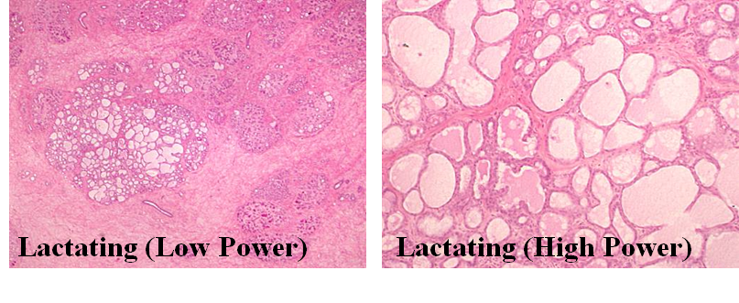
MAMMARY GLAND At puberty they enlarge by accumulation of fat, but contain only a duct system. Secretory units appear only during pregnancy and are functioning only during lactation.
Resting Mammary Gland | Lactating Mammary Gland
It is divided into lobes and lobules. The interlobular C.T. is dense and contains numerous fat cells. The intralobular C.T. is loose and contains no fat cells. Within the lobules, there are widely separated ducts lined by simple cuboidal epithelium. Ducts collect to form lactiferous ducts lined by stratified columnar epithelium and open at the top of the nipple. | Interlobular and intralobular C.T. become reduced. Lobules are made of ducts and alveoli. Alveoli are distended with milk and lined by cuboidal or flat cells surrounded by myoepithelial cells. Milk appears acidophilic with vacuoles of dissolved fat.

Slide 10
1C 2A 3A 4C 5B 6D
1: : Which of the following is the normal epithelium of the oviduct? A. Simple columnar epithelium. B. Stratified squamous epithelium. C. Simple columnar epithelium partially ciliated. D. Simple squamous epithelium.
2: Which ONE of the following can be found in a mature graafian follicle?
A. Zona pellucida
B. Granulosa lutein cells
C. Theca lutein cells
D. Cytotrophoblast
3: Which of the following structures is formed of stratified squamous epithelium?
Vagina
fundus and body of the uterus
body of uterus
fallopian tubes
4: At which day ovulation commonly occur
at day 11 of the cycle
at day 28 of the cycle
at day 14 of the cycle
at day 8 of the cycle
5: Which one of the following is true about Resting Mammary Gland
The interlobular C.T. is loose
The intralobular C.T. is loose
The interlobular contains no fat cells
The intralobular contains numerous fat cells.
6: Which ONE of the following structures Is found In ovary of a 5 years old girl?
A. ­Corpus luteum.
B. ­Mature Graafian follicle.
C. ­Primary ovarian follicle.
D. Primordial follicle.

Slide 11
Team Leaders
Good luck ❤
Abdullah shadid
Sarah Alflaij

