Slide 1
Male Reproductive System
Objectives:
At the end of this lecture, the student should be able to describe the microscopic structure of :
Testis and epididymis.
Vas deferens.
Seminal vesicles.
Prostate.
Editing file
Important
Doctor notes / Extra
Note: this is the last histo lecture :) good bye

Slide 2
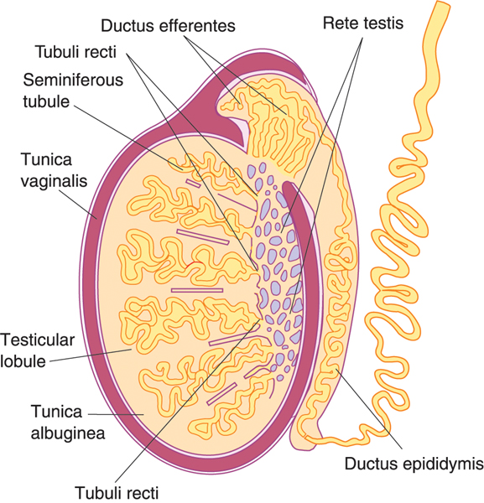
Testis
Formed of
Stroma
Parenchyma
Tunica vaginalis
Seminiferous tubules
Tunica albuginea
Interstitial cells of Leydig
Tunica vasculosa
Septa
Interstitial tissue

Slide 3
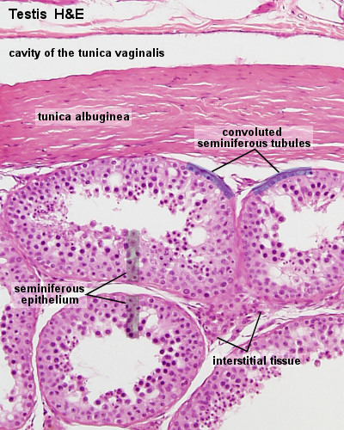
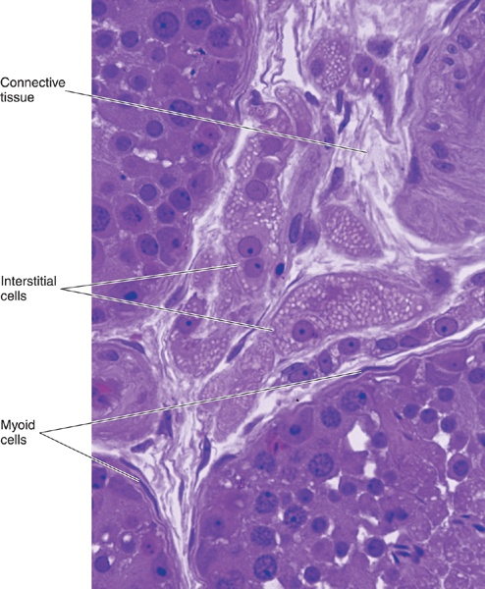
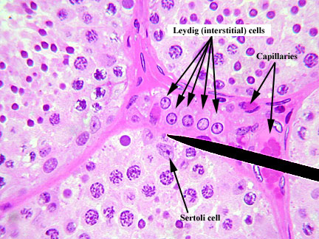
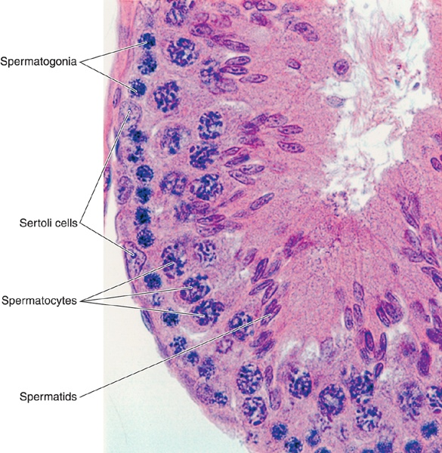
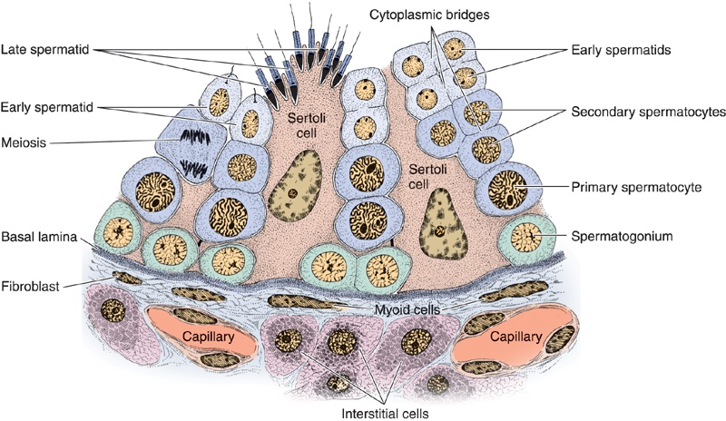
Testis
Stroma:
Tunica Vaginalis | Tunica Albuginea | Tunica Vasculosa | Septa of the Testis | Interstitial Tissue
It is formed of mesothelial cells | Dense irregular collagenous C.T. | It is formed of loose highly vascular C.T. lining tunica albuginea & septa from inside. | Dense irregular collagenous C.T. Divide the testis into about 250 intercommunicating compartments (testicular lobules = lobuli testis). | Loose vascular C.T. in between the seminiferous tubules. Contents: Loose vascular C.T. Interstitial cells of Leydig
Parenchyma:
Endocrine part interstitial cells of Leydig which produce testosterone | Exocrine part The seminiferous tubules which produce spermatozoa
Interstitial Cells of Leydig rounded or polygonal cells with central rounded nucleus. Cytoplasm: acidophilic & vacuolated. Function: Secrete testosterone. | Seminiferous Tubules Each tubule is lined with a stratified epithelium called seminiferous epithelium which is formed of 2 types of cells: 1- Spermatogenic cells. 2- Sertoli cells. Each tubule is surrounded by a basement membrane.

Slide 4
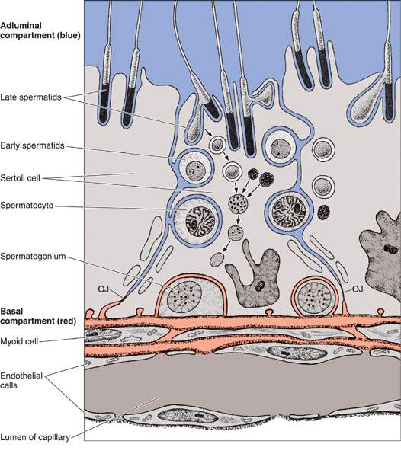
Seminiferous Tubules (seminiferous epithelium) cells
Sertoli Cell
Are columnar or pyramidal cells. Nucleus: Basal, vesicular, irregular with prominent nucleolus. Functions: Support & Nutrition of spermatogenic cells. Phagocytosis of cytoplasmic remnants of spermatogenesis. Secretion: Testicular fluid Androgen Binding Protein (ABP) Inhibin hormone Formation of blood-testis barrier.
Single layer somatic widely separated cannot divide Its apex reaches the lumen Pale basophilic cytoplasm contains crystalloid material contains intermediate filaments contains lysosomes
Spermatogenic Cells
A series of cells lining the seminiferous tubules extending from the BM to the lumen. Include: Spermatogonia. The only basal one 1ry spermatocytes. 2ry spermatocytes. Spermatids. Spermatozoa.
Side notes
Testicular fluid: nutritive medium for transport of immotile spermatozoa.
Androgen-binding protein (ABP): combines with testosterone and concentrate it inside the seminiferous tubules.
Inhibin: inhibits FSH thus controlling rate of spermatogenesis.

Slide 5
Blood-Testis Barrier
It is formed by the tight junctions between the basal parts of the lateral borders of adjacent Sertoli cells.
It divides the seminiferous tubule into 2 compartments:
Basal compartment: contains spermatogonia.
Adluminal compartment: contains the other spermatogenic cells.
Function:
1- It protects the developing spermatogenic cells from drugs and toxic materials.
2- It prevents autoimmune infertility.
Side notes:
The barrier separates the tissue fluid outside the seminiferous tubule from the spermatogenic cells inside the seminiferous tubule.
Isolation: and protection of the sensitive developing spermatogenic cells from any harmful substance in the blood stream.
Prevention of autoimmune reaction: prevents the passage of any autoantibodies against the developing gametes into the seminiferous tubule.
It isolates the adluminal compartment from connective tissue influences, thereby protecting the developing gametes from the immune system. Because spermatogenesis begins after puberty, the newly differentiating germ cells would be considered "foreign cells" by the immune system.

Slide 6
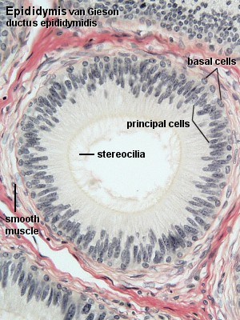
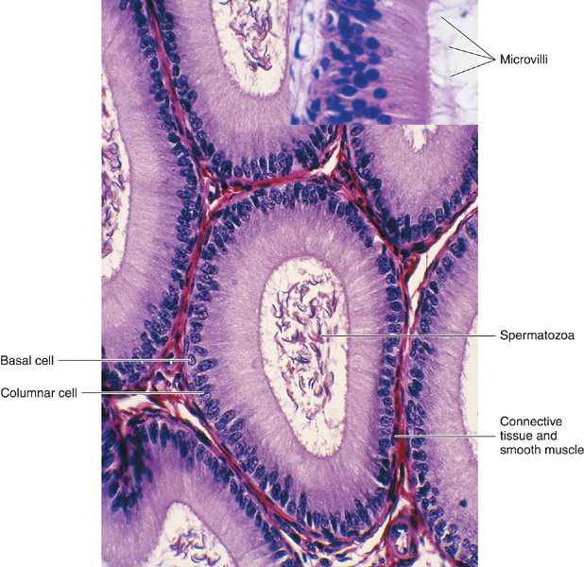
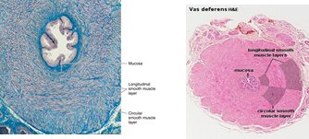
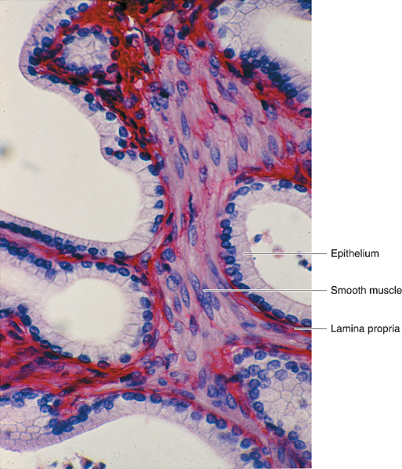
 | EPIDIDYMIS (DUCTUS EPIDIDYMIS) | DUCTUS DEFERENS (VAS DEFERENS) | SEMINAL VESICLES
 | Epithelium: pseudostratified columnar epithelium with stereocilia Basal lamina. Loose C.T. Layer of circularly-arranged smooth muscle cells. A single tubule; 4-6 m in length. Highly convoluted to form a compact organ 7.5 cm long. Divided into head, body & tail. The tail gives rise to the vas deferens. | It is a muscular narrow tube with irregular lumen. Structure: 1. Mucosa: pseudostratified columnar epithelium with stereocilia (immotile cilia) on a corium of loose C.T. 2. Musculosa (thick; 3 layers): inner longitudinal layer Middle circular layer Outer longitudinal layer 3. Adventitia: loose C.T. starting at the tail of the epididymis, enters the abdomen through the inguinal canal to join the duct of the seminal vesicle to form the ejaculatory duct. Length is about 30 cm. | Mucosa: is highly folded. Epithelium: pseudostratified columnar epithelium (no stereocilia) Lamina propria of C.T. Musculosa: Inner circular layer Outer longitudinal layer Adventitia: C.T. They are two highly convoluted tubes
 | Storage & maturation of spermatozoa. Propelling spermatozoa to the vas deferens. | Propelling of spermatozoa by strong peristalsis. | Secretion of most of seminal fluid, rich in fructose & vit. C. which are the main nutrients for spermatozoa.
Structure
Function
Pic

Slide 7
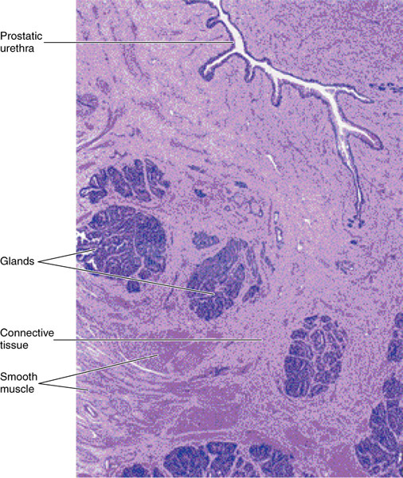
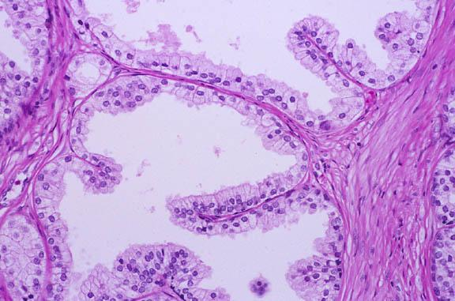
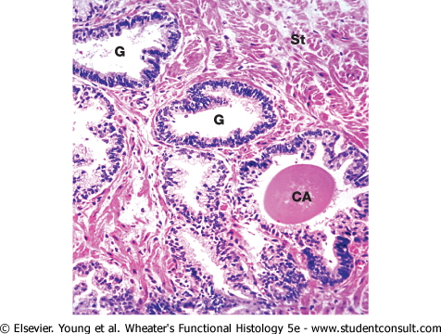
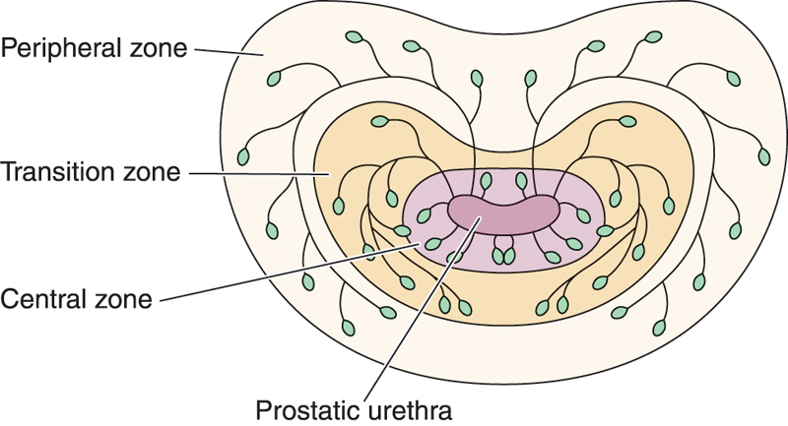
Prostate
Stroma | Parenchyma | Acini and ducts | Prostatic concretions (corpora amylacea)
fibromuscular capsule & trabeculae | 30-50 glands in 3 concentric groups around the prostatic urethra: Mucosal group: small. Submucosal group: medium-sized. Main group: Large, 70% of all glands. Where adenocarcinoma mainly occurs (note: acid phosphatase is a tumor marker for it) | are lined with simple columnar or pseudostratified columnar epithelium according to activity of the glands. Acini have prostatic papillae | Round or oval masses of glycoprotein in the lumen of some glands. Increase with advancement of age & become calcified.
Function:
participates in the secretion of the seminal fluid. Its secretion is rich in acid phosphatase & proteolytic enzymes.

Slide 8
1.D 2.C 3.D 4.B 5.B 6.A
1: Which of the following part of testis exocrine part? A. Tunica vasculosa. B. Tunica albuginea. C. Tunica vaginalis. D. Seminiferous tubules.
2: Which of the following have mesothelial cells? A. Tunica vasculosa. B. Tunica albuginea. C. Tunica vaginalis. D. Septa.
3: The blood testis barrier is formed by?
the capillary endothelium
the basement membrane of tunica propria
Leydig cells
Sertoli cells
4: Which ONE of the following structures contains corpora amylacea ?
A. Ductus epididymis
B. Prostate
C. Seminal vesicles
D. Testis
5: What is the surface modification seen on the cells of the epididymis?
Microvilli
Stereocilia
Cilia
Keratinization
6: What type of epithelium lines the Vas deferens ?
A Pseudostratified columnar
B. Simple columnar
C. Stratified squamous
D. Simple squamous

Slide 9
Team Leaders
Good luck ❤
Abdullah shadid
Sarah Alflaij

