Slide 1
Kleinfelter, Turner & Down Syndrome
Editing file

Slide 2
Describe cell cycle and stages of mitosis and meiosis.
Define nondisjunction and describe its consequences for meiosis and mitosis.
Classify chromosomal abnormalities.
Understand the common numerical chromosomal disorders:
Monosomy and Trisomy.
Understand the common numerical autosomal & sex chromosome disorders:
Down, Turner & Klinefelter syndromes.
According to female’s doc (nomenclature of syndromes is super imp)

Slide 3
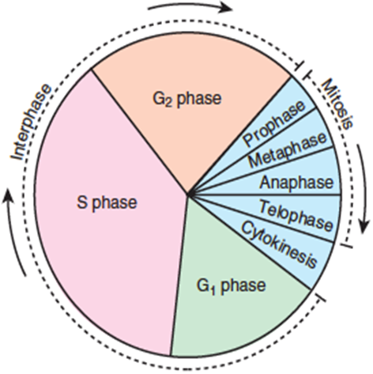
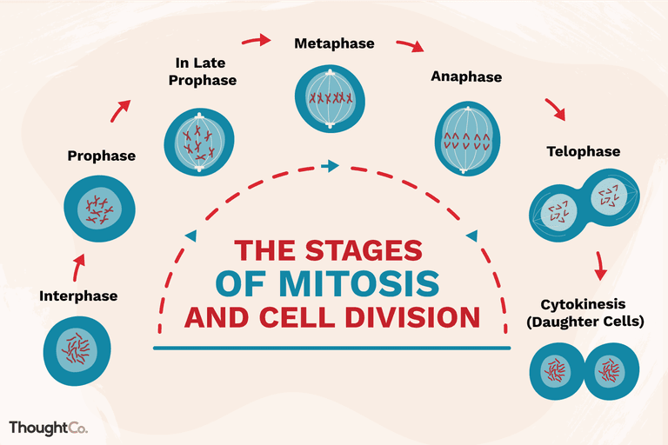
IMP
Read according to the females doctor but you should know the end results of cell cycle mitosis or meiosis I & II (haploid/diploid + # of cells)
The Cell Cycle
Interphase = Cellular components are replicated.
G1 and G2 = Cell duplicates specific molecules and structures.
S phase = Cell replicates DNA.
Mitosis = Cell distributes its contents into two daughter cells.
Stages of Mitosis
Interphase: Chromosomes are uncondensed.
Prophase: Condensed chromosomes take up stain, the spindle assembles, centrioles appears and the nuclear envelope breaks down.
Metaphase: Chromosomes align.
Anaphase: Centromeres part and chromatids.
Telophase: The spindle disassembles and the nuclear envelope re-forms.
Two identical diploid daughter cells (2n).
1

Slide 4
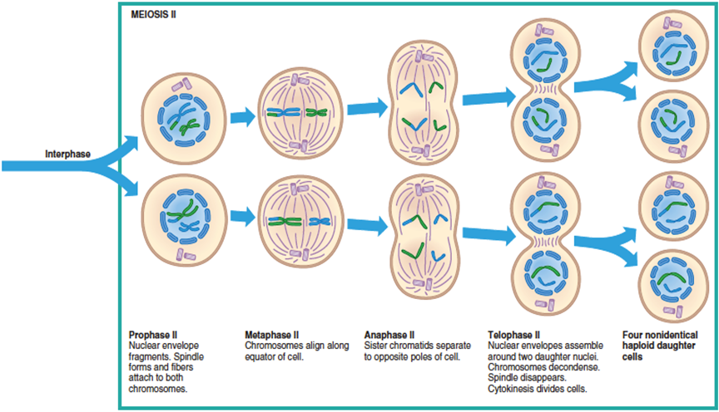
Stages of Meiosis I & II
Prophase I (early): Synapsis and crossing over occurs.
Prophase I (late): Chromosomes condense, become visible. Spindle forms. Nuclear envelope fragments. Spindle fibers attach to each chromosomes.
Metaphase I: Paired homologous chromosomes align along equator of cell.
Anaphase I: Homologous chromosomes separate to opposite poles of the cell.
Telophase I: Nuclear envelope partially assemble around chromosomes. Spindle disappears. Cytokinesis divides cell into two.
Prophase II: Nuclear envelope fragments. Spindle forms and fibers attach to both chromosomes.
Metaphase II: Chromosomes align along equator of cell.
Anaphase II: Sister chromatids separate to opposite poles of cell.
Telophase II: Nuclear envelopes assemble around two daughter nuclei. Chromosomes decondense. Spindle disappears.
Four non-identical haploid daughter cells (1n).
Meiosis I
Prophase I
(early)
Prophase I
(late)
Metaphase I
Anaphase I
Telophase I
Meiosis II
Prophase II
Metaphase II
Anaphase II
Telophase II
2

Slide 5
Comparison Between Mitosis & Meiosis
Mitosis | Meiosis
One division | Two divisions
Two daughter cells per cycle | Four daughter cells per cycle
Daughter cells genetically identical | Daughter cells genetically different
Chromosome number of daughter cells same as that of parent cell (2n) (Diploid) | Chromosome number of daughter cells half that of parent cell (1n) (haploid)
Occurs in somatic cells | Occurs in germline cells
Occurs throughout life cycle | In humans, completes after sexual maturity
Used for growth, repair & asexual reproduction | Used for sexual reproduction & producing new gene combinations
Any division post-zygotic (After fertilization)
3

Slide 6
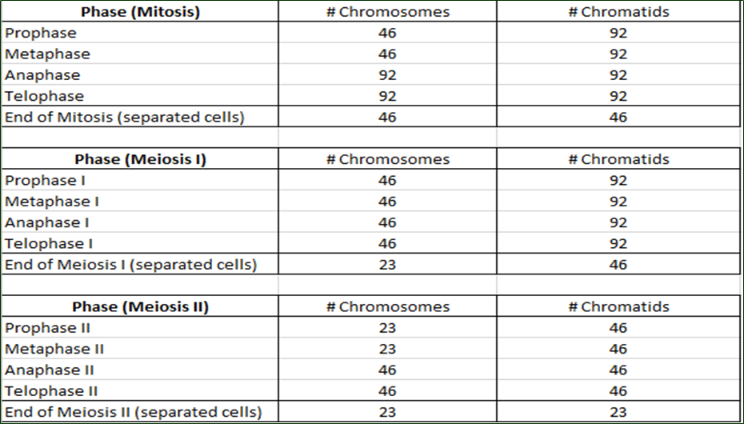
Summary of The Chromosome and Chromatid Number During Mitosis, Meiosis I & II in Humans
4

Slide 7
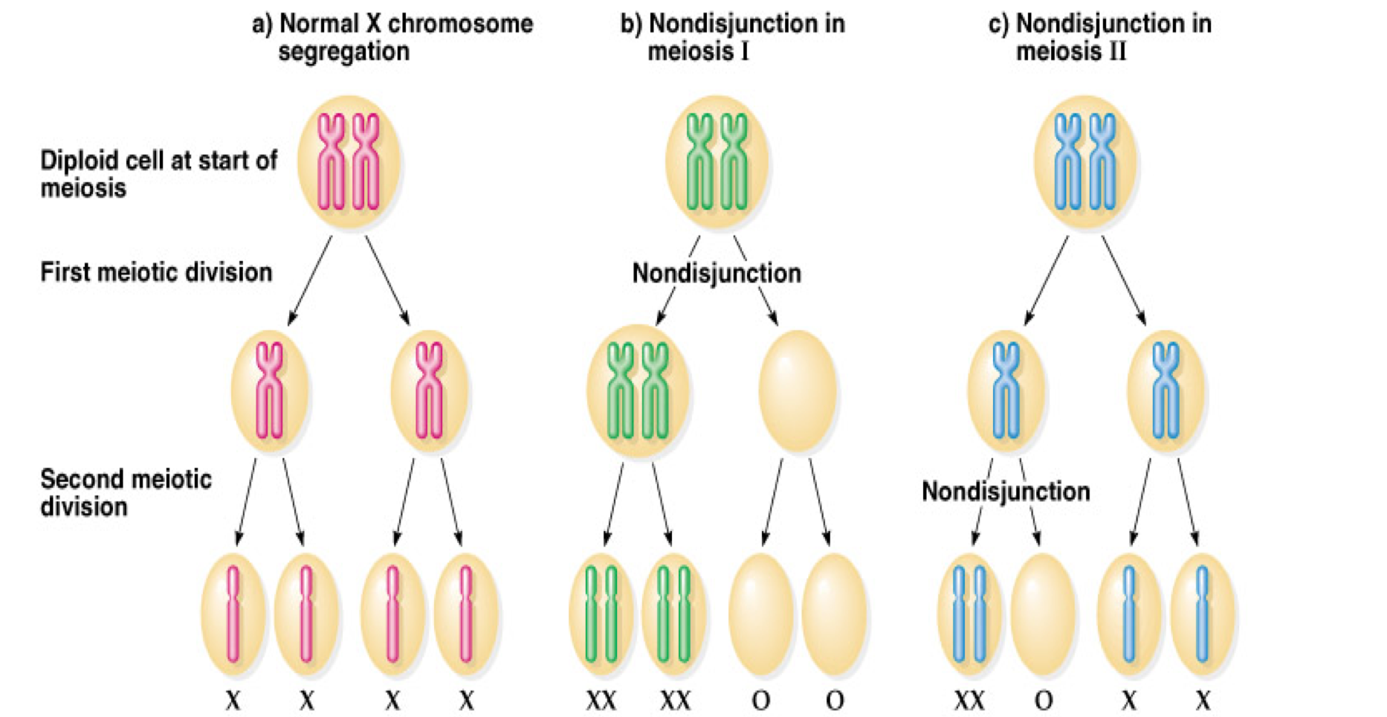
Nondisjunction "not coming apart" in Meiosis
It is the failure of a chromosome pair to separate properly during meiosis I, or of two chromatids of a chromosome to separate properly during meiosis II or mitosis (not coming apart).
Is not a rare event.
Can affect each pair of chromosomes.
As a result, one daughter cell has two chromosomes or two chromatids and the other has none.
Chromosomal abnormality:
Numerical
structural
In this case it's numerical abnormality.
The result of this error is a cell with an imbalance of chromosomes (Aneuploidy).
Autosomal
Sex Chromosomes
Trisomy 21 (Down syndrome)
47XXY (Klinefelter syndrome)
45X (Turner syndrome).
A: Result of normal chromosome segregation:
4 haploid gametes.
B: Result of Nondisjunction in Meiosis I:
2 gametes with diploid number of X chromosome, and 2 gametes lacking X chromosomes.
C: Result of nondisjunction in Meiosis II:
2 gametes with haploid number of X chromosome, 1 gamete with diploid chromosome, and 1 gamete lacking X chromosome.
IMP
Disomic gametes = 1 gamete with diploid number of X chromosome.
Nullisomic gametes = 1 gamete lacking X chromosome.
5

Slide 8
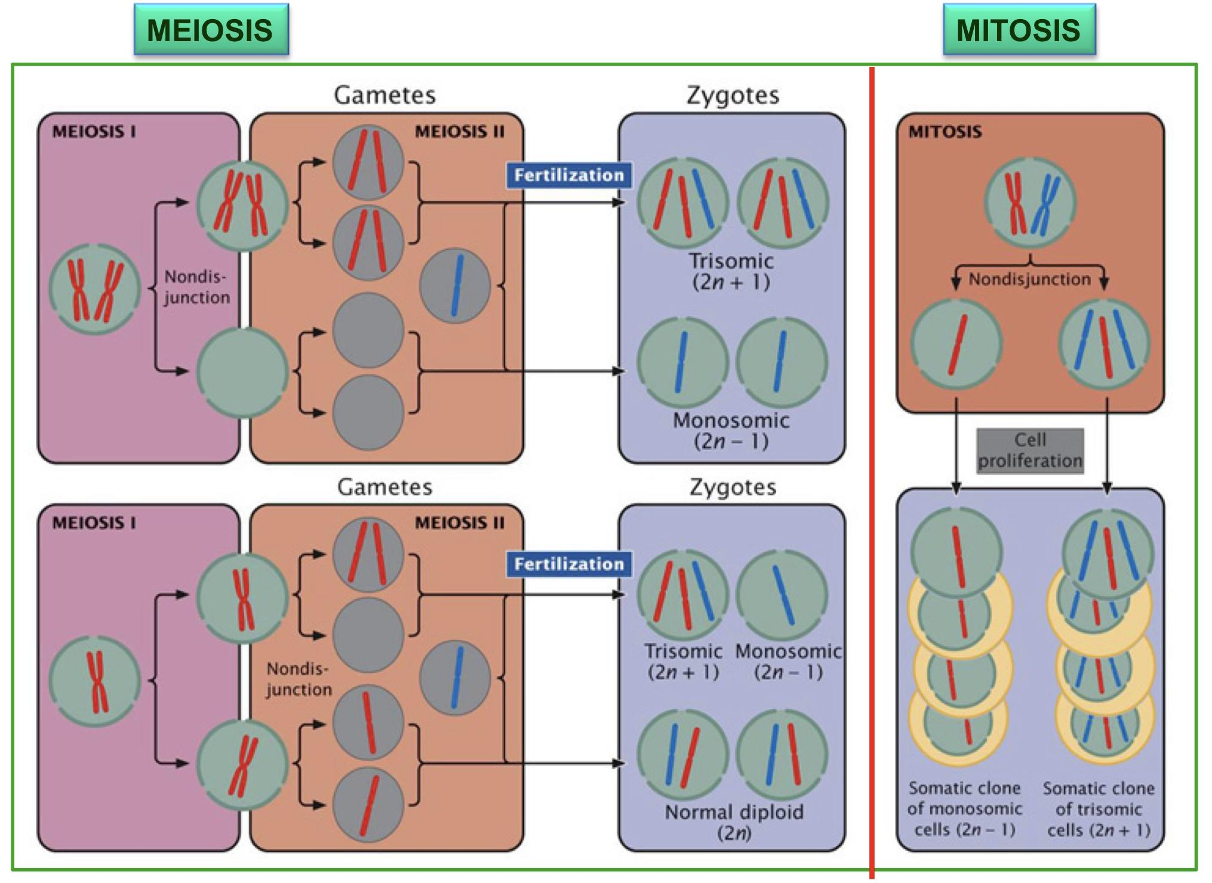
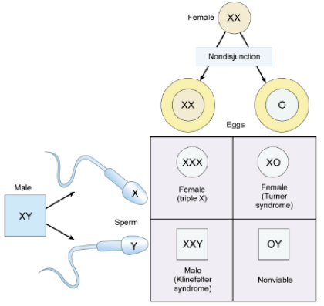
If the nondisjunction occurred in meiosis I the result is 100% abnormal cells.
If the nondisjunction occurred in meiosis II the result is 50% abnormal cells.
6

Slide 9
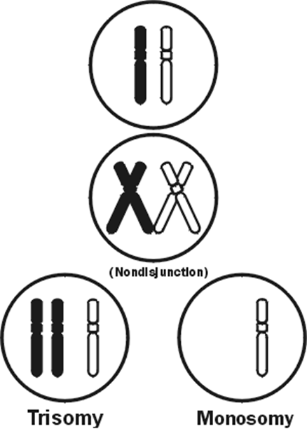
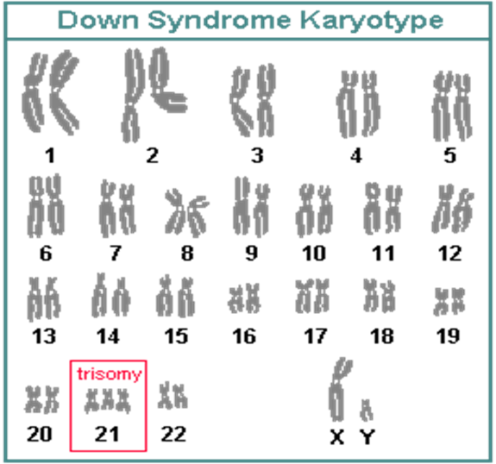
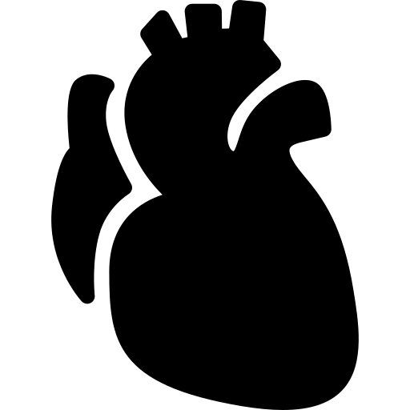
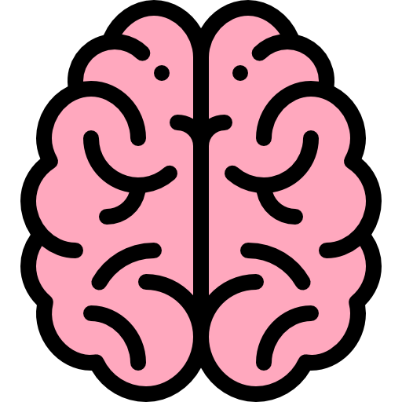
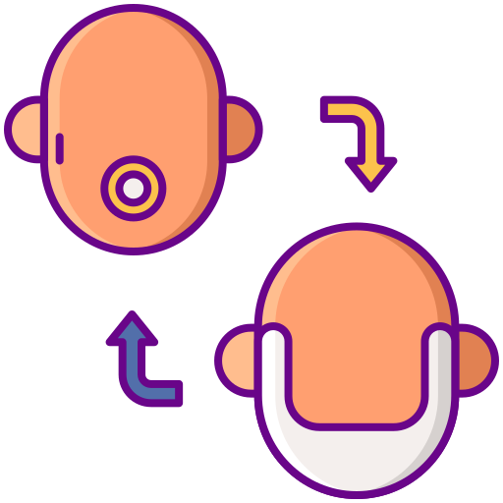
IMP
According to female’s doc: nomenclature is important, understand the features and link them to the syndrome, read the rest.
Down Syndrome (47, XY, +21)
Mostly caused by: Nondisjunction restricted to meiotic errors in the egg.
Source of extra chromosome: Mothers & ↑ with age.
Advanced maternal age was significantly associated with both meiosis I (MI) and meiosis II (MII).
Epidemiology:
Nondisjunction occurred in MII, mothers were 15.1 times more likely to be ≥40 years compared to 8.5 times of nondisjunction in MI.
A small proportion of cases are mosaic and these probably arise from a nondisjunction event in an early zygotic division = mitotic.
Features of Down Syndrome
↓ muscle tone Loose & floppy side
Impotency in males = Inability to sustain an erection sufficient for sexual intercourse or the inability to ejaculate.
Abnormalities of the extremities: (Short and broad hands, Stubby fingers), single deep crease across the center of the palm.
Head and facial malformations: (small round face, protruding tongue).
Heart malformations.
Developmental delays (mental retardation).
Life expectancy increased from 25 in 1983 to 60 today.
7

Slide 10
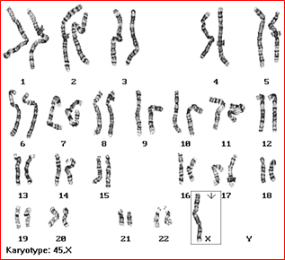
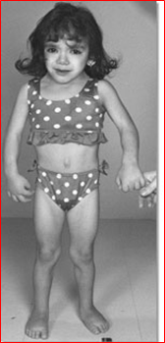
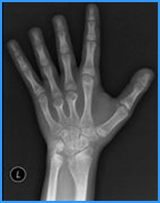
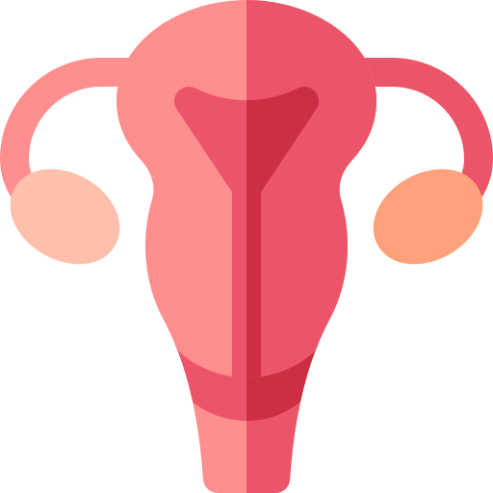
IMP
According to female’s doc: nomenclature is important, understand the features and link them to the syndrome, read the rest.
Turner Syndrome (45, XO)
Monosomy of sex chromosome: (Monosomy X: 45, XO) i.e. only one X chromosome is present.
The only viable monosomy in humans.
Individuals are genetically female, not mature sexually and sterile.
Occurrence: 1 in 2500 live female births.
They hardly survive.
Features of Turner Syndrome
Short stature, broad chest, low hairline.
Skeletal disorders (e.g. scoliosis, dislocated hips/elbows).
↑risk of osteoporosis, cardiovascular abnormalities (e.g. constriction of aorta & HT).
Normal life span.
Neck abnormalities (webbed neck).
Lack of ovarian development (streak ovaries).
No development delays, normal intelligence.
Cardiovascular: (Bicuspid aortic valve, Coarctation of aorta, Thoracic aortic aneurysm (aortic root dilatation) ).
Skeletal: (Short stature, Short 4th metacarpal/metatarsal bone (± short 3rd and 5th), Osteoporosis (due to lack of estrogen), Scoliosis).
Reproductive: (Women with Turner syndrome are almost universally infertile).
8

Slide 11
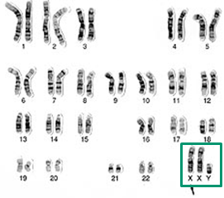
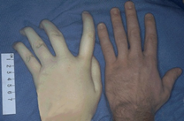
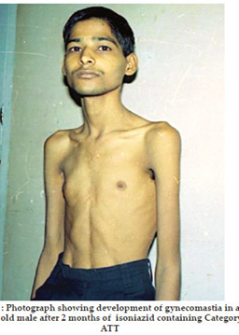
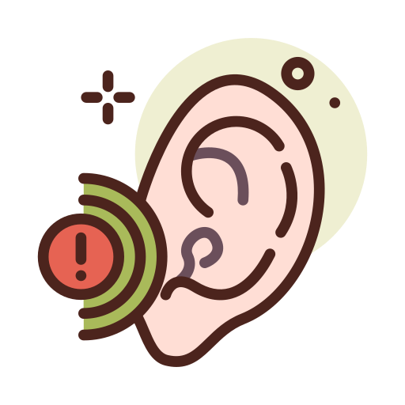
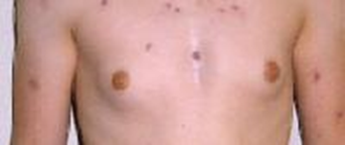
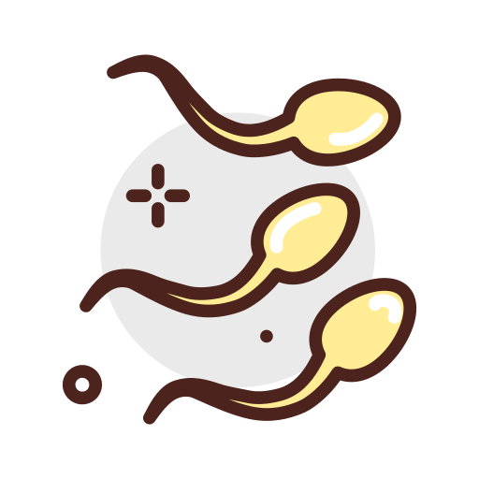
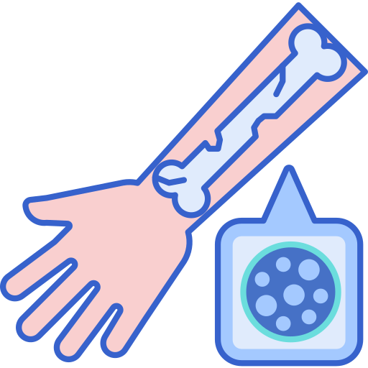
IMP
According to female’s doc: nomenclature is important, understand the features and link them to the syndrome, read the rest.
Klinefelter Syndrome (47, XXY)
Occurrence: 1 in 2500 live female births
Treatment: Testosterone therapy and assisted learning, In some cases testicular function is preserved.
Aggressive outcome but survival rate is higher than Turner’s.
Features of Klinefelter Syndrome
Tall, longer fingers and nails, delicate skin.
Sparse facial & body hair.
Deficits in attention, auditory processing and social skills.
Gynaecomastia and other feminine body characteristic.
Normal life span.
Sexually underdeveloped & infertile (no spermatogenesis).
Delays in speech and motor skills.
Low mental ability (slight reduction in IQ, but usually normal intelligence).
Increased risk of autoimmune disorders, breast cancer, osteoporosis, leg ulcers, depression, and dental problems.
Very rarely more extreme forms of Klinefelter syndrome occur where the patient has 48, XXXY or even 49, XXXXY karyotype. These individuals are generally severely retarded.
9

Slide 12
IMP
According to female’s doc: read it while drinking coffee during quarantine but tests are done to high risk mothers only.
Chromosomal Tests
Prenatal: Maternal age > 37 yrs; Ultrasound scan (USS) changes; Family history.
Triple test:
Measuring the alpha fetoprotein (AFP) = detect the vast majority of neural tube defects and and a small portion of trisomy 21–affected pregnancies.
Human chorionic gonadotropin (hCG), and estriol): if positive it indicates an increased risk of trisomy 21 and 18.
Postnatal: Learning & developmental disability; growth retardation.
Infertility: Recurrent miscarriage, primary infertility.
Rapid Aneuploidy Screening by Fluorescence in Situ hybridization (FISH)
New Techniques
Quantitative Fluorescence PCR (qf PCR): is able to measure number of copies of a chromosome – used for trisomy screening.
Cell-free fetal DNA from maternal plasma at 6-8 weeks of gestation. It is a non-invasive prenatal diagnostic tool for chromosomal aneuploidy. It can be used to determine the fetus sex: look for presence of Y chromosome material.
Available on amniocentesis sample.
Uncultured amniocytes.
FISH probes for X,Y, 21.
Result in 24-48 hours.
Proceed onto full karyotype (11-14 days).
10

Slide 13
Sex Chromosome Imbalance is Much Less Deleterious
Klinefelter Syndrome (47,XXY).
47,XYY Syndrome (May be without any symptoms. Males are tall but normally proportioned. 10 - 15 points reduction in IQ compared to sibs).
Trisomy X (47,XXX) females: (It seems to do little harm, individuals are fertile and do not transmit the extra chromosome. They do have a reduction in IQ comparable to that of Klinefelter males).
Turner Syndrome (45,X and variants).
TAKE HOME MESSAGES
Normal human karyotype is 46,XY or 46,XX.
Chromosome abnormalities can be numerical or structural.
Numerical abnormalities include aneuploidy and polyploidy.
In monosomy or trisomy, a single extra chromosome is absent or present, usually as a result of nondisjunction in the 1st or 2nd meiotic division.
Structural abnormalities include translocations, inversions, deletions, isochromosome & rings.
11

Slide 14
Answers: 1) C, 2) D, 3) C, 4) D, 5) D, 6) A, 7) B, 8) A
Q1. Nondisjunction defect in the meiotic cell division happens at which phase?
Prophase.
Metaphase.
Anaphase.
Telophase.
Q2. Meiosis occurs in which one of the following cells?
Somatic cells.
Germline cells.
Ovum and sperm.
B & C.
Q3. A 16 years old girl presented to the hospital complaining of delayed puberty, on examination the doctor noticed the that patient is short with a webbed neck, chromosomal karyotyping showed 45,X . What is the diagnosis?
Klinefelter syndrome.
Down Syndrome.
Turner Syndrome.
Constitutional delayed puberty.
Q4. Which of the following chromosome complements will not be viable?
XXX.
XO or X.
XXY.
OY or Y.
Q5. Which one of the following tests is the best for detecting a chromosomal abnormality?
FISH.
Karyotyping.
PCR.
A & B.
Q6. Which one of the following chromosomal disorders correlates with the karyotype 47,XXY?
Klinefelter Syndrome.
Down Syndrome.
Turner Syndrome.
Trisomy X.
Q7. Which one of the following is the result of nondisjunction in meiosis I?
2 haploid , 1 nullisomy , 1 Diosomy.
2 Diosomy , 2 nullisomy.
4 Haploid.
3 Haploid , 1 nullisomy.
Q8. Which of the following chromosome complements will be least phenotypically affected?
XXX.
XO or X.
XXY.
OY or Y.

