Slide 1
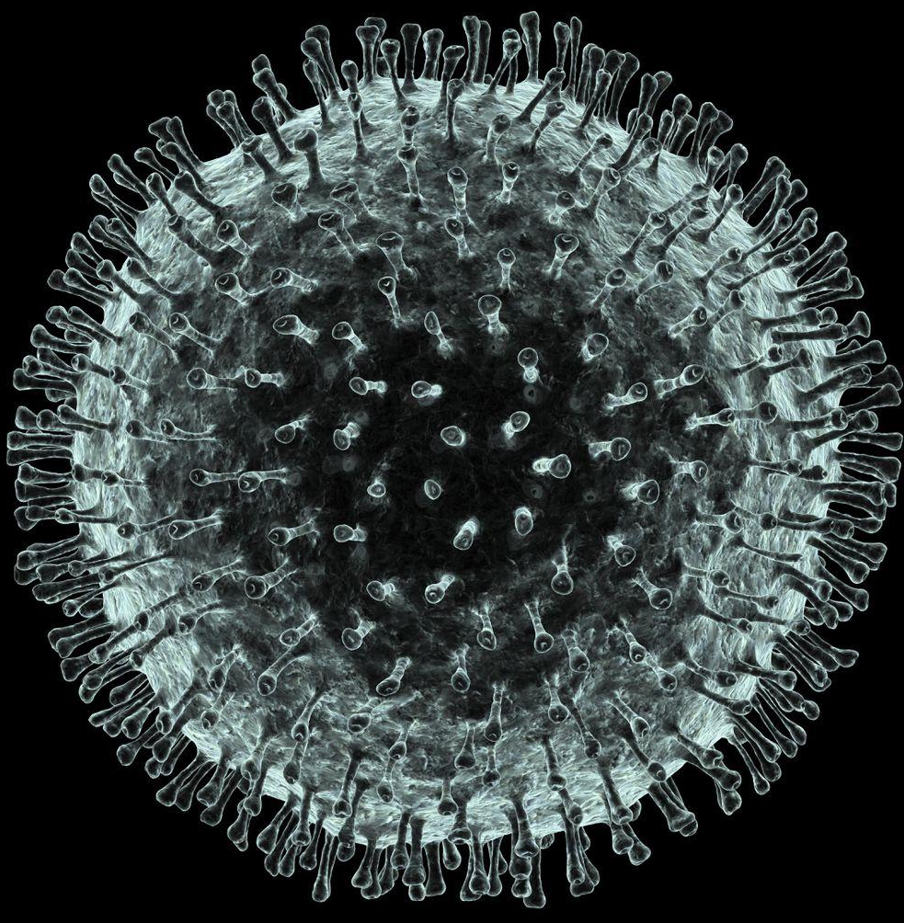
Genetics of Breast & Ovarian Cancer
Editing file
This Lecture was prepared during COVID-19 outbreak

Slide 2
Recognize carcinoma of the female breast as the leading cause of cancer morbidity and mortality among women.
Know the risk factors of breast cancer with special emphasis on the genetics and importance of family history.
Know the role of molecular prognostic and predictive factors in breast cancer with special emphasis on hormonal receptors and HER2-neu status.

Slide 3
Breast Cancer
Breast Cancer is a disease of women who are > 50 years of age.
There are predisposing factors that may lead to breast cancer, which are:
The Age: The older the women the most likely to have a breast cancer.
Family History: Especially first degree relatives & people who carry theses two genes (BRCA1 & BRCA2) & also p53 gene (the guardian of the genome) which also involved in breast cancer (we can't do screening for this gene) & also p10 gene also involved in breast cancer.
When there is a breast cancer in the contralateral breast, that a predispose the patient to cancer in the other breast.
Obesity: The people who have high BMI will predispose the patient to breast cancer because the adipose tissue when it is present in high amount it will secrete Estrogen and breast cancer is hormone dependent (that's mean need estrogen to grow, need the estrogen to multiply & when they have other source of estrogen because of obesity the cancer will grow).
Epithelial Hyperplasia: Typical & Atypical types (likelihood to have a breast cancer).
Consistency (Density) of breast tissue: The more the stroma of breast the greater to have breast cancer.
Nulliparous women (Never have children): Have increase incidence of breast cancer.
Women who get menarche at early age: Is a predisposing factor to breast cancer (may more exposure to estrogen hormone).
Late Menopause: Is a predisposing factor to breast cancer (long-period exposure to estrogen hormone).
Alcohol: May increase incidence of breast cancer.
1

Slide 4
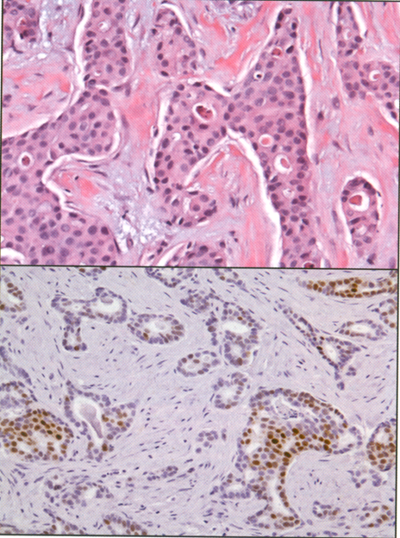
BRCA Genes
About 5% to 10% of breast cancers are related to specific inherited mutations.
Those mutations happen in those genes:
BRCA1 and BRCA2 which are mutated in familial breast cancers are involved in DNA repair.
BRCA1 is located on chromosome 17q 21.3 - Mutation in this gene will increase the risk of ovarian cancer.
BRCA2 is located on chromosome 13q 12-13 - Mutation in this gene will increase the risk of estrogen dependent breast cancer.
Most carriers of those mutant genes will develop breast cancer by the age of 70 years, as compared with only 7% of women who do not carry a mutation.
When they are mutated, their function of stopping breast cancer will stop.
Estrogen (ERs), Progesterone (PRs) receptors
60% to 70% of breast carcinomas express estrogen receptors (ERs) and progesterone receptors (PRs).
The presence of ERS in breast cancer is a weak prognostic factor, however, it is optimally useful as a predictive factor for the benefit of adjuvant tamoxifen or aromatase inhibitor therapy.
The positivity of tumor to (estrogen or progesterone receptors):
Positivity to Estrogen: We use Immunohistochemical stain for estrogen - If the number of cell stained by this stain and become brown in color and more than 10% thats mean it is estrogen receptor cancer (positive).
Tamoxifen (Aromatase inhibitor or Anti-estrogen): Therapy for the tumor who is positive to estrogen receptor - stopped the growth of the tumor.
Immunohistochemistry for the evaluation of estrogen receptor (ER)
2

Slide 5
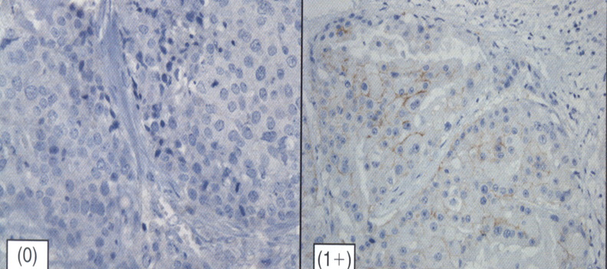
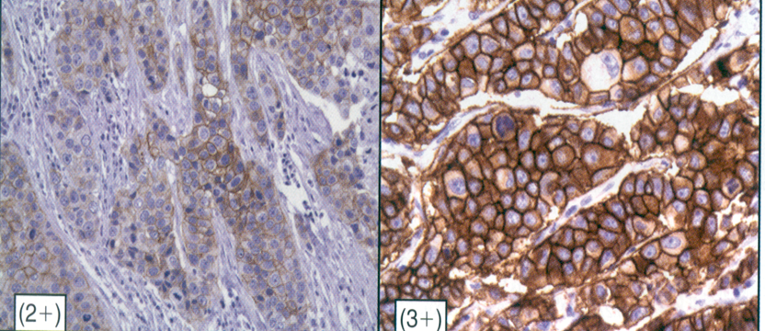
HER2 Gene
HER2 (Human epidermal growth receptor 2) gene: Located in chromosome 17, Control tissue growth - if it is get mutated and the patient has breast cancer this cancer is going to spread and grow and multiply very quickly.
If this gene is present in the tumor cell more than one copy (overexpression), the tumor will grow quicker, will multiply and spread more, will produce worse prognosis.
Normal cells have one copy of the HER 2 (HER2-neu) gene on each chromosome 17 (CHR17) and when this gene is expressed in normal epithelial cells, it is transmits signals regulating cell growth and survival.
In approximately 15% to 25% of breast cancer, the HER2 gene is found to be amplified 2 fold to greater than 20 folds in each tumour cell nucleus.
As a result, HER2 positive breast cancers tend to be aggressive.
The positivity of tumor to (HER2 receptors). We use Immunohistochemistry for the assessment of the level of HER2 expression at the tumor cell membrane, If the number of cell stained by this stain and become slightly brown in color (+2) that's mean it is NOT enough (equivocal). but if it is full of brown color (+3) that’s mean it is HER2 receptor cancer (Positive).
Treatment of HER2 mutation:
The herceptin molecule (Trastuzumab) has been shown to demonstrate a high specificity and affinity for the HER2 receptor and also acts as a biologic targeted therapeutic agent against HER2 receptors (stop the growth of the tumor).
Immunohistochemistry (IHC) for the assessment of the level of HER2 protein expression at the tumor cell membrane.
Need FISH for confirmation
Need Trastuzumab (Herceptin) therapy
3

Slide 6
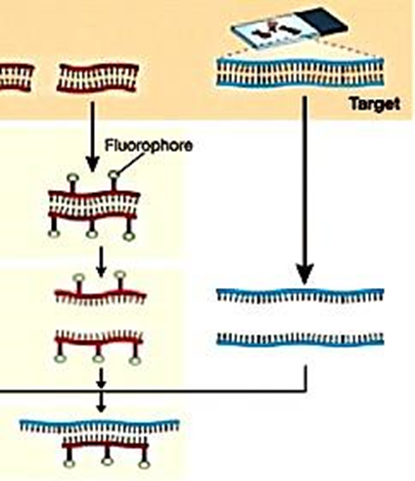
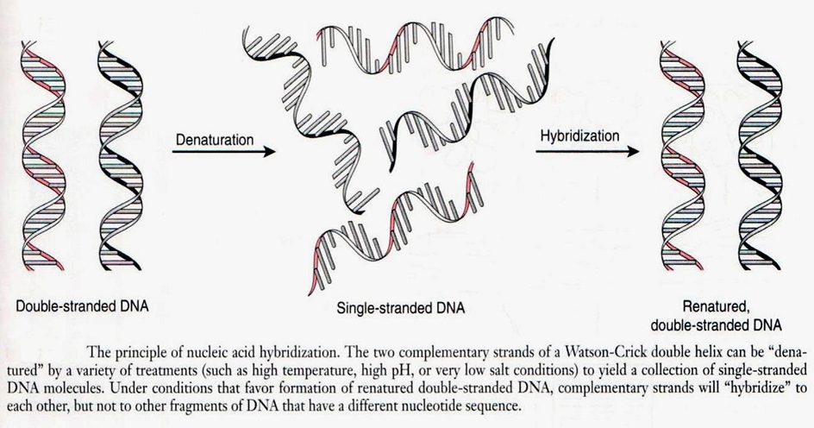
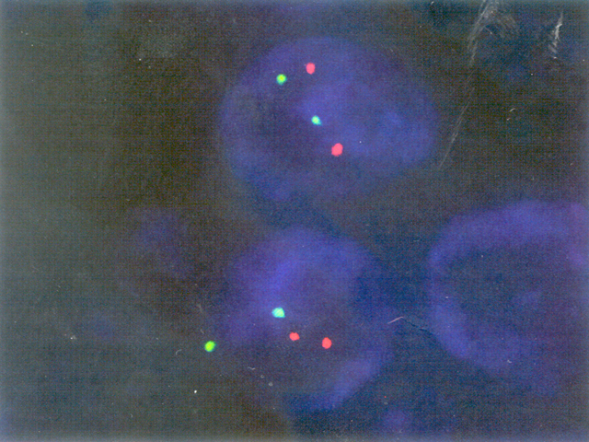
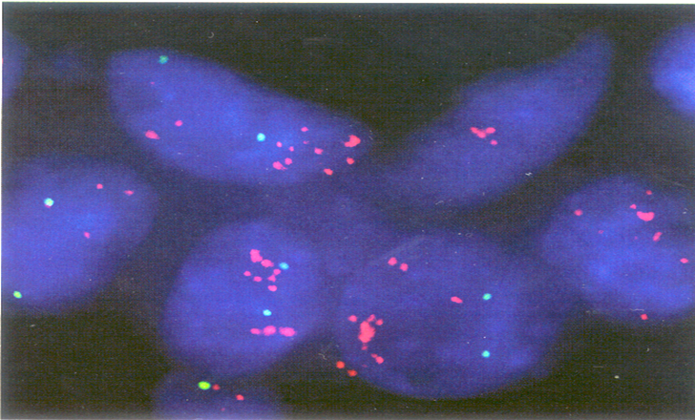
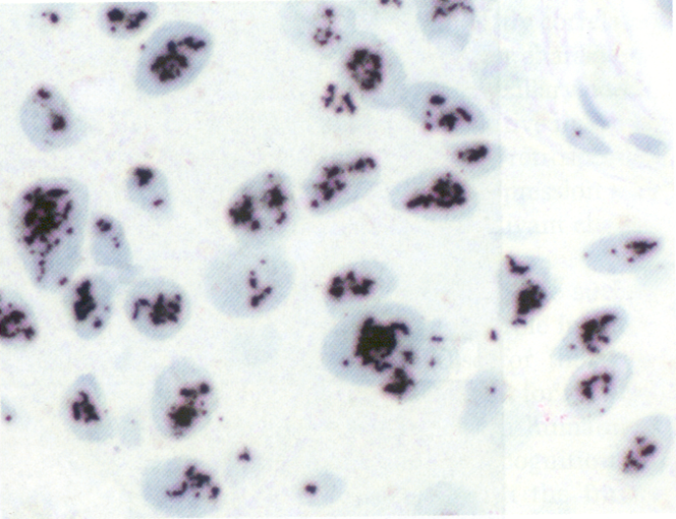
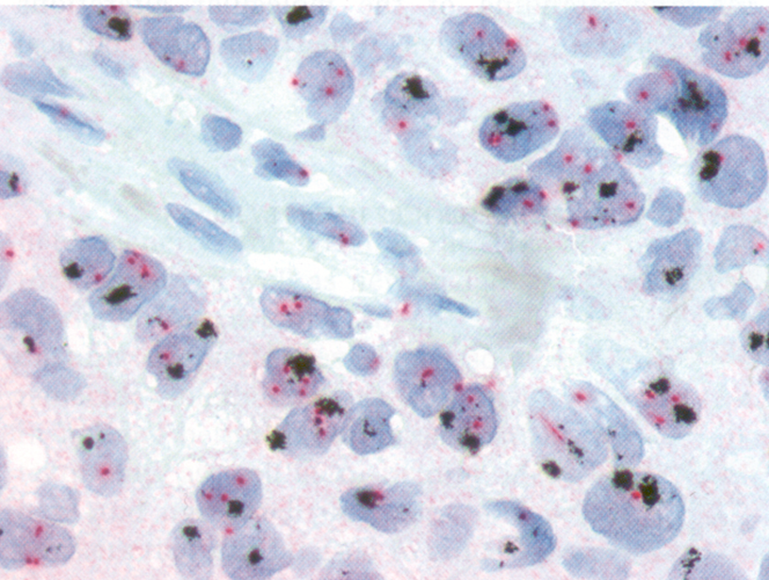
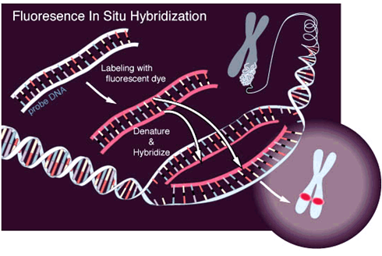
Principles of Hybridization
DNA is double stranded.
Bonds between complementary bases hold strands together (Cytosine → Guanine; Adenine → thymine).
Heat/alkalinise DNA – separation of strands (‘denaturation’) occurs.
Cool separated strands – complementary double strands re-form.
Labelled complementary single-strand DNA can identify a DNA sequence (e.g. a gene) in intact cells or disrupted cell preparations.
FISH (Fluorescence in situ hybridization) technique (molecular technique): We use it if we can determine the tumor positivity to the HER2 receptors - for the (+2) patients ONLY.
FISH denature dsDNA to ssDNA (break the bonds between various proteins) and then hyperdizate them to dsDNA again (bring hybride stranded that has fluorophore “radiant stain” and tagging of it, after that impeding of the hybride DNA with the patient DNA to become a “Double Stranded DNA”).
SISH: (Silver in situ hybridization) technique (molecular technique): Same as FISH but we use silver stain.
Silver in situ hybridization image
Dual-color silver in situ hybridization (SISH) image
Negative for HER2 receptor
Positive For HER2 receptor
Fluorescence in situ hybridization image
Schematic illustration of FISH technique
4

Slide 7
Classifications (Types) of Breast Cancer (Important)
Immunophenotyping as a Surrogate for Molecular Category Using Estrogen Receptor and HER2 Status
Molecular Category
 | Luminal A | Luminal B | HER2 | Basal-like
ER (Estrogen Receptor) | + | + | - | -
PR (Progesterone Receptor) | + | + | - | -
HER2 | - | + | + | -
Four types of breast cancer:
Luminal A: Estrogen & Progesterone Positive but HER2 Negative. The treatment is Tamoxifen (Anti-Estrogen) therapy.
Luminal B: Estrogen, Progesterone & HER2 Positive. The treatment is Tamoxifen (Anti-Estrogen) & Herceptin Molecule or Trastuzumab (HER2 receptor antagonist) COMBINED therapy.
HER2: Estrogen & Progesterone Negative but HER2 Positive (should be High grade +3). The treatment is Herceptin Molecule or Trastuzumab (HER2 receptor antagonist) therapy.
Basal-like: Estrogen, Progesterone Positive & HER2 Negative (Triple-Negative). The treatment mainly is Aggressive Chemotherapy, Have the worst prognosis.
5

Slide 8
ASCO/CAP Guideline Recommendations for The Optimal Algorithm for HER2 Testing By IHC (Important)
Breast Cancer Specimen (Invasive Component)
HER2 testing by validated IHC assay for HER2 protein expression
Positive for HER2 protein expression IHC 3+ (defined as uniform intense membrane staining of > 10% of invasive tumor cells)
Negative for HER2 protein expression IHC 0 or 1+
Equivocal for HER2 protein expression IHC 2+
Test with validated assay for HER2 gene amplification
Positive for HER2 gene amplification (many copies)
Negative for HER2 gene amplification
Equivocal HER2 gene amplification (Patients with HER2/CEP17 ratio ≥ 2.0 were eligible for the adjuvant trastuzumab trials)
6

Slide 9
DR. RIKABI’S NOTES (IMPORTANT)
Breast Cancer is very important & common in female.
Breast Cancer is a fatal disease in women.
Breast Cancer is more common in Europeans and Americans.
Breast Cancer is affect younger women in saudi arabia.
Breast Cancer is a disease of women who are > 50 years of age.
There are predisposing factors that may lead to breast cancer.
Women she is not have any predisposing factors, what's the incident of breast cancer in this women? 3%
Women have a predisposing factor, e.g. family history (mutation is certain gene), what's the incident of breast cancer in this women? 3-90%.
The two genes is BRCA1 & BRCA2 - mutated in familial breast cancer & involved in DNA repair.
When they are mutated, their function of stopping breast cancer will stop.
Not only increase their chances to develop breast cancer but also ovarian cancer.
These predisposing factors are:
The Age: The older the women the most likely to have a breast cancer.
Family History: Especially first degree relatives & people who carry theses two genes (BRCA1 & BRCA2) & also p53 gene (the guardian of the genome) which also involved in breast cancer (we can't do screening for this gene) & also p10 gene also involved in breast cancer.
When there is a breast cancer in the contralateral breast, that a predispose the patient to cancer in the other breast.
7

Slide 10
DR. RIKABI’S NOTES (IMPORTANT)
Obesity: The people who have high BMI will predispose the patient to breast cancer because the adipose tissue when it is present in high amount it will secrete Estrogen and breast cancer is hormone dependent (that's mean need estrogen to grow, need the estrogen to multiply & when they have other source of estrogen because of obesity the cancer will grow).
Epithelial Hyperplasia: Typical & Atypical types (likelihood to have a breast cancer).
Consistency (Density) of breast tissue: The more the stroma of breast the greater to have breast cancer.
Nulliparous women (Never have children): Have increase incidence of breast cancer.
Women who get menarche at early age: Is a predisposing factor to breast cancer (may more exposure to estrogen hormone).
Late Menopause: Is a predisposing factor to breast cancer (long-period exposure to estrogen hormone).
Alcohol: May increase incidence of breast cancer.
BRCA1 gene is located in chromosome 17q (long arm) & the locus is 21.3.
BRCA2 gene is located in chromosome 13q (long arm) & the locus is 12-13.
Mammography for the follow-up the patients who have breast cancer.
Patients who have mutation in BRCA2: The tumor more likely to be estrogen dependent & BRCA1 is not.
Most people who have mutation in these genes will develop cancer by the age of 70.
People who have not mutation in these genes and no family history of genes mutations the percentage of cancer will likely to develop is 7% instead of 70% with mutation in these genes of family history related them.
If we have source of estrogen & progesterone & also a receptors for them, the patients more likely to develop breast cancer (the tumor should be positive for the estrogen receptor to grow).
8

Slide 11
DR. RIKABI’S NOTES (IMPORTANT)
How we can determine the prognosis & how we treat the patient who has breast cancer?
1. Tumor MALIGNANT or BENIGN.
2. The grade (degree of differentiation) of the tumor is determined by HISTOLOGY.
3. The stage of tumor is determined by clinical examination & investigation which depend on 3 things (TNM):
T: Describes the size of the original (primary) tumor and whether it has invaded nearby tissue - The larger the tumor the more aggressive it is.
N: Describes nearby (regional) lymph nodes that are involved (metastasize) - axillary lymph nodes is first likely to be involved. We determine the number of lymph nodes by radiology methods (imaging techniques), biopsy, clinical examination.
M: Describes distant metastasis (spread of cancer from one part of the body to another).
4. The positivity of tumor to (estrogen or progesterone receptors):
Positivity to Estrogen: We use Immunohistochemical stain for estrogen - If the number of cell stained by this stain and become brown in color and more than 10% thats mean it is estrogen receptor cancer (positive).
Tamoxifen (Aromatase inhibitor or Anti-estrogen): Therapy for the tumor who is positive to estrogen receptor - stopped the growth of the tumor.
HER2 (Human epidermal growth receptor 2) gene: Located in chromosome 17, Control tissue growth - if it is get mutated and the patient has breast cancer this cancer is going to spread and grow and multiply very quickly.
If this gene is present in the tumor cell more than one copy (overexpression), the tumor will grow quicker, will multiply and spread more, will produce worse prognosis.
9

Slide 12
DR. RIKABI’S NOTES (IMPORTANT)
The positivity of tumor to (HER2 receptors). We use Immunohistochemistry for the assessment of the level of HER2 expression at the tumor cell membrane, If the number of cell stained by this stain and become slightly brown in color (+2) that's mean it is NOT enough (equivocal). but if it is full of brown color (+3) that’s mean it is HER2 receptor cancer (Positive).
Herceptin Molecule or Trastuzumab (HER2 receptor antagonist): Therapy for the tumor who is positive to HER2 receptor - stopped the growth of the tumor.
FISH (Fluorescence in situ hybridization) technique (molecular technique): We use it if we can determine the tumor positivity to the HER2 receptors - for the (+2) patients ONLY.
FISH denature dsDNA to ssDNA (break the bonds between various proteins) and then hyperdizate them to dsDNA again (bring hybride stranded that has fluorophore “radiant stain” and tagging of it, after that impeding of the hybride DNA with the patient DNA to become a “Double Stranded DNA”).
Four types of breast cancer:
Luminal A: Estrogen & Progesterone Positive but HER2 Negative. The treatment is Tamoxifen (Anti-Estrogen) therapy.
Luminal B: Estrogen, Progesterone & HER2 Positive. The treatment is Tamoxifen (Anti-Estrogen) & Herceptin Molecule or Trastuzumab (HER2 receptor antagonist) COMBINED therapy.
HER2: Estrogen & Progesterone Negative but HER2 Positive (should be High grade). The treatment is Herceptin Molecule or Trastuzumab (HER2 receptor antagonist) therapy.
Basal-like: Estrogen, Progesterone Positive & HER2 Negative. The treatment mainly is Aggressive Chemotherapy, Have the bad prognosis.
SISH: (Silver in situ hybridization) technique (molecular technique): Same as FISH but we use silver stain.
10

Slide 13
ROBBINS BASIC PATHOLOGY (IMPORTANT)
Major factors of breast cancer are delayed childbearing, fewer pregnancies and reduced breastfeeding with the lack of access to optimal health.
Almost all breast malignancies are adenocarcinomas.
Breast cancer is divided based on the expression of hormone receptors: estrogen receptor (ER) and progesterone receptor (PR),
The expression of the human epidermal growth factor receptor 2 (HER2 — that is also known as ERBB2) into three major groups:
ER positive (HER2 negative; 50%-65% of cancers).
HER2 positive (ER positive or negative; 10%-20% of cancers).
Triple negative (ER, PR and HER2 negative; 10%-20% of cancers).
An alternative classification system with substantial overlap relies on gene expression profiling which is used in clinical research, it divides breast cancer into 4 major types:
Luminal A: the majority are lower-grade ER-positive cancers that are HER2 negative.
Luminal B: the majority are high-grade ER-positive cancers that may be HER2 positive.
HER2 enriched: the majority over-express HER2 and do not express ER.
Basal-Like: the majority by gene expression profiling resemble basally located myoepithelial cells and are ER-negative, HER2-negative.
11

Slide 14
ROBBINS BASIC PATHOLOGY (IMPORTANT)
Breast cancer risk factors:
Age and gender (increases in women with age).
Family history of breast cancer.
Geographic factors (high in America and Europe over Asia and Africa).
Race/Ethnicity.
Reproductive history.
Ionizing radiation.
Pathogenesis:
genetically it can be divided into inherited and acquired.
The major germ-line mutations conferring susceptibility to breast cancer affect genes that regulate genomic stability or that are involved in progrowth signaling pathways.
BRCA1 & BRCA2 are classic tumor suppressor genes, in that cancer arises only when both alleles are inactivated or defective. BRCA2 is associated with ER-positive tumors while BRCA1 with triple negative tumors.
TP35 & PTEN (an important negative regulator of the progrowth PI3K-AKT pathway) are associated with familial breast cancer.
The pathways in which familial breast cancer genes function also are often disturbed in sporadic breast cancer. somatic mutations in BRCA1 & BRCA2 are rare in sporadic cancers. Somatic mutations in TP35 are common in breast cancer particularly triple negative and HER2 positive tumors.
12

Slide 15
Answers: 1) C, 2) D, 3) C, 4) B, 5) D, 6) C
Q1. Which one of the following is FALSE regarding BRCA1 gene?
It is a DNA repair gene.
It is located on the chromosome 17q.
It is only involved in breast cancer.
Mutation in it is more aggressive than BRCA2.
Q2. A 39 years female presented for a routine check up, on examination a mass was found in her right breast, a biopsy was taken from the mass and ERs was seen ,some degree of mitosis in the ductal cells. Which one of the following is the best to be used for the treatment?
Trastuzumab.
Aromatase inhibitor Thereby.
Tamoxifen.
B&C.
Q3. Immunohistochemistry for HER2 gene from a breast specimen was found to be (2+). What should be the next step?
Start trastuzumab.
Chemotherapy.
Use FISH method.
Start Tamoxifen.
Q4. How many copies of HER2-neu gene is normally expressed on cells?
One copy.
Two copies.
Five copies.
20 Copies.
Q5. Normal function of HER2-neu gene is ?
Tumor suppressor gene.
DNA Repair gene.
Sex determination gene.
Regulates cell growth by protein production.
Q6. BRCA2 gene is located in which chromosome?
Chromosome 11p.
Chromosome 17q.
Chromosome 13q.
Chromosome 13p.

