Slide 1
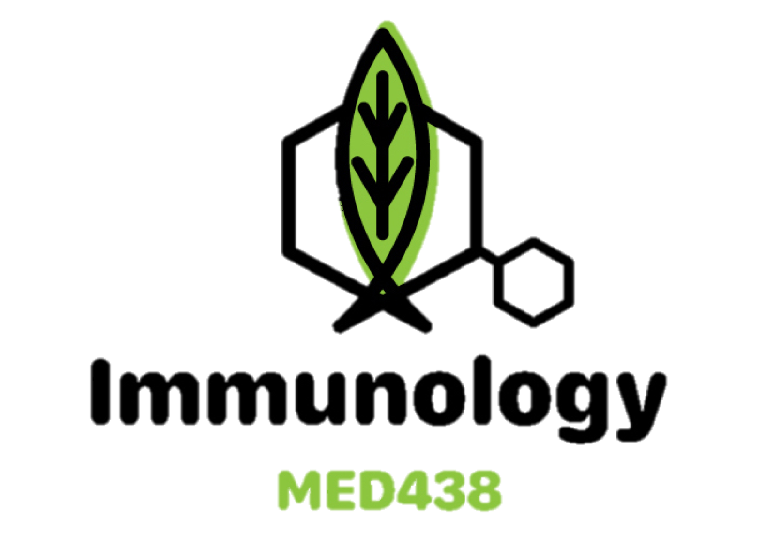
Color code:
Important in red
Extra in blue
HIV/AIDS
:(
Editing file

Slide 2
Objectives
To know the modes of transmission of HIV.
To understand HIV interactions with CD4 positive helper lymphocytes.
To understand the mechanisms involved in immunodeficiency associated with HIV.
To know the course of immunological events from the time of infection with HIV until the development of AIDS.

Slide 3
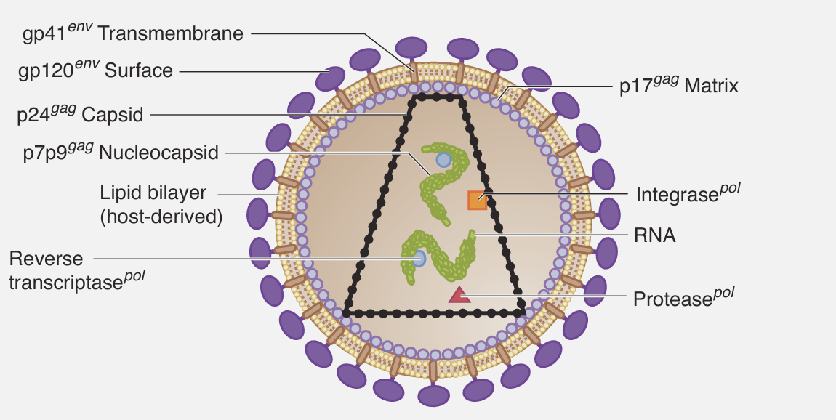
Structure of HIV
APCs work via MHC Class II, thus they express the CD4 receptor.
- HIV is an enveloped retrovirus that infects CD4 receptor-expressing cells (CD4 cells and APCs such as macrophages).
- Transmission: Sexually, Parenterally (blood transfusions, needles, ,etc...), Perinatally, or through Occupational exposure.
- Cells infected: Lymphocytes (Lymph nodes, thymus, Bone marrow) and Macrophages (Brain, Body fluids, Skin, GIT, Lung).
Structural genes
Gag | Matrix (p17) Conical Capsid (p24)
Pol | Reverse transcriptase (synthesizes dsDNA from genomic RNA) Integrase (integrates the dsDNA into host DNA) Protease (cleaves viral polyprotein)
Env | GP120 (surface protein that binds to CD4 receptor + coreceptors) GP41 (transmembrane protein for fusion into host cell)
Regulatory genes (extra)
Tat | Transcription activator Enhances replication by upregulating transcription
Nef | Auxiliary gene (not required for replication) Decreases CD4 proteins and MHC I expression on T cells Required for progression to AIDS
Rev | Regulatory protein Transports mRNA from the nucleus to the cytoplasm
Loss of Function mutations of regulatory genes (extra):
Nef → Slow rate or no progression to AIDS
Tat/Rev → Virus is unable to replicate
Host cell mutation of CCR5 coreceptor (extra):
Homozygous → Immunity (reason discussed in the next slide)
Heterozygous → Slower progression to AIDS

Slide 4
Pathophysiology
1- Surface GP120 binds to host CD4 receptor and coreceptors (chemokines)
Coreceptors are CXCR4 (on CD4 cells) and CCR5 (on Macrophages, microglia, dendritic cells, etc...)
Early infection, virus binds to CCR5 (M-tropic) → hence the immunity in a homozygous mutation
Late infection, virus binds to CXCR4 (T-tropic)
2- HIV goes inside the cell and the RNA is uncoated
3- RNA is converted into dsDNA by Reverse Transcriptase
4- The dsDNA and Integrase migrate to the nucleus, and the DNA is integrated into the host genome
forming the provirus (which can remain latent in the host DNA)
5- Transcription produces both cleaved and uncleaved +ve SSRNA
Cleaved → used as mRNA for viral proteins
Uncleaved → used as RNA genome of the virus
6- Translation of mRNA into polypeptides (which will be cleaved by protease)
7- Assembly of the virus
8- Maturation and release
Note from the figure that the envelope of the virus is derived from the host cell membrane

Slide 5
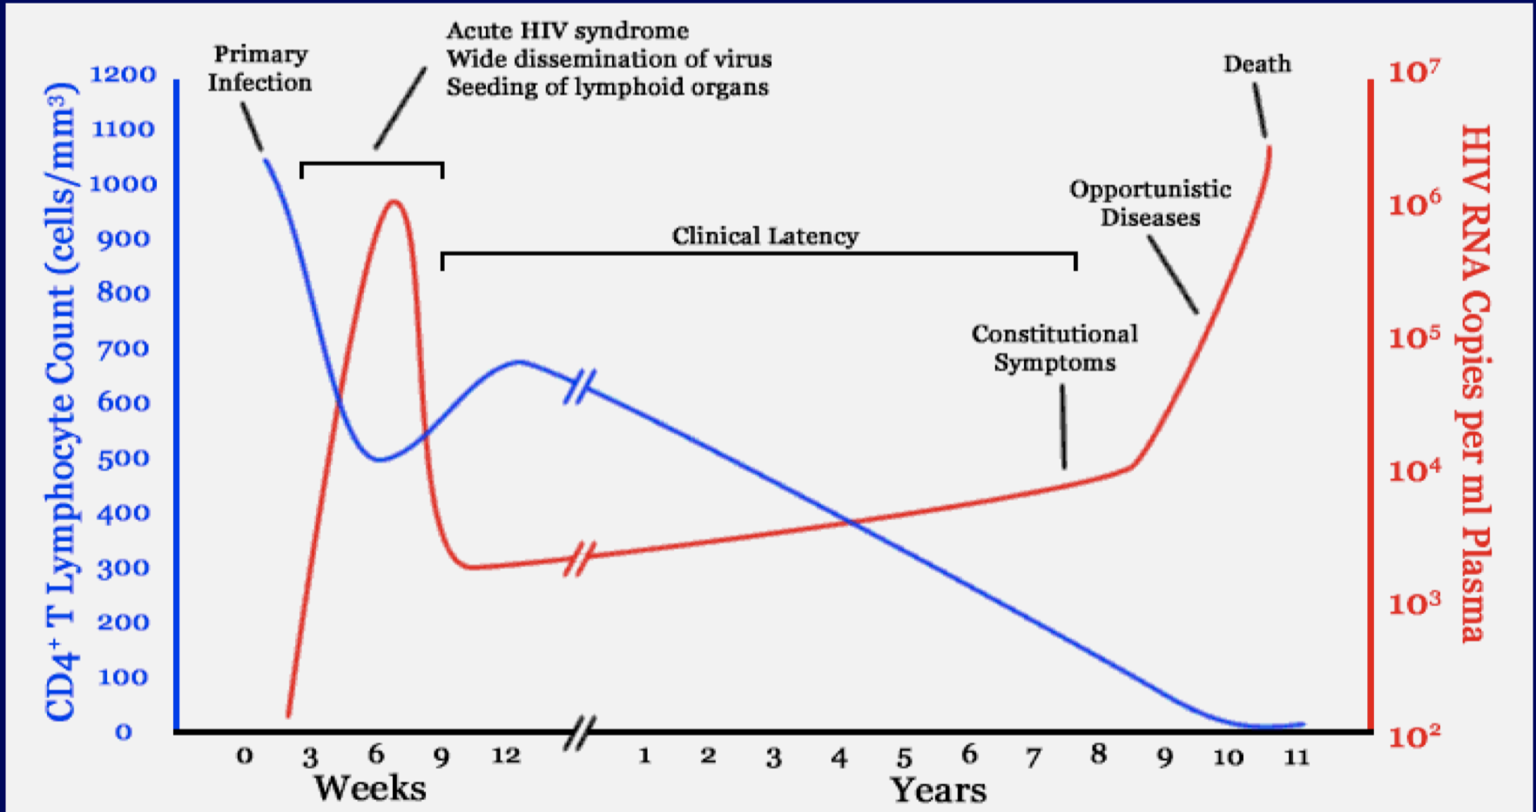
Stages of Infection
Primary (Acute) | 3-12 weeks after exposure (2-week Incubation Period), recovery in 7-14 days 70-80 % symptomatic: Fever, rash, cervical lymphadenopathy, aseptic meningitis, encephalitis, myelitis, polyneuritis Surge of viral RNA (load) to >10⁶ and fall of CD4 count to 300-400 cells/mm³ (normal: 500-1500 cells/mm³)
Latent (Chronic) | Asymptomatic and can last for 10 years No evidence of HIV infection except for Persistent Generalized Lymphadenopathy CD4 count falls by 50-150 cells/mm³ per year Gradual increase in the viral load (which is inversely proportional to the gradually decreasing CD4 count)
AIDS | CD4 count <200 cells/mm³ and surge of viral RNA Very high susceptibility to opportunistic infections
(enlargement of 2 or more lymph nodes other than the inguinal for at least 3 consecutive months)
Viral-Host Dynamics:
About 10 billion virions are produced daily
The lifespan of an HIV virions is around 6 hours, while that of an infected CD4 cell is 1.6 days on average
Unlike other retroviruses, HIV can lie dormant within a cell for many years (especially memory CD4 cells)
Viral-Host Interaction:
Infects CD4 cells and integrates into host cell DNA
High rate of mutation
Hides in tissue hard for the immune system to access (e.g. microglia + Bone Marrow)

Slide 6
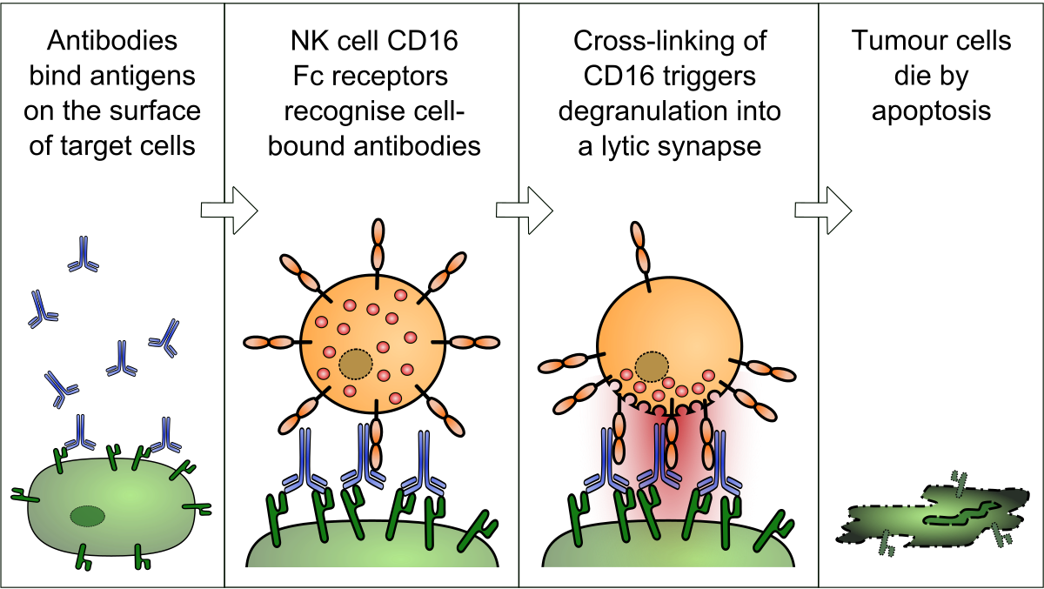
Immune Response
- HIV induces immune activation, which may seem paradoxical since it ultimately leads to severe immunosuppression.
Cellular (most important) | Derived from naive CD8 T cells, which recognize viral antigens via MHC Class I to then directly destroy the infected cell Augmented by Th1 cells (they activate CD8 cells via IFN-gamma)
Humoral | Neutralization by antibodies binding to the surface of the virus, preventing its attachment to host cells Antibody-Dependent Cell-Mediated Cytotoxicity → Fc portion of Ab binds to NK cell → Stimulate it to destroy infected cell Augmented by Th2 cells (they activate B cells via IL-4)
Cytokine Dysregulation | Increased expression of pro-inflammatory cytokines: IL-1, IL-6, IL-10, IFN-gamma Disruption and loss of immunoregulatory cytokines: IL-2, IL-12 (necessary for modulating CMI response)
Activated T cells support HIV-replication:
Intercurrent infections are associated with transient increase in viremia (activated immunity → more T cells to infect)
Accounts for why TB worsens an underlying HIV disease (HIV can also reactivate a latent TB as immunosuppression develops)
HIV-immune dysfunction:
All elements of the immune system are affected
Advanced stages have substantial lymphoid tissue disruption
Impaired ability to initiate an immune response or to even maintain memory responses

Slide 7
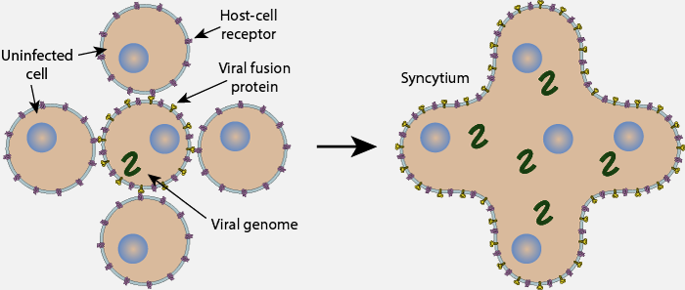
CD4 Depletion/Dysfunction
- Any depletion in numbers of CD4 cells renders the body susceptible to opportunistic infections
- There are 2 mechanisms by which CD4 cells are depleted and dysfunctioned:
Direct | Elimination of HIV-infected cells by virus-specific immune responses (using up the CD4 cells to fight the infection) Loss of plasma membrane integrity because of viral budding (recall that the virus derives its envelope from the host cell membrane)
Indirect | Syncytium formation (a syncytium is a single cell containing several nuclei formed by fusion of cells or by division of nuclei) Most commonly in the brain (microglia) Infected cells express GP120, and adjacent uninfected cells may then bind to the expressed GP120, which results in fusion of the cell membranes and subsequent syncytium formation → highly unstable and quickly die Apoptosis Autoimmunity

Slide 8
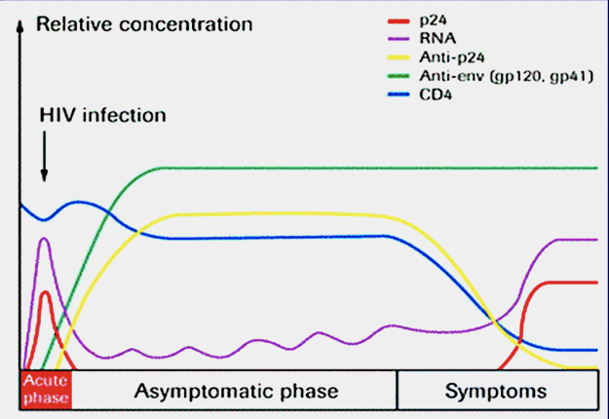
Diagnosis and Management
Lab markers:
Viral load (RNA) → Marker of replication rate
CD4 count → Marker of immunologic damage
Diagnosis:
ELISA: Detects the p24 antibody using the p24 antigen
Western blot: Detects HIV antibodies via gel electrophoresis and subsequent blotting (Used for confirmation if ELISA is positive)
PCR: Detects viral RNA (used for monitoring and following up)
Note that ELISA is positive only after the 4th week
This is due to Seroconversion → The development of detectable antibodies in the blood
Median 8 weeks after infection (according to the slides….)
The time it takes for seroconversion to occur is called the Window Period (during which an infected person tests negative)
The level of viral load post seroconversion correlates with risk of progression of disease (hence why PCR is used for follow up)
Management:
Antiretroviral therapy: Reverse Transcriptase inhibitors, Protease inhibitors, and Fusion inhibitors
Post exposure prophylactic treatment (PEP): within max 72 hours after exposure for 28 days

Slide 9
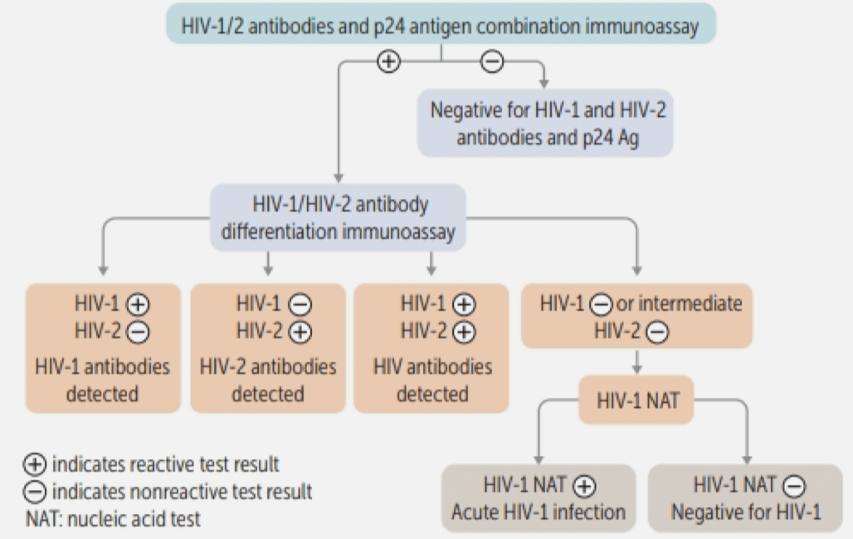
Diagnosis and Management
(EXTRA)
Western blots are no longer recommended for testing
Presumptive diagnosis is made with HIV-1/2 Ag/Ab immunoassays
These immunoassays detect viral p24 Ag capsid protein and IgG Abs to HIV-1/2 (Very high sensitivity and specificity)
They are not recommended in babies with suspected HIV due to maternally transferred antibodies. Use HIV viral load
Use HIV genotyping to determine appropriate therapy (Recall that there are two types of HIV, and Non-Nucleoside RTIs do not work on HIV-2)
Prophylaxis is indicated based on CD4 count:
Disease Agent | Begin Prophylaxis | Drug
Pneumocystis Jirovecii | CD4 <200 | TMP-SMX
Toxoplasma Gondii | CD4 <100 | TMP-SMX
Histoplasma Capsulatum (endemic areas) | CD4 <100 | Itraconazole
Mycobacterium Avium | CD4 <50 | Azithromycin

Slide 10
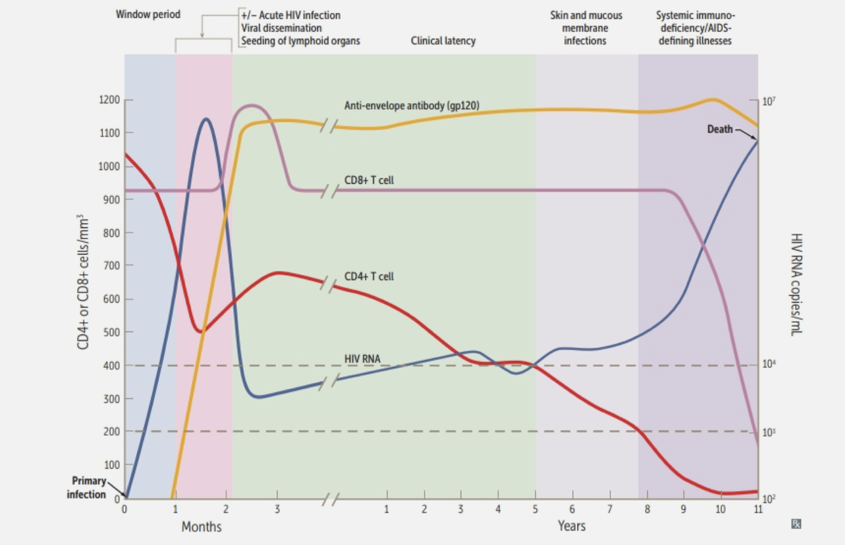

Slide 11
Take Home Messages
Infection with HIV usually occurs by sexual transmission, blood transfusion, mother to infant or accidental exposure
HIV targets the immune system and primarily infects CD4 positive lymphocytes
Immunodeficiency associated with HIV infections is mainly due to reduction in CD4 positive helper lymphocyte numbers
Increased viral load, significant reduction in CD4 lymphocytes and opportunistic infections are the hallmarks of progression to AIDS

Slide 12
Quiz:
1. Which of the following binds to the CD4 receptor upon entry of HIV to the host cell?
4. What is the most common site of syncytium formation?
CXCR4
GP120
GP41
CCR5
Bones
Brain
Lymph nodes
Lungs
2. Which of the following is a target cell for HIV?
5. Which of the following tests is used to monitor HIV patients?
Plasma cell
RBC
Neutrophil
Microglial cell
ELISA
Western blot
HIV RNA
Tuberculin test
3. What does HIV additionally bind to upon entry to the host cell?
6. The time between an HIV infection and a positive antibody test is known as?
Glycoprotein receptor
Chemokine receptor
TNF-alpha receptor
IFN-gamma receptor
Seroconversion
Window period
Door period
Latent period
1.B 2 D. 3.B 4.B 5.C 6.B

Slide 13
Team Leaders:
Ibrahim Aldakhil & Sedra Elserawani
THE editors:
Abdulrahman Alhawas & Lama Alzamil
:(

