Slide 1
Herpes simplex & Genital Warts
Lecture objectives
The main structural components of HSV-2 and HPV
Mode of transmission in HSV-2 and HPV infections
Main clinical features of HSV-2 and HPV infections
Diagnosis
Treatment and prevention
Important
Color index
Boys’ slides
Doctors’ note
Extra
Girls’ slides
EDITING FILE

Slide 2
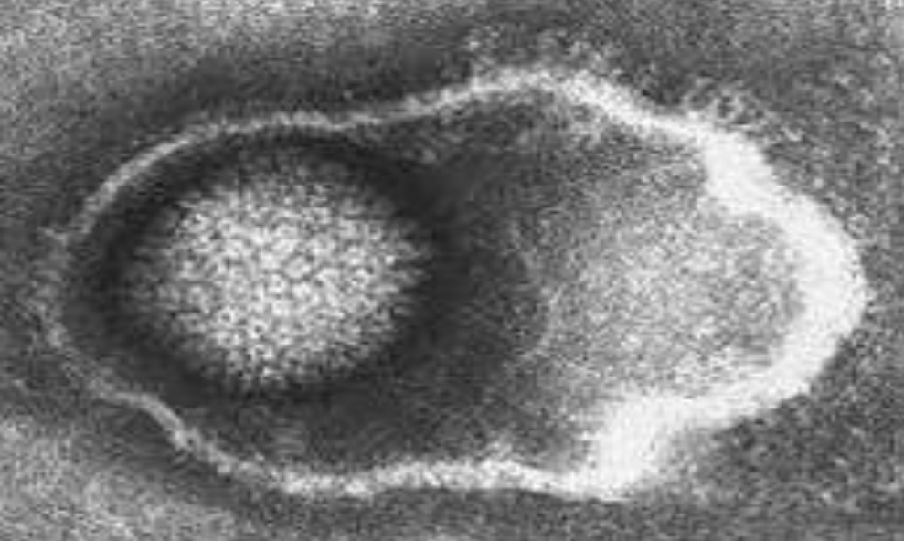
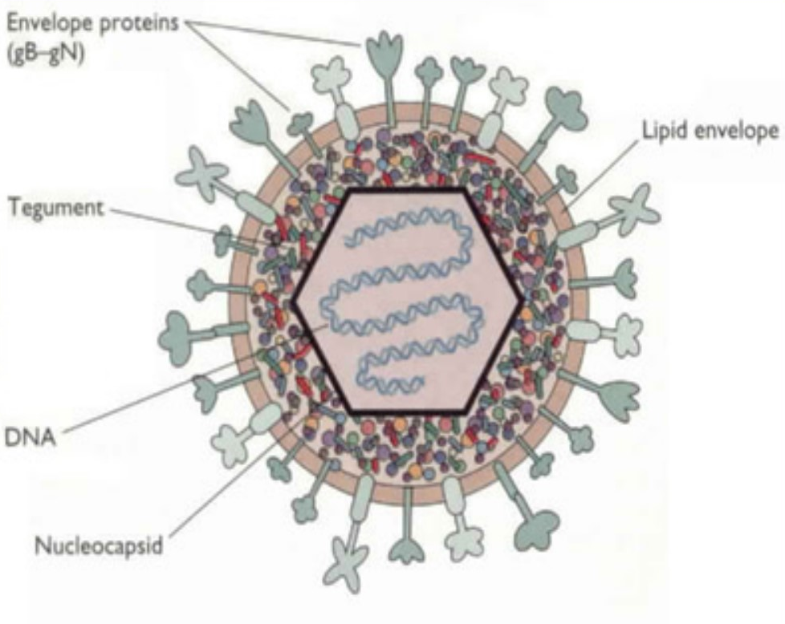
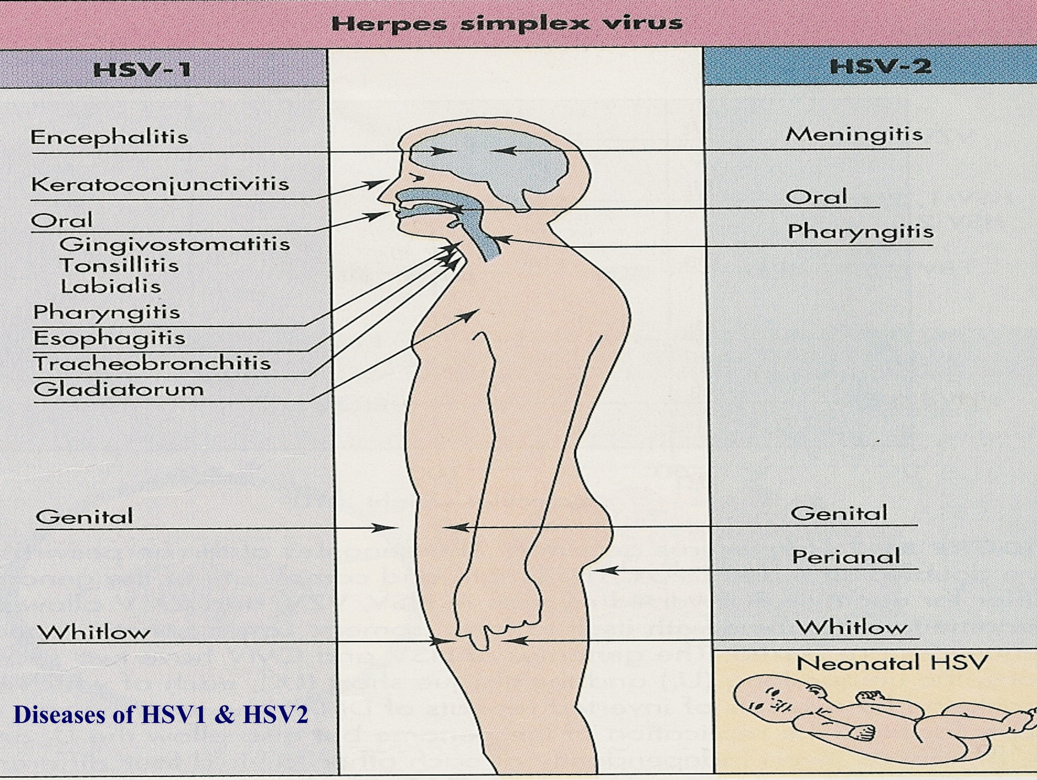
Introduction
1
1
Introduction:
Genital herpes and genital warts are recognized as the main sexual transmitted viral infections that might be acquired by any types of sexual contact.
Risk groups⁶:
Adults who have multiple sexual partners.
Immunocompromised individuals.
Infants of infected mothers.
Sexual child abuse
Homosexual
Genital herpes
Etiology:
There are two species of herpes virus capable of causing genital herpes:
Herpes simplex virus type 1 (HSV-1).
Herpes simplex virus type 2 (HSV-2).
90% of genital herpes cases are due to HSV-2 infection, whereas 10% are due to HSV-1⁵
Both (HSV-1 & HSV-2) are structurally very similar and share about 70% sequence homology¹.
Characteristics of Herpes virus
Family of herpesviridae Virion consist of: Glycoprotein envelope Icosahedral capsid Linear ds-DNA | The Herpes viruses has the ability to induce latent infection:² HSV (1&2) ➞ NERVE CELLS HSV-1 ➞ Trigeminal ganglia³ HSV-2 ➞ Sacral ganglia⁴
1- it’s difficult to differentiate between these 2 species in laboratory investigations.
2-Pathogenesis: HSV establishes infection in the mucosal epithelial cells and leads to formation of vesicles; virus travels up the ganglion to establish lifelong latent infection; stress triggers reactivation of virus in nerve and recurrence of vesicles
3- Because it mainly causes orofacial infection ( virus enters local sensory nerve endings → axonal transport proximally to sensory ganglion cell bodies → latent infection of trigeminal ganglion)
4- Because it mainly causes genital herpes
5- HSV-1 infections generally occur above the waist and HSV-2 infections generally occur below the waist
6-the same risk groups for all sexually transmitted disease ( bacterial or viral )

Slide 3
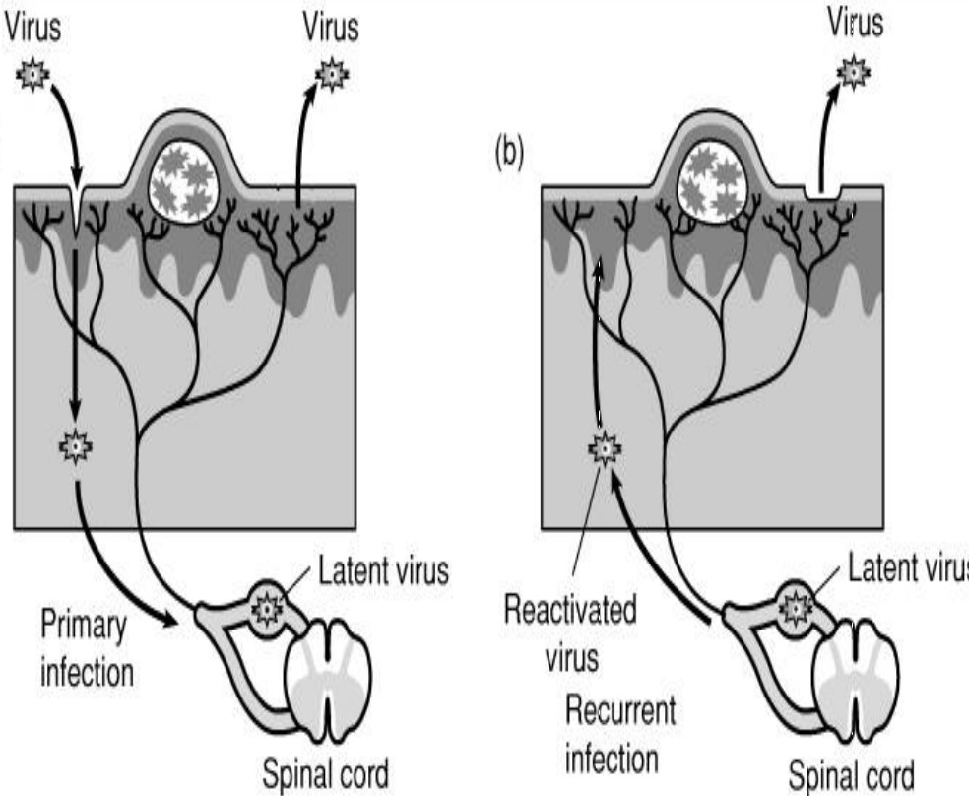
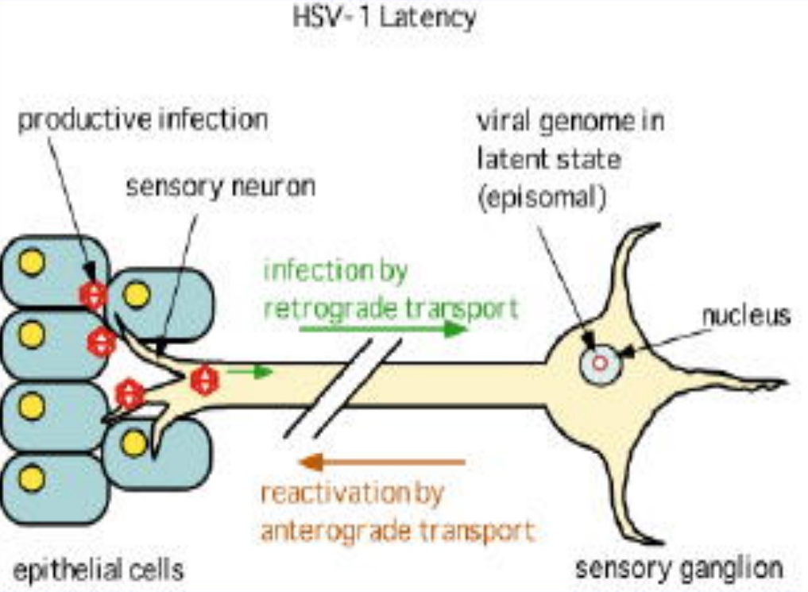
Genital herpes
1
2
Sexual Transmission¹: The number of different sexual partners correlates directly with acquisition of HSV-2 in both male & female. Homosexual men are more susceptible to HSV-2 infection. Genital infection can be acquired by auto-inoculation from lesions elsewhere on the body by touching vesicular fluids from any herpetic lesions (HSV-1&2). HSV-1 can cause genital herpes infection after oral sex, also can be seen in cases of child abuse
Perinatal Transmission (During Delivery): The majority of maternal infection (85%) occurs during delivery, due to direct contact between the baby and infected maternal birth canal. The risk of perinatal transmission is about 50% if the mother has primary genital herpes, while the risk is 8% if mother has recurrent infection². This infection can lead to either massive herpetic skin lesions or generalized infection affecting skin and internal organs e.g. lungs, liver or brain (neonatal herpes infections) To avoid perinatal infection we do caesarean section.
Intrauterine (Vertical Transmission) (10%): Maternal primary genital HSV (HSV-2) infection of the mother during first trimester can leads to spontaneous abortion. Maternal primary genital HSV (HSV-2) infection which develops after 20 weeks of gestations may induce malformation such as microcephaly, jaundice, hepatosplenomegaly, chorioretinitis and herpetic vesicles on the skin.
Transmission of Genital HSV infection
Pathogenesis of HSV-2 (Genital herpes infection)
Primary infection occurs when HSV-2 infects epithelial cells covering the mucosa ➞ Then the virus replicates and migrates to the nearest ganglion (sacral ganglia) via neurons where it establishes latency for life ➞ Once its reactivated due to stressors lowering immunity , it travels back through neurons to the site of the primary infection and causes recurrent infection.
Once the virus enters the human body, it remains for life (latency).
1-HSV is transmitted when the virus comes into contact with a mucosal surface or broken skin of a susceptible host. Such transmission requires direct contact with an infected person, because the virus is readily inactivated at room temperature, particularly if dried.
2- The risk of transmission to the newborn is much less than in a primary infection because considerably less virus is shed and there is maternal anti-HSV antibody in the baby.

Slide 4
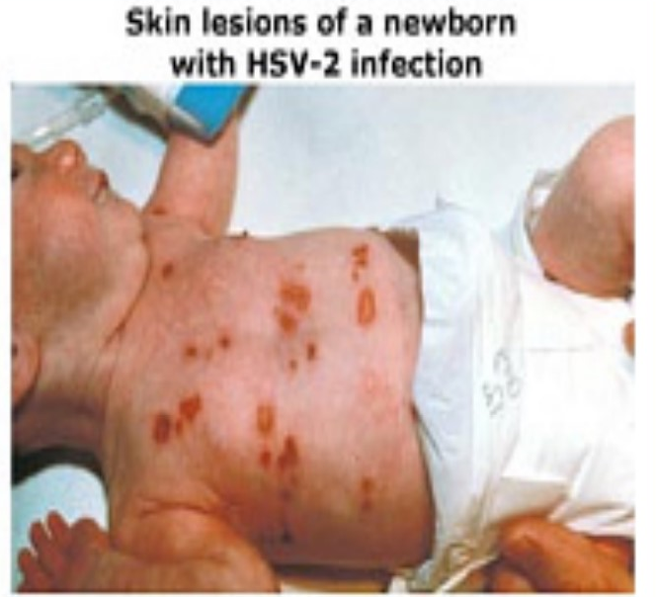
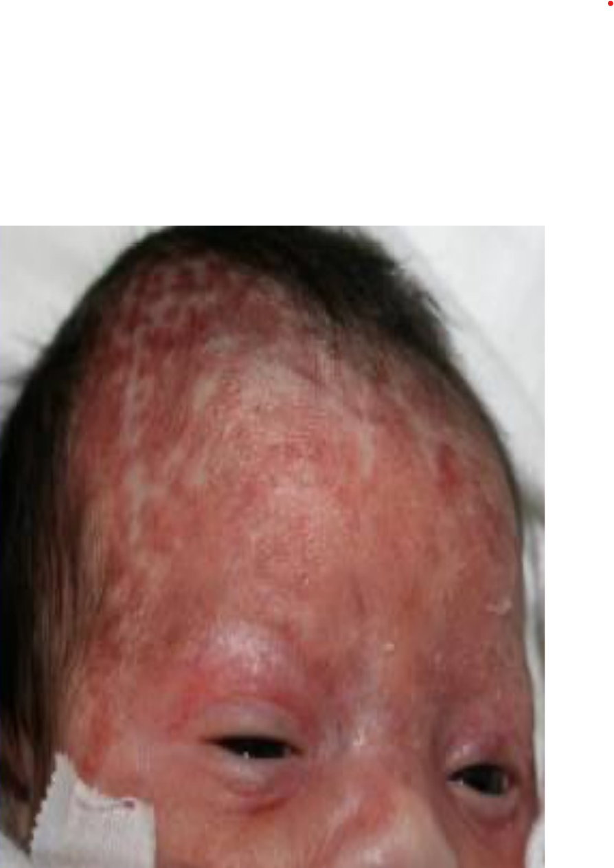
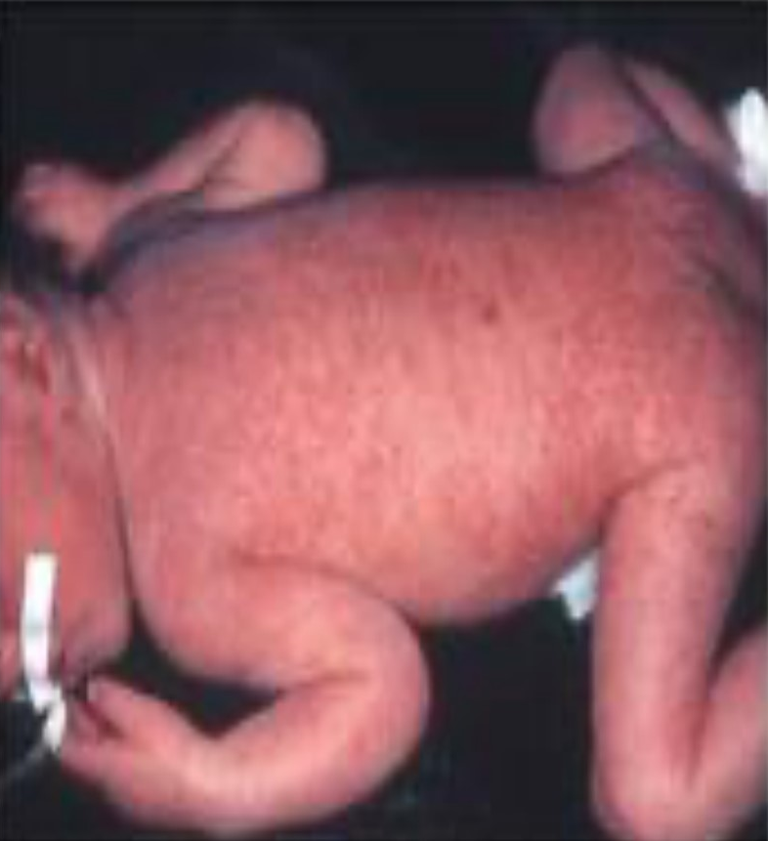
Genital herpes
1
3
Clinical features of HSV-2 infection
Primary genital infection
Recurrent genital infection
Vary from asymptomatic to mild or severe painful episode.
If symptoms are present (I.P. 2-12 days)
they may include:
Fever, Malaise, dysuria
Inguinal lymphadenopathy
Vesicular herpetic lesion or ulcer localized to the cervix, vagina, vulva or perineum of the female or the shaft of the penis in the male.
Aseptic meningitis have been observed in about 10% of cases as extra genital presentation
Occurs after reactivation by environmental or physiological factors such as stress, exposure to U.V. light, menstruation, pregnancy or any condition that decreased the immunity.
This can be as frequent as six or more episode a year, the attacks are milder and shorter than primary episode¹.
Accompanied with the appearance of herpetic vesicles on the external genitalia.
Symptoms may include pain and itching.
Neonatal herpes infection
Is not a common condition, but the mortality is >70% when it happens.
It occurs during labor and delivery through the vaginal canal when a mother is having a primary active herpetic lesion² and shedding the virus, also in small % as vertical transmission during pregnancy.
It may spread to other organs such as lungs, liver, brain.
1-Recurrent Infections are typically milder and of shorter duration than in the primary episode due to the presence of circulating antibodies.
2- the risk is higher if the mother is having a primary infection than if she is having a recurrent infection

Slide 5
Genital herpes
1
4
Localized skin infection
limited to massive skin vesicular lesions mild infection.
Localized brain infection
limited to CNS invasion causing encephalitis. mortality is high
Neonatal herpes infection
(has three forms)
Generalized neonatal herpes infection
severe massive infection of the skin (massive skin herpetic lesions) accompanied with internal organs infection including lungs (pneumonia) , liver (hepatosplenomegaly) , and brain (encephalitis).
usually fatal.
LAB DIAGNOSIS
ELISA main test for diagnosis | Serum sample is analyzed for detection the IgM Ab
IF² (Direct immunofluorescence) | Scraping of the base of the lesion sample or vesicle fluid sample is analyzed for detection the viral Ag.
PCR¹ | CSF sample in case of neonatal herpes.
Tissue culture | vesicle fluid sample is cultured in cell line (Vero or Hep-2 cells) and then identified by the following: Observe the viral CPE ( cytopathic effect ) Direct immunofluorescence (IF)
Tzanck smear | A rapid diagnosis can be made from skin lesion by using Tzanck smear ,in which: Cells from the base of the vesicle are stained with Giemsa stain The presence of multinucleated giant cells and cowdry type A intranuclear inclusions suggests herpes virus infection.
Management
No vaccine is available to prevent HSV-2 infection, and thus the best way to control the HSV infection is by: Avoid sexual contact with infected individuals. Abstain from making prohibited relations. Note: Condoms are not 100% protective against genital herpes infection Cesarean section is recommended for women who are having genital herpetic lesion.
Treatment
Acyclovir: The 1st choice therapy, and suitable for pregnant women. Famciclovir Valacyclovir
1- If the patient has meningitis or encephalitis, do PCR first.
2- can distinguish HSV-1 from HSV-2

Slide 6
1
Human Papillomavirus
5
Family
Family of Papillomaviridae
Characteristics
Virion is small non-enveloped and consist of:
Icosahedral capsid
Circular ds-DNA
HPVs exhibit great tissue and cell specificity, infecting only surface epithelia of skin and mucous membranes.
Does not grow in tissue culture
Resists detergent, heat, and can remain infectious in the environment for long time
Types of warts and HPV genotype
Types of warts
Cutaneous
Mucosal or anogenital
1. Cutaneous:
The virus is transmitted from infected skin ,either by direct contact hand to hand (common warts) or through fomites and enter its new host through abrasions especially in swimming pools (plantar warts)
Common Warts¹
(HPV genotype 2,4)
Plantar Warts²
(HPV1,)
Flat Warts³
(HPV 3,10)
1- On hands.
2-On sole of foot
3- On face.

Slide 7
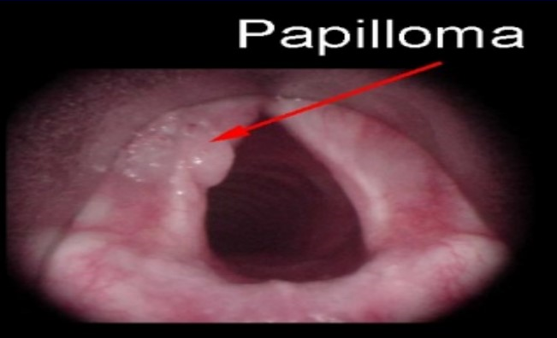
1
Human Papillomavirus
6
2. Anogenital or mucosal Warts:
Transmission of genital warts mainly occurs during sexual activity
There is strong association between increasing numbers of sexual partners and prevalence of genital HPV infections.
often occur in association with other sexual diseases as gonorrhea or chlamydial infection.
Vertical transmission; from mother to infant or prenatal transmission lesions appear within the first 6 weeks of life have been demonstrated as laryngeal papilloma
Genotypes are important
6,11 → Benign, 16,18 → oncogenic
Condyloma acuminata (benign)
(HPV 6,11)
Cervical carcinoma
(HPV 16,18, 31,45)
Penile and anal carcinoma in men
(HPV 16,18)
Laryngeal Warts (benign)
(HPV 6,11)
Clinical symptoms of genital warts
Appear within 3-4 months
after infection (I.P)^{.1}
Localized pain.
Discomfort.
Warts size vary
from small
round to large
Found in the anogenital tract (inside or outside
the genital and the anal areas of both males and females).
Abnormal vaginal bleeding and discharge.
1- Incubation period is very long.

Slide 8
1
Link between HPV and cervical cancer
7
Persistent HPV infection is considered the main cause of cervical cancer.
HPV DNA can be detected in most grades of premalignant lesions of the female and male genital tract.
HPV type 6 and 11 are mostly found in low-grade disease
HPV 16 and 18 are more commonly associated with lesions of greater severity and invasive cancer .
> 90% of positive Pap-smear is due to HPV infection.
Pap-smear: is a screening test for detection abnormal epithelial cells of the cervix.¹
Diagnosis & Prevention
Diagnosis | External genital warts can be easily diagnosed by medical examination. Internal genital warts can be visualized by colposcopy. Lab diagnosis: Polymerase chain reaction (PCR) ( main test for diagnosis ) is used to detect HPV DNA. In-situ DNA hybridization is used for HPV genotyping. Pap-smear test is used to identify abnormal epithelial cells of the cervix (cervical dysplasia).
Prevention | There are two vaccines available Gardasil and Cervarix and both are: Recombinant viral-like particles with no DNA.(only viral capsid) Given in 3 doses at 0², 2, 6 months. Recommended for young individuals ages 9-26 yrs old. Not given to pregnant women. Gardasil: a quadrivalent vaccine, provides protection against HPV genotypes 6,11,16,18 which causes genital warts and cervical cancer. Cervarix: a divalent vaccine, provides protection against HPV genotypes 16 and 18 which causes cervical cancer.
1- Doesn’t detect HPV directly, it detects the epithelial abnormality.
2- 0 doesn’t mean at birth, it’s just the beginning of the baseline provided for the vaccine. (first shot)

Slide 9
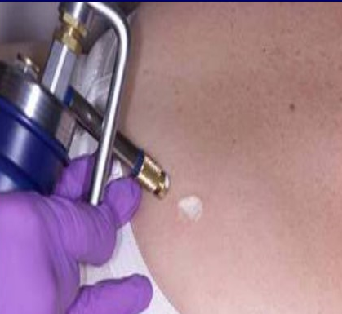
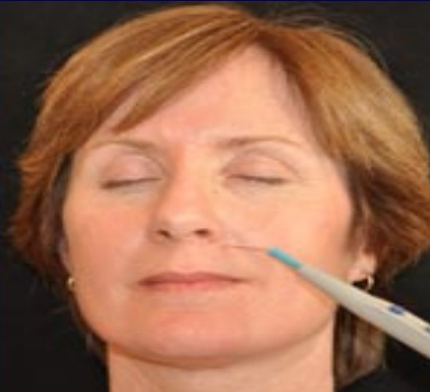
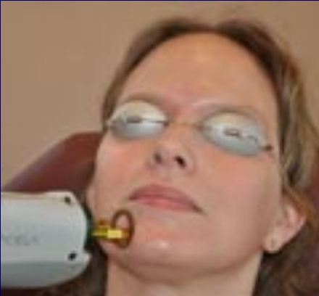
1
Human Papillomavirus
8
Treatment
1- Topical treatment Applied directly on external warts and Used for several weeks. Examples: Imiquimod, Podofilox. Podophyllin is applied by a doctor and contraindicated in pregnancy. Trichloroacitic acid (T.C.A) safe in pregnancy
2- Injection: Interferon alpha, 5-flurouracil epinephrine gel. Could be taken for several weeks (8-12).
3- Cryotherapy: freezing warts by liquid nitrogen
4- Electrocautery treatment: destroying warts by an electric current
5- Laser therapy: destroying warts by a focused light beam
6- Surgical excision: removing warts by surgical tools

Slide 10
Summary
1
9
Herpes | Sexually transmitted causes genital warts due to any type of sexual contact it has 2 types : HSV-1 , HSV-2 ( more common ) characteristics of the virus : structure : Ds-DNA with capsid & glycoprotein envelope Ability to induce latent infection Pathogenesis : Primary HSV infect epithelial covering mucosa ➞ replicate ➞ migrate to nearest ganglion to hide Recurrent When immune system is suppressed it gets reactivated & travel back to primary site causing recurrent infection Transmission : Sexual transmission different sexual partners correlates directly with acquisition of HSV-2 Homosexual men are more susceptible to HSV-2 infection. auto-inoculation Perinatal transmission during delivery 50% if the mother has primary genital herpes, while the risk is 8% if mother has recurrent infection. To avoid perinatal infection we do caesarean section. Intrauterine transmission if maternal primary genital infection developed in 1st trimester ➞ abortion , but if after 20 weeks ➞ induce malformation in baby , 3 forms : Localized skin infection Localized brain infection generalized neonatal herpes infection Lab diagnosis : ELIZA ( main ) : detect IgM Ab direct IF PCR : in case of neonatal herpes. Tissue culture Tzanck smear Treatment : acyclovir
HPV | Characteristics : Ds-DNA with capsid Does NOT grow in tissue culture & is very resistant & can remain in environment for long period Types : Cutaneous : transmitted by hand touch , causing common , planter or flat wart Anogenital : transmitted during sexual activity Condyloma acuminata & laryngeal wart ( HBV 6,11 ) Cervical carcinoma ( HBV 16,18,31,45 ) Penile/anal carcinoma ( HBV 16,18 ) Lab Diagnosis : PCR ( main ) : detect HBV DNA In situ hybridization Pap smear of cervix epithelium Vaccines : gardasil : protect against HBV 16,18,31,45 Cervarix : protect against HBV 16,18

Slide 11
Lecture Quiz
MCQ:
Answers: Q1:C | Q2:C | Q3:B | Q4:A | Q5:C
Q1: In primary genital HSV-2 infection the the virus replicates and migrates to the nearest ganglion which is?
A- Dorsal root ganglia
B- Trigeminal ganglia
C- Sacral ganglia
D- Paravertebral ganglia
Q2: Which of the following antiviral drugs is the first choice in the treatment of HSV-2?
A- Famciclovir.
B- Spiramycin.
C- Acyclovir.
D-sulfadiazine.
Q3: Herpes virus genome consist of?
A- ss-DNA
B- ds-DNA
C- ss-RNA
D- ds-RNA
Q4: Which one of the following HPV genotype commonly cause flat warts?
A- HPV-3
B- HPV-2
C- HPV-1
D- HPV-4
Q5: Which one of the following HPV genotype commonly cause laryngeal warts ?
A- HPV 13
B- HPV 31
C- HPV 11
D- HPV 16
SAQ:
CASE: A woman came to the clinic suffering from itching, pain and herpetic vesicles on the external genitalia. The symptoms appeared after menstruation and she mentioned that she had multiple sexual partners:
Q1: What is the most likely diagnosis?
A: Recurrent genital herpes infection
Q2: What is the most likely causative agent?
A: HSV-2 , HSV-1
Q4: What are the lab methods used for her diagnosis?
A: ELISA, IF, PCR, Tissue culture, Tzanck smear
Q5: What is the appropriate treatment for this patient?
A: Acyclovir, the 1st choice therapy

Slide 12
Members Board
Team Leaders:
Abdulaziz Alshomar Ghada Alsadhan
Team sub-leader:
Mohammed Alhumud (coolest sub leader ever)
This lecture was done by:
Nawaf Albhijan
Note takers:
Mashal Abaalkhail
Sarah Alhelal

