Slide 1
Transplacental Infections
Lecture objectives
Recognize the different types of infant infections.
Know major transplacentally transmitted pathogens causing congenital infections .
(Toxoplasma , TP ,ParvoV , VZV, Rubella V & CMV.)
Describe their structures.
Know their major epidemiology features.
Describe clinical manifestations of their congenital infections.
Illustrate different laboratory diagnosis of maternal and congenital infections
know their treatment and preventive measures.
Important
Color index
Boys’ slides
Doctors’ note
Extra
Girls’ slides
EDITING FILE

Slide 2
Introduction
1
1
Terminology & Routes of transmission
Classification | Timing of events | Mechanisms
Congenital | Intra-uterine (In utero) | Transplacental
Perinatal¹ | Intra-partum (During labour and delivery) | Exposure to genital secretions and blood
Neonatal¹ | Post-partum (After birth) | Direct contact Breastfeeding Nosocomial
Congenital infections
Mostly due to viruses.
Previously known as (TORCH) infections:
T= Toxoplasma gondii
O= Other e.g. (Treponema pallidum², parvovirus &VZV),
R= Rubella virus
C= CMV
H= Herpes (Hepatitis & HIV)⁶,
Primary maternal infection in the first half of pregnancy poses the greatest risk to the fetus.
Risk of IUI & fetal damage depends on:
Type of Organism (Teratogenicity)
Type of maternal
Infection (Primary³
,recurrent⁴)
Time during pregnancy
(1st⁵,2nd,3rd Trimester)
1- e.g. Group B streptococcus infections
2- Causes syphilis
3- Initial acquisition of virus during pregnancy. (Higher risk) why? Because in recurrent infections there will be specific antibodies from the previous exposure which can cross the placenta and protect the fetus.This is not seen in primary infection thus making it higher risk.
4- In women who are already seropositive., reactivation of old infection. (Lower risk)
5- 1st trimester has higher risk for fetal damage compared to 2nd,3rd trimesters.why? Because during 1st trimester there is intensive cell division and organ development so any disturbances results in anomalies and malformations.
6- Mainly herpes simplex virus type 1 ,hepatitis B&C and we may include human papillomavirus(viruses that start with H are mainly transmitted perinatally and cause perinatal infections)

Slide 3
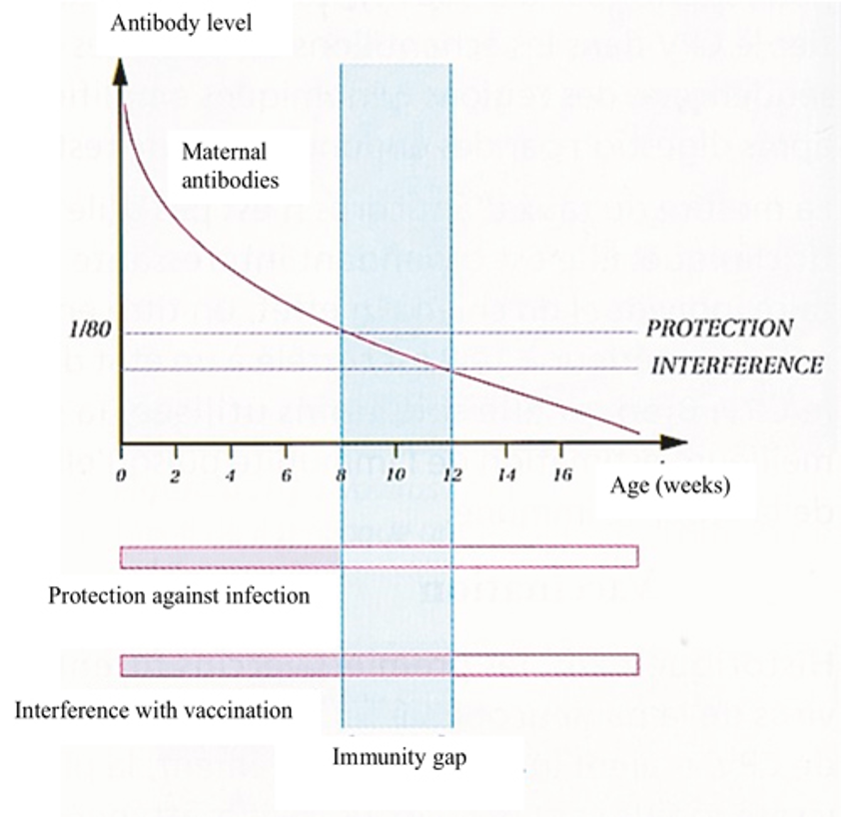
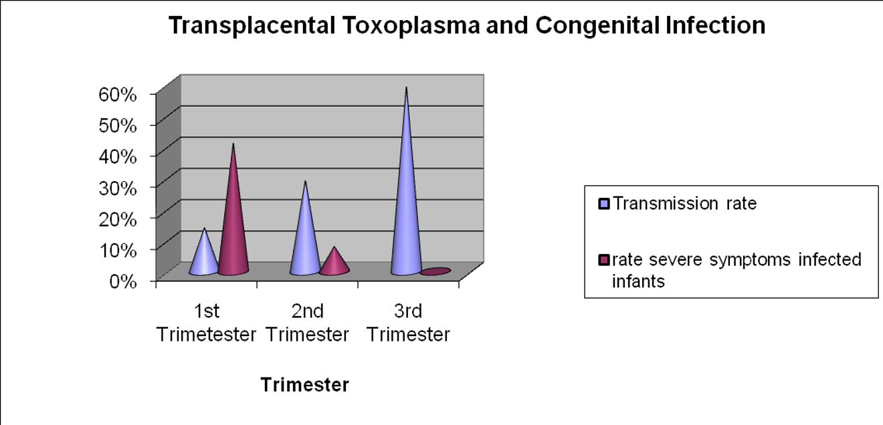
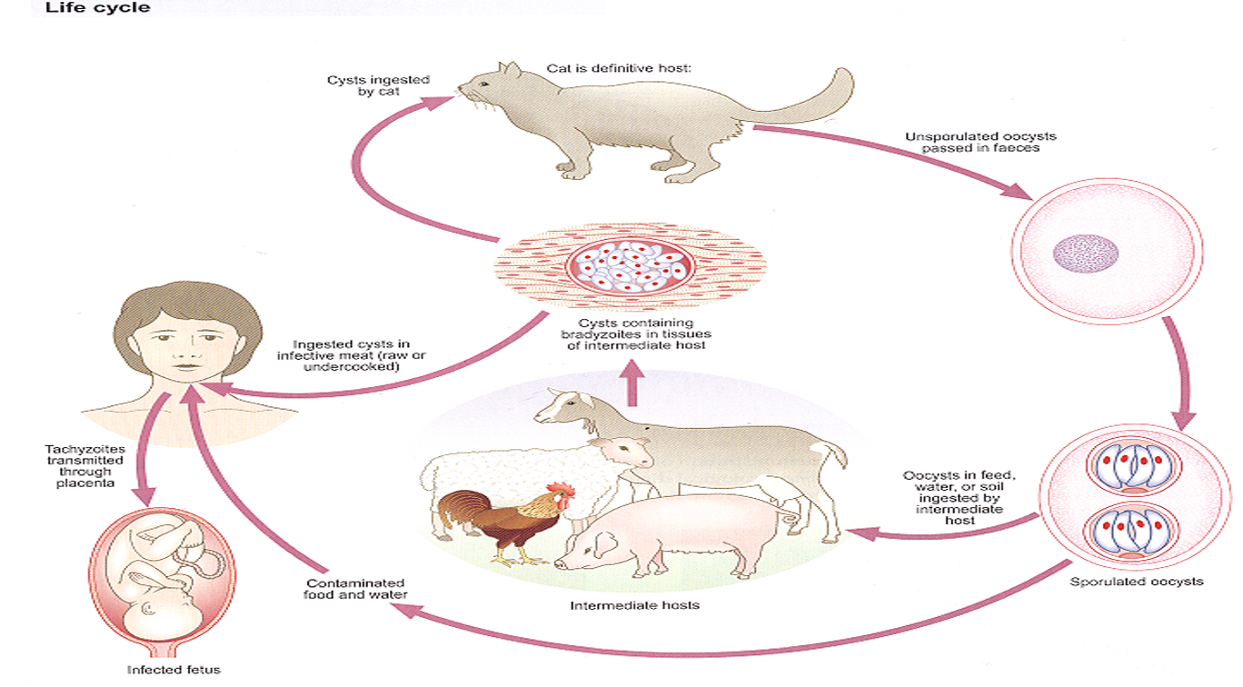
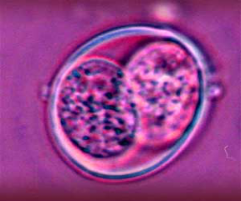
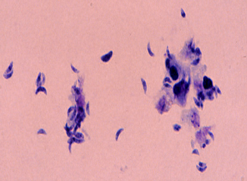
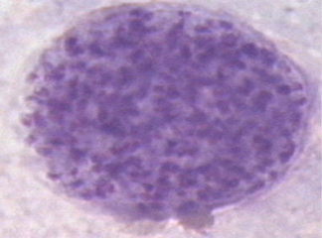
1
Congenital infections cont.
2
Common features of congenital infections:
Intrauterine growth retardation(IUGR)
Microcephaly or hydrocephalus
Hepatosplenomegaly(HSM)
Thrombocytopenia may result in rash
There is also certain organ damage (eye ,ear and the heart)
NOTE: Majority of Congenital infections are asymptomatic at birth however some develop mental retardation and hearing loss later in life. Preventative and therapeutic measures are possible for some of the agents
Neonatal serological Diagnosis:
IgM antibody.¹
Absence of fetal IgM at birth doesn’t exclude infection.
Persistence of specific IgG antibody > 12 months of age.²
1- Toxoplasmosis
Causative organism: Toxoplasma gondii
Obligate intracellular parasite.
Definitive host: Cats
Epidemiology:
Most cases are due to primary maternal infection.
Rarely, reactivation of a latent infection in immunocompromised
pregnant woman
The rate of transmission is the highest in the 3rd trimester
Fetal death higher with infection in 1st trimester
Life cycle is Important
Life cycle:
Transmission:
Ingestion of oocytes: cat feces contaminate fingers, soil, water.
Ingestion of cysts in undercooked meats
Blood transfusion and organ transplant
Vertical transmission: from mother to fetus (transplacental)³
Morphology
Oocysts | Tachyzoites⁴ | Bradyzoites⁴
Shed in cat feces | Rapidly dividing forms Acute phase Can pass through placenta. | Slowly dividing forms Chronic phase
Immunity +
Immunity -
1- If you do serology for a neonate and find + IgM it indicates that the fetus has experienced an infection.
2- If you do serology for a neonate and find + IgG this doesn’t necessarily indicate a previous infection, because it's probably Maternal IgG , IgG can cross the placenta unlike other Abs, so we do the test again after 12 months (Maternal IgG will be gone), if positive this indicates that the fetus has experienced an infection before, if negative he/she hasn’t.
3- Only pregnant mothers with an active primary infection can result in congenital toxoplasmosis; mothers with previous infections mount an immune response that protects the fetus. Pregnant mothers, especially those without previous exposure, are encouraged to avoid cats to prevent congenital toxoplasmosis.
4-With adequate immune response, tachyzoites(rapidly dividing) will be transformed into bradyzoites(slowly dividing form), but if the host becomes immunocompromised, reactivation will occur and bradyzoites will transform to tachyzoites

Slide 4
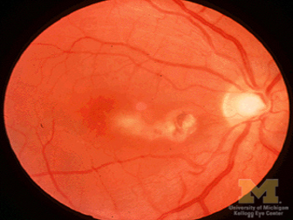
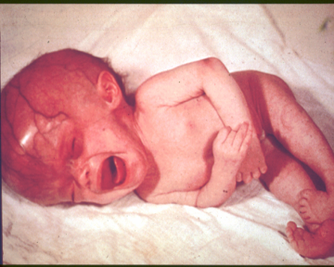
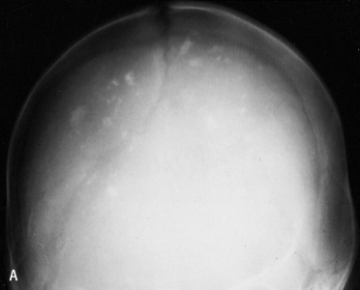
1
1- Toxoplasmosis cont.
Keywords:
Cat/undercooked meat
Chorioretinitis
IgG avidity
3
Clinical presentation:
Mostly (70-90%) are asymptomatic at birth, but are still at high risk of developing abnormalities, especially eye (chorioretinitis)/neurologic disease(MR) later.
Classic triad of symptoms:
Other symptoms include:
Fever, rash, HSM, microcephaly,seizures, jaundice, thrombocytopenia, lymphadenopathy.
Abortion & Intrauterine death.
Chorioretinitis | Hydrocephalus | Intracranial calcifications
Diagnosis & Treatment
Diagnosis | Pregnant mother | Infant
 | Serology: -IgM¹ -IgG² -IgG avidity³ -IgG seroconversion⁴ compared to booking blood. | Prenatal | Postnatal/Newborn
 |  | Serial ultrasound. To detect sign of congenital infection PCR.It is the definitive dx Culture. | 1- Serology: - IgM Note: -ve result does not exclude infection - High IgG or persistently +ve > 12 months. 2- PCR 3- Culture 4- Evaluation of infant e.g. neuroimaging
Treatment | Spiramycin macrolide used to treat pregnant women and to prevent the transmission of toxoplasma to the fetus but it does not treat the fetus if the infection has already occurred Pyrimethamine and sulfadiazine use if fetal infection is confirmed or maternal infection occurred in 3rd trimester .Treatment should be shifted to this combination and continued until delivery.After delivery neonate should receive this combination for 1 year.
Prevention | 1- Avoid: Exposure to cat feces. 2- Wash: - Hands with soap and water. - Fruits/vegetables - Surfaces that touched fruits/vegetables/raw meat. 3- Cook: all meats thoroughly.
IgG
-
+
not infected, retest every 1-3 ms for seroconversion
IgM
-
+
old infection >1 year
acute infection or false positive
IgG avidity
High
Low
Old infection
New infection
1- IgM-specific antibodies(Marker of acute infection) can be detected 2 weeks after infection (IgG-specific antibodies usually are negative during this period), achieve peak concentrations in 1 month, decrease thereafter, and usually become undetectable within 6 to 9 months.
2- IgG-specific antibodies(Marker of chronic infection/immunity) achieve a peak concentration 3 to 5 months after infection and remain positive indefinitely. The vast majority of patients will have low-positive IgG antibody titers 6 months after the acute infection.
3- Used to differentiate between old (recurrent) and new (Primary) infections: IgG produced early in infection is less avid and binds to T gondii antigens more weakly than do antibodies produced later in the course of infection. High antibody avidity indicates an older infection
4-seroconversion is the time period during which a specific antibody develops and becomes detectable in the blood. After seroconversion has occurred, the disease can be detected in blood tests.

Slide 5
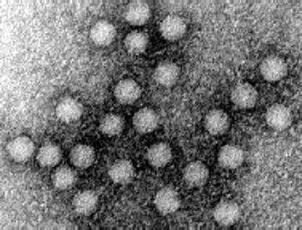
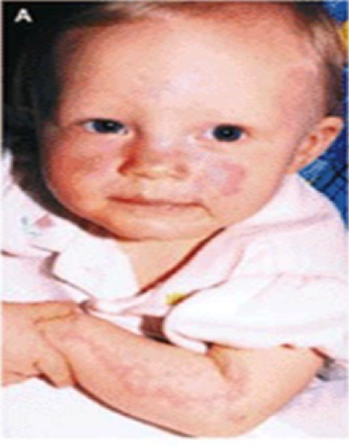
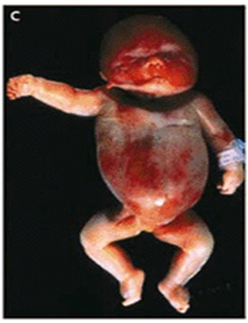
1
Keywords:
Hydrops fetalis
Anemia, rash
slapped cheek
4
2- Parvovirus B₁₉
General info:
Family: Parvoviridae
Non-enveloped, Icosahedral capsid and SS DNA genome
Causative agent of Fifth disease¹ (erythema infectiosum)
Epidemiology:
Worldwide distribution
Humans are known hosts evidence of teratogenicity
Transmission: (Human to Human transmission)
Respiratory route.(Mainly)
Blood transfusion.
Transplacental route.
erythema infectiosum
Hydrops fetalis
Clinical presentation
Acquired infection |  | Congenital infection
Immunocompetent host | immunocompromised host | Risk of congenital infection is greatest when infection occur in 1st 20 weeks (1st and 2nd trimesters): Infection in the 1st trimester → IUD (Intrauterine death) Infection in the 2nd trimester → HF (Hydrops fetalis)² Infection in the 3rd trimester → Lowest risk Causes fetal loss through hydrops fetalis, CHF, generalized edema and fetal death.
Erythema infectiosum (Rash) Usually self-limiting | -
Diagnosis & Treatment
Diagnosis | Pregnant mother | Prenatal
 | Specific IgM. IgG seroconversion. | Ultrasound (hydrops) Not grow in cell culture PCR may be used on amniotic fluid.
Treatment | Intrauterine transfusions
Prevention | Hygiene practice No vaccine (TRIAL)
1- AKA Slapped cheek disease. Erythema infectiosum is called “fifth disease” because it is one of the five most common pediatric diseases with rash.
2- Edema due to congestive heart failure caused by severe anemia which is the result of RBC destruction.

Slide 6
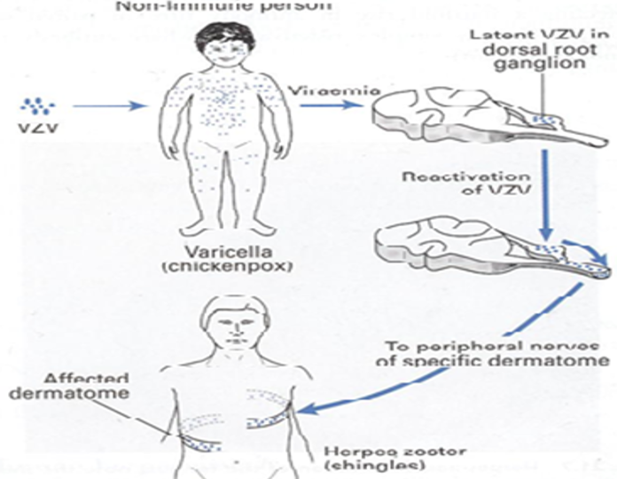
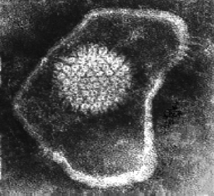
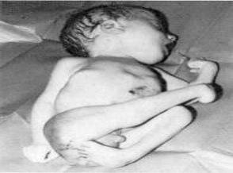
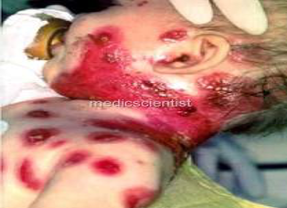
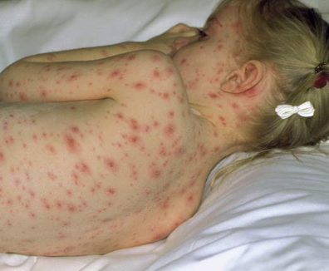
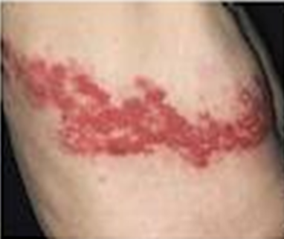
Keywords:
Vesicular rash, VZIG
Chickenpox,Shingles
1
3- Varicella Zoster Virus
5
General info:
Family: Herpesviridae
dsDNA , Enveloped, Icosahedral Virus
90% of pregnant women already immune
Transmission:
Respiratory route
Transplacental route
Direct contact with ruptured varicella vesicles
Clinical presentation
Acquired infection | Congenital infection
1- Varicella (Chickenpox) : Primary illness Generalized vesicular rash(itchy) Common in children. 2- Zoster (Shingles): Recurrent infection Localized painful unilateral vesicular rash Common in old people | Primary infection carries a greater risk of severe disease, in particular pneumonia. Intrauterine infections: 1- Congenital varicella syndrome(CVS): 1st 20 weeks of Pregnancy The incidence of CVS is ~ 2% Symptoms: Scarring of skin Hypoplasia of limbs CNS & Eye defects 2- Neonatal varicella: Less than 5 days before delivery → severe disease ¹ More than 5 days before delivery → mild disease¹ Can be prevented by Cesarean delivery
Chickenpox
Shingles
Diagnosis & Treatment
Diagnosis | Pregnant mother | Infant
 | -Direct from the vesicles: 1- Vesicular fluid for virus isolation. 2- Cells scraping from the base of vesicles → ImmunoFluorescent(Ag) 3- DNA-VZV by PCR -Serological: 1- IgM AB | Prenatal | Postnatal
 |  | 1- Ultrasound. 2- VZV DNA in fetal blood or amniotic fluid or placenta villi (usually the sample is amniotic fluid) | 1- VZV IgM 2- Virus isolation 3- VZV DNA in VF or CSF (CSF infection)
Treatment | Acyclovir
Prevention | Pre-exposure | Varicella live-attenuated vaccines. Contraindicated to use in immunocompromised patients and pregnancy.
 | Post-exposure | VZIG (Varicella zoster immunoglobulin): Susceptible pregnant women have been exposed to VZV. infants whose mothers develop Varicella < 5 to 2 days after delivery.
1- If the maternal rash begins 6 days or more before delivery, her antibody response will have developed and been transferred across the placenta so that the baby does not develop disease. However, the infant is at serious risk if maternal varicella occurs 5 days or less before delivery this allows viraemic spread across the placenta, before antibody is made and transferred to the baby.

Slide 7
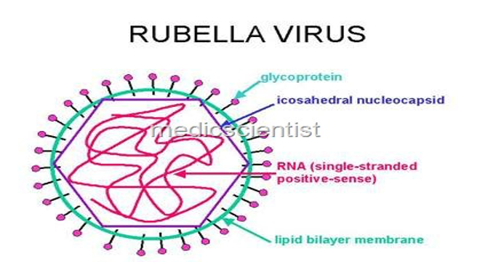
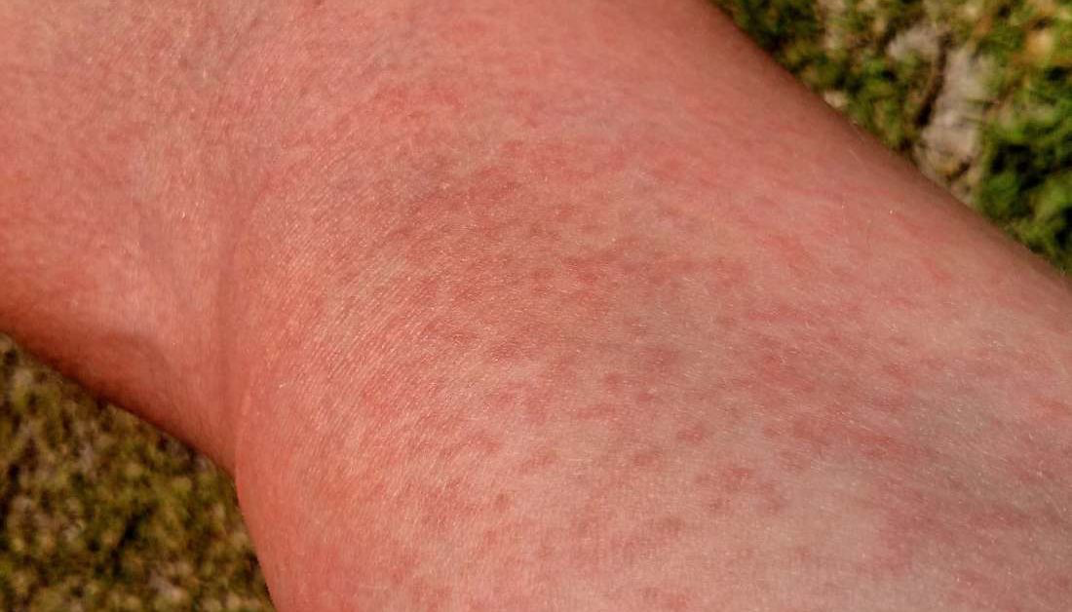
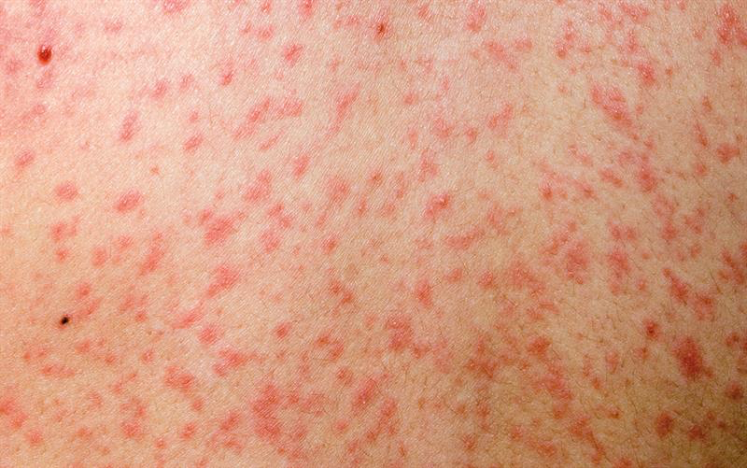
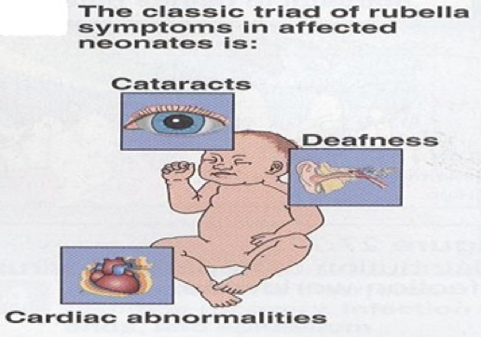
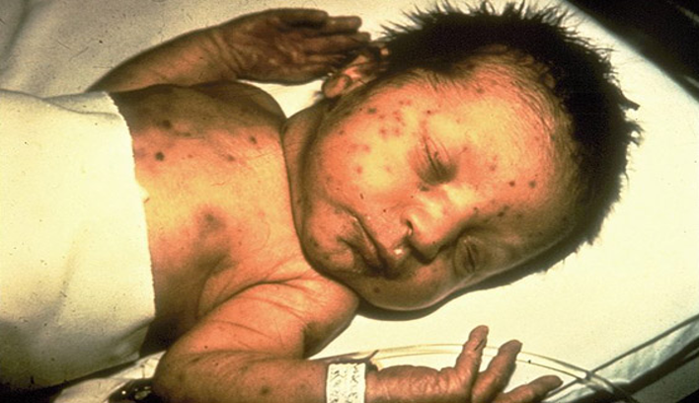
4- Rubella Virus
Keywords:
Routine antenatal screening
Deafness, PDA.
Maculopapular rash
1
6
General info:
Family: Togaviridae
vSS RNA genome, Icosahedral capsid, Enveloped Virus
Rubella = German measles
Epidemiology:
Vaccine-preventable disease in human → No longer considered endemic.
Transmission:
Respiratory route. (Mainly)
Transplacental route.
Clinical presentation
Acquired infection
Ex. Maculopapular rash¹
Congenital infection
Normal → Congenital rubella syndrome (CRS) → IUD (Intrauterine Death) Risk of acquiring congenital rubella infection varies and depends on gestational age of the fetus at the time of maternal infection: 0-12 weeks → 70% 13-16 weeks → 20% >16 weeks → infrequent Congenital rubella syndrome: Triad of abnormalities affect → Ears, Eyes and Heart: Ears: Sensorineural hearing loss.(Most common) Eyes: Cataracts and glaucoma Heart: Cardiac malformations e.g. Patent ductus arteriosus(PDA) Neurologic defects (Less common) Others: Growth retardation, Bone disease, HSM, Thrombocytopenia, “blueberry muffin” lesions
Diagnosis & Prevention
Diagnosis | Pregnant mother | Infant
 | Serological diagnosis: 1- Rubella specific IgM 2- IgG seroconversion | Prenatal | Postnatal
 |  | 1- Ultrasound 2- Culture 3- PCR | 1- Serology: IgM Persistence of IgG >9-12 months 2- Culture: 3- PCR
Prevention | Rubella vaccine (Live attenuated vaccine) Routine Antenatal screening: Rubella Specific IgG² Non-immune women → vaccination (avoid pregnancy for 3 months)
1- A type of rash characterized by a flat, red area on the skin that is covered with small confluent bumps.
2-If pregnant woman is +ve for rubella specific IgG ➝ Means she is immune against rubella infection and there is no risk of congenital rubella syndrome.If she is -ve for rubella specific IgG ➝ Means she is suspscebtlie (non-immune) and is at risk.

Slide 8
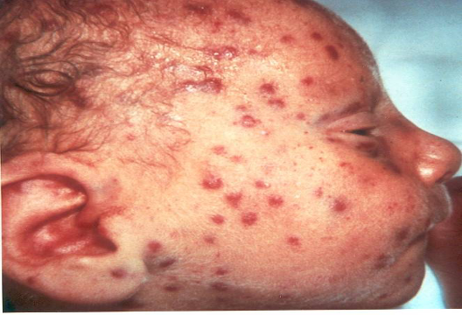
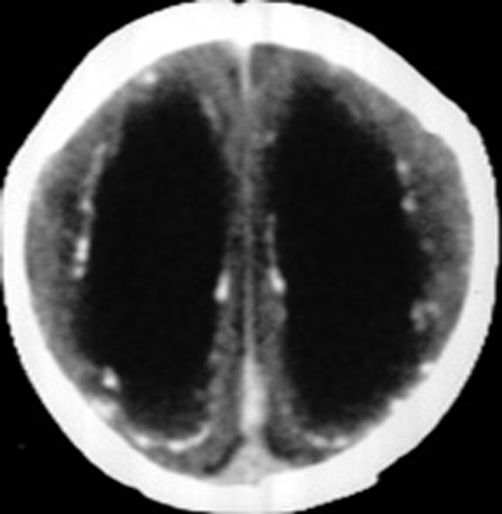
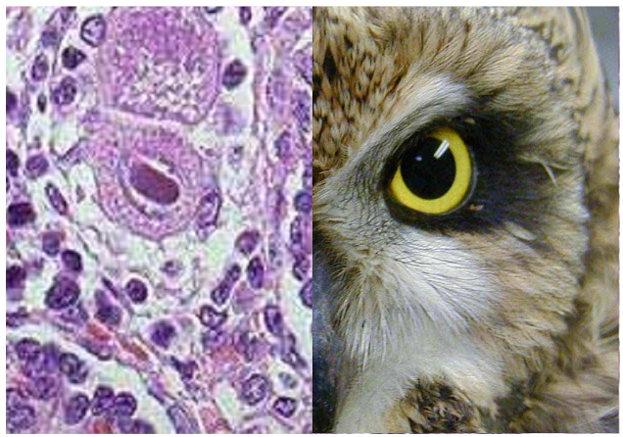
1
5- Cytomegalovirus (CMV)
7
Keywords:
Owl’s eye,
intranuclear inclusion bodies
Urine
General info:
Family: Herpesviridae
dsDNA , Enveloped ,Icosahedral Virus.
Establishes in latent form → reactivation → Recurrent infection.
Epidemiology:
Human ,worldwide .
Transmission:
Horizontal transmission:
Young children: saliva
Later in life: sexual contact
Blood transfusion & organ transplant
Vertical transmission²:
Primary CMV infection (40%)
Recurrent CMV infection (~1%)
Clinical presentation:¹ “Congenital infection”
Clinically normal (80%)
Hearing defect and mental retardation (15%)
Death (1%)
Cytomegalic inclusion disease (4%)³:
Symptoms:
Blueberry muffin” spots
Ventriculomegaly & calcifications
of congenital CMV
CNS | Eye | Ear | Liver | Lung | Heart | other
microcephaly, periventricular calcification. | chorioretinitis | sensorineural deafness | HSM and jaundice. | pneumonitis | myocarditis | Thrombocytopenic purpura
Diagnosis & Treatment
Diagnosis | Pregnant mother | Infant
 | Serological diagnosis: 1- CMV IgM 2- CMV IgG 3- CMV IgG avidity | Prenatal | Postnatal
 |  | 1- Ultrasound 2- Culture 3- PCR | 1- By isolating CMV or detection of its genome in first 3 weeks of life. Body fluid(Sample) : urine, saliva, blood. Using: Standard tube culture method Shell vial assay PCR 2- Histology; Detection of Cytomegalic intranuclear Inclusion Bodies in affected tissue (Owl’s eye) (sight-o-megaly) 3- Serology; CMV IgM
Treatment | Symptomatic infants → Ganciclovir
Prevention | No vaccine, Education about CMV & how to prevent it through hygiene; hand washing
1- CMV is a well known cause of Infectious mononucleosis-like syndrome [Heterophile AB –ve].(Acquired infection)
2-The risk of intrauterine transmission is much higher during primary maternal CMV infection than recurrent maternal CMV infection
3-Cytomegalic inclusion disease characterized by small baby,hepatosplenomegaly,hematologic disorder including anemia and thrombocytopenia which result in a rash called blueberry muffin spot .it’s common sign is intracranial calcification,microcephaly and thrombocytopenia.

Slide 9
Main notes are within the lecture, this is just the summary he mentioned at the end of the lecture.
Dr.Khalifa
1
8
Summary
Introduction:
Primary infections are worse than recurrent infections,
Early pregnancy infections are worse than late pregnancy infections..
1- Toxoplasmosis:
Source: Cat, undercooked meat.
Transplacental transmission especially in primary infections.
Triad of symptoms: Chorioretinitis, hydrocephalus, intracranial calcification.
Diagnosis:
Mother: IgM, IgG, IgG avidity, IgG seroconversion.
Prenatal: Ultrasound to see transplacentally for any suggestive findings of intrauterine infection e.g. Intrauterine growth retardation, microcephaly.
Postnatal: Serology and molecular testing if applicable.
2- Parvovirus:
Mainly associated with hydrops fetalis especially if it occured in 2nd trimester.
It’s also associated with respiratory infections and erythema infectiosum (Slapped cheek appearance).
3- Varicella - zoster:
Vaccine preventable disease.
If patient is previously exposed to chickenpox he will be protected as well, unlike in primary infections in which the mother hasn’t been exposed to varicella before, she will transmit it to fetus → Congenital Varicella Syndrome.
If reactivation((Shingles) occurred during delivery → Neonatal varicella
Non-immune pregnant women exposed to VZV → Give VZIG
4- Rubella:
Vaccine preventable disease
Routinely tested antenatal infection.(Rubella Specific IgG only)
Affects Eye, Ear, Heart.
Prevention: Rubella vaccine (Live attenuated vaccine)
5- CMV:
Affects many things e.g. Eye(Chorioretinitis) , potentially hearing loss, heart(Myocarditis) , intracranial calcification.
Diagnosis: almost all have the same diagnosis
Serological testing for mother and neonate
Extra: To sum up for pregnant mother diagnosis:
1) - IgG & - IgM → No serological evidence of infection.
2) - IgG & + IgM → possible acute infection or false-positive IgM result.
3) + IgG & - IgM → Infection for more than 1 year.
4) + IgG & + IgM → Possible recent infection within the last 12 months..
Prenatal: ultrasound
Cases by Dr:
1- A newborn with evidence of chorioretinitis and intracranial calcification. The mother was exposed to cat feces. What’s the most likely cause? Toxoplasma gondii
2- A newborn with evidence of hydrops fetalis. The mother had contact with a child who has rash on his face and body. What’s the most likely cause? Parvovirus B19

Slide 10
Lecture Quiz
MCQ:
Answers: Q1:C | Q2:A | Q3:C | Q4:C | Q5:B
Q1: This virus causes a mononucleosis-like syndrome caused by a latent herpesvirus; it is often a congenital infection. Large amounts of the virus are excreted in the urine; thus, urine becomes the fluid of choice for diagnosis of this disease which is caused by:
A- Toxoplasma gondii
B- Rubella virus
C- CMV
D- VZV
Q2: A 2-week-old premature male infant is examined in the neonatal intensive care unit, and shows a wide pulse pressure and a holosystolic and holodiastolic murmur. On echocardiography he has blood flow between the left pulmonary artery and the aorta. Which of the following symptoms would the mother have experienced during pregnancy to increase the risk of having a child with this disorder?
A- Maculopapular rash spreading from face to body
B- Mild fever, sore throat, body aches, malaise, and swollen glands
C- Prolonged, persistent paroxysmal cough
D- Vaginal itching and mucopurulent discharge
Q3: There is considerable overlap of signs and symptoms seen in congenital and perinatal infections. In a neonate with “classic” symptoms of congenital cytomegalovirus (CMV) infection, which one of the following tests would be most useful in establishing a diagnosis?
A- CMV IgG titer on neonate’s serum at birth
B- CMV IgG titer on mother’s serum at birth of infant
C- CMV IgM titer on neonate’s serum at birth and at 1 month of age
D- Culture of mother’s urine
Q4: Chicken pox is a common disease of childhood. It is caused by which of the following viruses?
A- Cytomegalovirus
B- Rotavirus
C- Varicella-zoster virus
D- Papillomavirus
Q5: Which of the following pathogens require routine antenatal screening test?
A- Toxoplasma gondii
B- Rubella virus
C- CMV
D- VZV
SAQ:
CASE: At birth, a newborn is noted to be unresponsive to verbal stimulation from the doctors, nurses, and his parents. A routine physical examination of the child reveals a split S2 heart sound with an accentuated P2 component (PDA). The newborn has bounding pulses with a wide pulse pressure. After a week the newborn’s parents notice that he has developed shortness of breath and respiratory distress. What pathogen did the mother contract during her pregnancy that could explain the newborn’s current condition?
Q1: What is the most likely diagnosis?
A: Congenital rubella syndrome
Q2: What pathogen did the mother contract during her pregnancy that could explain the newborn’s current condition?
A: Rubella virus
Q4: How is it transmitted?
A: Respiratory, transplacental routes
Q5: How to prevent it?
A: 1- Rubella vaccine (Live attenuated vaccine) 2- Routine Antenatal screening: Rubella Specific IgG

Slide 11
Members Board
Team Leaders:
Abdulaziz Alshomar Ghada Alsadhan
Team sub-leader:
Mohammed Alhumud (coolest sub leader ever)
This lecture was done by:
Mashal Abaalkhail
Note takers:
Mashal Abaalkhail
Rema Alkahtani

