Slide 1
AIDS & HIV
Lecture objectives
HIV main structural components.
Mode of transmission.
Stages of HIV infection:
Main clinical features of each stage of HIV infection.
Serological profile during the stages of HIV infection.
Diagnosis.
Management & treatment.
Important
Color index
Boys’ slides
Doctors’ note
Extra
Girls’ slides
EDITING FILE

Slide 2
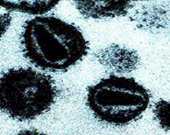
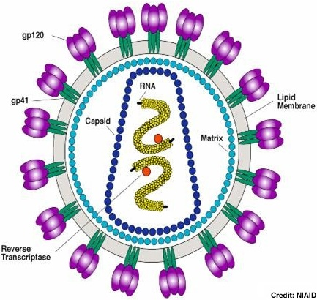
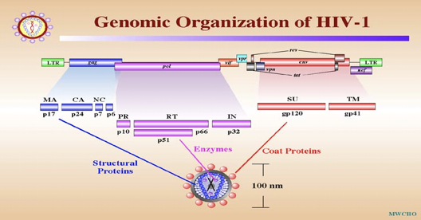
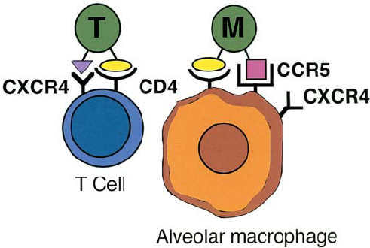
1
1
1
Introduction, Characteristics & Pathophysiology of HIV
Introduction
Human immunodeficiency virus (HIV):
Is a retrovirus that causes human AIDS, and was initially identified in 1983.
HIV infects mainly CD4+ T cells, macrophages⁶, and dendritic cells⁶ which express the surface receptor CD4.
Destroying CD4+ T cells leads to severe immunologic impairment and eventually death.
Initially observed in homosexuals.
Acquired immunodeficiency syndrome (AIDS):
Is the end stage of the disease that is associated with CD4+ T cell depletion, multiple or recurrent opportunistic infections, and unusual cancer (Kaposi sarcoma)¹.
Characteristics of HIV:
Family: Retroviridae.
Virion consist of:
Glycoprotein envelope (surface gp120 & Transmembrane gp41 glycoproteins).
Matrix layer (p17) .
Capsid (p24).
Two copies of ss-RNA.
Enzymes:
Reverse transcriptase: converts viral RNA into DNA.
Integrase: integrates viral DNA with host DNA (provirus), persisting infection.
Protease: viral protein maturation.
HIV genome:
The genome consists of 9 genes:
3 structural genes (gag², pol³, env⁴).
6 non-structural genes (tat, nef, rev, vif, vpr, vpu).⁵
Life cycle & Pathophysiology
1- HIV virus binds to CD4 receptor on CD4+ T cells, Macrophages & Dendritic cells using gp 120, which also binds to the co-receptor:
T-tropic (T-cell tropic) strains bind to the co-receptor CXCR4 .
M-tropic(macrophage-tropic) strains bind to the co-receptor CCR5.
* There are some theories that state that initially the virus is in the M-tropic form then later it’s transformed into T-tropic.
2- HIV viral envelope fuses with the cell membrane, releasing the viral RNA into the cytoplasm.
3- Viral RNA gets transcribed into DNA using Reverse Transcriptase (RT) enzyme. It can be blocked using Anti-RT.
4- Viral DNA (pre-virus) enters the nucleus and integrates with the host’s DNA using Integrase (IN) enzyme. It can be blocked using Anti-IN.
5- Viral RNA (Virus) is Transcribed from DNA and leaves the nucleus.
6- Protease (PR) enzyme produces viral proteins. It can be blocked using Anti-PR.
7- New viruses are now exocytosed and ready to infect other cells.
Video from Dr. Mona
1- Associated with Human herpesvirus 8.
2- Encodes for P17 matrix protein,P24 capsid protein and nucleocapsid protein
3- Encodes for RT, integrase and protease enzymes
4- Encodes for gp120 & gp41 glycoproteins.
5- Play a major role in invasion and replication.
6-Reason why HIV also infects macrophages and dendritic cells is because they express the same receptor as CD4+ cells.
-According to Dr.Mona we just need to memorize glycoprotein (gp120), capsid (p24) and the 3 enzymes are VERY important you must memorize the name and their function, however for HIV genome no need to memorize names.

Slide 3
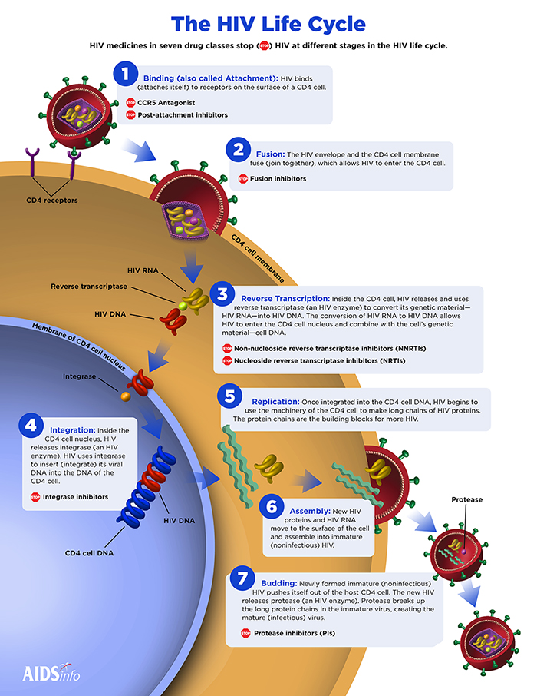
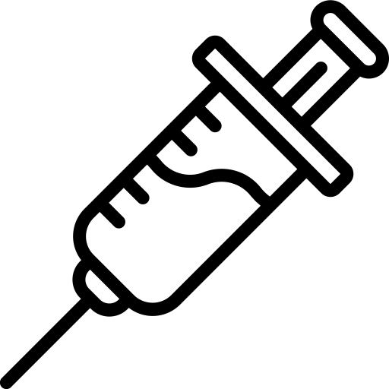
1
HIV Species & Routes of Transmission
2
HIV species
There are two HIV species known to cause AIDS in humans HIV-1 and HIV-2, and the overall sequence homology between HIV-1 & HIV-2 is less than 50%.
HIV - 1
HIV - 2
– Causes infection worldwide.
– Highly virulent.
– Highly susceptible to mutations.
– More common
– Causes the infection in specific regions e.g. West Africa.
– Relatively less virulent.
– Relatively less susceptible to mutations.
Sexually (unprotected sex): The virus is present in blood, semen and vaginal secretions.¹
Parenterally: Direct exposure to infected blood or body fluids (e.g. receiving blood from infected donor). Using contaminated or not adequately sterilized tools in surgical or cosmetic practice (dental, tattooing, body piercing). Sharing contaminated (with blood) needles, razors, or tooth brushes²
Perinatally (From mother to baby): Infected mothers can transmit HIV to their babies transplacentally (25%), but Treatment of the mothers with the reverse transcriptase inhibitor (Zidovudine) during pregnancy can reduce transmission in most cases. Virus spread to child perinatally mainly (50%) during delivery, but given the reverse transcriptase inhibitor (Nevirapine) as single dose during delivery can reduce the transmission. Breastfeeding is also an important way of perinatal transmission (25%).
Transmission of HIV
1-High risk patients are homosexuals and those who have multiple sexual partners.
2-HIV is a very sensitive virus it does not usually survive long outside of the body unlike hepatitis B virus where it is able to live on surfaces for up to a year

Slide 4
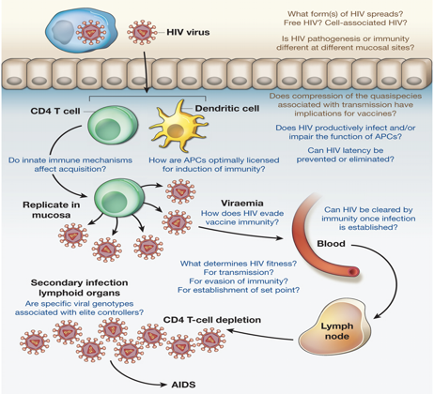
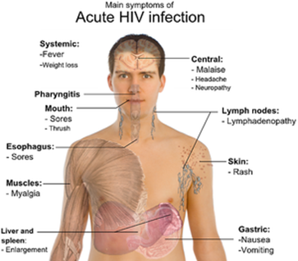
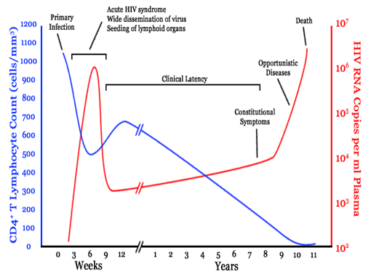
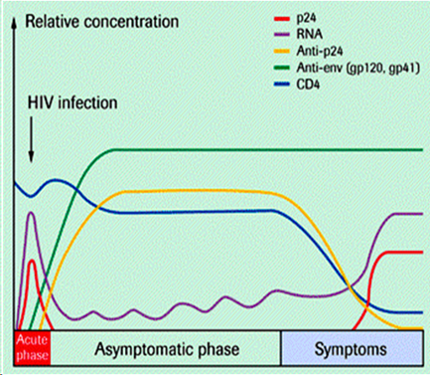
1
3
Viral Inactivation & Course of HIV Infection (Acute Phase)
Virus Inactivation
- HIV is easily inactivated by treatment for 10 min at 37ºC with any of the following:
10% Sodium Hypochlorite (household bleach).
50% Ethanol.
35% Isopropanol.
0.5% Paraformaldehyde.
0.3% Hydrogen Peroxide.
HIV can't survive for long in the environment(2 hours).
Blood Contaminated with HIV will not cause disease unless it reaches bloodstream
The course of HIV infection
The course of HIV infection is divided into 3 stages based on CD4+ T cell count and presence of opportunistic infections:
The Acute Phase
The Chronic Phase
Divided into:
1 - Persistent generalized lymphadenopathy (PGL).
2 - AIDS-related complex (ARC).
Acquired Immune Deficiency Syndrome (AIDs)
(the end stage of the disease).
I - Acute Phase:
Incubation period 2 weeks and lasts for about 12 weeks.
Mostly asymptomatic, but in about 25-65% of the cases, patients may develop non-specific symptoms resemble infectious mononucleosis or Flu (fever, headache, anorexia, fatigue, lymphadenopathy, skin rash). which resolved in 2 weeks.
Rapid viral replication (high viral load >10⁶ copies/mL).
Gradual decrease in CD4+ T cell count. (but still in normal range)
Serological markers of Acute Phase:
Normal to slightly decrease in number of CD4+ T cells.
Appearance of viral RNA¹, and then core antigen (p24 antigen)² which indicates active viral replication.
Appearance of two antibodies³, Anti-envelop (Anti-gp120)⁴ & Anti-core (Anti-P24)⁵.
The 1st choice marker for detection HIV in the acute phase is HIV RNA.
-
HIV RNA copies vs CD4+ T cell counts
1-First marker to appear in the serum, extremely increased in Acute Stage: Viral RNA
2-Second marker to appear: p24 antigen
3-Both Anti-core & Anti-envelop Antibodies appear late in the Acute stage. These antibodies will persist in the serum until death.
4-Third marker to appear: Anti-envelope gp120
5-Fourth marker to appear: Anti-core gp24

Slide 5
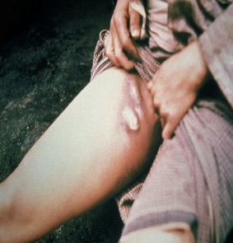
1
Course of HIV Infection (Chronic Phase)
4
II - Chronic Phase:
Lasts for about 10 years in adults, and 5 years in children.
Totally asymptomatic but the patients is still contagious.
Relatively low viral load (<10⁴ copies/mL).
CD4+ T cell count > 200 cells/mm³.
At the end of this stage patients start to develop:.
1-Persistent generalized lymphadenopathy (PGL):
Is defined as an enlargement of lymph nodes for at least 1 cm in diameter, In the absence of any illness or medication known to cause PGL.
Clinical Features:
In two or more lymph nodes out of the inguinal area⁵.
Persists for at least 3 months.
2-AIDS-related complex (ARC):¹
Is a group of clinical symptoms that come before AIDS and may include the following:
Fever of unknown origin that persists > 1 month.
Chronic diarrhea, persisting > 1 month.
Weight loss > 10% original weight (Slim disease).
Fatigue, night sweating, and malaise.
Neurological disease (eg. myelopathies & peripheral neuropathy.
Slim disease
Serological markers of Chronic Phase:
Viral load (HIV RNA) increases gradually², but HIV core antigen (p24) may not appear in blood.
Anti-envelop (Anti-gp120) & Anti-core (Anti-p24) are positive.³
CD4+ T cell count gradually decreases⁴, but remains above 200 cells/mm³.
1- Anything other than opportunistic infections will be considered part of ARC. Has patient reached AIDS? No as CD4+ count is 200 cells/mm or more.
2- Viral genome will always be positive in blood and semen, unless the patient is taking antiviral medications then it’ll be negative in blood but positive in semen.
3- Appear in late acute stage and will last forever. Used for testing HIV in blood donors as NAT isn’t always precise, Why? Because if an AIDS patient is on antivirals, HIV RNA will be negative! So if they give his blood to other recipients based on NAT results everynone will have AIDS. That’s why they do serological tests and look for Abs to confirm if the donor has AIDS or not.
4- CD4+ count will initially rebounces after the decrease in the Acute phase, as the immune system attempts to fight the virus. However, it will then decrease gradually. In a few years, it will be markedly decreased.
5-Lymph nodes enlargement could be in cervical or apical area or anywhere BUT not inguinal area.

Slide 6
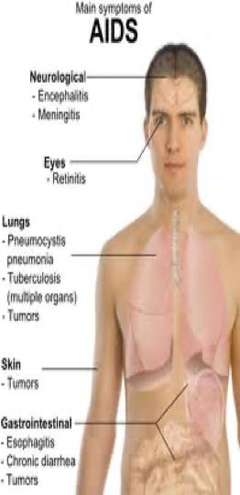
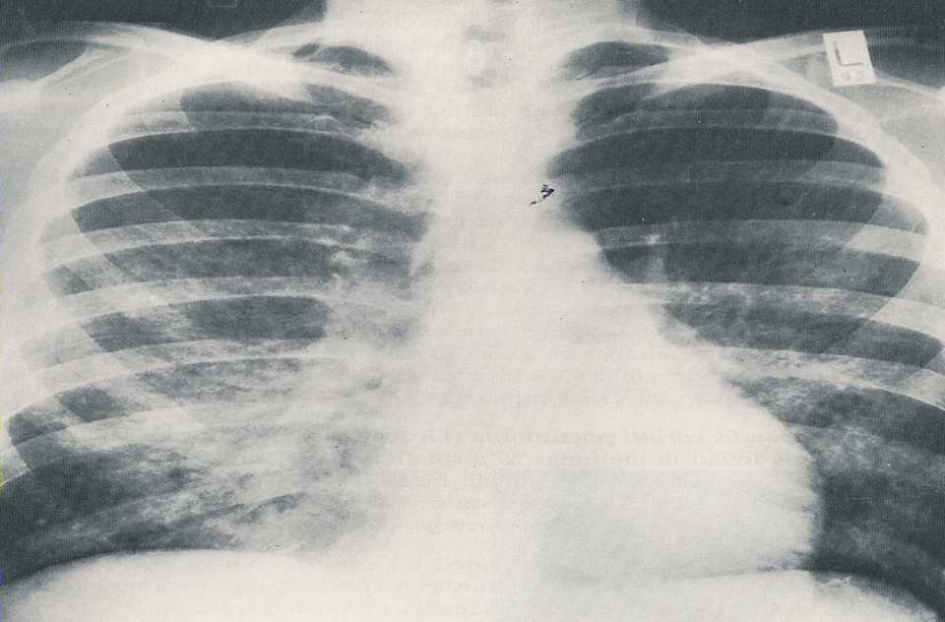
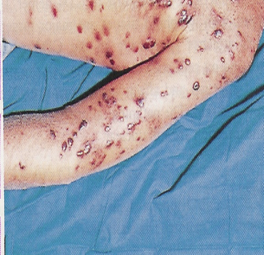
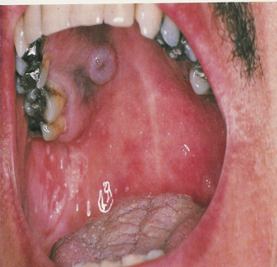
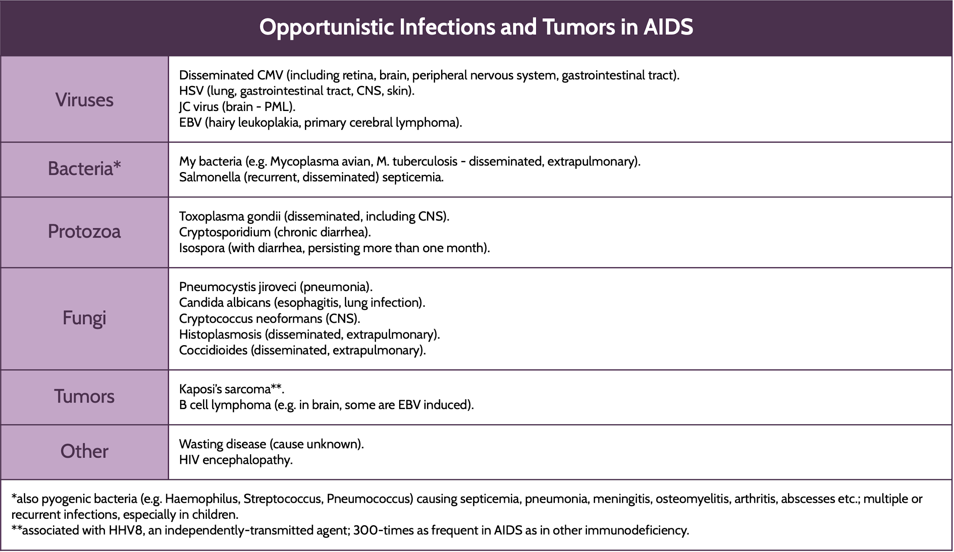
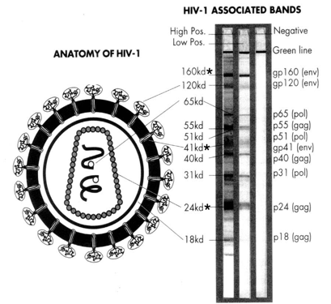
1
5
Course of HIV Infection (AIDS) & Diagnosis of HIV
Keywords:
End stage
Opportunistic infection +Unusual cancer
CD4+ count less than 200 cells/mm
Viral load is high
III - Acquired Immune Deficiency Syndrome (AIDs⁴):
The end stage of the disease.
Continuous viral replication (high viral load (viral RNA) in the serum).
Marked decrease in CD4+ T cell count < 200 cell/mm³.
Defects in cellular immunity.
Persistent or frequent multiple opportunistic infections. ¹
Unusual cancer (Kaposi sarcoma).
Serological markers of AIDS:
High viral load (HIV RNA), and HIV core antigen (p24) appears in blood.
Detection of both HIV RNA & the antigen p24 indicative of active viral replication.
Anti-envelop (Anti-gp120) & Anti-core (Anti-p24) are positive.
CD4+ T cell count decreased to very low levels (<200 cells/mm³).
-
Pneumocystis pneumonia²
Kaposi’s sarcoma / Candida infection
⁵
Diagnosis of HIV
History Indication | Patients history with or without clinical symptoms provides hints for a physician whether the patient has ever exposed to HIV or not.
Screening ELISA | Detection of both HIV Ag & Ab in the patient serum by ELISA. If result is positive, repeat the screening test in duplicate.
Confirmation | If ELISA was repeatedly reactive (positive), do confirmatory tests: Western blot³, recombinant immunoblot assay (RIBA), or PCR.
Follow up | Blood viral load by PCR is also used to monitor HIV replication and follow up patients treatment.
Western Blot
1- The main cause of death in AIDS patients.
2- Caused by Pneumocystis jirovecii.
3- There must be at least 2 bands similar to the positive control core to consider the patient positive for HIV
4-To reach end stage CD4+ count must drop below 200 cells/mm----> AIDS stage. Remember the cut point in differentiating aids related complex and AIDS is CD4+ count.
5-Just know pneumocystis jiroveci (pneumonia)(it was formerly known as Pneumocystis carinii pneumonia (PCP))

Slide 7
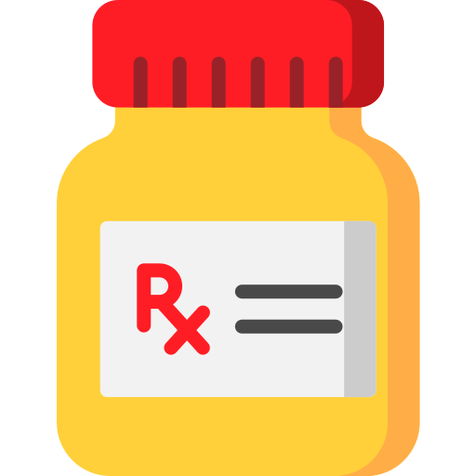
1
Treatment & Prevention of HIV
6
Treatment & Prevention of HIV
Treatment (HAART)²
Is a combined therapy known as high active antiretroviral therapy (HAART). NOTE: HAART does not clear (eradicate) the virus from the body, and should be taken all life. NOTE: HAART treated patients are still contagious even if their blood viral load below detection level (< 50 copies/mL). HAART is usually composed of two reverse transcriptase inhibitors and one protease inhibitor. ¹
Reverse Transcriptase Inhibitors | Nucleoside analog RT inhibitors for HIV-1 & HIV-2³ | Non-nucleoside analog RT inhibitors for HIV-1 only³
 | - Zidovudine (AZT) - Zalcitabine (ddC) - Stavudine (d4T) - Lamivudine (3TC) | - Nevirapine - Delavirdine - Efavirenz
Protease inhibitors | - Saquinavir - Indinavir - Nelfinavir - Ritonavir
Goals of HIV treatment: To inhibit viral replication. To control chronic immune activation and keep the immune system as close as possible to the normal state. To prevent the development of opportunistic infections. To minimize the chance of viral transmission especially from mother to neonate.
Prevention
No vaccine is available to prevent HIV infection, and thus the best strategies to control the spread of HIV infection are the following: Religious education (teaching the risk of making prohibited relations). Public health education (teaching the risk of using shared materials). Practice safer sex by having one sexual partner. Advise of using condoms when is necessary.
1- Just know 1 or 2 from each group.
2-They delay the virus from performing its function . resulting in an increase in the duration of the chronic phase and a very low viral load (making patient not infectious). Remember you’re NOT eradicating the virus.
3-Dr.Mona said there is no need to memorize all the drug names only memorize the drugs names in red.

Slide 8
Lecture Quiz
MCQ:
Answers: Q1:B | Q2:C | Q3:B | Q4:C | Q5:A
Q1: What is the first marker to appear in the serum of an HIV patient?
A- Anti-P24.
B- Viral RNA.
C- p24 antigen.
D- Anti-envelop.
Q2: A newborn male presents to the emergency room with a fever and the oropharyngeal findings (leukoplakia). The patient's mother reports that he also has chronic diarrhea, and laboratory workup shows lymphocytopenia. During a careful review of the social history, you learn that the mother has a history of IV drug abuse and commercial sex work. She was prescribed prenatal medications, but failed to take one of them as directed. Which of the following may have helped prevent this patient's condition?
A- Folic acid.
B- Acyclovir.
C- Zidovudine.
D- Ribavirin.
Q3: A 27-year-old G2P1 woman is diagnosed with an HIV infection after undergoing routine prenatal blood work testing. Her estimated gestational age by first-trimester ultrasound is 12 weeks. Her CD4 count is 150 cells/mm^3 and her viral load is 126,000 copies/mL. She denies experiencing any symptoms of HIV infection. Which of the following is appropriate management of this patient's pregnancy?
A- Antibiotics.
B- HAART.
C- Vaginal delivery.
D- HAART after delivery.
Q4: A patient who has tested positive for the human immunodeficiency virus (HIV) arrives at the clinic with a report of fever, nonproductive cough, and fatigue. The patient’s CD4 count is 184 cells/mcL. How should the healthcare provider interpret these findings?
A- These findings provide evidence that the patient has seroconverted.
B- The patient is now in the latent stages of HIV infection.
C- The patient is diagnosed with acquired immunodeficiency syndrome (AIDS).
D- This is an expected finding because the patient has tested positive for HIV.
Q5: The healthcare provider is assessing the skin of a patient who is at risk for becoming infected with the human immunodeficiency virus (HIV). Which of the following findings requires immediate follow-up by the healthcare provider?*
A- Purplish-red raised lesions.
B- Numerous moles on the chest and back.
C- Ecchymoses on the legs.
D- Patches of dry, flaky skin.
SAQ:
CASE: A 27-year-old man presents to the urgent care clinic with a 2-week history of fever, macular rash, and generalized lymphadenopathy. He denies a sore throat, genital ulcers, or urethral discharge. Sexual history is remarkable for having unprotected sex with both male and female partners while inconsistently using condoms. His last sexual encounter was a month prior to the onset of illness. His fourth-generation combination HIV-1/2 immunoassay is positive, and an HIV-1/HIV-2 antibody differentiation immunoassay confirms the diagnosis.
Q1: What is your provisional diagnosis?
A: HIV Infection
Q2: How would you screen for it?
A: Screening patient’s serum by ELISA for both (HIV Ag & HIV Ab).
Q4: If the result of your screening test was positive, and it was repeated in duplicate and came back positive, how would you confirm the diagnosis, and how would you monitor the course of the disease?
A: 1. Electrophoresis (Western Blot), recombinant immunoblot assay (RIBA), or PCR.
2. PCR
Q5: What is the appropriate treatment for this patient?
A: HAART: Two reverse transcriptase inhibitors & one protease inhibitor.
For example: Zidovudine, Nevirapine & Indinavir.
*Explanation: Kaposi sarcoma

Slide 9
Members Board
Team Leaders:
Abdulaziz Alshomar Ghada Alsadhan
Team sub-leader:
Mohammed Alhumud (coolest sub leader ever)
This lecture was done by:
Mohammed Alhumud
Note takers:
Mashal Abaalkhail
Rema Alkahtani

