Slide 1
Part 2
Today is the 18th of April 2020, the number of COVID-19 cases is still growing fast, even in our country the number reached 8,274 patients. I really hope this ends soon and people can go back to their normal lives. I have finished 7 tv series and 11 videogames, soon I will run out of content to entertain me during this pandemic, god I miss my friends, I’m starting to even forget their names, what about their faces you ask? Long forgotten, I don’t think I’ll recognize any of them if I saw them on the streets, that is if I ever get another chance to see them. What am I saying? I don’t even know, the lack of human interaction is driving me insane, writing these notes for no one to read is the only thing keeping me sane, barely that is.
Don’t mind this, it’s just the gibberish of a dying man, slowly losing his sanity.
-A Worried Man.
Candida infection, trichomonas vaginalis & bacterial vaginosis
Lecture objectives
To recognize the different types of infant infections.
To know major transplacentally transmitted pathogens causing
congenital infections .
(Toxoplasma , TP ,ParvoV , VZV, Rubella V & CMV.)
To describe their structures.
To know their major epidemiology features.
To describe clinical manifestations of their congenital infections
To illustrate different laboratory diagnosis of maternal and
congenital infections.
To know their treatment and preventive measures.
Important
Color index
Boys’ slides
Doctors’ note
Extra
Girls’ slides
EDITING FILE

Slide 2
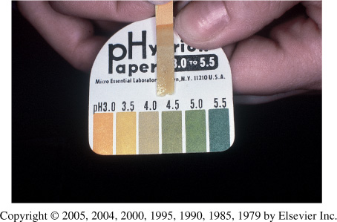
1
Introduction
1
The normal vagina
Lined with 25 layers of epithelium cells.
Separation of microbial pathogens from the normal genital microbiota.
Characteristic of normal vaginal secretion
Desquamated vaginal epithelial cell
Lactobacilli dominate
PH 3.5 to 4.6 (Acidic)
Odorless
No itching or irritation
Does not soil underclothing
Normal flora of the vagina:
Lactobacilli
Corynebacterium spp.
Gardnerella vaginalis
coagulase-negative Staphylococci, Staphylococcus aureus
Streptococcus agalactiae
Enterococcus spp.
Escherichia coli
Anaerobes
Yeasts
Abnormal vaginal secretion
Normal physiological vaginal secretion should be colorless and odorless
Causes of abnormal vaginal secretion:
Vaginal infection
Trichomoniasis
Vulvovaginitis candidiasis
Bacterial vaginosis
Desquamative inflammatory vaginitis
Cervicitis
Infectious
Noninfectious
Estrogen deficiency
Footnotes:
“So much room for activities”

Slide 3
1
2
1
Introduction cont’
2
Types of infections
Females
Males
Cervicitis
Vulvovaginitis
Urethritis
Bacterial vaginosis (BV)
Salpingitis (pelvic
inflammatory disease [PID])
Endometritis
Genital ulcers
Pregnant females: Disease in the neonate.
Children and postmenopausal
women
Urethritis
Epididymitis
Prostatitis
Genital ulcers
Vulvovaginitis
History
(Vaginal disorders in general, not only vulvovaginitis)
Symptoms
General gynecological history (Age: Neonate, Prepubescent, Adolescent, Adult, Post menopausal (atrophic).
Estrogen depletion
Onset
Menstrual history
Pregnancy
Sexual Hx
Contraception
Sexual relationships
Prior infections
General medical Hx: Allergies, DM, Malignancies, Immunodeficiency
Medication: OCP, steroids, douche¹
Discharge:
quality
quantity: scanty
Physiological or due to OCP
Oder ( BV,FB,EV fistula )
Valvular discomfort (HSV)
Dyspareunia
Abdominal pain (tricho) PID
Examination
Breast for detection of abnormal masses
Adequate illumination
Magnification if possible
Give a patient mirror
Inspect external genitalia
Lesions
Erythema
Vaginal mucosa
Erythema
Lesion
Secretion
Examination of cervix
Ectropion
Lesions
Erythema
Endocervical secretion
Collect cervical and vaginal specimen
Bimanual examination
Footnotes:
1-Douching is washing or cleaning out the inside of the vagina with water or other mixtures of fluids.

Slide 4
1
2
1
Vulvovaginitis
3
Classification of vulvovaginitis
Uncomplicated Vulvovaginitis
Complicated Vulvovaginitis
Sporadic
No underlying disease
By Candida albicans
Not pregnant
Mild to moderate severity
Any available topical agent
Fluconazole 150mg as a single oral dose
Underlying illness (HIV, DM)
Recurrent infection 4 or more per year
Non albican candida
Pregnancy
Severe infection
Culture confirmation mandatory
Antifungal suscep. Testing
Treat for 10-14 days with vaginal or oral agent
Other: topical
Boric acid
5 fluorocytocine
Consider treatment of the partners
Long term suppressive treatment for frequently recurrent diseases
Dr. Khalifa skipped most previous content and started here
Candidal Vulvovaginitis (Vaginal Thrush)
Candida infections yeast infection (moniliasis):
Candida is a unicellular yeast fungus. That appears on the Microscope as Round Budding yeast and pseudohyphae.
Culture: appears as creamy white colonies on SDA
Candidiasis or thrush is a fungal infection (mycosis) of any of the Candida species (yeasts) of which Candida albicans is the most common.
Common superficial infections of skin and mucosal membranes by Candida causing local inflammation and discomfort.
Candidal vulvovaginitis (Vaginal Thrush):
Infection of the vagina’s mucous membranes
by Candida albicans.
75% of adult women
Candida Albicans is Found naturally in the vagina
Hormonal changes
Change in vaginal acidity.
Use of Broad-spectrum antibiotics.
Use of corticosteroid medications.
Pregnancy.
Poorly controlled diabetes mellitus.
Age: 20-30 years
Footnotes:

Slide 5
1
Candidal Vulvovaginitis
4
Risk factors
Antibiotics
Pregnancy
Diabetes (poorly controlled)
Immunodeficiency
Contraceptives
Sexual behaviour
Tight-fitting clothing
Female hygiene
Symptoms
Vulval itching
Vulval soreness and irritation
Superficial dyspareunia.
Dysuria¹
Odourless vaginal discharge
thin and watery or thick and white (cheese-like)²
Erythema (redness)
Fissuring
satellite lesions.
Types of candidal vulvovaginitis
1
Uncomplicated thrush
Complicated thrush
2
single episode/less than four episodes in a year.
mild or moderate symptoms
caused by the Candida albicans .
four or more episodes in a year.
severe symptoms.
Pregnancy
poorly controlled diabetes/immune deficiency.
not caused by the Candida albicans
Footnotes:
1- if the urethra is infected
2- in all 3 organisms in this lecture , the color of discharge is a hint for the diagnosis

Slide 6
1
Candidal Vulvovaginitis
5
Diagnosis and Treatment
Diagnosis
History & symptoms physical and pelvic exam Gram stain Wet mount Culture Direct Microscopy: Budding yeast cells and pseudohyphae Candidiasis can be similar to other diseases: Sexually transmitted diseases Chlamydia Trichomoniasis Bacterial vaginosis Gonorrhea
Treatment
Butoconazole cream Clotrimazole 1% cream vaginal tablet Miconazole 2% cream vagina suppository Nystatin vaginal tablet Oral Agent: Fluconazole : oral one tablet in single dose Short-course topical formulations single dose and regimens of 1–3 days effectively treat uncomplicated candidal vulvovaginitis Topical azole drugs are more effective than nystatin Azole drugs relief of symptoms in 80%–90% of cases. Treatment failure In up to 20% of cases If the symptoms do not clear within 7–14 days
Candida albicans
Part 2
Today is the 18th of April 2020, the number of COVID-19 cases is still growing fast, even in our country the number reached 8,274 patients. I really hope this ends soon and people can go back to their normal lives. I have finished 7 tv series and 11 videogames, soon I will run out of content to entertain me during this pandemic, god I miss my friends, I’m starting to even forget their names, what about their faces you ask? Long forgotten, I don’t think I’ll recognize any of them if I saw them on the streets, that is if I ever get another chance to see them. What am I saying? I don’t even know, the lack of human interaction is driving me insane, writing these notes for no one to read is the only thing keeping me sane, barely that is.
Don’t mind this, it’s just the gibberish of a dying man, slowly losing his sanity. -A Worried Man.
Footnotes:

Slide 7
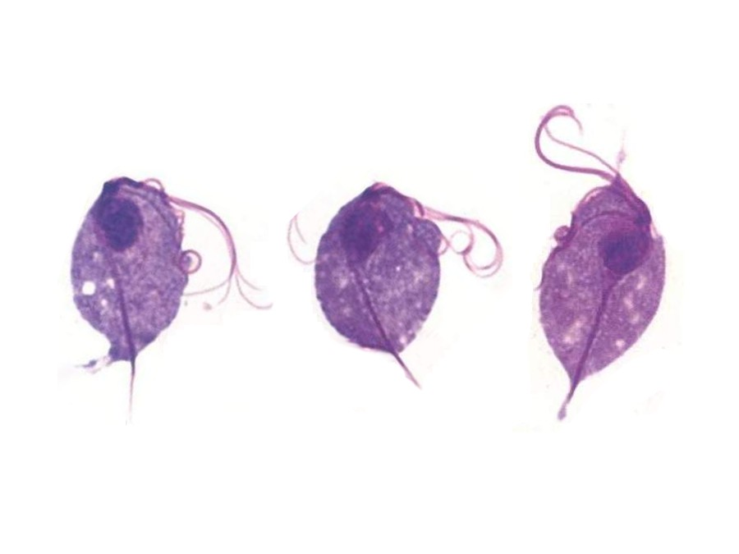
1
Trichomoniasis
6
Introduction
sexually-transmitted infection
Caused by :
Trichomonas vaginalis , a flagellated and motile protozoan parasite
Transmission:
sexual (can’t exist outside human because it can’t form cysts)
Symptoms
Purulent vaginal discharge , yellow or greenish in color
Vulvar irritation (strawberry)
Dysuria
Dyspareunia
Abnormal vaginal odor
Management
1
Confirm the diagnosis
Wet preparation¹ (miss 30%)
Culture² :
Culture is considered the gold standard for the diagnosis of trichomoniasis.
Its disadvantages include cost and prolonged time before diagnosis , and it requires a special media
Gram Stain
2
3
Confirm all current sexual partners treated
Treatment
Oral metronidazole (drug of choice)
500 mg bid for 7 days
2 g daily for 3-5 days
If Rx failure :
Consultation with experts
Susceptibility testing
Higher dose of metronidazole
Alternative Tinidazole
The wet mount's fast results
Culture
Footnotes:
1-placing the specimen of vaginal discharge on a glass slide and mixing with a salt solution to see the motility of the parasite. It should be done immediately or you will lose the motility
2- culture is the gold standard for diagnosis but we don't usually do it because it takes time and clinical diagnosis and wet mount are more than enough

Slide 8
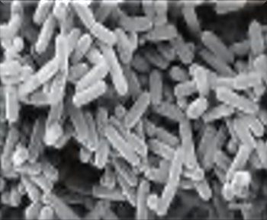
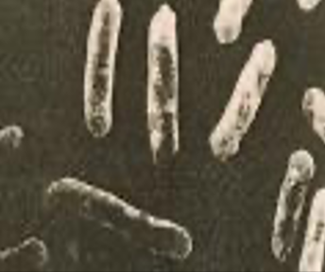
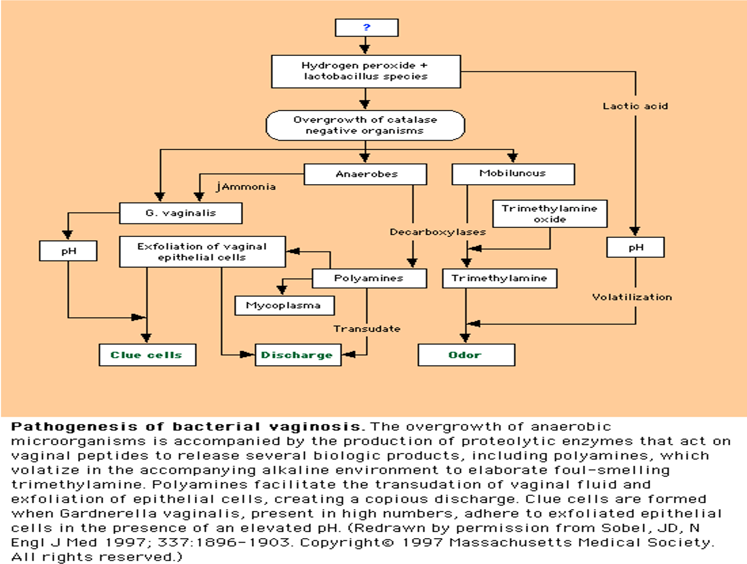
1
Bacterial Vaginosis
7
Bacterial Vaginosis:
Bacterial Vaginosis is a floral imbalance¹.
↓ Lactobacillus acidophilus ↑other normal flora
Vaginal Normal Flora
Lactobacillus acidophilus.³
Gardnerella vaginalis.
Anaerobes:
- Bacteroides (Porphyromonas). - Prevotella.
- Peptostreptococcus. - Fusobacterium.
Mycoplasma hominis.
Mobiluncus species.
Lactobacilli:
Compete with other microorganisms for adherence to epithelial cells.
Produce antimicrobial compounds such as organic acids (which lower the vaginal pH²), hydrogen peroxide (Acidic), and bacteriocin-like substances.
Gram positive anaerobic rods
Pathogenesis
Marked reduction in lactobacillus.
After metronidazole treatment: Lactobacilli predominate again.
Decreased hydrogen peroxide production.
Polymicrobial superficial infection:
overgrowth of G. vaginalis and anaerobic bacteria
The enzymes released in result to the abnormal balance of the normal flora is responsible for the alkaline PH and the foul smell
Epidemiology
Bacterial Vaginosis is the most common vaginal infection in women of childbearing age-29%
Risk factors:
Multiple or new sexual partners (sexual activity alteration of vaginal pH).
Early age of first sexual intercourse.
Douching.
Cigarette smoking.
Use of IUD.
Note: Although sexual activity is a risk factor for the infection, bacterial vaginosis can occur in women who have never had vaginal intercourse.
Footnotes:
1- usually the overgrowth of Gardnerella vaginalis, which is normally found in small amounts
2- acidic PH kills bacteria
3- is the predominant normal flora

Slide 9
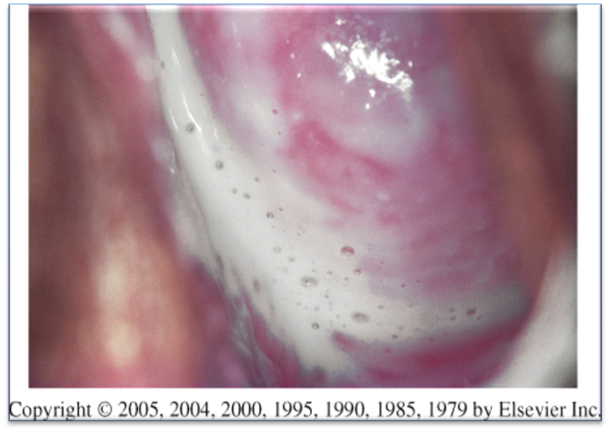
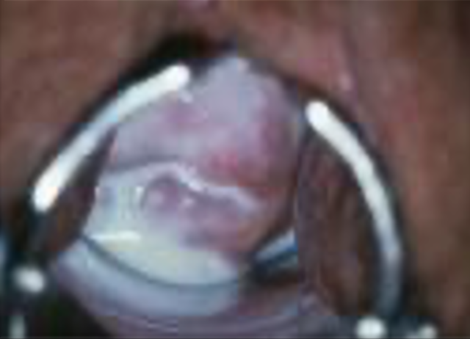
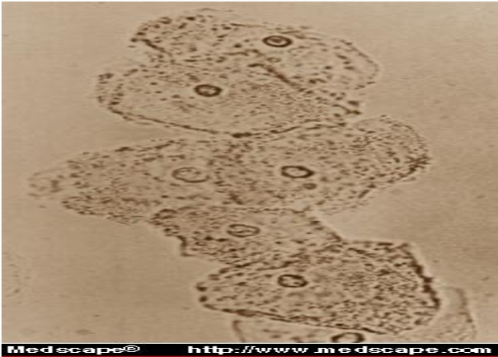
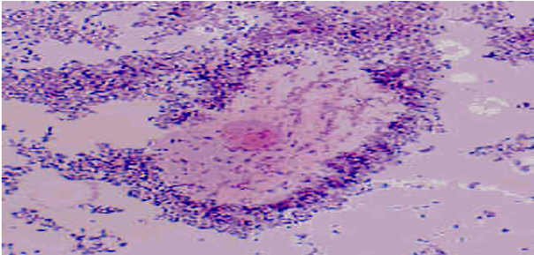
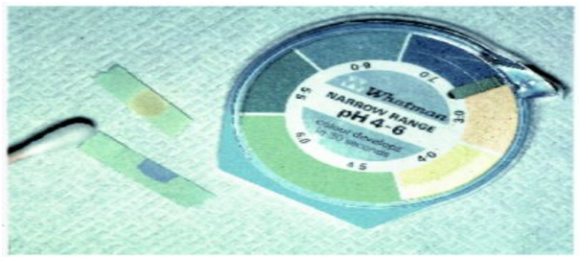
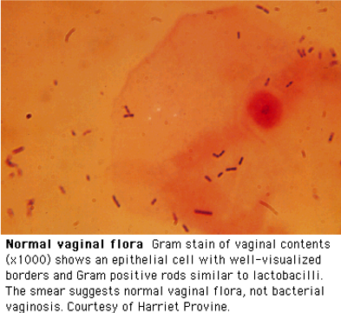
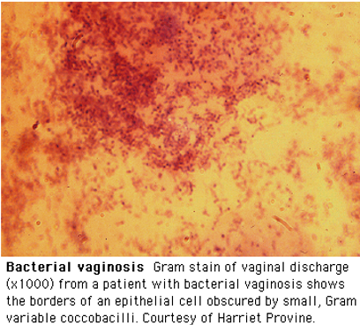
1
Bacterial Vaginosis
8
Clinical Features & Diagnosis of Bacterial Vaginosis
Clinical Features
Most cases (50-75%) Homogenous grey vaginal discharge. Dysuria and dyspareunia rare. Pruritus and inflammation are absent . Fishy vaginal discharge: (Greyish in color) During menstruation. After intercourse. Minimal itching or irritation. Absence of inflammation is the basis of the term "vaginosis" rather than vaginitis.
Diagnostic Methods
Clinical/Microscopic Criteria: | -
Gram Stain “Gold Standard”: | Clue cells¹ on saline wet mount of vaginal discharge (on >20% cells). Bacteria adhered to epithelial cells; most reliable single indicator. Vaginal pH > 4.5.
Elevated pH & increased amine: | Sensitivity: 87%. Specificity: 92%.
Culture has a poor predictive value for G. vaginalis as it is prevalent in healthy asymptomatic women. DNA probes are expensive, and have a poor predictive value alone.
Treatment Recommendations:
Oral:
Metronidazole (Drug of choice) 500 mg bid x 7 days ($5):
84-96% cure rate.
Single dose therapy (2g) may be less effective.
Clindamycin 300 mg bid x 7 days ($28):
Less effective.
Topical (higher recurrence rates):
Metronidazole gel (0.75%) 5 g PV qhs x 5 days ($30);
70-80% cure rate.
Clindamycin cream (2%) 5 g PV qhs x 7 days ($31):
Less effective.
May lead to Clindamycin resistant anaerobic bacteria.
1- epithelial cells covered with adherent Gardnerella vaginalis and other anaerobic bacteria, and is the main diagnostic parameter.

Slide 10
1
Microbiology of Gynecological examinations
9
Microbiology of Gynecological examinations
Specimens obtained during Gynecological examination
Vaginal secretion | PH. Saline wet preparation. KOH wet preparation.
Cervical cultural and non cultural¹ | GC. C.trachomatis.
Vaginal culture | Candida. Trichomonas vaginalis.
Cervical cytological examination if not documented within previous 12 months
Specific Tests
Routine Bacterial Cultures ARE NOT HELPFUL
Wet mount (60% sensitive for Trichomoniasis & BV) | Wet mount with yeast & Trichomonas cultures: Recommended tests to diagnose vaginitis.
 | Wet mount, without yeast or Trichomonas cultures: 50% of either of these agents of vaginitis will be missed.
(KOH) "Whiff test” | Presence of abnormal or foul odor.
Gram stain (Using the Nugent scoring) | Useful to diagnose BV.
Sensitive DNA probe assay² | Combines the detection of yeasts, Trichomonas, and G. vaginalis as a marker for BV.
Footnotes:
1- we rarely do it , it's usually done in case of resistant candida infection
2- easy and rapid way to diagnose yeasts, Trichomonas, and G. vaginalis .

Slide 11
1
Summary from dr.khalifa
10
 | PH | Sign and symptoms | Whiff test¹ | Gram stain/Wet prep | Culture | Immunologic / Molecular test | Treatment
Candida Vaginitis | < 4.5 | · Inflammation · Vulval itching and erythema · White discharge · Odorless | - | Yeast and pseudohyphae | Candida appear as creamy white colonies on SDA | DNA probe² | · Fluconazole · Nystatin
Trichomonas vaginalis | > 4.5 | · Inflammation · Vulvar irritation and erythema · Yellow or greenish in color · Foul smelling discharge | +- | · Trichomonas · culture is the gold standard method for diagnosis but it’s not usually used because it takes time and clinical diagnosis and wet mount are more than enough | Motile trophozoites | · DNA probe² · EIA (enzyme immunoassays) | Oral metronidazole
Bacterial Vaginosis | > 4.5 | · No inflammation and pruritus · No or minimal itching or irritation · Grey discharge Fishy odor | +++ | · Gram stain: Clue cells ·Gram stain is gold standared | Not helpful | DNA probe² | Oral metronidazole
Footnotes:
1- Sample of vaginal secretions are placed in a test tube with 10% KOH.
KOH alkalizes amines produced by anaerobic bacteria-results in a sharp "fishy odor"
2- a technique for identifying a segment of DNA, using a known sequence of nucleotide bases from a DNA strand to detect a complementary sequence in the sample by means of base pairing.

Slide 12
Dr. Khalifa notes
1
He gave us a few cases Check SAQ
11
1- Candidal vulvovaginitis:
Infection of the vagina’s mucous membranes by yeast.
Risk factors:
Antibiotics → kill normal flora → yeast overgrowth.
Pregnancy
Poorly controlled diabetes
Immunodeficiency
Symptoms:
White (cheese-like) odourless vaginal discharge.
Types:
Uncomplicated:
Single episode or less than 4 episodes in a year.
Caused by candida albicans
Complicated:
4 or more episodes in a year.
Not caused by c.albicans
Associated with pregnancy/ poorly controlled diabetes/immune deficiency.
Diagnosis:
Gram stain: we will see pseudohyphae yeast
Wet mount: we will see pseudohyphae yeast
Culture: helpful in cases of recurrent infection
Treatment:
Mainly Fluconazole
2- Trichomoniasis (vaginitis)
Seuxually transmittted parasitic infection caused by Flagellate protozoa (T. vaginalis.)
Symptoms:
Yellow or greenish vaginal discharge
Vulvar irritation (strawberry/reddish)
Diagnosis:
Culture (takes time & requires special media): Motile trophozoites
Wet mount (quick): We can see corkscrew motility
Gram stain
Treatment:
Drug of choice: Metronidazole (effective against anaerobes and some parasitic infections)
Sexual partner has to be treated as well.
3- Bacterial Vaginosis: (not vaginitis)
A disease caused by floral imbalance: Marked reduction in lactobacillus & overgrowth of G. vaginalis, Mobiluncus species and anaerobic bacteria. (Normally lactobacillus is the dominant bacterial flora in vagina)
Risk factors: (Although sexual activity is a risk factor for the infection, bacterial vaginosis can occur in women who have never had vaginal intercourse)
Multiple or new sexual partners
Smoking & Use of IUD
Older age
Symptoms:
Fishy vaginal discharge, greyish in color
Pruritus and inflammation are absent
Diagnosis:
Gram stain (gold standard): look for clue cells (bacteria-coated epithelial cells.).
Wet mount: look for clue cells
Vaginal pH >4.5 (will be high in trichomoniasis as well, but unchanged in candida)
Treatment:
Drug of choice: oral or topical Metronidazole
Or clindamycin

Slide 13
Lecture Quiz
MCQ:
Answers: Q1:C | Q2:A | Q3:B
Q1: A 30-year-old woman presents to her gynecologist with complaints of vaginal itching and a frothy, yellow discharge. She also complains of painful urination. She admits to being sexually active with several men in the past two weeks. Cultures are negative for bacterial growth, but organisms are visible via a wet prep on low power. The most likely causal agent is:
A- Candida albicans
B- Trichophyton rubrum
C- Trichomonas vaginalis
D- Trichophyton rubrum
Q2: A 38-year-old oncology patient comes to the physician complaining of vaginal burning and itching. On physical examination a whitish, curd-like vaginal discharge and inflammation of the walls of the vagina and vulva are observed. Which of the following is a risk factor for this condition?
A- Immunodeficiency
B- Cigarette smoking
C- PPIs
D- Use of IUD
Q3: Which of the following is the most prevalent microorganism in the vagina that may also be protective?
A- α-hemolytic streptococci
B- Lactobacillus
C- S. epidermidis
D- E. coli
SAQs: By Dr. Khalifa
1- CASE: A 50 year-old diabetic female presents to family physician complaining of vaginal discharge and itching. The discharge was whitish in consistency (Cheese-like).
Q1: What’s the most likely diagnosis?
Candidal vulvovaginitis
Q2: How to diagnose it?
Wet mount, gram stain, culture.
Q3: What are the main risk factors?
Pregnancy, Diabetes, Antibiotics
Q4: What’s the appropriate treatment?
Mainly fluconazole or nystatin
2- CASE: A 60 year-old female presents to family physician complaining of discomfort and vaginal discharge, greyish in color with fishy like odor. The physician took a swab and a sent it to the lab to do gram stain, Clue cells were found.
Q1: What’s the most likely diagnosis?
Bacterial Vaginosis
Q2: What’s the appropriate treatment?
Metronidazole (oral or topical)
3- CASE: A 30 year-old sexually active female, a new partner recently, and had an unprotected sexual activity. Presents to family physician complaining of Greenish vaginal discharge.
Q1: What’s the most likely diagnosis?
Trichomoniasis (vaginitis)
Q2: What will we see if the physician ordered a wet mount of vaginal discharge?
Motile parasite (Trichomonas)
Q3: What’s the appropriate treatment?
Metronidazole

Slide 14
Members Board
Team Leaders:
Abdulaziz Alshomar Ghada Alsadhan
Team sub-leader:
Mohammed Alhumud (coolest sub leader ever)
This lecture was done by:
Suhail Basuhail
Note takers:
Mashal Abaalkhail

