Slide 1
Chlamydia, gonorrhea & syphilis
Lecture objectives
Recall the causative agents of syphilis, gonorrhea and Chlamydia infections.
Describe the pathogenesis of syphilis, gonorrhea and Chlamydia infection.
Describe the clinical features of Chlamydial infections
Recall the different genera, species and serotypes of the family Chlamydophila.
Describe the laboratory diagnosis of Chlamydia
Describe the clinical features of gonorrhea that affect only men, only women and those ones which affect both sexes.
Describe the different laboratory tests for the diagnosis of gonorrhea
Describe the clinical feature of the primary, secondary tertiary syphilis and complications.
Recall the different diagnostic methods for the different stages of syphilis.
Recall the treatment regimens of syphilis, gonorrhea and Chlamydia infections.
Recall that there are no effective vaccines against all these three diseases.
Important
Color index
Boys’ slides
Doctors’ note
Extra
Girls’ slides
EDITING FILE

Slide 2
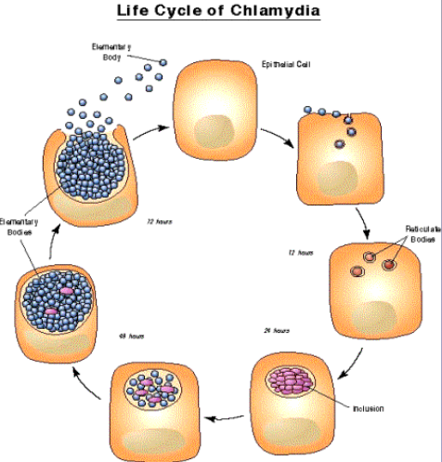
1
Chlamydia
1
Introduction
An obligate intracellular bacteria with elements of bacteria
but no rigid cell wall⁴.
Fail to grow on artificial media¹
Uses host cell metabolism for growth and replication.
Chlamydia species
Chlamydia serotype |  | Disease
C. trachomatis | (A,B,C) | Trachoma
 | (D - K)² | Inclusion conjunctivitis, genital infection
 | (L1, L2, L3)² | Lymphogranuloma venereum (LGV)
C.psittaci |  | Psittacosis
C.pneumoniae |  | Respiratory infections
Epidemiology
C.trachomatis is a common cause of sexually transmitted disease (STD).
Spread by genital secretions, anal or oral sex
Wide spread, 5-20 % among STD clinic in USA
Human are the sole reservoir
1/3 of male sexual contacts of women³ with C.trachomatis cervicitis develop urethritis after 2-6 weeks incubation period.
Pathogenesis of Chlamydia
Chlamydia have tropism for epithelial cells of endocervix and upper genital tract of women, urethra, rectum and conjunctiva of both sexes.
LGV can enter through skin or mucosal breaks
Release of pro-inflammatory cytokines, lead to tissue infiltration by inflammatory cells, progress to necrosis, fibrosis then scarring.
1- Only cultured in cell lines (intracellular growth).
2- Seuxually transmitted orgnaisms.
3-Men usually develop symptoms like urethritis but majority of women infected with the bacteria are asymptomatic making them a source of infection.
4-Difficult to stain it with gram stain due to fact it has no rigid cell wall (Lack of peptidoglycan (muramic acid) in the cell wall).

Slide 3
1
Chlamydia
2
Genital infections caused by C.trachomatis
In MEN
urethritis [non gonococcal urethritis (NGU)]
Urethritis presents as dysuria⁶ and thin urethral discharge in 50 % of men.
Complication:
epididymitis & proctitis
In WOMEN
Cervicitis, salpingitis, urethral syndrome, endometritis & proctitis
Uterine cervix infection may produce vaginal discharge but is asymptomatic¹ in 50-70% of women.
Complication: Salpingitis and pelvic inflammatory disease² can cause sterility and ectopic pregnancy.
50% of infants born to mothers excreting C.trachomatis during labor³ show evidence of infection during the first year of life:
Most develop inclusion conjunctivitis.
5-10% develop infant pneumonia syndrome.
LGV caused by C.trachomatis strains L1,L2,L3⁴
LGV is common in South America and Africa. Papule and inguinal lymphadenopathy. Chronic infection leads to abscesses, strictures and fistulas
Diagnosis, treatment & prevention of Chlamydia
Diagnosis
Polymerase chain reaction (PCR) | Isolation on tissue culture (McCoy cell line)
-the most sensitive methods of diagnosis. Performed on vaginal, cervical, urethral swabs, or urine . -Gold standard | -C.trachomatis inclusions can be seen by iodine or Giemsa stained smear. -Rarely done
Treatment
Azithromycin | Azithromycin or Erythromycin | Doxycycline
Single dose for non- LGV infection⁵ | For pregnant women | For LGV, given for 7 days
Prevention
Prevention and control through early detection of asymptomatic cases, screening women under 25 years to reduce transmission to the sexual partner.
1- But they still can transmit the disease.
2- bacteria may spill into peritoneal cavity (peritonitis) → may infect liver capsule (Fitz-Hugh-Curtis syndrome) and cause RUQ pain.
3- Neonatal infection occurs as child passes through birth canal of infected mother → pneumonia, conjunctivitis
4- sexually transmitted → painless ulceration at site of infection → ulcers heal spontaneously but bacteria spread to regional lymph nodes → lymphadenopathy (buboes) weeks later → buboes fuse, soften, and suppurate → creates multiple draining sinuses → may lead to proctitis, rectal stricture
5- In practice usually If we suspect that the patient has Chlamydia or Gonorrhea or both we give Azithromycin and ceftriaxone together.
6-In young healthy individual dysuria is sometimes mistaken for cystitis.

Slide 4
1
Gonorrhea
3
Epidemiology of Gonorrhea
Rates among adolescents are high, about 10% increase per year in USA
Inability to detect asymptomatic cases such as women and patient fail to seek medical care hampers control .
Major reservoir for continued spread are asymptomatic cases
Non-sexual transmission is rare.
Clinical Aspects
A STD disease acquired by direct genital contact. It is localized to mucosal surfaces with infrequent spread to blood or deep tissues. Caused by N.gonorrhoeae. Clinical manifestations: 2-5 days incubation period (IP). Gonorrhea in days. While chlamydia in weeks Symptoms are similar to Chlamydia infection¹ Pharyngitis may occur. Conjunctivitis in neonates born to infected mothers both sexes: urethritis & proctitis Pelvic inflammatory disease (PID) in women
Men | Women
acute urethritis acute profuse purulent urethral discharge³. Complications: epididymitis | mucopurulent cervicitis urethritis with discharge. Complications: endometritis and PID.
Pelvic inflammatory disease (PID)
PID occurs in 10-20% of cases, include fever, lower abdominal pain, adnexal tenderness, leukocytosis with or without signs of local infection.
Salpingitis and pelvic peritonitis cause scarring and infertility.
Disseminated Gonococcal Infection (DGI) due to spread to the bloodstream.
Disseminated Gonococcal Infection (DGI)
Due to spread of the bacteria to the bloodstream.
Clinically : Fever, migratory arthralgia and arthritis. Purulent arthritis involving large joints². Petechial and maculopapular rash.
Metastatic infections such as Endocarditis, Meningitis & Perihepatitis may develop⁴.
1- Gonorrhea infections are more likely to be symptomatic and have purulent discharge.
2- Neisseria gonorrhoeae is the most common cause of septic arthritis in sexually active people., Knee joint mainly.
3-Make sure you are able to differentiate between the discharge in chlamydia (thin discharge)and discharge in gonorrhea ( acute profuse purulent)
4- It’s rare and usually the result of late treatment
Note: if a patient with arthritis is young, healthy and sexually active and not necessarily having urethral discharge you need to have high index of clinical suspicion.

Slide 5
1
Gonorrhea
4
Neisseria gonorrhoeae
A Gram negative diplococci grows on chocolate agar and on selective enriched media and CO2 required. Not a normal flora.
Pathogenesis
Mainly a localized infection of epithelium, leads to intense inflammation.
Possess pili and outer membrane proteins that mediate attachment to non-ciliated epithelium.
Diagnosis
Transport media required unless transfer to the lab is immediate.
Direct smear for Gram stain of urethral specimens to see:¹
Gram negative diplococci within a neutrophil (intracellular)
Culture :
on Thayer-Martin³ or other selective medium
Confirmation:
fermentation of glucose only
(does not ferment maltose or sucrose)⁴ or Co-agglutination test
Nucleic acid amplification tests
(e.g PCR):
is an option for diagnosing genital infections.
Note: Molecular testing is usually done on the clinical sample directly.
Treatment of Gonorrhea
Guided by local resistance pattern and susceptibility testing. Partner should be treated as well.
Drug of choice: Ceftriaxone IM + Azithromycin
1
2
3
Ceftriaxone IM (or oral Cefixime) recommended
Alternatives
Counseling
+ Combination with Azithromycin⁵ is recommended
Ciprofloxacin or Ofloxacin
Azithromycin, Doxycycline (orally for 7 days) both cover C.trachomatis infection as well
1- Clinical samples are similar to chlamydia: Urethral and cervical swab for culture and gram stain, and Urethral, cervical or vaginal swab or urine for molecular testing.
2- Why is Gram stain more specific for males? E.g. we took a urethral swab from a male and on gram stain it showed Gram- diplococci, we can be 99% sure that he has gonorrhea, unlike if it was a female we wouldn’t be sure. That’s because females have neisseria species as part of their vaginal flora along with other gram - cocci anaerobic bacteria.
3- Thayer martin: Chocolate based agar + Antibiotics.
4- Unlike neisseria meningitidis which ferments glucose and maltose, Neisseria gonorrhoeae ferments glucose only.
5-To cover chlamydia

Slide 6
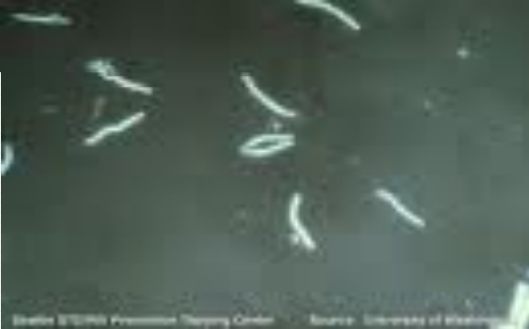
1
Syphilis
5
Characteristics
A chronic systemic infection, sexually transmitted.
Caused by spiral organism called Treponema pallidum subsp.pallidum.
The organism grow on cultured mammalian cells only, NOT stained by Gram stain but readily seen only by immunofluorescence (IF), dark field microscopy or silver impregnation histology technique.
Epidemiology of Syphilis
An exclusively human pathogen.
Transmission by contact with mucosal surfaces or blood, less commonly by non-genital contacts with a lesion, sharing needles by IV drug users, or transplacental transmission to fetus.
Early disease is infectious
Late disease is not infectious.
Pathogenesis
01
02
03
04
05
• Bacteria access through inapparent skin or mucosal breaks.
• Slow multiplication , endarteritis & granulomas
• Ulcer heals but spirochete disseminate
• Latent periods may be due to surface binding of host components.
• Injury is due to delayed hypersensitivity responses to the persistence of the spirochetes
Clinical Manifestations:
Overview (EXTRA)
Pathogenesis:
human is the only host → transmitted from skin lesions containing spirochete (sexual or casual contact) → spirochete penetrates mucous membranes → systemic spread within hours of inoculation leading to:
1° Syphilis (visible 6 weeks after exposure): organism multiplies at inoculation site → painless chancre (ulcerated lesion shedding spirochetes) → lesion heals spontaneously over 6 weeks
2° Syphilis (visible 6 weeks after chancre heals): disseminated spirochetes proliferate → form lesions throughout body including condyloma lata (wart-like painless lesions in moist areas, e.g., genitals) → lesions may heal spontaneously or may become latent syphilis (no symptoms but serologically ) → cycle of 2° syphilis can repeat multiple times
3° Syphilis (many years later): chronic inflammation against remaining spirochetes → damage to soft tissue and bone (gummas), CV system (aortitis), CNS transplacental transmission → congenital syphilis: stillbirth, fetal abnormalities
Clinical presentation summary:
1° Syphilis: painless chancre
2° Syphilis: condyloma lata; maculopapular rash on palms and soles; meningitis, hepatitis, arthritis, and others
3° Syphilis:
CVS: aortitis, ascending aortic aneurysm
CNS: tabes dorsalis, general paralysis, meningitis.
gummas (granulomas of soft tissue, bone)

Slide 7
1
Syphilis
6
Clinical manifestations:
Stages of Syphilis
Primary syphilis | Chancre is a painless¹, indurated ulcer² with firm base and raised margins on external genitalia or cervix ,anal or oral site, appear after an IP of about 2-6 weeks Enlarged inguinal lymph nodes may persist for months Lesion heals spontaneously after 4-6 weeks without therapy. Lesion is infectious
Secondary Syphilis (also called the great imitator) | Develops 2-8 weeks after primary lesion healed. Characterized by symmetric mucocutaneous rash, mouth lesions (snail track ulcers) and generalized non-tender lymph nodes enlargement (full of spirochete) with bacteremia causing fever, malaise and other systemic manifestations³. Skin lesion (maculopapular rash) distributed on trunk and extremities often palms, soles and face. 1/3 develop Condylomata Lata: which are painless mucosal warty erosions on genital area and perineum Secondary lesion resolve after few days to many weeks but disease continue in 1/3 of patients. If not treated Disease will enter into a latent state Lesions are infectious
Latent syphilis | A stage where there is no clinical manifestations but infection evident by serological tests. Relapse cease Risk of blood-borne transmission from relapsing infection or from mother to fetus continue
Tertiary syphilis | Occurs in 1/3 of untreated cases. Manifestations may appear after 15-20 years or may be asymptomatic but serological tests positive Neurosyphilis: -Chronic meningitis, with increased cells and protein in CSF, leads to degenerative changes and psychosis. -Demyelination causes peripheral neuropathies. -Most advanced cases result in PARESIS (personality, affect , reflexes, eyes, sensorium, intellect, speech) due to the effect on the brain parenchyma and posterior columns of spinal cord and dorsal roots Cardiovascular Syphilis: - Due to arteritis, leads to aneurysm of aorta and aortic valve ring. -Localized granulomatous reaction called gumma on skin, bones, joints or other organs leads to local destruction
Congenital syphilis
Develop if the mother not treated, Fetus susceptible after 4th month of gestation
Fetal loss or congenital syphilis result. Rhinitis ,rash and bone changes
(saddle nose, saber shine) anemia ,thrombocytopenia, and liver failure
1- unlike HSV which causes painful ulcer.
2- At site of inoculation.
3- it can mimic many diseases e.g. meningitis, hepatitis, arthritis

Slide 8
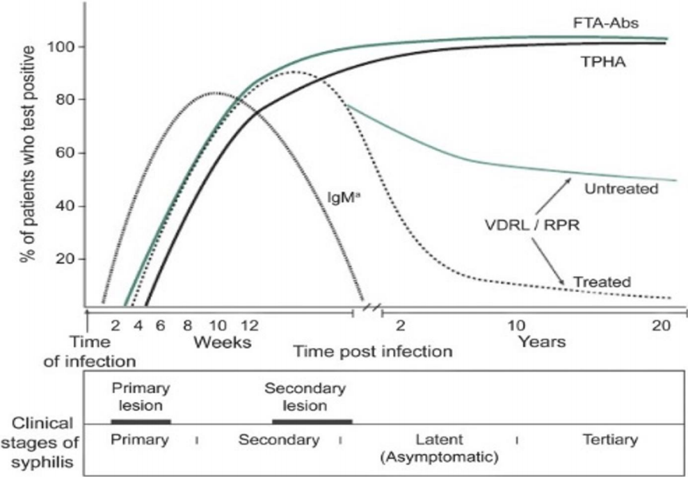
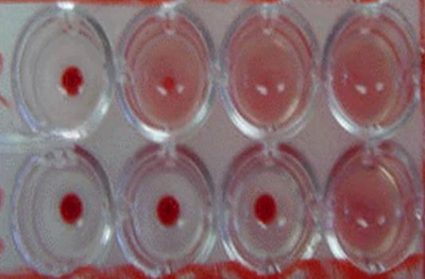
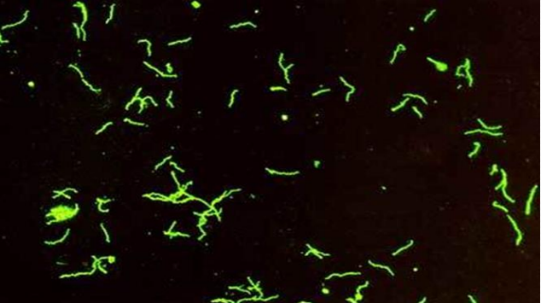
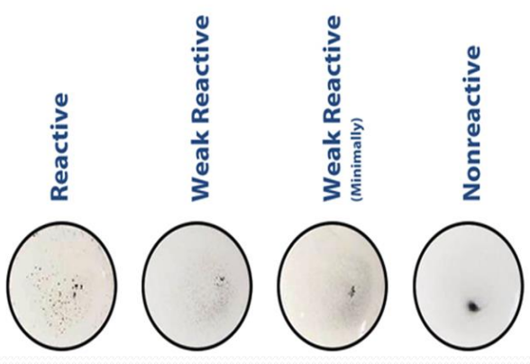
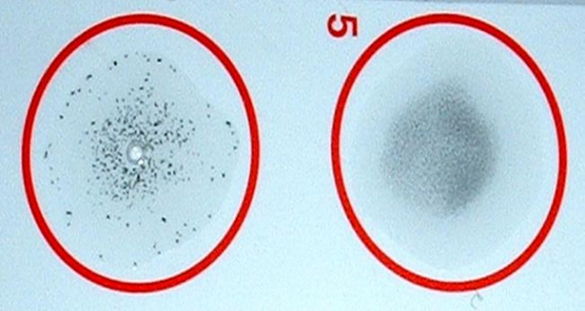
1
Syphilis
7
Syphilis natural history
30-50 %
25%
30%
Exposure
Primary
Syphilis
Secondary
Syphilis
Latent
Syphilis
Tertiary
Syphilis
Incubation period ~3-4 weeks upto 90 days
2-6 weeks
After 3-8 weeks, lesions disappear spontaneously
2-20 years
Neurosyphilis can occur at any stage⁵
Laboratory Diagnosis of Syphilis
Direct microscopic examination:
Rarely used
Of a smear from primary or secondary lesions using dark field microscopy.
Has many limitations.
If positive it confirms the diagnosis.
Serologic tests¹:
commonly used, Gold standard
Specific (treponemal tests): used initially for diagnosis and for confirmation (mainly).
Non specific (Non-treponemal tests): used for screening and follow up (mainly) of therapy
Treponemal tests² | Nontreponemal tests³
- Specific to treponemal antigens - Detect IgG and IgM directed against treponema membrane lipoproteins - Becomes positive after 3 weeks after infection. - Used for confirmation of RPR & VDRL. - Remain positive even after effective therapy. - Commonly used tests are: FTA-ABS (Fluorescent treponemal antibody absorption) TP-PA (T. palladium particle agglutination) most common EIA (Enzyme Immunoassay) | - Non specific⁴ ,directed against lipoidal antigens released as a consequence of cell damage. -Becomes positive 6 weeks after infection: Rapid Plasma Reagin (RPR) Venereal Disease Research Laboratory (VDRL). - Become positive during the primary stage (possible exception HIV) ,antibody peak in secondary syphilis. -Negative following effective therapy -Used for screening and staging the disease & follow up therapy - Gives us a titer.
1- Both treponemal and non treponemal are antibody-antigen based tests.
2- detects anti-treponemal antibodies
3- detects reagin antibodies against cardiolipin
4- Non-specific because it cross reacts with other infections and conditions e.g. SLE and infectious mononucleosis patients can have false-positive VDRL tests due to anti-cardiolipin antibodies. Clarify with more specific FTA-ABS test.
5-But it commonly occurs in the tertiary stage

Slide 9
1
Syphilis
8
Interpretation of serological test¹
Possible explanation | Treponemal Tests (TP-PA/FTA-ADS) | Non-Treponemal Tests (RPR/VDRL)
Syphilis- recent or previous Yaws or Pinta | + | +
No syphilis False positive | - | +
Consistent with previously treated or untreated late syphilis Yaws², Pinta², Bejel² | + | -
No syphilis Syphilis in Incubation Period | - | -
Interpretation of serological tests for syphilis:
❖ Both positive = the patient has syphilis
❖ If the nontreponemal tests positive and treponemal test is negative = No syphilis (false positive)
❖ Nontreponemal tests Negative and treponemal tests positive= previously treated / late latent stage
❖ Both negative? No syphilis / in Incubation Period
Reverse algorithm
Treponemal test
eg. (EIA)
Reactive
Non-reactive
Non-Treponemal test
Eg. (RPR)
Negative for syphilis
Reactive
Non-reactive
Syphilis
Second Treponemal test
eg. (TP-PA)
Reactive
Non-reactive
Evaluation required
Negative for syphilis
1- First we do non-treponemal for screening then treponemal for confirmation or sometimes both at the same time..
2- Treponema pallidum subspecies cause nonvenereal skin ulcers and skin/bone gummas:
T. pallidum endemicum → Bejel (common in Africa, Middle East).
T. pallidum pertenue → Yaws (gummas disfigure face).
T. pallidum carateum → Pinta (red → blue → white lesions, limited to Latin America).

Slide 10
1
Syphilis
9
Syphilis Staging flow chart
Symptoms or signs?
YES
NO
Primary
(Ulcer)
Secondary
(Rash, etc)
Latent
Any in past year?
Negative syphilis serology
Known contact to any early case of syphilis
Good history of typical signs/symptoms
YES
NO
Early latent (<1y)
Unknown or
Late latent (>1y)
Summary of Syphilis serology
Reverse sequence syphilis serology
Test | Stage
Treponemal tests (FTA-ABS , TP PA , EIA) | Positive at all stages , confirm RPR & VDRL
Non-treponemal tests (RPR or VDRL) | Positive during primary & secondary stages .Used for screening ,staging and follow up effective therapy
IgM² antibody | Congenital syphilis
Treatment & prevention
Treponema is sensitive to Penicillin (drug of choice)¹.
Hypersensitive patients treated with Tetracycline, Erythromycin or Cephalosporins
Prevention: counseling.
Take Home Message
Syphilis, Chlamydia and Gonorrhea are main STDs ,caused by delicate organisms ,cannot survive outside the body.
Clinical presentation may be similar ( urethral or genital discharge, ulcers ).
One or more organisms ( Bacteria, virus, parasite ) may be transmitted by sexual contact.
If not treated early may end in serious complications.
Screening for HIV required.
Infection may not be localize.
1- If pregnant, we use penicillin as well but if penicillin isn’t allowed due to allergy do penicillin desensitization.
2-IgG should be positive, most often because of passive antibody transfer from mother. Infant does not begin producing his/her own IgG until about 2 to 3 months of age. That’s why we measure IgM and not IgG for congenital syphilis.
Desensitization:
refers to a process of giving a medication in a controlled and gradual manner, which allows the person to tolerate it temporarily without an allergic reaction.

Slide 11
1
Clinical cases (EXTRA)
10
To help you differentiate between the 3 diseases
Syphilis: Secondary stage
A sexually active man seeks medical attention for a wart-like lesion developing on his genitals. He recalls a painless ulcer on his genitals over a month ago, but now is concerned because papules are appearing in his armpits and palms as well. Recently, he has also suffered fever and chills, and the doctor notices a nontender, generalized lymphadenopathy. The doctor questions the man about the health of his sexual partners. A dark-field analysis confirms the doctor’s suspicion of the etiology and the patient is prescribed penicillin G.
Gonorrhea
A teenager complains of pain during sexual intercourse and irregular intermenstrual bleeding. She has also begun to experience lower abdominal pain. A pelvic exam reveals a yellow mucopurulent discharge; during the exam, the cervix begins to bleed. Gram stain of discharge reveals Gram negative intracellular diplococci. The teenager reports that she has been sexually active with several partners over the last year. One of her partners, a male, comes to the same clinic complaining of dysuria and profuse yellow urethral discharge.
Chlamydia
A woman is brought to the EW complaining of vaginal discharge and RUQ abdominal pain. On history, the patient reports having many sexual partners. Pelvic exam reveals cervical motion tenderness, and labs of vaginal discharge detect numerous PMNs but no organisms on Gram stain. The doctor makes a diagnosis based on these findings and administers Azithromycin and ceftriaxone. Later, surgeons, concerned about the patient’s abdominal pain, rule out cholecystitis by imaging, but laparoscopy reveals adhesions around the patient’s liver capsule.

Slide 12
Lecture Quiz
MCQ:
Answers: Q1:C | Q2:D | Q3:D | Q4:B | Q5:A
Q1: Vertical transmission is not seen in ... ?
A- Syphilis
B- Toxoplasmosis
C- Tuberculosis
D- Varicella
Q2: Which of the following is not true about chancre
A- The first sign of syphilis
B- Hard syphilitic primary ulcer
C- it may be produced 2 or 6 weeks after infection
D- Not infectious
Q3: Which of the following is untrue of diagnostic test for syphilis
A- RPR & VDRL are believed to be standard tests for syphilis
B- TP-PA test is a specific test for syphilis
C- IgM antibody test is useful to detect congenital syphilis
D- In secondary syphilis, VDRL is negative.
Q4: Non-gonococcal urethritis in men is mainly due to … ?
A- Streptococcus
B- Chlamydia
C- Trichomonas
D- E. coli
Q5: Which of the following is mainly disseminate to large joints like the knee?
A- N.gonorrhoeae.
B- Trichomonas
C- Treponema pallidum
D- E. coli
SAQ:
CASE: A 29-year-old pregnant woman is seen for her initial pregnancy visit. She is estimated to be at 20 weeks gestation. She reports being in a monogamous relationship with her current partner of 3 months. She has had 4 partners in the year prior to becoming pregnant. She was last tested for sexually transmitted diseases (STDs) 9 months ago, and all tests were negative. Her physical examination is unremarkable. Routine laboratory screening tests are performed. They show a positive treponemal enzyme immunoassay (EIA) and a positive Rapid Plasma Reagin (RPR) assay (titer 1:16). The HIV antigen-antibody test is negative. She is brought back into clinic for treatment and she tells you she gets hives when exposed to penicillin. She has no neurological or eye signs or symptoms.
Q1: What is the most likely diagnosis?
A: Syphilis
Q2: What is the most likely causative agent?
A: Treponema pallidum subsp.pallidum
Q4: What are the stages for this disease?
A: Primary, secondary, latent and tertiary.
Q4: What are the possibilities of the serological tests in this disease?
A:
Nontreponemal tests positive and treponemal test is Positive = Syphilis
Nontreponemal tests positive and treponemal test is negative = No syphilis (false positive)
Nontreponemal tests Negative and treponemal tests positive = Previously treated / late latent stage
Nontreponemal tests Negative and treponemal tests negative = No syphilis / in Incubation Period
Q5: What is the appropriate treatment for this patient?
A: Penicillin.
Because she is pregnant, she should be desensitized and treated with penicillin

Slide 13
Members Board
Team Leaders:
Abdulaziz Alshomar Ghada Alsadhan
Team sub-leader:
Mohammed Alhumud (coolest sub leader ever)
This lecture was done by:
Jehad Alorainy
Note taker:
Mashal Abaalkhail
Rema Alkahtani

Slide 14
ALL DONE !
Since it’s the last microbiology lecture for the basic years, we hope that we were able to simplify as much information as possible and made studying microbiology more easy and fun!
This work would’ve never been as good without the AMAZING :
Mohammed Alhumud
Mashal Abaalkhail
Special thanks to the team leader/team members for their help this year :
CNS Males Team leader:
Badr Alqarni
Team members:
Abdullah Alhawamdeh
Abdullah alothman
Abdulrahman Alsayed
Abdulrahman alhajri
Alhanouf Alhaluli
Alwaleed Alzunaidi
Bader Alhammad
Danah Alhalees
Deana Awartani
Faisal Alzahrani
Faris Almubarak
Hani Alhudhaif
Jehad Aloraini
Joud Aljebreen
Jude alotaibi
Khyal alderaan
Huge thanks to the academic leaders for their time in revising the work:
Ibrahim aldakhil
Razan Alrabah
The hidden reviewers
Leena Alnassar
Mohammed Alhamad
Naif Alhoseini
Naif Alsolais
Nawaf Albhijan
Noura Almazrou
Noura Alturki
Raghad Alkhashan
Razan Alrabah
Reem Aljabr
Rema Alkahtani
Sarah Alhelal
Saud Alaqeel
Suhail basuhail
Tariq Aloqail
Ziyad Aljofan

