Slide 1
Obstetric and Gynecology
“Human Papillomavirus”
Objectives:
What is HPV & HPV related infections
Prevalence in US and Saudi arabia
Types of vaccines available & Doses and administrations
Time of vaccination & Duration of protection
Safety of the vaccine
Color index:
Main content
Important
Doctor’s Notes
Females Slides
Males Slides
Done By:
Razan AlRabah
Raghad AlKhashan
Special thanks to Ibrahim AlDakhil
Editing File

Slide 2
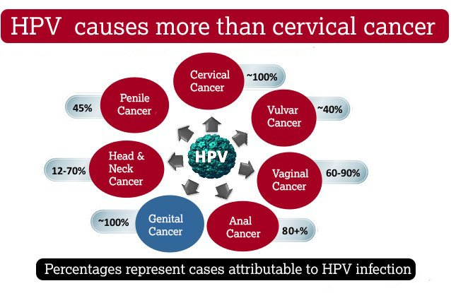
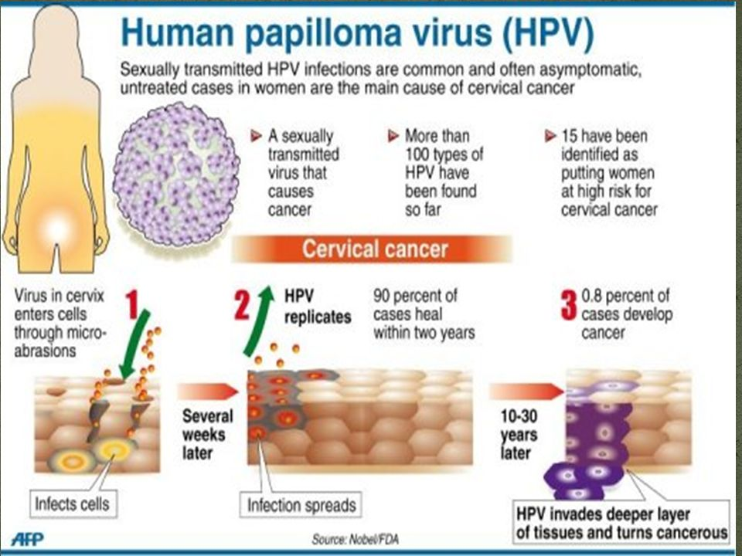
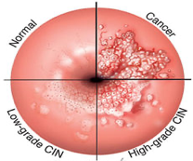
Human Papillomavirus¹
HPV Related Diseases in Females
DNA virus from the papillomavirus family.
Over 150 types are known, and more than 40 types are transmitted through sexual contact and infect the anus and genitals, oropharyngeal cavity.
Spread by sustained direct skin-to-skin contact with vaginal, oral, anal sex, & vertical transmission. (NOT by blood). However, It does not spread via common items like toilet seats.
Cannot be cultured without living tissue.
Cervical cancer² and precursor lesions | The third most common female cancer worldwide four stages of HPV: 1st- infection: 80% of infected patients’ immune systems will get rid of the virus and this stage and nothing will happen. 2nd- persistence: In immunocompetent patients, the virus will persist in the “persistence stage” for 5 to 30 years until it start developing. 3rd- progression. 4th- invasion (carcinogenesis): is the process separating the dysplasia phase and the cancer (we don’t start calling it cervical cancer until the basement membrane is invaded) Anything before this stage is curable. In United State: the estimated annual incidence of CIN among female who undergo cervical cancer screening is 0.4 % for CIN 1 and 0.5% for CIN 2&3 HPV type 16 and 18 cause approximately 70% of cervical cancer and 50 % of precancerous cervical lesions. HPV type 31, 33, 45, 52, & 58 are estimated to cause an additional 19 % of invasive cervical cancers. In Saudi Arabia: Which has a population of 6.5 million women over the age of 15 years, approximately 152 new cases of Cervical cancer are diagnosed, and 55 women die from the disease annually. Ranking number 12 between all cancers in females. Accounts only for 2.4% of all new cases, despite the lack of national screening programs.
Vulvar and vaginal cancer, and precursor lesions | Rare cancer globally In United State: Estimated incidence of 27,000 vulvar cancers and 13,000 vaginal cancers in 2008. The attributable fraction due to HPV infection has been estimated to be 43 % for vulvar and 70 % for vaginal cancer.
Females slides only
Females slides only
A rare complication in neonates is laryngeal papillomatosis
Almost all cervical cancers are HPV positive.

Slide 3
Studies Regarding HPV in Saudi Arabia
HPV Related Diseases in Females & Males
Females slides only
Human Papillomavirus Prevalence and Type Distribution Among Women Attending Routine Gynecological Examinations in Saudi Arabia:
This was an observational, epidemiological cross-sectional study conducted between April 2010 and December 2011 at three hospitals in Saudi Arabia.
Results:
The overall prevalence of HPV was 9.8% in Saudi Arabia, but was higher in women over 55 years, as well as in non-Saudi nationals.
The most prevalent high risk types were: HPV-68/73 (5 cases), HPV-18 (4 cases), HPV-16 (3 cases).
The most prevalent low risk types were: HPV-6 (4 cases) HPV-42, HPV-53 and HPV-54 (2 cases each).
HPV prevalence and genetic predisposition to cervical cancer in Saudi Arabia:
100 patients with histopathologically proven, locally advanced, cervical cancer were enrolled in this study out of 218 patients followed at KFSHRC from 2009 to 2012. There was no restriction on patients’ age or histological type of cervix cancer.
Conclusions:
The prevalence of HPV infection in invasive cervical cancer in Saudi Arabia (82%) is at the lower range of that observed in the world (85%-99%).
The most common HPV genotype was HPV-16 (71%), followed by HPV-31 (7%), HPV-18, 45, and 73 (4% each), Double infections were present in 8.5% of HPV-positive patients.
HPV oncogenic strains (16,18,31,45,52, and 58) account for 98 to 99% of cervical cancers
Anal cancer and precursor lesions | Rare cancer globally HPV types 16 and 18 cause around 70 to 85 % of anal cancers and precancerous lesions (ie, Anal intraepithelial neoplasia grade 2 and 3)
Genital warts¹ | HPV types 6 and 11 (benign genotypes) cause 90% of genital warts. It is associated with physical and psychological morbidity. High rate of treatment failure, and treatment of recurrent episodes is costly.
Oropharyngeal cancer | HPV infection may also play a role in the pathogenesis of squamous cell carcinomas of the head and neck. Primarily found in the oropharynx and base of the tongue, tonsil, and larynx. Transmitted through birth (vertical transmission) or through oral sex.
Females slides only
Females slides only
Genital warts doesn’t transform to cancer.

Slide 4
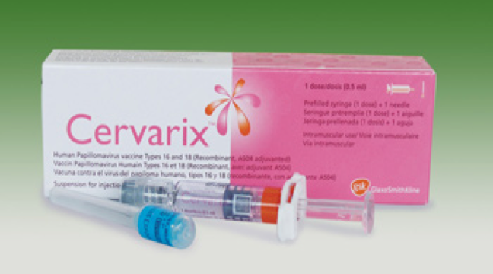
HPV Related Diseases in Males
HPV Vaccine History
Vaccines Against HPV¹
Females slides only
Penile cancer and precursor lesions | Rare cancer globally because the penile area is exposed and can be easily cleaned. HPV 16 and HPV 18 cause approximately 35 to 40 % of penile cancers, and 70-80 % of HPV-positive penile cancers.
Ian Hector Frazer, a Scottish-born Australian scientist, born in 6 January 1953.
He met with virologist Jian Zhou, and the two considered the problem of developing a vaccine for HPV in 1989.
In 2006, the FDA approved the first preventive HPV vaccine.
In 2010, Saudi Food and Drug Administration approved prophylactic HPV vaccine. Although, awareness about the importance of HPV vaccine is incredibly low.
Gardasil
1
2
3
Cervarix
Gardasil 9
HPV Vaccine | 1. Cervarix
Features | Bivalent vaccine, targets HPV types 16 and 18 Approved for girls and women aged 9 to 25 for the prevention of cervical cancer and CIN.
Studies The National Cancer Institute Reviewed: November 2, 2016 | One large randomized clinical trial in more than 18,000 young females aged 15 to 25 years demonstrated the efficacy of bivalent HPV vaccine Among HPV-naïve patients, the efficacy of the vaccine for preventing CIN2 or more severe disease due to HPV types included in the vaccine was 93 % In the overall population of study participants (with and without prior HPV infection), vaccine efficacy for preventing CIN2 or more severe disease due to HPV types included in the vaccine was significantly lower at 53 % after a mean follow-up period of approximately 3 years.
Vaccination is considered as a primary prevention.
Ideally, the vaccine should be taken before the first sexual intercourse to avoid the exposure to any genotype before getting vaccinated. But the patient should still take the vaccine even after testing positive for one of the strains to get protected against the rest.

Slide 5
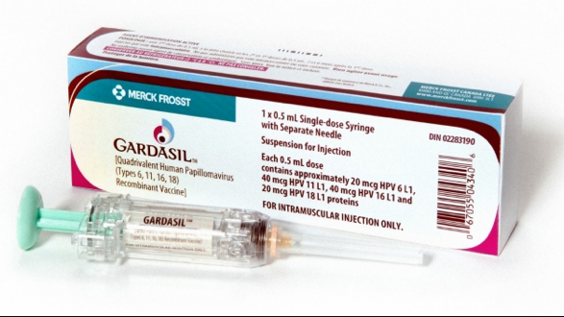
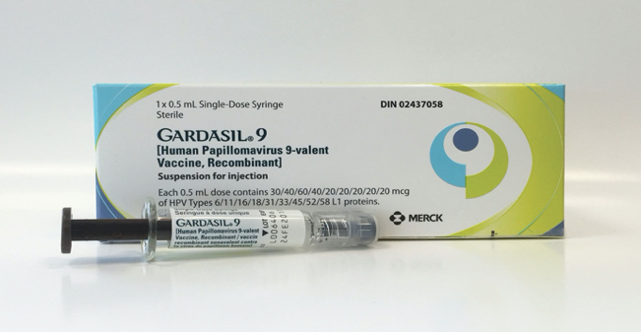
Vaccines Against HPV (cont.)
HPV Vaccine | 2. Gardasil¹
FDA Approval | FDA licensed in June 8,2006.
Features | Quadrivalent HPV vaccine, targets HPV types 6, 11, 16, and 18 Approved for the prevention of cervical cancer, and cervical and vulvar intraepithelial neoplasia in young women. Approved for both men and women from the ages of 9 to 26 for the prevention of genital warts, anal cancers, and anal intraepithelial neoplasias. In October 2018, it was approved too for women at age 27-45.
Studies The National Cancer Institute Reviewed: November 2, 2016 | Two large, randomized, double-blind, placebo-controlled trials have evaluated the efficacy of this vaccine in more than 17,000 adolescents and young females : Among HPV-naïve populations, the efficacy for preventing CIN2 or more severe disease due to HPV types included in the vaccine, was 97 to 100 % In the overall population of study participants (with or without prior HPV infection), the efficacy for preventing CIN2, or more severe disease due to HPV types included in the vaccine was significantly lower at approximately 44 % after a mean follow-up period of 3 years. This reduction in efficacy reflects the fact that the vast majority of enrollees in this trial were already sexually active and many had been previously infected with vaccine HPV types.
HPV Vaccine | 3. Gardasil 9
FDA Approval | Approved In December 2014
Features | 9-valent vaccine, targets the same HPV types as the quadrivalent vaccine (6,11,16, & 18) as well as types 31,33,45,52, & 58. Approved for women and girls aged 9 to 26, and men and boys aged 9 to 15.
Studies The National Cancer Institute Reviewed: November 2, 2016 | An international trial reported the efficacy of this vaccine in approximately 14,000 females aged 16 to 26 years who were randomly assigned to receive the vaccine: Among HPV-naïve populations, the efficacy of 9-valent vaccine for preventing CIN2 or more severe disease, VIN2 or 3, and VaIN2 or 3 associated with HPV types 31, 33, 45, 52, and 58 was 97 % In the overall population of study participants (with and without prior HPV infection), the rates of high-grade cervical, vaginal, and vulvar disease were the same among women who received the 9-valent vaccine and those who received the quadrivalent vaccine (14 cases/1000 person years in both groups).
Gardasil is better than Cervarix in the sense that it protects against genital warts. Genital warts can be a serious problem. Some patients’ warts could be serious enough to require a total vulvectomy. Warts can also lead to family problems, divorce, and even depression.

Slide 6
When should HPV Vaccine taken ?
Study Regarding HPV Vaccine in Saudi Arabia
Pre-vaccination Assessment
American Cancer Society guidelines
World Health Organization guidelines
Females slides only
Should be routinely offered to Females aged 11 to 12 years¹; immunization may begin at 9 years of age².
Catch-up vaccination for females aged 13 to 18, who have not been previously vaccinated or completed their vaccine series.
The ACS notes that there is insufficient evidence to recommend for or against vaccination of females aged 19 to 26 years.
Suggests that girls within the age range of 9 through 13 years, should be the primary target population for HPV immunization.
Local public health programs should recommend vaccination of older females, only if it is affordable and cost effective and does not divert resources from vaccinating the primary target population or screening for cervical cancer.
Attitudes and perceptions towards HPV vaccination among young women in Saudi Arabia
Conclusion:
Knowledge and perception of HPV infection as an STDS and its vaccine was significantly low in this cohort of patients.
Higher age and educational levels directly correlated with increased knowledge of HPV infection and its complications.
It is recommended that awareness should be raised, and access to HPV vaccination increased to help reduce the health care burden of HPV sequelae in the Kingdom.
Females slides only
Females slides only
The Advisory Committee on Immunization Practices (ACIP) does not recommend serologic or HPV DNA testing prior to immunization in females or males.
HPV test should be done every 5 years starting by 30 years of age. Started at the age of 30 because 80% of females exposed to HPV before the age of 30 will get rid of it through their immunity. Those who are still positive at the age of 30 or above are the ones having a persistent infections.
In persistent infection, HPV has 2 proteins E6 and E7 that combine with 2 tumor suppressor genes P53 and retinoblastoma gene in the DNA respectively, causing them to be inhibited, thus the cells are replicating without checkpoints, eventually leading to cancer.
Pap smear should be done every 3 years starting by 21 years of age.
HPV test and pap smear are considered as secondary prevention.
Studies showed that in the US, about 50% of females have experienced some type of a sexual contact by the age of 12.
Optimal age: 9-14 and the upper limit is at age 45.

Slide 7
Immunization in special patient populations
1
Pre-existing cervical abnormalities or genital warts
A history of genital warts, abnormal cytology, or positive HPV DNA test result is not evidence of prior infection with any or all of the vaccine HPV types.
Vaccination can still provide protection against infection with HPV vaccine types not already acquired.
Assessment with Pap testing or screening for existing HPV infection is NOT indicated as part of the determination for HPV vaccine candidacy.
These patients should be advised that vaccination will have no therapeutic effect on pre-existing HPV infection or CIN, and the potential benefit of HPV vaccination is not as great as if they were vaccinated before they started having sex.
2
HIV Infected Patient & Transplant Recipient
According to CDC recommendations:
Studies of the HPV quadrivalent vaccine in HIV-infected adult men and women aged 16 to 23 years , boys and girls aged 7 to 12 years suggest that it is both immunogenic and safe in these populations.
Efficacy data are not yet available.
For solid organ transplant recipient, It is safe to be given 3 to 6 months following transplantation
3
Pregnancy
According to CDC recommendations:
Not recommended¹ given that safety in this setting has not been thoroughly evaluated.
If a woman is found to be pregnant after initiating the vaccination series, the remainder of the three-dose regimen² should be delayed until after completion of the pregnancy, but she should continue taking the doses after.
In quadrivalent HPV vaccine trials, the composite rate of adverse pregnancy outcome (spontaneous abortion, late fetal death, congenital anomaly) was similar for the 3819 females who became pregnant and controls who did not receive the vaccine (22.6 versus 23.1%)
Similarly reassuring findings have been reported for the bivalent HPV vaccine and for the 9-valent HPV vaccine, although data are more limited.
Safe in lactating females as it does not affect the infant breastfeeding.
Explanations to the doctor’s note:
Primary Prevention: trying to prevent yourself from getting a disease (e.g. HPV Vaccine)
Secondary Prevention: trying to detect a disease early and prevent it from getting worse (e.g. treating the precancerous lesions)
Tertiary Prevention: trying to improve your quality of life and reduce the symptoms of a disease you already have (e.g. treating the cervical cancer)
Even though it is not live attenuated, but rather a dead virus.
If by mistake a woman received a dose and found to be pregnant, we don’t terminate the pregnancy because of it.

Slide 8
Vaccine Dose and Administration¹
Duration of protection²
Study Regarding the duration of protection
Individuals younger than 15 years should receive 2 doses of HPV vaccine at least 6 months apart.
Individuals 15 years or older should receive 3 doses of HPV vaccine over a minimum of 24 weeks, The minimum interval between the first two doses is 4 weeks and the minimum interval between the second and third doses is 12 weeks.
Gardasil and Gardasil 9 are administered in 3 doses at time 0, 2, and 6 months of follow-up.
Cervarix is administered, at time 0, 1, and 6 months of follow-up.
According To CDC guidelines
dec 2016
If the vaccination series is interrupted for any length of time, it can be resumed without restarting the series.
According To CDC guidelines dec 2016:
In all clinical trials persistent antibody levels and protection against HPV infection have been reported up to 10 years following vaccination. Of note, the precise level of antibody needed for protection against infection is unknown.
Further data will become available in the future as female and male participants in vaccine studies are followed over time.
Long-term Persistence of anti-HPV-16 and -18 Antibodies Induced by Vaccination With the AS04-adjuvanted Cervical Cancer Vaccine: Modeling of Sustained Antibody Responses
Results:
HPV-16 and -18 antibodies peaked at Month 7 and gradually plateaued at Months 18–24 and remained stable through 6.4 years.
Mean antibody levels at the last time point were several fold higher than those associated with natural infection.
The study predict that HPV-16 and -18 mean antibody levels will remain well above those associated with natural infection for at least 20 years
Ideally, the second dose should be given 1-2 months after the first (and no later than 5 months). Then the 3rd dose is given 4 months after the second.
For about 20-30 years

Slide 9
Vaccine Safety
All vaccines use virus-like particles (VLPs), which mimic the viral capsid.
VLPs do not contain genetic material and are produced in biologic systems, which have well-established safety records
The vaccine is very safe, the only side effects are pain at the site of injection and possibly flu-like symptoms.
Quadrivalent vaccine (Gardasil)
Prelicensure data:
The safety profile of the quadrivalent vaccine was evaluated in diverse populations of females from resource-rich and resource-limited settings .
Mild injection site reactions were the most commonly observed adverse events.
The safety profile of quadrivalent vaccine in males was reported to be similar to that of studies in females.
Postlicensure data:
In the U.S, adverse events following immunization are collected and analyzed within the Vaccine Adverse Event Reporting System (VAERS), following HPV vaccine are compared with background rates following other immunizations.
Between June 2006 and March 2013, approximately 57 million doses of quadrivalent HPV vaccines were distributed.
Reports of adverse events to VAERS have been consistent with the pre-licensure data:
From 2006 to 2013, VAERS received 21,194 reports of adverse events following HPV immunization among females The vast majority (92 %) were considered mild. The proportion of events reported as serious peaked in 2008.
VTE rates reported to the VAERS were higher for quadrivalent vaccine than other vaccines, of the 31 patients with thromboembolism reported through 2008, 90 % had a known risk factor (ie, estrogen-containing birth control pills or a family history of clotting disorder)
Anaphylaxis had also been reported following administration of the quadrivalent vaccine
Among serious events, headache, nausea, vomiting, fatigue, dizziness, syncope, and generalized weakness were the most frequently reported.
There is no increased risk of Guillain-Barré Syndrome compared with other vaccines in similar age groups
Through 2011, 72 post-vaccination deaths had been reported, of which 34 were confirmed. There was no unusual pattern or clustering to the deaths that would suggest that they were caused by the vaccine

Slide 10
Vaccine Safety (cont.)
Cost Effectiveness
Female slides only
9-valent vaccine (Gardasil 9)
In an analysis of seven trials in which over 15,000 individuals received at least one dose of the 9-valent vaccine, the most common adverse effects were:
Mild or moderate injection site reactions (pain, erythema, and swelling) more frequently than with the quadrivalent vaccine.
Systemic adverse effects (eg, headache, fever, nausea, dizziness) were similar with the 9-valent and quadrivalent vaccines.
Serious adverse effects occurred in <0.1%.
Bivalent vaccine (Cervarix)
In a phase III, multinational prospective, double-blind, placebo-controlled trial of more than 18,000 females aged 15 to 25 years, the vaccine was well tolerated and there were no differences in serious adverse events between vaccine and placebo recipients.
Because of low uptake of the bivalent vaccine in the U.S only sparse post-licensure data are available.
As of September 2011, there have been 52 VAERS reports of adverse events following administration of bivalent vaccine and the majority (98%) were considered non serious.
Female slides only
Mathematical models have examined the cost effectiveness of HPV vaccination, one study suggested that vaccination of the entire United States population of 12-year-old girls would annually prevent:
> 200,000 HPV infections
100,000 abnormal cervical cytology examinations
3300 cases of cervical cancer if cervical cancer screening continued as currently recommended
Important Messages
HPV vaccination appears to be safe and effective in preventing subsequent infection in older women, but the overall benefit is less than that in younger females.
The need to vaccinate individuals before the onset of sexual activity to gain the greatest benefit and maximize cost effectiveness.
None of the three vaccines treats or accelerates the clearance of pre-existing vaccine-type HPV infections or related disease.

Slide 11
QUIZ
01
05
02
06
03
07
04
08
Which of the following is a HPV related disease in both genders ?
Which of the following HPV strains Gardasil vaccine cover ?
Brain Cancer
Anal Cancer
Lung Cancer
Liver Cancer
16 and 18
16,18,6, and 11
16, 18, 6, 11, 31, and 33
6, 11, 31, and 33
How many doses should the 19 years old woman receive of the Gardasil 9 vaccine, and when should the dose(s) be administered?
In which of the following conditions HPV vaccine is not recommended ?
2 doses at 0 and 6-12 months
1 dose is all that is needed
3 doses at 0, 2, and 6 months
4 doses at 0, 1-2, 6, and 12 months
Breastfeeding Woman
HIV patient
Pregnancy
Genital warts
Which of the following HPV strains causes the majority of cervical cancers?
Which of the following is a bivalent vaccine ?
HPV 6 and 16
HPV 16 and 18
HPV 6 and 11
HPV 11 and 18
Cervarix
Gardasil
Gardasil 9
B&C
Which of the following is the benign strains of HPV ?
Which of the following genes are affected in HPV induced cancer ?
HPV 6 and 16
HPV 16 and 18
HPV 6 and 11
HPV 11 and 18
P53
RB
BRCA1
A&B
#StaySafeAndSane
Answers: 1- B | 2- C | 3- B | 4-C | 5-B| 6-C | 7-A | 8-D

