Slide 1
Editing file
Systemic Manifestations
of AIDS
Objectives
Understand the pathogenesis of AIDS syndrome
Recognize the systemic manifestations of AIDS with a special emphasis on Kaposi Sarcoma and opportunistic infections that can be encountered in AIDS patients

Slide 2
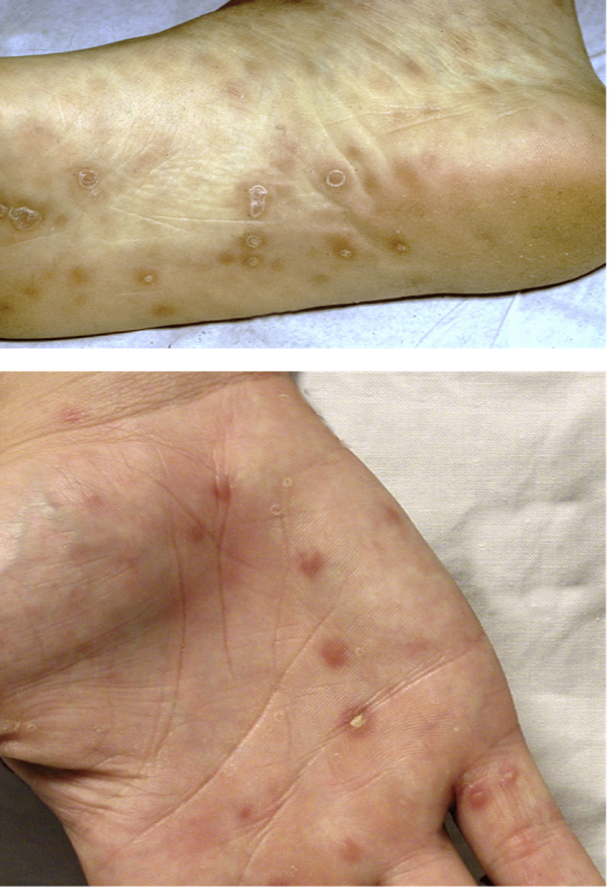
STDs “not part of objectives”
الأمراض الزهرية
السيلان البني
Gonorrhea
Caused by N. gonorrhoeae (gonococci)
Symptomes:
Female: asymptomatic
Male: burning sensation in penis & urethra, along with pus.
Occurs few days after suspicious intercourse...patient will deny
Treated by: Ampicillin & penicillin, with good prognosis
Chronic infection leads to infertility; rare, as it responds to therapy,
Patient will usually go to private clinics to avoid scandals.
Non-specific Urethritis
Caused by Chlamydial infection (intracellular)
Symptomes:
Male: burning sensation, and secretions.
Female: causes cervicitis
Treatment: Erythromycin & tetracycline
A
Syphilis الزهري
Caused by: Treponema pallidum اللولبية الشاحبة
Detected by dark-field microscopy
Primary syphilis: “chancres” superficial painless ulcer (Pic A)
Secondary syphilis: 4 weeks after primary if not treated
Mucocutaneous lesions (on palms & soles) Rich in plasma
Lymphadenopathy
Condyloma latum: (Pic B) elevated lesion on moist areas (around anus, inner thigh..) can be seen in transplacental infection (newborns)
Tertiary Syphilis: after more than one year if untreated
Neurological symptoms Tabes dorsalis
CVS symptoms
Diagnosis
VRDL: serological test that tests positive in syphilis, false
positive in autoimmune disease
Treatment: large doses of penicillin
B

Slide 3
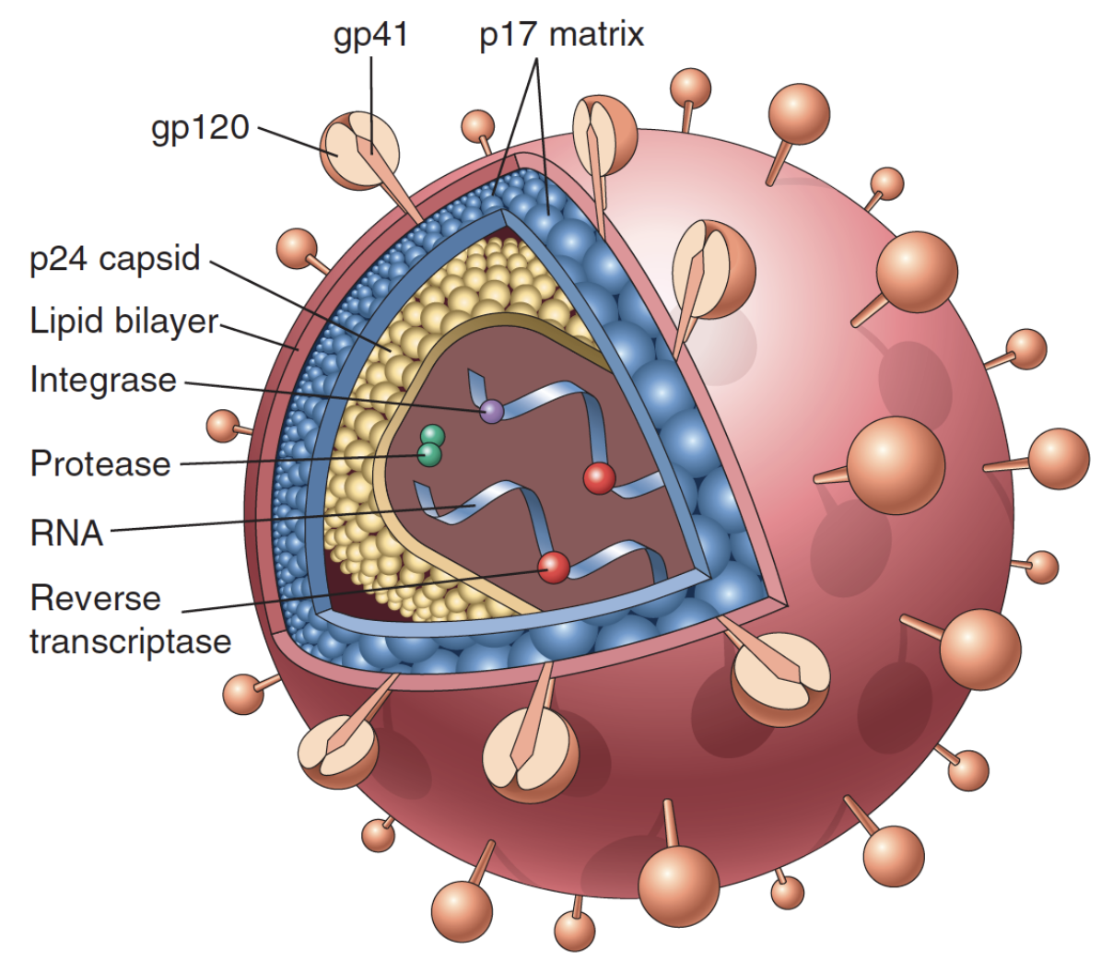
Introduction to HIV
Introduction this is not AIDS
Human Immunodeficiency Virus (HIV) is the causative agent for AIDS.
All HIV infected patients are at a risk of developing deadly illnesses caused by opportunistic infections and tumors.
HIV is a retrovirus from lentivirus family that contains single stranded RNA. HIV is divided into:
HIV-1: most common (worldwide epidemic) areas: America, Europe, Central Africa
HIV-2: less common ( found in: West Africa, Southeast Africa, India)
HIV Structure
1
Viral genome: 2 short RNA strands
2
Enzymes: Reverse transcriptase, protease, ribonuclease and integrase
3
Envelop: Outer lipid envelope with glycoproteins 41 and 120
HIV infection
Any CD4+ cell can be infected by HIV. Target cells include: blood monocytes and tissue macrophages, T lymphocytes, Langerhans cells in skin, B lymphocytes, Natural Killer lymphocytes, Dendritic cells, hematopoietic stem cells, endothelial cells, microglial cells in brain, gastrointestinal epithelial cells.
Macrophage and Langerhan cells are important reservoir for CNS involvement as they cross the BBB. They can spread the virus elsewhere in the body but unlike T-cells they cannot get destroyed
Once the infection extends to the lymph nodes, the HIV virions are trapped in the processes of follicular dendritic cells FDCs and will pass the infection to the T-cells.
HIV has the ability to mutate easily which leads to the rise of different variants of HIV inside a human, increasing its resistance to drug therapy

Slide 4
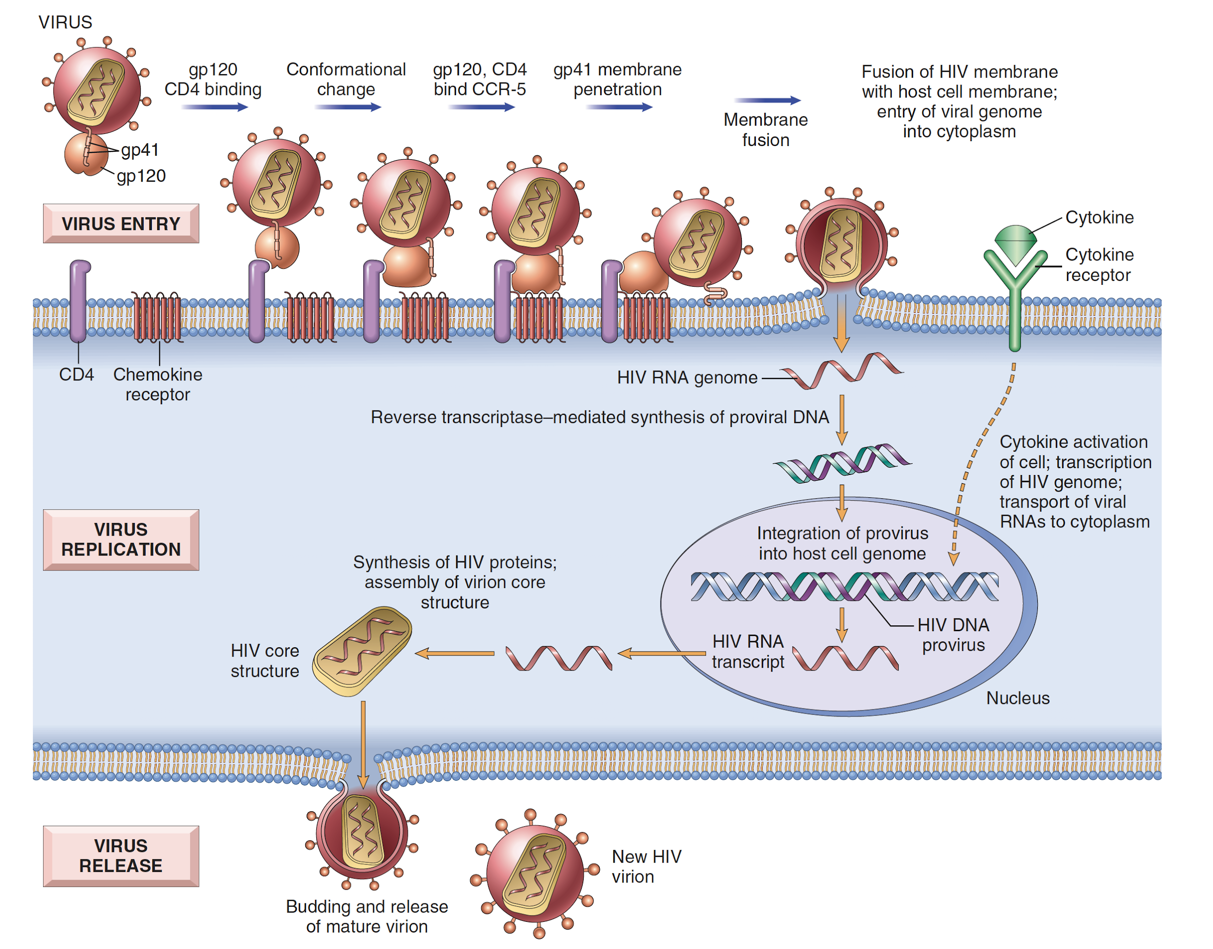
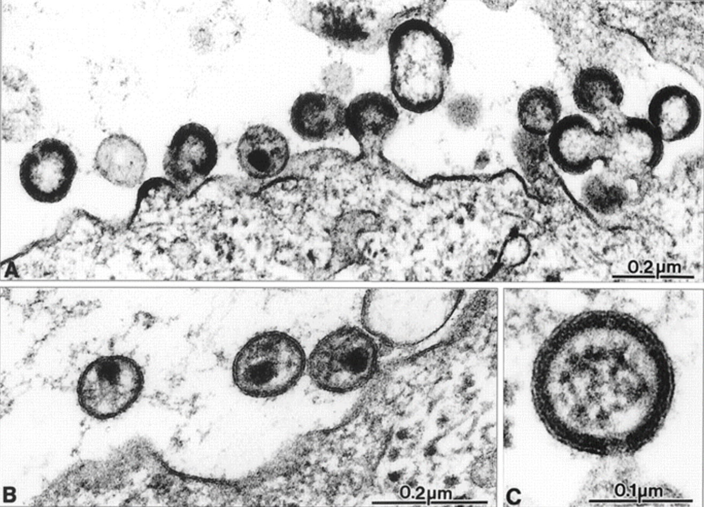
HIV Pathogenesis
HIV Life Cycle and Pathogenesis
1- Virus Entry
HIV is shown to cross the mucosa of the genital tract and infect CD4+ cells. The probability of getting infected depends on both the number of virions in the body fluid and the number of receptors in the CD4+ cells.
The gp120 on the HIV binds to CD4 receptors (found on T-cells, macrophages, and other APCs) and facilitate the viral entry.
In addition, gp120 also binds to two co-receptors CXCR4¹ and CCR5² on the host cell surface, which assist in the entry of the virus.
2- Virus Replication
Retroviruses cannot replicate on their own because they contain RNA only.
Once HIV infects a cell it uses its reverse transcriptase enzyme to convert its RNA into a proviral DNA.
The proviral DNA is inserted into the host genomic DNA using integrase enzyme.
Once the proviral DNA is integrated, the HIV is replicated by the host cells to produce addition virion.
3- Virus Release
Viral components assemble together and form virions. And can be released
whether through: budding or through lysis of the infected cells.
1. Receptor on T cells.
2. Receptor on Macrophages and other monocytic lineage cells.
Target cell

Slide 5
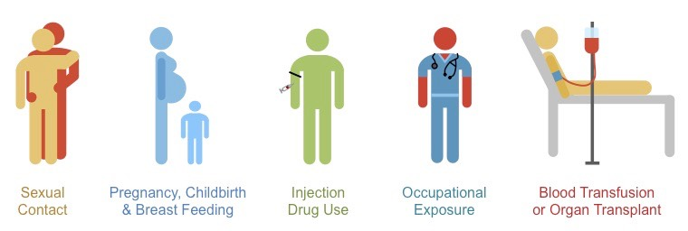
Modes of transmission
Modes of Transmission
HIV is primarily spread as a sexually transmissible disease.
Transmission of HIV can occur from male to male, male to female, and female to male. Female to female transmission remains extremely rare.
Parenteral routes:
IV drug users sharing infected needles. Tattoo needles that are not disinfected.
Health care workers with percutaneous exposures (needle puncture) to HIV-containing blood.
Persons receiving multiple blood transfusions, e.g. hemophiliacs. Less common now due to blood screening.
HIV can be present in blood, genital secretions, and breast milk.
Urine, sweat, tears, saliva, are not clinically important due to low concentration of HIV there.
Congenital Infection: perinatally or in infancy.
Transplacental infection
During delivery through birth canal
Infection through breastfeeding
Does not spread by casual contact in public places, workplace, or household, nor by insect vector.
There is no vaccine to prevent HIV infection.
Diagnosis
Test for HIV antibodies is done with a rapid test using an (ELISA) technique.
If rapid test is positive, then the next step is to:
Confirm HIV infection with Western blot or immunofluorescence assay (IFA) or PCR
The average HIV-infected person may take up to several weeks to become seropositive (Window period) (in some reports up to 15 months)

Slide 6
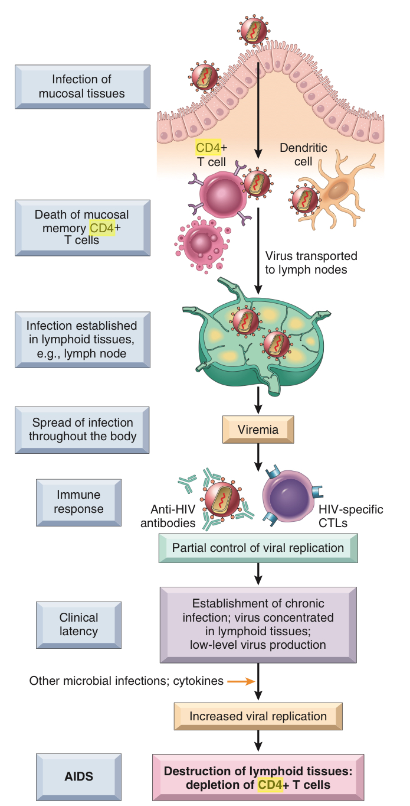
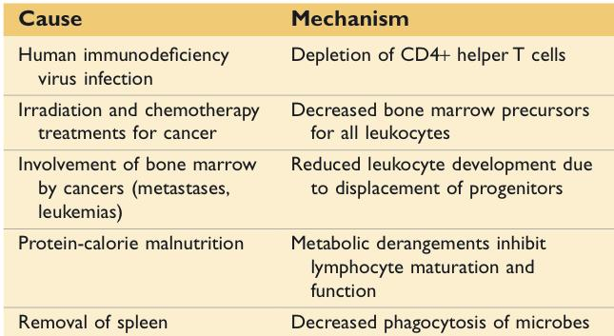
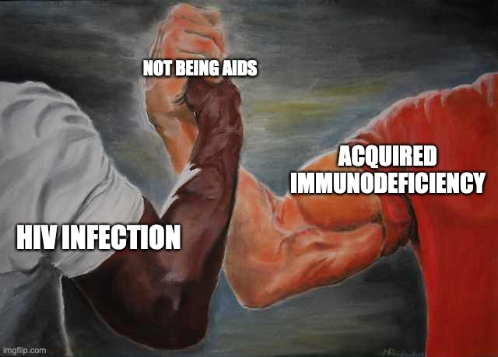
HIV & AIDS
Clinical presentation
Primary HIV infection may go unnoticed (asymptomatic) in at least half of cases.
In others produce a mild disease which quickly subsides, or produce an acute HIV infection:
fever, generalized lymphadenopathy, pharyngitis, rash, arthralgia and diarrhea.
These symptoms diminish over 1 to 2 months.
followed by a long "latent" period lasting years (8-10 years) before AIDS.
Pathogenesis of AIDS/clinical AIDS
The progression to AIDS is marked by the appearance of syncytia-forming (SI) variants of HIV in about half of HIV infected patients.
SI variants are associated with faster CD4+ cell decline. “Patient reaches AIDS faster”
signs and symptoms of AIDS correlates with the CD4+ lymphocyte count.
CD4+ lymphocyte count less than 200/microliter = AIDS.
Opportunistic infections and neoplasms of AIDS appear.
CD4+ T-cells to CD8+ T-cells ratio reduced, often to less than 1.0;
where the normal ratio is about 3:1.
Acquired immunodeficiency in not AIDS
Acquired (Secondary) immunodeficiency can be found in many conditions including cancer, metabolic diseases, malnutrition, and most importantly AIDS, however AIDs is not the only cause. Here are some common causes and their mechanisms.

Slide 7
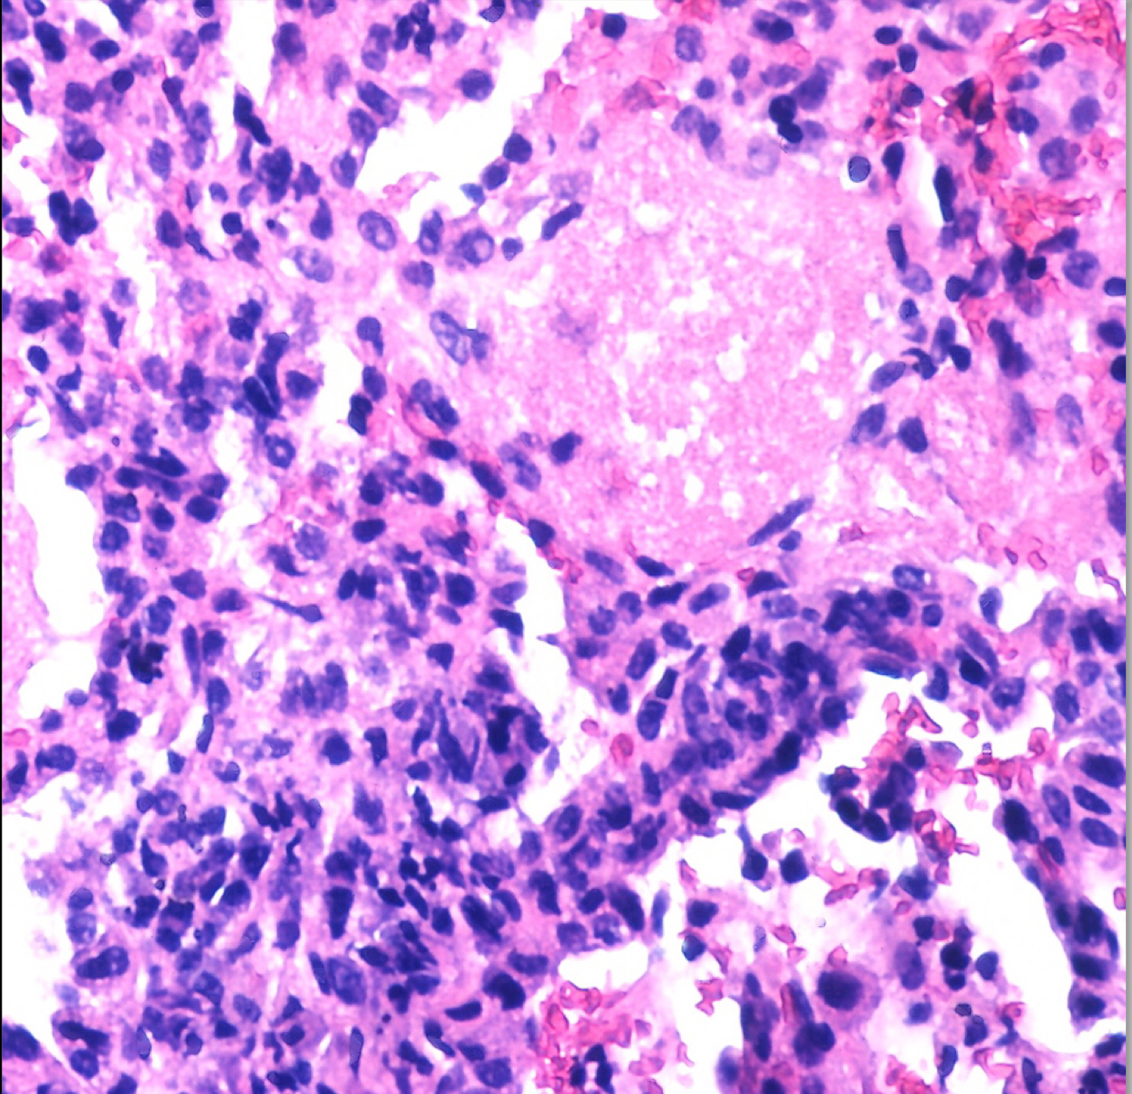
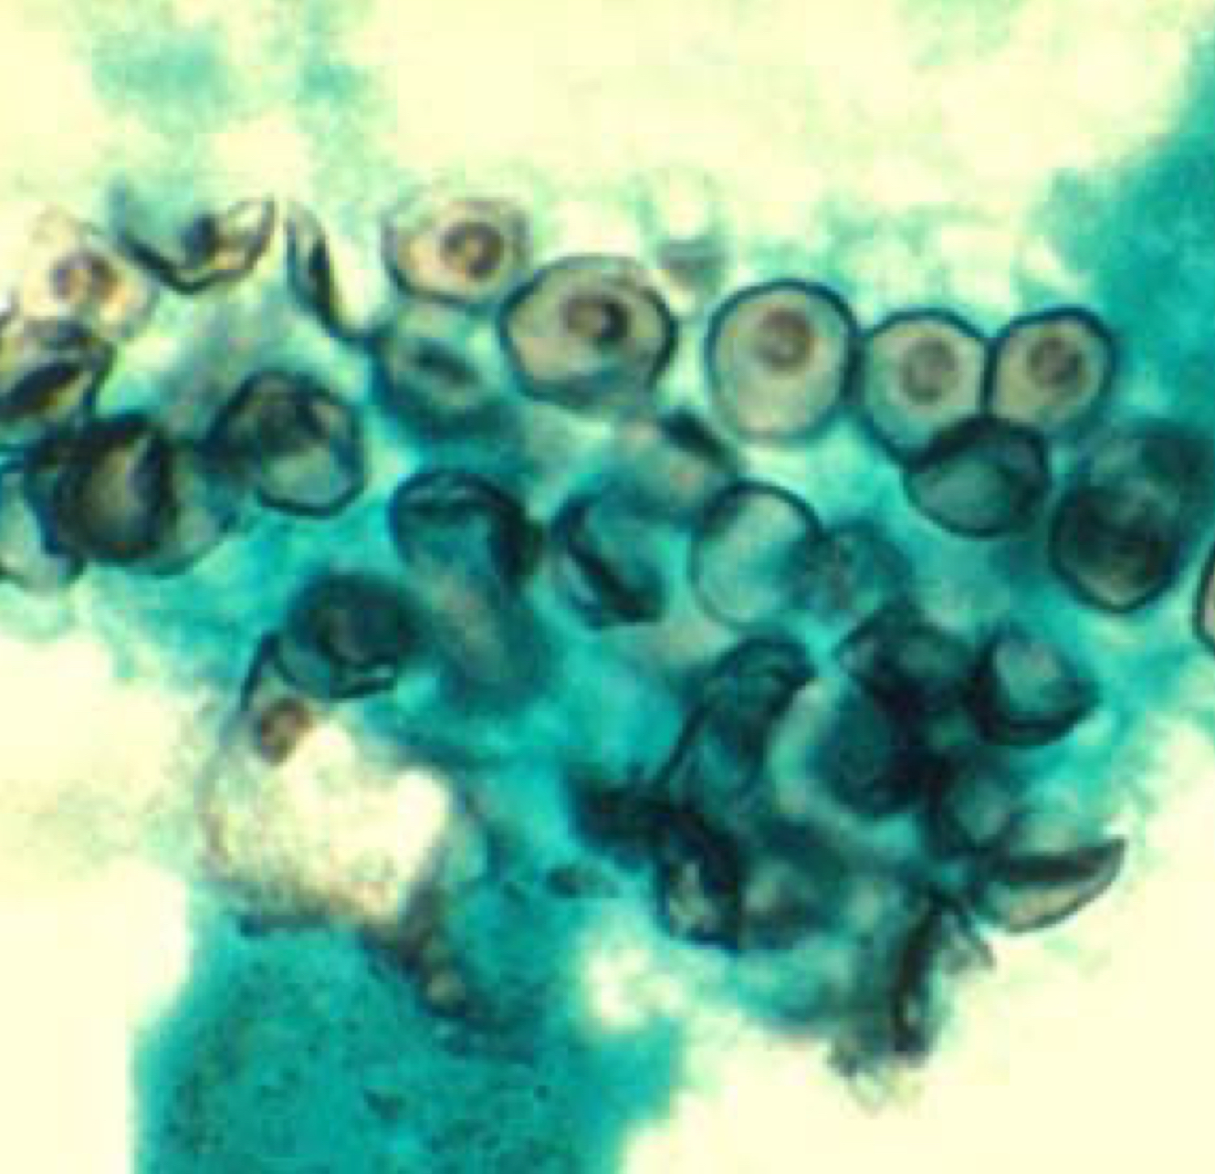
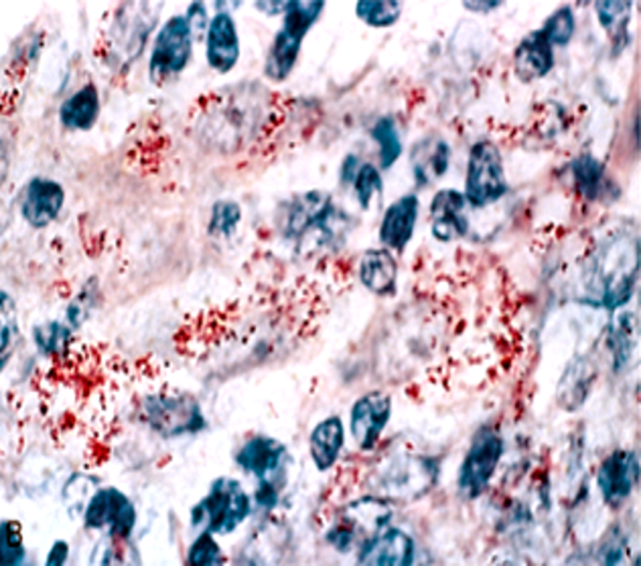
Complications of AIDS
Acquired Immunodeficiency Syndrome (AIDS) = < 200 CD4+/ mm³
Clinical AIDS is reached years after the initial infection and is marked by the development of one or more of the typical opportunistic infections or neoplasms common to AIDS.
Following are some of the more common complications seen in AIDS:
Infections
Neoplasms
Infections
Pneumocystis Jiroveci
Pneumocystis jiroveci (P. carinii) is the most frequent opportunistic infection seen in AIDS. It commonly produces a pneumonia.
The diagnosis is made histologically by finding the organisms in
cytology (bronchoalveolar lavage) or biopsy (transbronchial biopsy) material from the lung.
In the lung, there is soap bubble like intra alveolar exudate
(cotton candy exudate) and the organism appears as cyst like
structures that are positive to silver stain.
Cytomegalovirus
CMV infection is seen in AIDS. It causes pneumonia and it can also cause serious diseases in the brain and gastrointestinal tract.
It is also a common cause for retinitis and blindness in persons with AIDS.
Histology (pic C): Long arrow: prominent nucleus. Short Arrow: ill defined cytoplasmic inclusions
H & E stain
Silver stain
C
Mycobacterial infections
Mycobacterium avium complex (MAC) infection. (opportunistic)
Mycobacterium Leprae: Leprosy disease; (Acid-fast bacilli) (pic D)
Mycobacterium tuberculosis. (Secondary Tb: bilateral & affect upper poles)
Definitive diagnosis of mycobacterial disease is made by culture and PCR.
No caseating granuloma; as there is depletion of CD4+ cells.
Fungal Infections
Candidiasis of the esophagus, trachea, bronchi, or lungs.
Cryptococcus neoformans (produces pneumonia and meningitis), Histoplasma capsulatum, and Coccidioides immitis.
D

Slide 8
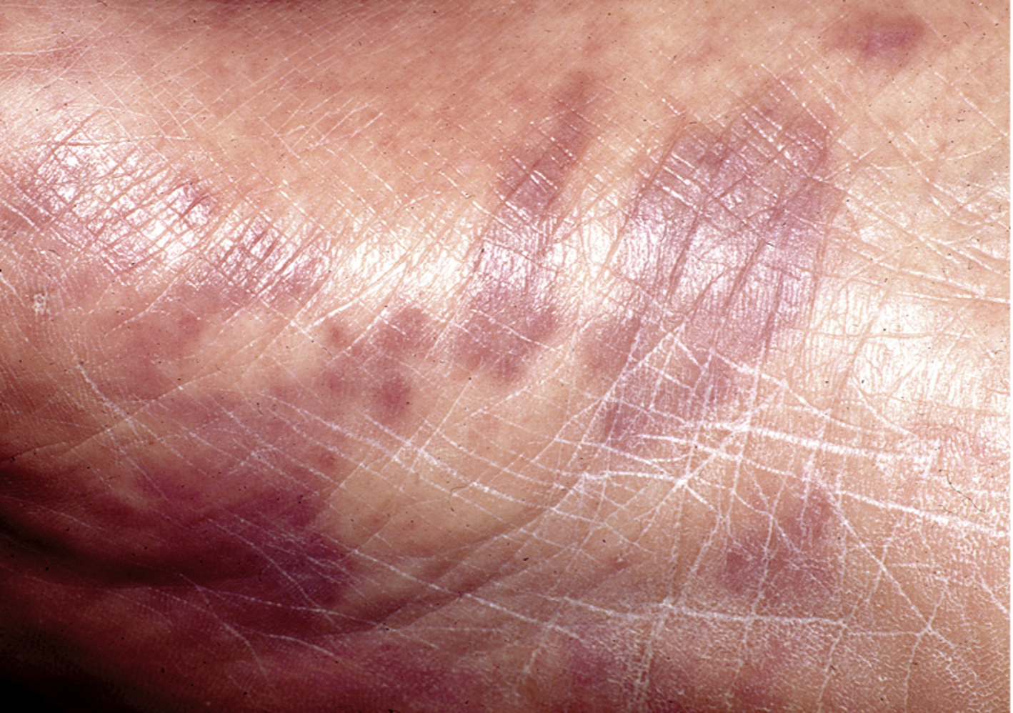
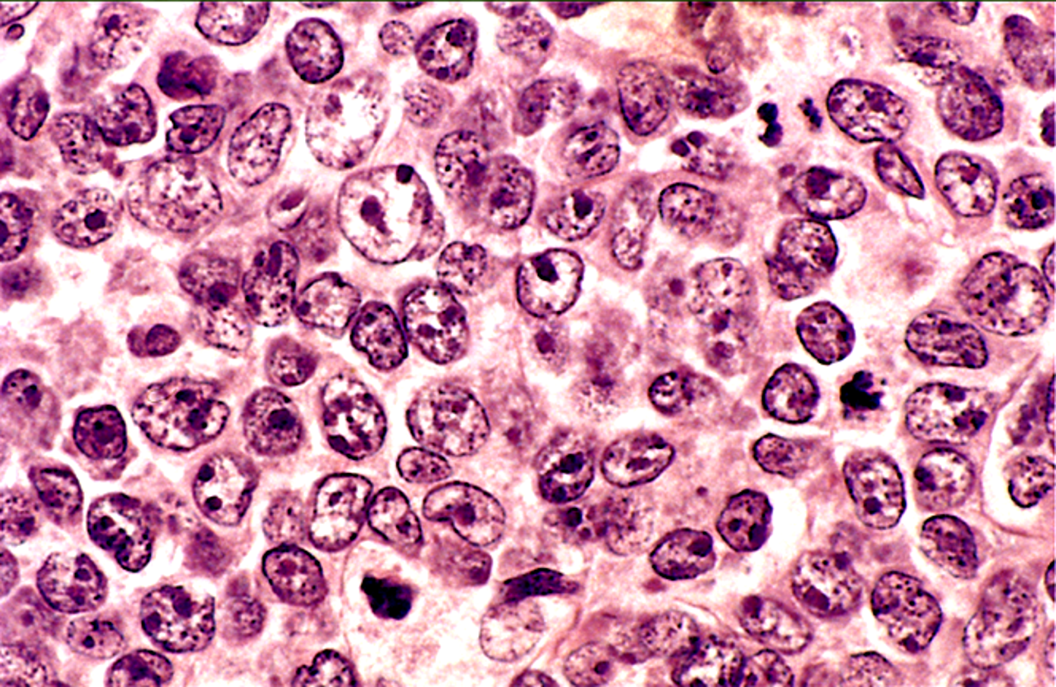
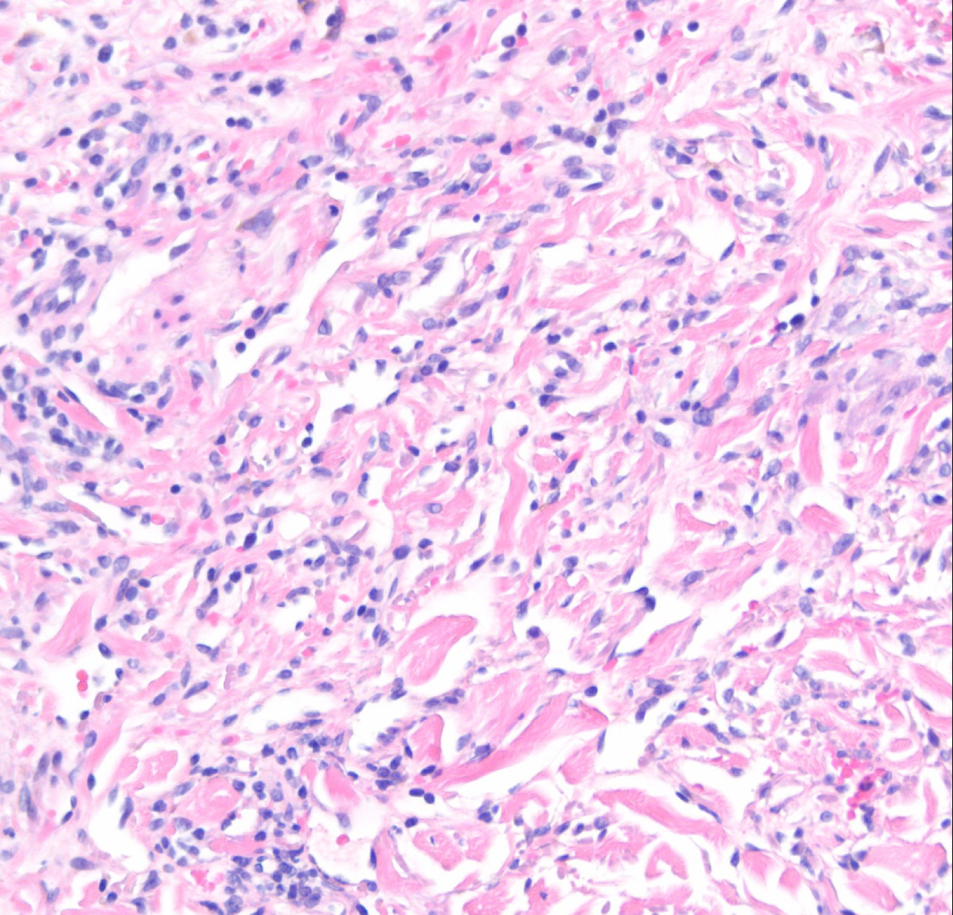
Complications of AIDS
Toxoplasmosis
Caused by Toxoplasma gondii is a protozoan parasite that most often leads to infection of the brain with AIDS.
Cryptosporidium and Microsporidia
Produce voluminous watery diarrhea in patients with AIDS
Could also affect the CNS
Herpes simplex Virus
Infection in the mucosa
Aspergillosis
Especially in the lung.
Viral HIV encephalitis
Syphilis (primary, secondary and tertiary)
Neoplasms
Kaposi's sarcoma
It is a sarcoma of the blood vessels.
Visceral organs can also be involved with Kaposi's sarcoma.
Produces reddish purple patches or nodules over the skin. (A)
It is associated with HHV-8 and on histology, it shows malignant spindle cells of vascular origin.
Diagnosed with skin biopsy.
A
Lymphoma
Malignant lymphomas are seen with AIDS.
They are commonly diffuse large B-cell non-Hodgkin's lymphoma. (B)
They are typically of high grade and often in the brain.
They are very aggressive and respond poorly to therapy.
B
عال...
large nuclei with open chromatin and prominent nucleoli

Slide 9
Summary
HIV
General informations | Human Immunodeficiency Virus (HIV) is the causative agent for AIDS HIV is a retrovirus from lentivirus family that contains single stranded RNA. HIV is divided into: HIV-1: most common (worldwide epidemic) HIV-2: less common
Structure | Viral genome: 2 short RNA strands Enzymes: Reverse transcriptase, protease, ribonuclease and integrase Envelop: Outer lipid envelope with glycoproteins 41 and 120
Infection | Any CD4+ cell can be infected by HIV. Target cells include: T lymphocytes, macrophages, Langerhans cells, B lymphocytes, Natural Killer lymphocytes, Dendritic cells, hematopoietic stem cells, endothelial cells, microglial cells… etc.
Pathogenesis | 1- Virus Entry Cross the mucosa and Infect CD4+ gp120 binds to CD4+ receptors and facilitate viral entry. 2- Virus Replication HIV infects a cell it uses its reverse transcriptase enzyme to convert its RNA into a proviral DNA. 3- Virus Release through: budding or through lysis of the infected cells
Modes of transmission | Sexually: unprotected sex Parenteral: IV drug users, health care workers with percutaneous exposures, blood transfusions. Congenital infections: pregnancy, at time of delivery, breastfeeding.
Diagnosis | Test for HIV antibodies is done with a rapid test using an enzyme-linked immunosorbent assay (ELISA) technique. If rapid test is positive, then the next step is to: Confirm HIV infection with Western blot or immunofluorescence assay (IFA)
AIDs
Pathogenesis | The development of signs and symptoms of AIDS correlates with the CD4+ lymphocyte count. CD4+ lymphocyte count less than 200/microliter = AIDS opportunistic infections and neoplasms of AIDS appear. CD4+ T-cells to CD8+ T-cells ratio reduced, often to less than 1.0.
Infections | Pneumocystis Jiroveci: most frequent opportunistic infection seen in AIDS. It commonly produces a pulmonary infection. In the lung, there is soap bubble like intra alveolar exudate. Cytomegalovirus. 3. Mycobacterial infections 4.Fungal Infections. 5. Toxoplasmosis 6. Cryptosporidium and Microsporidium 7. Herpes simplex Virus. 8. Aspergillosis 9. Viral HIV encephalitis 10. Syphilis (primary, secondary and tertiary)
Neoplasms | Kaposi's sarcoma: Produces reddish purple patches or nodules over the skin. Lymphoma: typically of high grade and often in the brain.

Slide 10
Quiz
1) A 28-year-old woman with a 9-year history of injection drug use has developed a chronic watery diarrhea that has persisted for the past week. On physical examination, she is afebrile and has mild muscle wasting. Her body mass index is 18. Laboratory studies of her stool show cysts of Cryptosporidium parvum. One month later, she develops cryptococcal meningitis, which is treated successfully. Oral candidiasis is diagnosed 1 month later. This patient is at greatest risk of developing which of the following neoplasms?
A- Cerebral astrocytoma
B- Cervical clear cell carcinoma
C- Cerebral non-Hodgkin lymphoma
D- Pulmonary adenocarcinoma
2) At 19 years of age, a previously healthy woman had an acute illness with fever, myalgia, sore throat, and mild erythematous rash over the abdomen and thighs. These symptoms abated after 1 month. She then remained healthy for 10 years. Now she has decreased visual acuity and pain in the right eye. Funduscopic examination shows findings of cytomegalovirus retinitis. Examination of her oral cavity shows thrush (candidiasis). Which of the following laboratory findings would most likely be present after her ocular problems began to appear?
A- ANA titer 1:1024
B- Anticentromere antibody titer 1:512
C- CD4+ lymphocyte count 102/μL
D- Positive HLA-B27
3) In epidemiologic studies of HIV infection and AIDS, investigators noticed that certain individuals did not develop HIV infection despite known exposure to the virus under conditions that caused HIV disease in all other individuals similarly exposed. When CD4+ lymphocytes from resistant individuals are incubated with HIV-1, they fail to become infected. Such resistance to infection by HIV is most likely caused by a mutation affecting genes for which of the following cellular components?
A- CD28 receptor
B- Chemokine receptor
C- Fc receptor
D- Interleukin-2 receptor
E- T cell receptor
4) An epidemiologic study is conducted to determine risk factors for HIV infection. The study documents that individuals with coexisting sexually transmitted diseases such as chancroid are more likely to become HIV-positive. It is postulated that an inflamed mucosal surface is an ideal location for the transmission of HIV during sexual intercourse. Which of the following cells in these mucosal surfaces is most instrumental in transmitting HIV to CD4+ T lymphocytes?
A- CD8+ cells
B- Langerhans cells
C- Natural killer cells
D- Neutrophils
E- Plasma cells
5) A 17-year-old boy has been sexually active for the past 3 years. He has had fever, lymphadenopathy, and pharyngitis for the past 3 weeks. Serologic testing shows that he is HIV- positive. He is now currently healthy and is not an intravenous drug user. Which of the following is the most likely outcome of his disease within the next year?
A- Appearance of an extranodal non-Hodgkin lymphoma
B- Development of cryptococcal meningitis
C- Seronegativity with repeat HIV testing
D- Transmission of infection with unprotected sex
E- Worsening cognitive and motor function
6) A 40-year-old man has been infected with HIV for the past 10 years. During this time, he has had several bouts of oral candidiasis, but no major illnesses. He is now diagnosed with Kaposi sarcoma involving the skin. He has had a 7-kg weight loss in the past 6 months. Laboratory studies show the HIV-1 RNA viral load is currently 60,000 copies/mL. Which of the following types of cells is most depleted in his lymph nodes?
A- CD4+ lymphocyte
B- CD8+ lymphocyte
C- CD19+ lymphocyte
D- Macrophage
E- Natural killer cell
F- Plasma cell
1- C
2- C
3- B
4- B
5- D
6- A

Slide 11
Team Subleader
Alhanouf Alhaluli
Done by the brilliant minds
Alwaleed Alsaleh
Mohammed Al Haqbani

Slide 12
Farewell…حتوحشونا
Serving this wonderful batch through this team was a true pleasure. We hoped to have liced up to your expectation, and thank you for investing your trust in us...
We would like to thank Our Amazing Academic leaders: Ibrahim & Razan ...whom we casually have tested their patients
The Dream team
Alwaleed Alsaleh
Abdulaziz Alshomar
Omar Aldosari
Mohammed ajarem
Bader Aliyyar
Omar Alotaibi
Ahmed Alajlan
Mohammed K Alqahtani
Alwaleed Alarabi
Muaath AlJehani
Meshari Alzeer
Suhail Basuhail
Khalid Nagshabandi
Mohaned Makkawi
Mohammed ALHuqbani
Aued Alanazi
Abdullah Alhawamdeh
Abdullah Alghamdi
Alhanouf Alhaluli
Renad Alkanaan
Raghad Alkhashan
Danah Alhalees
Deana Awartani
Njood Alali
Noura Alturki
Taiba Alzaid
Taif Alshammari
Taef Alotaibi
Deema Almaziad
Joud Abudahesh
Nouf Albrikan
Nouf Alshammari
Joud Aljebreen
Sarah Alfaraj
We would never forget our talented psychic: Mashal abaalkhail 🔮

