Slide 1
Uterine Corpus Pathology
Editing file
Objectives
Lesions of endometrium of uterus: risk factors, clinical presentation, macroscopic and histological features of:
Endometrial hyperplasia.
Endometrial carcinoma.
Lesions of myometrium of uterus:
Leiomyoma: pathology and clinical features.
Leiomyosarcoma.

Slide 2
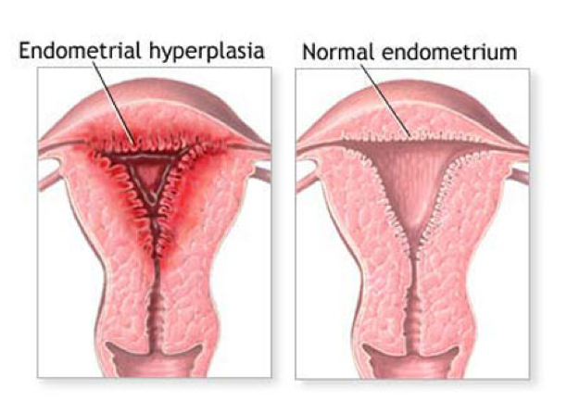
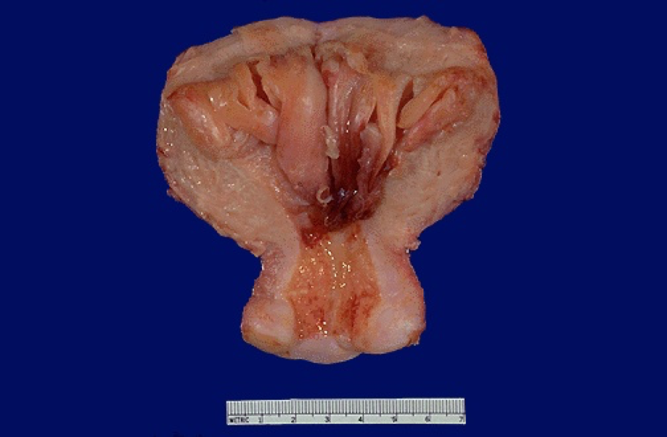
Endometrial hyperplasia
Introduction
Proliferation of endometrial glands; resulting in increased gland:stroma¹ ratio of the endometrium relative to normal tissue.
Induced by persistent, prolonged stimulation of the endometrium by high levels of estrogen.
It may progress to endometrial carcinoma.
Risk of developing to carcinoma depends on:
Level & duration of estrogen excess.
Severity of hyperplasia.
Presence of cellular atypia.
Causes
Any condition where there is high estrogen.
Anovulatory menstrual cycles (failure of ovulation) such as in
perimenopause.
Excessive endogenous production of estrogen:
Polycystic ovary syndrome (Stein-Leventhal syndrome).
Granulosa cell tumors of the ovary.
Cortical stromal hyperplasia (excessive ovarian cortical function).
Exogenous administration or intake of estrogenic steroids without counter balancing progestin, over a long period of time.
Risk factors (Males slides)
Obesity, western diet.
Nulliparity (never having given birth).
Diabetes mellitus.
Hypertension.
Hyperestrinism.
Clinical features
Most common: abnormal uterine bleeding (menorrhagia).
Mild types occur in younger patients.
regress spontaneously or after treatment.
Severe types occur in perimenopausal or postmenopausal women.
This form has a significant premalignant potential.
1- Both gland and stroma proliferate with normal ratio of 1:1, but glandular proliferation is more. Leading to crowding of glands

Slide 3
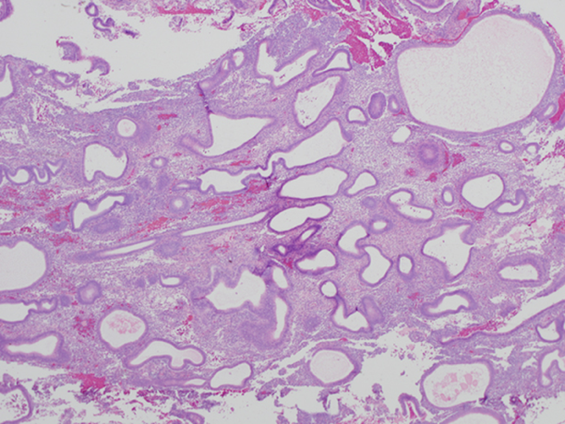
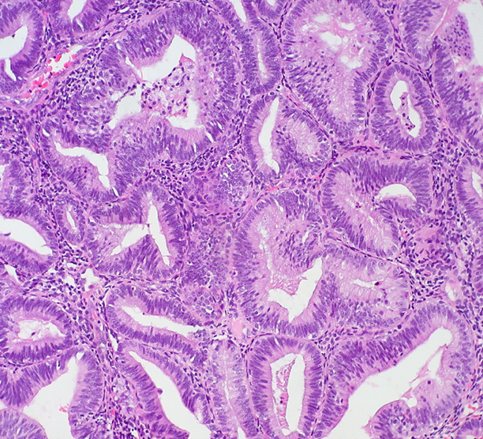
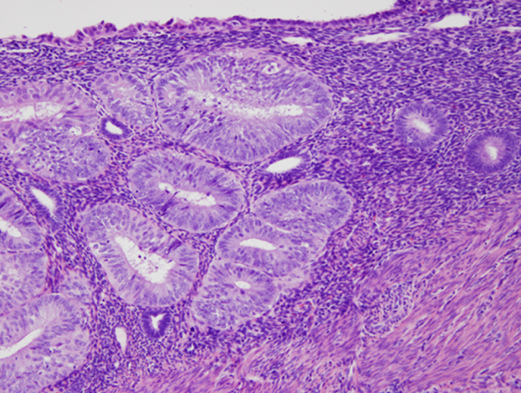
Endometrial hyperplasia
A
B
Classifications
Simple hyperplasia
Without atypia
With atypia
Complex hyperplasia
Without atypia
With atypia
Atypia: loss of polarity, vesicular nuclei, prominent nucleoli, rounded cells.
Based on the presence or absence of atypia of the cells lining the endometrial glands.
Based on the architecture of the endometrial glands, i.e. depending on the degree of glandular complexity and crowding it can be:
With Atypia
Simple
Without Atypia
Complex
Simple hyperplasia without atypia
Cystic hyperplasia: glands are variably shaped and sized, and are cystically dilated, with abundant stroma.
Mild increase in gland to stroma ratio.
May progress to cystic atrophy.
Rarely progress to adenocarcinoma (1% may develop).
Simple hyperplasia with atypia
Uncommon.
Architecture of simple hyperplasia, but there is atypia within the glandular epithelial cells. (less crowding then complex)
10% progress to carcinoma.
Swiss cheese appearance
Complex hyperplasia without atypia
Complex, crowded glands with papillary infoldings.
Crowded glands: the glandular structures are close to each other “back-to-back” with little stroma in between.
However, epithelial cells are normal without atypia.
3% progress to adenocarcinoma.
Complex hyperplasia with atypia
Complex proliferation “back-to-back” with atypia.
Nuclei are:
Enlarged and rounded.
Show loss of polarity¹.
Have irregular nuclear membranes.
30% of women with this diagnosis have a carcinoma
somewhere else in the uterus.
30% progress to adenocarcinoma.
1- Do not grow in a uniform direction.

Slide 4
Endometrial hyperplasia
New classification
Endometrial hyperplasia is placed into two categories based on presence of atypia:
Non atypical endometrial hyperplasia, which carries a low risk ( 1% - 3%) for progression to endometrial carcinoma.
Atypical endometrial hyperplasia /Endometrioid intraepithelial neoplasia (EIN), associated with a much higher risk (20%–50%).
The importance of this classification is that atypia correlates with presence endometrial carcinoma.
When atypia is discovered it must be evaluated for the presence of cancer, and usually indicates a hysterectomy in patients no longer desiring fertility. In younger patients high dose progestin may be used to preserve the uterus.
This space is designated for the sole purpose of having more slides and making you feel the lecture is harder♡
Here is a cookie to make you feel better

Slide 5
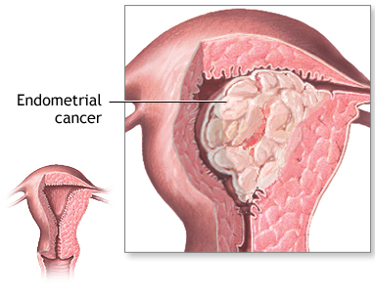
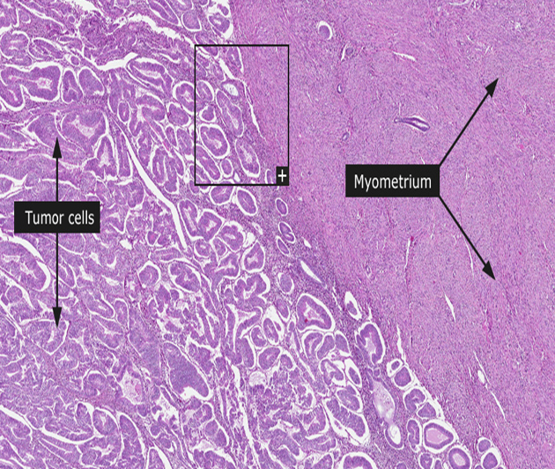
Endometrial carcinoma
Introduction
The fifth most common cancer in women.
Usually arise is postmenopausal women causing bleeding.
Early detection and cures are possible.
Classified into:
Type 1: endometrioid carcinoma.
Type 2: serous carcinoma.
Type 1: Endometrioid carcinoma
Account for 80% of endometrial cancer (the most common type).
It is sequential to endometrial hyperplasia, however may occur independently, especially in older patients.
It is associated with estrogen excess.
Risk factors
Obesity, western diet, hypertension, DM.
Nulliparity.
Hyperestrinism.
Chronic anovulation (the ovaries are not releasing an oocyte).
Estrogen therapy.
Late menopause.
Tamoxifen therapy (in breast cancer).
High socioeconomic status.
Genetics
Women with germline mutation in in PTEN (cowden syndrome).
Also germline mutation in DNA mismatch repair gene (Lynch syndrome).
TP53 are uncommon, and are found in later stages of the development of this tumor. Seen in half of poorly differentiated endometrioid carcinoma.
Well differentiated
No invasion
Invasion of myometrium
Moderately differentiated
Poorly differentiated

Slide 6
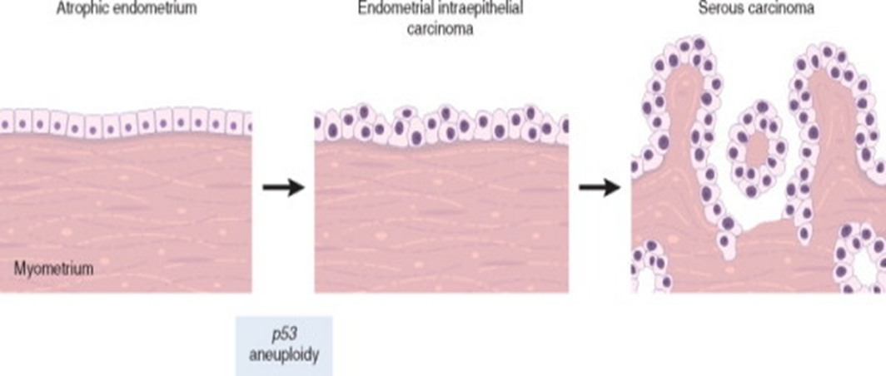
Endometrial carcinoma
Type 2: Serous Carcinoma
Could be:
Serous papillary (papillary is more common).
Clear cell carcinoma.
Serous carcinoma
Account for 15% of endometrial cancer.
Occur later in life, about one decade later than type 1 carcinoma, in older women with endometrial atrophy.
Not associated with hyperestrinism or preexisting hyperplasia.
Genetics
Mutation in p53 is present in at least 90% of serous endometrial carcinoma.
It is preceded by Serous Endometrial Intraepithelial Carcinoma SEIC (similar to carcinoma in situ).
TP53 mutation is often detected in SEIC, giving the mutation a role in the development of the disease.
Clinical features
Most patients are between 50 and 60 years.
Patients tend to be obese and nulliparous.
Menorrhagia and leucorrhea.
Elderly women present with postmenopausal bleeding.
Diagnosis confirmed by biopsy or curettage and histological examination.
Morphology
Gross:
Tumors are large, bulky, and poorly differentiated which invade into the myometrium.
May appear normal or exophytic¹ or infiltrative.
1- Grow beyond the surface.

Slide 7
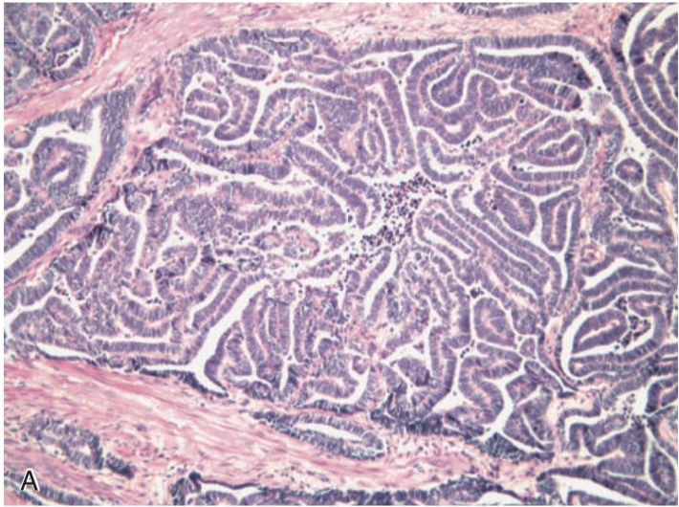
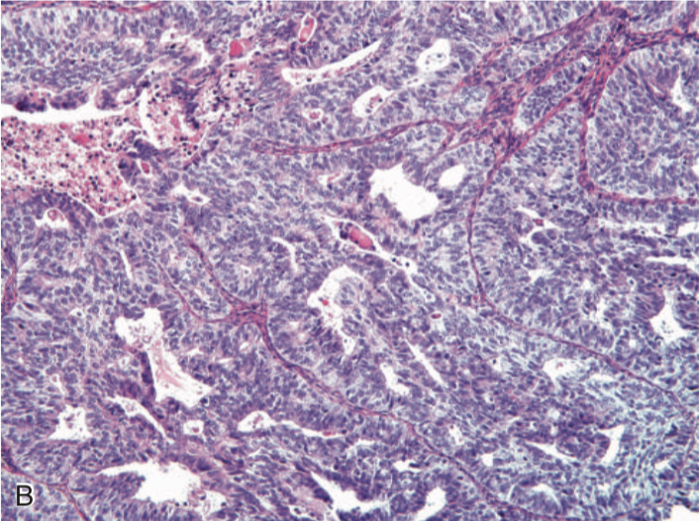
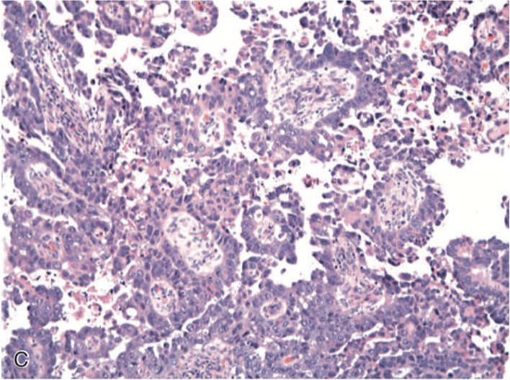
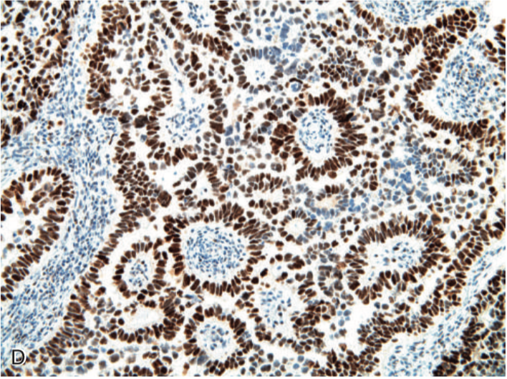
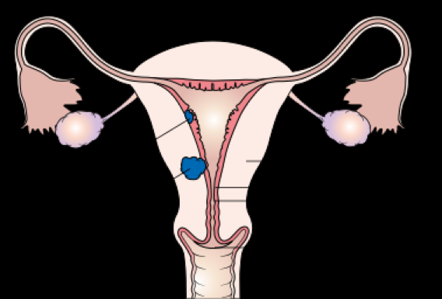
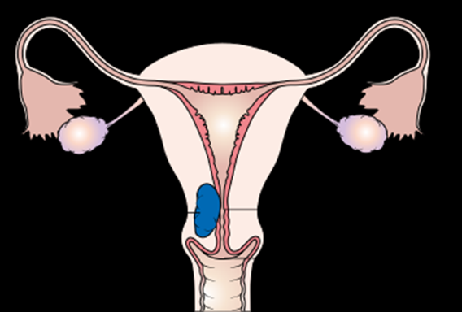
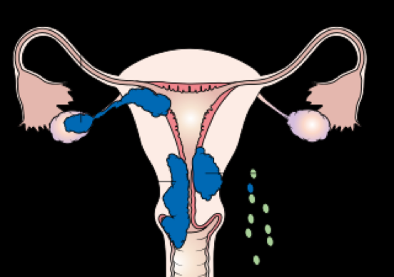
Endometrial carcinoma
Histopathology:
Both type I and type II are adenocarcinomas.
Tumor originate in the endometrium, and can infiltrate myometrium, and enter vascular and lymphatic spaces.
Serous carcinoma has a much greater cytological atypia and poorly differentiated; therefore more aggressive.
Endometrioid: infiltrating myometrium, growing in glandular pattern (stage 1)
Endometrioid: stage 3; solid growth pattern
Serous carcinoma: papilla formation and marked cytological atypia
Immunohistochemistry show accumulation of P53
Prognosis
Tumor spread:
Direct myometrial invasion followed by extension to periuterine structures.
Lymphatic: to lymph nodes
By blood: in late stages to lung liver, and bone.
Prognosis depend on:
Histological type.
Stage.
Grade (extent of spread).
Endometrioid (type 1) has better prognosis than other types.
Serous (type 2) has poorer prognosis.
However, stage is the major determinant factor of survival.
 | Type 1 | Type 2
Histological type | Endometrioid adenocarcinoma | Serous or clear cell carcinoma
Age | Premenopausal & perimenopausal (50-60 yrs) | Post menopausal (~ 70 yrs)
Unopposed estrogen | Present | Absent
Precursor lesion | Hyperplasia with atypia | Endometrial intraepithelial carcinoma
Growth | Slow growing | Rapidly progressing
Grade | Low | High
Myometrial invasion | Usually superficial | Usually deep
Prognosis | Favorable | Poor
Genetic alteration | PTEN, microsatellite instability | P53 mutations

Slide 8
Leiomyoma
Introduction
Benign tumors that arise from smooth muscle cells of the myometrium.
Clinically referred to as fibroids, due of their firmness.
Most common benign tumor in females, affecting 30-50% of female at the reproductive age. More common in black women.
Stimulated by estrogen:
They increase in size during pregnancy or taking contraceptives.
Decrease In size after menopause.
Genetics
40% have chromosome abnormalities
Rearrangement of chromosomes 6 & 12 which are also found in other benign neoplasms like lipomas and endometrial polyps.
Mutation in the MED12 gene has been found in 70% of leiomyomas, which encodes component of the RNA polymerase transcription complex.
Clinical features
Asymptomatic, discovered incidentally on routine pelvic examination.
Menorrhagia (Most common) with or without metrorrhagia which can cause anemia.
Sometimes pelvic pain.
Urinary frequency (if the fibroid is compressing the urinary bladder).
May cause infertility by interfering with implantation
In pregnant women:
It may cause abortion.
Obstructed labor.
Postpartum hemorrhage.
Rarely progress to sarcoma, if ever.

Slide 9
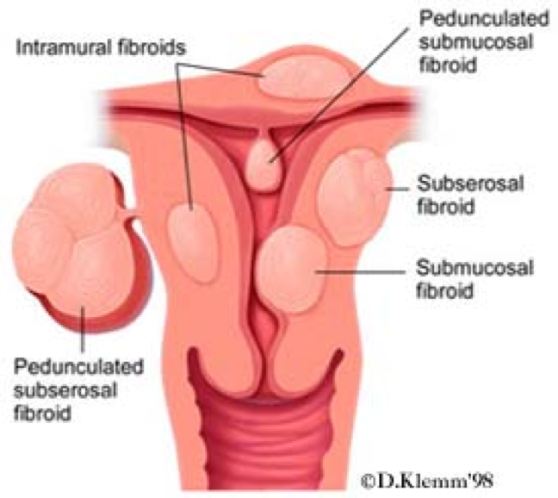
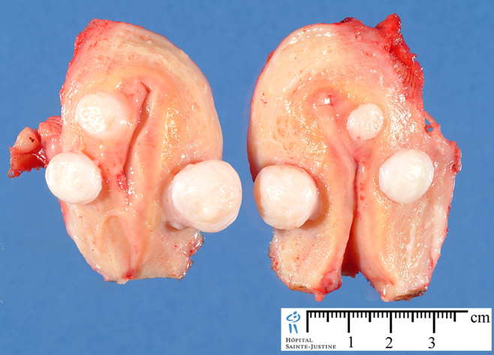
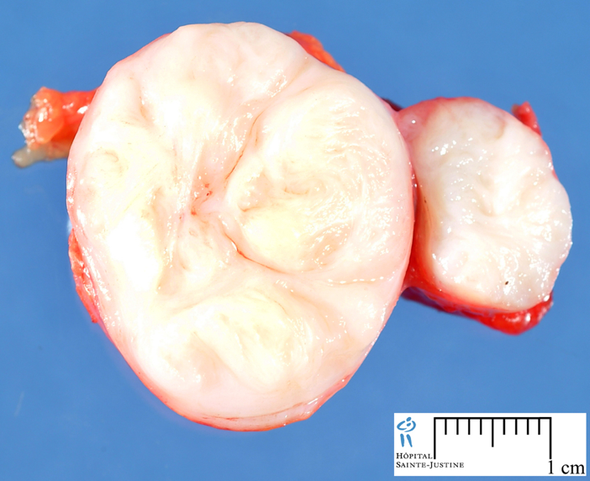
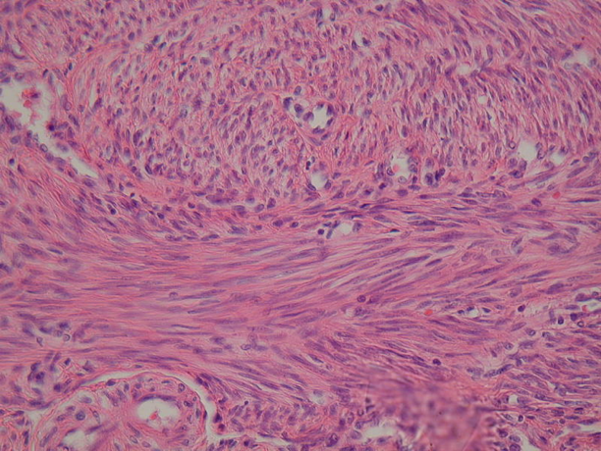
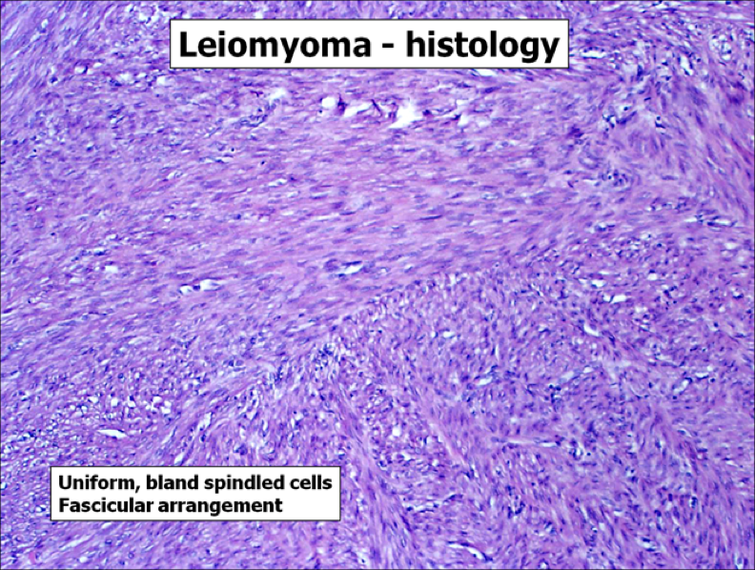
Leiomyoma
Morphology
Gross:
Well circumscribed, firm, spherical mass.
Cut surface: whorled, tan-white
Could be single but more likely multiple scattered within uterus, with ranging size.
Locations:
Intramural: within myometrium (most common)
Submucosal: directly beneath endometrium
Subserosal: beneath serosa; may become attached to surrounding organs or are pedunculated and attached to the serosa
Parasitic leiomyoma: A pedunculated subserosal fibroid that undergoes torsion, detaches from the uterus, and sustains its growth through neovascularization from adjacent tissues.
Histopathology:
Interlacing bundles of smooth muscle cells with
collagenous stroma.
Individual cells are uniform in shape and size.
Characteristic oval to elongated nucleus.
Mitotic figures are scarce.
Leiomyosarcoma
Introduction
Rare, malignant tumor that almost always arises de novo¹ from the mesenchymal cells of the myometrium.
Unlike leiomyomas. Leiomyosarcomas are solitary and arise in postmenopausal women.
Poor prognosis:
Recurrence is common after surgery .
may metastasize, typically to the lung.
Morphology
Diagnostic features:
Tumor necrosis.
Cytological atypia.
Mitotic activity.
Because increased mitotic activity may be found in benign smooth muscle tumors; all three features must be present to make a diagnosis or malignancy.
1- starting from the beginning - no precursor.

Slide 10
Summary
Endometrial hyperplasia
Intro | Proliferation of endometrial glands, may progress to carcinoma Clinical features: menorrhagia, in young regress normally, in postmenopausal women.
Causes | Persistent prolonged estrogen stimulation: - anovulatory cycle - excessive production of estrogen: polycystic ovarian syndrome, granulosa cell tumor - Exogenous intake of estrogen steroids
Classification | Based on architecture of glands: - simple: abundant stroma, less crowded - complex: crowded glands, “back-to-back”, papillary infolding Based on Presence of Atypia: With Atypia: show loss of polarity, vesicular nuclei, prominent nucleoli, rounded cells. Without Atypia: does not show features of Atypia Atypia has the strongest correlation with development of carcinoma.
Uterine Tumors
Endometrial carcinoma | Malignancy of endometrium, usually in postmenopausal women 1- Endometrioid: it is sequential to endometrial hyperplasia, associated with estrogen excess. - genetic: PTEN mutation Better prognosis 2- Serous: occurs later than type one, associated with p53 mutation, - it is preceded by Serous endometrial intraepithelial carcinoma. Poorer prognosis
Leiomyoma | Benign tumors of smooth muscle cells, referred to as fibroids. Stimulated by estrogen: - It increase in size during pregnancy or taking contraceptives - Decrease In size after menopause Mutation in MED12 gene. Or chromosome 6 & 12 rearrangement Clinical features: Asymptomatic or menorrhagia, urinary frequency, infertility, rarely progress to sarcoma.
Leiomyosarcoma | - Malignant tumor of smooth muscle cells - Solitary and arise in postmenopausal women. - poor prognosis: recurrence & metastasis is common. Morphology: necrosis, Atypia, Mitotic activity.

Slide 11
Quiz
1) A 42-year-old woman has had menometrorrhagia for the past 2 months. She has no history of prior irregular menstrual bleeding, and she has not yet reached menopause. On physical examination, there are no vaginal or cervical lesions, and the uterus appears normal in size, but there is a right adnexal mass. An abdominal ultrasound scan shows the presence of a 7-cm solid right adnexal mass. Endometrial biopsy shows hyperplastic endometrium, but no cellular atypia. What is the most likely lesion that underlies her menstrual abnormalities?
A- Corpus luteum cyst
B- Endometrioma
C- Granulosa-theca cell tumor
D- Mature cystic teratoma
2) A 62-year-old childless woman noticed a blood-tinged vaginal discharge twice during the past month. Her last menstrual period was 10 years ago. Bimanual pelvic examination shows that the uterus is normal in size, with no palpable adnexal masses. There are no cervical erosions or masses. Her body mass index is 33. Her medical history indicates that for the past 30 years she has had hypertension and type 2 diabetes mellitus. An endometrial biopsy specimen is most likely to show which of the following?
A- Adenocarcinoma
B- Choriocarcinoma
C- Leiomyosarcoma
D- Malignant müllerian mixed tumor
3) A study of patients with postmenopausal uterine bleeding reveals that some of them have malignant neoplasms that arise from prior atypical hyperplastic lesions. The peak incidence is between 55 and 65 years of age in women who have obesity, hypertension, and/or diabetes mellitus. Molecular analysis reveals mutations of the PTEN tumor suppressor gene in most of them. Their malignancies tend to remain localized for years before spreading to local lymphatics. Which of the following neoplasms is most likely to have these characteristics?
A- Clear cell carcinoma
B- Endometrioid carcinoma
C- Leiomyosarcoma
D- Müllerian mixed tumor
E- Serous carcinoma
F- Stromal sarcoma
4) A 62-year-old obese, nulliparous woman has an episode of vaginal bleeding, which produces only 5 mL of blood. On pelvic examination, there is no enlargement of the uterus, and the cervix appears normal. A Pap smear shows cells consistent with adenocarcinoma. Which of the following preexisting conditions is most likely to have contributed to the development of this malignancy?
A- Adenomyosis
B- Chronic endometritis
C- Endometrial hyperplasia
D- Use of oral contraceptives
5) A 53-year-old woman whose last menstrual period was 3 years ago notes vaginal bleeding for a week. On physical examination, her uterus is markedly enlarged, but there are no adnexal masses. CT imaging reveals an irregular 8-cm mass in the body of the uterus. A total abdominal hysterectomy is performed, and microscopic examination of the soft, hemorrhagic mass shows spindle cells with atypia and numerous mitoses. There is coagulative necrosis of tumor cells. Which of the following is the most likely cell of origin for this mass?
A- Cytotrophoblastic cells
B- Endometrial glandular cells
C- Germ cells
D- Smooth muscle cells
E- Squamous epithelial cells
6) A 69-year-old woman has passed blood per vagina for a month. On pelvic examination no abnormal findings are noted. Which of the following diagnostic procedures should be performed next?
A- Endometrial biopsy
B- Magnetic resonance imaging
C- Microbiologic culture
D- Pap smear
E- Pregnancy test
7) Which of the following is the most common benign tumor in females?
A- Leiomyoma.
B- Lipoma.
C- Thecoma.
D- Brenner tumor.
1- C
2- A
3- B
4- C
5- D
6- A
7- A

Slide 12
Team Subleader
Alhanouf Alhaluli
Done by the brilliant
Who nothing rhymes with his name
Note Taker
Taibah Alzaid

