Slide 1
Editing file
Pathoma Video
Ovarian Cysts and Tumors
Objectives
The pathology of the major types of ovarian cysts: follicular and luteal.
The classification and pathology of common ovarian tumors including surface epithelial, germ cell, stromal and metastatic neoplasms.

Slide 2
Lecture content
1- Non-neoplastic ovarian cysts
Follicular cyst
Corpus luteum cyst
Theca lutein cyst or hyperreactio luteinalis
Chocolate⁴ cyst or Endometriotic cyst
3- Germ cell tumor “Oocyte”
2- Epithelial tumors
Teratoma
Dysgerminoma
Yolk sac tumor
Embryonal Carcinoma
Choriocarcinoma
Serous
Mucinous
Endometrioid
brunner
4- Sex cord- Stromal cells
Thecoma & fibroma
Granulosa
sertoli-leydig
5-metastasis

Slide 3
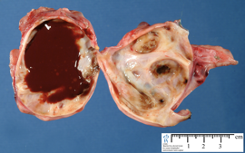
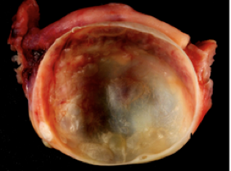
Ovarian Cysts
Causes
Non neoplastic functional cysts.
Inflammation of ovaries: rare. It is associated with salpingitis of fallopian tubes (salpingo-oophoritis: inflammation of a fallopian tube and an ovary)
Endometriosis: the presence of endometrial tissue outside the endomyometrium.
Ovarian Tumors (neoplasms).
Non-Neoplastic Cysts
More common than neoplastic and usually cause no problems.
Rarely can rupture and cause acute pain and intra abdominal hemorrhage.
Follicular cyst | Arise from the ovarian follicles due to distension of unruptured Graafian follicle.
Corpus luteum cyst | Results from hemorrhage into a persistent mature corpus luteum.
Theca lutein cyst or hyperreactio luteinalis | - Thin walled cysts lined by luteinized theca cells. - Associated with high levels of circulating gonadotropins¹ (e.g. pregnancy, hydatidiform mole², etc).
Chocolate⁴ cyst or Endometriotic cyst | - Ovary is the most frequent site of endometriosis. - Chocolate cyst is a blood filled (thick brown fluid) cyst of the ovary due to endometriosis with hemorrhage.
Polycystic ovarian syndrome (females slides)
Formerly called Stein-Leventhal syndrome.
Complex endocrine disorder characterized by:
Hyperandrogenism, menstrual abnormalities, polycystic ovaries, chronic anovulation, and decreased fertility.
Diagnosed after menarche³ in teenage girls or young adults who present
with oligomenorrhea, hirsutism, infertility, and sometimes with obesity.
Morphology
Gross | Microscopic⁴
- Ovaries are usually twice the normal size. - Gray white with a smooth outer cortex. - Studded with subcortical cysts 0.5 to 1.5 cm. | - Thickened, fibrotic ovarian capsule. - Innumerable cystic follicles lined by granulosa cells. - Hyperplastic luteinized theca interna. - Conspicuous absence of corpora lutea in the ovary.
1. Especially progesterone since it causes luteinization.
3. Growth of an abnormal fertilized egg or an overgrowth of tissue from the placenta causes uterus enlargement.
4. The first occurrence of menstruation.
5. PCOS is not diagnosed by histology.

Slide 4
Ovarian Tumors
Introduction
Neoplasms are the most important medical problems in ovaries.
One of the leading cause of cancer death in women.
Death from ovarian cancers is more common than that of cervix and uterus together:
because ovarian tumors grow silently and are usually diagnosed late, after the occurrence of metastasis.
Classification
Secondary metastatic tumors (5%).
Primary tumors: based on the origin of the tumor cell:
1
Surface epithelial ovarian tumors (65%)
2
Germ cell tumors (15%)
3
Sex cord stromal tumors (10%)
Surface epithelial tumors
Serous tumors:
- Benign (cystadenoma). - Borderline tumors (serous borderline tumor). - Malignant (serous adenocarcinoma).
Mucinous tumors:
- Benign (cystadenoma). - Borderline tumors (mucinous borderline tumor). - Malignant (mucinous adenocarcinoma).
Endometrioid tumors:
- Benign (cystadenoma). - Borderline tumors (endometrioid borderline tumor). - Malignant (endometrioid adenocarcinoma).
Clear cell tumors:
- Benign. - Borderline tumors. - Malignant (clear cell adenocarcinoma).
Transitional cell tumors:
- Brenner tumor. - Brenner tumor of borderline malignancy. - Malignant Brenner tumor. - Transitional cell carcinoma (non-Brenner type).
Others
Sex cord stromal tumors
Almost always Benign: Fibromas/ Fibrothecomas /Thecomas.
With Malignant Potential: Granulosa cell tumors. Sertoli-Leydig cell tumors.
Others
Germ cell tumors
Teratoma:
- Immature (malignant). - Mature (benign). Solid Cystic (dermoid cyst) - Monodermal (e.g., struma ovarii, carcinoid).
Dysgerminoma
Yolk sac tumor (endodermal sinus tumor)
Choriocarcinoma
Embryonal carcinoma
Mixed germ cell tumors

Slide 5
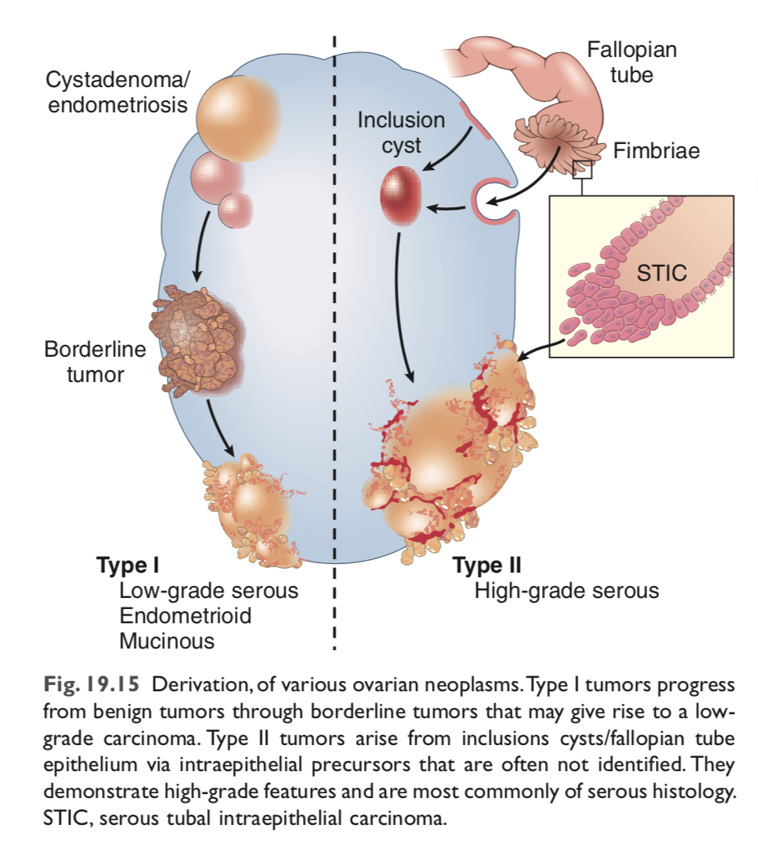
Surface Epithelial Ovarian Tumors
Introduction
Neoplasms derived from the cells on the surface of the ovary.
Account for majority of all primary ovarian tumors:
65–70% of overall tumors.
90% of primary ovarian cancer.
Occurs in adults >20.
Pathogenesis (females slides)
Not all tumors under this category actually arise from the epithelium of the ovaries. recently, it was discovered that some arise from fallopian tubes.
Type I:
Tumor progress from benign cortical epithelial cysts through
borderline tumor. Progress slowly to low grade carcinoma.
E.g: Low grade serous associated with KRAS¹ gene mutation.
Type II:
Develop rapidly in the fimbriated end of the fallopian tube
via serous tubal intraepithelial carcinoma (STIC), rather than
ovarian coelomic epithelium.
E.g: High grade serous 95% of cases present with TP53 mutations.
The epithelium lining the cortical cysts may be derived from displaced ovarian surface epithelium or the fallopian tube. These can become metaplastic or neoplastic.
Risk factors (females slides)
Nulliparity.
5% to 10% of ovarian cancers are familial and associated with germline mutations in certain tumor suppressor genes:
BRCA1 → 30% increase risk in carriers.
BRCA2 → lower risk.
Both are associated with hereditary breast cancer.
Other frequently mutated genes include the tumor suppressors NF1 and RB.
Protective factor: prolonged use of oral contraceptive.
1. a member of the RAS gene family, encoding signaling proteins.
2. Requires close follow up.

Slide 6
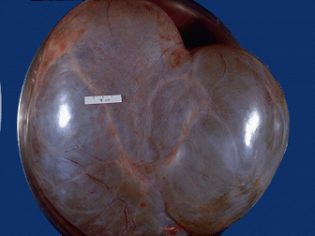
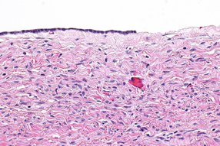
Surface Epithelial Ovarian Tumors
Further divisions:
Each subtype of Epithelial tumor is further divided based on malignancy:
Benign: they do not spread and invade other tissues.
Malignant: are carcinomas and have potential to metastasize beyond the ovary.
Borderline/intermediate: this is a gray zone²
They are ‘semi-malignant’ with better prognosis.
These tumors may seed or implant into the peritoneum.
These appear to be low grade cancers with limited invasive potential.
Serous tumors
The most common of the ovarian epithelial tumors and most common overall, with greatest fraction of malignancy.
About 60% are benign, 15% are borderline, and 25% are malignant.
Benign lesions → seen between 30 and 40 years of age.
Malignant serous tumors → seen between 45 and 65 years of age.
Morphology
Large, spherical to ovoid, cystic structures up to 30 - 40 cm.
Cut section: Small cysts have single cavity, while
Large cysts → divided by multiple septa into multiloculated masses.
The cystic spaces lined by serous cells and contain thin, clear yellow fluid.
Serous Cystadenoma
Gross:
25% are bilateral.
Smooth and glistening serosal covering.
Large thin walled unilocular cyst.
Microscopic:
Single layer of columnar epithelial cells lining the cyst(s).
The cells often are ciliated.
Psammoma bodies (concentrically laminated calcified concretions).
2. Requires close follow up.

Slide 7
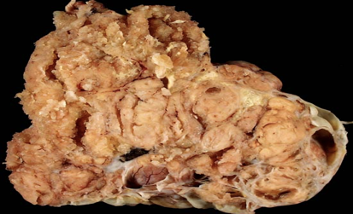
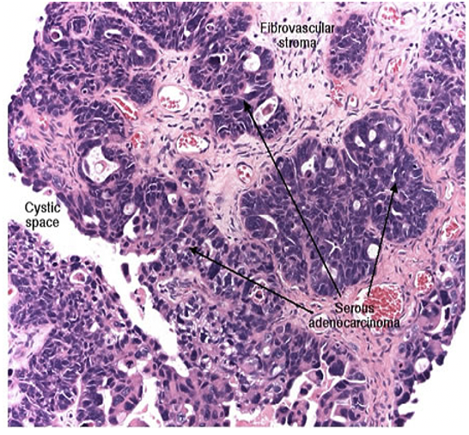
Surface Epithelial Ovarian Tumors
Borderline serous tumor
Gross:
Multiple papillary excrescences (grape-like clusters),
protruding the lumen.
Microscopic:
Cytologic atypia.
No stromal invasion.
Serous cystadenocarcinoma
The commonest malignant ovarian tumor. ⅓ of all ovarian cancer.
Present with ascites due to abdominal metastases.
Morphology:
Gross: Nodular irregularities invading serosa.
Cut section: Papillary projections: Protruding into the cystic cavities.
Microscopic:
Atypical cells with necrosis and hemorrhage.
Multilayered and complex papillary formations: nests or
sheets of malignant cells invade the ovarian stroma.
Treatment: surgery, chemotherapy and radiotherapy.
Poor prognosis.
Partly cystic and partly solid
Prognosis of Serous Tumors (females slides)
Malignant serous tumors spread to:
The peritoneal cavity.
Regional lymph nodes, including periaortic lymph nodes.
Distant lymphatic and hematogenous metastases are infrequent.
High-grade serous carcinoma has poor prognosis, even after surgery and chemotherapy, and depends on the stage of the disease at diagnosis.

Slide 8
Surface Epithelial Ovarian Tumors
Mucinous Tumors
The tumor cells are:
Mucin-producing cells: either endocervical or intestinal type cells.
Can be very large.
Cystic and multilocular and filled with thick sticky, viscous mucoid fluid.
25% of all ovarian neoplasms and less likely to be malignant.
80% are benign, 10% are borderline, 10% malignant.
Morphology (females slides)
Mucinous cystadenoma:
Gross (A): multicystic cut section with glistening mucoid material.
Micro (B): cyst is lined by mucin producing columnar epithelium.
Malignant tumors:
Solid areas of growth, piling up stratification of lining cells.
Cytologic atypia and stromal invasion.
To differentiate primary from metastatic:
Primary Mucinous Tumors → less likely bilateral.
Mucinous tumors metastasized from mucinous adenocarcinoma of gastrointestinal tract¹ → more often bilateral masses.
A
B
Endometrioid Tumors
Transitional cell
(Brenner Tumor)
- Tubular gland that resemble the endometrium.
- 10% - 20% of all ovarian tumors.
- Mostly malignant (carcinoma)
- Some are accompanied by an endometrial carcinoma in the uterus and/or endometriosis of ovaries.
- Cells are transitional-type epithelium resembling that of the urinary tract.
- Most are benign.
1. Called “Kurkenberg tumor”.

Slide 9
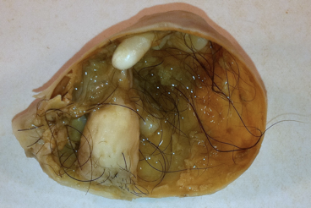
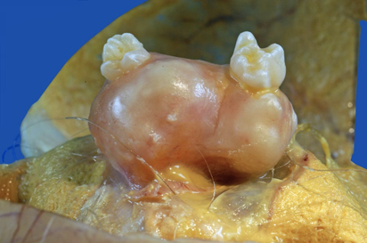
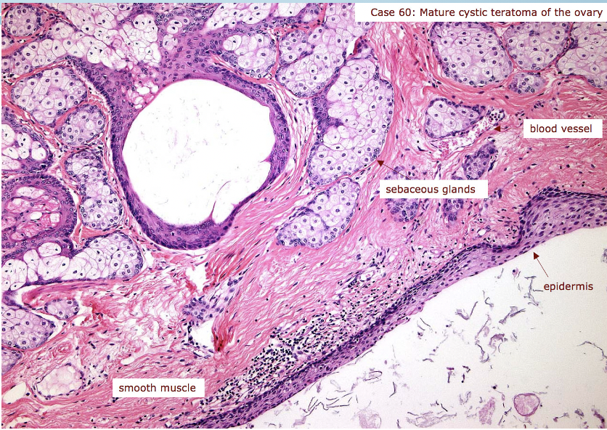
Germ Cell Tumors
Are Tumors derived from the egg producing cell of the ovaries.
All Ovarian Germ cell tumors are malignant except for mature teratomas.
Teratoma
15% to 20% of ovarian tumors.
Arise in the first 2 decades of life 0-25 years, younger age increases the risk of malignancy.
90% are benign (mature cystic teratomas), rarely malignant (immature).
Benign mature cystic teratoma
Benign neoplasm of mature tissues of all 3 germ cell layers: ectoderm, endoderm and mesoderm.
Contains Dermoid cysts: cysts lined by epidermis with adnexal appendages and filled with sebaceous material, hair and teeth.
Most common ovarian germ cell tumor, and ovarian teratoma.
Discovered in young women (reproductive years) as:
Ovarian masses.
Or found incidentally on abdominal radiographs or scans due to the foci of calcification produced by toothlike structures within the tumor.
Morphology
90% are unilateral.
Cut section: Filled with sebaceous secretion and matted hair that, when removed, reveal a hair-bearing epidermal lining .
Nodular projection from which teeth protrude.
Foci of bone and cartilage.
Nests of bronchial or gastrointestinal epithelium, or other tissues.
Complications
10-15% of cases produce infertility and prone to ovarian torsion¹.
1% of cases undergo malignant transformation to squamous cell carcinoma.
Rupture or infection.
1. Ovarian twist around the ligaments.

Slide 10
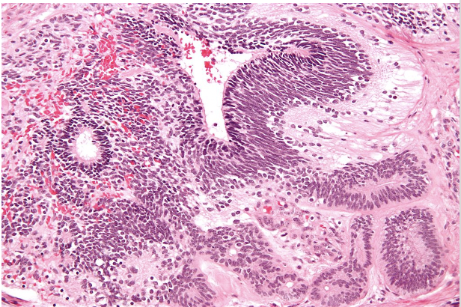
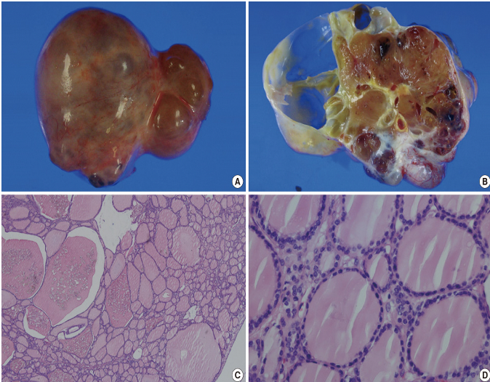
Germ Cell Tumors
Immature malignant teratoma
Found early in life, clinical detection at 18 years.
The prognosis depends on grade and stage.
Morphology
Unilateral, bulky and appear solid and necrotic on cut section.
Microscopic:
Similar to mature teratoma but in addition they contain
immature or embryonic tissues especially immature neuroepithelial cells.
Specialized monodermal teratoma
A rare teratoma composed of one tissue element.
The most common example is struma ovarii. which is composed entirely of mature thyroid tissue that may produce hyperthyroidism.
The thyroid tissue can sometimes become malignant.
Other specialized teratomas include ovarian carcinoid, can
produces carcinoid syndrome.
Gross: Small, solid, unilateral brown ovarian masses.
Other germ cell tumors (GST)
Dysgerminoma | Endodermal sinus tumor
- Uncommon & malignant. - Occur between 10 to 30 years of age. - Placental-like alkaline phosphatase (PLAP) positive. Morphology: - Gross: unilateral and solid mass. - Microscopically: look like its counterpart in testis (Seminoma) and brain (germinoma). - Highly sensitive to radiation therapy. | - known as yolk sac tumor. - Under 30 years of age. - Can be pure or a component of a mixed germ cell tumor. - Associated with elevated serum αlpha-fetoprotein and αlpha-1-antitrypsin. - +ve αlpha-fetoprotein immunostain. - Histopathology: Schiller-Duval bodies. - Radioresistant but responds well to chemotherapy.
Embryonal carcinoma | Choriocarcinoma
- Rare, aggressive, highly malignant. - 2nd and 3rd decade (children and young adults). - Similar to that seen in testis, usually a component of a mixed germ cell tumor (GCT). - CD30 immunostain positive. - Morphology: Unilateral, solid, hemorrhagic and necrotic. - Radioresistant but responds to chemotherapy. | - Rare, aggressive, highly malignant, metastasizes to the lungs, liver, bone etc. - Similar to that seen in testis, usually a component of a mixed germ cell tumor (GCT). - Elevated serum hCG levels, +ve HCG immunostain. - Morphology: unilateral, solid, hemorrhagic tumor, composed of malignant cytotrophoblast and syncytiotrophoblast. - Radioresistant AND chemoresistant.

Slide 11
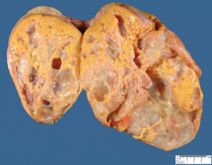
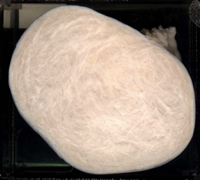
Males slides :(
Sex Cord-Stromal tumors
Thecoma and Fibroma
Occur at any age.
Benign and unilateral.
They can be pure fibroma, thecoma or mixture of both (fibrothecoma).
Thecoma produce estrogen, while Fibromas do not except when mixed with thecomas.
About 40% cases are associated with ascites and hydrothorax and this combination is called as Meig’s Syndrome.
Morphology:
Solid tumors.
Vary in color from white to yellow.
Fibromas are whiter, harder with whorled cut surface.
Granulosa Cell Tumor
Unilateral, solid and cystic .
5 to 25% show malignant behavior.
Produce estrogen.
Can be associated with endometrial hyperplasia and carcinoma .
The Adult form: is more common in postmenopausal women & present with abnormal vaginal bleeding.
The juvenile form: first three decades, can present with isosexual precocity.
Sertoli–Leydig cell tumor
Rare tumors of low malignant potential.
All ages.
Unilateral yellowish solid tumor.
Produces androgens and present with virilization in 1/3 of cases (oligomenorrhea, amenorrhea, loss of female secondary sex characteristics with hirsutism, clitoromegaly, deepening of voice).
Metastatic carcinoma in ovary
Accounts for approximately 5% of ovarian tumors.
Older ages, mostly Bilateral and sometimes very large.
Primary tumor from Gastrointestinal tract (Most common), breast and lung.
The Krukenberg tumor:
One of the most classic forms of metastatic carcinoma involving the ovaries.
Composed of signet ring cells in a fibrous background.
The most common sites of origin is the GIT (stomach, colon and appendix).

Slide 12
Summary
Non-neoplastic ovarian cysts
Follicular cysts | Due to distension of unruptured graafian follicle.
Corpus luteum cyst | Results from hemorrhage into a persistent mature corpus luteum.
Theca lutein cyst or hyperreactio luteinalis | - Thin walled cysts lined by luteinized theca cells. - Associated with high levels of circulating gonadotropins (e.g. pregnancy)
Chocolate cyst or Endometriotic cyst | - Due to endometriosis in the ovary with hemorrhage.
Polycystic ovarian syndrome | - Endocrine disorder characterized by: Hyperandrogenism, menstrual abnormalities, polycystic ovaries, chronic anovulation, and decreased fertility.
Neoplastic ovarian tumors
Surface Epithelial Ovarian Tumors (>20 years)
Serous tumors | - Most common epithelial ovarian tumor.
 | Low grade: From benign or borderline lesions with KRAS mutation. High grade: From fimbriated end of the fallopian tube via STIC + TP53 mutation.
 | 1- Cystadenoma: Single layer of columnar epithelial with psammoma bodies. | 2- Borderline: cytologic atypia. | 3- Cystadenocarcinoma: atypical cells with papillary formations.
Mucinous Tumors | - Mucin producing cells within a mucoid filled cysts. - Less likely bilateral.
Endometrioid Tumors | - Tubular gland that resemble the endometrium, Mostly malignant.
Transitional cell (Brenner Tumor) | - Benign transitional cell type.
Germ cell tumor (0-25 years)
Immature teratoma | - Most common ovarian germ cell tumor - Benign neoplasm of mature ectoderm, endoderm and mesoderm. - Complications: infertility and torsion.
Mature teratoma | - Malignant Immature elements or minimally differentiated cartilage, bone, muscle, nerve, or other tissues.
Specialized teratoma | - Struma ovarii. which is composed entirely of mature thyroid tissue.
Sex cord-stromal tumors: unilateral and occur in any age
Thecoma & fibroma | Benign: Thecoma: produce estrogen, unlike fobroma. Whem both are mixed called Meig’s Syndrome
Granulosa cell | 5-25% malignant; produce estrogen. Adult form: cause bleeding. Juvenile form: isosexual precocity associated with endometrial hyperplasia and carcinoma
Sertoli–Leydig cell tumor | Low malignant potential: produce androgen, therefor cause virilization effect

Slide 13
Quiz
1) A 35-year-old woman has had increasing abdominal enlargement for the past 6 months. She states that she feels like she is pregnant, but results of a pregnancy test are negative. On physical examination, there is abdominal distention with a fluid wave. A pelvic ultrasound scan shows bilateral cystic ovarian masses, 10 cm on the right and 7 cm on the left. The masses are surgically removed. On gross examination, the excised masses are unilocular cysts filled with clear fluid, and papillary projections extend into the central lumen of the cyst. Microscopic examination shows that the papillae are covered with atypical cuboidal cells that invade underlying stroma. Psammoma bodies are present. What is the most likely diagnosis?
A- Endometrioid tumor
B- Cystadenocarcinoma
C- Dysgerminoma
D- Metastatic cervical carcinoma
2) A 54-year-old female has had weight loss accompanied by abdominal enlargement for the past 6 months. She is concerned because there is a family history of ovarian carcinoma. An abdominal ultrasound reveals a 10-cm cystic mass involving the left adnexal region, with scattered 1-cm peritoneal nodules. peritoneal fluid cytology reveals the presence of malignant cells, consistent with a cystadenocarcinoma. Which of the following mutated genes is most likely a factor in the development of this neoplasm?
A- KRAS
B- BRCA1
C- TP53
D- NF1
3) A 25 year old female was discovered to have a tumor with high levels of alpha-fetoprotein in the serum. What is most likely the diagnosis?
A- Dysgerminoma/seminoma
B- Embryonal carcinoma
C- Endodermal sinus tumor
D- Fibrothecoma
4) 42 year old female was diagnosed with cystic and multilocular and filled with thick sticky viscous mucoid fluid tumor, which type of tumors is that?
A- Granulosa Cell Tumor.
B- Sertoli – Leydig cell tumor
C- Dysgerminoma
D- Mucinous tumor
5) Which of the following tumors is more common in postmenopausal women?
A- Granulosa Cell Tumor
B- Fibrothecoma
C- Serous cystadenoma
D- Brenner Tumor
6) Which of the following tumors progress from fimbriated end of the fallopian tube?
A- High grade serous tumor.
B- Low grade serous tumor.
C- Mucinous Tumors
D- The Krukenberg tumor.
7) A female patient presented to clinic with
symptoms of hyperthyroidism, clinical
examination reports no goiter. Ultrasound
revealed an ovarian mass. What’s most likely the
diagnosis؟
A- Mature cystic teratoma
B- Krukenberg tumor
C- Struma ovarii
D- Dysgerminoma
8) A 19-year-old woman has the sudden onset of abdominal pain. On physical examination, there is pelvic pain on palpation. Her stool is negative for occult blood. The serum and urine pregnancy tests are negative. Transvaginal ultrasound shows no intrauterine gestational sac, and uterus and adnexa are normal in size. Culdocentesis yields a small amount of blood-tinged fluid. Which of the following has most likely led to these findings?
A- Ectopic pregnancy
B- Endometriosis
C- Follicle cyst
D- Invasive mole
E- Pelvic inflammatory disease
1- B
2- B
3- C
4- D
5- A
6- A
7- C
8- C

Slide 14
Team Subleader
Alhanouf Alhaluli
Done by the brilliant
Note Takers
Mohammed Alhumud & Taibah Alzaid
The

