Slide 1
Editing file
Testicular Pathology
Objectives
Know the predisposing factors and pathology of Epididymitis and orchitis:
Non specific Epididymitis and orchitis.
Granulomatous/Autoimmune Orchitis.
Gonorrhea.
Tuberculosis.
Be familiar with the basic classification and pathology of testicular tumors:
Seminoma.
Yolk sac tumor.
Embryonal carcinoma.
Teratoma.
Choriocarcinoma.

Slide 2
Content
2- Testicular Tumors (GCT)
Seminoma
Spermatocytic tumor
Yolk sac tumor
Embryonal Carcinoma
Choriocarcinoma
Teratoma
1- Epididymitis & Orchitis
Non specific
Gonorrhea
Tuberculosis
Granulomatous

Slide 3
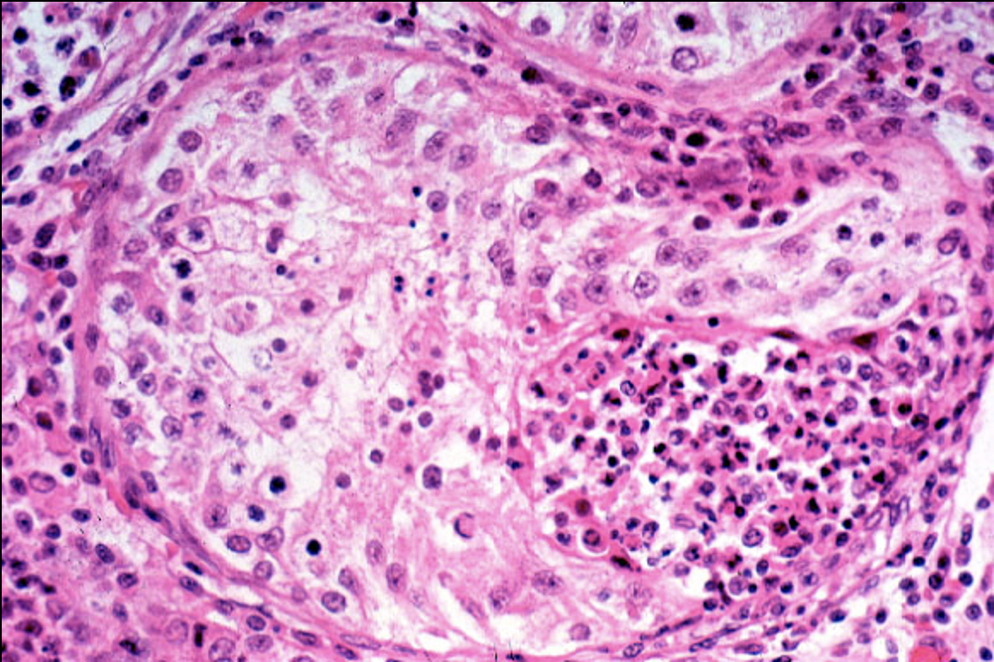
Epididymitis and orchitis
Introduction
Epididymitis: Inflammation of epididymis.
Orchitis: Inflammation of testis.
Inflammatory conditions are more common in the epididymis than in testis.
Some infections (e.g: Syphilis), may begin in testis with secondary involvement of epididymis.
Non specific¹ Epididymitis and Orchitis
Pathology
Commonly related to urinary tract infections (cystitis, urethritis, and genitoprostatitis).
Infections reach the epididymis/testis through:
Vas deferens.
The lymphatics of spermatic cord.
Causative organisms
Children: Uncommon, but usually associated with Gram -ve rods and a congenital genitourinary abnormality.
Men younger than 35: Chlamydia trachomatis and Neisseria gonorrhoeae.
Men older than 35: E.Coli and pseudomonas.
Microscopic findings
Vascular congestion, edema, and infiltration by neutrophils,
macrophages and lymphocytes.
Initially involves interstitium but later involves the seminiferous
tubules.
May progress to frank abscess, and heals by fibrosis²
Leydig cells are not usually destroyed.
1. Secondary involvement of the testis or epididymis.
2. Tissue will not be renewed and replaced.

Slide 4
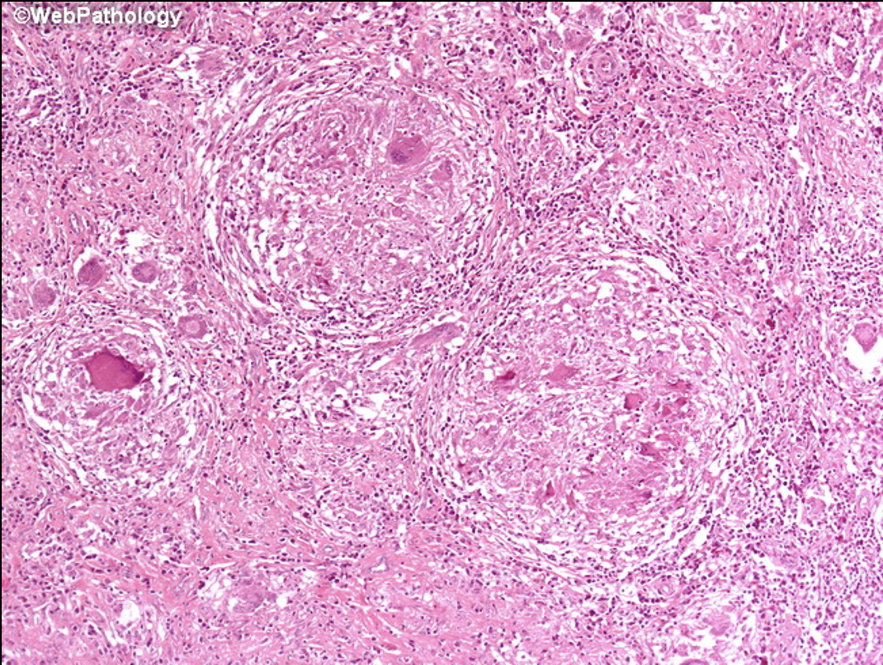
Epididymitis and orchitis
Specific Epididymitis and Orchitis
Gonorrhea
Gonococcal infection can spread from urethra to prostate, seminal vesicles then to epididymis/testis leading to suppurative orchitis and abscess.
Tuberculosis
It begins in epididymis and spreads to testis.
There is associated tuberculous prostatitis and seminal vesiculitis.
Microscopy: Caseating granulomas.
Granulomatous (autoimmune)
It affects middle-aged men.
Present with unilateral testicular mass (mimics testicular tumor).
May be in response to disintegrated sperm¹, post-infectious, due to trauma or sarcoidosis².
Microscopy: Granulomatous³ inflammation with plasma cells and lymphocytes.
1. Caused by injury to the seminiferous tubules → sperms are out → autoimmune reaction.
2. Autoimmune disease.
3. Culture to rule out TB, because they are similar microscopically.

Slide 5
Testicular tumors
Classification of testicular tumors
Germ cell tumors 95% of testicular tumor in adults, malignant. | Sex cord stromal tumors Uncommon and usually benign.
Tumors with one histologic pattern (Pure form): Seminomatous germ cell tumors: Seminoma. Spermatic seminoma. Nonseminomatous germ cell tumors: (malignant) Embryonal carcinoma. Yolk sac tumor. Choriocarcinoma. Teratoma: can be mature or immature (malignant transformation). Tumors with more than one histologic pattern (mixed form): mixed germ cell tumor. | Leydig cell tumor Sertoli cell tumor
Germ cell tumors
Testicular tumors are the most important cause of a firm, painless enlargement of testis.
Peak incidence is between the age of 15 and 34 years.
Highly aggressive cancers, capable of extensive dissemination.
Germ cell tumors may have:
Single component (Pure form).
Mixture (40% of cases) e.g. mixture of seminomatous and nonseminomatous components.
Most GCTs originate from precursor lesion called intratubular germ cell neoplasia (it’s like carcinoma-in-situ).
Risk factors
Cryptorchidism: 3 to 5 fold increase in the risk of cancer in both undescended testis contralateral descended testis.
About 10% cases of testicular cancer have cryptorchidism.
Testicular dysgenesis.
Genetic factors. (e.g. Klinefelter syndrome).
Strong family predisposition: brothers, fathers and sons are at risk.
If Contralateral testis has cancer.
Race: more common in whites than in blacks.

Slide 6
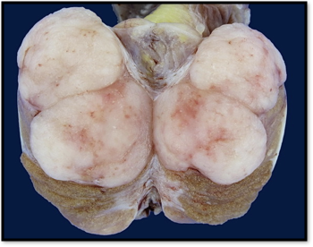
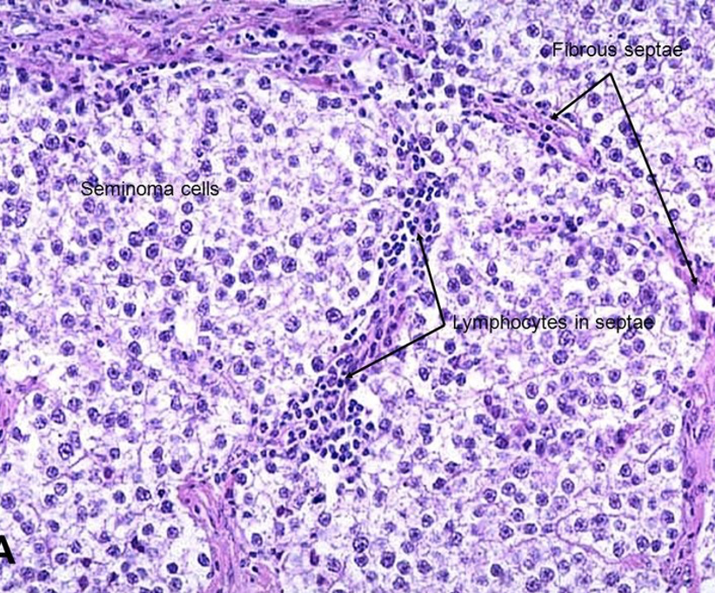
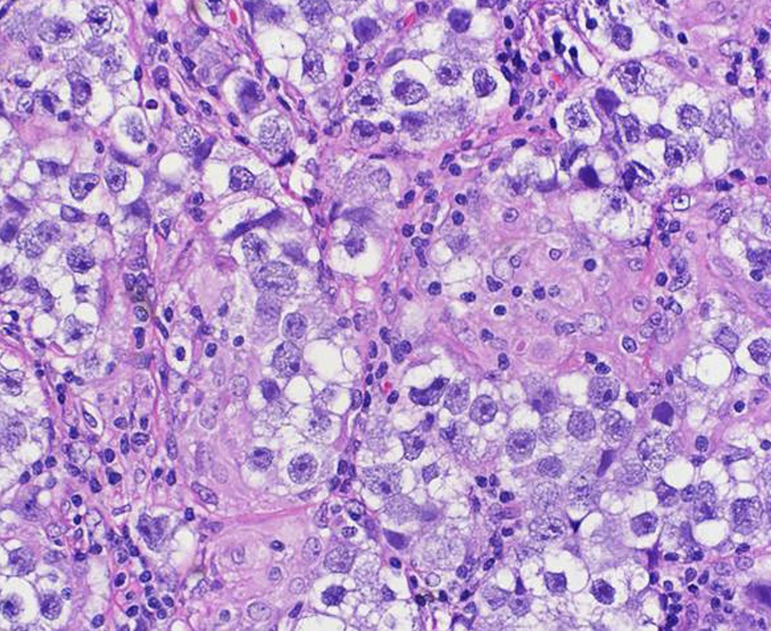
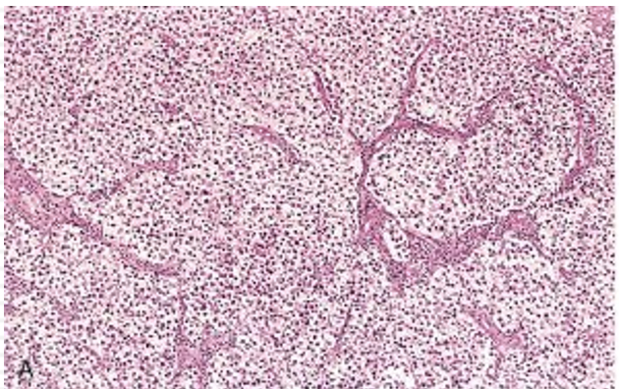
Germ cell tumors
Seminomatous germ cell tumors
1- Seminoma
Most common type of testicular tumors.
Most common type of germ cell tumors (50%).
Identical tumor occurs in the ovary (called dysgerminoma).
Secretes lactate dehydrogenase LDH.
Peak incidence is between 40–50 years of age. Almost never occur in infants.
Classic seminoma is highly sensitive to radiation therapy, overall 5-year survival is 90%-95%.
Morphology
Gross
Microscopic
Bulky masses, sometimes very large.
Homogenous, gray-white, lobulated cut surface.
Large tumors may contain foci of coagulative necrosis, usually without hemorrhage.
Sheets of uniform cells (undifferentiated¹ germ cells)
Divided into lobules by delicate fibrous septa containing lymphocytes.
Cells are large and round with large nucleus and prominent nucleoli.
Cytoplasm of tumor cell contains glycogen (Appears white and vacuolated).
Tumor cells are positive for stains: PLAP, OCT4, and c-kit (CD117).
2- Spermatocytic tumor
It was called previously spermatocytic seminoma.
Uncommon: 1-2 % of testicular GCTs
Men >65 years of age.
Prognosis
Slowly growing tumor that does not metastasize.
Not associated with intratubular germ cell neoplasia. (Precursor)
Prognosis is excellent.
Fried egg Seminoma appearance = prominent nuclei with clear cytoplasm.
1. Important feature to differentiate it from other germ cell tumors.

Slide 7
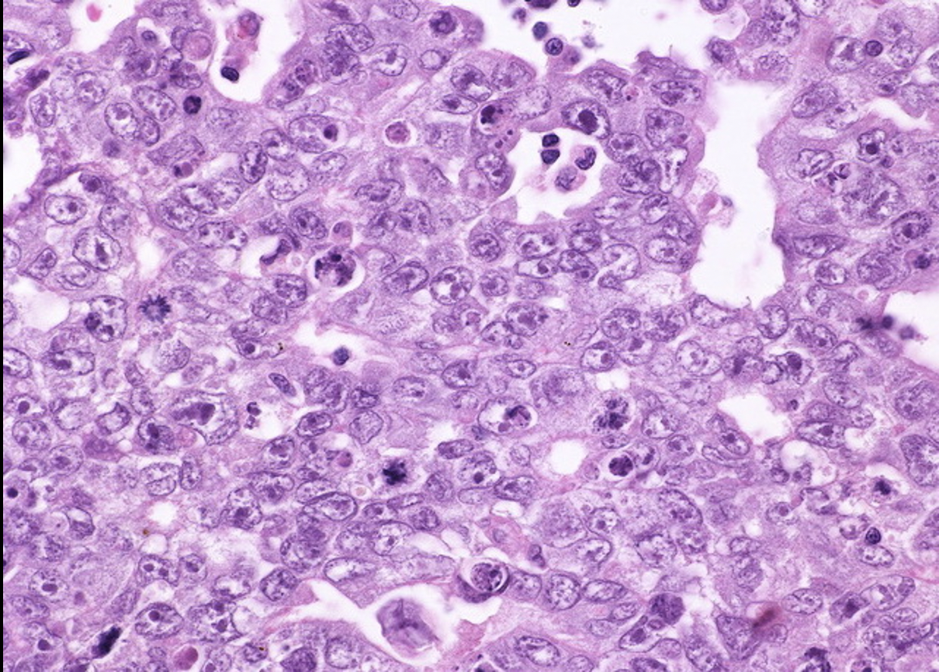
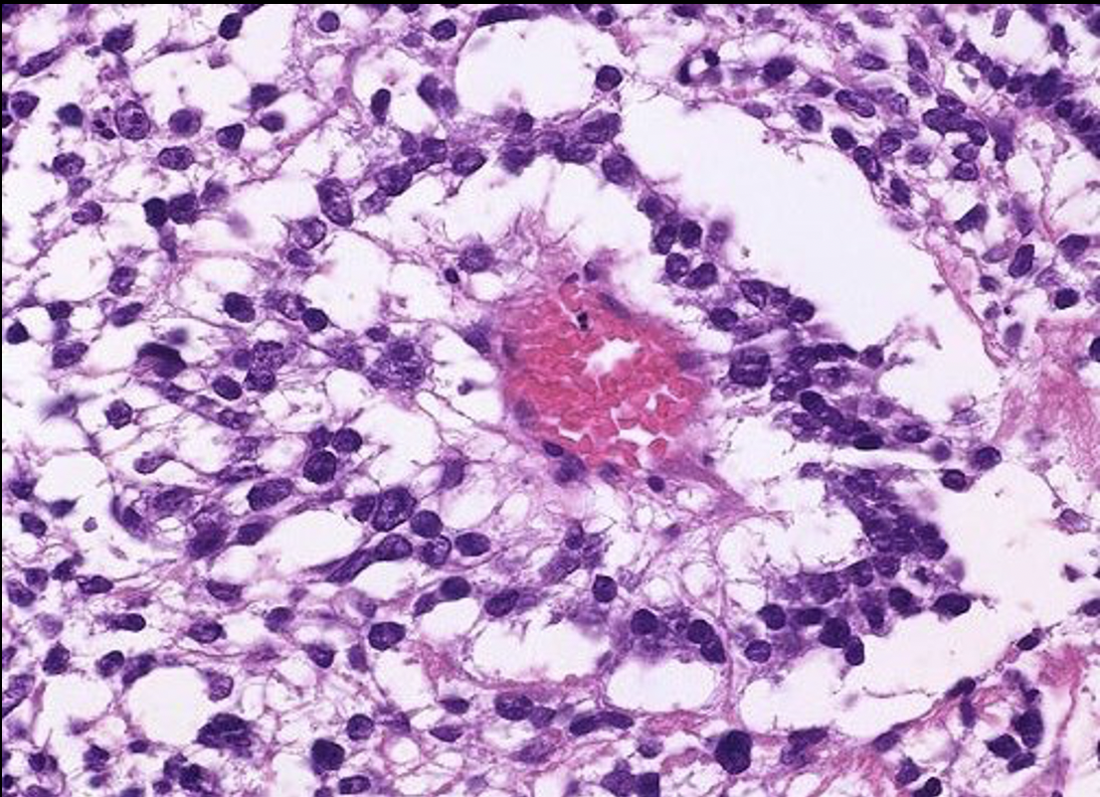
Germ cell tumors
Nonseminomatous germ cell tumors
1- Embryonal carcinoma
15 to 35% of testicular GCTs.
Age group: 20 to 30 years.
Can be seen combined with other GCTs (in mixed GCTs).
Tumor cells are positive for cytokeratin (CK) and CD30 stain.
Morphology
Gross: smaller than seminomas and poorly demarcated.
Microscopic: variegated surfaces with foci of necrosis and
hemorrhage.
Prognosis
More aggressive than seminomas.
Metastasizes early via both lymphatic and hematogenous routes.
Not radiosensitive, they are chemosensitive.
New chemotherapeutic agents are very effective and greatly improve prognosis.
2- Yolk sac tumors
Yolk sac tumor is also called endodermal sinus tumor.
Occur in two forms :
Pure form: seen in young children, rare in adults.
Combination: with other NSGCTs seen in adults, commonly mixed with embryonal carcinoma.
It is the most common tumor in infant and children up to 3 years of age with a very good prognosis.
Patients have elevated serum alpha fetoprotein (AFP):
Used as a marker of disease progression and diagnosis.
Tumor cell are positive for AFP and alpha-1-antitrypsin stain.
The biologic behavior of YST is similar to that of embryonal carcinoma.
Morphology
Gross: non encapsulated, homogenous, yellow white, mucinous.
Microscopic:
Tumor shows structures resembling endodermal sinuses
called as Schiller-Duval bodies.
Hyaline–pink globules.

Slide 8
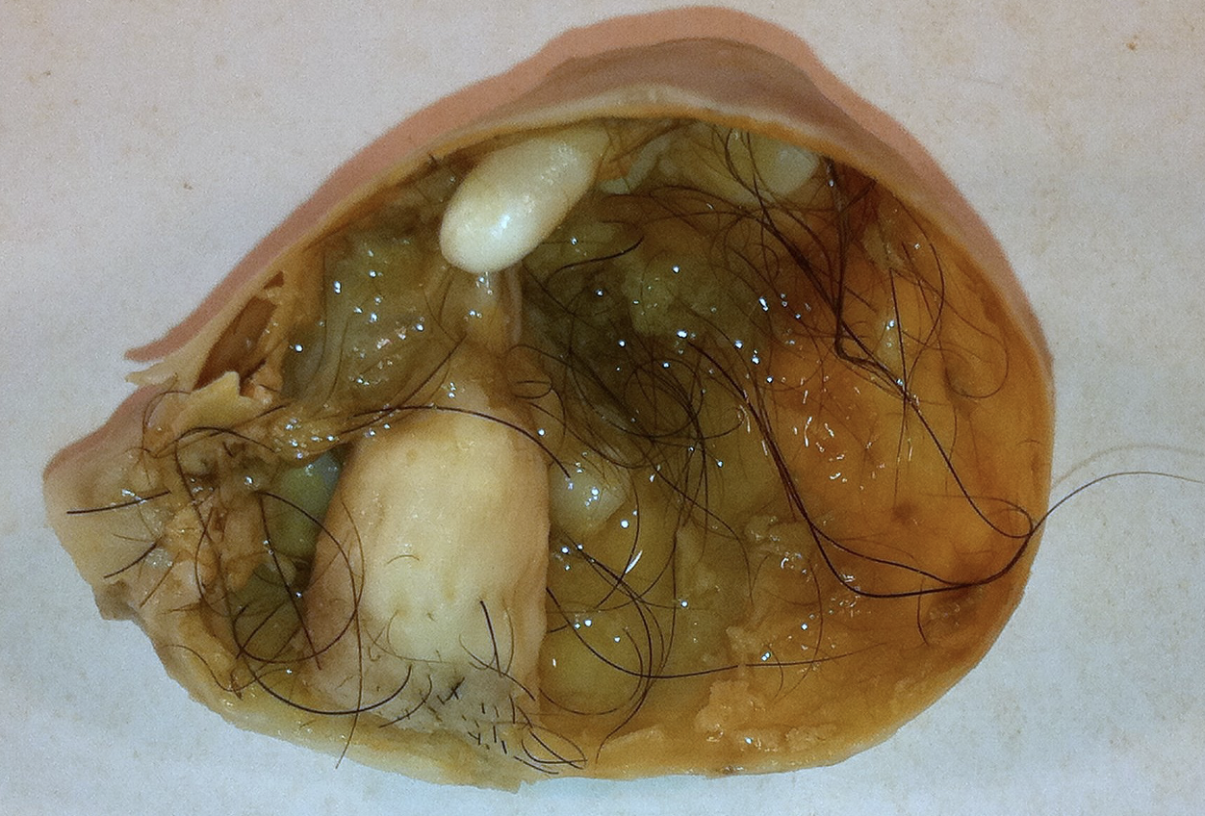
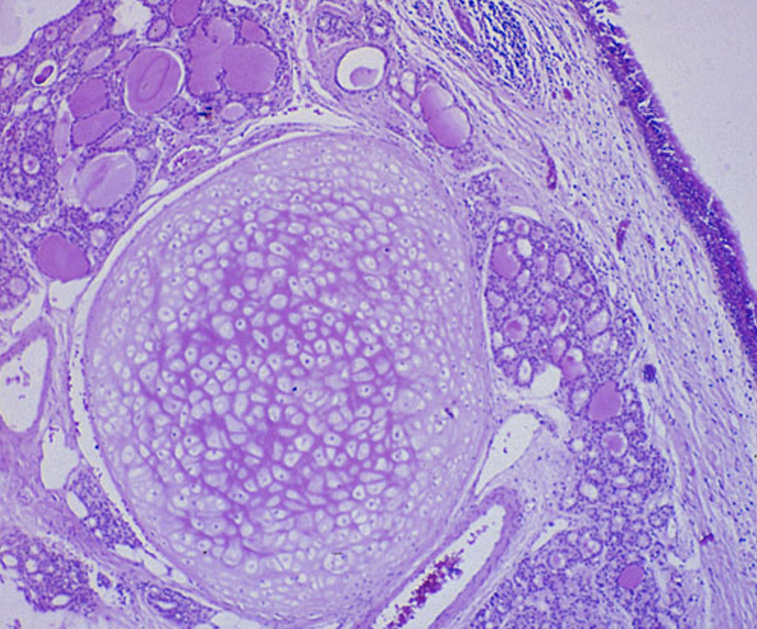
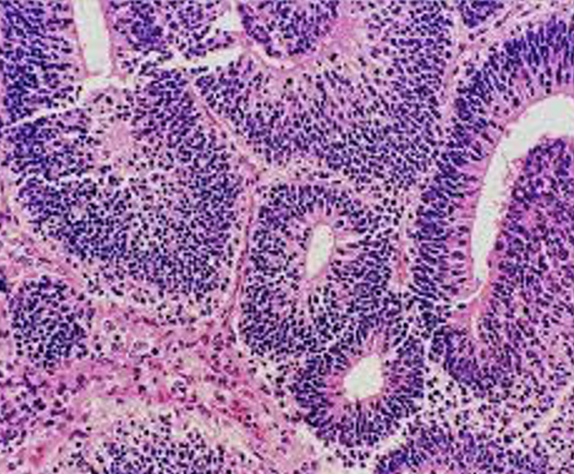
Germ cell tumors
3- Choriocarcinoma
It is a highly malignant tumor.
Pure form is extremely rare and it is the most aggressive non-seminomatous tumor.
It is more common as a component of mixed GCT.
Tumor cells are positive for human chorionic gonadotropin HCG stain.
Morphology
Gross: small sized lesions.
Microscopic:
Malignant trophoblastic (placental) tissue: cytotrophoblastic and syncytiotrophoblastic cells.
Prominent hemorrhage and necrosis.
4- Teratoma
Composed of various different types of cells or organ components.
They can occur at any age.
Pure form: Second most common in infants and children after yolk sac tumor.
Mixed form: usually in adults.
Prognosis
Prepubertal males → benign.
Postpubertal males → malignant (regardless of maturity, unlike females)
Mature and immature teratomas are both capable of metastasis.
Morphology
Gross:
Large (5 -10 cm).
Solid and cystic areas.
Heterogeneous: bizarrely distributed collection of different type
of cells or organ structures (e.g: bone, cartilage and teeth).
Microscopic:
Any cell type can be present: neural, cartilage, bone, squamous
epithelium, hair, glandular cells, smooth muscle, thyroid tissue,
bronchial epithelium of lung, pancreatic tissue etc.
A
A. Mature | If the cells/tissue is mature looking.
B. Immature | If some of the cells/tissue component is immature.
Teratoma with malignant transformation | If any of the cells/tissue undergoes non germ cell type of malignant transformation (e.g. squamous cells develop into squamous cell carcinoma).
B

Slide 9
Germ cell tumors
Mixed Germ Cell Tumors (GCTs)
Common. Half of testicular tumors are composed of a mixture of GCTs.
The common combinations or mixtures are:
Seminoma + embryonal carcinoma.
Teratoma + embryonal carcinoma +/- yolk sac tumor.
Clinical Features
Painless solid enlarging mass in the testis.
They secrete hormones and enzymes that can be detected in blood:
HCG, AFP, and lactate dehydrogenase LDH.
GCTs can metastasize by:
Direct extension to the epididymis, spermatic cord, or scrotal sac.
Lymphatic spread: Retroperitoneal and para-aortic nodes are first to be involved.
Hematogenous spread to Lung, liver, Brain, and bones
A biopsy of a testicular tumor is not recommended because it is associated with a risk of tumor spillage and it is very painful,
Management
The standard management: radical orchiectomy.
Seminomatous tumors → radiosensitive: respond well to radiotherapy.
95% of patients can be cured.
Non-seminomatous tumors → chemosensitive: respond very well to chemotherapy.
90% of patients achieve complete remission with aggressive chemotherapy.
Differences between GCTs
Seminomas | Nonseminomatous GCT
Radiosensitive | Non radiosensitive
Chemosensitive | Chemosensitive
Late metastasis | Early metastasis to retroperitoneal lymph nodes.
Excellent prognosis | More aggressive

Slide 10
Summary
Epididymitis and orchitis
Non specific | Related to urinary tract infections. Causative organism: children (gram -ve rods), men younger than 35 (Chlamydia trachomatis and Neisseria), men older than 35 (E Coli and pseudomonas). Microscopy: Congestion and infiltration by neutrophils, macrophages & lymphocytes.
Gonorrhea | Spread from urethra to epididymis and testis leading to orchitis and abscess.
Tuberculosis | Begins in epididymis and spread to testis. Microscopy: Caseating granuloma.
Granulomatous | Mimic testicular tumor (unilateral mass). Microscopy: Granulomatous inflammation with plasma cells and lymphocytes.
Testicular tumors
Seminomatous germ cell tumors
Seminoma | Most common type of testicular tumors and germ cell tumors (50%). Age group: peak incidence in 30s, almost never occur in infants. Secretes lactate dehydrogenase LDH.
Spermatocytic tumor | Uncommon: 1-2% of testicular GCTs It affects men over the age of 65 years.
Non-Seminomatous germ cell tumors
Embryonal carcinoma | They account for about 15% to 35% of testicular GCTs. The age group: 20 to 30 years. They are more aggressive than seminomas. Tumor cells are positive for cytokeratin (CK) and CD30 stain.
Choriocarcinoma | It is a highly malignant tumor. Patients have elevated serum human chorionic gonadotropin (HCG).
Yolk sac tumor | It is the most common tumor in infant and children up to 3 years of age and it has a very good prognosis in infants and children. In adults it occurs as mixed GCT. Elevated serum alpha fetoprotein (AFP) Microscopy: Schiller-Duval bodies.
Teratoma | It is a tumor composed of various different types of cells or organ components. They can occur at any age Benign in prepubertal males and malignant in postpubertal males. Microscopy: it can be mature, immature, or with malignant transformation.
Mixed GCTS | Common, half of testicular tumors are composed of a mixture of GCTs.

Slide 11
Quiz
1) A 32 year old male present with testicular enlargement, microscopy findings shows
granulomatous inflammation with plasma cells and lymphocytes, what’s the most likely diagnosis?
A- Orchitis
B- Seminoma
C- Embryonal carcinoma
D- Urethritis
2) A 32-year-old man presents with a testicular mass that he noticed 2 weeks ago. The mass cannot be transilluminated and appears solid and homogeneous on ultrasound examination. No tumor markers are detected on serologic testing. An orchiectomy is performed, and the surgical specimen shows Bulky masses with homogenous, gray-white, lobulated cut surface. Which of the following is the most likely diagnosis?
A- Choriocarcinoma
B- Embryonal carcinoma
C- Lymphoma
D- Seminoma
3) Which of the following is the most aggressive type of testicular tumors?
A- Seminoma
B- Spermatocytic tumor
C- Choriocarcinoma
D- Teratoma
4) Which of the following is the most common testicular tumor in infants and children?
A- Yolk sac tumor
B- Embryonal cell Carcinoma
C- Seminoma
D- Teratoma
5) A-26-year old male came to the hospital with a right testicular mass and history of cryptorchidism. which of the following is most likely diagnosis?
A- Sex cord tumors.
B- Germ cell tumors.
C- Tuberculoma of the intrascrotal cord.
D- Vascular aneurysm.
6) A 26 year old man. He was diagnosed with testicular cancer. The patient was treated with radiotherapy. However, treatment was not effective. Later investigations showed Cytokeratin and CD30 positive tumor cells. Which of the following types is most likely in this case?
A- Yolk sac cells B- Seminoma
C- Embryonal carcinoma
D- Choriocarcinoma
7) A 32-year-old man has noticed an increased feeling of heaviness in his scrotum for the past 10 months. On physical examination, the left testis is three times the size of the right testis and is firm on palpation. An ultrasound scan shows a 6-cm solid mass within the body of the left testis. Laboratory studies include an elevated serum α-fetoprotein level. Which of the following cellular components is most likely to be present in this mass?
A- Cytotrophoblasts.
B- Embryonal carcinoma cells.
C- Seminoma cells.
D- Yolk sac cells.
8) A 26-year-old man has occasionally felt pain in the scrotum for the past 3 months. An ultrasound scan shows a 1.5-cm mass within the right testis. A right orchiectomy is performed, and gross examination shows the mass to be hemorrhagic and soft. A retroperitoneal lymph node dissection is done. Microscopic examination shows that areas of viable tumor are composed of cuboidal cells intermingled with large eosinophilic syncytial cells containing multiple dark, pleomorphic nuclei. Immunohistochemical staining of syncytial cells is most likely to be positive for which of the following?
A- α-Fetoprotein.
B- CD20.
C- Carcinoembryonic antigen.
D- Human chorionic gonadotropin.
1- A
2- D
3- C
4- A
5- B
6- C
7- D
8- D

Slide 12
Team Subleader
Alhanouf Alhaluli
Done by the brilliant minds
Joud Aljebreen / Njoud Alali / Joud Abudahesh

