Slide 1
Editing file
Prostate Pathology
Objectives
Know the epidemiology, pathogenesis and histopathologic features of:
Benign prostatic hyperplasia.
Carcinoma of the prostate.

Slide 2
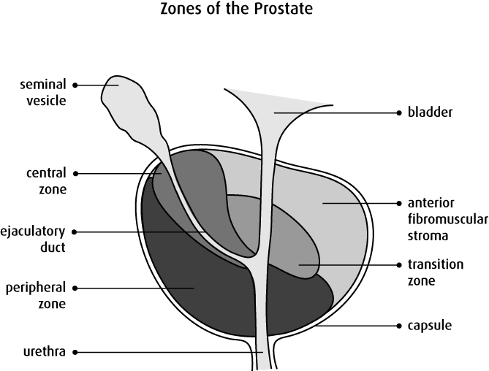
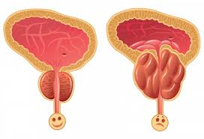
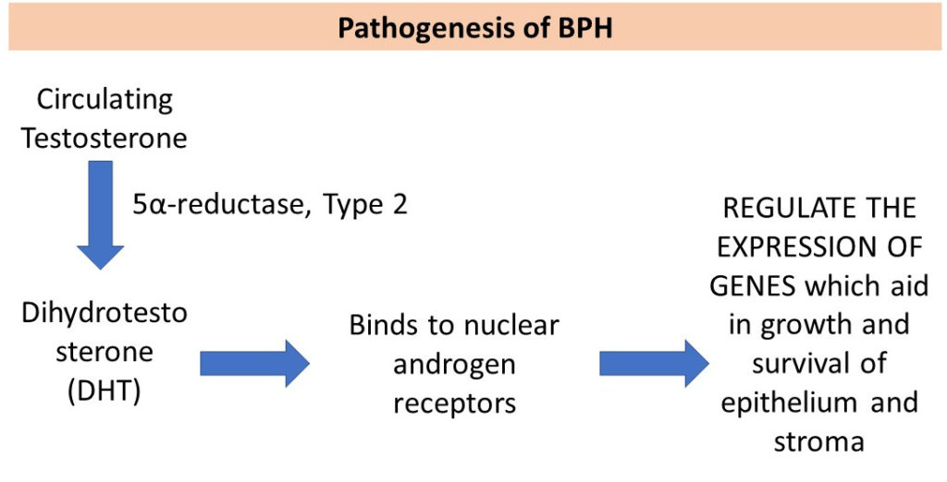
Prostate Pathology
Introduction
The prostate is divided into zones:
Central zone.
Peripheral zone: most common zone of cancer.
Transition zones: surrounds the urethra and the
most common zone of BPH.
The prostate is a tubulo-alveolar organ lined by two
layers of cells, basal cells and columnar secretory cell.
Benign Prostatic Hyperplasia
Benign prostatic hyperplasia (BPH) is also known as benign nodular hyperplasia.
It is extremely common in men > 50 years of age.
About 20% men have BPH by age 40
About 70% men have BPH by age 60
About 90% men have BPH by age 80
BPH is not a premalignant lesion.
Prepubertal castration¹ prevents BPH.
Pathogenesis of BPH
The essential cause of BPH is unknown but the pathogenesis is related to the action of androgens.
Dihydrotestosterone (DHT) is the ultimate mediator for prostatic growth:
It increases the proliferation of stromal cells.
Inhibits epithelial cell death.
Therefore DHT is implicated in the pathogenesis of both benign prostatic hyperplasia and prostate cancer.
Testosterone is converted to dihydrotestosterone by the 5-alpha reductase enzyme.
Drugs that act as inhibitors of 5-alpha reductase have an important role in the prevention and treatment of BPH and prostate cancer.
The process of removing the testicles

Slide 3
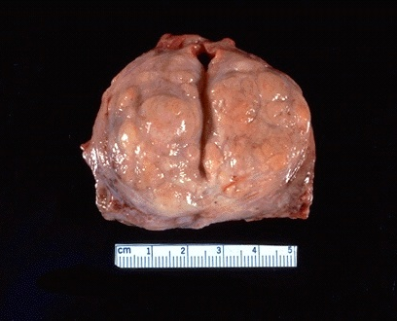
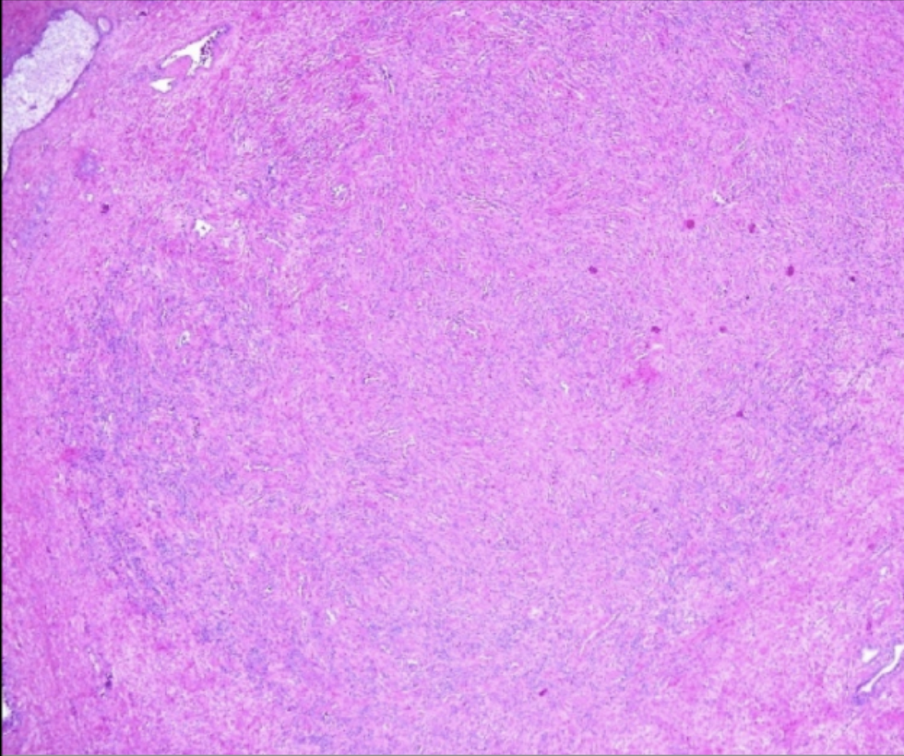
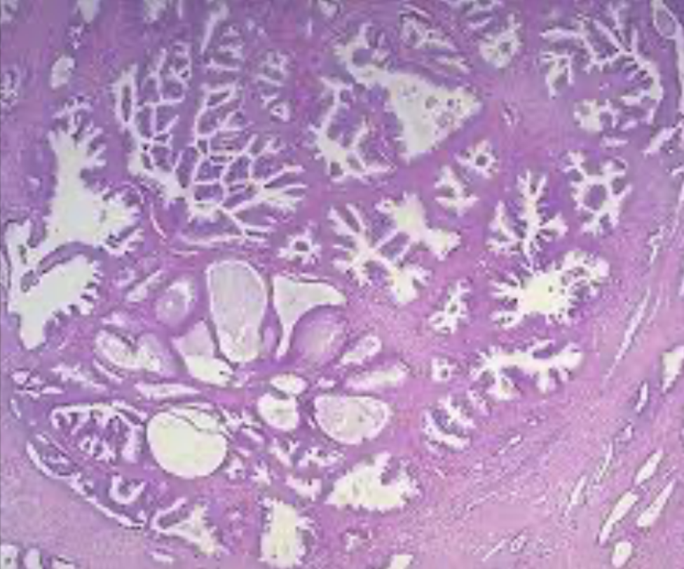
Benign Prostatic Hyperplasia
Gross Morphology
The prostate weighs between 60 and 100 grams.
The hallmark of BPH is nodularity due to glandular and fibromuscular proliferation starting from the transition zone of the prostate.
It compresses the wall of the urethra resulting in a slit-like orifice.
Cut-section: nodules which vary in size, color and consistency.
depending on which element is proliferating more (glandular is softer vs. fibromuscular is firmer).
A
Microscopic Features
Since the main feature of BPH is nodularity, the nodules can be one of the following:
(B) Purely stromal nodules composed mainly of fibromuscular elements.
(C) Fibroepithelial with both glandular and fibromuscular component:
Aggregation of small to large to cystically dilated glands.
Lined by two layers of epithelium¹.
Surrounded by fibromuscular stroma.
B
C
Clinical Presentation
Bladder hypertrophy: the nodules compress the prostatic urethra causing urethral obstruction which leads to urinary retention and bladder hypertrophy.
Infection: the inability to empty the bladder completely leads to an increased volume of residual urine, therefore infection.
Urinary frequency, Dysuria, Nocturia.
Difficulty in starting and stopping the stream of urine.
Some present with acute urinary retention. (Medical Emergency)
Treatment
Mild cases of BPH may be treated with α-blockers and 5-α-reductase inhibitors.
Moderate to severe cases require transurethral resection of the prostate (TURP).
Note:
Needle biopsies do not sample the transitional zone where BPH occurs, therefore the diagnosis of BPH cannot be made on needle biopsy.
Tall columnar epithelial cell layer and a peripheral layer of flattened basal cells

Slide 4
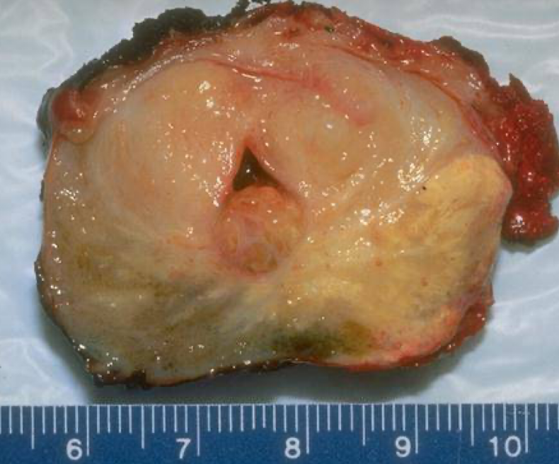
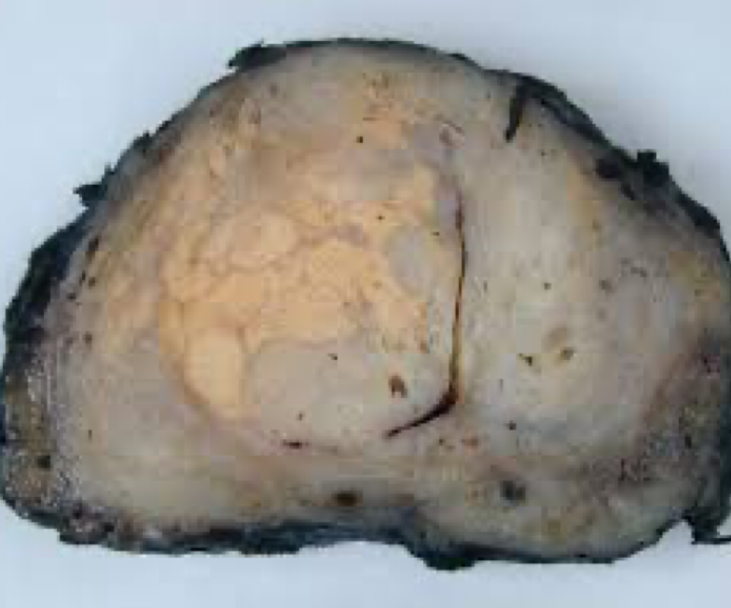
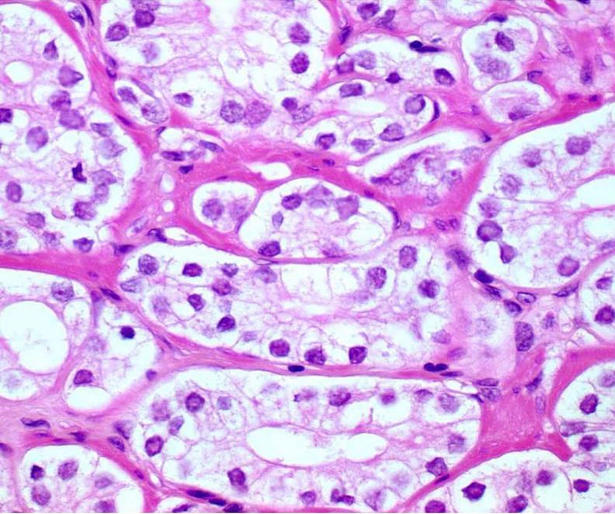
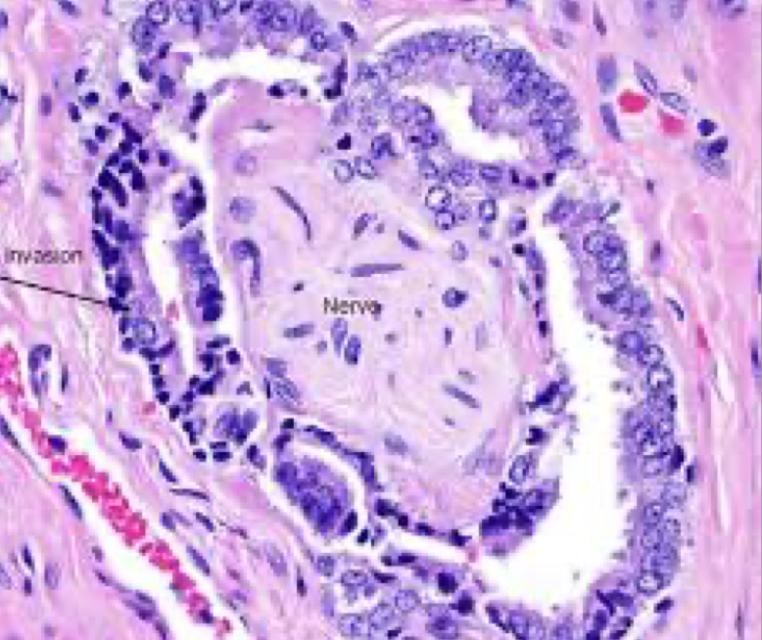
Prostatic Adenocarcinoma
Introduction
It is the most common form of cancer in men over the age of 50 years.
It is more prevalent among African Americans.
Androgens are believed to play a major role in the pathogenesis.
Tumor can spread by:
Direct local invasion, through blood vessels, and lymphatics.
Local extension most commonly involves:
The periprostatic tissue, seminal vesicles and the base of the urinary bladder (leading to ureteral obstruction)¹.
Risk factors
Age above 50.
Race.
Hormone level (increase level of androgens).
Family history.
Environmental influences.
Gross morphology
70% of tumors arise in the peripheral zone in the posterior part of the gland.
The tumor is firm and gritty and is palpable² on rectal exam.
Microscopic features
Most lesions produce well-defined gland patterns.
The malignant glands are lined by a single layer of cuboidal or low columnar.
Large nuclei and one or more large nucleoli.
Nuclear pleomorphism is not marked.
The outer basal cell layer, typical of benign glands, is absent.
Perineural invasion is common. (B)
B
Because of the peripheral location, prostate cancer is less likely to cause urethral obstruction in initial stages, the manifestations occur late.
In opposite to BPH which is difficult to palpate because of deep origin (Transitional zone).

Slide 5
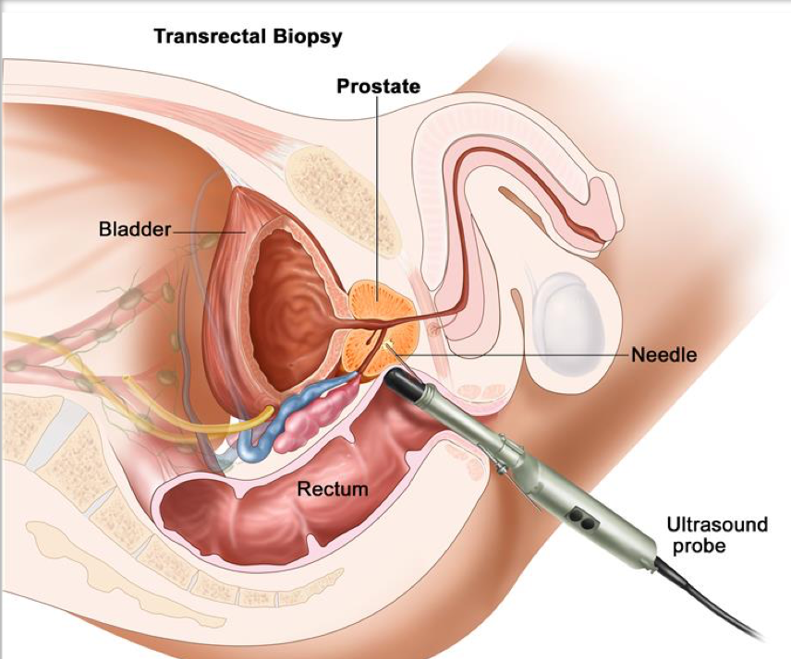
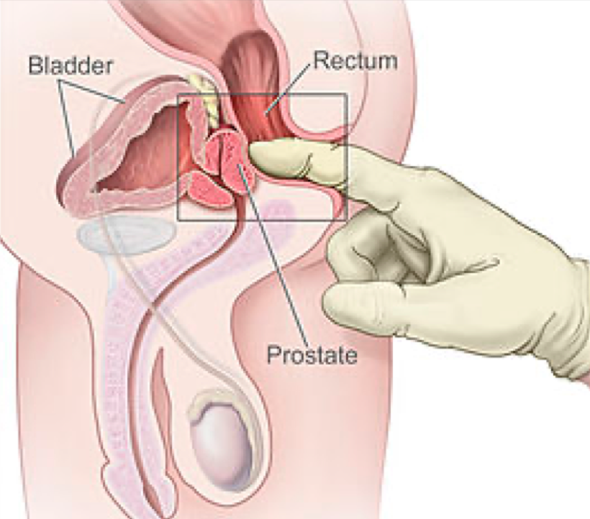
Prostate Adenocarcinoma
Grading Prostate Cancer
Gleason system is a histological grading and scoring system for prostatic adenocarcinoma done on the microscopic level.
There are five grades (1 to 5) depending on the degree and pattern of differentiation as seen microscopically.
Grade 1 = well-differentiated
Grade 5 = very poorly differentiated.
Prostate carcinomas usually have more than one pattern within any given tumor.
Gleason Score: is the final sum of two grades within the tumor:
In biopsies: the most predominant grade + most aggressive grade are added and the final sum is Gleason Score.
On resection: the predominant grade + second predominant grade are added to give the Gleason score
Gleason grading and scoring is very useful in predicting the prognosis of a patient.
Staging Prostate Cancer
Staging in prostate cancer depends on the TNM (tumor size, lymph node, metastasis) system.
It is the most important indicator of prognosis.
Clinical Presentation
Microscopic (small size) cancers are asymptomatic and are discovered incidentally.
Urinary symptoms occurs late.
Occasionally patients present with back pain caused by vertebral metastases.
Diagnosis
Digital rectal examination: may detect some early cancers.
PSA (Prostate Specific Antigen): are important in the diagnosis and management of prostate cancer, However, a minority of prostate cancers may have low PSA.
PSA is organ-specific but not cancer specific thus it can increase in BPH and prostatitis.
Transrectal needle biopsy: is required to confirm the diagnosis.

Slide 6
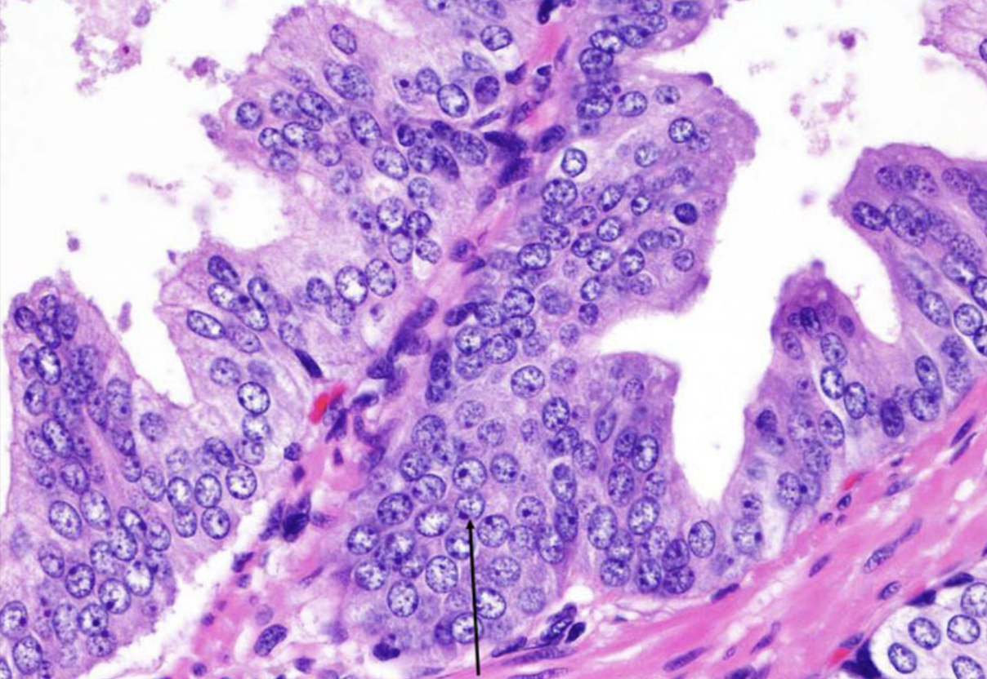
Prostate Adenocarcinoma
Treatment
Surgery, radiotherapy and hormonal therapy are used for treatment
90% of treated patients are expected to live for 15 years.
Currently the most acceptable treatment for clinically localized cancer is radical surgery.
Locally advanced cancers can be treated by radiotherapy and hormonal therapy.
Hormonal therapy (anti-androgen therapy) can induce remission.
Advanced, metastatic carcinoma is treated by androgen removal treatment, either by orchiectomy or by hormonal anti-androgen therapy.
Prognosis
Depends on the Gleason score and stage of tumor.
Metastases: first spread via lymphatics initially to the obturator nodes and eventually to the para-aortic nodes
Hematogenous extension occurs chiefly to the bones.
The bony metastasis are typically osteoblastic in nature.
Prostatic Intraepithelial Neoplasia
Prostatic intraepithelial neoplasia (PIN) is the precursor lesion
for invasive carcinoma.
It can be low grade PIN or high grade PIN (carcinoma in situ)¹.
PIN like prostatic carcinoma occurs in the peripheral zone.
Basal layer
How to differentiate between benign & malignant (female doctor)
 | Benign | Malignant
Clinical symptoms | Symptomatic | Asymptomatic
Examination | Nothing (deep in transitional zone) | Firm (peripheral zone)
Microscopic | Two layers (basal and columnar epithelium) | One layer (only columnar epithelium)
You can find the Basal layer in this lesion because it’s in situ

Slide 7
Summary
Prostatic tumors
Benign prostatic Hyperplasia
intro | Benign nodular hyperplasia most commonly in the transition zone. The ultimate mediator Dihydrotesterone increase proliferation of stromal cells. Common above the age of 50, it is not premalignant.
Morphology | Gross (weight 60-100 grams) Nodular of varying size, color, and consistency. Microscopic Cystically dilated glands. Two layer of epithelium.
Clinical features | Bladder hypertrophy. Infection. Urinary frequency, Dysuria, Nocturia. Treatment: Inhibitors of 5-alpha reductase.
Prostatic Adenocarcinoma
Intro | Most common cancer above the age of 50, and among african americans. Androgens play a major role. Risk factors: age, race, hormonal level, family history, environmental factors.
Morphology | Gross Most commonly in the peripheral zone. Tumor is firm, gritty, and palpable on rectal exam. Microscopy Well-defined gland patterns, lined by a single layer of cuboidal cells. Large nuclei, large nucleoli, pleomorphism not marked.
Clinical presentation & diagnosis | Asymptomatic, occasional back pain. Digital rectal examination: may detect early cancer. Prostate specific antigens: important in diagnosis and management, but a minority will have low PSA. Transrectal needle biopsy: required to confirm diagnosis.
Prognosis | Depends on Gleason score & Stage of tumor. Lymphatic metastasis: first to obturator nodes, then to Para-aortic nodes. Blood metastasis: bone, osteoblastic in nature. 90% of treated patients are expected to live for 15 years. Treatment: Surgery, radiotherapy, Hormonal therapy.

Slide 8
Quiz
1) A 65-year-old man has had multiple, recurrent urinary tract infections for the past year. Escherichia coli and streptococcal organisms have been cultured from his urine during these episodes, with bacterial counts of more than 105/mL. He has difficulty with urination, including starting and stopping the urinary stream. Over the past week, he has again developed burning pain with urination. Urinalysis now shows a pH of 6.5, and specific gravity of 1.020. No blood or protein is present in the urine. Tests for leukocyte esterase and nitrite are positive. Microscopic examination of the urine shows numerous WBCs and a few WBC casts. Which of the following is the most likely condition predisposing him to recurrent infections?
A- Epispadias
B- Nodular prostatic hyperplasia
C- Phimosis
D- Posterior urethral valves
E- Prostatic adenocarcinoma
F- Vesicoureteral reflux
2) A clinical trial of two pharmacologic agents compares one agent that inhibits 5α-reductase and diminishes dihydrotestosterone (DHT) synthesis in the prostate with another agent that acts as an α1-adrenergic receptor blocker The subjects are 40 to 80 years old. The study will determine whether symptoms of prostate disease are ameliorated in the individuals who take these drugs. Which of the following diseases of the prostate is most likely to benefit from one or both of these drugs?
A- Acute prostatitis
B- Adenocarcinoma
D- Chronic prostatitis
C- Leiomyoma
E- Nodular hyperplasia
3) Microscopic examination of a prostatic adenocarcinoma shows glands that have....
A- one layer
B- two layers
C- three layers
D- the layered structure is lost
4) Initial metastasis of adenocarcinoma via lymphatics spreads to which one of the following?
A- Superficial inguinal node
B- paraaortic nodes
C- obturator nodes
D- Internal iliac nodes
5) A 72-year-old man has had increasing difficulty with urination for the past 10 years. He now has to get up several times each night because of a feeling of urgency, but each time the urine volume is not great. He has difficulty starting and stopping urination. On physical examination, the prostate is enlarged to twice its normal size, but is not tender to palpation. One year ago, his serum prostate-specific antigen (PSA) level was 6 ng/mL, and it is still at that level when retested. Which of the following drugs is most likely to be effective in treatment of this man?
A- Estrogen (hormone)
B- Finasteride (5α-reductase inhibitor)
C- Mitoxantrone (chemotherapy agent)
D- Nitrofurantoin (antibiotic)
E- Prednisone (corticosteroid)
6) A 71-year-old, previously healthy man comes to his physician for a routine health examination. On palpation, there is a nodule in his normal-sized prostate. Laboratory studies show a serum prostate-specific antigen (PSA) level of 17 ng/mL. A routine urinalysis shows no abnormalities. Which of the following histologic findings is most likely to be found in a subsequent biopsy specimen of his prostate?
A- Acute prostatitis
B- Adenocarcinoma
C- Chronic abacterial prostatitis
D- Nodular hyperplasia
E- Prostatic intraepithelial neoplasia
7) What is the most common location of benign prostatic hyperplasia?
A- Central zone
B- Peripheral zone
C- Transitional zone
D- None of the above
8) Which of the following is the most important mediator of BPH?
A- Estrogen
B- DHT.
C- Testosterone
D- DHET
1- B
2- E
3- A
4- C
5- B
6- B
7- C
8- B

Slide 9
Team Subleader
Alhanouf Alhaluli
Done by the brilliant minds
Omar Alotaibi & Ahmad Alajlan

