Slide 1
Editing file
Pathoma Video
Pathology of Cervix
Objectives
Some common benign conditions and infections.
Understand the concepts of dysplasia and intraepithelial neoplasia in the female genital tract and the role of a cervical screening program.
Know the incidence, risk factors, clinical presentation, pathological features and prognosis of cervical squamous cell carcinoma.

Slide 2
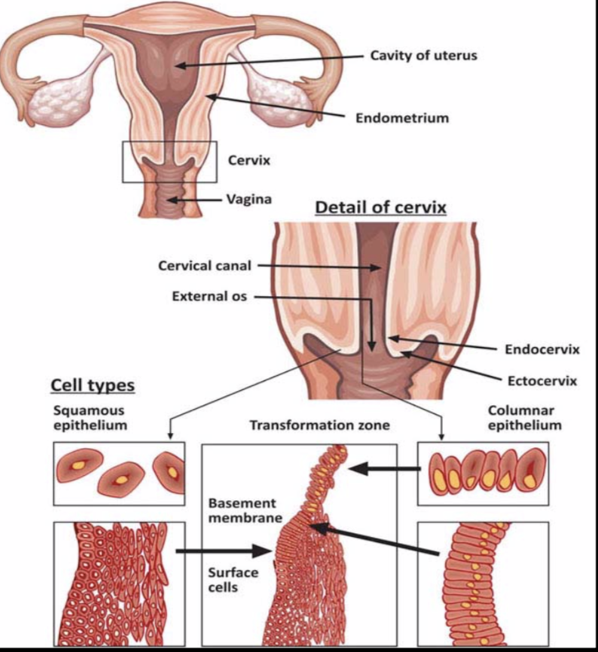
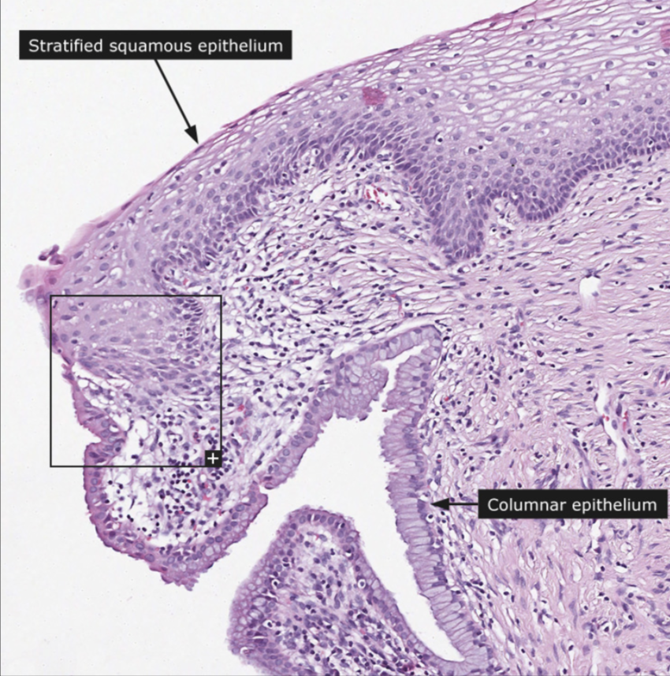
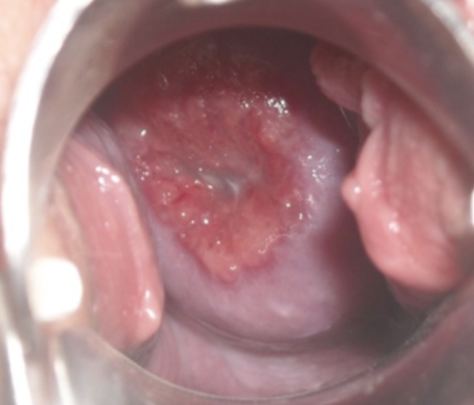
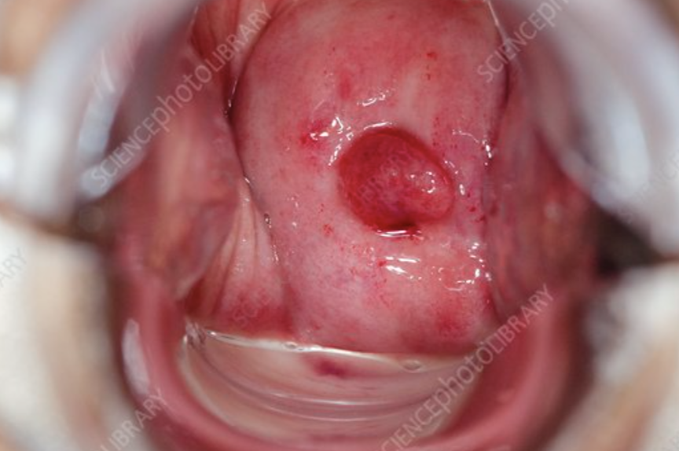
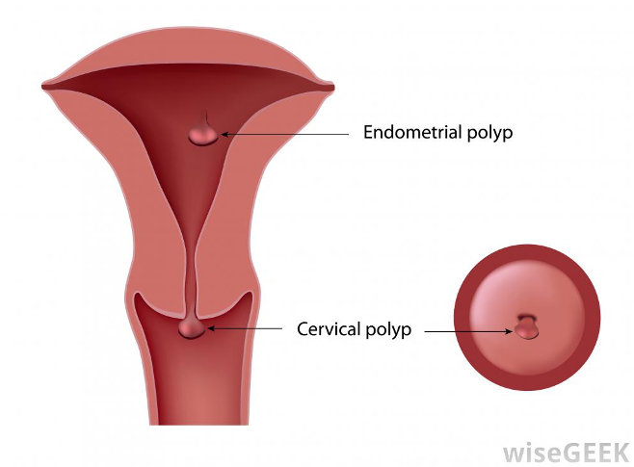
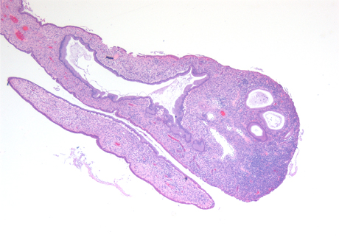
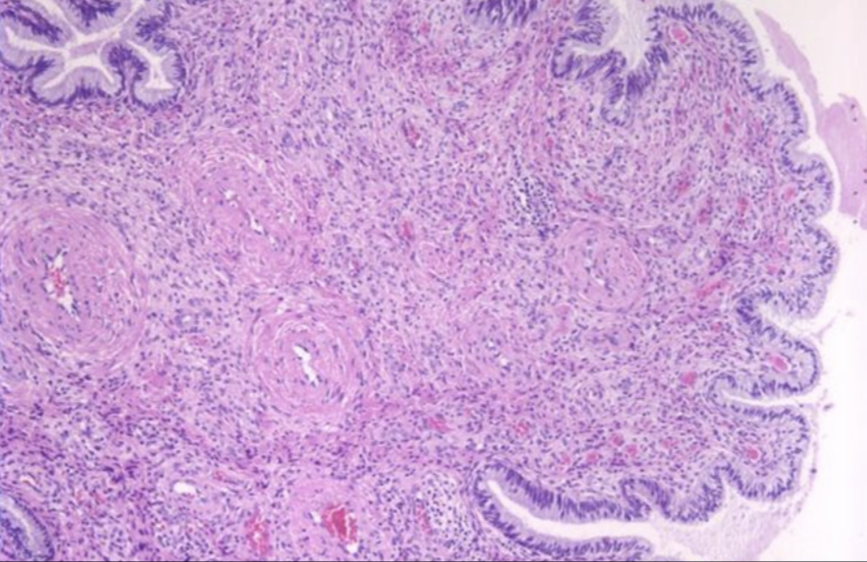
Pathology of Uterine Cervix
Introduction
Endocervix: lined by columnar epithelium.
Ectocervix: lined by Stratified squamous epithelium.
Transformation zone: the area in between. Most common
place of cervical pathology.
Cervical Ectropion (Erosions) (Female slides)
Squamous Epithelium is replaced by columnar epithelium.
Resulting in an erythematous area¹.
Benign, with no malignant potential.
It occurs in response to (causes):
Hormones, irritation, oral contraceptives and inflammation (chronic cervicitis).
Squamous Metaplasia
The columnar cells are replaced by squamous cells².
It is seen in the cervix at the squamocolumnar junction (transitional zone).
Squamous metaplastic epithelium is a sensitive area that is most affected by human papillomavirus (HPV) infection.
The area where dysplasia and malignant transformation starts.
However, it is benign and by itself not considered premalignant.
Cervical polyp
This is a small, pedunculated mass (not a true neoplasm)
Types:
1
Endocervical polyps:
- Originate from endocervix.
- Most common polyps.
2
Ectocervical polyps:
- Originate from ectocervix.
- Less common.
Polypoidal in shape
Morphology
Overgrowth of benign cervical stroma covered by cervical epithelium:
The epithelium covering the polyp: can be columnar (most common) or stratified squamous or sometimes partly both.
The stroma: is made up of fibrous tissue with thick-walled blood vessels and inflammatory cells.
1. Extending distally out of the external OS.
2. Extend proximal.

Slide 3
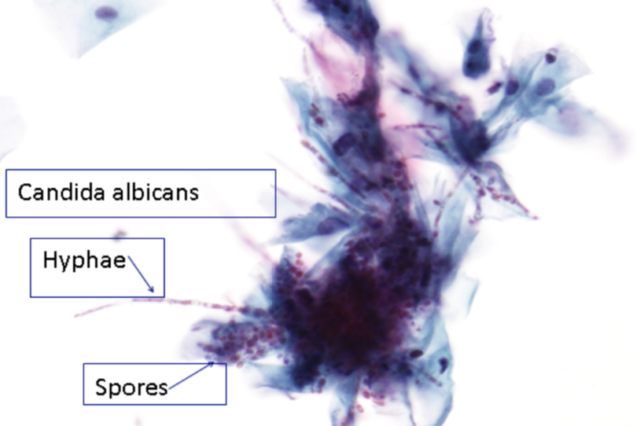
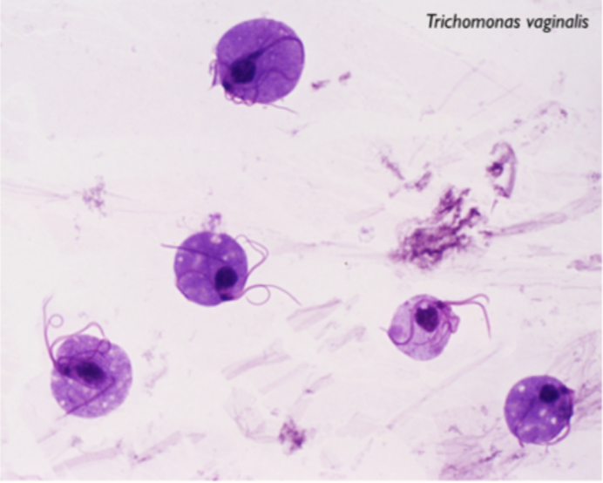
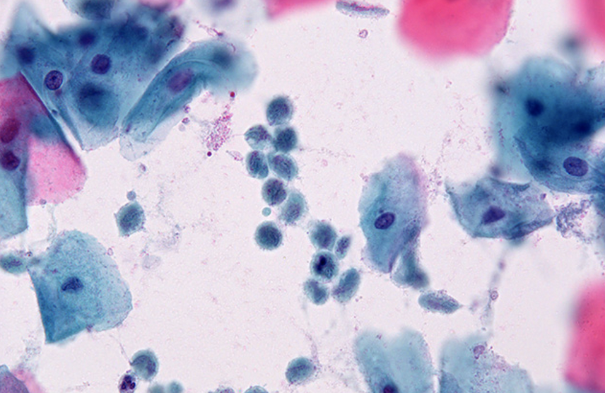
Cervicitis
Non-infectious Cervicitis
Is inflammation (acute or chronic) of the cervix caused by:
Chemical irritation (e.g. douche).
Mechanical irritation (e.g. tampon, diaphragm).
Clinical appearances
Often asymptomatic.
The cervix appears red and swollen.
Histology
Inflammatory cells: neutrophils in acute, plasma cells and lymphocytes in chronic.
Squamous metaplasia is common in chronic cervicitis.
Infectious cervicitis
Can be caused by various organisms:
e.g. staphylococci, enterococci, Gardnerella vaginalis, Trichomonas vaginalis, Candida albicans, Chlamydia trachomatis and HPV.
Most often involves the endocervix.
May be asymptomatic.
May manifest as vaginal discharge or itching.
 | 1. Candidiasis (moniliasis) | 2. Trichomoniasis | 3. Chlamydia trachomatis
Organism | - Candida Albicans. - Fungal colonies. - Vaginal flora. | - Trichomonas vaginalis: unicellular flagellated protozoa. | - Obligate, gram -ve intracellular pathogen. - May coexist with N. gonorrhoeae.
Transmission/Association | Immunosuppression: DM, pregnancy, antibiotic therapy, oral contraceptives. | Sexually transmitted disease involves the vagina and cervix. | Most common sexually transmitted disease in the developed countries.
Clinical Features | - Involve cervix & vagina. - White patchy mucosal lesion. - Thick curdy white discharge. - Vulvovaginal pruritus (itching). - Ulcers in severe cases. | - Greenish-yellow frothy and foul smelling vaginal discharge. - Painful urination, - Vulvovaginal itching. - Dyspareunia. | - Most often asymptomatic. - Mucopurulent cervical discharge. - Reddened, congested and edematous cervix. - Maybe associated with urethritis. - Common cause of pelvic inflammatory disease which leads to ectopic pregnancy and infertility. - Can cause lymphogranuloma venereum (ulcerative disease of the genital area caused by the L1,L2,L3 serotypes).
Pap smear (Cytology) | - Appear as spores. - Branching pseudohyphae on the cervical epithelium. - Chronic inflammatory cells. | - Seen in a background of inflammatory cells. - Saline wet preparation: motile trophozoites are seen.
Saline wet preparation
Cytology

Slide 4
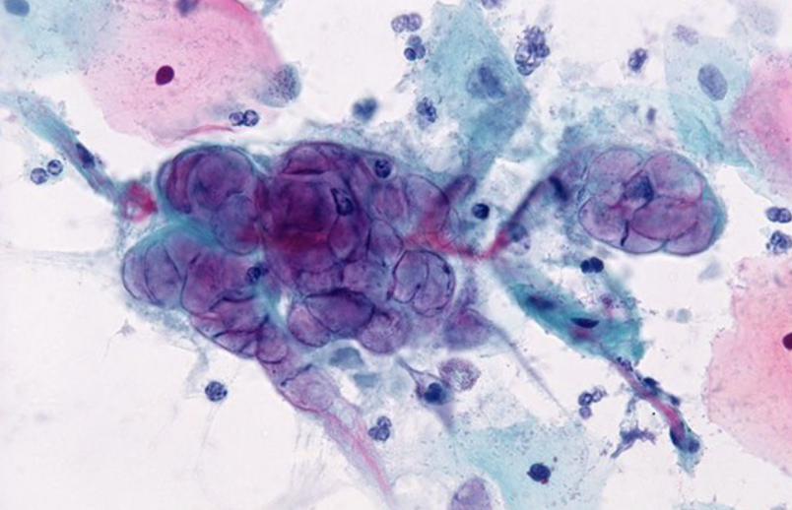
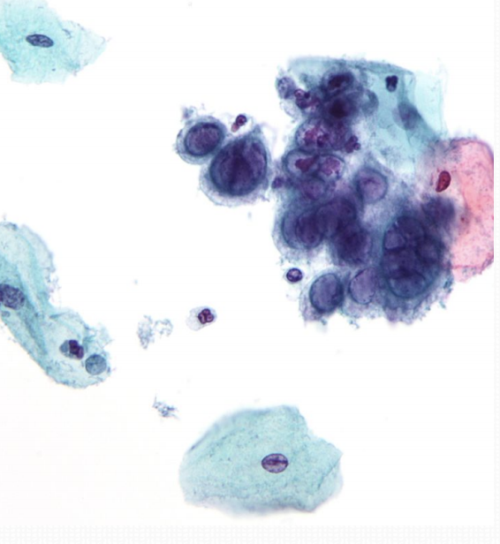
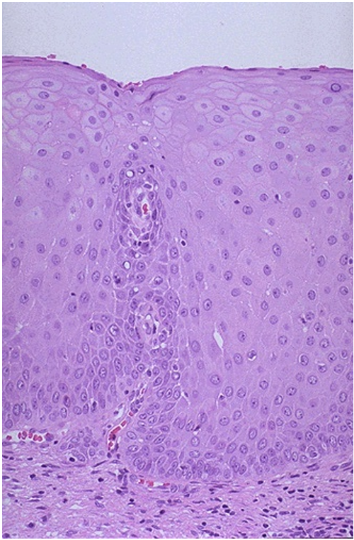
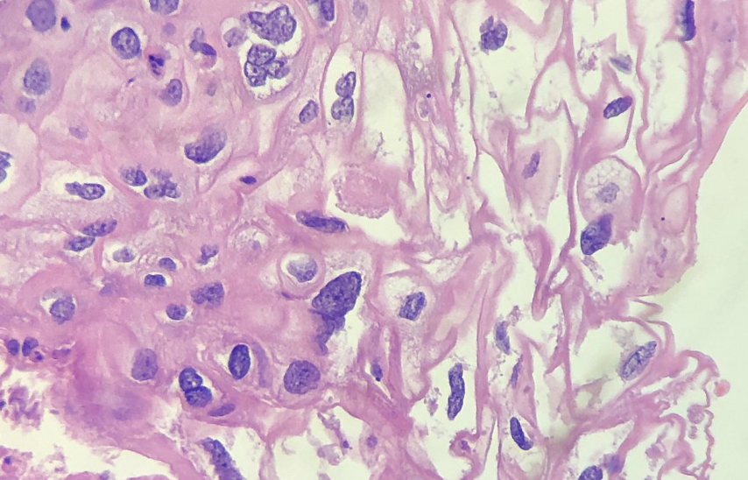
Cervicitis
4. Herpes simplex virus (HSV)
HSV Type 2 infection (most common cause of genital herpes)
Sexual transmission.
It produces vesicles and ulcers that can involve the cervix,
vagina ,vulva, urethra, and perianal skin.
Pap smears (cytology):
3 Ms: Multinucleation, molding of nuclei and margination of
chromatin.
Intranuclear “Cowdry type A” viral inclusions.
Nucleic Ground glass appearance due to accumulation of viral particles.
5. Human papillomavirus infection (HPV)
HPV infection of the cervix is common.
Over 20 serotypes of HPV infect the female genital areas.
Clinical behavior
koilocytic atypia in the cervical squamous epithelium.
Associated with increased risk of subsequent cervical cancer.
HPV may cause any of the following depending on the serotype:
1. Condyloma | 2. Low grade (Mild) dysplasia | 3. High-grade dysplasia
In the squamous epithelium of the ectocervix. The lesions may be flat or exophytic (called exophytic condyloma acuminatum). Usually caused by serotypes 6 & 11. | usually caused by: Low risk HPV serotypes, 6 and 11. Usually associated with condyloma. | usually caused by: - High risk HPV (types 16 and 18). - Moderate risk HPV (types 31, 33 and 35).
4. Koilocytes: are squamous epithelial cells that have undergone
structural change due to infection of the cell by HPV.
They show koilocytosis or koilocytic atypia which include the
following cellular changes:
Nuclear enlargement.
Irregular nuclear membrane.
Nuclear hyperchromasia (Dark nuclei).
Perinuclear halo (clear area around the nucleus).
Normal
koilocytosis

Slide 5
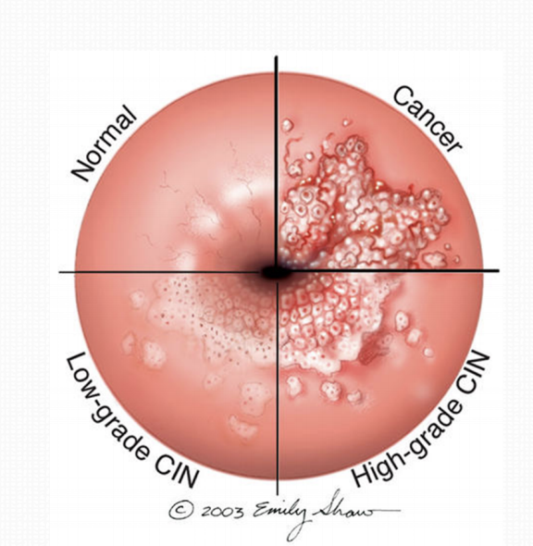
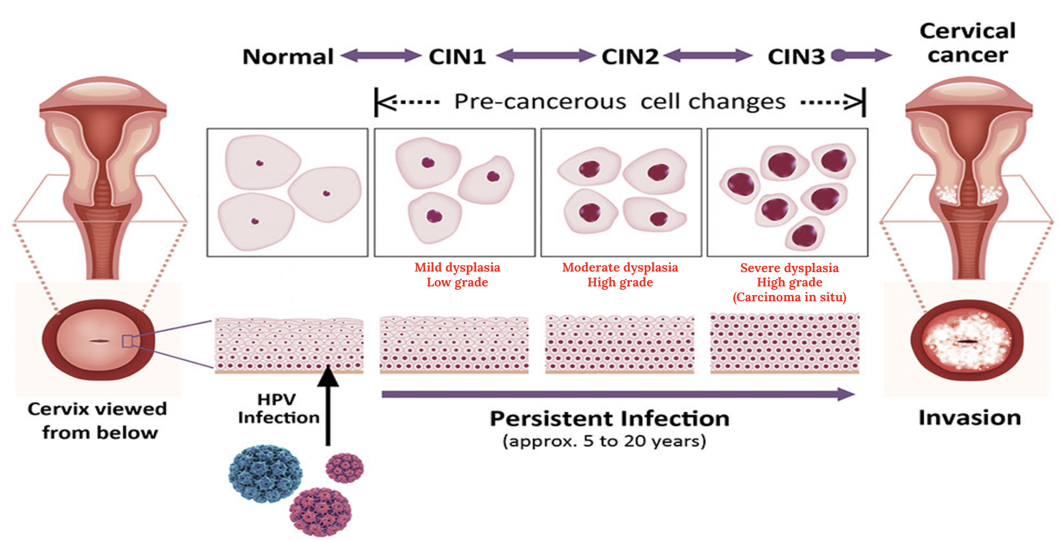
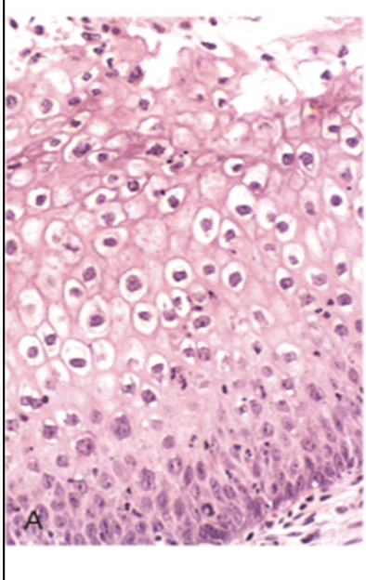
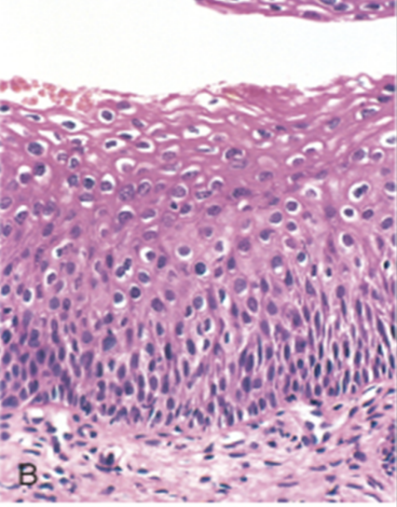
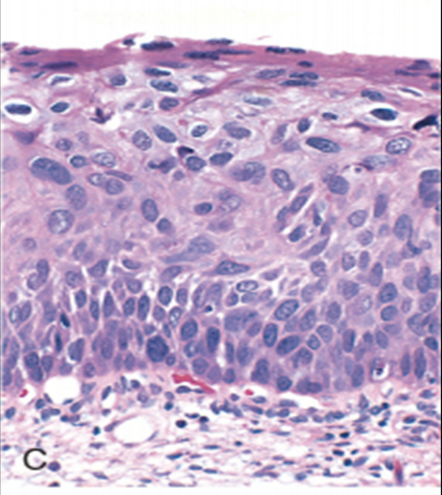
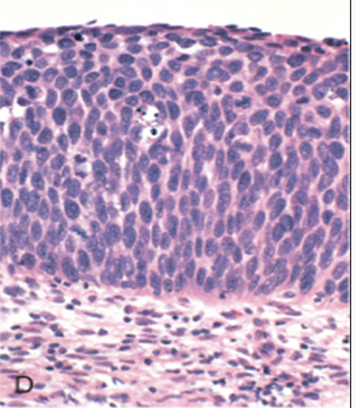
Neoplasia of the cervix
CIN - SIL
The most common cervical cancer is squamous cell carcinoma.
All invasive squamous cell carcinomas arise from non invasive precancerous cervical squamous epithelium called: cervical intraepithelial neoplasia (CIN) or squamous intraepithelial lesions (SIL).
NOT all cases of CIN/SIL progress to invasive cancer, some cases may spontaneously regress.
Cases of high grade CIN/SIL are associated with:
High-risk HPV serotypes and a higher risk of progression to cancer.
Timely detection and diagnosis of CIN/SIL is essential in preventing the development of invasive carcinoma.
CIN Histological Reporting
Terminology used for histological reporting is Cervical intraepithelial neoplasia (CIN).
CIN lesions may begin as Low Grade CIN and progress to High Grade.
Or they might begin straight away as High Grade CIN.
Based on histology, pre-cancer lesions are graded as:
CIN I: Mild Dysplasia.
CIN II: Moderate Dysplasia .
CIN III: Severe Dysplasia and Carcinoma in situ (CIS).
Normal | Koilocytes of HPV | CIN I | CIN II. | CIN III (CIS)
 |  | Mild dysplasia | Moderate dysplasia | Severe dysplasia
 | To differentiate | - Koilocytes in the upper part. - In the lower ⅓ of epithelium the maturation is lost and the cells are replaced by pleomorphic cells. | - Progressive koilocytic atypia in the upper layers. - In the lower ⅔ of the epithelium the maturation is lost and the cells are replaced by pleomorphic cells. | - There is diffuse koilocytic atypia and - All of the epithelium lost its maturation and the cells are replaced by pleomorphic cells, (full thickness).

Slide 6
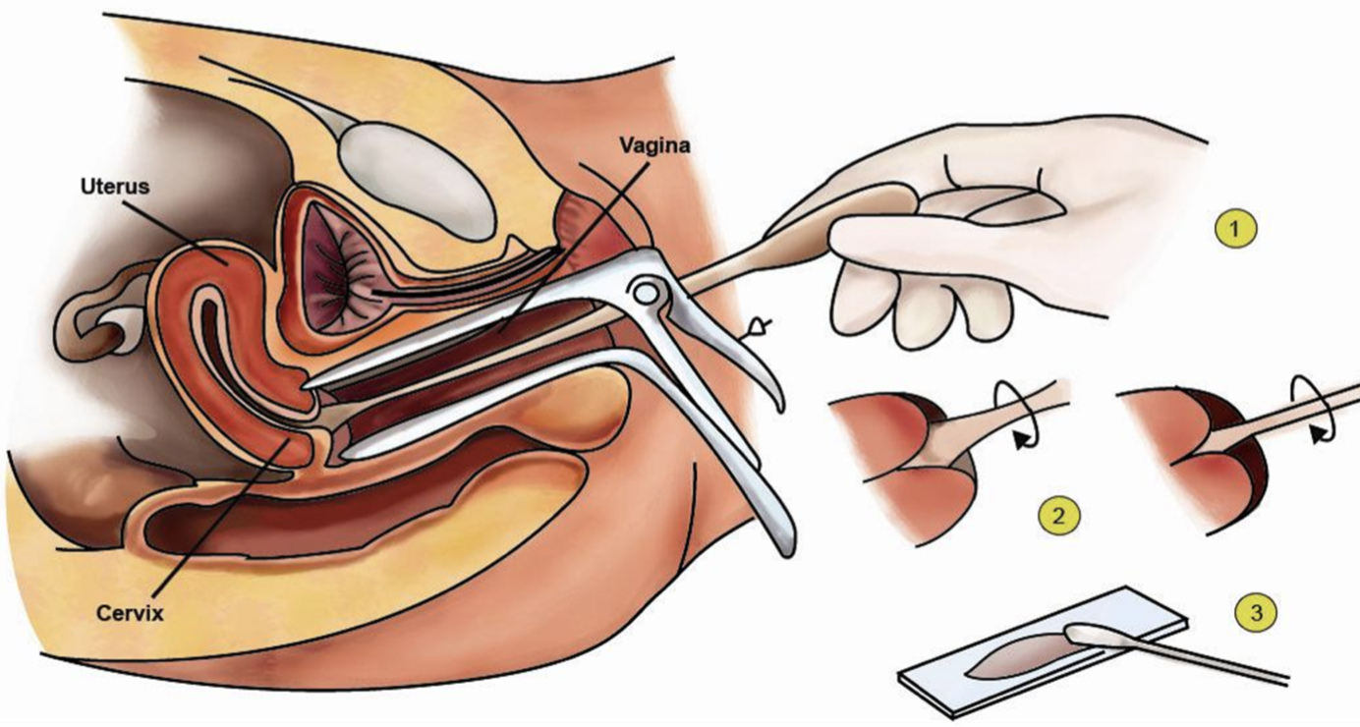
Neoplasia of the cervix
PAP Screening Test
Cytological examination (PAP screening test) can detect SIL long
before any abnormality can be seen grossly.
Deaths from cervical carcinoma are decreasing and there is an improvement of treatment due to the early diagnosis by PAP screening test.
PAP test is the cytological examination of the cells of cervix.
1. The cells lining the cervical wall at the transformation zone are scrapped off (sampled) with a spatula.
2. Then transferred onto a slide, processed, stained (Papanicolaou stain).
3. Then examined under a light microscope to look for squamous intraepithelial lesions (SIL) and a diagnosis is made.
Cytology Pap Smear
Terminology used in Pap smears is squamous Intraepithelial lesions (SIL).
In cytology smear report these are few of the possible diagnoses:
Normal cells: Negative for squamous intraepithelial lesion.
Low Grade SIL (LSIL): CIN 1 (mild dysplasia on histology).
High Grade SIL¹ (HSIL): CIN 2 and CIN 3 (moderate to severe dysplasia on histology).
About 1 to 5% of low Grade SIL become invasive squamous cell carcinomas.
About 6 to 74% of high Grade SIL become invasive squamous cell carcinomas.
Normal exfoliated superficial squamous epithelial cells
CIN I = low grade SIL
CIN II = high grade SIL
CIN III = high grade SIL
Cytoplasmic staining in superficial cells (PIC A&B) may be either red or blue.
In higher grade lesions: there is reduction in cytoplasm and increase in the nucleus to cytoplasm ratio.
This reflects the progressive loss of cellular differentiation on the surface of the lesions from which these cells are exfoliated.
1. Difficult to differentiate CIN 1 from CIN 2 on cytology, easier on histology.

Slide 7
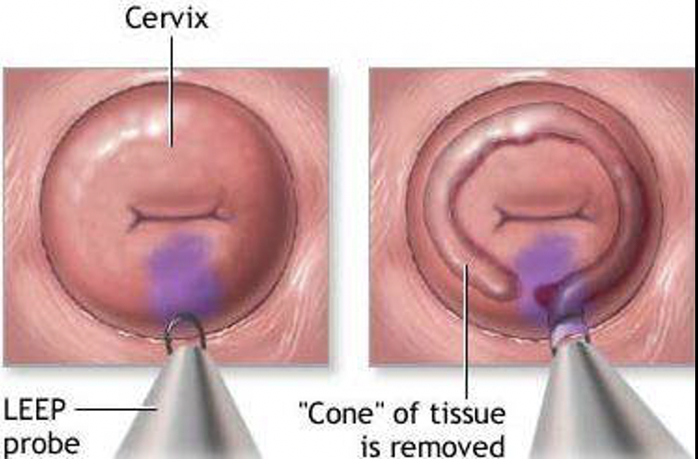
Neoplasia of the cervix
Rules for PAP TEST
Women may not show visible signs or symptoms so it is difficult to diagnose SIL/CIN without a Pap smear.
Therefore a regular pap exams should be done on women, to detect any SIL.
It is a common testing procedure for HPV infection. it detects HPV infection early.
General rules of pap smear test are:
Should start pap test by the age of 21.
For women between age 21 to 29: pap test should be done every 3 years.
For women between age 30-64 : there are 2 possibilities.
Either do only pap test once every 3 years.
Or do two tests (co-testing) at the same time the pap test + DNA in-situ hybridization (ISH) HPV testing, every 5 years.
Side note: ISH is done to identify the serotype of the HPV. This test will determine whether you carry high or low risk strains of the virus. It should not be used before age 30 if pap test is normal.
Risk Factors
Smoking.
Early age at first intercourse.
Multiple sexual partners.
Male partner with multiple previous sexual partners.
Persistent infection by high risk papillomaviruses.
Other risk factors: low socioeconomic groups.
Rare among virgins and multiple pregnancies¹.
Causes
The HPV virus is the number one cause.
HPV can be detected in 85 -90 % of pre-cancer lesions.
High risk types HPV: 16, 18, 31, 33, 35, 39, 45, 52, 56, 58, and 59.
Low risk types HPV: 6, 11, 42, 44 . These types result in condylomas.
Treatment
Laser or cone biopsy²: is the most effective method of managing
patients with High grade SIL in cancer prevention.
1. Protective factor.
2. By removing part of cervix (transformation zone).

Slide 8
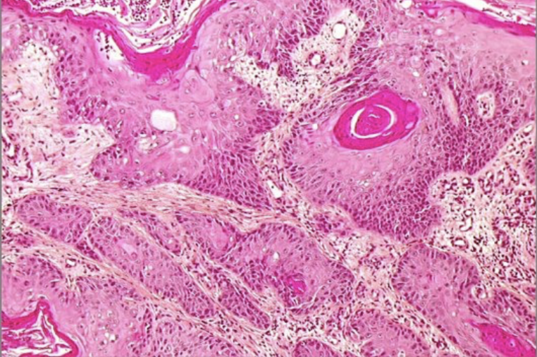
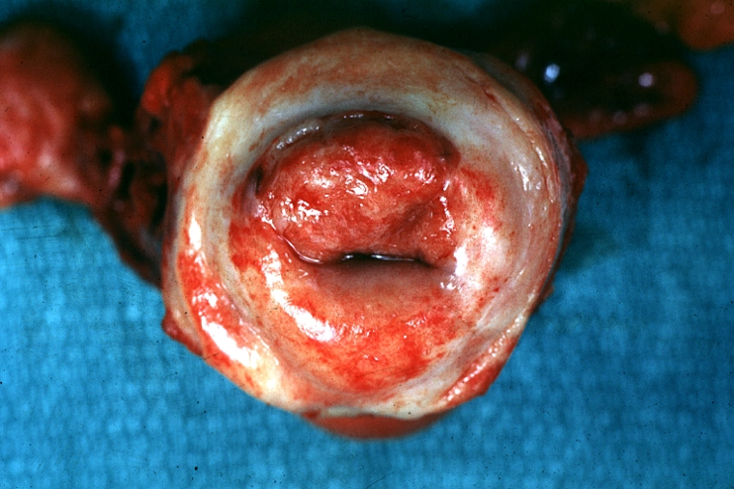
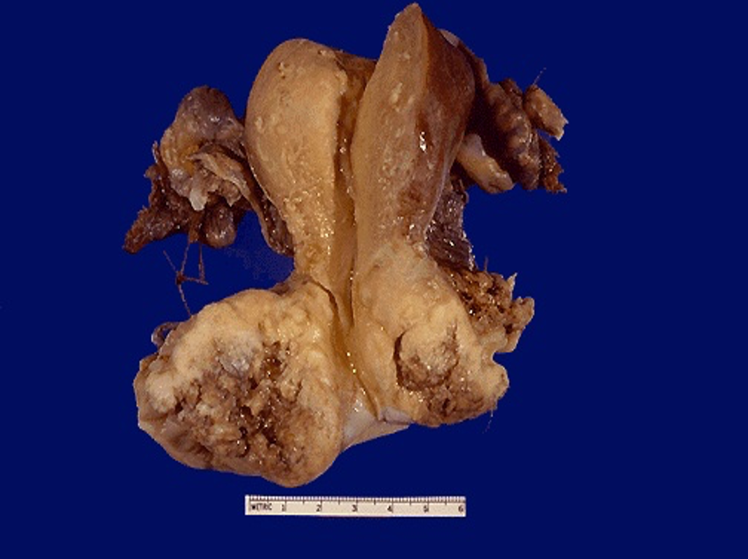
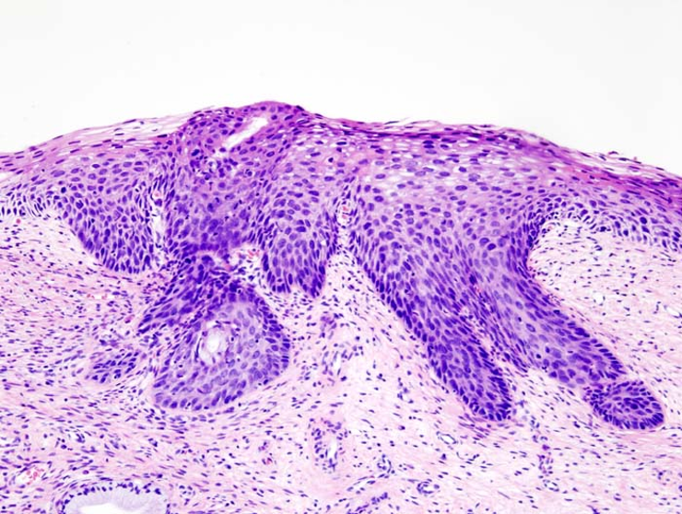
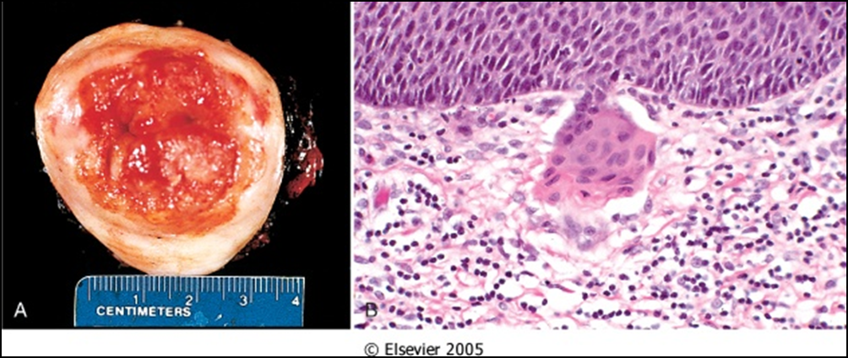
Invasive Cervical Carcinoma
Invasive Cervical Carcinoma
About 75-90% of invasive cancers are squamous cell carcinomas (ectocervix).
The remainder are adenocarcinoma (endocervix), and neuroendocrine carcinoma.
Reduction in the West is due to PAP smear test which detects premalignant lesions.
Morphology
The tumors may be invisible or present as an exophytic mass.
Cervical carcinomas are:
Graded from 1 to 3¹ (i.e. well, moderately and poorly differentiated) based on cellular differentiation.
Staged From 1 to 4 depending on clinical spread.
Well differentiated
Invasive Squamous Cell Carcinoma
Squamous cell carcinomas typically arise from pre-cancer CIN/SIL lesions at the transformation zone.
Peak incidence at the age of about 45 years, some 10 to 15 years after detection of precursor SIL.
Majority are diagnosed in the pre-invasive CIN/SIL phase due to pap test.
Advanced cases of Squamous cell carcinoma are seen in:
Women who either have never had a PAP smear.
Have waited many years since the last PAP smear.
1. Sometimes 4 = undifferentiated.

Slide 9
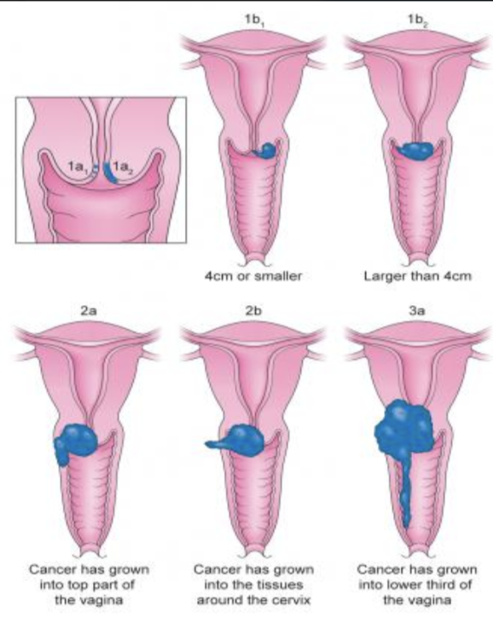
Invasive Cervical Carcinoma
Clinical features
The early stages may be completely asymptomatic (invisible lesions).
On colposcopy: cervix shows a mosaic¹ vascular pattern and the lesions appear as white patches after application of acetic acid to cervix.
Vaginal bleeding, contact bleeding, or cervical mass.
In advanced disease, metastases may be present in the abdomen, lungs or elsewhere.
Symptoms of advanced cervical cancer may include:
Loss of appetite, weight loss.
Fatigue.
Pelvic pain, back pain, leg pain, swollen legs.
Heavy bleeding from the vagina.
Bone fractures.
Treatment
Depending on the stage there are different treatment options: .
If patient wants to have children, the cancer is removed with a cone biopsy (cervical conization), and then followed up regularly.
Simple hysterectomy (removal of the whole uterus including part of the vagina).
Radical hysterectomy (removal of the whole uterus including part of the vagina along with the removal of lymph nodes in the pelvis)
Chemotherapy and radiotherapy maybe needed in advanced cases.
Mosaic vascular pattern
Cervical Carcinoma Staging²
Carcinoma in Situ.
Confined to the cervix.
Extension beyond the cervix without extension to the lower third of Vagina or Pelvic Wall.
Extension to the pelvic wall and/or lower third of the vagina.
Extends to adjacent organs.
1. Heterogenous.
2. Dr Maria: for your knowledge.

Slide 10
Summary
Pathology of Uterine Cervix
Cervical erosions | - Benign, Squamous Epithelium is replaced by columnar epithelium. - Causes erythematous area.
Squamous metaplasia | - Benign, The columnar cells are replaced by squamous cells. - Seen at the squamocolumnar junction. - Most affected area by HPV.
Cervical polyp | - Non neoplastic small, pedunculated mass, can be endo or ectocervix. - Overgrowth of benign cervical stroma covered by cervical epithelium (commonly columnar).
Cervicitis
Infectious
Candidiasis (moniliasis) | - Common and Involves both of the cervix and vagina. - In immunosuppression. - Characterized by white patchy mucosal lesions with thick curdy white discharge.
Trichomoniasis | - It is sexually transmitted disease and Involves the vagina and cervix. - Greenish-yellow frothy and foul smelling vaginal discharge + Painful urination.
Chlamydia trachomatis | - Chlamydia trachomatis is an obligate, gram -ve intracellular pathogen. - Most common sexually transmitted disease also coexist with Neisseria gonorrhoeae infection. - Mucopurulent cervical discharge + associated urethritis.
Herpes simplex virus (HSV) | - It produces vesicles and ulcers. - Cytology: intracellular “Cowdry type A” viral inclusion and the 3 Ms → multinucleated cells, molding of nuclei, margination of chromatin.
Human papillomavirus (HPV) | - Most important because it increases the risk of cervical cancer. - Pathology: - Condyloma: caused by serotypes 6 & 11. - Low grade dysplasia: caused by low risk serotypes 6 & 11. - High grade dysplasia: caused by moderate risk serotypes 31, 33 & 35 and high risk serotypes 16 & 18. - Koilocytosis.

Slide 11
Summary
Neoplasia of the cervix
Grading | - CIN: Terminology used for histological reporting. - SIL: Terminology used in Pap smears (cytology). - Low grade SIL (LSIL): - CIN I: low dysplasia, loss of maturation in the lower ⅓ epithelium on histology. - 1-5% become invasive. - High grade SIL (HSIL): - CIN II: moderate dysplasia, loss of maturation in the lower ⅔ epithelium. - CIN III and CIS: severe dysplasia, loss of maturation in all epithelium on histology. - 6-74% become invasive.
Risk Factors | - Early age at first intercourse, Multiple sexual partners, Persistent infection.
Causes | - The HPV virus number one cause for abnormal cells of the cervix.
Treatment | - Laser or cone biopsy.
Invasive Cervical Carcinoma
Introduction | - 75-90% of invasive cancers are ectocervical squamous cell carcinomas which arise from CIN/SIL lesions at the transformation zone. - The remainder are endocervical adenocarcinoma.
Morphology | - Invisible or visible as an exophytic mass.
Clinical features | - Vaginal bleeding, contact bleeding, or cervical mass In advanced disease, metastases may be present.
Treatment | ● Simple hysterectomy ● Radical hysterectomy ● Chemotherapy and radiotherapy

Slide 12
Quiz
1) A 31-year-old, sexually active woman has had a mucopurulent vaginal discharge for 1 week. On pelvic examination, the cervix appears reddened around the os, but no erosions or mass lesions are present. A Pap smear shows numerous neutrophils, but no dysplastic cells. A cervical biopsy specimen shows marked follicular cervicitis. Which of the following infectious agents is most likely to produce these findings?
A- Candida albicans
B- Chlamydia trachomatis
C- Gardnerella vaginalis
D- Herpes simplex virus
2) A 31-year-old woman has had vulvar pruritus along with a thick, whitish, odorless, globular vaginal discharge for the past week. On pelvic examination, the cervix appears erythematous, but there are no erosions or masses. A Pap smear shows budding cells and pseudohyphae. No dysplastic cells are present. Which of the following infectious agents is most likely to produce these findings?
A- Candida albicans
B- Chlamydia trachomatis
C- Neisseria gonorrhoeae
D- Trichomonas vaginalis
3) A healthy 30-year-old woman comes to the physician for a routine health maintenance examination. No abnormalities are found on physical examination. A screening Pap smear shows cells consistent with a low-grade squamous intraepithelial lesion (LSIL). Subsequent cervical biopsy specimens confirm the presence of cervical intraepithelial neoplasia (CIN) I. Which of the following risk factors is most likely related to her Pap smear findings?
A- Diethylstilbestrol (DES) exposure
B- Multiple sexual partners
C- Oral contraceptive use
D- Prior treatment for a malignancy
4) A 33-year-old woman comes to her nurse practitioner for a routine health maintenance examination. On physical examination, there are no abnormal findings. A Pap smear reveals Dysplasia extending to the middle third of epithelium with some pleomorphism and mitosis. In which stage is she?
A- CIN I
B- CIN II
C- CIN III
D- SCC
5) A 42-year-old woman has a Pap smear as part of a routine health maintenance examination. There are no remarkable findings on physical examination. The Pap smear shows cells consistent with a high-grade squamous intraepithelial lesion (HSIL) with human papillomavirus type 18. Cervical biopsy specimens are obtained, and microscopic examination confirms the presence of extensive moderate dysplasia (CIN II) along with intense chronic inflammation with squamous metaplasia in the endocervical canal. What is the most likely explanation for proceeding with cervical conization for this patient?
A- Her reproductive years are over
B- HPV infection cannot be treated
C- Risk for invasive carcinoma
D- Presence of chronic cervicitis
6) A 43-year-old woman has had postcoital bleeding for 6 months. She experienced menarche at age 11 years and has had 12 sexual partners during her life. She continues to have regular menstrual cycles without abnormal intermenstrual bleeding. Pelvic examination shows a focal, slightly raised area of erythema on the cervix at the 5 o’clock position. A Pap smear shows a high-grade squamous intraepithelial lesion (HSIL), also termed severe cervical intraepithelial neoplasia (CIN III). Analysis of cells from the cervix shows the presence of human papillomavirus type 16. Which of the following malignancies is she at greatest risk of developing if the lesion is not treated?
A- Clear cell carcinoma
B- Immature teratoma
C- Krukenberg tumor
D- Squamous cell carcinoma
7) A 34-year-old woman has a routine Pap smear for the first time. The results indicate that dysplastic cells are present, consistent with a high-grade squamous intraepithelial lesion (HSIL), also called cervical intraepithelial neoplasia (CIN) III. She is referred to a gynecologist, who performs colposcopy and takes multiple cervical biopsy specimens that all show CIN III. Conization of the cervix shows a focus of microinvasion at the squamocolumnar junction. Based on these findings, what is the next most likely step in treating this patient?
A- Bone scan for metastatic lesions
B- Course of radiation therapy
C- No further therapy
D- Vaginal hysterectomy
1- B
2- A
3- B
4- B
5- C
6- D
7- C

Slide 13
Team Subleader
Alhanouf Alhaluli
Done by the brilliant minds
Alwaleed ALarabi, Mohammed ajarem
Note taker

