Slide 1
Editing file
Polycystic Ovarian Disease and Endometriosis
Objectives
Know the clinicopathologic features of endometriosis with special emphasis on: definition, typical sites and theories behind its pathogenesis.
Understand the clinical manifestations and pathologic features of polycystic ovarian disease.

Slide 2
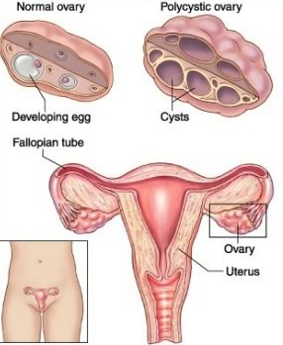
Polycystic ovarian disease
Introduction
PCOD is characterized by:
Bilateral enlargement of ovaries by multiple small cysts. (Radiological)
Chronic anovulation.
Clinical manifestations secondary to excessive production of estrogens and mainly androgens. (Clinical & Biochemical)
Other names for this disease include polycystic ovarian syndrome and Stein-Leventhal syndrome.
Pathophysiology
Unknown but related to Hypothalamus-pituitary dysfunction.
Over secretion of luteinizing hormone (LH).
LH stimulates the ovary to produce excess androgens.
Secretion of (FSH) is inhibited.
Suppression of ovulation and formation of cystic follicles in the ovary.
So, Patients have:
High levels of LH.
Low FSH.
High testosterone.
High estrogen¹.
Clinical presentation
It usually affects young women (between 15 and 30 years) and they present with:
Secondary amenorrhea with anovulation.
Oligomenorrhea or irregular menses.
Virilism² (due to increased androgenic masculinizing hormones).
Infertility.
Hirsutism.
Obesity.
Acne (due to excess androgens).
Morphology
Gross
A: Numerous nodular elevations of clear cysts.
B: Cut surface, Subcortical cystic follicles in the ovary.
1- follicles that underwent cystic dilation and degeneration secrete estrogen
2- only in severe cases along with hirsutism and voice hoarseness .

Slide 3
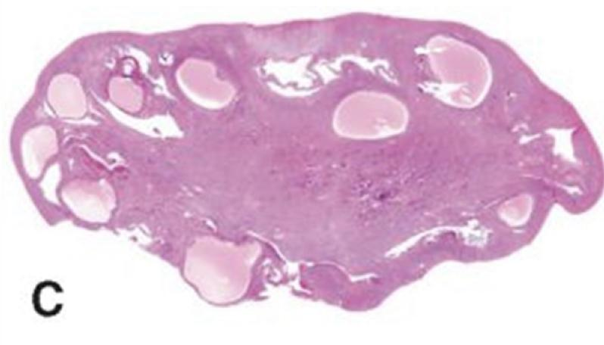
Polycystic ovarian disease
Microscopic
Ovaries | Endometrium
2 times the normal size with many subcortical cysts measuring 0.5 to 1.5 cm in diameter. The outer stromal portion of the cortex is thickened and fibrotic with multiple cysts underneath. The follicular cysts usually have a prominent theca interna layer. Absent Corpora lutea¹. | Chronic anovulation → unopposed estrogen → hyperestrogenic state → endometrium may develop estrogen associated hyperplasia and show any of the following: Simple with or without atypia. Complex hyperplasia, with or without atypia. Endometrial adenocarcinoma.
Risks associated with PCOD
Endometrial hyperplasia & cancer.
Insulin resistance → Type II diabetes.
Depression, Anxiety.
Metabolic syndrome: Dyslipidemia, weight gain, hypertension, CVD, strokes.
Autoimmune thyroiditis.
Miscarriage.
Acanthosis nigricans: patches of darkened skin under the arms, in the groin area and on the back of the neck.
Treatment
The goal of treatment is to initiate ovulation and regulate the menstrual cycle to restore fertility by:
Treatment with drugs such as: clomiphene or hCG.
Reduction² of ovarian volume by wedge resection of the ovaries
The endometrial changes usually regress once ovulation is achieved.
No ovulation occurs, women with PCOD have anovulatory cycles. Corpus luteam: collection of fibrous tissue ( scar).
In severe or resistant cases

Slide 4
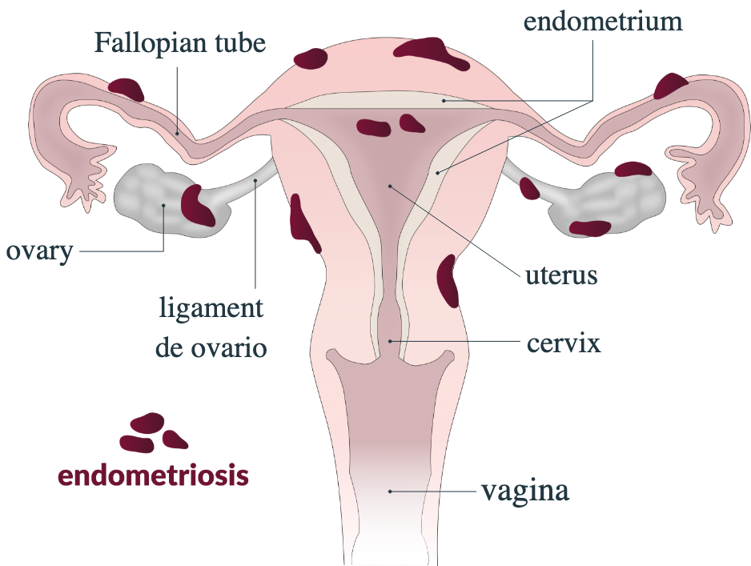
Endometriosis
Introduction
Endometriosis is the presence of ectopic endometrial glands and stroma outside the uterus.
It is a non-neoplastic condition.
Like the uterine endometrium:
it is responsive to the hormonal variations of the menstrual cycle, and bleeds during menstruation.
Therefore, there is menstrual type bleeding at the site of the ectopic endometrium, resulting in blood filled areas (chocolate cysts).
Locations
Found on the peritoneal surfaces of the reproductive organs and adjacent pelvic organs.
The most frequent locations are:
Ovary, the most common site, around 50%.
Pouch of Douglas¹ and uterine ligaments, second most common.
Occasionally: cervix, vagina, perineum, bladder, large bowel and umbilicus.
Rarely: small bowel, kidneys, lungs, nose and brain.
It has been reported in men. The sites involved have been the bladder, scrotum and prostate.
Clinical presentations
Depends on the site of endometriosis:
Dysmenorrhea: pain during menstruation.
Dyspareunia: painful sexual intercourse.
Cyclic abdominal pain, there is severe menstrual related pain.
Infertility.
Fibrous adhesions²
It may recur after surgical excision but the risk is low.
Rectouterine pouch: extension of the peritoneal cavity between the rectum and the uterus.
Cause disruption of anatomy, pain and improper fertilization leading to infertility.

Slide 5
Endometriosis
Morphology
Gross
Red or brown nodules:
Multiple.
Due to hemosiderin.
1 mm to 5 mm, or may form larger mass or cysts.
Fibrous adhesions:
Dense may surround the foci.
Chocolate cyst:
Cysts filled with chocolate brown material.
Produced by repeated hemorrhage into the ovary with each menstrual cycle.
With time the ovaries become totally cystic and turn into large cystic masses filled with chocolate brown fluid.
Microscopic
Ectopic endometrial glands and endometrial stroma are present.
Denatured blood from previous bleeding is present.
Macrophages containing hemosiderin (siderophages) are present.
When endometriosis develops in a muscular organ (e.g bowel), the smooth muscle around it becomes hyperplastic.

Slide 6
Adenomyosis
Introduction
Presence of endometrial glands and endometrial stroma deep in the myometrium of the uterus.
It is more common in the posterior wall than the anterior wall, but it may affect both walls of the same uterus.
The disease is primarily a disorder of parous women (having produced offspring) and is uncommon in the nullipara.
Clinical presentation
Asymptomatic in ⅓ of the patients.
Associated with menorrhagia¹ and severe dysmenorrhea.
When extensive the lesions cause:
Myometrial thickening.
Small yellow or brown cystic spaces containing fluid or blood.
Prognosis
Benign with no known malignant potential.
Usually regresses after the menopause.
Morphology
Cross section through the wall of a hysterectomy specimen of a 30 year old woman who reported chronic pelvic pain and abnormal uterine bleeding:
The endometrial surface is at the top of the image.
The serosa is at the bottom.
Because the myometrium contraction is what limits bleeding, so when it’s affected it will not perform its job normally.

Slide 7
Summary
Polycystic ovarian disease
Definition | - Bilateral enlargement of ovaries with multiple small cysts, chronic anovulation. - Clinical manifestations secondary to excessive production of androgens.
Pathology | Patients have: High LH, Low FSH, High testosterone, High estrogen.
Morphology | Gross: Numerous nodular elevations of clear cysts with a cut surface of subcortical cystic follicles in the ovaries. Microscopic: Ovaries: subcortical cysts, outer portion of the cortex is thickened and fibrotic, corpora lutea are absent. Endometrium: estrogen associated hyperplasia.
Clinical presentation | Amenorrhea with anovulation, Oligomenorrhea, Virilism, Infertility, Hirsutism, Obesity, Acne.
Risks | Endometrial hyperplasia & cancer, metabolic syndrome, autoimmune thyroiditis, miscarriage, acanthosis nigricans.
Endometriosis
Definition | - Ectopic endometrial glands and stroma outside the uterus. - Non-neoplastic condition. - Most common in ovaries.
Morphology | - Gross: red or brown nodules, chocolate cyst, fibrous adhesions. - Microscopic: endometrial gland and stroma, siderophages.
Clinical presentation | Infertility, fibrous adhesions, dysmenorrhea, dyspareunia, cyclic abdominal pain.
Adenomyosis
Definition | - Endometrial glands and endometrial stroma deep in the myometrium. - Disorder of parous women.
Morphology | Presence of Endometrial glands and endometrial stroma in the myometrium of the uterus.
Clinical presentation | - Menorrhagia and severe dysmenorrhea. - Benign and regresses after menopause.

Slide 8
Quiz
1) A 21-year-old woman experienced menarche at age 14 years and had regular menstrual cycles for the next 3 years. For the past year, she has had oligomenorrhea and has developed hirsutism. She has noticed a 10-kg weight gain in the past 4 months. On pelvic examination, there are no vaginal or cervical lesions, the uterus is normal in size, and the adnexa are prominent. A pelvic ultrasound scan shows that each ovary is twice normal size, whereas the uterus is normal in size. MRI shows multiple small ovarian cysts. Which of the following conditions is most likely to be present in this woman?
A- Immature teratomas.
B- Krukenberg tumors.
C- Endometriosis.
D- Polycystic ovarian syndrome.
2) A 36-year-old woman has had menorrhagia and pelvic pain for six months. She had a normal, uncomplicated pregnancy 10 years ago but has failed to conceive since then. She has been sexually active with one partner for the past 20 years and has had no dyspareunia. On pelvic examination she has a symmetrically enlarged uterus, with no apparent nodularity or palpable mass. A serum pregnancy test result is negative. What is the most likely diagnosis?
A- Endometriosis.
B- Adenomyosis
D- Polycystic ovarian syndrome.
C- Leiomyoma
3) The clinical presentations of PCOD are caused by which of the following ?
A- Excessive secretion of androgens.
B- Excessive secretion of FSH.
C- Decreased secretion of LH.
D- Decreased secretion of androgens.
4) Which of the following is the most common site of endometriosis?
A- Fallopian tube.
B- Pouch of Douglas.
C- Ovary.
D- Vagina.
5) A 34 year old female presenting with concerns of infertility. She has been attempting a pregnancy over the past 16 months with no success. Patient reports that several times she thought she could be pregnant due to a cessation in her menses with accompanying constipation and some abdominal pain. Patient also reports pain that is more intense during menstruation, with “sharp and stabbing” characteristics that is not relieved by use of NSAIDs or hot compresses. Patient reports her cycle can be irregular, or occasionally no period at all. She is concerned that her and her husband have not had enough intercourse for a pregnancy due to general pelvic pain and dyspareunia. What is the most likely diagnosis?
A- Polycystic ovarian syndrome.
B- Endometriosis.
C- Adenomyosis.
D- Dysgerminoma.
6) Gross morphology of endometriosis includes ALL but:
A- Multiple red or brown nodules.
B- Dense fibrous adhesions surrounding the foci.
C- Chocolate cysts.
D- Numerous nodular elevations of clear cysts.
7) Women with PCOS are at high risk of developing:
A- Weight loss.
B- Hypotension.
C- Endometrial hyperplasia.
D- Kidney failure.
8) A presence of endometrial glands and endometrial stroma in the uterine myometrium is called?
A- Ectopic pregnancy.
B- Chronic endometriosis.
C- Endometriosis.
D- Adenomyosis.
1- D
2- B
3- A
4- C
5- B
6- D
7- C
8- D

Slide 9
Team Subleader
Alhanouf Alhaluli
Done by the brilliant minds
Alhanouf Alhaluli & Danah AlHalees
Note taker
Taibah Alzaid

