Slide 1
Editing file
Helpful video
Breast Pathology
Objectives
Benign breast diseases:
Know the ways that benign breast conditions can clinically present.
Know the common inflammatory conditions of breast (mastitis and abscesses).
Understand the pathology of fibrocystic change.
Know the common benign breast tumours with special emphasis on fibroadenoma and phyllodes tumour.
Know the risk of subsequent breast cancer in women with diagnosed benign breast lesions.
Breast cancer:
Know the risk factors, classification, behavior and spread of breast cancer.
Know the prognostic indicators of breast carcinoma.

Slide 2
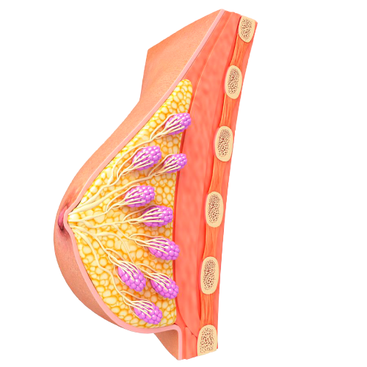
Lecture Content
1- Inflammatory lesions
Acute mastitis
Periductal mastitis
Mammary duct ectasia: dilated ducts disease
Fat necrosis: due to mechanical trauma, surgical or otherwise
Lymphocytic mastopathy (sclerosing lymphocytic lobulitis) seen in diabetics
Granulomatous mastitis
2- Benign epithelial lesions
Non proliferative breast changes
Proliferative breast disease without atypia.
Proliferative breast disease with atypia
3- Stromal tumors
Fibroadenoma
Phyllodes tumors
4- Carcinoma in situ
5- Invasive carcinoma
Ductal carcinoma in situ
Lobular carcinoma in situ
Ductal carcinoma
Lobular carcinoma

Slide 3
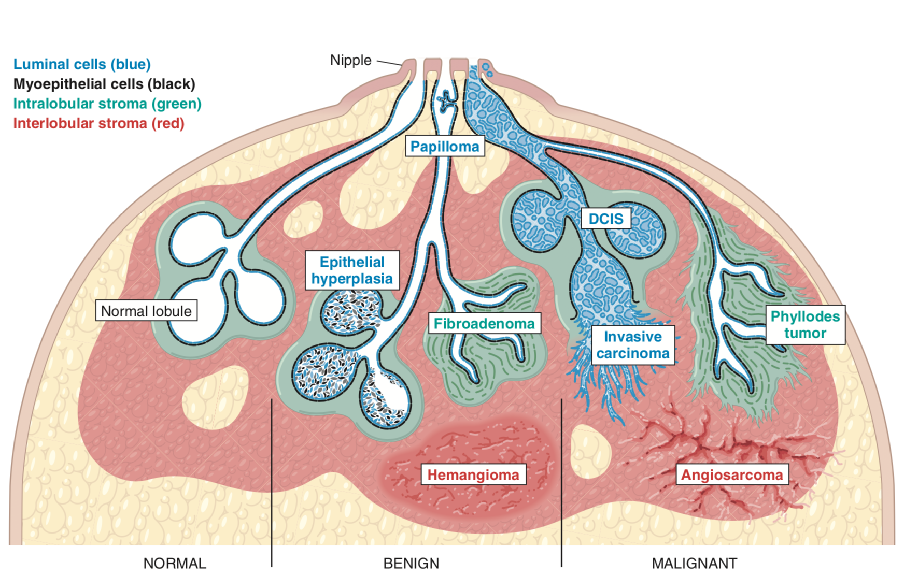
Breast Inflammatory diseases
Introduction
The functional unit of the breast is the lobule, which is
supported by intralobular stroma.
Lined by myoepithelial and luminal cells.
Each normal constituent is a source of Inflammatory,
benign and malignant lesions.
Mastitis
1) Acute mastitis¹:
Rare and may be caused by autoimmune disease, or foreign body–type reactions.
Or Infections:
The only agent is Staphylococcus aureus.
Cause breast disease with any frequency.
Gains entry via fissures in nipple skin during the first weeks of breastfeeding.
Leads to the formation of lactational abscesses: collections of neutrophils and associated bacteria in fibroadipose tissue.
If untreated, tissue necrosis may lead to the appearance of fistula tracks opening onto the skin.
Symptoms include:
Erythema and edema, often accompanied by pain and focal tenderness.
Because it is rare, the possibility that the symptoms are caused by inflammatory carcinoma should always be considered.
Most cases are treated adequately with antibiotics and continued expression of milk. Rarely, surgical incision and drainage is required.
2) Periductal mastitis: strongly associated with smoking, not lactation.
Gains entry via fissures in nipple skin during the first weeks of breastfeeding.
Forms lactational abscesses: collections of neutrophils and associated bacteria in fibroadipose tissue.
If untreated, tissue necrosis may lead to the appearance of fistula tracks opening onto the skin.
1. Most cases are treated with antibiotics and continued expression of milk.

Slide 4
Intro to Breast tumors
Clinical presentation
Pain (mastalgia or mastodynia)
Inflammation
Nipple discharge
- Common symptom often related to menses, possibly due to cyclic edema and swelling.
- Pain localized is usually caused by a ruptured cyst or trauma to adipose tissue (fat necrosis).
- Almost all painful masses are benign, but for unknown reasons about 10% of cancers cause pain.
- Causes an edematous and erythematous breast.
- It is rare and is most often caused by infections, which only occur with any frequency during lactation and breastfeeding.
- An important mimic of inflammation is “inflammatory” breast carcinoma.
- May be normal when small in quantity and bilateral.
- The most common benign lesion producing a nipple discharge is a large duct papilloma.
- Discharges that are spontaneous, unilateral, and bloody are of greatest concern for malignancy.
Lumpiness, or a diffuse nodularity
Palpable masses¹
Gynecomastia
- Throughout the breast, is usually a result of normal glandular tissue.
- When pronounced, imaging studies may help to determine whether a discrete mass is present.
- Can arise from proliferations of stromal or epithelial cells.
- Detected when they are 2-3 cm size.
- Most (95%) are benign; these tend to be round to oval and to have circumscribed borders.
- In contrast, malignant tumors usually invade across tissue planes and have irregular borders.
- The only common breast symptom in males.
- There is an increase in both stroma and epithelial cells resulting from an imbalance between estrogens, which stimulate breast tissue, and androgens, which counteract these effects.
Mammographic screening
Detect early, nonpalpable asymptomatic breast carcinomas before metastatic spread has occurred.
The average size of invasive carcinomas detected by mammography is significantly smaller than cancers identified by palpation, and only 15% will have metastasized to regional lymph nodes at the time of diagnosis.
Generally recommended to start after age 40.
Densities (mass):
Most tumors appear radiologically denser than the normal breast.
Fibroadenomas, cysts etc. can also present as densities.
Calcifications:
Calcium gets deposited in secretions, necrotic debris, or hyalinized stroma.
It can be seen in benign and malignancy (small, irregular, numerous, & clustered).
Ductal carcinoma in situ (DCIS) is most commonly detected as mammographic calcifications. it has increased the diagnosis of DCIS.
1. because some cancers grow deceptively as circumscribed masses, all palpable masses require evaluation.

Slide 5
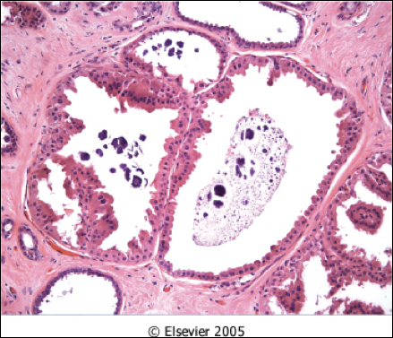
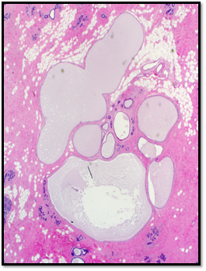
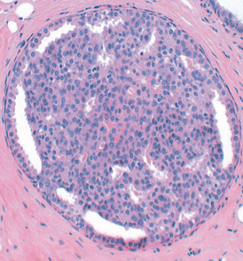
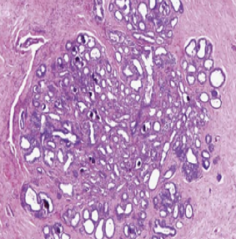
Benign epithelial lesions
1- Non proliferative Breast Changes (Fibrocystic changes)
Most common disorder of the breast.
No increased risk for cancer.
Produce palpable masses, mammographic densities, nipple discharge. Cyclic pain
Age: 20-55 years, decreases progressively after menopause.
Thought to be due to caused by hormonal imbalances.
Histology
Nonproliferative because the lesions contain 2 layers of cells (Epithelial & myoepithelial
Three morphological changes:
1- Cysts with apocrine metaplasia | 2- Fibrosis (fibrocystic changes) | 3- Adenosis
- Cysts are lined by luminal benign flattened to columnar epithelium. - With focal apocrine metaplasia: cells become large and have abundant eosinophilic cytoplasm. - Apocrine secretions may calcify and be detected by mammography. | - The cysts can rupture and cause inflammation and fibrosis in response to the spilled debris. - May produce palpable firmness (nodularity) of the breast. | - An increase in the number of acini per lobule. - can also be seen in pregnancy.
2- Proliferative Disease without Atypia.
Rarely form palpable masses.
Incidental finding; detected as small mammographic densities.
Risk for cancer is 1.5 – 2 times normal.
Include the following entities:
a- Epithelial Hyperplasia | - Defined as the presence of more than 2 layers. - Range from mild, moderate to severe/florid. | Microscopy: - Both epithelial and myoepithelial cells proliferate. - Can be seen in the ducts and lobules.
b- Sclerosing Adenosis | - Mostly as incidental microscopic finding but may occasionally present as a palpable mass that is mistaken clinically for cancer. - Calcification is commonly seen in the lesion, so even on mammography it can mimic cancer. Almost always associated with fibrocystic changes | Microscopy: - Adenosis and stromal fibrosis in the lobule which leads to compression and distortion of the lobule.

Slide 6
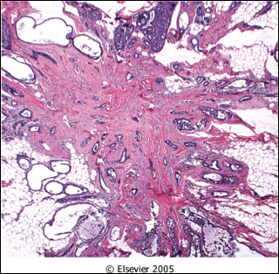
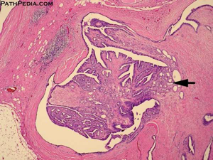
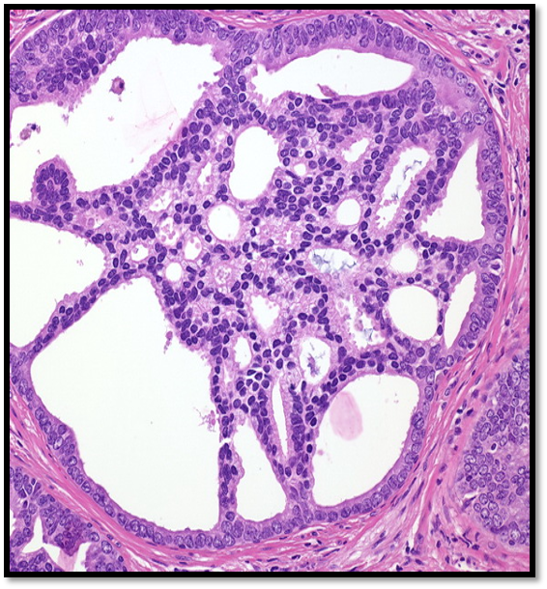
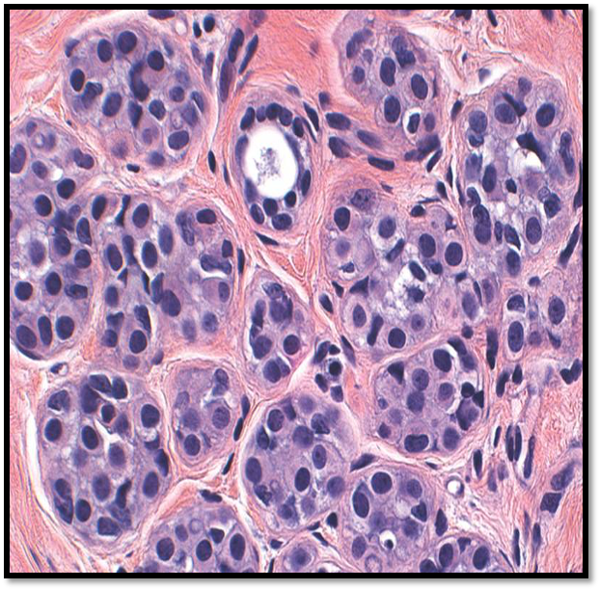
Benign epithelial lesions
c- Complex Sclerosing Lesion (Radial Scar) | - Radial scars¹: are stellate lesions characterized by a central nidus of entrapped glands in a hyalinized stroma. Nidus is surrounded by radiating arms of epithelium w/ cysts & hyperplasia | - Present as an irregular mammographic density. - Closely mimic an invasive carcinoma² both mammographically and grossly.
d- Papillomas | - Is a papillary tumor that arises from the ductal epithelium.
 | Large duct papillomas (central papillomas): | Small duct papillomas:
 | - More common. - Solitary and situated in the lactiferous duct at the nipple. - Patients present with bloody nipple discharge. Sometimes, subareolar mass | - Commonly multiple and located deeper within the ductal system. - Increase the risk of subsequent carcinoma.
E-Proliferative variant of Fibrocystic disease | - when epithelial hyperplasia features are seen in fibrocystic disease it is called proliferative variant of fibrocystic disease
3- Proliferative breast disease with atypia
Atypical hyperplasia is a cellular proliferation.
Risk for cancer is 4-5 times normal.
Has some of the architectural and cytologic features of carcinoma in situ but lack the complete criteria for that diagnosis and is categorized as:
1
Atypical ductal hyperplasia
2
Atypical lobular hyperplasia
Stromal tumors
Interlobular stroma
Monophasic: only comprised of mesenchymal cells.
Include benign soft tissue tumors found elsewhere in the body, such as hemangiomas and lipomas.
The only malignancy derived from this type is angiosarcoma, which may arise in the breast after local radiotherapy.
1- The word "scar" refers to the morphologic appearance, and not a prior inflammation, trauma or surgery.
2- Difficult to differentiate from carcinoma.

Slide 7
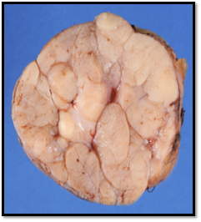
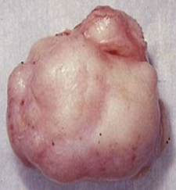
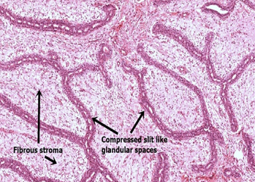
Stromal tumors
Intralobular stroma
Biphasic: comprised of both stromal cells and epithelial cells.
As the neoplastic proliferation of specialized lobular fibroblasts also stimulates reactive proliferation of lobular epithelial cells.
Two types: fibroadenoma and phyllodes tumors.
Fibroadenoma
The most common benign tumor of female breast, Almost never malignant.
Any age, most common before age 30.
Classic presentation:
Firm, mobile lump “breast mouse”.
It may increase in size during pregnancy or stop growing and regress after menopause.
usually solitary but may be multiple and involve both breasts.
Treatment: lumpectomy (only the lump is removed)
Morphology
Gross:
Spherical nodules, size vary (1cm to 10cm).
Sharply demarcated and circumscribed
Freely movable and can be shelled out.
Cut surface: pearl-white and whorled.
Histology:
Mixture of ducts and fibrous connective tissue.
The stromal proliferation push and distort the
associated epithelium. Sharp borders.
Phyllodes
Can occur at any age, but most present in the 40s and 50s.
Much less common than fibroadenomas.
Most present as large palpable masses (usually 3 to 4 cm in diameter)
Morphology: fibroepithelial tumors, have a Phyllodes (leaflike) pattern
and a cellular stroma.
Benign phyllodes | Low-grade phyllodes | High-grade phyllodes
- Most (75%) of phyllodes tumors are benign. | - They tend to recur locally and a rarely metastasize. | - Uncommon and they behave aggressively. - Frequent local recurrences. - Can metastasize to lung, bone, CNS.

Slide 8
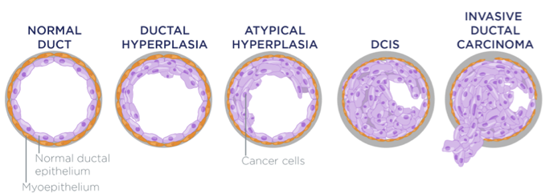
Introduction to Breast Carcinoma
Introduction
The most common malignancy¹ and causes the majority of cancer deaths of women.
Women by the age of 90 have a ⅛ chance of developing breast cancer.
>95% of breast malignancies are adenocarcinomas.
The most common location is in the upper outer quadrant (50%), followed by the central portion (20%). About 4% of women have bilateral primary tumors or sequentia llesions in the same breast.
Classification
First system:
Breast cancers are divided based on the expression of:
Hormone receptors: estrogen receptor (ER) and progesterone receptor (PR).
The human epidermal growth factor receptor 2 (HER2), also known as (ERBB2).
Classified into 3 major groups:
ER positive (HER2 negative; 50%–65% of cancers).
HER2 positive (ER positive or negative; 10%–20% of cancers).
Triple negative (ER, PR, and HER2 negative; 10%–20% of cancers).
These three groups show striking differences in patient characteristics, pathologic features, treatment response, metastatic patterns, time to relapse, and outcome.
Second system²:
An alternative classification system with substantial overlap relies on gene expression profiling.
Divides breast cancers into four major types:
Luminal A: are lower-grade, ER-positive, HER2 negative.
Luminal B: are higher-grade, ER-positive, may be HER2 positive.
HER2-enriched: overexpress HER2 and do not express ER.
Basal-like: The majority by gene expression profiling resemble basally located myoepithelial cells and are ER-negative, HER2-negative.
Morphological classification:
Classified according to whether they have penetrated the basement membrane.
The main forms are as follows:
Noninvasive (remains within the basement membrane):
Ductal carcinoma in situ.
Lobular carcinoma in situ.
Invasive:
Discussed later in the slides..
Excluding nonmelanoma skin cancer.
This system is currently used mainly in the context of clinical research.

Slide 9
Introduction to Breast Carcinoma
Risk factors
Age and gender | Reproductive History
- Rare in women < age 25 - Increases in incidence rapidly after age 30 - 75% of women with breast cancer are > age 50 - 5% are < 40 - Incidence in men is only 1% of that in women. | - Early age of menarche. - nulliparity - absence of breastfeeding, - older age at first pregnancy (because each increases the exposure of breast epithelial cells to estrogenic stimulation)
Family history | Race/Ethnicity
- Individuals with multiple affected first-degree relatives with early-onset breast cancer are at high risk. - In most families, it is thought that various combinations of low penetrance, “weak” cancer genes are responsible for increased risk. - However, approximately 5% to 10% of cases occur in persons who inherit highly penetrant germline mutations in tumor suppressor genes which will increase the risk by 90%. | - The highest rate of breast cancer is in women of European descent, largely because of a higher incidence of ER-positive cancers. - Hispanic and African American women tend to develop cancer at a younger age and are more likely to develop aggressive tumors. - Such disparities are thought to result from a combination of differences in genetics, social factors, and access to health care and are an area of intense study.
Geographic factors | Ionizing Radiation
- High risk in the Americas and Europe than in Asia and Africa. - Diet, reproductive patterns, and breastfeeding practices are thought to be involved. - Breast cancer rates appear to be rising in parts of the world that are adopting Western habits. | - Radiation to the chest increases the risk of breast cancer if exposure occurs while the breast is still developing. - For example, breast cancer develops in 25% to 30% of women who underwent irradiation for Hodgkin lymphoma in their teens and 20s, but the risk for women treated later in life is not elevated.
Other
- Postmenopausal obesity, postmenopausal hormone replacement, mammographic density, and alcohol consumption also have been implicated as risk factors. - The risk associated with obesity probably is due to exposure of the breast to estrogen produced by adipose tissue. In keeping with this, obesity is only associated with an increased risk of tumors that express ER.

Slide 10
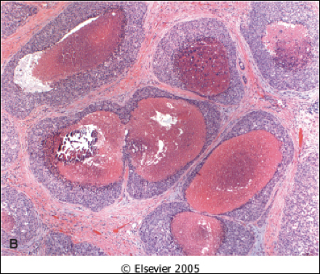
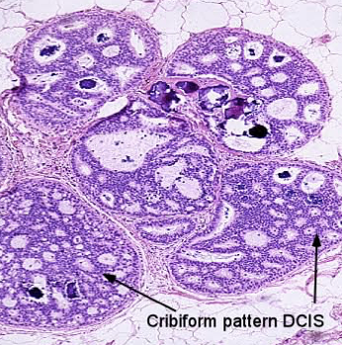
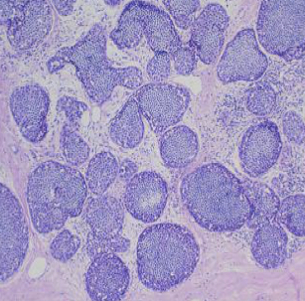
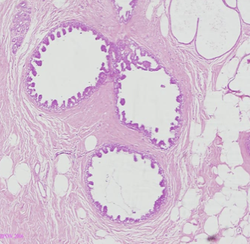
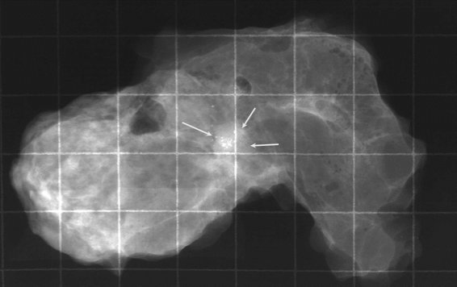
Carcinoma In Situ
Ductal Carcinoma In Situ
The non-invasive proliferation of malignant cells within the duct system without breaching the underlying basement membrane.
Relative risk of development invasive carcinoma is 8-10 times normal in both types of carcinoma in situ.
Morphology
Variety of histological appearance/subtypes:
Comedo: Extensive central necrosis, which produces toothpaste like necrotic tissue with calcified debris.
Most frequently detected as radiologic calcifications.
Less commonly, the surrounding desmoplasia results in an ill-defined palpable mass or a mammographic density.
If untreated, 100% will become invasive.
Cribriform:
Cells forming round, regular (cookie cutter) spaces.
The lumens are often filled with calcifying secretory material.
Solid (cells fill spaces).
Micropapillary and papillary.
30% of Pure cribriform/micropapillary become invasive.
Nuclear appearances:
Bland and monotonous: low nuclear grade.
Pleomorphic: high nuclear grade.
A
B
C
D
Mammography
(E) micro-Calcifications due to calcification of necrotic debris or secretory material.
Mammography is specifically important here because there may not be a palpable mass, or discharge.
Treatment
surgery: Wide local excision or mastectomy.
Treatment with anti-estrogenic agents such as tamoxifen also is used to decrease the risk of recurrence of ER-positive DCIS.
Prognosis
The prognosis is excellent, with greater than 97% long-term survival.
If untreated, DCIS progresses to invasive cancer in roughly ⅓ of cases, usually in the same breast and quadrant as the earlier DCIS.
E

Slide 11
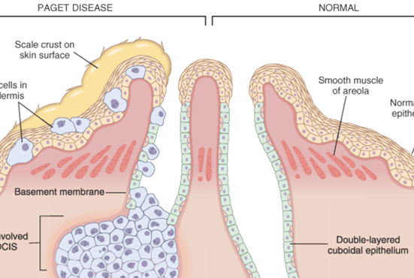
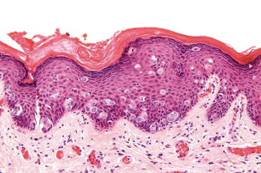
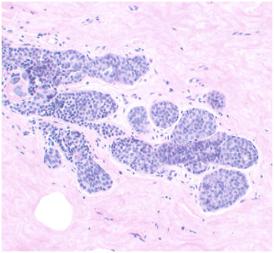
Carcinoma In Situ
Paget disease
Paget disease of the nipple is caused by the extension of DCIS up the lactiferous ducts and into the contiguous skin of the nipple.
Produce a unilateral crusting exudate over the nipple and areolar skin.
The prognosis of the carcinoma of origin is affected by the presence of paget disease and is determined by other factors.
Morphology
Histologic hallmark: the infiltration of the epidermis by:
Large neoplastic ductal cells with abundant cytoplasm.
Pleomorphic nuclei and prominent nucleoli.
The cells usually stain positively for mucin.
Extension without crossing the basement membrane.
Palpable mass in 50% of patients
Lobular Carcinoma In Situ
Always an incidental finding because, unlike DCIS, it is only rarely associated with calcifications.
Approximately ⅓ of untreated women eventually develop invasive carcinoma (mostly lobular):
⅔ may arise in the same breast and ⅓ in the contralateral breast.
LCIS is both a marker of an increased risk of carcinoma in both breasts and a direct precursor of some cancers.
Morphology
Has a uniform appearance.
The cells are monomorphic.
With bland, round nuclei, and are found in loosely cohesive clusters within the lobules.
The cells fill and expand the acini, but the normal structure can still be recognized.
Treatment (Female only)
Current treatment options include close clinical and radiologic follow-up.
Chemoprevention with tamoxifen.
Less commonly, bilateral prophylactic mastectomy.

Slide 12
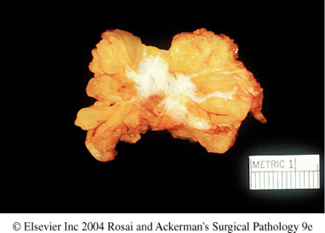
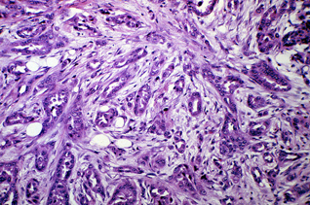
Invasive breast carcinoma
Introduction
Invasive breast carcinoma is tumor that has extended across the basement membrane.
This permits access to lymphatics and vessels and Therefore the potential to metastasize.
Classification
Invasive ductal carcinoma: 70% to 80%. (NOS; not otherwise specified)
Invasive lobular carcinoma: ~10% to 15%.
Carcinoma with medullary features: ~5% .
Mucinous carcinoma (colloid carcinoma): ~5%.
Tubular carcinoma: ~5%.
Other types.
Invasive Ductal Carcinoma
Includes all carcinomas that cannot be subclassified into one of the specialized types.
It is associated with Ductal Carcinoma In Situs, require large excisions with wide margins to reduce local recurrences.
Gene expression classification:
50-60% are ER positive
20% are HER2 positive
15% are negative for both ER and HER2
Morphology
Gross:
Firm, hard, with an irregular border.
Cut surface:
Gritty and shows irregular margins with stellate infiltration
(sometimes it can be soft and well demarcated).
In the center there are small foci of chalky white stroma
and occasionally calcifications.
Histology:
Cells are large and pleomorphic usually within a dense stroma.
Adenocarcinomas: so they show glandular formation but
can also be arranged in cords or sheets of cells.
Range from well differentiated → moderately → poorly differentiated.

Slide 13
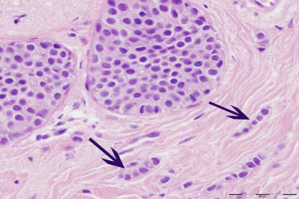
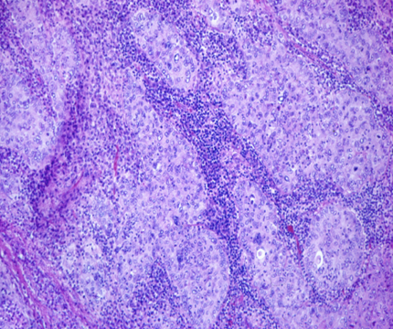
Invasive breast carcinoma
Invasive Lobular Carcinoma
It is the second most common invasive breast cancer.
It may occur alone or in combination with ductal carcinoma.
Clinical features
Tend to be bilateral and multicentric.
⅔ of the cases are associated with LCIS.
Almost all express hormone receptors, whereas HER2 overexpression is rare.
The pattern of metastasis is unique:
they frequently spread to CSF, serosal surfaces, GIT, ovary, uterus, and bone marrow.
The amount of stromal reaction to the tumor varies:
Marked fibroblastic (desmoplastic) response to little to no reaction¹.
therefore the presentation varies from a discrete mass to a subtle, diffuse indurated area.
Morphology
Morphologically similar to the tumor cells seen in LCIS.
Gross: Most are firm to hard with irregular margin.
Microscopic: Single infiltrating malignant cells, forming a
line often one cell width (called as indian file pattern).
No tubules or papillary formation.
Medullary Carcinoma
Special type of triple-negative cancer.
5% of all breast cancers.
Typically grow as rounded masses that can be difficult to distinguish from benign tumors on imaging.
Seen frequently in women with germline BRCA1 mutations, but most women with these carcinomas are not carriers.
Morphology
Sheets of large anaplastic cells.
Pronounced lymphocytic infiltrates predominantly (T cells).
The presence of lymphocytes lead to a better response to chemotherapy compared to poorly differentiated carcinomas without lymphoid infiltrates.
1. Clinically occult and difficult to detect by imaging.

Slide 14
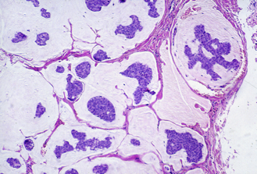
Invasive breast carcinoma
 | Colloid Carcinoma (mucinous) | Tubular Carcinoma
general | - ER-positive/HER2 negative - produce extracellular mucin - may be pure, more mixed with other type | - ER-positive/HER2 negative - mammography: as a small irregular mas
Gross | - Sharply well circumscribed - Lack fibrous stroma, slow growing - Soft & gelatinous, glistering surface
Microscopy | Small islands of tumor cells and single cells in a pool of mucin | - Cells are arranged in well formed tubules - low grade nuclei
prognosis | Lumpectomy, mastectomy | Lymph node metastases are rare, and the prognosis is excellent
Inflammatory carcinoma
Defined by its clinical presentation, rather than a specific morphology.
Patients present with a swollen erythematous breast without a palpable mass.
Morphology
The underlying invasive carcinoma is poorly differentiated and diffusely infiltrates and obstructs dermal lymphatic spaces, causing the inflamed¹ appearance.
Prognosis
Many of these tumors metastasize to distant sites.
The overall 5-year survival is less than 50%, and lower in metastasis.
About half express ER.
40% to 60% overexpress HER2.
Invasive carcinoma Grading
Based on nuclear pleomorphism, tubule formation and proliferation²:
Low grade nuclei:
Similar to normal cells.
Most form well-defined tubules,
Difficult to distinguish from benign lesions.
High grade nuclei:
Enlarged with irregular nuclear contours.
Invade as solid sheets or single cells.
1. True inflammation is absent.
2. Proliferation is evaluated by counting mitotic figures.

Slide 15
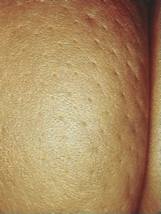
Invasive breast carcinoma
Clinical presentations
Unscreened population:
Most breast cancers are detected as a palpable mass by the affected patient.
Such carcinomas are almost all invasive and are typically at least 2 to 3 cm.
At least ½ of these cancers will already have spread to regional lymph nodes.
Tumor may be fixed to the chest wall, causing dimpling of the skin
Older screened populations:
60% of breast cancers are discovered before symptoms are present.
About 20% are in situ carcinomas.
Invasive carcinomas detected by screening in older women are 1 to 2 cm.
Only 15% will have metastasized to lymph nodes.
Peau d'orange:
Lymphatics may become involved and the lymphatic drainage of that
area and the overlying skin gets blocked causing lymphedema and thickening of the skin.
When the tumor involves the central portion of the breast,
retraction of the nipple may develop.
Prognostic factors
Biologic type
The biologic type of cancer is evaluated by a combination of histologic appearance, grade (including proliferative rate), expression of hormone receptors, and expression of HER2.
Proliferation | Expression of ER or PR | Overexpression of HER2
- Evaluated by mitotic count. - Tied to responsiveness to cytotoxic chemotherapy. | - Predicts response to anti-estrogen therapy. - The growth of hormone receptor positive cancers can be inhibited with therapy and survival with distant metastases is possible. - Resistance often develops in because of mutations in the ER gene. - In contrast, there is no therapy available for triple negative cancers, which are treated with chemotherapy. | - Is seen in about 20% of breast cancers. - HER2 remains one of the best-characterized examples of an effective therapy that is directed against a tumor-specific molecular lesion.

Slide 16
Invasive breast carcinoma
RNA expression
RNA expression profiling is a newer method of sub classifying cancers.
Tumor stage
Stage is a measure of the extent of tumor at the time of diagnosis and is important for all biologic types of carcinoma.
Based on features of (TNM):
The primary tumor (T):
Tumors classified as T1, T2, and T3 based on the tumor size.
T4 tumors have ulceration of the skin, involvement of the deep muscles of the chest wall, or are clinically diagnosed as inflammatory carcinoma.
Involvement of regional lymph nodes (N):
Lymphatic drainage goes to one or two sentinel lymph nodes in the axilla in most patients.
If these nodes are not involved, the remaining axillary nodes are usually free of carcinoma.
Sentinel node biopsy has become the standard for assessing nodal involvement, replacing more extensive lymph node dissections, which are associated with significant morbidity.
The presence of distant metastases (M):
Only detected in 5% of newly diagnosed women.
Stages:
0
- CIS
- Survival rates >95%.
1
- Includes smaller cancers and either free nodes or with micrometastases.
- Survival is ~86% at 10 years.
2
- Larger tumor size or up to 3 positive nodes.
- Survival declines to ~71% at Stage II.
3
- large size, involvement of skin or chest wall, or by 4 or more positive nodes.
- Only ~54% of patients survive 10 years.
4
- Distant metastases
- survival is very poor (~11%).

Slide 17
Summary
Benign Epithelial Lesions | Risk of Cancer | Histopathology | Comments
Non proliferative | No risk | - Cysts with apocrine metaplasia - Fibrosis & Adenosis | Most common disorder of the breast.
Proliferative without atypia
Epithelial Hyperplasia | 1.5 - 2 times normal | Proliferation of both epithelial and myoepithelial cells | Defined as the presence of more than 2 layers.
Sclerosing Adenosis |  | Adenosis and stromal fibrosis with compression of the lobule. | Incidental microscopic finding
Complex Sclerosing |  | Central nidus of entrapped glands in a hyalinized stroma. | Mimic an invasive carcinoma
Papiloma |  | Large Duct: - Solitary. - In lactiferous duct. | Large Duct: - Bloody nipple discharge. - Subareolar palpable mass.
 |  | Small duct: - Multiple. - Deeper within ductal system. | Small duct: - Increase the risk of subsequent carcinoma
Proliferative without atypia | 4-5 times normal | Atypical ductal or lobular hyperplasia. | Resembling carcinoma in situ but lack the sufficient features for that diagnosis.
Intralobular stromal tumors
Fibroadenoma | Most common benign tumor | - Cut surface: pearl-white and whorled. - Mixture of ducts and fibrous connective tissue.
Phyllodes | Most present as large palpable masses | - Phyllodes (leaflike) pattern and a cellular stroma.

Slide 18
Summary
Breast cancer
Noninvasive
DCIS | - Non-invasive proliferation of malignant cells within the duct system. - Histological Variants: comedo (necrotic center), Cribriform (cookie cutter). - Micro-Calcifications is common.
LCIS | - Incidental finding. - ⅓ of women eventually develop invasive carcinoma. - Rarely associated with Calcifications
Invasive
Invasive Ductal Carcinoma | - Includes all carcinomas that cannot be subclassified into one of the specialized types. - Associated with DCIS. - 50-60% are ER positive.
Invasive Lobular Carcinoma | - Tend to be bilateral and multicentric. - Unique metastatic pattern, to CSF, GIT, ovary, uterus and bone marrow. - Single file invasion of stroma.
Medullary Carcinoma | -Triple negative cancer presenting as a rounded mass. - Associated with BRCA1 germline mutations. - Sheets of large anaplastic cells associated with lymphocytic infiltrates (T cells).
Colloid (Mucinous) Carcinoma | -ER positive, HER2 negative. - Produces abundant amounts of extracellular mucin. - Soft and gelatinous.
Tubular carcinoma | -ER positive, HER2 negative. - Detected on mammography as a small irregular mass. - Cells are arranged in well formed tubules, with low grade nuclei.
Inflammatory carcinomas | -Defined by clinical presentation, swollen erythematous breast without a palpable mass. - Metastasize to distant sites. - 50% are ER positive, 40-60% overexpress HER2. - Cause inflamed appearance.

Slide 19
Quiz
1) Which of the following is the most common benign tumor of the female breast?
Phyllodes tumor
Papiloma
Fibroadenoma
LCIS
2) A 52-year-old woman presents with a 3 month history of a palpable breast mass. Physical examination confirms a 1-cm nodule in the upper outer quadrant of the right breast. A biopsy shows small cuboidal cells with round nuclei and prominent nucleoli. The cells are arranged in single cell columns between strands of connective tissue. What is the most likely diagnosis?
Acute mastitis with abscess
Invasive lobular carcinoma
Fibroadenoma
Intraductal carcinoma
3) A 48-year-old woman has noticed a red, scaly area of skin on her left breast that has grown slightly larger over the past 4 months. On physical examination, there is a 1-cm area of eczematous skin adjacent to the areola. The figure shows the microscopic appearance of the skin biopsy specimen. What is the most likely diagnosis?
Paget disease of the breast
Fat necrosis
Apocrine metaplasia
Lobular carcinoma in situ
4) A 38-year-old woman feels a lump in her right breast. Examination of the cross-section showed a firm mass with gritty margins and stellate infiltration, and small foci of chalky white stroma. The most likely diagnosis is:
Invasive ductal carcinoma
Invasive lobular carcinoma
Fibroadenoma
Intraductal carcinoma
5) A 52-year-old woman was diagnosed with breast cancer. Upon examination of the tumor, it was soft, sharply circumscribed, and lacked fibrous stroma. It also had small islands of tumor cells and single tumor cells floating in pools of extracellular mucin. The most likely diagnosis is:
Invasive ductal carcinoma
Medullary carcinoma
Colloid carcinoma
Intraductal carcinoma
6) A 40-year-old woman noticed a red, scaly appearance on her left nipple and surrounding areola. On histological examination of the nipple, there was infiltration of the epidermis by large neoplastic ductal cells with abundant cytoplasm, pleomorphism, and prominent nucleoli. The cells stain positive for mucin? What is the most likely diagnosis?
Ductal carcinoma in-situ
Fibroadenoma
Fibrocystic change
Paget’s disease of the breast
Granulomatous mastitis
7) A 35-year-old nulliparous woman presents with swollen breasts that are nodular upon palpation. A mammogram shows foci of calcification in both breasts. A breast biopsy reveals cystic duct dilation and ductal epithelial hyperplasia without atypia. What is the appropriate diagnosis?
Fibrocystic change
Fibroadenoma
Ductal carcinoma in situ
Granulomatous mastitis
1) C
2) B
3) A
4) A
5) C
6) D
7) A

Slide 20
Team Subleader
Alhanouf Alhaluli
Done by the brilliant minds
Nouf Albrikan, Renad Alkanaan,
Taef Alotaibi, Deana Awartani

