Slide 1
Editing file
Trophoblastic Diseases
Objectives
Understand the pathology and predisposing factors of ectopic pregnancy and spontaneous abortion.
Know the clinical presentation and pathology of hydatidiform mole and choriocarcinoma.

Slide 2
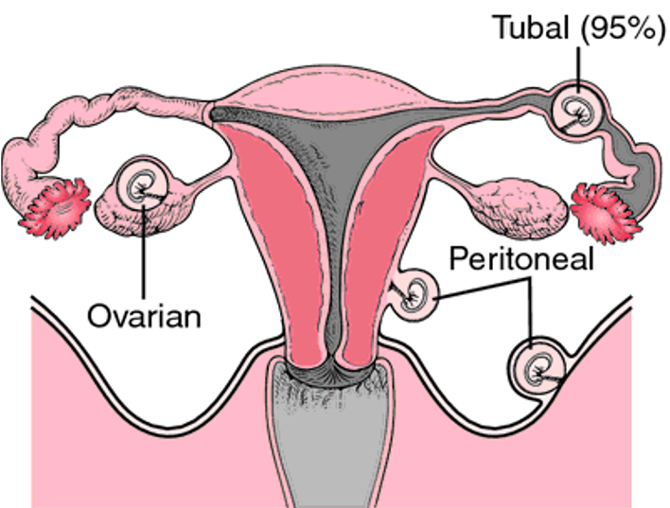
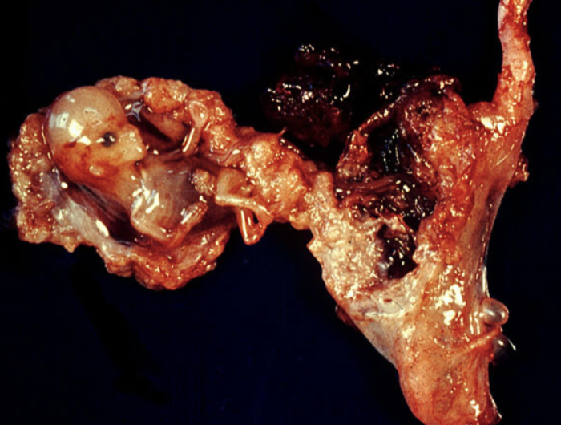
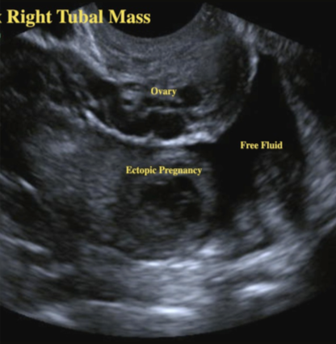
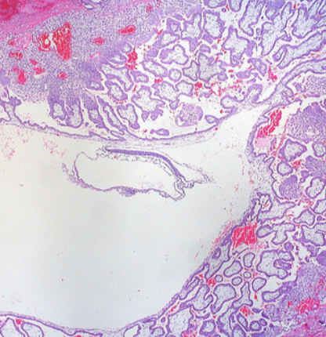
Ectopic Pregnancy
Introduction
Definition: implantation of a fertilized ovum in any site other than
the endometrium of the uterine cavity.
About 1% of all pregnancies are ectopic.
Sites:
>90% of ectopic pregnancies are in the fallopian tubes (tubal pregnancy).
The rest are in the:
Ovaries: rarely when ovum is fertilized just as the follicle ruptures.
Abdominal cavity: when fertilized egg drops out of the fimbriated end of the oviduct and implants on the peritoneum.
Uterine cervix.
Clinical features
Tubal pregnancy:
Pelvic pain and abnormal bleeding following a period of amenorrhea.
Many present as an emergency with tubal rupture, severe acute
abdominal pain and hemorrhagic shock.
Diagnosis
Clinically:
Abdominal/pelvic ultrasound: Gestational sac within fallopian tube.
A positive pregnancy test (high HCG levels).
Microscopically: Placental tissue or fetal parts within the tube.
Risk factors
Any factor that retards passage through the tubes predisposes to
ectopic pregnancy.
Inflammation & multiple sexual partners
- Pelvic inflammatory disease/infections/salpingitis is the most common cause. - Inflammation causes: Damage ciliary activity (the ovum will stuck in fallopian tube). Tubal obstruction. Pelvic adhesions with scarring. Distortion of the fallopian tubes. - Pelvic infection causes 5 times greater risk of ectopic pregnancy, (usually by N. gonorrhea & chlamydia). - Chronic inflammation causes ½ the cases of ectopic.
Congenital anomaly of tubes
Intrauterine contraceptive device (IUD)
Infertility | Diethylstilbestrol
May be due to: - Underlying infertility related issues. - Fertility drugs and treatments. - In vitro fertilization. | - Exposure in utero increases the risk due to abnormal tubal morphology and causes congenital anomaly.
Smoking | Surgery
- Decrease tubal motility. - Predispose to infection (due to decreased immunity). | - Abdominal/pelvic surgery. - Tubal ligation surgery.
Intrauterine tumors and endometriosis
History of previous ectopic pregnancy

Slide 3
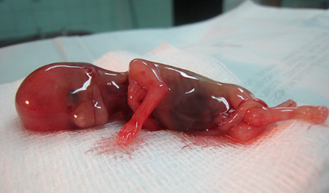
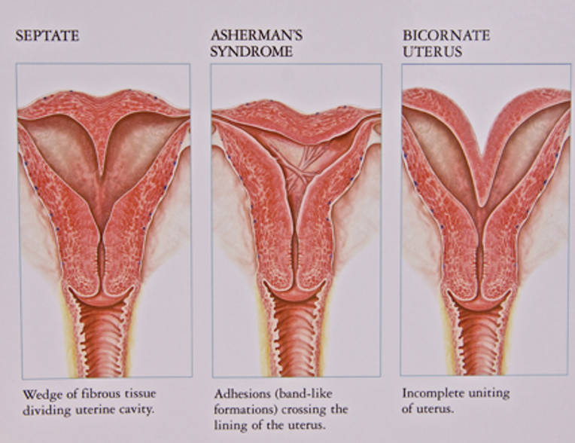
Spontaneous Abortion
Introduction
Definition: It is the spontaneous end of a pregnancy at a stage where the embryo or fetus is incapable of surviving.
Miscarriages that occur:
Before the 6th week are called early pregnancy loss or chemical pregnancy.
After the 6th week of gestation are called clinical spontaneous abortion.
About 10-25% of all pregnancies end in miscarriage.
Most miscarriages occur during the first trimester (13 weeks) of pregnancy.
Causes
The cause of a miscarriage cannot always be determined.
The causes are as follows:
Chromosomal abnormalities
Hormomal abnormalities
Infections
- ½ of the 1st trimester miscarriages have abnormal chromosomes (most common cause).
- Age: women over age 35 have a higher rate of miscarriage
- A pregnancy with a genetic problem has a 95% probability of ending in miscarriage.
- Cushing’s Syndrome.
- Thyroid disease.
- Polycystic ovary syndrome (PCOS)
- Poorly controlled DM increases the risk of birth defects.
- Inadequate function of the corpus luteum: progesterone produced will not be enough for maintenance.
- Listeria monocytogenes.
- Toxoplasma gondii
- Parvovirus B19.
- Rubella.
- Herpes simplex.
- Cytomegalovirus.
- Lymphocytic choriomeningitis virus.
Maternal health problems
Lifestyle & trauma
Abnormal structural anatomy
- Systemic Lupus Erythematosus (SLE)
- Antiphospholipid antibody syndrome. (which leads to thrombosis → affecting blood supplying pregnancy).
- Smoking.
- Drug use.
- Malnutrition.
- Radiation exposure.
- Toxic substances.
- Trauma to the mother.
- Septate or bicornuate¹ uterus affect placental attachment and growth → an embryo implanting on the septum will be at risk of miscarriage.
- Uterine fibroids can interfere with the embryo implantation and blood supply, thereby causing miscarriage. (rare)
Tow cavities
Others: surgical procedures in the uterus during pregnancy
e.g. amniocentesis and chorionic villus sampling.
1. In addition to Asherman’s syndrome where the uterus is filled with fibrous adhesions.

Slide 4
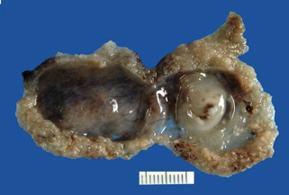
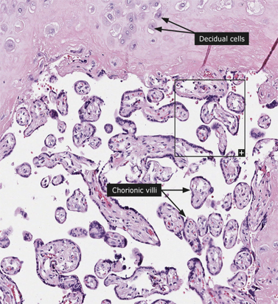
Spontaneous Abortion
Diagnosis
A miscarriage can be confirmed:
By ultrasound study.
They make sure that the endometrial cavity is empty and the placenta and fetal tissue has passed.
By the examination of the passed tissue microscopically for the products of conception. The products of conception include:
Chorionic villi.
Trophoblasts.
Fetal parts and changes in the endometrium (hypersecretory).
Genetic tests may also be performed to look for chromosomal anomalies.
Pale spongy tissue = placenta
If you are reading this before the end of the block I truly Admire your strong will

Slide 5
Gestational trophoblastic disease
Introduction (Males slides)
GTD: a group of related disorders in which there is abnormal proliferation of placental trophoblasts.
Abnormal fertilization causes the growth of a placenta without fetal tissue.
The maternal age >40 years has a 5 times more risk of trophoblastic disease.
Most women who have had gestational trophoblastic disease can have normal pregnancies later.
Most GTD produces the beta subunit of human chorionic gonadotropin (HCG).
Even though HCG is high in both GTD and normal pregnancy, it is only persistent after the 14th week in GTD.
Types of GTD
Benign non-neoplastic trophoblastic lesions | Hydatidiform mole¹ | Gestational trophoblastic neoplasia (GTN)
Incidental finding on an endometrial curettage or hysterectomy specimen. | Result from abnormalities in fertilization. Benign, but may develop to choriocarcinoma. | Tumors that have the potential for local invasion & metastases.
- Exaggerated placental site. - Placental site nodule. | - Complete hydatidiform mole. - Partial hydatidiform mole. - Invasive mole /chorioadenoma destruens. | - Choriocarcinoma - Placental site trophoblastic tumor - Epithelioid trophoblastic tumor
Hydatidiform mole
Introduction
Definition: It is an abnormal placenta due to excess of paternal genes.
The most common form of GTD; occurs in 1/1,000-2,000 pregnancies.
It is caused by Abnormal gametogenesis and fertilization. .
Risk Factors
Maternal age: younger than 15 years of age and women over 40 are at higher risk.
Ethnic background: incidence higher in Asian women.
Women with a prior hydatidiform mole have a 20-fold greater risk of a subsequent molar pregnancy than the general population.
1. الحمل العنقودي

Slide 6
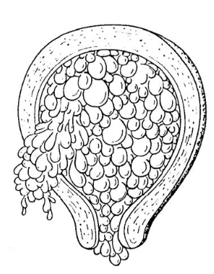
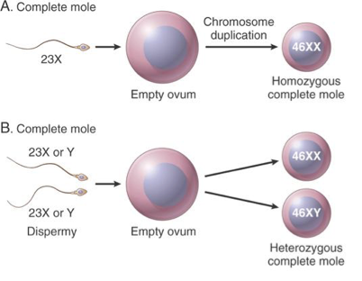
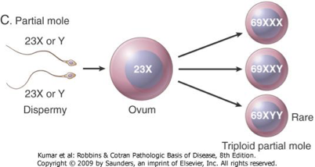
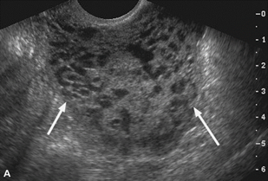
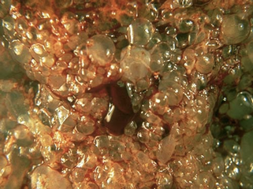
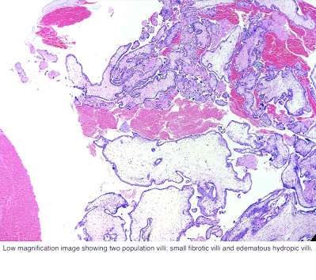
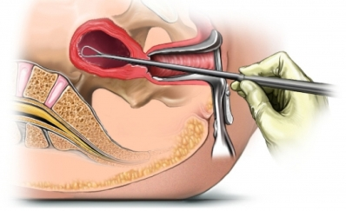
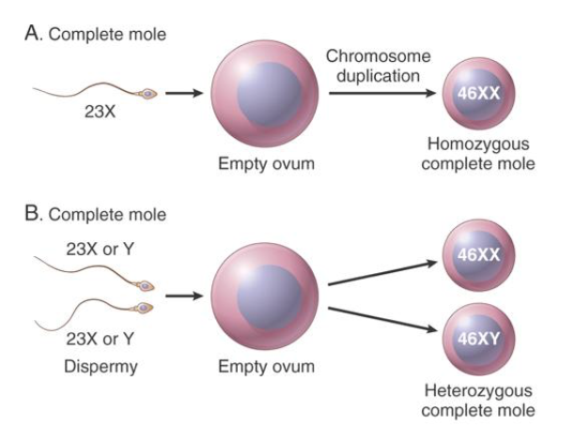
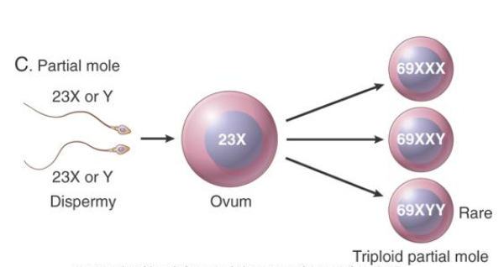
Types of Hydatidiform Mole
 | Complete HM | Partial HM
Pathogenesis & Karyotype | An Ovum without maternal DNA is fertilized by a sperm cell, All DNA is paternal. (Androgenic Pregnancy). The full set of chromosomes arise from duplicated chromosomes of a haploid sperm. Duplication: 90% of are 46 XX, after fertilization, the one sperm duplicates its DNA. Dispermy: while, 10%, 46 XY, two sets of DNA are from two sperms that fertilized the egg. It is a genetically abnormal placenta with hyperplastic trophoblasts without fetus. | Partial hydatidiform mole results from fertilization of a normal ovum by 2 normal sperms. 15-35% of all moles. The result is triploid cell (69 chromosomes). One maternal set (23). Two paternal (23+23). Abnormal placenta: uneven villi, with hyperplasia of trophoblast. There is a fetus. 58% are 69XXY 40% are 69XXX 2% are 69XYY
Symptoms | Abdominal swelling (due to rapid increase in uterine size) mistaken for normal pregnancy. However, the rapid increase is disproportionate to the stage of pregnancy. Vaginal bleeding, nausea, vomiting. High HCG levels. | - The fetus usually dies after 10 weeks' gestation and the mole (pregnancy) is aborted shortly thereafter. - Uterine size small or appropriate for gestational age. - High HCG but not as complete.
Morphology | Large villi with prominent trophoblastic cell proliferation, no embryo. “Cluster of grapes” Ultrasound: snowstorm appearance, indicating abnormal placenta. | Abnormal placenta: uneven (large and small) villi, with slight hyperplasia of trophoblast. Gross: mixture of large chorionic villi and normal smaller villi.
Treatment | Evacuation of uterus by curettage and sometimes chemotherapy. With appropriate therapy cure rate is very high. | - Evacuation of uterus by curettage or chemotherapy.
Complications | Uterine hemorrhage or perforation. Trophoblastic embolism. Infection. Few patients develop an invasive mole (invade the myometrium or a blood vessel). The most important complication is the development of choriocarcinoma. | Risk for development of choriocarcinoma very low “almost never”. Follow-up is mandatory.
Edematous chorionic villi

Slide 7
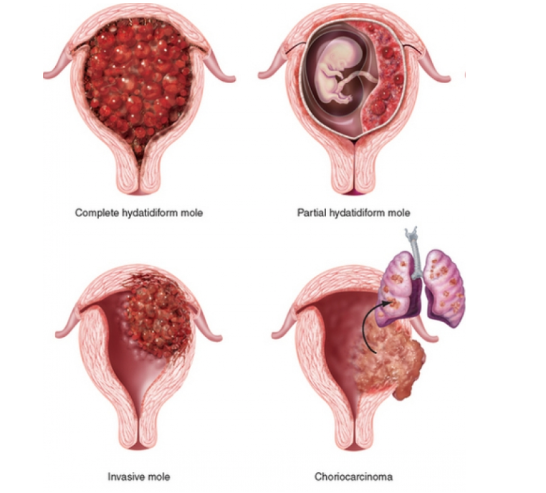
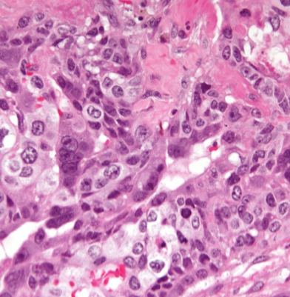
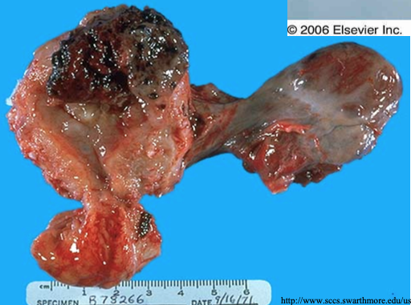
Invasive Mole
Introduction
Invasive mole is when the villi of a hydatidiform mole extends/infiltrates into the myometrium of the uterus.
Enter into the veins of the myometrium, and a times spread via the vascular channels to distant sites, mostly the lungs (not fatal).
It occurs in about 15% of complete moles and rarely in partial mole.
Can cause hemorrhage and uterine perforation.
Choriocarcinoma
Introduction
Definition: Malignant tumor of placental tissue, composed of a proliferation of malignant cytotrophoblast and syncytiotrophoblast, without villi formation.
It is an aggressive malignant neoplasm.
Choriocarcinomas are aneuploidic (abnormal number of chromosomes).
Predisposition
50% are preceded by complete hydatidiform mole.
Can preceded by partial mole (rare), abortion, ectopic pregnancy and occasionally a normal term pregnancy.
It can also arise as a spontaneous germ cell tumor. (poorer response to chemotherapy)
Clinical feature
Very high levels of serum HCG. (used as a marker and stain for diagnosis)
Prognosis
Metastasis: via blood to the lungs and other organs.
Responds to chemotherapy.
Solid sheaths of trophoblasts
No fetal cells

Slide 8
Summary
Ectopic pregnancy
Introduction | -Implantation of a fertilized ovum in any site other than the endometrium of the uterine cavity - Sites: fallopian tubes, ovaries, abdominal cavity, uterine cervix
Clinical features | Pelvic pain,abnormal bleeding, amenorrhea, severe acute abdominal pain, hemorrhagic shock
Diagnosis | Clinically: Ultrasound & High HCG levels Microscopically: Placental tissue or fetal parts within the tube
Risk factors | Inflammation, multiple sexual partners, smoking, surgery, IUD, infertility .
Spontaneous abortion
Introduction | -It is the spontaneous end of a pregnancy at a stage where the embryo or fetus is incapable of surviving. -types Before the 6th week of gestation are called early pregnancy loss or chemical pregnancy. After the 6th week of gestation are called clinical spontaneous abortion.
Causes | Chromosomal abnormalities, Hormonal problems, Infections, lifestyle, trauma, maternal health problems, abnormal structural anatomy.
Diagnosis | -Ultrasound study -Examination of the passed tissue microscopically -Genetic tests
Gestational trophoblastic disease
Introduction | Gestational trophoblastic disease is a group of related disorders in which there is abnormal proliferation of placental trophoblasts.
Types | -Benign non-neoplastic trophoblastic lesions. -Hydatidiform mole. -Gestational trophoblastic neoplasia.
Hydatidiform Mole
Introduction | Results from abnormalities in fertilization. They are essentially benign, but these patients carry an increased risk of subsequently developing choriocarcinoma
Types | -Complete HM -Partial HM -Invasive mole
Choriocarcinoma
Introduction | -Malignant tumor of placental tissue. -Aggressive and malignant.
Clinical feature | Very high levels of serum HCG.
Prognosis | -Metastases to lung and other organs. Responds to chemotherapy.

Slide 9
Quiz
1)Which of the following is a diagnostic method for ectopic pregnancy ?
A) high HCG levels and pelvic Ultrasound
B) high HCG levels and pelvic X-ray
C) Low HCG levels and pelvic X-ray
D) Low HCG levels and pelvic Ultrasound
2) What is the most common site of ectopic pregnancy?
A) ovaries
B) abdominal cavity
C) peritoneal cavity
D) Fallopian tubes
3) A young female just married 6 months ago came, had a short history of couple of weeks of pelvic pain and abnormal bleeding following a period of amenorrhea. She came to the emergency due to severe acute abdominal pain which then proceeded to a hemorrhagic shock. A Microscopic sample showed Placental tissue within the Fallopian tubes. She was diagnosed with tubal Ectopic pregnancy, which of the following could be the cause of the ectopic pregnancy?
A) ovum is fertilized just as the follicle ruptures.
B) fertilized egg drops out of the fimbriated end of the oviduct
C) chronic inflammation and scarring in the oviduct
D) chronic inflammation and scarring in the vagina
4) What is the most common cause of early miscarriages?
A) Diabetes
B) Chromosomal abnormalities
C) Smoking
D) NSAIDS
5) which of the following is the most common karyotype for partial Hydatidiform mole ?
A) 46 XX
B) 47 XXY
C) 69 XXY
D) 69 XYY
6) Which of the following is considered a Hydatidiform mole Gestational Trophoblastic Disease?
A) Choriocarcinoma
B) Placental site trophoblastic tumor
C) chorioadenoma destruens
D) Epithelioid trophoblastic tumor
7) Which of the following is a risk factor for Hydatidiform Mole?
A) Being younger than 15 years
B) Maternal trauma
C) Diabetes
D) History of multiple sexual
8) A 40 years old pregnant women came to emergency complaining from vaginal bleeding, severe nausea and vomiting, uterus is disproportionately large for her stage of pregnancy. Blood sample showed Very High HCG Level, doctors requested Ultrasound which showed cluster of grapes appearance signifying an abnormal placenta. Which of the following is probably the diagnosis?
A) partial HM
B) Complete HM
C) Choriocarcinoma
D) chorioadenoma destruens
9) Most of the choriocarcinoma are preceded by which of the following ?
A) partial HM
B) Complete HM
C) Normal pregnancy
D) ectopic pregnancy
10) In contrast to a complete mole, Partial Mole has which of the following?
A) All Villi are hydropic and no normal villi are seen
B) No Fetal tissue present
C) Higher chance to progress to choriocarcinoma
D) Mild proliferation of Trophoblast
1- A
2- D
3- C
4- B
5- C
6- C
7- A
8- B
9- B
10- D

Slide 10
Team Subleader
Alhanouf Alhaluli
Done by the brilliant mind
Omar AlDosari

