Slide 1
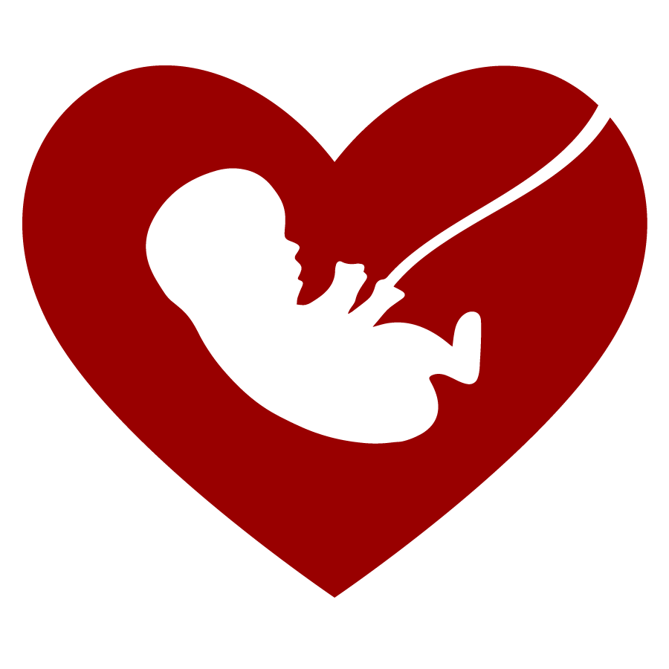
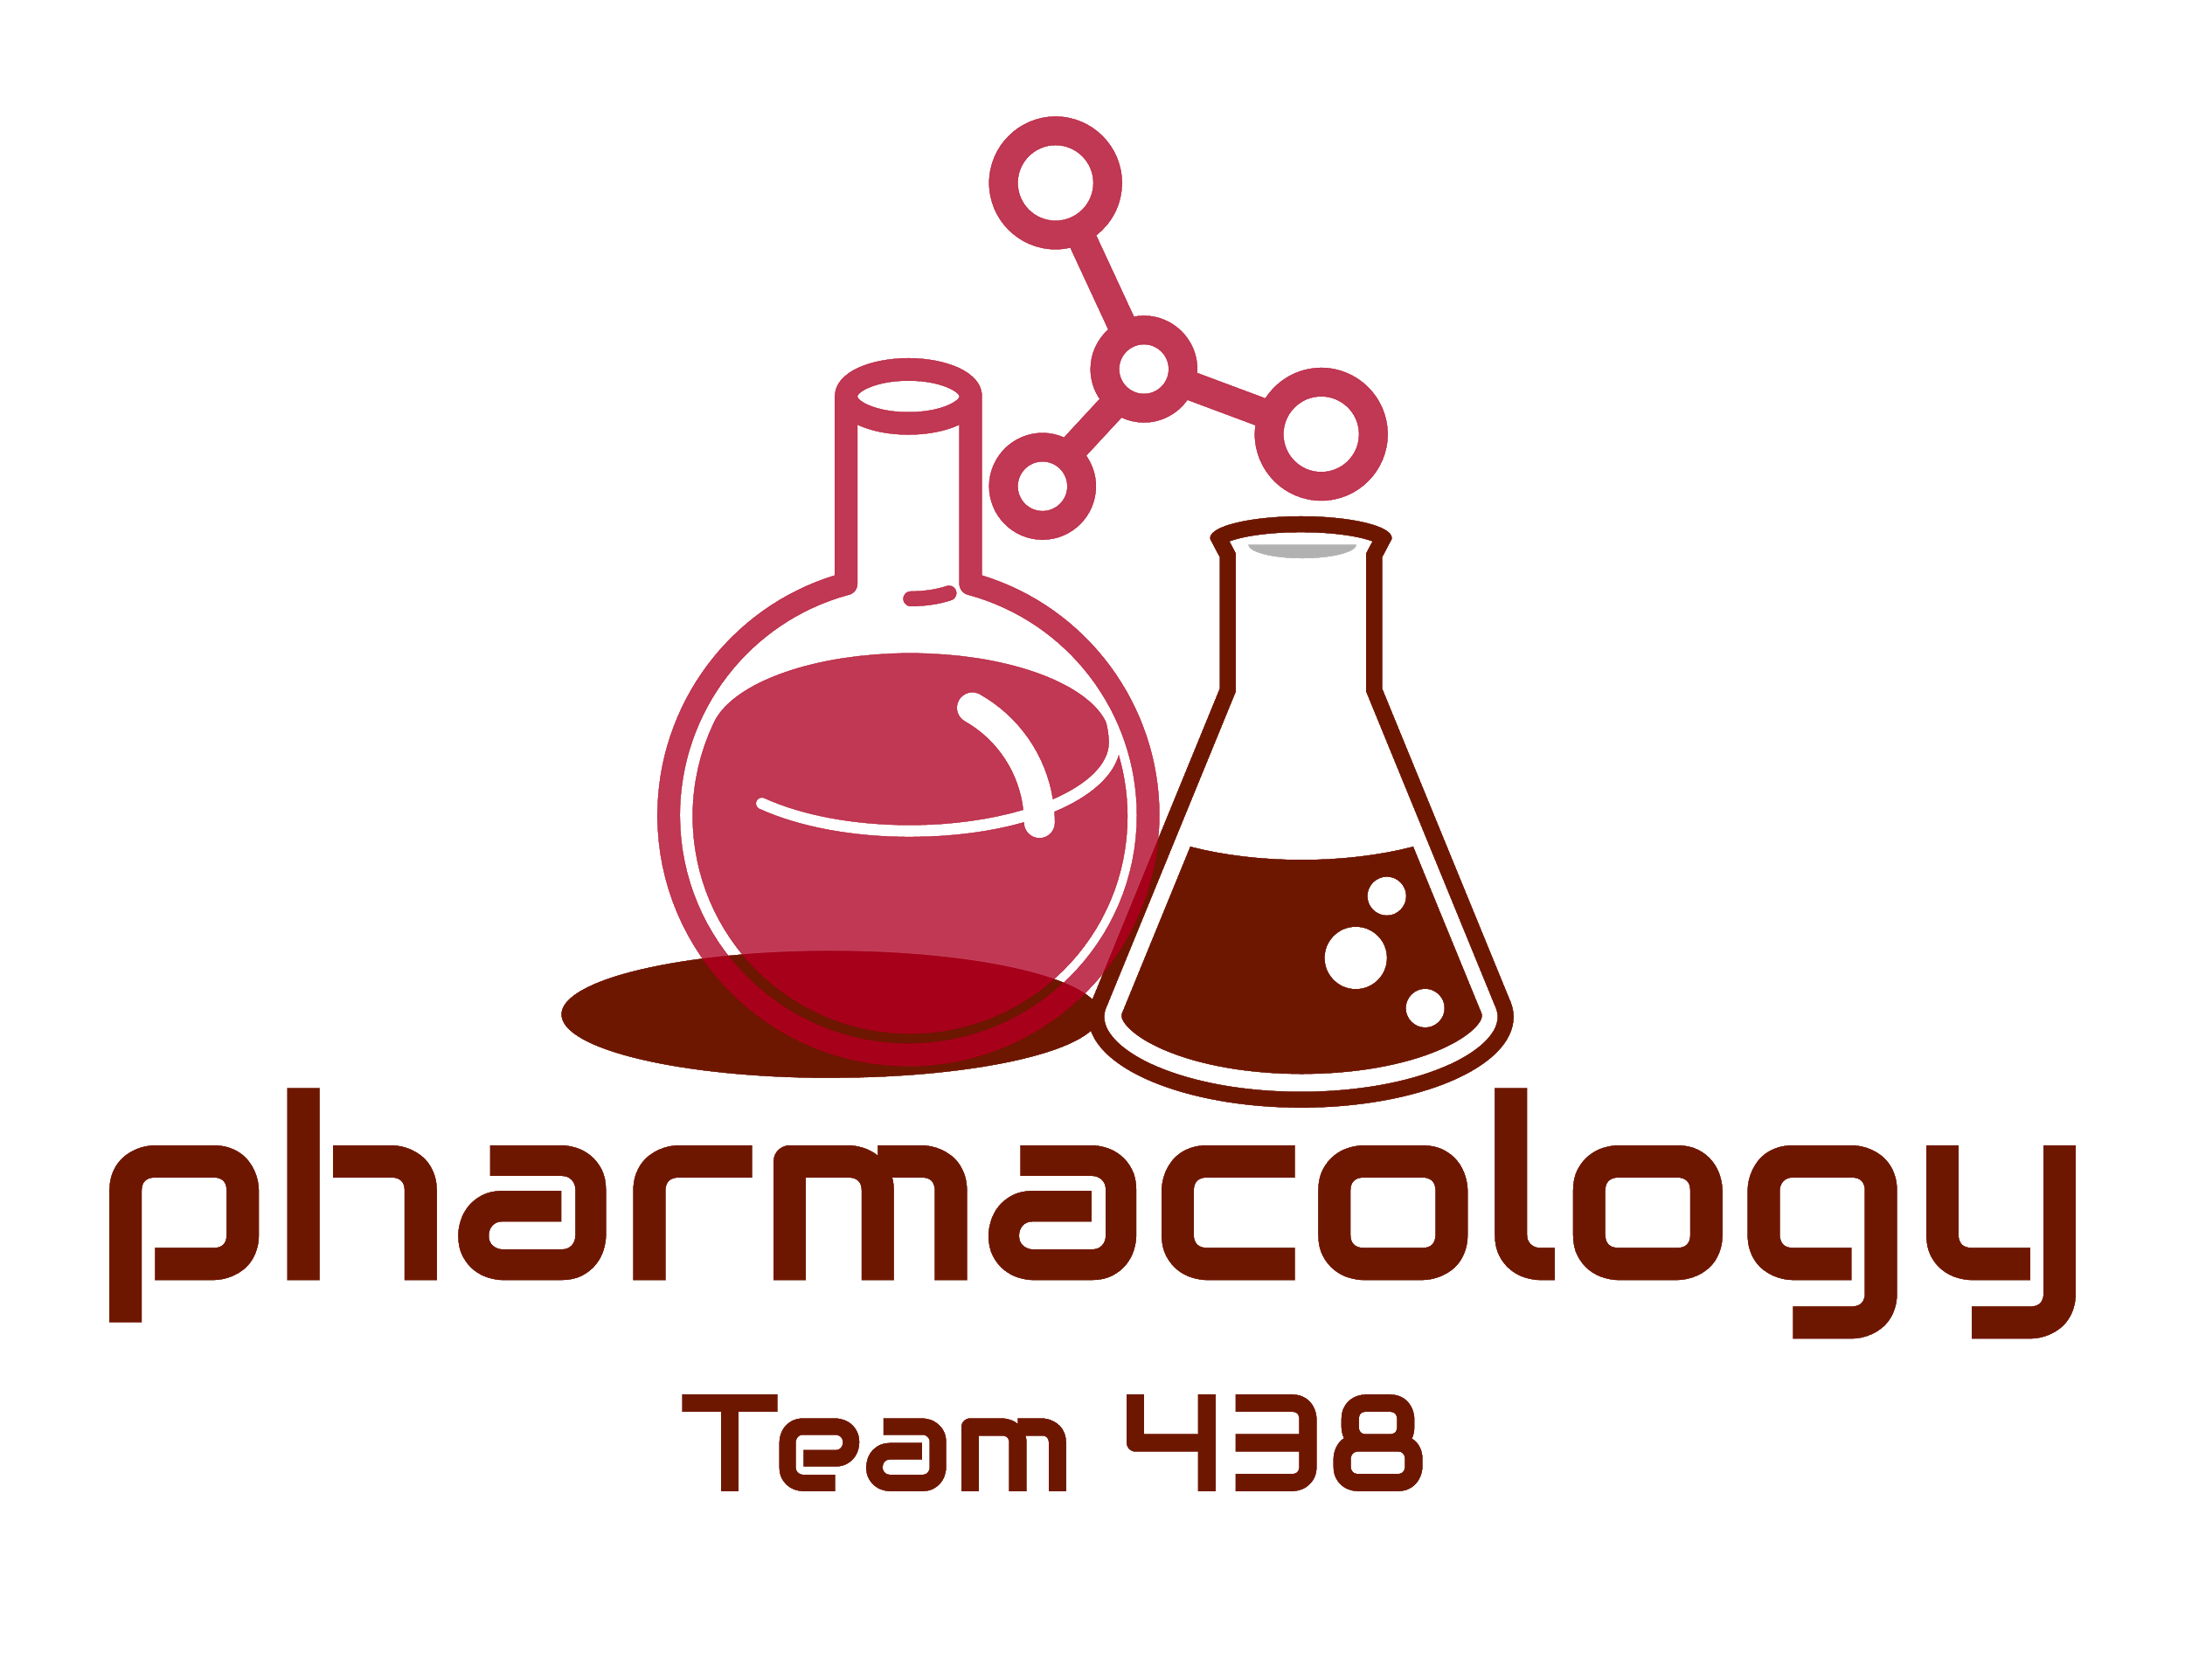
Editing File
Mnemonic File
Reproduction Block
Pharmacology team 438
Drugs Used in Males Infertility
Objectives:
By the end of the lecture , you should know:
Define male infertility
Recognize regulations contributing to male infertility & dysregulations leading to infertility
Classify hormonal & non-hormonal therapies used in male infertility whether being empirical or specific.
Expand on the mechanism of action, indications, preparations, side effects, contraindications, & interactions of most hormonal therapies.
Highlight some potentialities of non-hormonal therapies
Color index:
Black : Main content
Red : Important
Blue: Males’ slides only
Purple: Females’ slides only
Grey: Extra info or explanation
Green : Dr. notes

Slide 2
Male Infertility
Definition: Inability of a male to achieve conception in a fertile woman after one year of frequent unprotected intercourse.
Prevalence: Infertility has traditionally been thought of as a woman’s problem. However, about one out of every three cases of infertility is due to the man alone.
Infertility
VS
Impotence
The male sexual behavior is fine but the problem is in the sperm
(low count, abnormal shape, abnormal motility).
The male has problems in his sexual behavior
(Erectile Dysfunction)
Semen Analysis in Infertility
In male infertility, the semen analysis is abnormal:
Count is low (oligospermia)
Sperms are absent in the ejaculate (azoospermia)
Sperm motility is seriously affected (asthenospermia).
Sperms are totally immobile or dead (necrospermia)
Causes of Male Infertility
Idiopathic
Pre-testicular causes
Unknown causes
(poor hormonal support & poor general health) including:
Hypogonadism, Drugs, Alcohol, Tobacco, Strenuous riding (bicycle & horse riding), Medications (chemotherapy, anabolic steroids).
Testicular causes
Post-testicular causes
(Problems related to sperm production):
Age, Malaria, Testicular cancer, Idiopathic (unexplained sperm deficiencies).
(Problems of sperm transport\ erection and ejaculation):
Vas deferens obstruction,
infection e.g. prostatitis, TB, Ejaculatory duct obstruction, Impotence.

Slide 3
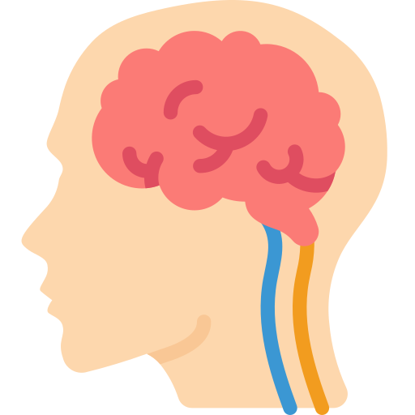
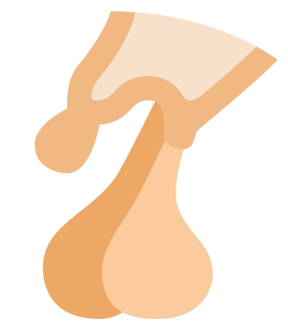
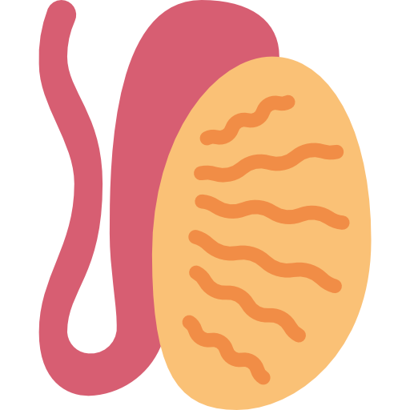
Recall Hypothalamic pituitary gonadal axis
Pulsatile secretion of GnRH from hypothalamus will stimulate anterior pituitary to secrete (FSH, LH) that will lead to initiation & maintenance of spermatogenesis
FSH: will act on sertoli cell in seminiferous tubule for spermatogenesis. It is also release inhibin → -ve feedback on anterior pituitary
LH: will act on leydig cells leading to secretion of testosterone → -ve feedback on anterior pituitary and hypothalamus
Some of testosterone converted to (DHT) and Estradiol → +ve feedback on leydig cells and -ve feedback on anterior pituitary, hypothalamus
LH releases Testosterone in a pulsatile rhythm (chronic LH levels makes testis refractory)
So, Drugs used to treat male infertility includes:
Testosterone and synthetic androgen
Anti estrogen
SERM
Aromatase inhibitors
GnRH
GnH together with hcG
Non hormonal therapy
Special thanks for 436 pharmacology team
Hypothalamus
GnRH
Pituitary gland
LH
FSH
Testis
Leydig cells
Sertoli cells
inhibin
Testosterone
Spermatogenesis
Estrogen & DHT
Drug Treatment of Male Infertility
(Needs 3 months before semen quality changes)
Hormonal Therapy | Specific | Hyperprolactinemia | DA 2- agonists
 |  | Hypothyroidism | Thyroxine
 |  | Congenital adrenal hyperplasia | Corticosteroids excess
 |  | Glucocorticoids excess | Correct levels
 | Empirical | Idiopathic | Androgens, Antiestrogen, GnH (FSH)
 |  | Eugonadotrophic hypogonadism (↓T only) | Antiestrogens (SERMs & Aromatase inhibitors )
 |  | Hypogonadotrophic hypogonadism [secondary Hypogonadism “Hypothalamo-Pituitary” ] (↓ T & ↓ FSH/LH) | Pulsatile GnRH, hCG, hMG¹, Androgens, Clomiphene, Mesterolone
 |  | Hypergonadotrophic Hypogonadism [primary Hypogonadism “testicular dysfunction” ] (↓T & ↑LH) | Assisted Reproduction (no treatment)
Non- hormonal Therapy | Specific | Erectile dysfunction | PDE5 inhibitors, e.g. sildenafil (viagra), vardenafil (levitra), tadalafil (cialis)
 |  | Premature Ejaculation | SSRIs e.g Fluoxetine (prozac)
 |  | Infection of testes, prostate & UT | Antibiotics
 | Empirical | - | Kallikrein, Antioxidants e.g. vit E & vit C, Zinc supplements, folic acid, L-Carnitine
1- AKA Menotropin

Slide 4
Testosterone
Drugs | Testosterone and Synthetic androgens
info | Principle male sex hormone produced in testis (> 95%), small amount in adrenals. It follows a circadian pattern→ increase in early morning & decrease in evening.
MOA | In the prostate and seminal vesicles testosterone is converted by 5α-reductase to DHT. In bones and brain it is metabolized to estradiol by c-p450 aromatase Bone: estradiol accelerates maturation of cartilage into bone leading to closure of the epiphysis & conclusion of growth. Brain: estradiol serves as the most important feedback signal to the hypothalamus (esp. affecting LH secretion).
Action | 1- Virilizing Effects: Gonadotropin regulation Spermatogenesis Sexual dysfunction Sexual restoration and development 2- Protein anabolic effects: (anabolic steroids not used in infertility) Increase bone density Increase muscle mass Increase red blood cell mass
P.K | Natural Androgens Ineffective orally (inactivated by 1st pass metabolism), given I.M or S.C, skin patch & gels are also available. Binds to Sex Hormone Binding Globulin [SHBG] t1⁄2 =10–20 min Inactivated in the liver. 90% of metabolites excreted in urine. Disadvantages: Rapidly absorbed, rapidly metabolized (Short duration of action). | Synthetic Androgens Less rapidly metabolized & more lipid soluble → increasing its duration of action. Derived from Testosterone: Esters, propionate, enanthate,cypionate → in oil for IM (every 2-3 weeks) Other derivatives as Fluoxymesterone, Methyltestosterone, Danazol→ given Orally (daily) Derived from DHT as Mesterolone: given Orally (daily) Mesterolone: More safe and can be given in ↓testosterone or in 2ndry hypogonadism; because of the following: 1. Not aromatised into estrogens "no –ve feedback of GnHs " encourages natural testosterone production. thus spermatogenesis is enhanced. 2. Unlike other oral synthetic androgens it is not hepatotoxic.
Uses | As Testosterone Replacement Therapy (TRT): Therapy for androgen deficiency in adult male infertility. In delayed puberty with hypogonadism give androgen slow & spaced for fear of premature fusion of epiphyses (short stature).

Slide 5
Testosterone Cont...
Antiestrogen ¹
Drug | Testosterone and synthetic androgens
ADRs | Excess androgens (if taken > 6 weeks) can cause impotence, decreased spermatogenesis & gynecomastia Alteration in serum lipid profile: ↓HDL & ↑LDL, hence,↑risk of premature coronary heart disease Salt & water retention leading to edema Hepatic dysfunction:↑AST levels,↑alkaline phosphatase,↑bilirubin & cholestatic jaundice Hepatic carcinoma (long term use) Behavioral changes: physiologic dependence, ↑aggressiveness, psychotic symptoms Polycythemia (increased number of RBC) →↑risk of clotting Premature closing of epiphysis of the long bones Reduction of testicular size
C.I | Male patients with cancer of breast or prostate. Severe renal & cardiac disease as they predispose to edema. Psychiatric disorders. Hypercoagulable states. Polycythemia.
inter- action | Testosterone + Corticosteroids → edema. Testosterone ↓ Warfarin metabolism → ↑bleeding. Insulin or oral hypoglycemics + Testosterone → hypoglycemia. Testosterone↑ Propranolol Clearance → ↓Propranolol Efficacy.
Class | SERMs | Aromatase Inhibitors
Drugs | Tamoxifen, Clomiphene | Anastrozole
MOA | Because estrogens have -ve feedback on hypothalamus → decrease GnRH pulse frequency & pituitary responsiveness to GnRH So antiestrogens → increase GnRH & improve its pituitary response.
 | Competes with estrogen for its receptor in hypothalamus | Blocks conversion of testosterone to estrogen within the hypothalamus.
P.K | Given as daily dose over a period of 1–6 months.
Uses | All are used for inducing spermatogenesis in oligospermia (count is low). Best to improve sperm count & motility with good pregnancy rates
ADRs | Both drugs (Tamoxifen, Clomiphene) can induce libido & bad temper in men | _
Antiestrogen therapy is better than Androgen replacement therapy.

Slide 6
Other Drugs In Treating Male Infertility
Non-hormonal Therapy
Drugs | GnRH | GnHs
P.K | Given as Pulsatile GnRH therapy (4-8 ug subcut every 2 hours) using a portable pump Exogenous excess of GnRH → down-regulation of pituitary GnRH receptors & decrease LH responsiveness | GnHS replacement must combine: hCG (IM for 2 Ms.) followed by hCG + hMG (IM for 6-12 Ms.)
Uses | Used in hypothalamic dysfunction for androgenization & spermatogenesis | Used in 2ndry hypogonadism (FSH or both FSH or LH absent) to promote spermatogenesis
ADRs | Headache Depression generalized weakness pain Gynecomastia osteoporosis | Headache local swelling (at injection site) Nausea Flushing Depression Gynecomastia precocious puberty
Antioxidants -e.g. vit E, C | Protect sperm from oxidative damage
Kallikrein | Has proteolytic activity, cleaving kininogen to kinins →important for sperm motility.
Folic acid | Plays a role in RNA and DNA synthesis during spermatogenesis & has antioxidant properties.
Zinc | Plays an important role in testicular development, sperm production & sperm motility.
L-carnitine | Is important for sperm maturation.

Slide 7
Quiz
MCQ
Q1- A patient with hypothalamic dysfunction is treated with GnRH, which one of the following conditions he may present with following the treatment?
A- Local swelling. B- Precocious puberty. C-Osteoporosis. D- Polycythemia.
Q2- L-carnitine is important for:
A- Sperms motility B- Sperms protection C- Sperms production D- Sperms maturation
Q3- Which of the following oral synthetic androgens is not hepatotoxic ?
A- Fluoxymesterone. B- Mesterolone. C- Methyltestosterone. D- Danazol.
Q4- A patient is using Anastrozole for treating oligospermia, Which one of the following is the mechanism of action of this drug?
A- DA-2 agonist
B- Phosphodiesterase-5 inhibitor
C- Blocks conversion of testosterone to estrogen within the hypothalamus
D- Selective Serotonin Reuptake Inhibitor
SAQ
27-years-old man married 2 years ago visit the clinic due to inability to conceive, doctor order hormonal profile for patient and the results from lab shows decreased (testosterone,FSH ,LH).
Q1-Which drug would be effective in treating infertility due to hypothalamic dysfunction?
Q2-Mention 2 ADR of that drug?
35-years-old male visit the clinic due to inability to conceive after investigation it turns out that he has infertility due to abnormal sperm motility.
Q3-Which non-hormonal drug should he used in this case?
Q4-What is the M.O.A of that drug?
If Testosterone and Warfarin are used together, What is the effect that might be occur?
MCQ
SAQ
Q1 | C
Q2 | D
Q3 | B
Q4 | C
Q1 | Pulsatile GnRH
Q2 | Gynecomastia - pain
Q3 | Kallikrein
Q4 | Has proteolytic activity, cleaving kininogen to kinins
Q5 | Bleeding
Answers:

Slide 8
Thank you for all the love and support you gave the team in those two years!
Hope we made the context much easier to study.
God bless you, Future doctors.
Team Leaders:
May Babaeer Zyad Aldosari
This Amazing Work was Done By:
Reema AlSerhani Deana Awartani
Note writers
Nouf AlShammari
Quiz writers
Noura AlMazrou Shahad AlSahil

