Slide 1
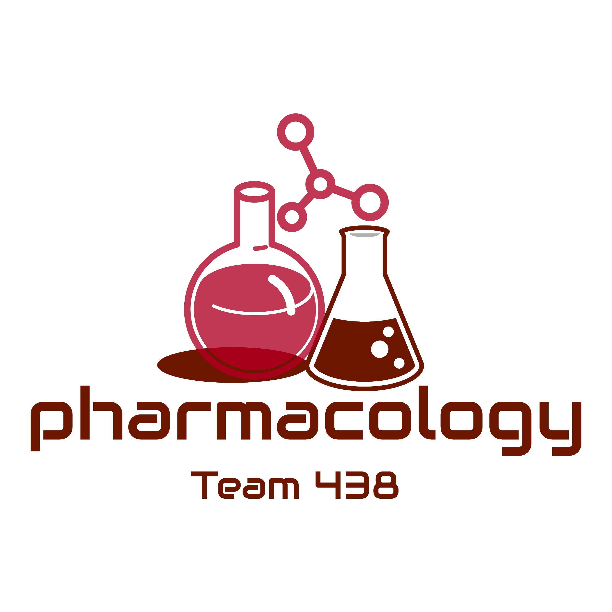
Editing File
Mnemonic File
Reproduction Block
Pharmacology team 438
Medications Affecting Erectile Dysfunction
Objectives:
By the end of the lecture , you should know:
Revise the haemodynamic changes inducing normal erection
Interpret its different molecular control mechanisms
Define erectile dysfunction [ED] and enumerate its varied risks
List drugs inducing ED and reflect on some underlying mechanisms
Correlate drugs used in treatment of ED to the etiopathogenesis
Classify oral 1st line therapy relevant to; Mechanism / Utility / ADRs
Compare the pharmacological difference of PDE5 inhibitors
Study the transurethral, intracavernous or topical 2nd line therapies; Mechanism / Utility / ADRs
Enumerate lines of treatment of priapism
Color index:
Black : Main content
Red : Important
Blue: Males’ slides only
Purple: Females’ slides only
Grey: Extra info or explanation
Green : Dr. notes

Slide 2
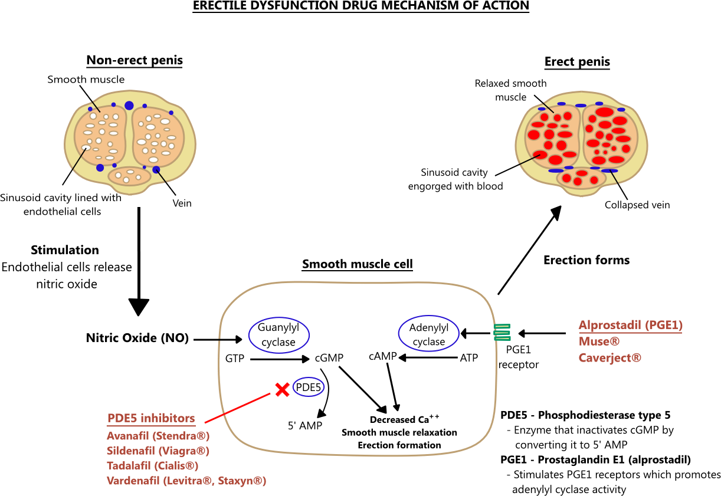
Mechanism of Erection
01
An erection occurs when the amount of blood rushing to the penis is greater than the amount of blood ﬂowing from it¹
02
A massive influx of blood accumulates in the sinusoidal spaces due to relaxation of smooth muscle & dilatation of arteries ➞ Corpora cavernosa to swell (tumescence/erection)
03
Tumescence compresses the veins that normally drain the penis ➞ reduces venous outﬂow & maintains penile rigidity
A normal erection relies on the coordination:
Vascular
Neurological
Hormonal²
Psychological
An erection can occur following direct genital stimulation or auditory or
visual stimulation aspects that contribute to the inﬂux of blood to the penis
04
Peripheral haemodynamic changes inducing erection
(Flaccid)
1
2
3
4
4
Explanation of the picture:
Erection is maintain by increased level of of cyclic nucleotides cGMP and cAMP
Sexual stimulation -direct, visual ..etc- causes the releasing of nitric oxide from the endothelial cells lining the cavernosal arteries → diffuse into the smooth muscle cells of corpora cavernosa
Nitric oxide activate guanylyl cyclase system to release cGMP as a second messenger to produce the muscle relaxation action by decreasing the level of Ca+ ; PDE5 degrade cGMP to stop its action
PGE1 receptor activated by various stimuli leads to activation of adenylyl cyclase system to release cAMP as a second messenger to help in muscle relaxation
Some drugs used in treating ED aim to ↑ cGMP as PDE5 inhibitors , or ↑ cAMP as Alprostadil
1: due to smooth muscle relaxation.
2: e.g.: thyroid hormone (negatively affect erection)

Slide 3
Causes:
Endothelial dysfunction is the commonest cause
Erectile Dysfunction “ED”
It is a persistent or recurrent inability to attain (acquire)& maintain (sustain) an erection (rigidity) suﬃcient for satisfactory sexual performance
Impotent: is reserved for those men who experience erectile failure during attempted intercourse more than 75 % of the time
Complete ED 10%
Diabetes
Dyslipidemia
Moderate ED 25%
No ED 48%
Precursors
Hypertension
Oxidative stress
Tobacco
Minimal ED 17%
Prevalence
Prof. Yieldez = only know what are highlighted in red
Causes
Atherosclerosis
Endothelial cell injury
Vasoconstriction
Inﬂammatory | Prostatitis, urethritis
Mechanical | Peyronie's disease , chordee
Psychological | Depression, performance anxiety, stress, relationship difficulties
Occlusive Vascular | Arterial: hypertension, smoking, hyperlipidemia, DM, peripheral vascular disease Venous: venous occlusion due to anatomical or degenerative changes
Trauma | Pelvic fracture, Spinal cord injury, penile trauma
Endocrine | Hypogonadism, hyperprolactinemia, hypothyroidism, hyperthyroidism
Neurologic | Parkinsons, multiple sclerosis, spina bifida, pelvic surgery, peripheral neuropathy
Chemical¹ | Anti-hypertension, anti-arrhythmics, antidepressant, anxiolytics, anti-androgens, anticonvulsants, alcohol, marijuana, anti-parkinsonism, LHRH analogues
Extra factors | Prostatectomy, old age², CRF, cirrhosis
Outcomes
Erectile dysfunction
Thrombosis
Precursors
Endothelial dysfunction is the commonest cause
Outcomes
Dyslipidemia
Thrombosis
Tobacco
Erectile dysfunction
Oxidative stress
Endothelial cell injury
Diabetes
Atherosclerosis
Hypertension
Vaso-
constriction
1:asking about the patient’s drug history is extremely important.
2: due to hypogonadism.

Slide 4
Drugs Adversely Causing ED
Drug class | Examples
Beta-blockers Calcium-channel blockers Alpha- adrenergic agonists Cardiac glycosides | Propranolol, metoprolol, atenolol Verapamil, nifedipine Clonidine Digoxin
Thiazide diuretics Aldosterone antagonists | Hydrochlorothiazide Spironolactone
Fibric acid derivatives | Gemfibrozil , clofibrate
SSRI Tricyclic antidepressants Other antidepressants | Fluoxetine, sertraline,paroxetine, citalopram Amitriptyline , desipramine, nortriptyline Lithium
Benzodiazepines | Lorazepam, alprazolam, diazepam
Histamine (H2) receptor antagonists | Ranitidine, cimetidine
Butyrophenones and phenothiazines | Haloperidol, prochlorperazine, chlorpromazine
Hydantoin anticonvulsant | Phenytoin
Cytotoxic agents | Cyclophosphamide, methotrexate
Recreational drugs | Alcohol, cocaine, marijuana
Mechanisms of How these Drugs Causing ED
Central Acting drugs
anti-Depressant Drugs E.g non-selective (TCAs) selective (SSRIs) | Dopamine¹ promotes arousal more than epinephrine which have an opposite effect of 5HT (serotonin) on 5HT2 → ↓dopamine release →↓arousal anti-depressant drugs ↓ 5HT uptake which lead to ↑5HT in synapse act on 5HT2 → ↓ dopamine release →↓ arousal. SSRI² have a peripheral eﬀect: antagonize Nitric Oxide actions →↓ genital sensation→ delay ejaculation (use for treatment of premature ejaculation)
Anti-psychotic drugs | They are DA antagonist, causing hyperprolactinemia
Anti-epileptic drugs E.g phenytoin | They have GABA eﬀect (inhibitory neurotransmitter) → antagonize excitatory Amino acid → increase sedation → ↓ arousal.
Anti-Hypertension
Central hypotensive | Methyldopa, Reserpine: ↓ arousal Clonidine (α2 agonist): ↓ arousal centrally
Other hypotensive | β2 blockers: antagonise vasodilating β2 effect + potentiate α1 effect (vasoconstriction) Thiazide diuretics: ↓ spinal reflex controlling erection + ↓ arousal
1: hormone of sex and desire.
2: out of all anti-depressants, SSRIs causes erectile dysfunction the most.

Slide 5
Anti-androgen ( They ↓ desire¹ )
Finasteride² | α reductase inhibitor (prevent production of active testosterone) → irreversible erectile dysfunction
Cyproterone Acetate³ | synthetic steroidal antiandrogen
Other drugs | Cimetidine (high doses), ketoconazole, Spironolactone causes hyperprolactinemia + gynecomastia Estrogen-containing medications
Habituating agents
Smoking | Cigarette smoking cause vasoconstriction + penile venous leakage
Alcohol | Small amount: ↑ desire + ↓ anxiety + vasodilatation Large amount: ↑ sedation + ↓ desire Chronic alcoholism: hypogonadism + polyneuropathy
Drugs Used for the Treatment of ED
According to the route of administration
Oral:
-Selective PDE5 inhibitors⁴
-Testostero
- Apomorphine⁵
-Oral Phentolamine
- Yohimbine
-Trazodone
- Korean Ginseng
Transurethral:
- Alprostadil⁶
Topical:
- Combinations of
[ Papaverine , Minoxidil,
Nitroglycerine,
Drug absorption enhancer ]
Intracavernosal:
- Alprostadil
- Papaverine
- Phentolamine⁷
Oral Drugs: Selective PDE5 Inhibitors
PDE receptors family and their location
Prof. Yieldez = not imp, some effects will be discussed in the next slide “know them”
Receptor | Location | Receptor | Location
PDE1 | Heart,brain,lung,smooth muscle | PDE7 | Skeletal muscle, heart, kidney, brain, pancreas, T-Lymphocytes
PDE2 | Adrenal gland , heart ,lung ,liver, platelets | PDE8 | Testes, eye, liver, skeletal muscle, heart, kidney, ovary, brain, T-Lymphocyte
PDE3 | Heart, lung, liver, platelets, adipose tissue, inflammatory cells | PDE9 | Kidney, liver, lung, brain, possibly heart
PDE4 | Sertoli cells, kidney, brain, liver, lung, inflammatory cells | PDE10 | Testes, brain
PDE5 | Lung, platelets, vascular smooth muscle, heart | PDE11 | Skeletal muscle, prostate, kidney, liver, pituitary gland, salivary gland, testes
PDE6 | Photoreceptor | - | -
(cGMP)
(cAMP)
(cAMP)
(cAMP)
(cAMP)
(cGMP)
(cAMP)
(cAMP)
(cGMP)
(cGMP)
(cGMP)
1:due to decreased testosterone. 2: used in penile prostate hypertrophy.
3: Used for acne treatment in females. 4: First line therapy.
5: increase sexual desire.
6: prostaglandin analogue.
7: a₁ receptor inhibitor.

Slide 6
Drugs | Sildenafil | Vardenafil | Tadalafil | Avanafil
MOA | Inhibit PDE5 → prevent breakdown of cGMP → pertain vasodilatation → erection They do not affect the libido¹, so sexual stimulation is essential
P.D | Pharmacodynamics action relevant to PDE5 inhibition: Vascular smooth muscle cells (VSMCc) of Erectile Tissue of Penis Other VSMCs e.g lung², brain and heart Other non-VSMCs e.g prostate, bladder, seminal vesicle, GIT Platelets Other tissues; testis, skeletal muscles, liver, kidney, pancreas
Uses | 1st line therapy in Erectile dysfunction, all types have similar efficacy: Sildenafil: 74-84% Vardenafil: 73-83% Tadalafil: 72-81% Pulmonary hypertension BPH & premature ejaculation
Selectivity | 10 folds selective on PDE5&6 | 16 folds selective on PDE5&6 | >200 fold selective on PDE5&6 | —
 | Selectivity on PDE5 is not absolute and vary with each drug: Can partially act on PDE targeting cGMP (1,5,6,9,11) In higher doses it can act on PDE targeting cAMP (2,3,4,7,8,10) Stimulation of different types can cause ADRs: PDE1&2 → Ischemic heart diseases , acute myocardial infarction PDE5&6 → Headache, flush, nasal congestion, altered vision PDE11 → Back pain
P.K | Fatty food interferes with Sildenafil & Vardenafil absorption, so taken on empty stomach or at least 2 hours after food |  | Tadalafil & Avanafil absorption doesn't affected by food
 | Metabolization: All by hepatic CYT3A4; Tadalafil more than the rest, thus: Increase ADRs with enzyme inhibitors; erythromycin & clarithromycin, ketoconazole, cimetidine, tacrolimus, fluvoxamine, amiodarone...etc. Decrease efficacy with enzyme inducers; rifampicin, carbamazepine, phenytoin
Dose | 50-100 mg | 10-20 mg |  | -
Frequency | Once a day |  |  | -
Time of adminis | 1 hour before intercourse |  | - 1-12 hours before intercourse | Has the advantage of been given 30 min before intercourse
Onset | 30-60 min |  | <30-45 min | -
Duration | 4h | 4-5h | 36h | -
1: = not aphrodisiac.
2: therapeutically used in treatment of pulmonary hypertension.

Slide 7
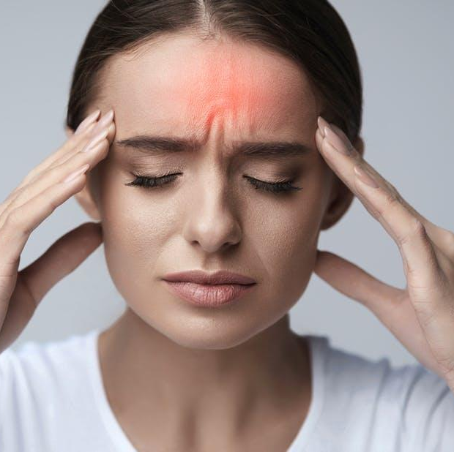
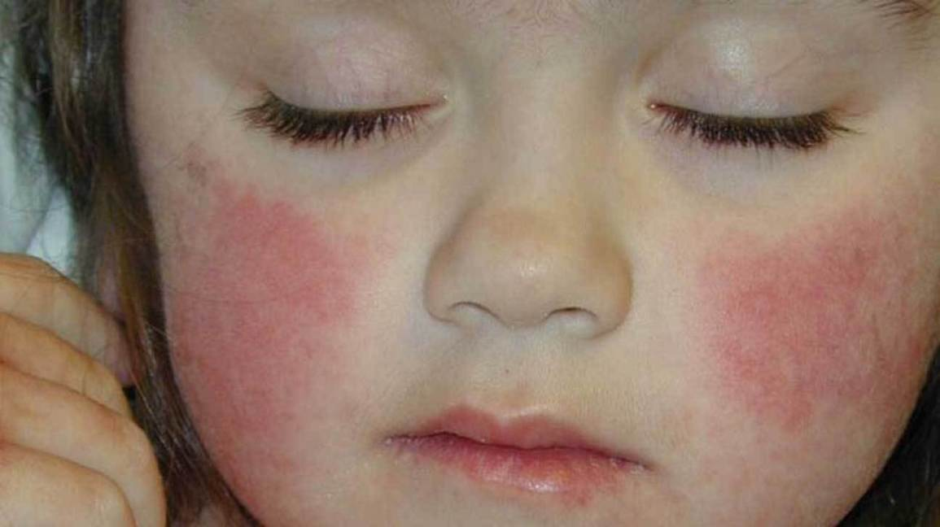
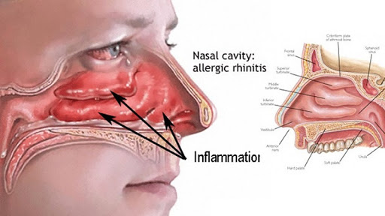
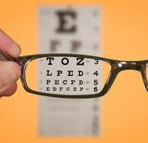
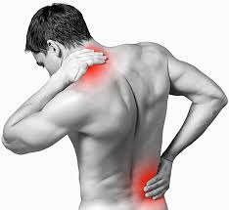
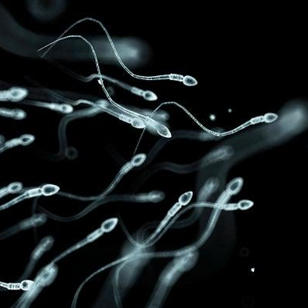
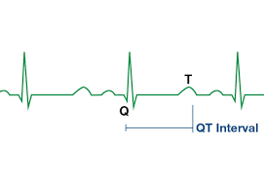
Common ADRs:
ADRs | Sildenafil | Vardenafil | Tadalafil
Headache % | 14 | 10 | 15
Flushing % | 12 | 11 | 3
Nasal | Congestion | Rhinitis | Congestion
Dyspepsia % | 7 | 3 | 15
Abnormal vision% | >4 | <2 | —
Myalgia & back pain% | — | — | 5
Sperm function | — | — | —
Q-T prolongation | — | ↑ | —
Specific ADR for Sildenafil
Specific ADR for Tadalafil
Specific ADR for Vardenafil
Major less common ADRs:
Precautions:
Ischemic heart diseases & Acute myocardial infarction: patients on large dose or on nitrates¹
Hypotension: patients on α-blockers than other antihypertensives
Bleeding: epistaxis ...etc
Priapism: if erection lasts longer than 4 hours → emergency situation
With α blockers (except tamsulosin²) → orthostatic hypotension
With hepato/renal insufficiency³
With bleeding tendencies (leukemia, hemophilia, Vit K deficiency, antiphospholipid syndrome,...etc)
Vardenafil: With quinidine, procainamide, amiodarone (class 1 & 3 antiarrhythmic)⁴
Dose adjustment; when using drugs that have interaction on hepatic liver microsomal enzymes i.e. inhibitors or inducers.
Major rare ADRs:
Ischemic Optic Neuropathy: can cause sudden loss of vision
Sudden Hearing loss
C.I:
Nitrates: total contraindication
Hypersensitivity to drug
Patients with history of acute MI, stroke, fatal arrhythmias <6 month
1: due to sudden drop in BP.
2: selectively block α receptors in the prostate, used in treatment of prostatic hypertrophy.
3: decrease drug clearance = prone to side effects
4: due to QR prolongation induced by vardenafil.

Slide 8
Other Oral Drugs to Treat ED
Testosterone (Androgens) | Given to those with hypogonadism or hyperprolactinemia. Given for promotion of desire centrally
Apomorphine | A dopamine agonist on D2 receptors. Activates arousal centrally; Erectogenic + Little promotion of desire Given sublingual, so Acts quickly. Not FDA approved, Weaker than PDE5 Given in mild-moderate cases, psychogenic and when PDE5 Is C.I ADRs: nausea, headache, and dizziness but safe with nitrate
Oral Phentolamine | An α1 blocker, has debatable efficacy
Yohimbine¹ | Central ( α2 antagonist) and peripheral presynaptic α2 agonist (Aphroditic² + Erectogenic) but low efficacy and many CV side effects³
Trazodone⁴ | Antidepressant, a 5HT reuptake inhibitor (priapism).
Korean Ginseng | Questionable, may be a Nitric Oxide donner.
2) Topical Drugs to Treat ED
- 20% Papaverine:
increase cAMP + cGMP
- 2% Minoxidil:
NO donner + K channel opener
- 2% Nitroglycerine
-a drug absorption enhancers
- Low efficacy and not FDA approval
- Female Partner can develop hypotension and headache due to vaginal absorption
Combinations
Disadvantages
3) Transurethral Drugs to Treat ED
Drug | Alprostadil
MOA | Stimulates PGE1 →increase cAMP⁵
P.K | Synthetic + more stable Applied by a special applicator into penile urethra & acts on corpora cavernosa which lead to erection Low - Intermediate Efficacy Minimal systemic effects and rarity of drug interactions.
ADR | Variable penile pain Urethral bleeding, urethral tract infection Vasovagal reflex, Hypotension Priapism or Fibrosis (rare)
1: alkaloid drug.
2: = stimulate desire and sexual drive.
3: e.g. angina pain.
4: causes vasodilation of blood vessels of corpus cavernosa.
5: by activation of adenylate cyclase.

Slide 9
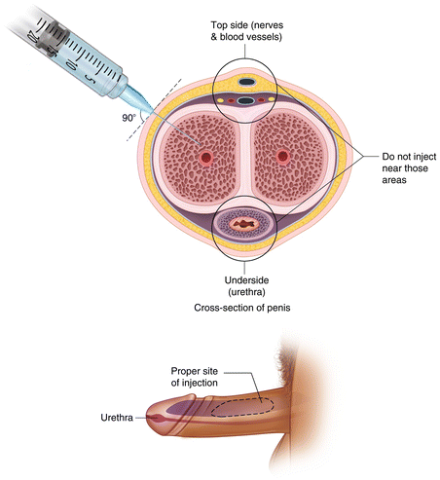
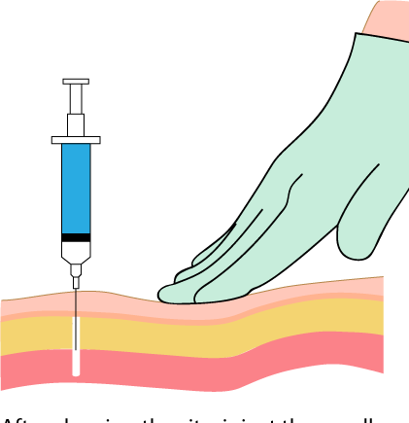
4) Intracavernosal Drugs to Treat ED
Alprostadil | PGE1→ increase cAMP Needs training: Erection → after 5-15 min and lasts according to dose injected May develop fear of self injury, so Discontinuation ADRs: Pain or bleeding at injection site Cavernosal fibrosis Priapism
Papaverine¹ | PG E1→ ↑cAMP + cGMP,It is a direct acting smooth ,muscle relaxant
Phentolamine¹ | α1 blocker
3 combined in severe cases
Treatment of Priapism
It is a medical emergency
Aspirate blood to decrease intracavernous pressure.
Intracavernous injection of Phenylephrine (local α1 agonist²) ⟶ Detumescence
1: promote vasodilation.
2: promote vasoconstriction.

Slide 10
Quiz
MCQ
Q1- Which of the following is/are contraindications to the use of PDE-5 inhibitors?
A- History of a myocardial infarction more than 6 months ago. B- Mild, stable angina.
C- Nitrate use. D- All of the above are contraindications to the use of PDE-5 inhibitors.
Q2- Sildenafil produces a penile erection by inhibiting what enzyme?
A- Cytochrome 3A4 B- cGMP C- Phosphodiesterase D- Adenyl cyclase E- Nitric oxide synthase.
Q3- Alprostadil produces an erection by
A- increasing tissue levels of GTP. B- increasing tissue levels of cAMP.
C- decreasing tissue levels of nitric oxide. D- decreasing tissue levels of cGMP.
E- increasing tissue levels of cGMP.
Q4- Finasteride causes irreversible erectile dysfunction by blocking:
A- α- reductase enzyme B- α receptors C- androgen receptors D- β receptors
Q5- The following drugs may be used in erectile dysfunction except?
A- Phenylephrine B- Apomorphine C- Alprostadil D- PGE1 analogues (Papaverine)
SAQ
66-years-old man complained of difficulty maintaining an erection. He is concerned about the use of drugs to restore sexual function, particularly about the need to time therapy with anticipated sexual activity.
Q1-What is the drug of choice that is indicated for this patient because of its long duration of action? Q2-What is the M.O.A of that drug?
42-years-old patient who is taking a PDE-5 inhibitors for treating ED, later he is diagnosed with angina and be treated with Nitroglycerin.
Q3-Which drug would be the safest to be used with Nitroglycerin in this patient to treat erectile dysfunction?
Q4-Mention 2 ADR of that drug.
44-years-old male came to ER with Priapism persist for 6 hours, What is the drug of choice that is indicated in this case ?
MCQ
SAQ
Q1 | C
Q2 | C
Q3 | B
Q4 | A
Q5 | A
Q1 | Tadalafil
Q2 | Inhibit PDE5 → prevent breakdown of cGMP → pertain vasodilatation→ erection
Q3 | Apomorphine
Q4 | nausea, headache, and dizziness
Q5 | Intracavernous injection of Phenylephrine
Answers:

Slide 11
Thank you for all the love and support you gave the team in those two years!
Hope we made the context much easier to study.
God bless you, Future doctors.
Team Leaders:
May Babaeer Zyad Aldosari
This Amazing Work was Done By:
Rema AlMutawa Ghalia AlNufaei
Note writers
Raghad AlKhashan
Quiz writers
Noura AlMazrou Shahad AlSahil

