Slide 1
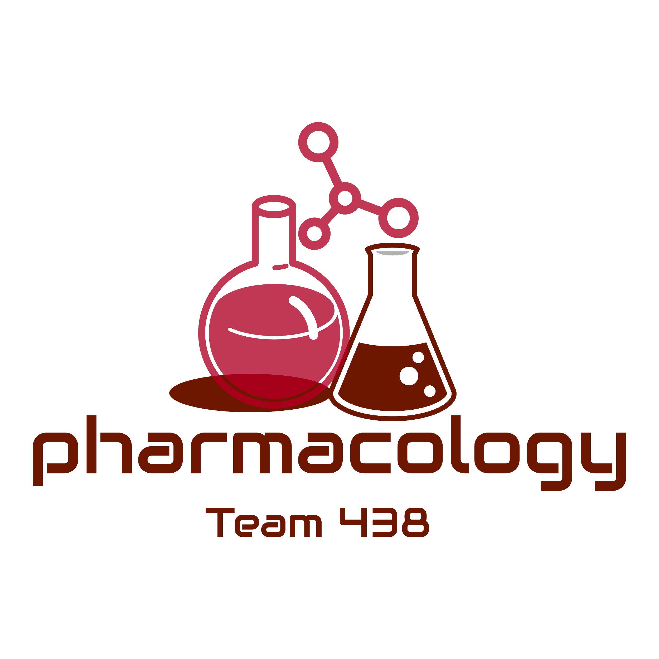
Editing File
Mnemonic File
Reproduction Block
Pharmacology team 438
Oral and Other Forms of Contraceptives
Objectives:
By the end of the lecture , you should know:
Perceive the different contraceptive utilities available.
Classify them according to their site and mechanism of action.
Justify the existing hormonal contraceptives present.
Read the objectives for once.
Compare between the types of oral contraceptives pills with respect to mechanism of action, formulations, indications, adverse effects, contraindications and possible interactions.
Hint on characteristics & efficacies of other hormonal modalities.
Color index:
Black : Main content
Red : Important
Blue: Males’ slides only
Purple: Females’ slides only
Grey: Extra info or explanation
Green : Dr. notes

Slide 2
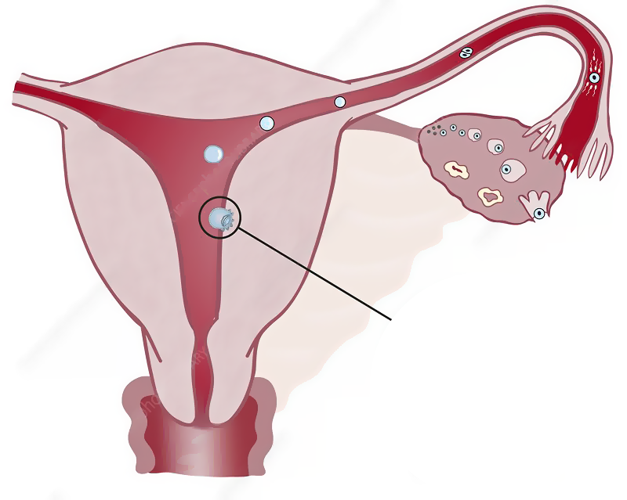
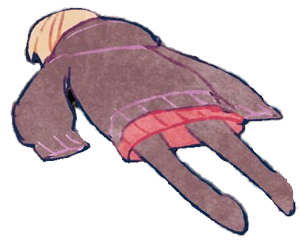
Introduction
Definitions
Conception: There is fusion of the sperm & ovum to produce a new organism.
Contraception: We are preventing this fusion to occur & This achieved by interfering with:
1
2
Preventing sperm from fertilizing the ovum
3
Implantation
Normal process
of ovulation
-IUD¹ (copper T)²
Killing the sperm:
-Spermicidals
- Jells
-Foams
Interruption by a barrier
-Condoms³
-Cervical caps⁴
-Diaphragms⁴
-Thin Films⁴
- Hormonal Therapy
- Oral Contraceptive Pills
- Contraceptive Patches
-Vaginal Rings
-Injectable⁵
-IUD (with hormone)
1
3
2
1: Intrauterine device
2: IUD with copper added to it, a form of non hormonal IUD that is wrapped in copper wires. Copper alters sperm mobility, preventing it from reaching the ovum.
3: male preventative barrier
4: female preventative barriers.
5: up to 3 months effect.

Slide 3
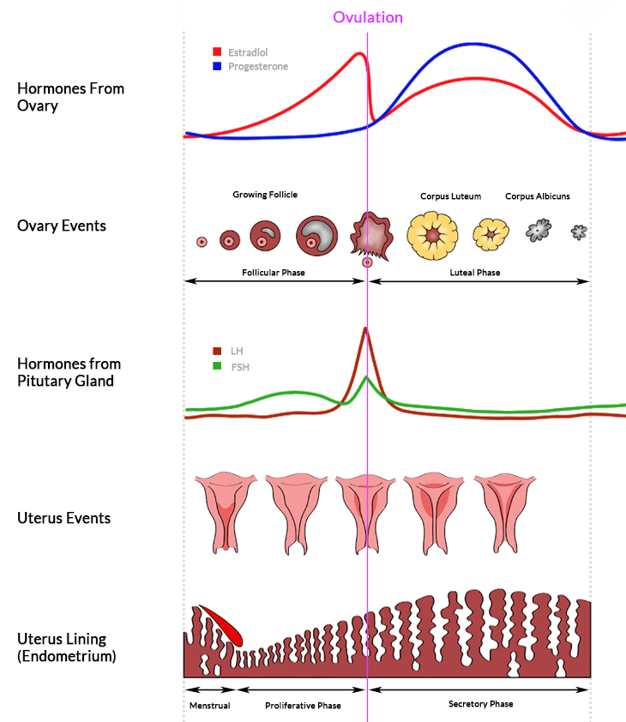
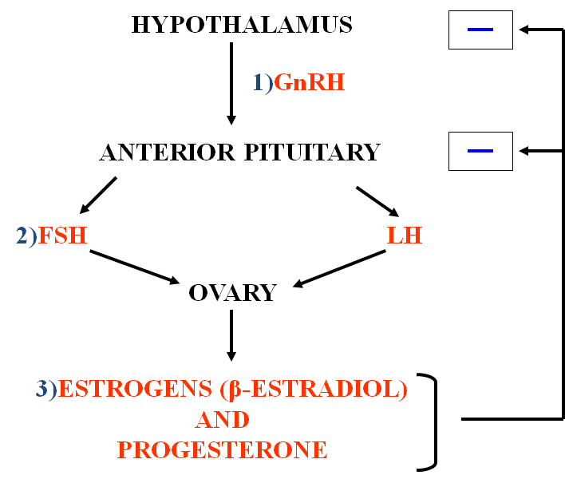
Physiology Overview
Hypothalamo - pituitary - gonadal axis
And the -ve feedback of estrogen and progesterone
Plasma concentrations of the gonadotropins & ovarian hormones during the normal female sexual cycle
Types of Oral Contraceptive Pills According to Composition & Intent of Use
Combined (COC)
MINI (POP)
Morning-After²
Contain Estrogen¹ & Progestins (100% effective)
Contain Only a Progestin (97% effective)
Contain both hormones or
Each one alone (high dose) OR Mifepristone (Antiprogestin) ± Misoprostol
(prostaglandin analogue)
Ethinyl estradiol or mestranol
[a “prodrug” converted to ethinyl estradiol].
Currently³ concentration used now is very low to minimize estrogen hazards.
Norethindrone, Levonorgestrel (Norgestrel) & Medroxyprogesterone acetate (Has systemic androgenic effect: acne, hirsutism, weight gain).
Currently: Norgestimate, Desogestrel & Drospirenone (Has no systemic androgenic effect).
Estrogen
Progestin
1: very effective in contraception.
2: = emergency contraceptives.
3: older preparations used to have higher conc.

Slide 4
Drug | Combined Oral Contraceptives (COC)
MOA | The main MOA is Inhibit ovulation by suppressing the release of gonadotropins¹ (FSH & LH) → no action on the ovary → ovulation is prevented. Inhibit implantation by causing abnormal contraction of the fallopian tubes & uterine musculature → ovum will be expelled rather than implanted. Increase viscosity of the cervical mucus making it so viscous → no sperm pass. Abnormal transport time through the fallopian tubes.
Admin. | Monthly Pills | Seasonal Pills
 | Pills are better taken at the same time of day. For 21 days: starting on day 5² / ending at day 26³. This is followed by a 7 day pill free period. To improve compliance we use a formulation of 28 pills: The first 21 pills are of multiphasic formulation (medicated). Followed by the last 7 pills are actually placebo (dummy pills). | Are known as Continuous / Extended cycle to cover 91 days schedule⁴. Taken continuously for 84 days, and then a break for 7 days. Has very low doses of both estrogens and progestins. Advantage: It lessens menstrual periods (1 period every 3 months), useful in those who have pain from endometriosis and can prevent migraines during period, useful in those who have premenstrual or menstrual disorders, and in perimenopausal⁵ women with vasomotor symptoms. Disadvantages: Higher incidence of breakthrough bleeding & spotting during early use.
Formulations of Monthly Pills | Currently, the formulation of monthly pills are improved to mimic the natural ongoing changes in hormonal profile. Accordingly we have now the phase formulations: 1. Monophasic: (a fixed amount of estrogen & progestin throughout the month). 2. Biphasic: (2 doses) (a fixed amount of estrogen, while the amount of progestin increases stepwise in the second half of the cycle). 3. Triphasic: (3 doses) (a fixed or variable amount of estrogen & while the amount of progestin increases stepwise in 3 phases).
ADR | Estrogen Related | Progestin Related
 | Nausea & Breast tenderness. Headache. ↑ Skin Pigmentation⁶. Impair glucose tolerance (hyperglycemia). ↑ Incidence of breast, vaginal & cervical cancer. Cardiovascular - major concern: Thromboembolism⁸. Hypertension. ↑ Frequency of gallbladder disease. | Nausea & Vomiting. Headache. Slightly higher failure rate. Fatigue. Depression of mood. Menstrual irregularities. Weight gain⁷. Hirsutism⁷. Masculinization⁷ (Norethindrone). Ectopic pregnancy.
1: Normally released by negative feedback induced by low estrogen and progesterone. 2: after menstruation.
3: to allow for menstruation.
4: the women will only experience her period once every 3 months (4 times a year).
5: during which the women experience very heavy periods accompanied by nervousness, mood swings, and other symptoms.
6: which happens normally during pregnancy due to increased estrogen.
7: androgenic effect. 8: it is contraindicated in women with varicose veins.

Slide 5
Drug | Combined Oral Contraceptives (COC)
C.I (Of estrogen containing pills) | Thrombophlebitis / thromboembolic disorders. Chronic Heart Failure (CHF) or other causes of edema. Vaginal bleeding of undiagnosed etiology¹. Known or suspected pregnancy. Known or suspected breast cancer, or estrogen-dependent neoplasms. Impaired hepatic functions. Dyslipidemia, diabetes, hypertension, migraine. Lactating mothers²: Instead, use progestin only pills (mini pills). Obese female, smokers³, females who are above 35 years: Instead, use progestin only pills.
Inter- actions | Medications that cause contraceptive failure: Impairing absorption (Antibiotics that interfere with normal GI flora → ↓ absorption → ↓ its bioavailability). CYT P450 Inducers (Microsomal Enzyme Inducers → ↑ catabolism of OC). e.g. Phenytoin, Phenobarbitone, Rifampin. Medications that ↑ COC toxicity: CYT P450 Inhibitors (Microsomal Enzyme Inhibitors → ↓ metabolism of OC → ↑ toxicity). e.g. Acetaminophen, Erythromycin. Medications that is altered in clearance: COC decrease the clearance→ ↑ in their toxicity. e.g. Warfarin, Cyclosporins, Theophylline.
Drug | MINI Pills (POP)⁴
MOA | Contains only a progestin as norethindrone or desogestrel. The main effect is → ↑ cervical mucus, so no sperm penetration & therefore, no fertilization.
Admin. | Should be taken every day, the same time, all year round⁵. I.M injection e.g. medroxyprogesterone acetate 150 mg every 3 months.
Uses | Are alternative when estrogen is contraindicated During breastfeeding, hypertension, cancer, smokers & over the age of 35.
Drug | Morning-After Pills
Uses | Emergency Contraceptives Post Coital Contraceptives. Contraception on instantaneous demand, secondary to unprotected sexual intercourse and when desirability for avoiding pregnancy is obvious: Unsuccessful withdrawal before ejaculation. Torn, leaking condom. Missed pills. Exposure to teratogen e.g. Live vaccine. Rape.
1: due to suspected cancer, estrogen will only help the cancer grow.
2: estrogen decreases lactation.
3: they have increased risk of CVS side effects.
4: less effective than COC.
5: for oral preparation.

Slide 6
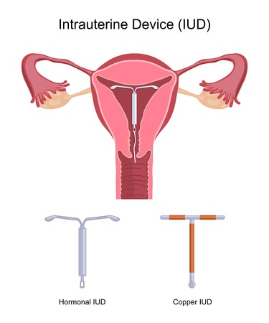
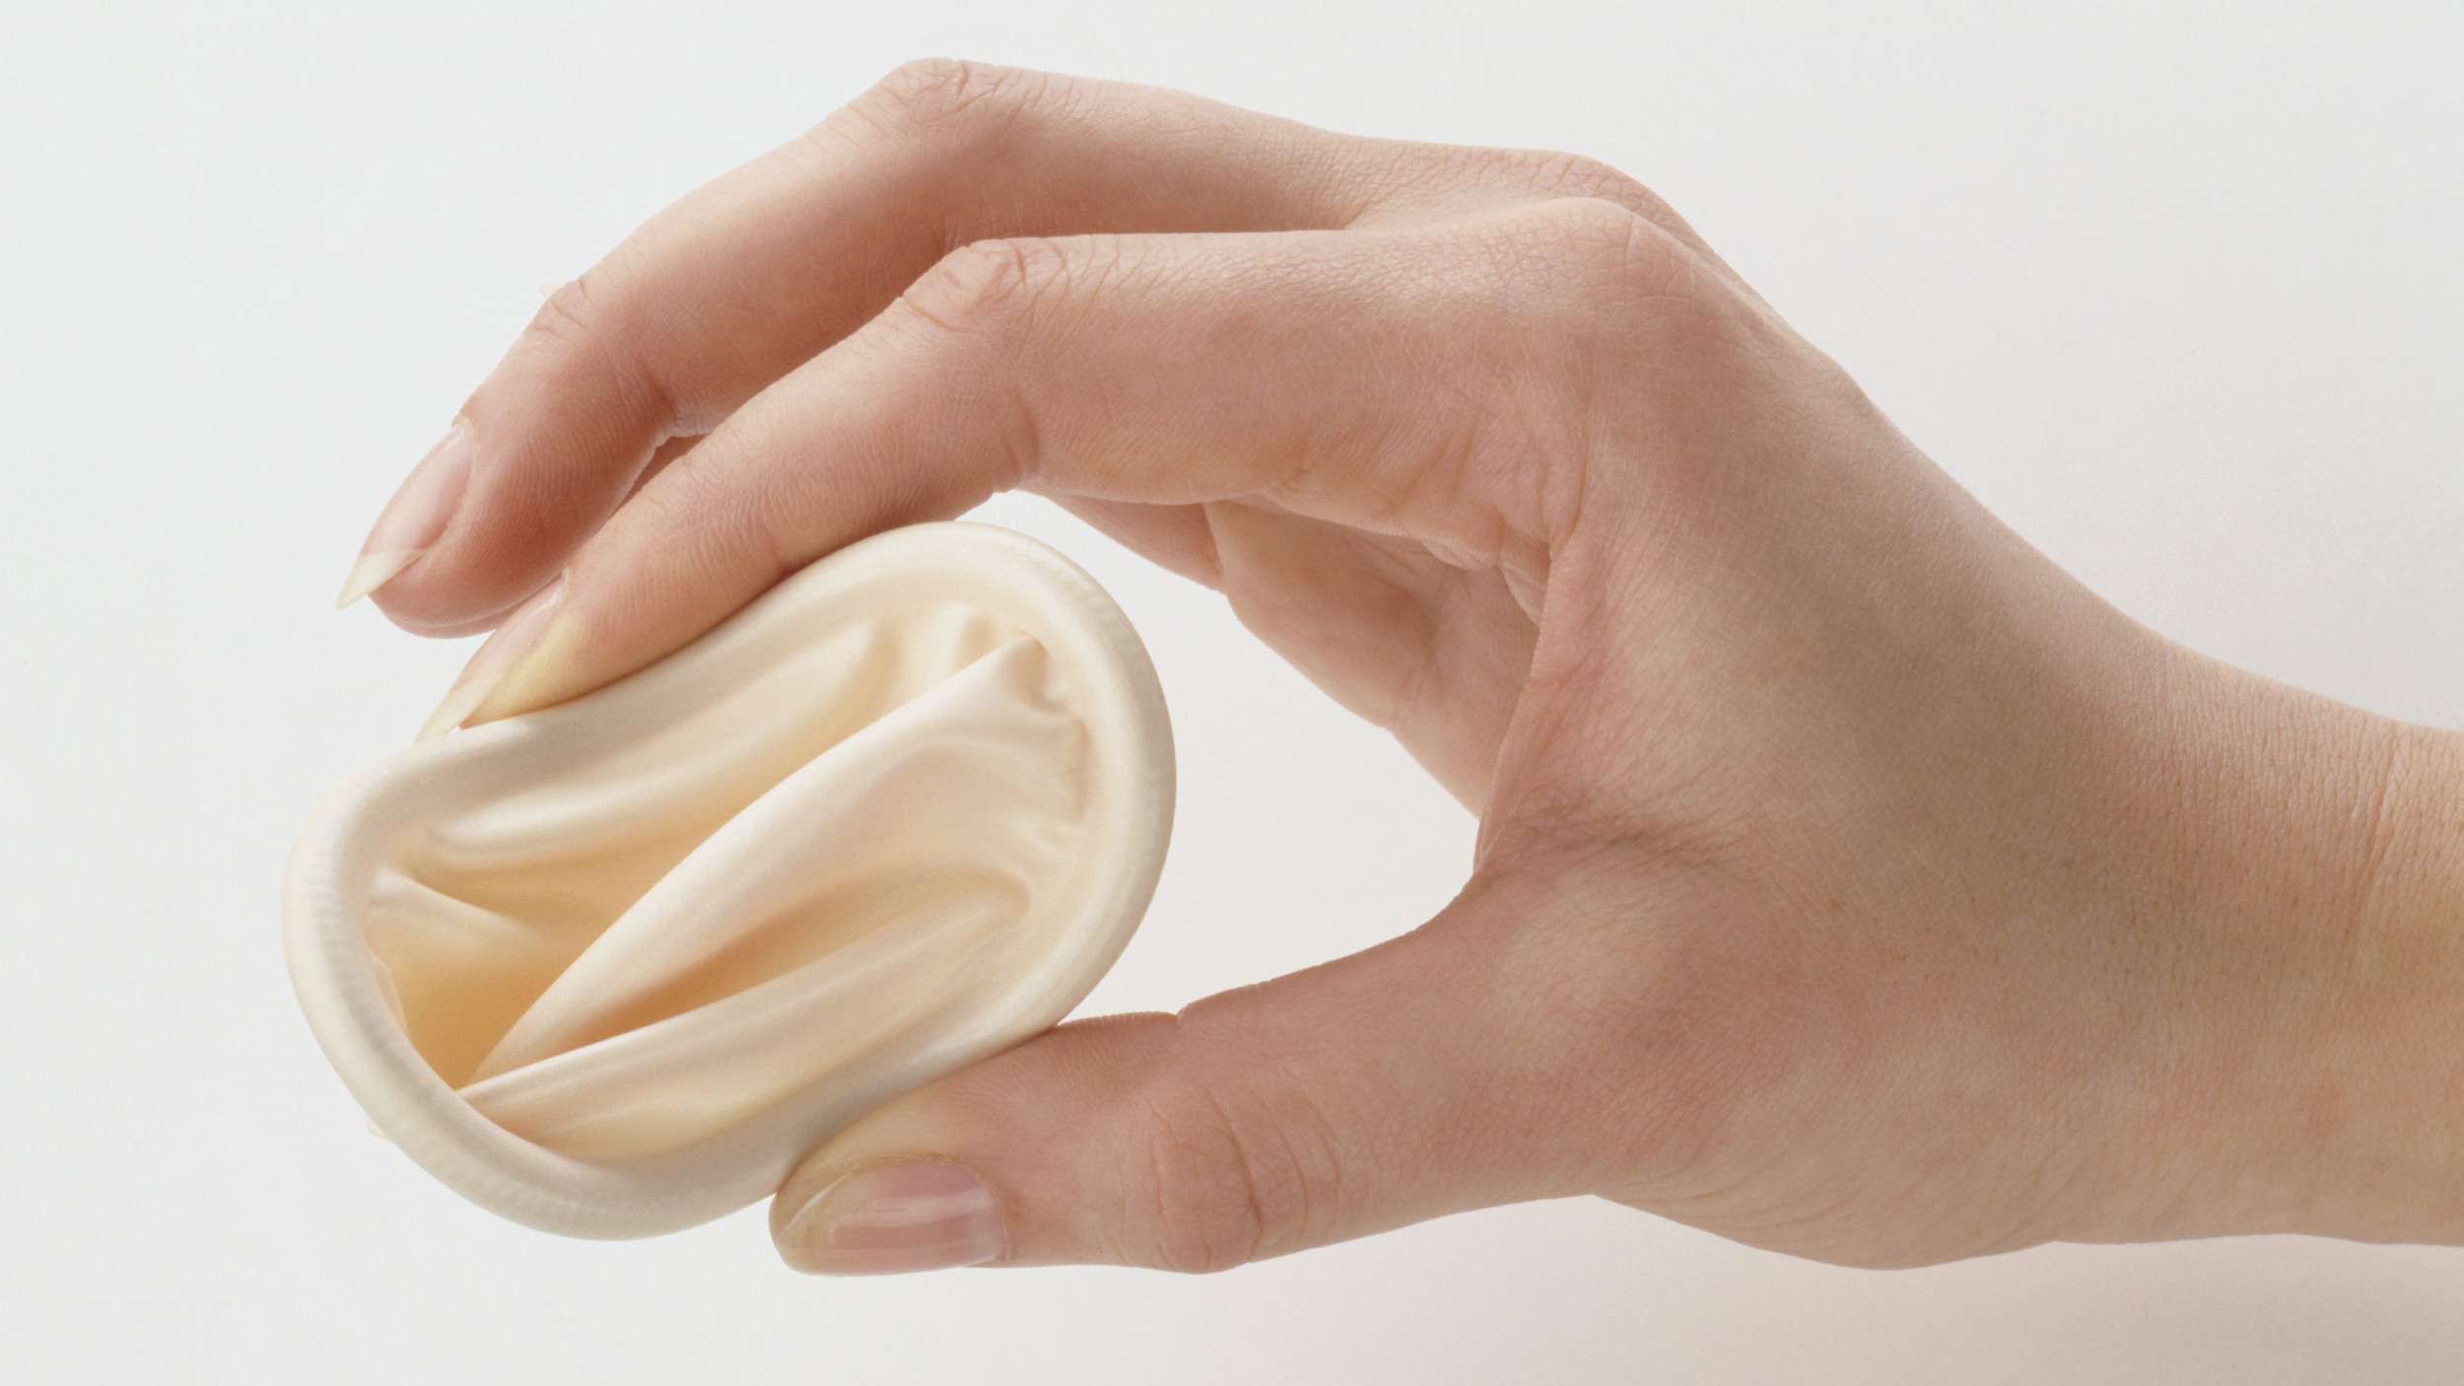
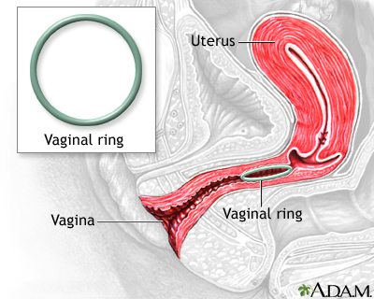
Types of Emergency Contraceptives
Composition | Method of Administration | Timing of 1st Dose After Intercourse | Reported Efficacy
Ethinyl estradiol + Levonorgestrel | 2 tablets twice with 12 hrs in between | 0-72 hrs | 75%
Ethinyl estradiol (High-dose only) | Twice daily for 5 days |  | 75-85%
Levonorgestrel (High-dose only) |  |  | 70-75%
(Mifepristone ± Misoprostol)¹ | A single dose | 0-120 hrs | 85-100%
0 hrs means immediately after intercourse
Other Forms of Contraceptives
Form of Contraceptive | Info. | Picture
Intrauterine Device | (Can be hormonal or copper IUD), 1. Create a foreign body → inflammatory response → lysis of the blastocysts (mature fertilized egg) & lysis of the sperm before reaching the ovum. 2. Stimulate secretion of the prostaglandins → more contractility of the uterus → expelled of ovum rather the implant it. 3. Works as a barrier prevent reaching the sperm to the ovum → prevent the fertilization.
Contraceptive Diaphragm | 1. Works as a barrier prevent reaching the sperm to the ovum → prevent the fertilization. 2. Can be covered with spermicidals (kill the sperm) → preventing the fertilization.
Vaginal Ring | (Made of some hormones), Covered with hormones → prevent the ovulation and implantation at the same time.
1: Most effective one. They initiate powerful uterine contraction and bleeding.

Slide 7
Quiz
MCQ
Q1: What is the main mechanism of action of progesterone only pills?
A. Increase cervical mucus B. Spermicidal C. Inhibit ovulation D. Makes sperm immotile
Q2: Which of the following is a progesterone only pill?
A. Ethinyl estradiol B. Levonorgestrel C. Misoprostol D. Norethindrone
Q3: Which of the following morning-after pills is given as a single dose?
A. Ethinyl estradiol B. Amitriptyline C. Misoprostol D. Norethindrone
Q4: Which of the following is not an indication for a morning-after pill?
A. Rape B. Paracetamol intake C. Recent Live vaccine D. Torn condom
Q5: Which of the following is a spermicidal?
A. Condom B. Cervical cap C. Diaphragm D. Certain jells
Q6: Which of the following is a major concern as an adverse effect related to Estrogen?
A. Menstrual irregularities B. Cardiovascular problems C. Headache D. Hirsutism
Q7: You use mini pills which contain only progestin with all of the following except?
A. Obese female B. Lactating female C. Female > 35 years D. Thrombophlebitis
Q8: Which of the following increase combined pills toxicity by inhibiting microsomal enzymes?
A. Erythromycin B. Warfarin C. Theophylline D. Ampicillin
SAQ
Q1: A 34 years old lactating mother went to the gynecologist for check up, after that the doctor said to her she should use a contraceptive before the sexual intercourse, what’s the most appropriate drug that should be given for her status?
Q2: What’s the most appropriate drug when she is Obese female or smokers or female > 35 years?
Q3: A 32 years old women went to the gynecologist because of ↑ Skin Pigmentation in different areas of her body, the doctor immediately asked her about taken any contraceptives, what’s the type of contraceptives that may cause this effect?
Q4: Mention the Mechanism of action of this drug?
Q5: Mention ONE indication for MINI pills contraceptives?
MCQ
Q1 | A
Q2 | B&D
Q3 | C
Q4 | B
Q5 | D
Q6 | B
Q7 | D
Q8 | A
SAQ
Q1 | Progestin Pills Only (mini pills).
Q2 | Progestin Pills Only
Q3 | Combined Oral Contraceptive
Q4 | Click for answer
Q5 | When estrogen is contraindicated
Answers:

Slide 8
Thank you for all the love and support you gave the team in those two years!
Hope we made the context much easier to study.
God bless you, Future doctors.
Team Leaders:
May Babaeer Zyad Aldosari
This Amazing Work was Done By:
Abdulrahman M. Bedaiwi
Note writers
Abdulrahman M. Bedaiwi Raghad AlKhashan
Quiz writer
Abdulrahman M. Bedaiwi

