Slide 1
Editing File
Mnemonic File
Reproduction Block
Pharmacology team 438
Teratogens and Drugs of Abuse in Pregnancy
Objectives:
By the end of the lecture , you should know:
Factors affecting placental transfer
Harmful effects of drugs during different stages of development
FDA classifications of drugs
Teratogenic Drugs
Keep on vibin
Adverse effects of drugs
Drugs of abuse
Color index:
Black : Main content
Red : Important
Blue: Males’ slides only
Purple: Females’ slides only
Grey: Extra info or explanation
Green : Dr. notes

Slide 2
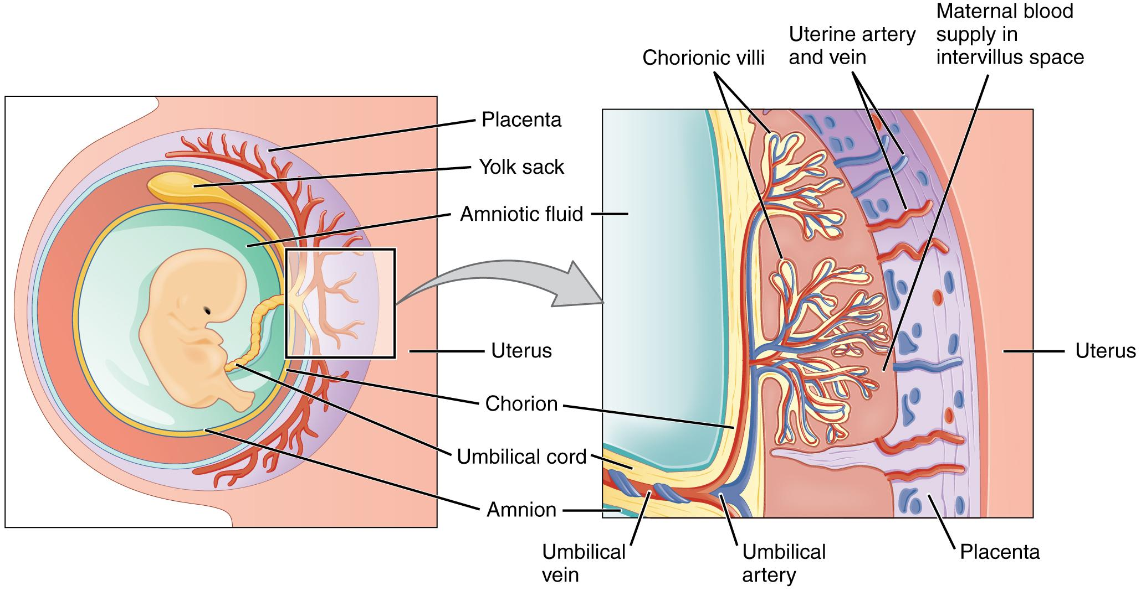
Medications in Pregnancy
How do drugs cross the placenta?
1- Physiochemical Properties of the Drug
Majority of women are exposed to medications during pregnancy
Unless necessary, drugs should not be used in pregnancy because many can harm the fetus
Half of the drugs have unknown effect on the fetus
About 2-3% of all birth defects are a result of the use of drugs
1
Most drugs can cross the placenta by passive diffusion
2
Placental membrane is semi-permeable
3
Movement of drugs through the placenta is limited by a single layer of trophoblasts
Factors controlling placental drug transfer
Physiochemical properties
Stage of development
Duration of exposure
Lipid solubility and Ionization
Lipid soluble drugs diffuse readily across the placenta and enter fetal circulation¹
Example: Thiopental → crosses placenta and causes sedation and apnea in infants
Ionized drugs cross the placenta slowly leading to very low concentration in fetus
Example: Succinylcholine and Pancuronium (skeletal muscle relaxants).
Molecular Size
MW of 250-500 → cross the placenta easily ²
MW of 500-1000 → crosses the placenta more difficulty
MW >1000 → can NOT cross the placenta
Example: Heparin
Protein Binding
Protein binding in the maternal circulation hinders the passage of drugs³
Example: Propylthiouracil, Chloramphenicol and heparin
lipid soluble drugs should not be used at all during pregnancy. Ionized drugs are preferable due to their slow rate of transfer.
High molecular weight drugs are preferable during pregnancy. Because if the MW is high, the ability to cross the placenta is less.
High protein binding drugs are preferable during pregnancy.

Slide 3
Factors controlling placental transfer
2- Stage of Placental and Fetal Development; they are 3 stages
First Trimester Week 1-12 | 2nd & 3rd Trimesters Week 13 - 28 | Near Term Weeks 29-40
Blastocyst formation Week 1-2 | Organogenesis Week 2 - 8 | Histogenesis and functional maturation Weeks 8 onwards
1
Blastocyst Formation:
Occurs from 1-16 days in the first trimester
Period of dividing zygote and implantation (pre-differentiation)
Drugs have all-or-nothing effect ¹
Exposure to drugs during this period → leads to prenatal death and abortion
2
Organogenesis:
Occurs in 17-60 days in the first trimester
Is the process where cells specialize to form tissues and organs
It is the most sensitive ² period of pregnancy
Exposure to harmful drugs during this period→ leads to major birth defects or gross malformation (teratogenesis)
3
Histogenesis and Functional Maturation
Growth and fetal development (maturation) occur at this stage
(2nd and 3rd trimesters)
Fetus depends on nutrients and hormonal supply
Exposure to drugs during this period → lead to functional problems, minor morphological abnormalities, growth retardation not gross malformations
However, CNS is sensitive to toxic effects throughout pregnancy
4
Near term
Occurs between 29th and 40th weeks
Exposure to drugs → lead to adverse effect on labor or neonates after delivery
If exposed to a harmful drug during this stage there are 2 possibilities:
1- The drugs is safe, nothing will happen and the pregnancy will continue normally.
2- Perinatal death and abortion.
Avoid drugs during this stage.

Slide 4
Teratogenesis
What is a teratogen?
FDA Classification System
Proven Teratogens (Category X)
It is the occurrence of congenital defects on the fetus
Is any agent that may cause permanent birth defects by interfering in fetal development
Examples: medications, street drugs, chemicals, diseases and environmental agents.
Could be severe during critical periods of development e.g. (organogenesis)
Category | Characteristics | Examples
A | Adequate and well-controlled human studies have failed to demonstrate a risk to fetus Drugs can be used in pregnancy | Folic acid Thyroxine
B | No risk in animal studies No adequate and well-controlled human studies Drugs can be used in pregnancy | Paracetamol Erythromycin
C | Adverse effects on the fetus in animals only No adequate and well-controlled studies in humans. Risk cannot be ruled out Drug may be used in serious situation despite its potential risk | Morphine
D | Positive evidence of human fetal risk based on adverse reaction data from studies in humans, investigational or marketing experience May be used in serious diseases or life threatening situations Used in cases were benefits outweigh risks | Antiepileptics
X | Proven fetal abnormalities in animal and human studies The risks involved in the use of the drug in pregnant women clearly outweigh potential benefits. Drugs are teratogens and contraindicated in pregnant women or planning to conceive. | Thalidomide (sedative)
Retinoids
Vitamin A (limit to 700 ug/day)
Isotretinoin (used to treat acne)¹
Thalidomide (hypnotic)
Lithium
Alcohol
Cytotoxic agents:
Folate antagonists (methotrexate)
Alkylating agents (cyclophosphamide)
6. Anticonvulsants
Valproic acid, phenytoin & carbamazepine
7. Anticoagulant (warfarin)
8. Antibiotics (tetracyclines, quinolone)
9. ACEIs
10. Ionizing radiation
(diagnostic x-ray\radiating therapy)
11. radioactive Iodine (I¹³¹)
12. Corticosteroids
13. Hormones
If a patient completed her Isotretinoin treatment and is planning on getting pregnant, one year should elapse before getting pregnant.

Slide 5
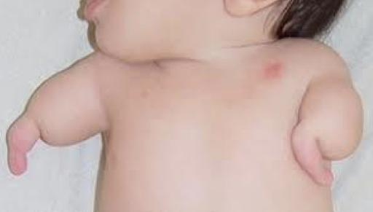
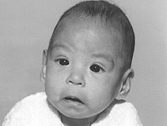
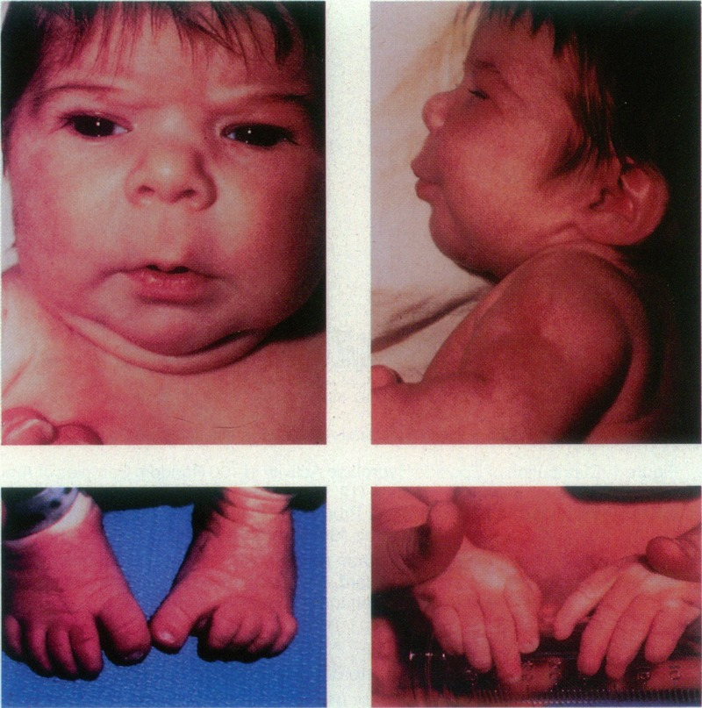
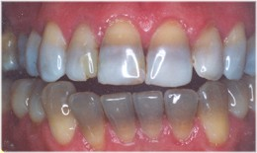
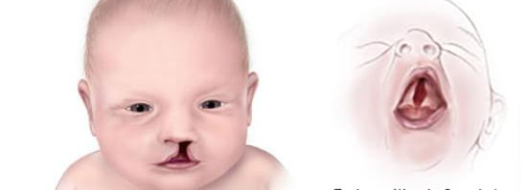
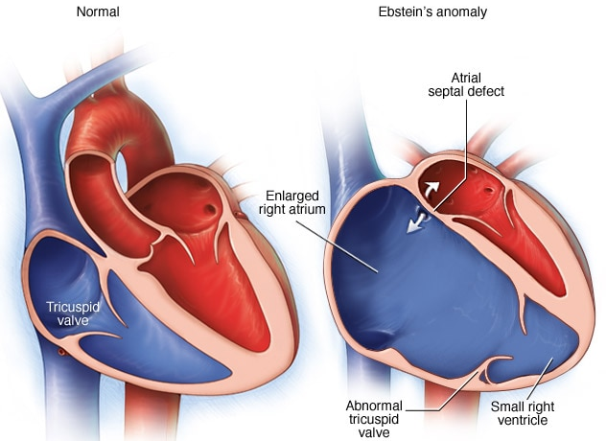
Teratogenesis of Drugs
(1st trimester)
Teratogen | Teratogenic Effect
Thalidomide ¹ | Phocomelia Shortened or absent long bones of the limbs Absence of external ear
Alcohol | Fetal Alcohol Syndrome Microcephaly Craniofacial abnormalities Intrauterine growth retardation CVS abnormalities CNS abnormalities
Phenytoin | Fetal Hydantoin Syndrome Nail and digital hypoplasia Oral cleft (cleft lip and palate) Cardiac anomalies Mental and growth retardation
Valproic acid | Neural tube defect (spina bifida) Antiepileptic drug Impaired folate absorption ²
Tetracyclines ³ | Altered growth of feet and bones Permanent teeth staining Enamel hypoplasia
Warfarin | Hypoplasia of nasal bridge CNS malformation
Corticosteroids | Cleft lip and palate
Lithium | Ebstein’s anomaly CVS anomalies mainly Valvular heart defect involving tricuspid valve
ACE inhibitors: Captopril Enalapril | Renal damage ACEIs disrupt fetal RAAS system which is essential for renal development Fetal & neonatal anuria Fetal hypotension Hypoperfusion Growth retardation
Hormones ( Cause serious genital malformation )
Estrogens | Testicular atrophy in male fetus
Androgens | Fetal masculinization in female fetus
Diethylstilbestrol | Vaginal carcinoma of female offspring
The most notorious human teratogen
Thalidomide was used for morning sickness in the past.
Folic acid supplements should be prescribed if the pregnant female is on antiepileptics.
Tetracyclines deposit in teeth and bones which causes the mentioned teratogenic effects.

Slide 6
Adverse Effects of Drugs
(2nd & 3rd trimesters)
During the 2nd and 3rd trimesters, some drugs can produce adverse effects on the fetus more likely than major malformations due to their pharmacological actions
They affect growth and fetal development or may have toxic effects on fetal tissues
Drug | Adverse Effect
Tetracyclines | Impaired teeth and bone development Yellow-brown discoloration of teeth
Aminoglycosides | Ototoxicity (8th cranial nerve damage) Examples: Streptomycin and Kanamycin
Chloramphenicol | Gray baby syndrome
Corticosteroids | Adrenal atrophy Growth retardation
Propranolol And beta-blockers in general | Bradycardia Neonatal hypoglycemia Placental insufficiency → poor uterine blood flow → fetal distress
Antithyroids | Risk for neonatal hypothyroidism and goiter Examples: Methimazole, Carbimazole, Iodide and Propylthiouracil
NSAIDs | Prostaglandin synthesis inhibitors Constriction of ductus arteriosus Pulmonary Hypertension in newborns Increase in gestation time Prolong labor, neonatal bleeding Increase risk for postpartum hemorrhage Examples: Aspirin-indomethacin
Benzodiazepines | Chronic use → neonatal dependence and withdrawal symptoms Examples: Diazepam
ACE inhibitors | Renal damage
Warfarin | Risk of bleeding
CNS depressants | Interference with suckling Respiratory depression Reduced blood flow → Fetal distress Examples: Diazepam and morphine
Sulfonamides | Displace bilirubin from albumin → neonatal jaundice (kernicterus)

Slide 7
Drugs of Choice During Pregnancy
Hypertension in Pregnancy
Probably Safe | Contraindicated
α -methyl dopa Labetalol Emergency ONLY: Hydralazine Labetalol | ACE inhibitors Angiotensin II receptor blockers Thiazide diuretics Propranolol Ca²⁺ channel blockers in mild HTN
Coagulation Disorders in Pregnancy
Probably Safe | Contraindicated
Heparin It is polar → doesn’t cross the placenta There’s an antidote (protamine sulphate) | Warfarin in all trimesters Cross the placenta 1st trimester: teratogenicity 2nd/3rd trimesters: risk of bleeding
Antibiotics in Pregnancy ¹
Probably Safe | Contraindicated
Penicillins (ampicillin, amoxicillin) Cephalosporins Macrolides (erythromycin, azithromycin) As an alternative in penicillin-sensitive patients but erythromycin estolate should be avoided ( risk of hepatic injury to mother) | Tetracyclines → teeth and bones deformities Quinolones (ciprofloxacin)→ arthropathy (bone and cartilage damage) Aminoglycosides → ototoxicity Sulfonamides → neonatal jaundice and kernicterus Chloramphenicol → Gray baby syndrome
Antithyroid Drugs in Pregnancy
Are used in thyrotoxicosis or Grave’s disease Propylthiouracil Methylthiouracil Carbimazole Radioactive iodine All can cross the placenta All have risk for congenital hypothyroidism and goiter The lowest dose of antithyroid drugs should be used Propylthiouracil is preferable over others ²
Other Drugs
Antidiabetics | Insulin is the best choice Avoid oral antidiabetics
Analgesics | Acetaminophen is the best choice
Anticonvulsants ³ | All antiepileptics have potential to cause malformations Avoid valproic acid because it’s highly teratogenic Folic acid supplementations can prevent neural tube defects associated with antiepileptics
Rule: All antibiotics are contraindicated EXCEPT Beta lactams and Macrolides
Has high protein binding ability
Monotherapy is preferred during pregnancy.

Slide 8
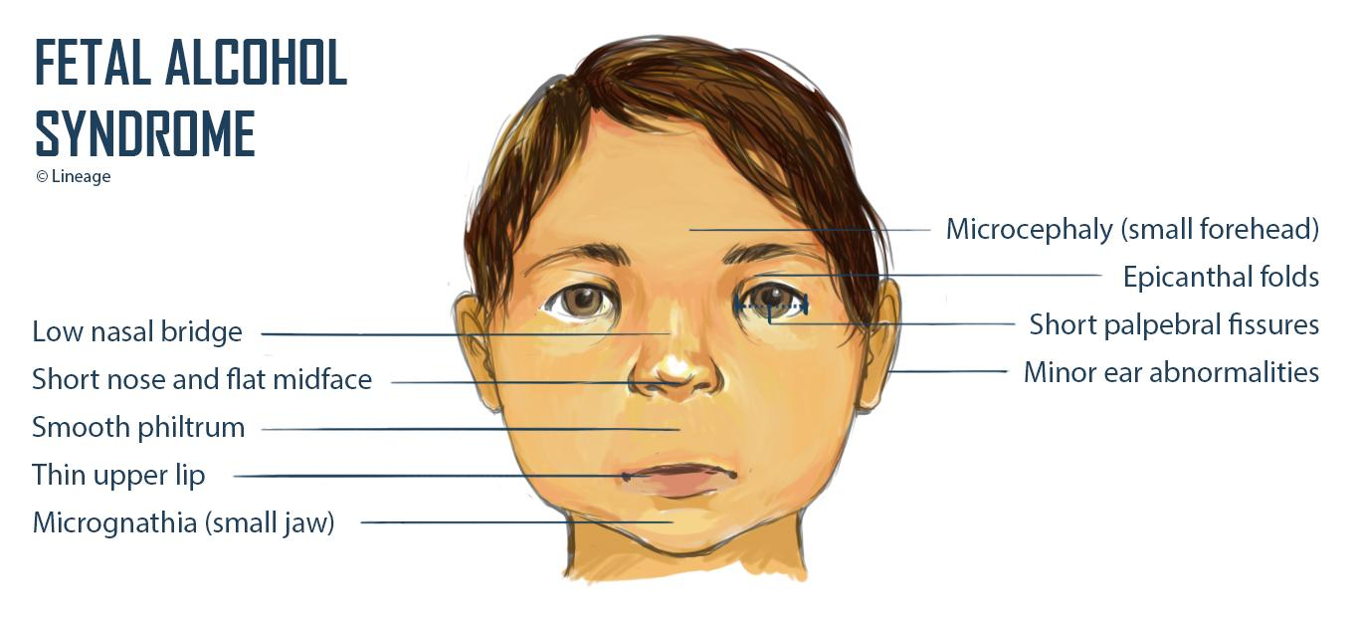
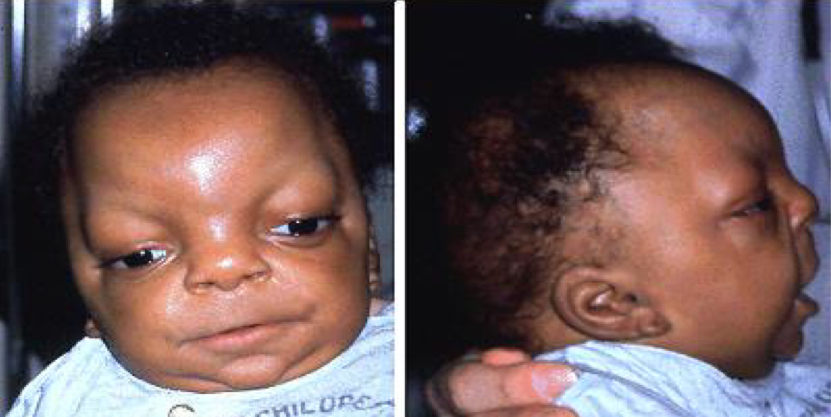
Drugs of Abuse During Pregnancy
What is a drug abuse?
It is the habitual use of drugs not for therapeutic purposes but for alteration of one's mood or state of consciousness.
The most commonly abused drugs are alcohol, barbiturates, benzodiazepines, opium alkaloids, amphetamines, cocaine, nicotine and marijuana
Drug abuse may lead to organ damage, dependence, addiction and behavioral disturbance
Abused Drug | Description
Alcohol | The use of Alcohol is contraindicated in all trimesters Chronic use of alcohol during early weeks of the 1st trimester leads to Fetal Alcohol Syndrome (FAS) which is characterized by: Microcephaly Low birth weight / Intrauterine growth retardation Craniofacial abnormalities CVS abnormalities CNS abnormalities Attention deficits Intellectual disability Mental retardation
Cocaine | Cocaine has low MW, so it can easily pass through the placenta It inhibits the reuptake of epinephrine, norepinephrine and dopamine causing: Vasoconstriction Rapid heart rate (tachycardia) Hypertension (vascular disruption) It decreases blood flow to uterus and fetal oxygenation (hypoxia) It increases uterine contractility Gross malformations include: Microcephaly Prematurity Growth retardation Low birth weight / Intrauterine growth retardation Mental retardation Placental abruption (early separation of the placenta from the uterus before delivery) Withdrawal symptoms
Tobacco | Tobacco contains nicotine and carbon monoxide which may harm the fetus. There is no evidence that it causes birth defects but it increases the risk of: Decreased blood flow to the placenta Fetal hypoxia Growth retardation Low birth weight Increased Spontaneous abortion Prematurity (preterm labor) Perinatal mortality (stillbirth)

Slide 9
Quiz
MCQ
Q1- A 19-year-old G1P0 woman lost her eyeglasses for a day. Constant squinting causes her to develop a headache, for which she takes ibuprofen. Which of the following poses the greatest risk to her fetus?
A- Acute tubular necrosis B- Decreased pulmonary surfactant at birth C- Low birth weight
D- Loss of physiologic heart shunt E- No risk—ibuprofen is a safe drug for pregnancy
Q2- A 33-year-old pregnant woman begins taking a new drug, Drug X, for morning sickness. Drug X has not been found to have adverse maternal or fetal effects in animal models, but no human studies have been done. Under which FDA Pregnancy Category would Drug X fall?
A- Category A B- Category B C- Category C D- Category D E- Category X
Q3- A 17-year-old pregnant woman asks her doctor what she can do about her acne. The doctor prescribes a topical benzoyl peroxide preparation, but the patient is unsatisfied with the results. She has a close friend taking isotretinoin for acne control, and her friend often tells her how well it works. She begins taking her friend’s pills and is pleased with the reduction in her acne. In which FDA Pregnancy Category does this drug belong?
A- Category A B- Category B C- Category C D- Category D E- Category X
Q4- A 19-year-old woman is 24 weeks pregnant. She has received no prenatal care. She presents to the emergency department complaining of an intermittent headache and fatigue during her pregnancy. Her blood pressure has been at least 150/110 mm Hg. What is the most appropriate treatment of this patient?
A- Hydralazine B- Propranolol C-Methyl dopa D- Prazosin E- Sodium nitroprusside
Q5- A 26-year-old G2P1001 woman at 33 weeks gestation presents to the emergency department with pain and swelling in her right calf. On physical examination, Homans sign is positive. A duplex of the right calf confirms the presence of a deep vein thrombosis (DVT). What is the most appropriate treatment for the rest of her pregnancy?
A- Streptokinase B- Aspirin C- Heparin D- Acetaminophen E- Warfarin
Q6- A 23-year-old woman with lifelong epilepsy controlled with medication has just found out that she is pregnant. She has seizures once a month but seem to be controlled at present. Which of the following statements about epilepsy in pregnancy is true?
A- Barbiturates should be considered
B- Divalproex is considered a drug of choice
C- Maintenance medication doses should be increased
D- She should be taking high doses of folic acid
E- She will likely have no change in seizure activity during pregnancy
Q1 | D; ibuprofen is a NSAID, which constricts the ductus arteriosus and cause pulmonary hypertension
Q2 | B; the study was done in animals but not humans
Q3 | E; isotretinoin is a well known teratogen during pregnancy
Q4 | A; Hydralazine is the drug of choice in hypertensive emergencies during pregnancy
Q5 | C; Heparin has a high MW and hugh polarity which prevents it from crossing the placenta
Q6 | D; antiepileptic impairs folic acid absorption and might cause a neural tube defect
Answers:

Slide 10
Thank you for all the love and support you gave the team in those two years!
Hope we made the context much easier to study.
God bless you, Future doctors.
Team Leaders:
May Babaeer Zyad Aldosari
This Amazing Work was Done By:
Mohammed Alhuqbani
Note writers
Nouf AlShammari
Quiz writers
Mohammed Alhuqbani

