Slide 1
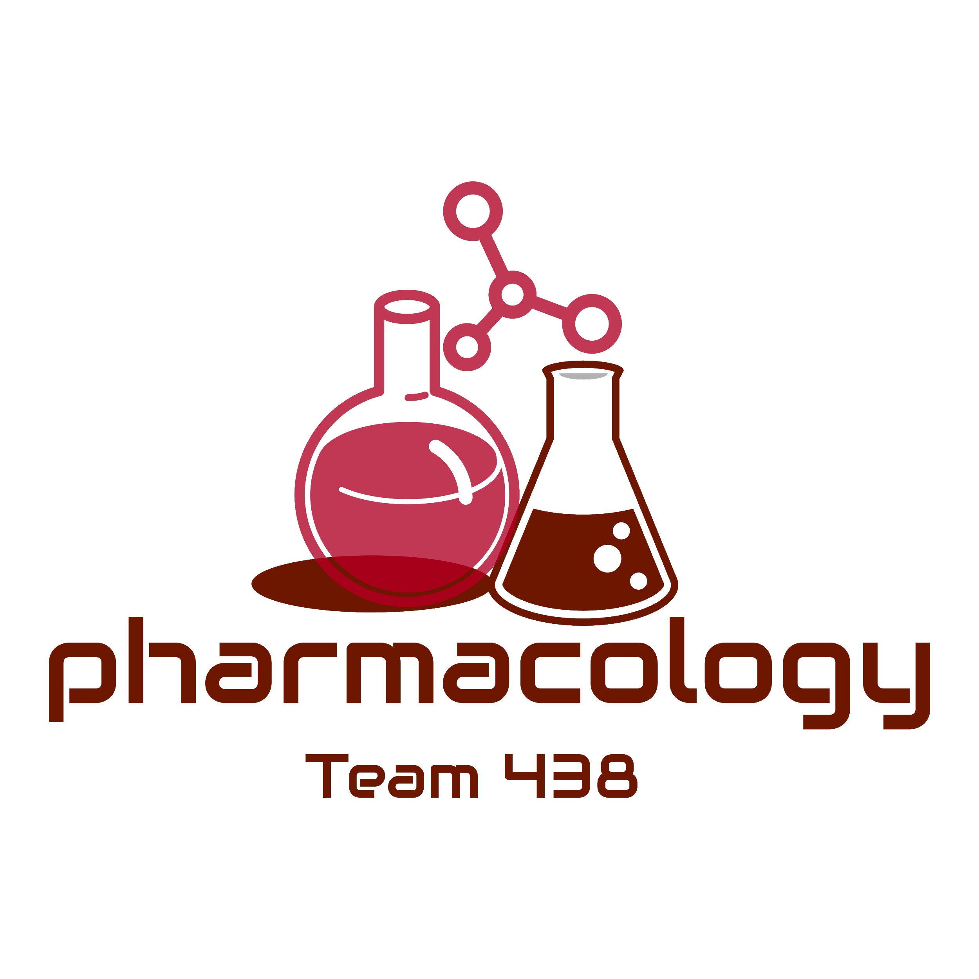
Editing File
Mnemonic File
Part 1
-For everyone reading this lec, if humanity survives let it be known that at this day, (17th of April 2020) the number of cases in the world just hit 2,173,432.
Yes you read that right, the number of cases just exceeded 2 million, humanity is in turmoil and no one knows where this is going. If someone from the future reads this it means that we have beaten this pandemic.
If not, then this is just the thoughts of a dying man, merely months before his end.
I decided to start writing these pieces, just to keep my mind in check and to interact with someone other than myself, even though no one will probably ever read this, I still think it’ll be good for my sanity.
But it’s fine, I don’t think this’ll go on for much longer, right?
Oh and if we die and somehow future generations ever read this, learn from our mistakes, don’t eat bats, lol.
-A Hopeful Man.
Reproduction Block
Pharmacology team 438
Tocolytics and Oxytocin
Objectives:
By the end of the lecture , you should know:
Drugs used to induce & augment labor.
Drugs used to control postpartum hemorrhage.
Drugs used to induce pathological abortion.
Drugs used to arrest premature labor.
The mechanism of action and adverse effects of each drug.
Color index:
Black : Main content
Red : Important
Blue: Males’ slides only
Purple: Females’ slides only
Grey: Extra info or explanation
Green : Dr. notes

Slide 2
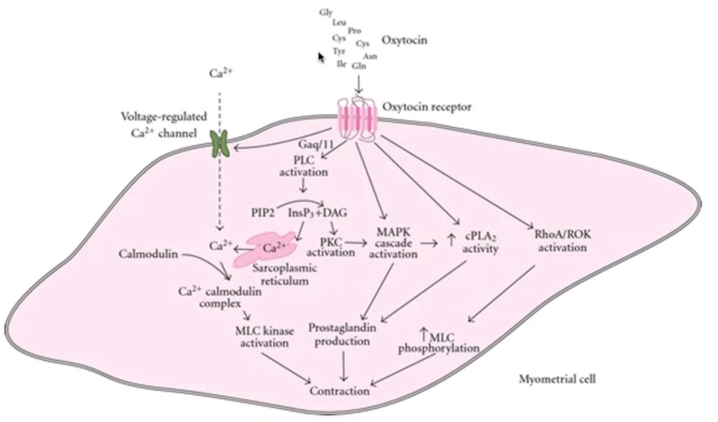
Drugs Producing Uterine Contractions (oxytocics)
Oxytocin
Ergot alkaloids
Prostaglandins
Syntocinon
- Natural:
Ergometrine(Ergonovine)
- Synthetic:
Methyl ergometrine
(Methylergonovine)
- Synthetic PGE1:
Misoprostol
- PGE2:
Dinoprostone
- PGF2α:
Dinoprost, Carboprost
Oxytocin
Prostaglandins
Ergot alkaloids
Syntocinon
Synthetic PGE1:
Misoprostol
PGF2α:
Dinoprost, Carboprost
PGE2:
Dinoprostone
Natural:
Ergometrine
Synthetic:
Methyl ergometrine
Drug | Oxytocin (Syntocinon)
MOA | The interaction of endogenous or administered Oxytocin with myometrial cell membrane receptor promotes the influx of Ca2+ from extracellular fluid and from sarco endoplasmic reticulum into the cell, this increase in cytoplasmic calcium → stimulates uterine contraction
Action | 1- Effect on uterus: Stimulates both the frequency and force of uterine contractility particularly of the fundus segment → to expel the baby out of the uterus. These contractions resemble the normal physiological contractions of uterus (contractions followed by relaxation)¹ Immature uterus is resistant to oxytocin. (low oxytocin receptors and gap junctions due to low estrogen/progesterone ratio) Contract uterine smooth muscle only at term. Sensitivity increases to 8 fold in last 9 weeks and 30 times in early labor. Clinically oxytocin is given only when uterine cervix is soft and dilated 2- Effect on Myoepithelial cells²: Oxytocin contracts myoepithelial cells surrounding mammary alveoli in the breast & leads to milk ejection.
P.K | Not effective orally as it is destroyed in GIT Administered I.V. to augment labor³ Also as nasal spray in impaired milk ejection Not bound to plasma proteins Catabolized by liver & kidneys T_{1/2} = 5 min
Uses | Synthetic preparations of oxytocin e.g. syntocinon are preferred. Induction & augmentation of labor (slow I.V infusion): Mild preeclampsia⁴ near term Uterine inertia Incomplete abortion Post maturity Maternal diabetes, as diabetes causes macrosomia Postpartum uterine hemorrhage⁵ (I.V drip): ergometrine is often used Impaired milk ejection: One puff in each nostril 2-3 min before nursing
1: Due to the refractory period of smooth muscle cells, only a strong stimulus can cause continuous (tetanic) contractions and diminish the refractory periods, this can happen with ergot drugs (discussed in next page) and very high oxytocin concentration. Which may lead to uterine rupture and fetal ischemia due to compression of endometrial arteries.
2:when the mother breastfeeds, suckling sends a positive feedback which increases the production of oxytocin. At the same time, the mother experiences uterine contractions due to increased oxytocin, which helps returning the uterus to its normal size postpartum.
3: given when the mother exceeds her due date and “the baby does not want to come to the world :)”.
4: is a pregnancy complication characterized by high blood pressure and signs of damage to another organ system, most often the liver and kidneys.
5: postpartum hemorrhage happens due to loss of the normal involution of the uterus which to atomic bleeding due to dilated blood vessels. We give a combo of ergometrine and oxytocin to increase contractions and “squeezes” the blood vessels.

Slide 3
Drug | Oxytocin (Syntocinon)
ADR | Maternal death due to hypertension. Uterine rupture, especially when administered continuously Fetal death¹ (ischemia). Water intoxication²: if oxytocin is given with relatively large volumes of electrolyte-free aqueous fluid intravenously.
C.I | Hypersensitivity. Prematurity of the uterus. Abnormal fetal position³.
Caution | Multiple pregnancy
Evidence of fetal distress.
cephalopelvic disproportion
Incompletely dilated cervix
Previous C-section⁴.
Hypertension.
Ergot Alkaloids
Drug | Natural: E.g. Ergometrine (Ergonovine) | Synthetics: E.g. Methyl ergometrine (Methylergonovine)
MOA | Ergot alkaloids induce Tetanic contraction of uterus without relaxation in between (not like normal physiological contraction) It causes contraction of uterus as whole i.e. fundus and cervix (tend to compress rather than to expel the fetus) → NEVER used to induce labor
P.K | Usually given I.M Extensively metabolized in liver 90% of metabolites are excreted in bile
Uses | Postpartum hemorrhage (third stage of labor) When to give ? 1- After birth 2- third stage of labor⁵ Preparation: syntometrine (ergometrine 0.5mg + oxytocin 5.0 I.U) , I.M
ADR | Vasoconstriction of peripheral blood vessels (toes & finger)⁶ Gangrene⁶ Severe hypertension ⁶ Nausea, vomiting, diarrhea⁷
C.I | Induction of labor → first and second stage of labor Vascular diseases Severe hepatic and renal impairment Severe hypertension
Oxytocin VS Ergometrine
 | Oxytocin | Ergometrine
 | Resemble normal physiological contraction | Tetanic contraction,does not resemble normal physiological contraction
Uses | To induce & augment labor Postpartum hemorrhage | Only in postpartum hemorrhage
Onset & Duration | Rapid onset Shorter duration of action | Moderate onset Longe duration of action
Type of contraction
1: continuous monitoring of heart sounds and rate for the baby is required to avoid fetal distress. But once fetal distress happen, oxytocin should be discontinued and the mother should deliver rapidly (whether normally or by c-section if needed).
2: oxytocin is released from posterior pituitary gland & is similar to ADH structurally, in could decrease diuresis. When administered with electrolytes free solution it could lead to severe hypervolemia and (more importantly) hyponatremia, thus possibly leading to convulsion, come, and death.
3: baby should be in cephalic position before administration. 4: increased risk of uterine rupture.
5: sometimes used when the placenta is not expelled fully (can lead to infections if not removed).
6: Ergometrine binds to alpha adrenergic receptors very strongly, leading to prolonged vasoconstriction and therefore hypertension.
7: Binds to dopaminergic receptors in chemoreceptor trigger zone. Ergometrines have dopaminergic, adrenergic, and serotonergic action.

Slide 4
Prostaglandins¹
Drug | Synthetic PGE1 E.g. Misoprostol | PGE2 E.g.Dinoprostone | PGF2α E.g.Dinoprost carboprost
Admin. | — | Vaginal suppository Extra-amniotic solution² | Intra-amniotic injection
Uses | Induction of abortion (pathological) Induction of labor when fetal death in utero occur Postpartum hemorrhage
ADR | Nausea,vomiting Abdominal pain³ Diarrhea
 | — | Flushing | Bronchospasm
C.I | Mechanical obstruction of delivery Fetal distress Predisposition to uterine rupture
Pre- caution | Asthma Multiple pregnancy Glaucoma Uterine rupture
Oxytocin VS Prostaglandins
 | Oxytocin | prostaglandins
 | Only at term Does not soften the cervix⁴ | Contraction throughout pregnancy Soften the cervix⁴
Uses | To induce & augment labor Postpartum hemorrhage | Induce abortion in second trimester of pregnancy Used as vaginal suppository for induction of labor
Duration | Shorter duration of action | Longer duration of action
Type of contraction
1: PGF2alpha, Thromboxane A2, PGE2 and PGE1 are the main prostaglandins that cause uterine contraction, PGI2 (prostacyclin) causes uterine relaxation.
2: injected by a catheter to the extra-amniotic fluids.
3: due to contraction of abdominal muscles.
4: Cervical smooth muscle play almost no role in softening the cervix, therefore oxytocin (its action is mainly on myometrium) plays almost no role in softening. It is PGs that cause uterine softening, this happens because they degrade the collagen within the cervix and increase the synthesis of glycosaminoglycans (make the cervix more flexible), so that the head of the fetus can easily dilate the cervix helped by the intrauterine pressure from uterine contractions.

Slide 5
Uterine Relaxants (tocolytic)
β2-Adrenoceptor agonists
Calcium Channel Blockers
Oxytocin Antagonists
Ritodrine
(1st choice)
Nifedipine
(2nd choice)
Atosiban
Drugs | Ritodrine | Nifedipine | Atosiban
MOA | Selective β2 receptor agonist used specifically as a uterine relaxant. Bind to β-adrenoceptors → activate enzyme Adenylate cyclase → increase in the level of cAMP → reducing intracellular calcium level. | Markedly inhibits the amplitude of spontaneous and oxytocin-induced contractions Causes relaxation of myometrium | Compete with oxytocin at its receptors on the uterus. New tocolytic agent Given by IV infusion for 48hrs
Action | Relax the uterus
Uses | Arrest threatened abortion Delay premature labor Severe Dysmenorrhea
ADR¹ | Hyperglycemia Hypokalemia Tremor Nausea, vomiting Flushing Sweating Tachycardia(high dose) Hypotension | Ankle edema² Flushing Constipation Headache, dizziness Hypotension Coughing Wheezing Tachycardia | _
1: due to general stimulation of the β2-Adrenoceptor.
2: Calcium channel blockers usually cause arteriolar dilation without venodilation, and since capillaries lie in-between arterioles and venules, this increases hydrostatic pressure leading to edema.

Slide 6
Quiz
MCQ
Q1- in case of impaired milk ejection which of the following we should use?
A- Oxytocin I.V B- Oxytocin I.M C- Oxytocin nasal spray D- none of the above
Q2- which of the following is a contraindication of Oxytocin?
A- Incompletely dilated cervix B- Abnormal fetal position
C- Multiple pregnancy D- A&B
Q3- Oxytocin-induced uterine contraction resemble which one of the following?
A- physiological contractions B- tonic contractions C- A&B D- none of the above
Q4- which of the following is a property of Ergometrine?
A- To induce or augment labor. B- only in Postpartum hemorrhage
C- Rapid onset of action D- Shorter duration of action than oxytocin
SAQ
- A diabetic pregnant women her cervix is soft and dilated.
Q1- Name a Drug can be used to induce labor especially her case
Q2- what's the M.O.A of the drug?
Q3- List two ADR of Ergot Alkaloids
Q4- Name two Uterine Relaxants (tocolytic) drugs
MCQ
SAQ
Q1 | C
Q2 | D
Q3 | A
Q4 | B
Q1 | IV Syntocinon
Q2 | interaction of oxytocin with myometrial cell membrane receptor promotes the influx of Ca2+ this increase in cytoplasmic calcium → stimulates uterine contraction .
Q3 | 1- Vasoconstriction of peripheral blood vessels (toes & finger) 2- Gangrene
Q4 | 1- Ritodrine 2- Nifedipine
Answers:

Slide 7
Thank you for all the love and support you gave the team in those two years!
Hope we made the context much easier to study.
God bless you, Future doctors.
Team Leaders:
May Babaeer Zyad Aldosari
This Amazing Work was Done By:
Khalid Aldossari Naif Aldossari
Abdullah Alnuwaybit
Note writers
Raghad AlKhashan, Nayef Alsaber
Quiz writers
Khalid Aldossari

Slide 8
This lec was reviewed by
Extremely hidden right? No one will ever find this right?
P.S: we know it isn’t, that’s the joke, nerd
You can clearly see that I’m completely mentally stable and dealing with all this quarantine thing in a healthy way right?
Btw do you like our new logo? It was made by the hands of the greatest logo maker in all the realms. But we’ll keep their name a secret🍕.

