Slide 1
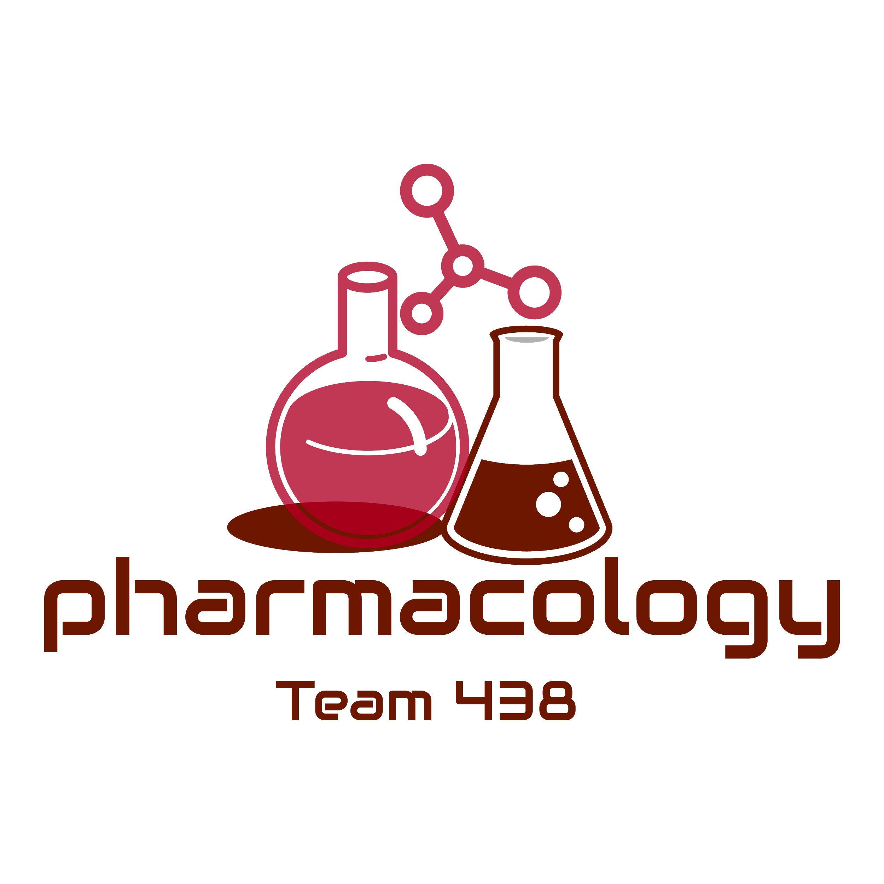
Editing File
Mnemonic File
Reproduction Block
Pharmacology team 438
Drugs Used in Treatment of Gonorrhea and Syphilis
Objectives:
By the end of the lecture , you should know:
List the drugs used in the treatment of syphilis & gonorrhea
Describe the mechanism of action and adverse effects of each drug
Describe the contraindications of drugs used
Describe the recommended regimens used for the treatment of syphilis & gonorrhea
Know the alternative treatments in allergic patients
Color index:
Black : Main content
Red : Important
Blue: Males’ slides only
Purple: Females’ slides only
Grey: Extra info or explanation
Green : Dr. notes

Slide 2
Syphilis
Stages of Syphilis
Disease progresses in stages (primary, secondary, latent and tertiary), signs and symptoms vary depending upon stage of disease.
Is a sexually transmitted disease caused by bacterium Treponema Pallidum
(a spiral -shaped, Gram-negative highly mobile bacterium).
T. pallidum enters the body via skin and mucous membranes through abrasions during sexual contact or blood transfusion or placental transfer from a pregnant woman to her fetus.
Congenital Syphilis: If a woman is pregnant and has symptomatic or asymptomatic early syphilis, disseminating organisms may pass through the placenta to infect the fetus.
Manifestation: Perforation of Palate.
May become chronic without treatment.
01
Primary stage :
Painless skin ulceration (a chancre).
02
Secondary stage :
Diffuse skin rash & mucous
membranes lesions.
03
Latent stage :
In latent syphilis there are little to no symptoms which can last for years.
70% may have no symptoms
04
Tertiary stage :
Approximately 30% of untreated patients progress to the tertiary stage within 1 to 20 years.
Rare because of the widespread use of antibiotics.
Manifestations as cardiovascular syphilis (syphilitic aortitis and an aortic aneurysm).

Slide 3
Drugs used in the treatment of Syphilis ¹
Penicillins
Tetracycline
Macrolides
Cephalosporins
- Penicillin G
- Procaine Penicillin G
- Benzathine Penicillin G
- Doxycycline
- Azithromycin
- Ceftriaxone
- Cefixime
First Choice
Used in case the patient is allergic to penicillins
β-Lactam Antibiotics:
Natural Penicillins
Drug | Benzylpenicillin (penicillin G) | Procaine penicillin G | Benzathine penicillin G
MOA | Inhibits bacterial cell wall synthesis through inhibition of transpeptidase enzyme required for crosslinks. Bactericidal.
P.K | Given I.V Short duration of action | Given I.M. delayed absorption. Long acting (24 hrs) | Given I.M. Delayed absorption. Long acting (days), 2.4 million units is given once.
 | All these penicillin preparations are: Acid unstable. ² Penicillinase ( β-lactamase )sensitive Not metabolized. Excreted unchanged in urine through acid tubular secretion. Renal failure prolong duration of action.
ADR | Hypersensitivity. Convulsions with high doses or in renal failure. Super infections.
2) 3rd generation cephalosporins
Drug | Ceftriaxone
MOA | Inhibits bacterial cell wall synthesis. Bactericidal.
P.K | Given parenterally (i.v.) Eliminated via biliary excretion Long Half-life
ADR | Hypersensitivity reactions Thrombophlebitis Superinfection Diarrhea
Not allergic to penicillins? Prescribe Penicillin. Allergic and not pregnant? Tetracycline.
Allergic and pregnant? Cephalosporins or Macrolides.
Thus never given orally.

Slide 4
Tetracyclines
Drug | Doxycycline
MOA | Inhibit bacterial protein synthesis by reversibly binding to 30S bacterial ribosomal subunits. Bacteriostatic.
P.K | Given orally. Well absorbed orally. Long acting. 100 mg twice daily for 14 days.
ADR | Nausea, vomiting ,diarrhea & epigastric pain (given with food). Brown discoloration of teeth in children. Deformity or growth inhibition of bones in children. Avoid dairy products. Hepatic toxicity in prolonged therapy with high dose. Vertigo. Superinfections. Phototoxicity.
C.I | Pregnancy. Breast feeding. Children (below 10 yrs).
Macrolides
Drug | Azithromycin
M.O.A | Inhibits bacterial protein synthesis by binding to bacterial 50S ribosomal subunits. Bacteriostatic
P.K | Acid stable → orally once daily Penetrates into most tissues except CSF. T1/2 2-4 days . Should be given 1 hour before or 2 hours after meals. No effect on cytochrome P450.
ADR | GIT upset: Nausea, vomiting, abdominal pain and diarrhea. Allergic reactions: urticaria and mild skin rashes.

Slide 5
WHO Guideline for Treatment of Syphilis
Prof Hanan: Doses aren’t important, just know the drugs and in late stage the duration will increase
Early syphilis
Adults
(primary, secondary and early latent syphilis of not more than two years duration)
Pregnant woman
benzathine penicillin G 2.4 million units once I.M.
procaine penicillin G 1.2 million units I.M. for 10–14 days .
If penicillin is not allowed due to allergy, use :
Doxycycline 100 mg twice daily orally for 14 days
Ceftriaxone 1 g IM once daily for 10–14 days
Azithromycin 2 g once orally.
benzathine penicillin G . 2.4 million units once I.M.
procaine penicillin G . 1.2 million units I.M. for 10–14 days
If penicillin is not allowed due to allergy, use :
Erythromycin 500 mg orally 4 times daily for 14 days
Ceftriaxone 1 g I.M once daily for 10–14 days
Azithromycin 2 g once orally.
Late syphilis
Adults
(infection of more than two years duration without evidence of treponemal infection)
Pregnant woman
benzathine penicillin G . 2.4 million units nits I.M. once weekly for three consecutive weeks.
procaine penicillin G . 1.2 million units I.M. for 20 days .
If penicillin is not allowed due to allergy, use :
Doxycycline 100 mg twice daily orally for 30 days
benzathine penicillin G . 2.4 million units nits I.M. once weekly for three consecutive weeks.
procaine penicillin G . 1.2 million units I.M. for 20 days
If penicillin is not allowed due to allergy, use :
Erythromycin 500 mg orally 4 times daily for 30 days
Ceftriaxone 1 g IM once daily for 10–14 days
Azithromycin 2 g once orally.
Congenital Syphilis
In infants with confirmed congenital syphilis or infants who are or clinically normal, but whose mothers had untreated syphilis
Aqueous benzylpenicillin ( I.V.) 100 000–150 000 U/kg/day for 10–15 days
Procaine penicillin (I.M.) 50 000 U/kg/day single dose for 10–15 days

Slide 6
Gonorrhea
Caused by Neisseria gonorrhea [ a gram -ve cocci ], a pus producing bacteria .
Transmitted during sexual contact with affected person.
Many people have no symptoms
Men may have burning with urination, discharge from the penis or testicular pain.
Women may have burning with urination, vaginal discharge, vaginal bleeding between periods or pelvic pain.
Treatment of uncomplicated Gonorrhea
Drugs | 3rd generation cephalosporins E.g Ceftriaxone | Cefixime | Fluoroquinolones E.g Ciprofloxacin
MOA | - | Inhibit DNA synthesis by inhibiting DNA gyrase enzyme (required for DNA supercoiling ) Bactericidal
P.K | Ceftriaxone (500 mg I.M ) Cefixime (400 mg orally ) Typically given in combination with a single dose of: azithromycin(1gm orally) or doxycycline(100 mg orally twice daily) for 7 days | Single oral dose of : Ciprofloxacin (500 mg) Ofloxacin (400 mg)
Uses | 1st line treatment for uncomplicated gonorrheal infections
ADR | - | Nausea ,vomiting & diarrhoea . Headache & dizziness. May damage growing cartilage & cause arthropathy. Phototoxicity, avoid excessive sunlight
C.I | - | Pregnancy Nursing mothers Children under 18 years.
Drug | Spectinomycin
MOA | Inhibits protein synthesis by binding to 30S ribosomal subunits
P.K | Given 2g I.M, once
Uses | Alternative treatment in patient cannot tolerate or be treated with cephalosporins or quinolones
ADR | Pain at the site of injection . Fever and Nausea . Nephrotoxicity (not common)
According to WHO recommendations:
First choice is 3rd generation cephalosporins.
Second choice is Fluoroquinolones.
Third choice is Spectinomycin.

Slide 7
Treatment of complicated Gonorrhea
Complicated gonorrheal infections : Spread through bloodstream into:
Eye
Joints
Heart valves
Brain
It can also spread from a mother to a fetus during birth
Newborn eye infection ( conjunctivitis ) may lead to blindness
WHO guidelines suggest one of the following options for topical application to both eyes immediately after birth:
Silver nitrate 1% solution
Erythromycin 0.5% eye ointment
Tetracycline hydrochloride 1% eye ointment
Povidone iodine 2.5% solution (water-based)
Chloramphenicol 1% eye ointment
Drugs | Silver nitrate 1% solution | Erythromycin
Info | It has germicidal effects due to precipitation of bacterial proteins by liberated silver ions. | 0.5% ointment for treatment & prevention of corneal & conjunctival infections.
Use | Put into conjunctival sac immediately after birth (no later than 1 hr after delivery)

Slide 8
Quiz
MCQ
Q1- A 22-year-old sexually active man presents to the Ambulatory care clinic with dysuria, penile discharge, and a swollen right knee. A joint aspirate of his right knee reveals many neutrophils as well as some gram negative diplococci. Which is the best choice to treat his condition?
A- Ceftriaxone B- Cephalexin C- Dexamethasone D - Meropenem
Q2-A 26-year-old sexually active HIV-negative man presents to his primary care physician with a nonpruritic maculopapular rash on his palms. He reports that about 6 weeks ago, he developed a non painful ulcer on his penis that healed spontaneously. He is injected with a single dose of benzathine penicillin G intramuscularly and sent home. What, if anything, should have been done differently for this patient’s care?
A - A different antibiotic class should have been used
B - A different preparation of penicillin G (not benzathine) should have been used
C- Nothing—the course of action taken is entirely appropriate
D - Penicillin V should have been given instead of penicillin G
Q3-Which one of the following is the drug of choice for treatment of syphilis?
A.- ceftriaxone B - Benzylpenicillin penicillin G C. silver nitrate D - Ciprofloxacin
Q4- Which of the following is mechanism of action of Azithromycin?
A- Inhibit bacterial cell wall synthesis
B- Inhibit DNA synthesis by inhibiting DNA gyrase enzyme
C- Inhibits bacterial protein synthesis by binding to bacterial 50S ribosomal subunits.
D-Inhibit bacterial protein synthesis by reversibly binding to 30 S bacterial ribosomal subunit
Q5-Which of the following is a contraindication for Fluoroquinolones ?
A - Pregnancy B - Renal failure C- Hepatic failure D- Bleeding disorders
SAQ
A 24- year- old sexually active young man presents to the emergency department with dysuria, penile discharge, and a swollen right knee .A joint aspirate of his right knee reveals many neutrophils as well as some gram negative diplococci. Which is the best choice to treat his condition?
Q1-Which is the best choice to treat his condition?
Q2- Mention its MOA.
Q3- Enumerate 3 ADRS.
MCQ
SAQ
Q1 | A
Q2 | C
Q3 | B
Q4 | C
Q5 | A
Q1 | Ceftriaxone
Q2 | Inhibits bacterial cell wall synthesis.(Bactericidal)
Q3 | Hypersensitivity reactions,Thrombophlebitis,Super infection Diarrhea
Answers:

Slide 9
Thank you for all the love and support you gave the team in those two years!
Hope we made the context much easier to study.
God bless you, Future doctors.
Team Leaders:
May Babaeer Zyad Aldosari
This Amazing Work was Done By:
Mohsen Almutairi Abdullah Alassaf
Bader Aldhafeeri
Note writers
Nouf AlShammari
Quiz writers
Abdullah Alassaf

