Slide 1
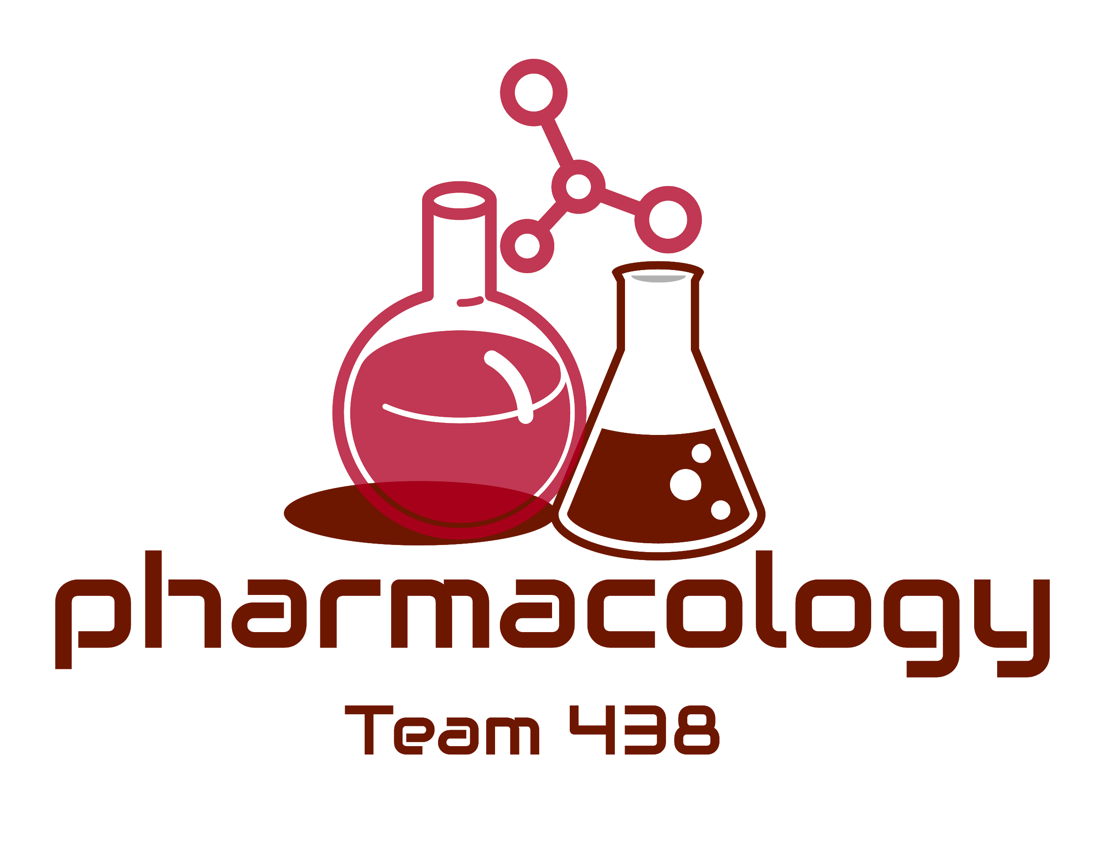
Editing File
Mnemonic File
Part 5
Today is the 18th of February, 2021. I still haven’t received any info about what’s happening in the world, but I don’t need newspapers or twitter trends to know that it has gone to shit. I’m pretty sure I’m one of the last few people still alive. We thought this would be a normal pandemic that’ll go away soon, but look at us now, a species at the brink of extinction.
I’m worried, my food storage is empty, it has been 5 days since the last time I ate anything, water is still barely running but I don’t think I should trust it anymore, it definitely does not taste like pure water nor looks like it.
I’ll have to leave my house, for the first time ever since this started, I’ll have to leave and look for food. I can’t stay here any longer or else I’ll starve to death.
But I know I’ll die if I leave my house, I’m not a fighter nor am I fit, I haven’t done any type of workout in years. But if I’m dying anyway, shouldn’t I at least try to go down fighting?
You’re enjoying this aren’t you? Reading about my suffering, I bet you do. And here I was thinking that we’re friends. But you’re just like them. They’ve been telling me to use my dad’s shotgun and end it all, but I won’t. I won’t let them win.
They’re in my head, I know it, that’s where they’re hiding, I’ll kill them all, I’ll show them. I’ll use the same shotgun they tried to kill me with. I will survive.
-A Dying Man.
“The letters above were found next to the victim’s body, there seems to be 5 of them that he labelled “Diaries of a Dying Man”. Investigations identified the victim as J.L, a 31 year old man with psychological issues who have been reported missing back in April. The victim seems to have locked himself in the family’s vacation cabin for months, and cut off all sorts of communication with the outside world. Is it possible that the victim never knew that the pandemic ended a back in September of 2020?”
Reproduction Block
Pharmacology team 438
Drugs Affecting Breast milk and Lactation
Objectives:
By the end of the lecture , you should know:
Recognize the main pharmacological characters that control the passage of drugs from milk to baby
Identify the adverse effects of major pharmacological categories on babies
Describe the best and safest medication to be given to breast feeding women if she is suffered from different diseases as epilepsy, infection, diabetes, heart failure, hypertension
Know drugs that can inhibit lactation and should be avoided in breast feeding
Know drugs that may enhance lactation
Color index:
Black : Main content
Red : Important
Blue: Males’ slides only
Purple: Females’ slides only
Grey: Extra info or explanation
Green : Dr. notes

Slide 2
Breast Feeding
Breastfeeding is very important because breast milk is the healthiest form of milk for babies
It provides the baby with immunoglobulins (IgA, IgM) that are essential for protection against gastroenteritis
Drugs and Lactation
Drugs ingested by the mother diffuse or are transported from the maternal plasma to the alveolar cells of the breast
The concentration of drugs achieved in breast milk is usually low (<1%)
However, even small amount of some drugs may be of significance for the suckling child
Few drugs are absolutely contraindicated
Some drugs may increase or decrease milk yield
Pharmacokinetics Changes in Pediatrics
There are many pharmacokinetic and pharmacodynamics changes in pediatrics:
Higher gastric pH
Higher concentration of free drug¹
Lower rate of metabolism due to immaturity of liver enzymes
Higher percentage of body water²
Premature babies have very limited capacity for metabolism and excretion
Renal clearance is less efficient (↓ renal blood flow, ↓ Glomerular filtration rate)
Physiological Differences between Neonates and Adults of Pharmacokinetic Importance:
 | Neonates | Adults
Gastric acid output (mEq/10kg/hr) | ↓ 0.15 | 2
Gastric emptying time (min) | ↑ 87 | 65
Total body water (% of body weight) | ↑ 78 | 60
Adipose tissue (% of b.wt.) | ↓ 12 | 12-25
Serum albumin (gm/dL) | ↓ 3.7 | 4.5
Glomerular filtration rate (ml/min/m2) | ↓ 11 | 70
Factors Controlling Passage of Drugs into Breast Milk
Factors related to the Drug
Factors related to the Mother
Factors related to the Neonate
1: due to low protein binding.
2: affects the concentration of water soluble drugs.

Slide 3
Factors Related to the Drug
Very small molecules (<200 Daltons) such as alcohol, equilibrate rapidly between plasma and breast milk via the aqueous channel surrounding alveoli
Large molecules drugs (>800 Daltons) are less likely to be transferred to breast milk than low molecular weight
Insulin: MW > 6,000 Daltons
Heparin: MW 40,000 Daltons
Monoclonal antibodies, pass very poorly into milk after the 1st week postpartum
The epithelium of the breast alveolar cells is most permeable to drugs during the 1st week postpartum, so drug transfer to milk may be greater during the 1st week of an infant's life
Molecular Weight
Lipid
Solubility
Lipid soluble drugs pass more freely into the breast milk than water soluble drugs
pH of milk is slightly more acidic (PH=7.2) than maternal blood (PH=7.4)
Weak basic drugs tend to concentrate in breast milk and become trapped secondary to ionization
Weak acidic drugs don’t enter the milk to a significant extent and tend to be concentrated in plasma
Maternal blood PH 7.4
Milk PH 7.2
Drug PH
Alkaline drug
Ionized alkaline enter
Acidic drug
Non-Ionized acidic diffuse back
Degree of Ionization
Ionized form of drugs are less likely to be transferred into breast milk¹
E.g. heparins pass poorly into breast milk
Protein
Binding
Drugs circulate in maternal circulation in unbound (free) or bound forms to albumin
Only unbound form gets into maternal milk
Definition of good protein binding > 90% . E.g. warfarin²
Drugs with high protein binding capacity are preferable in lactation
Half Life
Avoid the use of drugs with long half lives
Short half life are preferable
Oxazepam (short t1⁄2) vs diazepam (long t1⁄2)
Oral
Bioavailability
Transfer of drugs from maternal blood to milk is low with drugs that have large volume of distribution (Vd)
1: i.e. polar drugs are less likely to be transferred to breast milk.
2: remember that warfarin is totally contraindicated in pregnancy, but here we see that it can be given to breastfeeding women.
.

Slide 4
Factors Related to the Mother
Rote of
Admin.
Route of administration affect the concentration of the drug in maternal blood
Maternal use of topical preparations (creams, nasal sprays or inhalers) are expected to carry less risk to a breastfed infant than systemically administered drugs
Time of
Breast
feeding
The concentration of the drug in the milk at the time of feeding
Lactating mother should take medication just after nursing¹ and 3- 4 hours before the next feeding ; to allow time for drug to be cleared from the mother’s blood so drug concentration in milk will be low.
Breastfeeding is contraindicated in case of:
HIV- positive women
Active, untreated TB in mother
Herpes on breast
Use of illegal drugs² by mother
Certain medications used on a chronic basis
Health
Status
Dose of
The Drug
Maternal Drug Conc.
Factors Related to the Neonate
Age
Body Weight
Health Status
The amount of a drug to which the baby is exposed as a result of breastfeeding depends on:
The amount of milk consumed.
The amount of drug absorbed from GI (e.g oral medications)
The ability of the baby to eliminate the drug (depends on age)
Age & Health Status
Newborn
Infants (babies)
Children
Adolescent
(less than one month)
1. Preterm neonates: born before 38 weeks of pregnancy
2. Full-term neonates: 38-42 weeks of gestational age
( 1 month -12 months)
( 1 -12 years)
1. Toddler (young child):
1-5 years
2. Older child: 6-12 years
(13-18 years)
1: very beneficial especially in drugs with short duration of action as their action will have already been diminished by the next nursing time.
2: e.g. cocaine, heroine, and marijuana.

Slide 5
Age & Health Status Cont...
Special cautions are required in:
1. Premature infants 2. Low birth weight 3. Infants with G6PD deficiency
4. Infants with impaired ability to metabolize\excrete drugs. E.g Hyperbilirubinemia
Neonatal Methemoglobinemia
Methemoglobin: is an oxidized form of hemoglobin that has a decreased affinity for oxygen → tissue hypoxia.
Infants under 6 months of age are particularly prone to develop methemoglobinemia upon exposure to some oxidizing drugs¹
Neonatal Hyperbilirubinemia
When does it occur? Premature infants or infants with inherited G6PD deficiency are susceptible to oxidizing drugs that can cause hemolysis of RBCs→↑ ­ bilirubin (hyperbilirubinemia) →↑ Kernicterus
E.g of oxidizing drugs:
Antibiotics: Sulfonamides², Trimethoprim
Antimalaria: Primaquine
Drugs During Lactation
Drugs are C.I during lactation
Only few drugs are totally contraindicated:
Anticancer drugs e.g. Doxorubicin, cyclophosphamide, methotrexate. They will cause cytotoxicity and neutropenia
Radiopharmaceuticals e.g. radioactive iodine
CNS acting drugs e.g amphetamine, heroin, cocaine
Alcohol & Lithium (they have high milk to plasma ratio)
Chloramphenicol (causes bone marrow suppression)
Atenolol
Potassium iodide (thyroid effect)
Immunosuppressants e.g. cyclosporine
Ergotamin (used for migraine headaches) cause vomiting, diarrhea, convulsion in infants
Tobacco smoke: nicotine can cause vomiting, diarrhea and restless for the baby, decreased milk production & increase respiratory and ear infection
Drugs can suppress lactation
Drugs can augment lactation
These drugs reduced prolactin:
Levodopa (dopamine precursor)
Bromocriptine (dopamine agonist).
Estrogen, combined oral contraceptives that contain high-dose of estrogen and a progestin.
Androgens
Thiazide diuretics
Dopamine antagonists: they stimulate prolactin secretion galactorrhea
Metoclopramide & Domperidone (antiemetic)
Haloperidol (antipsychotic)
Methyldopa (antihypertensive drug)
Theophylline (used in asthma)
1: oxidizes hemoglobin to methemoglobin
2: (combining our knowledge from lecture 1) so now we know of two ways that sulfonamides can cause hyperbilirubinemia: by being an oxidizing agent (in G6PD) and by protein displacement of bilirubin (affecting fetus during pregnancy).

Slide 6
Drugs During Lactation Cont...
Drugs can be used | Drugs should be avoided
Antibiotics¹
Penicillins e.g Ampicillin, Amoxicillin ( No significant ADRs but mostly allergic reactions and diarrhea ) | Quinolones ( Theoretical risk of arthropathies )
 | Chloramphenicol (Avoid) (Gray baby syndrome)
Cephalosporins & Macrolides e.g Erythromycin, clarithromycin (No significant ADRs, alternation to infant bowel flora) | Tetracycline (Absorption by the baby is probably prevented by chelation with milk calcium, avoid due to possible risk of teeth discoloration)
 | Sulfonamides (co-trimoxazole) (Cause hyperbilirubinemia-neonatal jaundice, Should be avoided in premature infants or infants with G6PD deficiency)
Drugs of choice among Antibiotics: Cephalosporins and Penicillins
Sedative \ Hypnotics
- | Barbiturates e.g phenobarbitone (Lethargy, sedation, poor suck reflexes with prolonged use)
Benzodiazepines e.g Diazepam, Lorazepam (Single use of low doses is probably safe) | Benzodiazepines e.g Diazepam, Lorazepam (Lethargy, sedation in infants with prolonged use)
Antidiabetic
Insulin (safe) | Metformin (avoid due to lactic acidosis²)
Oral antidiabetics (compatible)
Drugs of choice among Antidiabetics: Insulin and Oral antidiabetic
Analgesics
Paracetamol (safe) | Aspirin (Theoretical risk of Reye’s syndrome)
Ibuprofen (compatible)
Drugs of choice among Analgesic: Paracetamol (Acetaminophen)
Antidepressants
Selective Serotonin Reuptake Inhibitors (SSRI) e.g Paroxetine is the preferred SSRI | -
1: basically beta lactams and macrolides are allowed.
2: even though it is a very rare side effect of metformin, one should never risk it.

Slide 7
Drugs During Lactation Cont...
Drugs can be used | Drugs should be avoided
Antithyroid
Propylthiouracil (Highly protein bound so less likely to be excreted) | Carbimazole, Methimazole, Potassium iodide (May suppress thyroid function in infants )
 | Radioactive iodine (Permanent hypothyroidism in infant,breastfeeding is C.I)
Drugs of choice among Antithyroid: Propylthiouracil is preferred over others and should be used rather than Carbimazole or Methimazole
Anticoagulants
Heparin (better) (Safe & not present in breast milk) | -
Warfarin (can be used & very small quantities found in breast milk →monitor the infant's prothrombin time during treatment )
Drugs of choice among Anticoagulants: Both Warfarin and Heparin
Anticonvulsants
Carbamazepine¹ (Prefered over others, compatible with breastfeeding) | Lamotrigine (avoid)²
Phenytoin (amount entering breast milk are not sufficient to produce ADRs) | Valproic acid (Infants must be monitored for CNS depression, better to be avoided in the first place)
Drugs of choice among Anticonvulsant: Carbamazepine and Phenytoin
Oral Contraceptive
Progestin only pills or mini-pills (Preferred for birth control) | Estrogens containing pills (Estrogen decreases milk quantity)
Drugs of choice among Oral contraceptive: Progestin only pills or mini-pills
Antihistaminics
Non-sedating antihistamine e.g Loratidine | Sedating antihistamine e.g Diphenhydramine
Antiasthmatic
Inhaled corticosteroid e.g prednisone | -
1: drug of choice.
2: lamotrigine is the first choice to treat pregnant women with epilepsy

Slide 8
Drugs During Lactation Cont...
Drugs should be avoided
Cytotoxic drugs (Breastfeeding should be avoided)
Lithium (Large amounts can be detected in milk)
Atenolol (Risk of Bradycardia & Hypoglycemia )
Summary for Choices of Drugs
Drugs known to have serious toxic effects in adults are avoided
Route of administration (topical, local, inhalation) instead of an oral form
Short acting
Highly protein bound
Low lipid solubility
High molecular weight
Poor oral bioavailability
No active metabolites
well-studied in infants
General Considerations
Infants should be monitored for adverse effects e.g. feeding, sedation, irritability, rash, etc.
Drugs with no safety data should be avoided or lactation should be discontinued
Don’t guess, do not predict, only use when you know for sure it is safe.

Slide 9
Quiz
MCQ
Q1- Strategies to lower infant exposure to medications through breast milk include all of the following except:
A- Recommend a drug with a shorter half-life
B- Recommend a drug with a poor oral bioavailability
C- Recommend a highly protein bound drug
D- Recommend a highly lipophilic drug
Q2- Breastfeeding is contraindicated in all of these conditions except:
A- Mother using illegal drugs B- Diabetic women
C- HIV-positive women D- women with Active TB
Q3- Breastfeeding mother was taking a drug, she noticed a decrease in milk quantities, what’s the most likely drug she was taking?
A- Estrogens B- Metformin C- Potassium Iodide D- Lamotrigine
Q4- Which of the following drugs is concentrated in breast milk and should be avoided by women who are breastfeeding?
A- Heparin B- Penicillin C- Alcohol D- cephalosporins
SAQ
A 24-years-old female has postpartum depression after delivery.
Q1-Which antidepressant drug is preferred if she’s breastfeeding?
Q2-What is the M.O.A of that drug?
A 30-years-old breastfeeding female came to the clinic with symptoms of infection.
Q3-Name 2 types of antibiotics that can be used safely in this case.
Q4-If her baby known to have G6PD deficiency and he develops jaundice while breastfeeding. Which antibiotic drug most likely was taken by the mother?
A 29-years-old diabetic female had a baby and she would like to breastfeed her baby
Q5-Which antidiabetic should be avoid in this case? Why?
MCQ
SAQ
Q1 | D
Q2 | B
Q3 | A
Q4 | C
Q1 | Paroxetine
Q2 | Selective serotonin reuptake inhibitor (SSRI)
Q3 | Penicillins - Cephalosporins
Q4 | Sulfonamides
Q5 | Metformin due to lactic acidosis
Answers:

Slide 10
Thank you for all the love and support you gave the team in those two years!
Hope we made the content much easier to study.
God bless you, Future doctors.
Team Leaders:
May Babaeer Zyad Aldosari
You two dropped these 👑👑
This Lecture was Done By:
May Babaeer
Note writers
Raghad AlKhashan
Quiz writers
Noura AlMazrou Shahad AlSahil

