Slide 1
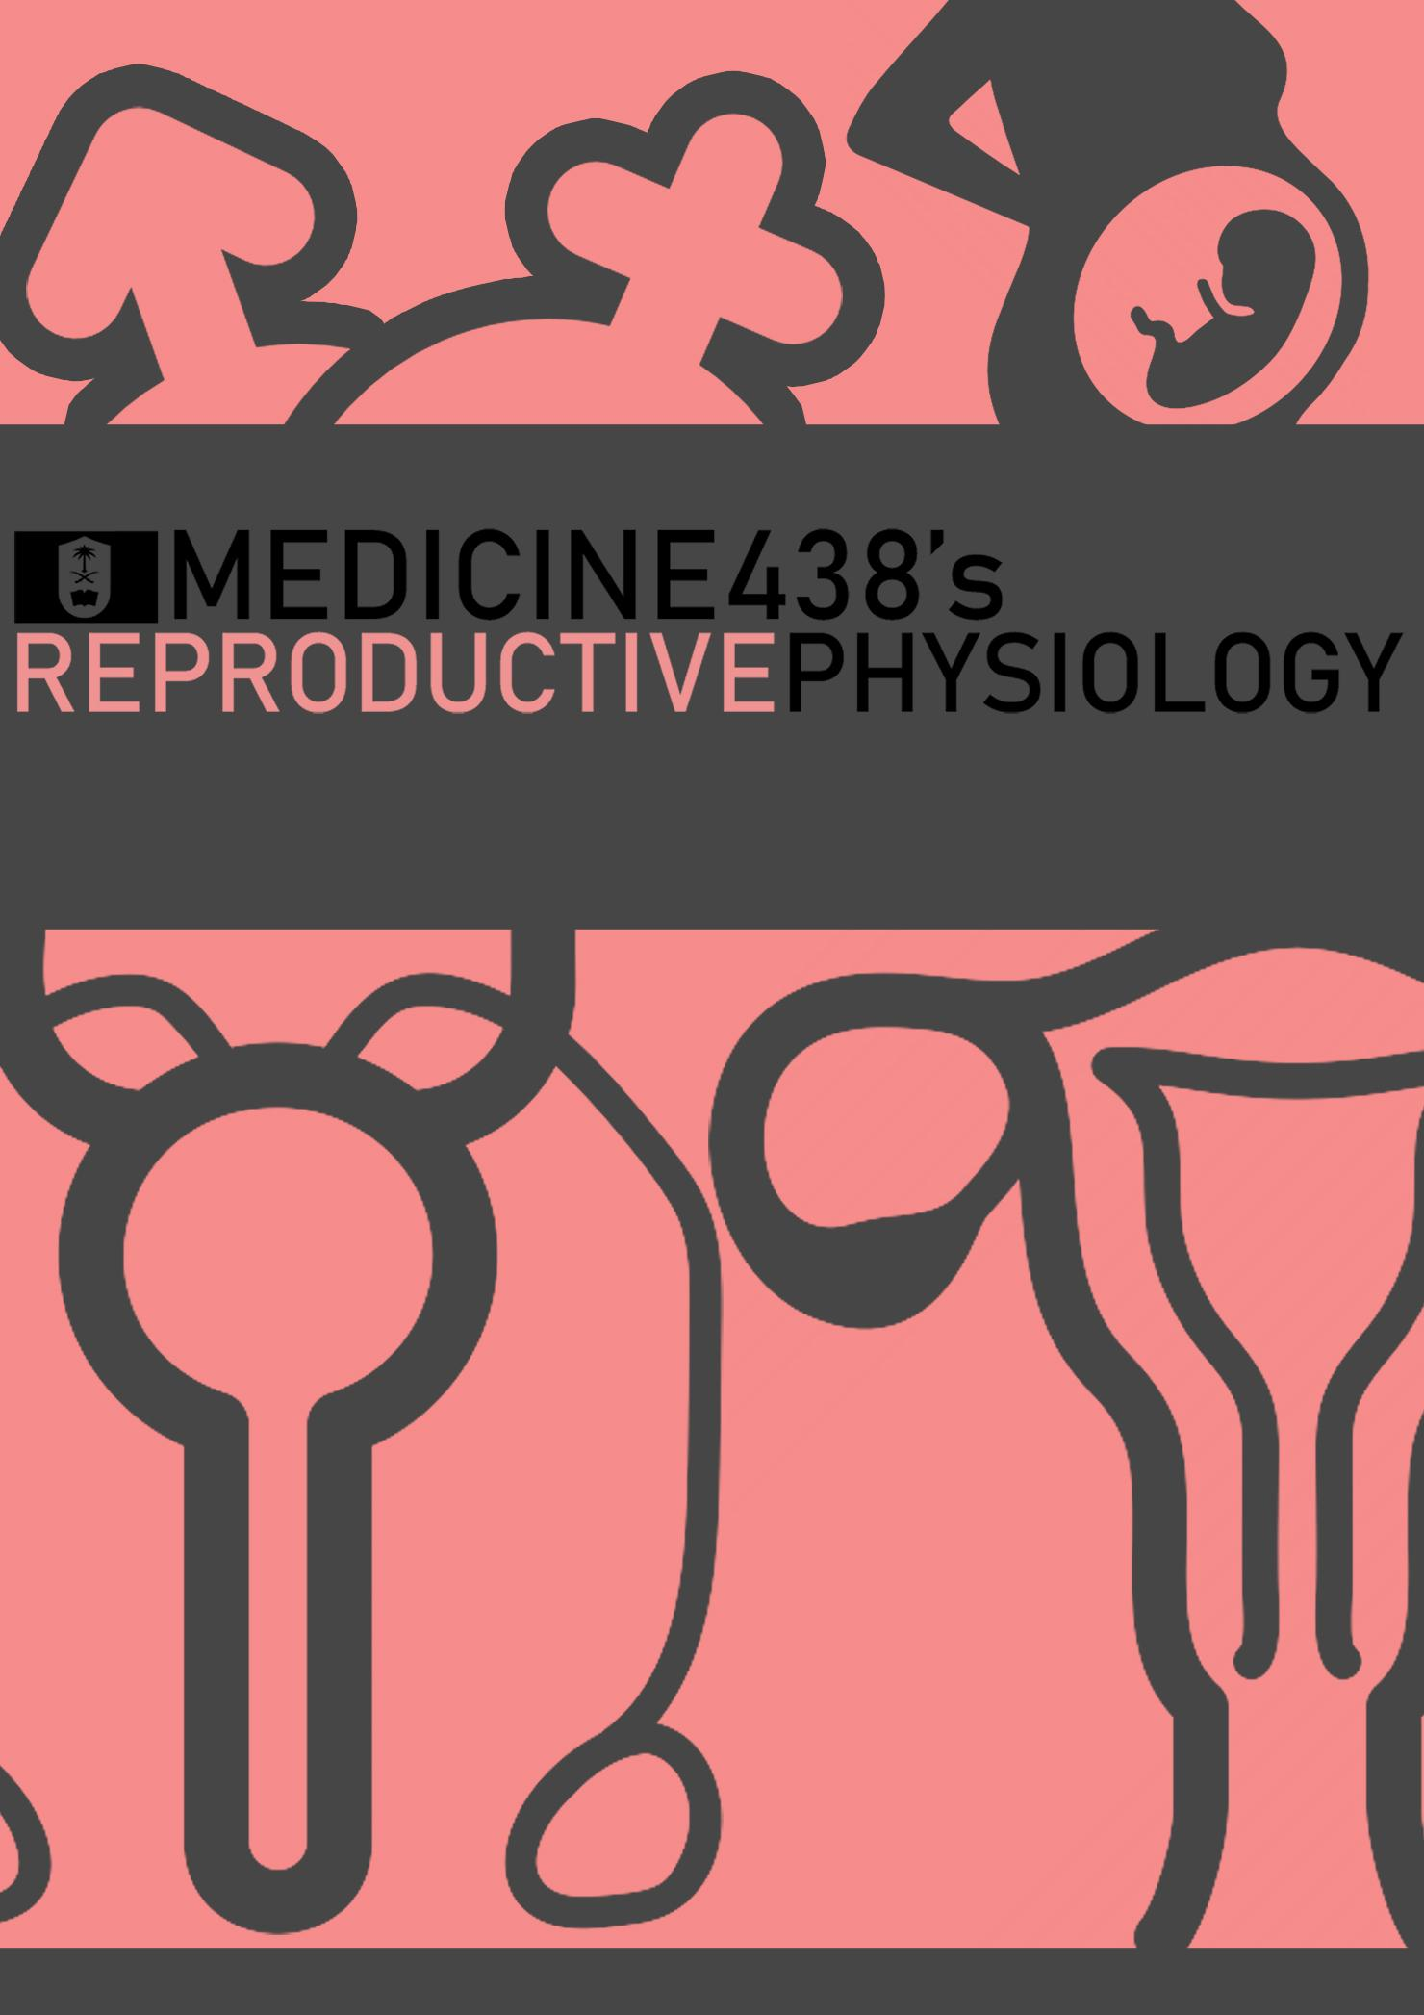
LECTURE I: Hypothalamus Pituitary Gonadal Axis
EDITING FILE
IMPORTANT
MALE SLIDES
EXTRA
FEMALE SLIDES
LECTURER’S NOTES

Slide 2
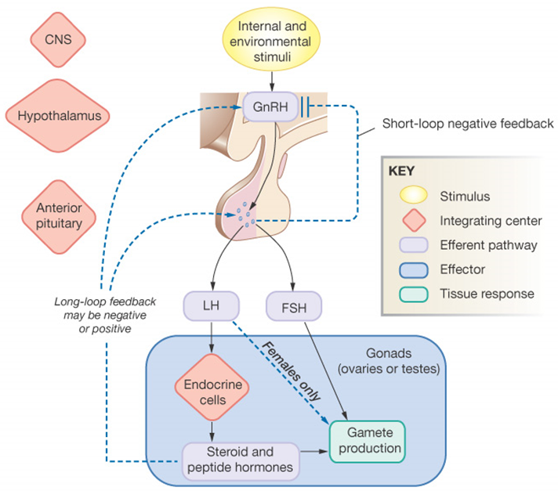
1
HYPOTHALAMUS PITUITARY GONADAL AXIS
Lecture One
OBJECTIVES
Define hypothalamic-pituitary –gonadal axis (HPG)
Name the hormones and target tissues of the HPG axis.
Describe the feedback mechanisms in the hypothalamic-pituitary-gonadal axis and their importance in the control of reproductive function.
Outline the endocrine regulation of testicular function: the role of GnRH, FSH, LH, testosterone, and inhibin.
Outline the endocrine regulation of ovarian function: the role of GnRH, FSH, LH, estrogen, Progesterone, and inhibin.
Characterize hypothalamic pituitary relationship
Name the hypophysiotropic hormones and outline the effects that each has on anterior pituitary function
It is recommended that students be at least familiar with the histology of both male and female reproductive systems before starting this lecture, a brief overview can be found in page 5.
Introduction
What are hormones?
Chemical substances secreted in a small amount from an endocrine gland directly to the bloodstream in response to stimulus to cause physiological responses at the target tissues.
Figure 1-1
How hypothalamus controls anterior pituitary?
By the secretion of hypothalamic-releasing and hypothalamic inhibitory hormones into the primary capillary plexus of the hypothalamo-hypophyseal portal system, which travel through portal veins to act on specific receptors on different pituitary cells to secrete their respective hormones.
What are the hormones secreted by anterior pituitary?
Numerous hormones are secreted by the anterior pituitary, main ones are: GH, LH, FSH, TSH, ACTH, Prolactin.
How hypothalamus controls posterior pituitary?
Through nervous signals that travel through hypothalamic-pituitary tract to trigger the release of hormones stored in axon terminals within the posterior pituitary.
What are the hormones secreted by posterior pituitary?
Oxytocin and ADH (also called vasopressin, AVP)
Figure 1-2
Figure 1-3
Hypothalamus-Pituitary-Gonadal Axis
GnRH¹ is a peptide secreted by the arcuate nuclei of the mediobasal hypothalamus through the hypothalamic-hypophyseal portal system.
It is secreted to the anterior pituitary gland and stimulates the release of gonadotropins (LH and FSH.)
Testis: Testosterone (by leydig cells) and Inhibin, MIS (by Sertoli cells)²
Ovaries: Estrogens and progestins (most important is progesterone)
Figure 1-4
FOOTNOTES
Footnotes
GnRH secretion is suppressed from birth and throughout childhood by a neural mechanism of uncertain causes. However, GnRH secretion increases between ages of 8-14, and this increase actually brings causes an increase in sex hormone secretion and enlargement of sex organs in both sexes. Secondary sex characteristics also develop during this time through the effects of estrogens in females and testosterone in males. However, when GnRH was injected in immature female monkeys, menstrual cycles were initiated.
Discussed in further readings, page 4.

Slide 3
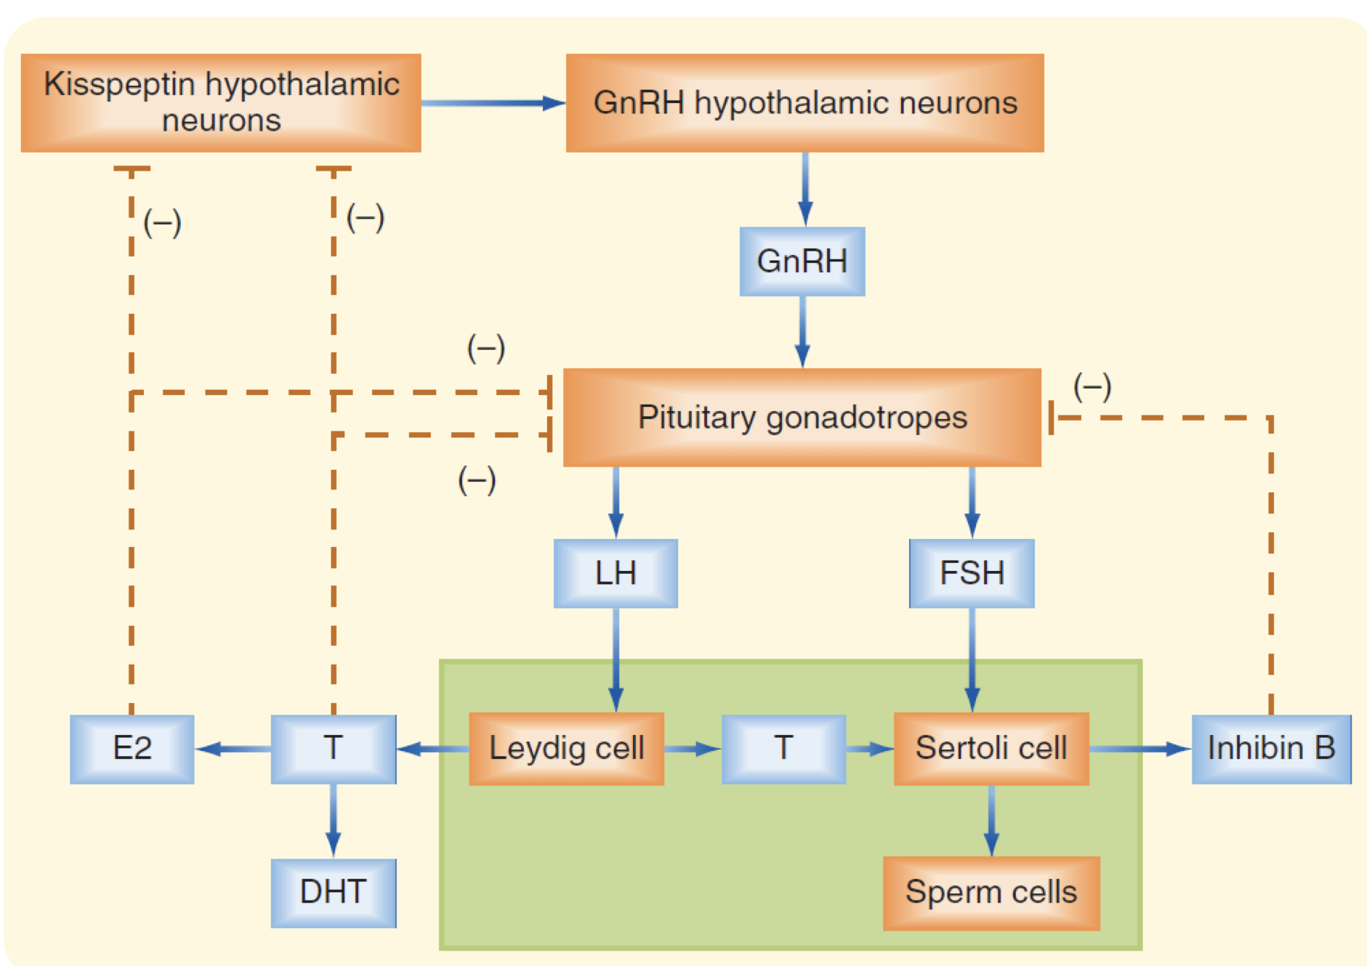
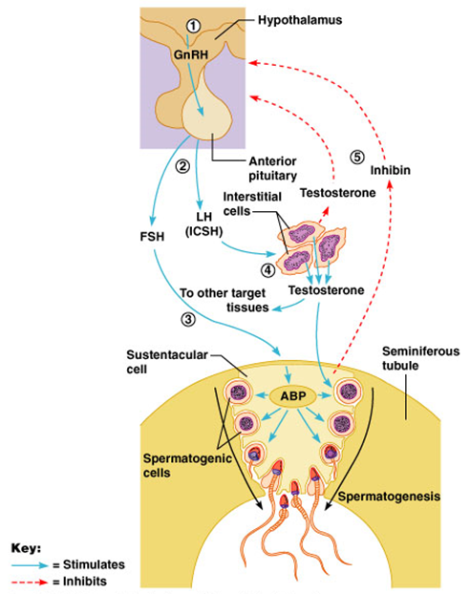
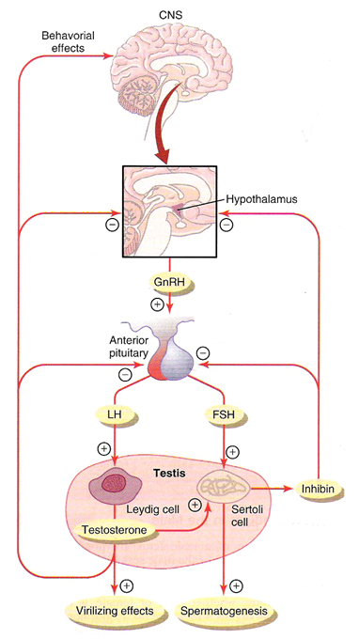
2
HYPOTHALAMUS PITUITARY GONADAL AXIS
Lecture One
Hormonal Regulation of Testicular Function
The hypothalamus releases gonadotropin-releasing hormone (GnRH)
GnRH stimulates the anterior pituitary to secrete FSH and LH
GnRH is secreted intermittently for few minutes every one to three hours.
The secretion of LH by the anterior pituitary is also cyclical following the pulsatile release of GnRH.¹
FSH Binds to its Receptors on Sertoli Cells in the Seminiferous Tubules.²
This causes these cells to grow & secrete spermatogenic substances
Also testosterone and dihydrotestosterone (metabolite of testosterone) diffuse into the seminiferous tubules from the leydig⁴ cells affect the spermatogenesis.
As a result, FSH & testosterone are necessary to initiate spermatogenesis.
When the seminiferous tubules fail to produce sperm the secretion of FSH from the AP increases.² Conversely, when spermatogenesis proceeds rapidly pituitary secretion of FSH diminishes.
This is due to the secretion of inhibin hormone from the sertoli cells which strongly inhibit the AP- FSH, and has slight inhibitory effect on the hypothalamus to inhibit GnRH secretion.
LH Binds to its Receptors on Leydig Cells⁴ in the Interstitium of the Testis.
This causes testosterone secretion.
Its release is directly proportional to the amount of LH.
Most of the inhibitory effect result from direct inhibition of GnRH release from the hypothalamus
Inhibition of GnRH leads to decrease secretion of both LH & FSH.
Mature leydig cells are found in a child’s testis few weeks after birth & then disappear until puberty when it appear again.
Feedback Inhibition On The Hypothalamus And Pituitary
Feedback inhibition on the hypothalamus and pituitary results from: (1) Rising levels of testosterone, (2) Increased inhibin.
Figure 1-5
Figure 1-6
Figure 1-7 Kisspeptin neurons secrete kisspeptin, a neuropeptide which activates GnRH neurons. It is thought that it plays an important role in the initiation of puberty.
Figure 1-8
Figure 1-9
FOOTNOTES
Footnotes
Even though the slides mention only LH here, the secretion of FSH also decreases and increases only slightly with the secretion of FSH over prolonged periods. But LH is secreted more rapidly, and usually in higher amounts in response to GnRH stimulation. Which is why GnRH is sometimes called LH-releasing factor.
Seminiferous tubules and Spermatogenesis: Functional unit of testes, please read further readings, page 5 for illustrations and description of male histology, including sertoli and leydig cells, and the mechanism of spermatogenesis.
Sertoli cells can act as “spermatogenesis sensors”, and produce inhibin when sperm levels are high in order to decrease FSH production and halt spermatogenesis. Sertoli cells are relatively inactive during childhood and become active by puberty due to FSH stimulation (which was secreted in very low levels in childhood)
Leydig cells are virtually nonexistent during childhood, therefore testosterone secretion is very low. And children, well, remain children.

Slide 4
3
HYPOTHALAMUS PITUITARY GONADAL AXIS
Lecture One
Hormonal Regulation of Female Monthly Rhythm
Interplay between the ovarian and hypothalamic-pituitary hormones:
Secretion of AP hormone is controlled by the hypothalamic GnRH.
GnRH released from the arcuate nucleus of the mediobasal hypothalamus that regulate most of the female sexual activity.
Intermittent, pulsatile secretion of GnRH by the hypothalamus stimulates intermittent pulsatile release of LH from the AP.¹
GnRH¹ is secreted in pulses lasting 5 to 25 minutes every 1 to 2 hrs. The intermittent pulsatile release of GnRH causes
intermittent pulsatile release of LH secretion about every 90
minutes.¹
Figure 1-10
Follicular (preovulatory) Phase of the Menstrual Cycle (for overview of ovarian cycle, click here an interpretation of Guyton and Hall and Ganong’s by the physiology team)
After menstruation the level of FSH & LH increases
Mainly FSH accelerates growth of few follicles (6-12 follicles).
The growing follicle secretes increasing amounts of estrogen.
2 -3 days before menstruation, corpus luteum regress & secretion of estrogen, progesterone & inhibin decrease.
This decrease remove the negative feedback effect on AP hormones.
Therefore a day after menstruation FSH secretion begins to increase (2 folds) while LH secretion is also slightly increased.
These hormones causes growth of a new follicle.
During the first 11 to 12 days of the follicular growth the rate of secretion of FSH & LH decrease due to the negative feedback effect of estrogen on the AP.
Positive Feedback Effect of Estrogen Before Ovulation – The Preovulatory LH Surge
AP secretes increased amount of LH for 1-2 days (at about the 12th day of the cycle) before ovulation.
FSH surge is much smaller than LH surge.²
The possible causes of LH secretion could be:
Estrogen has special positive feedback effect of stimulating pituitary secretion of LH & to a lesser extent FSH.
The granulosa cells of the follicle begin to secrete small increasing amount of progesterone about 1 day before ovulation which stimulate LH secretion.
Figure 1-11
Figure 1-12
FOOTNOTES
Footnotes
Even though the slides mention only LH here, the secretion of FSH also decreases and increases only slightly with the secretion of FSH over prolonged periods. But LH is secreted more rapidly, and usually in higher amounts in response to GnRH stimulation. Which is why GnRH is sometimes called LH-releasing factor.
LH causes the follicles at this time to secrete increasing amount of progesterone, which prepares the endometrium for implantation. The mechanisms of LH-induced ovulation is discussed in this link.

Slide 5
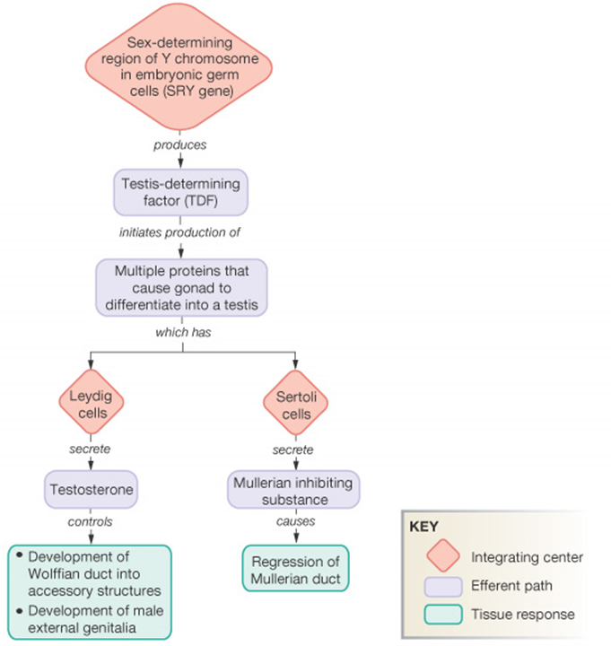
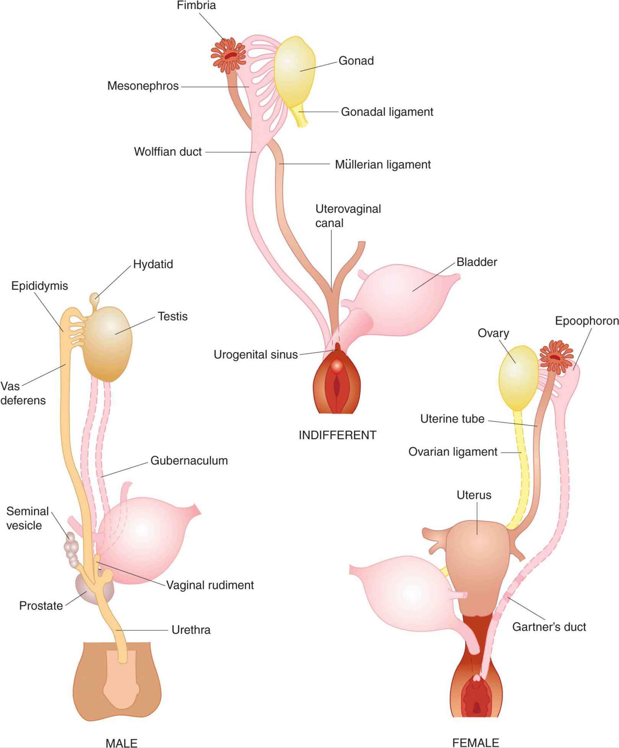
4
HYPOTHALAMUS PITUITARY GONADAL AXIS
Lecture One
Hormonal Regulation of Female Monthly Rhythm (continued)
Postovulatory Secretion of The Ovarian Hormones And Depression of The Pituitary Gonadotropins
During the postovulatory phase the corpus luteum secrete large quantities of both progesterone, estrogen & inhibin.
Which all together cause negative feedback effect on AP & hypothalamus to inhibit both FSH & LH secretion. (lowest level 3-4 days before the onset of menstruation)
Negative Feedback Effects of Estrogen and Progesterone
Estrogen in small amounts has strong effect to inhibit the production of LH & FSH.
This inhibitory effect of estrogen is increased when progesterone is available.
These inhibitory effects are acting more on the AP directly & to lesser extent on the hypothalamus to inhibit the secretion of GnRH.
Negative Feedback Effects of Inhibin
The hormone inhibin secreted by the granulosa cells of the ovarian corpus luteum.
It inhibits the secretion of FSH & to lesser extent LH.
Further Reading
Is Sex Determined by a Single Gene?: Females With an XY Genotype: Swyer’s Syndrome (SRY gene mutation)
In 1955, Gerald Swyer, an English endocrinologist, discovered a rare syndrome.
Females who were anatomically and biologically female, but chromosomally male.
These females lack a functioning SRY gene (also known as testis determining factor)
The differentiation between male and female depends on the expression of a single gene, SRY, as can be seen on the diagram on the right.
Expression of this gene will cause the differentiation of the precursor gonad into testes (before differentiation into testes or ovaries, as can be seen on the right).
Not only that, SRY, acts as a transcription factor to induce the expression of hormone called mullerian inhibiting substance “MIS”, this will cause apoptosis of the mullerian duct (precursor of female reproductive system)
SRY will induce the expression of testosterone in abundance which will promote the development of the wolffian duct (precursor of male reproductive system).
Therefore, the Y chromosome of Swyer’s syndrome fails to trigger ‘maleness’.
Sertoli cells continue to secrete MIS during adulthood, the function of MIS in adults is unknown.
Due to the lack of one copy of X chromosome, these females usually fail to achieve suxaul maturity and are amenorrhic as a result.
In an unrelated note, female mice who had SRY gene introduced into their genome started growing penises, testicles and even started mounting females. A single gene can thus potentially account for maleness.

Slide 6
5
HYPOTHALAMUS PITUITARY GONADAL AXIS
Lecture One
Further Reading
Female Menstrual Cycle (Click Here)
Spermatogenesis (What can happen in only 74 days?):
During the sperm formation, the germ cells of the embryo migrate to the testes (the seminiferous tubules). As they become immature germ cells ‘spermatogonia’ and proliferate mitotically to increase their numbers..
And triggered by gonadotropic hormones, during puberty, the spermatogonia crosses Sertoli cell layer, where it’s enveloped and progressively modified to form a primary spermatocytes.
These spermatocyte (46 chromosomes) undergo a meiotic divisions to form two secondary spermatocytes, which also divide to form spermatid (23 chromosomes), which are eventually modified to become spermatozoa (sperm) with only half of the genetic characteristics of the upcoming child along with the other half derived from the mother’s oocyte.
The Journey of a Sperm
Let’s start build a basic understanding of anatomy of the male sexual organs with a highlight on the testis, which is composed of 900 coiled seminiferous tubules, each averaging more than one-half meter long which largely contain Sertoli cells and, where sperm is formed. In-between the seminiferous tubules there is a connective tissue network containing testosterone-secreting cells, named Leydig cells.
The formed sperm empties next into the epididymis (a continuation of the seminiferous tubules) measuring up to six meters long, for it to mature, and once that takes place, although mature, the sperm here is still immotile and cannot fertilize as it’s inhibited by inhibitory factors-until ejaculation takes place.
Then these mature sperms travel through the vas deferens and from there to the ejaculatory duct.
There are two seminal vesicles, on each side of prostate, secreting fructose (nutrition for sperm), citric acid (plays a role in metabolism), PGs (enhance antiperistaltic contrac­tions in the uterus and Fallopian tubes, to move sperm towards the ovaries) and fibrinogen (forms a coagulum which hold semen in deeper regions of the vagina) which empty into the ejaculatory duct after the vas deferens empties the sperm. Which in addition to its physiological values adds bulk to the semen as it finally empties into the internal urethra
Note that the prostatic duct secretions (which contains Ca⁺², citrate ions, phosphates, clotting factors as well as fibrinolysin-helps free sperm from coagulum) also empty into ejaculatory duct and into the urethra
Finally, semen (along with the sperm) ejaculated from the urethra continues its journey in the female reproductive system. With that, one tale ends, and starts another.

Slide 7
Which of the following cells are famously known to secrete testosterone?
Cells of zona glomerulosa
Leydig cells
Sertoli cells
Granulosa cells
2. Which of the following best describes the effect of inhibin:
Secreted by sertoli cells to mainly inhibit FSH secretion
Secreted by leydig cells to mainly inhibit FSH secretion
Secreted by sertoli cells to mainly inhibit GnRH secretion
Secreted by sertoli cells to mainly inhibit LH secretion
3. What is the proposed reason of the LH surge that happens just before ovulation?
Positive feedback of estrogen
Hypothalamic release of kisspeptin
Positive feedback of inhibin
None of the above
4. A discovery was made of a major influencer of GnRH secretion, and is thought to be related to the initiation of puberty. From the following choices, which one best fits the description?
Neurokinin release from the neocortex
ACh from the allocortex of the hippocampus
Kisspeptin from the hypothalamus
Histamine from the tuberomammilary nucleus of the hypothalamus
5. Hormone controlling testosterone secretion by Leydig cells in adult testes is:
Growth hormone
FSH
Luteinising hormone
Estrogen
ANSWER KEY: B, A, A, C, C

Slide 8
Nayef Alsaber, Hameed M. Humaid
Co-editor: Njoud Alabdullatif
FEMALE PHYSIOLOGY CO-LEADERS
Maha Alnahdi, Taif Alshammari
MALE PHYSIOLOGY CO-LEADERS
Nayef Alsaber, Hameed M. Humaid
REFERENCES
Guyton and Hall Textbook of Medical Physiology
Ganong’s Review of Medical Physiology

